Slide 1
VOCABULARY

Slide 2

What is your job?

Slide 3

She is an engineer /ˌendʒɪˈnɪr/

Slide 4
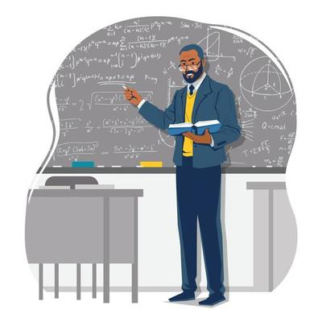
He is a teacher /ˈtiːtʃər/

Slide 5

They are students. /ˈstuːdnt/

Slide 6

This man is a doctor. /ˈdɑːktər/

Slide 7

She is a nurse. /nɜːrs/

Slide 8

They are police officers. /pəˈliːs ɑːfɪsər/

Slide 9
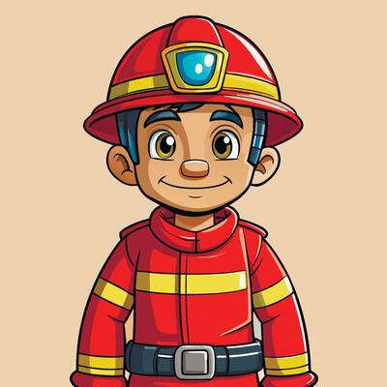
He is a firefighter /ˈfaɪərfaɪtər/ / fireman /ˈfaɪərmən/

Slide 10
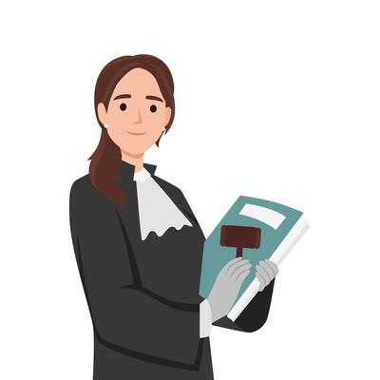
She is a lawyer. /ˈlɔɪər/

Slide 11

He is a chef. /ʃef/

Slide 12
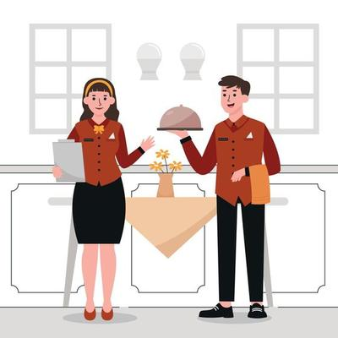
The girl is a waitress. /ˈweɪtrəs/
The man is a waiter. /ˈweɪtər/

Slide 13

He is a pilot. /ˈpaɪlət/

Slide 14

She is an accountant. /əˈkaʊntənt/

Slide 15

They are mechanics. /məˈkænɪk/

Slide 16

She is a dentist. /ˈdentɪst/

Slide 17

She is a pharmacist. /ˈfɑːrməsɪst/

Slide 18

They are journalists. /ˈdʒɜːrnəlɪst/

Slide 19

He is a software developer. /ˈsɔːftwer dɪˈveləpər/

Slide 20
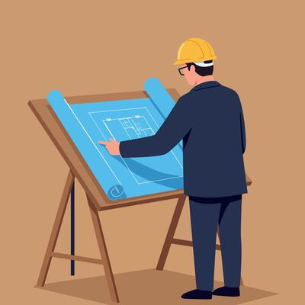
He is an architect. /ˈɑːrkɪtekt/

Slide 21

She is a sales executive. /seɪlz ɪɡˈzekjətɪv/

Slide 22

He is a businessman. /ˈbɪznəsmæn/
She is a businesswoman. /ˈbɪznəswʊmən/

Slide 23
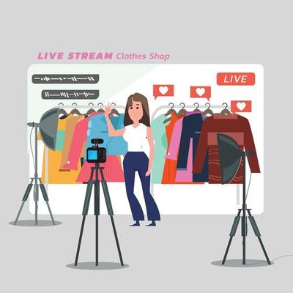
She is an online seller. /ˌɑːnˈlaɪn ˈselər/

Slide 24

He is a graphic designer. /dɪˈzaɪnər/

Slide 25

He is a school bus driver. /ˈdraɪvər/

Slide 26

He is a worker. /ˈwɜːrkər/

Slide 27

He is a farmer. /ˈfɑːrmər/

Slide 28

Job-Related Verbs

Slide 29

I want to apply for /əˈplaɪ/ the position of headhunter at a company.

Slide 30

The company want to hire /ˈhaɪər/ a new CEO.

Slide 31

The director promotes /prəˈməʊt/ him to chief executive.

Slide 32

My boss decides to fire /ˈfaɪər/ me.

Slide 33

I want to resign /rɪˈzaɪn/ after 10 years working at this company.

Slide 34
Job-Related Nouns

Slide 35
I will do my job interview /ˈɪntərvjuː/ next week.

Slide 36

The average monthly salary /ˈsæləri/ for an unskilled worker is $550.

Slide 37

I have over ten years’ experience /ɪkˈspɪriəns/ as a teacher.

Slide 38

She plans to pursue a career /kəˈrɪr/ in medicine.

Slide 39
SPEAKING

Slide 40
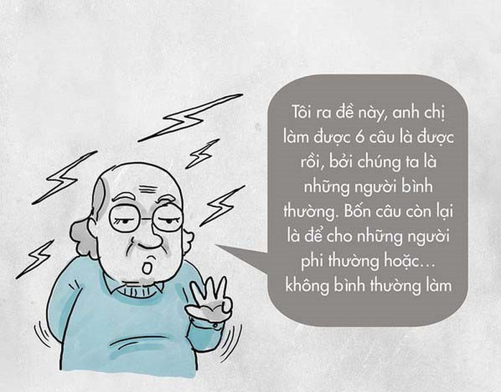
1. What job do you want to do in the future?
I want to be a teacher because I like to help
people learn new things.

Slide 41

2. What job does your parents do?
My father is a driver. He drives a bus in the city.
My mother is a lawyer. She works at the local court.

Slide 42

3. Do you think your job will be easy or difficult? Why?
I think it will be difficult
because I need to study a lot and work hard.

Slide 43
3. Do you think your job will be easy or difficult? Why?
I think it will be difficult
because I need to study a lot and work hard.

Slide 44
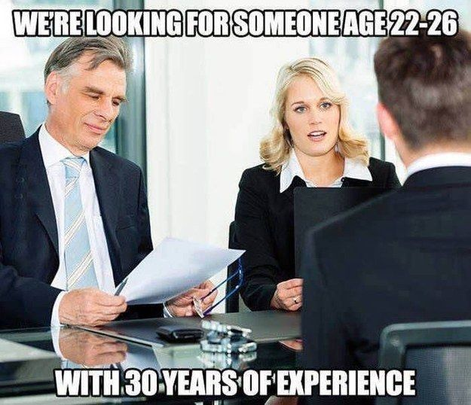
4. Is it better to work in the city or in the countryside
I think it's better to work in the city
because there are more jobs.

Slide 45
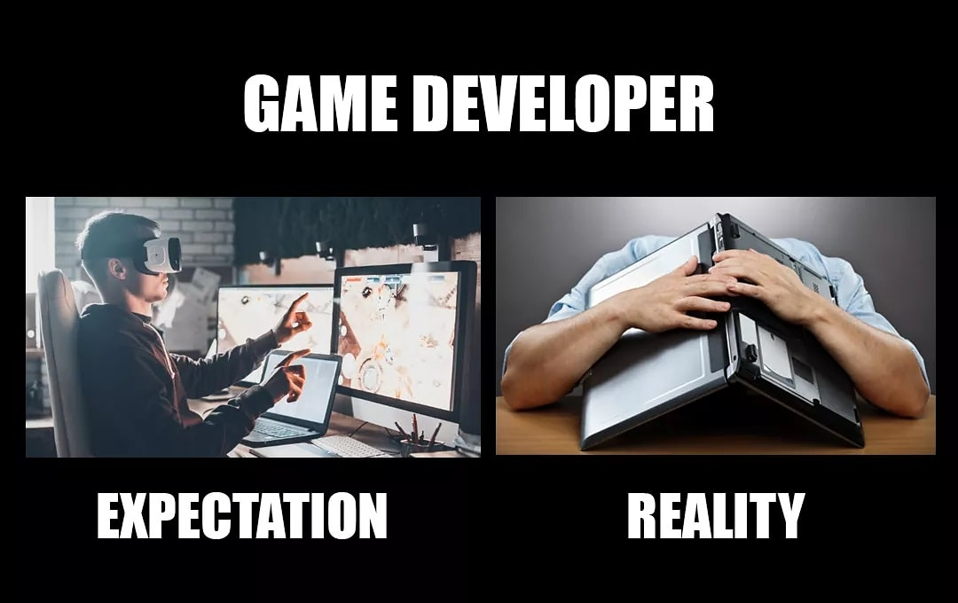
5. What job do you think is fun?
I think being a game designer is fun
because you can make video games.

Slide 46

6. Do you like to work on computers?
Yes, I do. I love computers
and I want to be a graphic designer

Slide 47
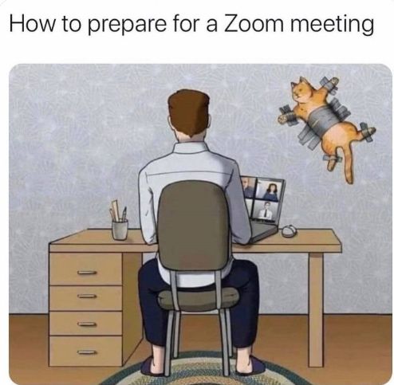
7. Do you like to work at a big company or at home?
I want to work at home because it's more comfortable.

Slide 48
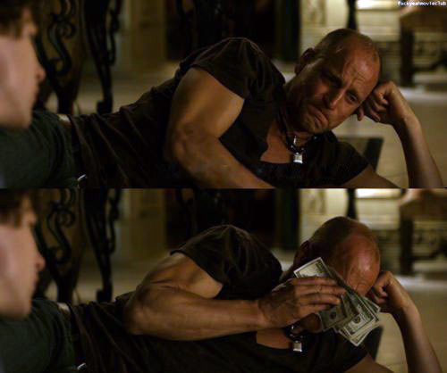
8. Would you rather have a job that is fun
or that is makes a lot of money?
I want a fun job. It's important to enjoy what you do.
I choose the second choice
because I can do anything with a lot of money

