Slide 1
World Health Expenditure and its Relation to Life Expectancy
Dina Mirijanian

Slide 2
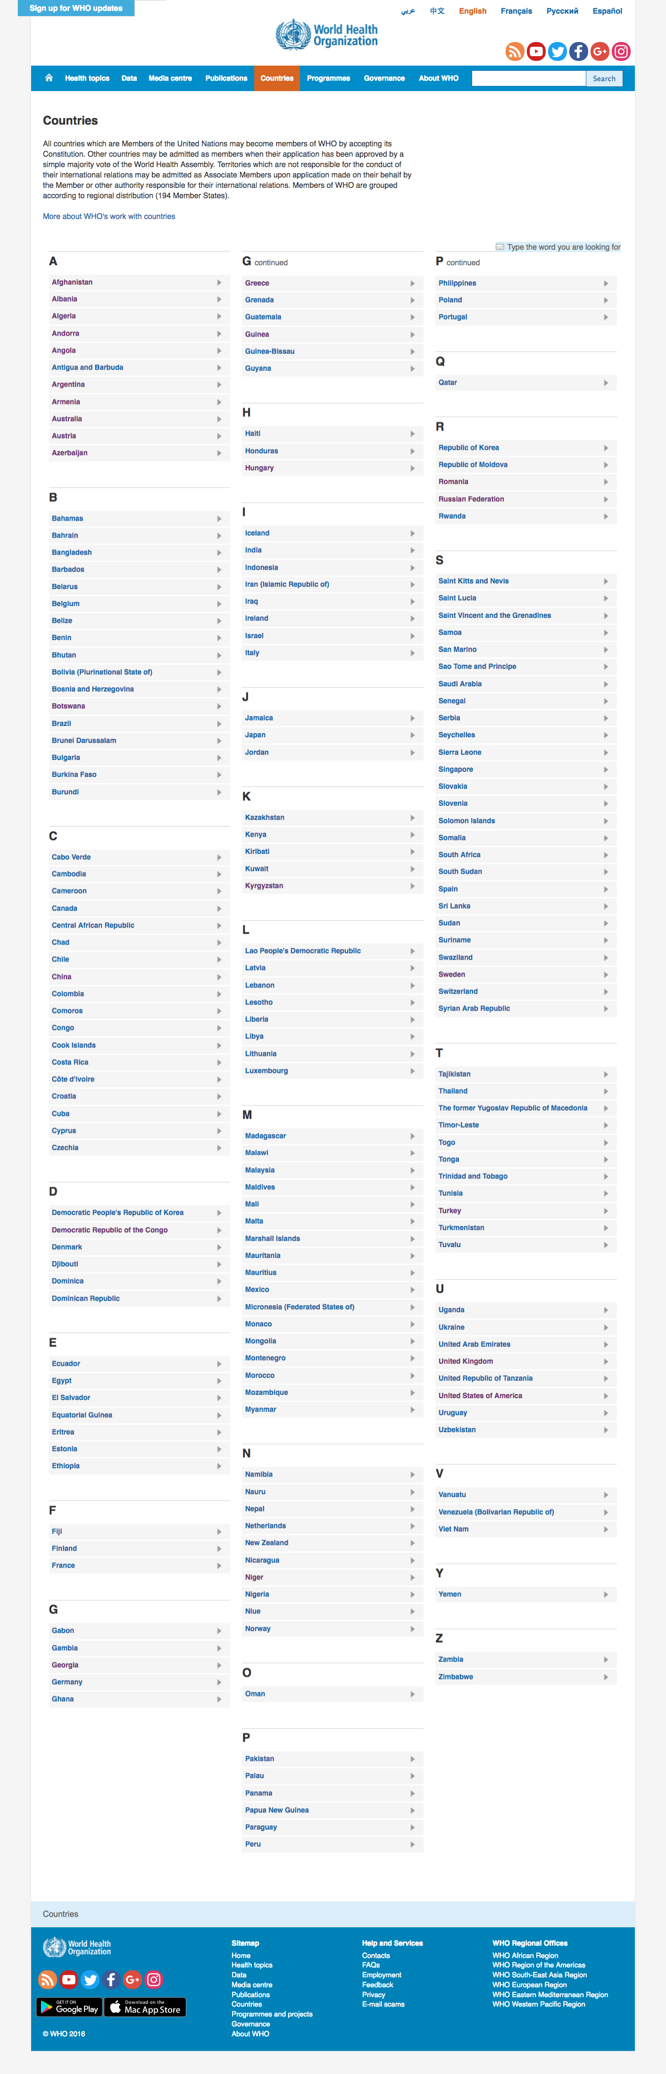
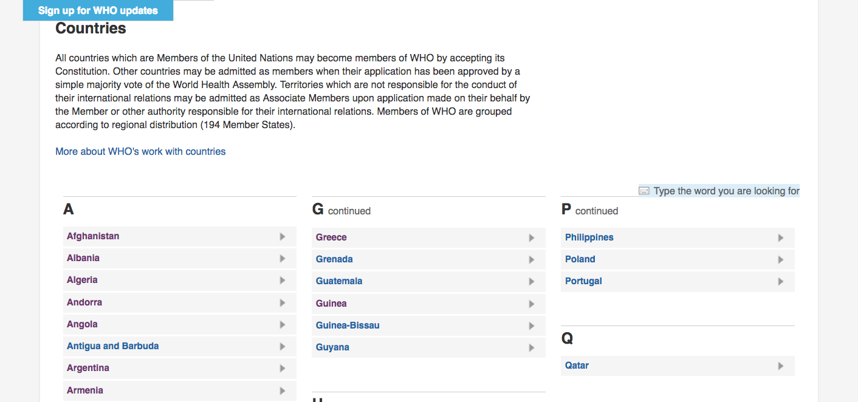
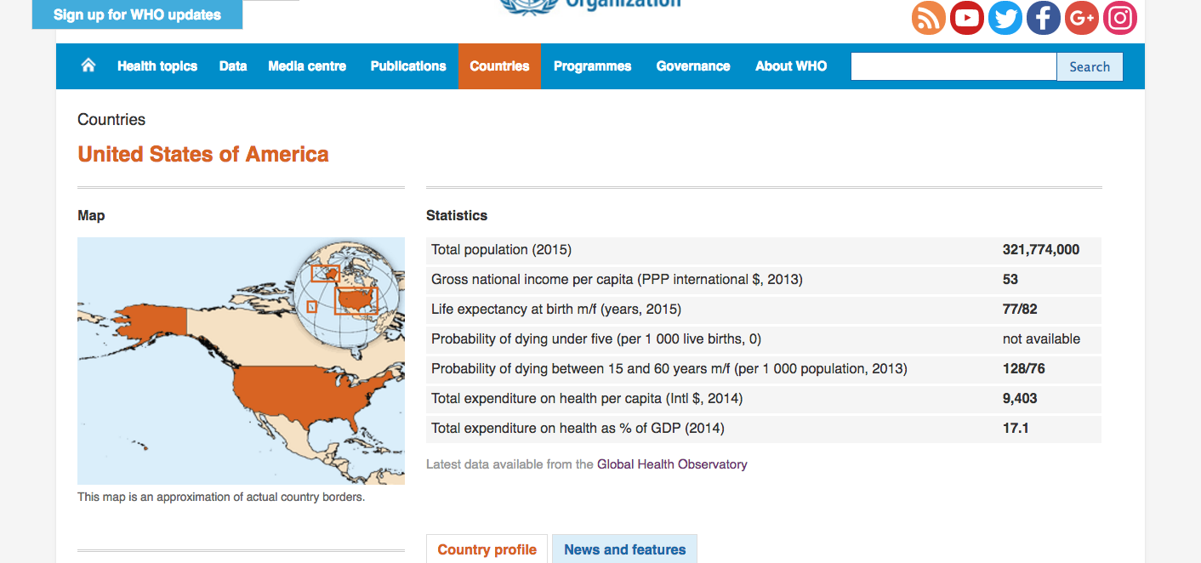

Slide 3
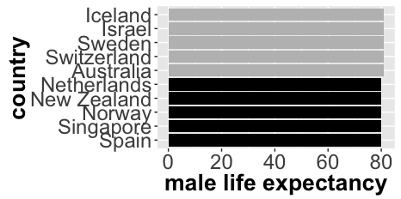
Countries highest life expectancy

Slide 4
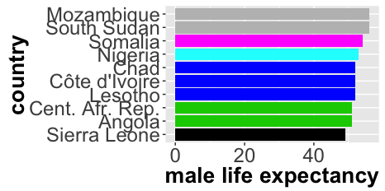
Countries lowest life expectancy

Slide 5
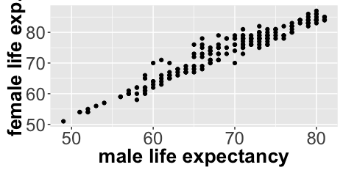
Strong linear relationship between male-female

Slide 6
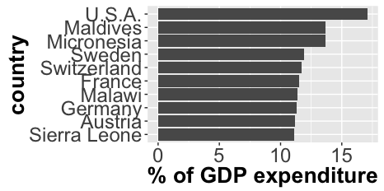
Countries highest GDP expenditure

Slide 7
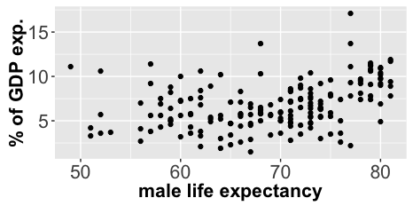
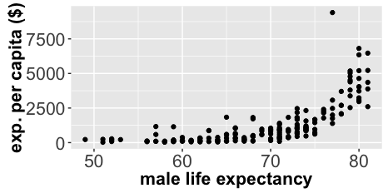
Corr. = 0.358
Corr. = 0.698

Slide 8
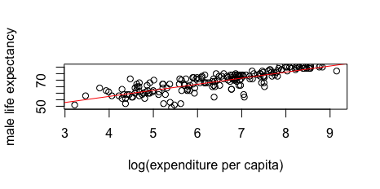
Linear model
Both β₀ and β₁ have p<<0.05 and are significant
p-value: < 2.2e-16
R-squared: 0.6202
β₀= 38.916 β₁= 4.657
(After random imputation of missing data)

Slide 9
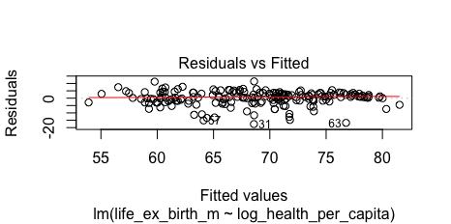
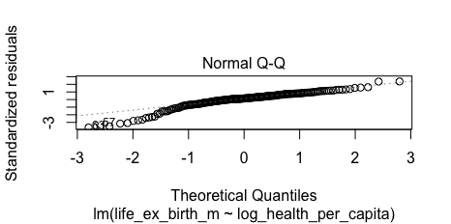

Slide 10
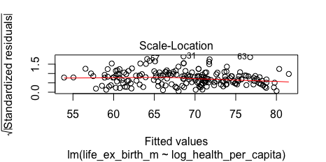
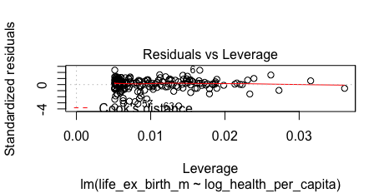

Slide 11
Conclusions and outlook
Expenditure per capita is a stronger indicator of life expectancy than % of GDP expenditure
May have small GDP and large % of GDP can still be very little.
Can predict how much life expectancy will change given the a certain increase of investment to health care expenditure.
Possible better linear model than the log relation used here.

Slide 12
health_per_capita(2)
#mean BEFORE imputation = 1307.583
#mean AFTER imputation = 1298.995
#SD BEFORE imputation = 1606.37
#SD AFTER imputation = 1600.712
life_ex_birth_m(11)
#mean BEFORE imputation = 68.9071
#mean AFTER imputation = 68.87113
#SD BEFORE imputation = 7.688803
#SD AFTER imputation = 7.77327

