Slide 1
selenium
Introduction to selenium

Slide 2
Selenium-introduction
Selenium is a free (open source) automated testing suite for web applications across different browsers and platforms.
It is quite similar to HP Quick Test Pro (QTP) only that Selenium focuses on automating web-based applications.
Selenium is not just a single tool but a suite of software, each catering to different testing needs of an organization.
It has four components.
Selenium Integrated Development Environment (IDE)
Selenium Remote Control (RC)
Web Driver
Selenium Grid

Slide 3
Who developed Selenium?
Primarily, Selenium was created by Jason Huggins in 2004. An engineer at Thought Works, he was working on a web application that required frequent testing.
Having realized that the repetitious manual testing of their application was becoming more and more inefficient, he created a JavaScript program that would automatically control the browser’s actions.
He named this program as the “JavaScriptTestRunner.”
Seeing potential in this idea to help automate other web applications , he made JavaScriptRunner open-source which as later re-named as Selenium Core.

Slide 4
Why the name selenium?
It came from a joke that Jason cracked one time to his team. Another automated testing framework was popular during Selenium’s development, and it was by the company called Mercury Interactive(yes, that company who originally made QTP before it was acquired by HP).
Since Selenium is a well-known antidote for Mercury poisoning, Jason suggested that name. His teammates took it, and so that is how we get to call this framework up to the present.

Slide 5
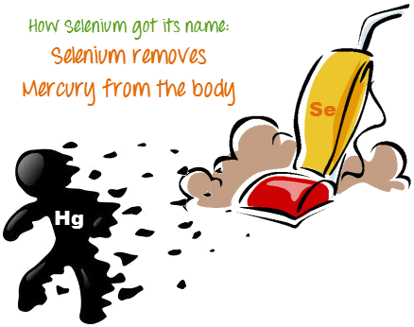

Slide 6
Birth of selenium IDE
Shinya Kasataniof Japan created Selenium IDE, a Firefox extension that can automate the browser through a record-and-playback feature. He came up with this idea to further increase the speed in creating test cases. He donated Selenium IDE to the Selenium Project in 2006

Slide 7
Selenium IDE
Selenium Integrated Development Environment (IDE) is the simplest framework in the Selenium suite and is the easiest one to learn.
It is a Firefox plugin that you can install as easily as you can with other plugins.
However, because of its simplicity, Selenium IDE should only be used as a prototyping tool.
If you want to create more advanced test cases, you will need to use either Selenium RC or WebDriver.

Slide 8
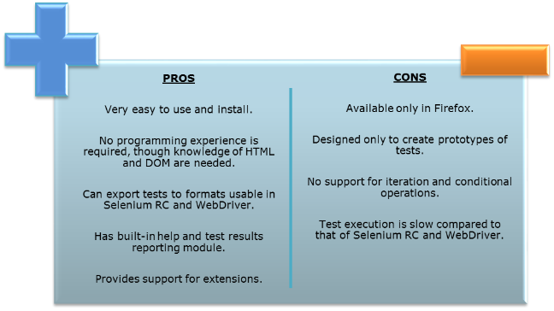
Selenium IDE

Slide 9
Why and when to use IDE?
To learn about concepts on automated testing and Selenium, including:
  Selenese commands such as type, open, clickAndWait, assert, verify, etc.
  Locators such as id, name, xpath, css selector, etc.
  Executing customized JavaScript code using runScript
  Exporting test cases in various formats
To create tests with little or no prior knowledge in programming
To create simple test cases and test suites that you can export later to RC or WebDriver
To test a web application against Firefox only

Slide 10
Birth of seleniumRC
. And so another ThoughtWorks engineer, Paul Hammant, decided to create a server that will act as an HTTP proxy to “trick” the browser into believing that Selenium Core and the web application being tested come from the same domain. This system became known as the Selenium Remote Control or Selenium 1.

Slide 11
Selenium Rc
Selenium RC was the flagship testing framework of the whole Selenium project for a long time. This is the first automated web testing tool that allowed users to use a programming language they prefer. As of version 2.25.0, RC can support the following programming languages:
Java
C#
PHP
Python
Perl
Ruby

Slide 12
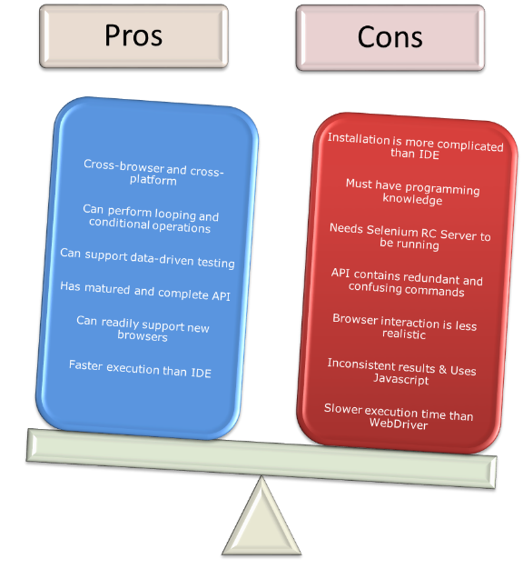

Slide 13
Why and when to use RC?
To design a test using a more expressive language than Selenese
To run your test against different browsers (except HtmlUnit) on different operating systems.
To deploy your tests across multiple environments using Selenium Grid.
To test your application against a new browser that supports JavaScript.
To test web applications with complex AJAX-based scenarios

Slide 14
Birth of WebDriver
Simon Stewart created WebDriver circa 2006 when browsers and web applications were becoming more powerful and more restrictive with JavaScript programs like Selenium Core.
It was the first cross-platform testing framework that can control the browser from the OS level.

Slide 15
Web Driver
The WebDriver proves itself to be better than both Selenium IDE and Selenium RC in many respects. It implements a more modern and stable approach in automating the browser’s actions. Web Driver, unlike Selenium RC, does not rely on JavaScript for automation. It controls the browser by directly communicating to it.
The supported languages are the same as those in Selenium RC.
Java , C# , PHP , Python ,Perl

Slide 16
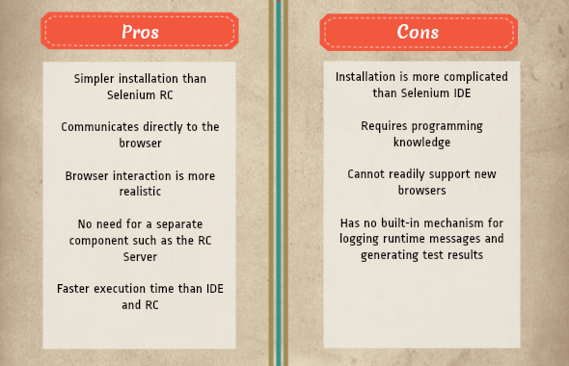

Slide 17
When and why Web driver?
To use a certain programming language in designing your test case.
To test applications that are rich in AJAX-based functionalities
To execute tests on the HtmlUnit browser.
To create customized test results

Slide 18
Birth of selenium Grid
Selenium Grid was developed by Patrick Light body to address the need of minimizing test execution times as much as possible.
He initially called the system as “Hosted QA.” It was capable of capturing browser screenshots during significant stages, and also of sending out Selenium commands to different machines simultaneously.

Slide 19
Selenium Grid
Selenium Grid is a tool used together with Selenium RC to run parallel tests across different machines and different browsers all at the same time. Parallel execution means running multiple tests at once.
Features:
Enables simultaneous running of tests in multiple browsers and environments
Saves time enormously.
Utilizesthe hub-and-nodes concept. The hub acts as a central source of Selenium commands to each node connected to it.

Slide 20
When and why to use grid?
To run your Selenium RC scripts in multiple browsers and operating systems simultaneously.
To run a huge test suite, and you need to complete it the soonest time possible.

Slide 21
Birth of selenium2
In 2008, the whole Selenium Team decided to merge WebDriver and Selenium RC to form a more powerful framework called Selenium 2, with WebDriver being the core. Currently, Selenium RC is still being developed but only in maintenance mode. Most of the Selenium Project’s efforts are focused on Selenium 2

Slide 22
Because of their architectural differences, Selenium IDE, Selenium RC, and WebDriver support different sets of browsers and operating environments.
 | Selenium IDE | Selenium RC | WebDriver
Browser Support | Mozilla Firefox | Mozilla Firefox Internet Explorer Google Chrome Safari Opera Konqueror Others | Internet Explorer versions 6 to 9, both 32 and 64-bit Firefox 3.0, 3.5, 3.6, 4.0, 5.0, 6, 7 and above (current version is 16.0.1) Google Chrome 12.0.712.0 and above (current version is 22.0.1229.94 m) Opera 11.5 and above (current version is 12.02) Android – 2.3 and above for phones and tablets (devices & emulators) iOS 3+ for phones (devices & emulators) and 3.2+ for tablets (devices & emulators) HtmlUnit 2.9 and above (current version is 2.10)
Operating System | Windows Mac OS X Linux | Windows Mac OS X Linux Solaris | All operating systems where the browsers above can run.

Slide 23
Comparison between qtp and selenium
Quick Test Professional(QTP)is a proprietary automated testing tool previously owned by the company Mercury Interactive before it was acquired by Hewlett-Packardin2006.The Selenium Tool Suite is similar to QTP in many respects, some of which are enumerated below:
Similarities:
They both perform automated testing
Both are capable of handling scalable test suites
Selenium IDE and QTP both have record and playback feature
They can facilitate data-driven, keyword-driven, model-based, and modularity-driven testing
Both frameworks support JavaScript
Selenium IDE, Selenium RC, and QTP all have built-in test reporting and event-logging capabilities
Both are capable of capturing screenshots of the application under test.
Both frameworks support regular expressions

Slide 24
Advantages of selenium over qtp
Selenium | QTP
Open source, free to use, and free of charge. | Proprietary, so it isn’t free.
• Highly extensible | • Limited add-ons
Can run tests across different browsers | Can only run tests in Firefox and Internet Explorer.
Supports various operating systems | Can only be used in Windows
Supportsmobile devices | Cannot be used in mobile devices.
Allows you to use an IDE of your choice (NetBeans, Eclipse, IDEA, etc.) | All test scripts can only be created within QTP
Can execute tests whilethe browser is minimized | Needs to have the application under test to be visible on the desktop
Can execute tests in parallel. | Can only execute tests sequentially

Slide 25
Advantages of qtp over selenium
QTP | Selenium
Can test both web and desktop applications | Can only test web applications
Comes with a built-in object repository | • Has no built-in object repository
Automates faster than Selenium because it has fewer components undergoing fewer processes. | Automates at a slower rate because it has more components undergoing more complicated processes.
Data-driven testing is easier to perform because it has built-in global and local data tables. | Data-driven testing is more cumbersome since you have to rely on the programming language’s capabilities for setting values for your test data
Can access controls within the browser (such as the Favorites bar, Address bar, Back and Forward buttons, etc.) | Cannot access elements outside of the web application under test
Can compare bitmap comparison between images | Cannot perform bitmap comparison
Provides professionalcustomer support | No official user support is being offered.
Has native capability to export test data into external formats | Has no native capability to export runtime data onto external formats

Slide 26
summary
Though clearly, QTP has more advanced capabilities, Selenium outweighs QTP in three main areas:
Cost (because Selenium is completely free)
Flexibility (because of a number of programming languages, browsers, and platforms it can support)
Parallel testing (something that QTP is only partially capable of)
Jason Huggins pioneered Selenium in 2004.Paul Hammantled the development of Selenium Remote Control. Patrick Lightbody developed Selenium Grid.Shinya Kasatani created Selenium IDE.Simon Stewart developed WebDriver.
The entire Selenium Tool Suite is comprised of four components:
Selenium IDE, a Firefox add-on that you can only use in creating relatively simple test cases and test suites.
Selenium Remote Control, also known as Selenium 1, which is the first Selenium tool that allowed users to use programming languages in creating complex tests
WebDriver, the newer breakthrough that allows your test scripts to communicate directly to the browser, thereby controlling it from the OS level.
Selenium Grid is also a tool that is used with Selenium RC to execute parallel tests across different browsers and operating systems.

