Slide 1

DDSN1001
Interpersonal Design Practices and Ethical Standards

Slide 2
Instructor Introduction
Welcome
Brightspace
Student Portal Profile
Notes:
Go over how Bright Space communication tool works. Make sure all students have set their student portal profile to an email they actually use. This is to ensure that all announcements from the course as well as grade updates and feedback will send notifications to their mailbox. Bright Space only uses what is in the student portal profile email (by default it the student’s NAIT email, which he/she might not check daily).

Slide 3
About DDSN1001
Course Introduction
Warning – hundreds of probing questions ahead!

Slide 4
Course Structure
Instructor/Student Communication Methods
Due Dates/No Lates/No Extensions
Typical Class Structure
Lecture
Demo
Exercise
Feedback
Breaks?
Notes:
Let your students know how to communicate with you. Let students know that DMIT does NOT have a late submission policy. Only what is submitted on time and to BS is what will be graded. No exception. Even if late by one minute. Do you wish to take a break in the middle of the class, or go straight until the class is done?

Slide 5
Today’s Goals
A bit about you
A bit about this course
A bit about expectations
A bit about what’s coming up

Slide 6
Introductions (30-40 Minutes)
Please share the following:
Your name
Your ideal career goal
Your communication style (outspoken, expressive, comfortable, quiet, reflective, shy, etc.)
Notes:
Make this less of a ho-hum intro session and more an invitation to students to take a chance and share their goals, assets and areas of improvement with respect to communication

Slide 7
What do you think is the #2 fear among ordinary people in the developed world? Hint: Death is #1

Slide 8
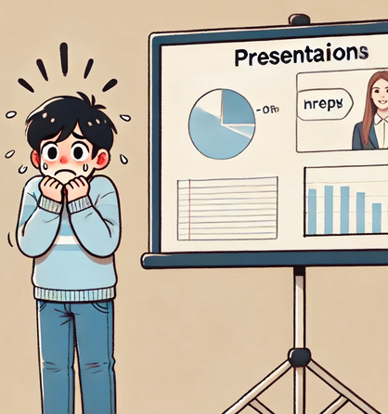
Public Speaking!
Source: The Book of Lists, 1977
AI-Generated Image
Notes:
Source: The Book of Lists, 1977

Slide 9
Public Speaking
Why is public speaking so frightening for many?
Please share one possible reason!

Slide 10
Communication Skills
Do you believe that communication skills are important in career success?
No
Maybe
Yes
Absolutely Yes
Why?

Slide 11
Presentation Skills
Do you believe that presentation skills are important in career success?
No
Maybe
Yes
Absolutely Yes
Why?

Slide 12
Working With Others
How about the ability to work with others?
Is that a valuable skill in most workplaces?
Are you sure?

Slide 13
Inclusivity
Do you believe that when communicating with others, we must be inclusive in our tone and style?
Please give an example of a situation that involves inclusivity.

Slide 14
Interpersonal Interaction
Do you believe that good interpersonal interaction with others can facilitate communication?

Slide 15
Beliefs
Do you agree that not all people have the same views or beliefs?
Do you agree that we must be sensitive to these differing views/beliefs in the workplace?

Slide 16
Interpersonal Relationships
Do you agree that having good interpersonal relationships with colleagues is important?

Slide 17
Preferences/Style
Do you agree that not everyone has the same preferences or style (how they work, communicate or relate to others)?

Slide 18
Tone
Do you agree that an effective communicator will adjust the tone and style of communication depending on the situation?

Slide 19
Teaching & Tone
Should a teacher have to adjust their tone according to the level of their students and their specific needs?
Can a teacher be great without being a great communicator?
Can students learn from a teacher they don’t like, respect or trust?

Slide 20
Why So Many Questions?
What do you think is the real reason that I am probing you with so many questions on day one?
Notes:
Explain this is your attempt to understand where the students are so that you can adjust the tone and even style of your teaching to their needs, focus on what needs focus and bypass concepts students clearly understand.
But the REAL reason is to convince the students of the validity and need for the concepts taught in this course. Once the student makes a connection between the concepts and his/her career, motivation for learning increases.

Slide 21
Teacher/Student Interactions
This course is an organization
Structure, participants, assumed leader
Fairness & equitability
Notes:
Explain that this course by itself is an organization. Our interactions are not all that different than a typical workplace. We have a structure, some participants and an assumed leader. The teacher must be ethical in the decisions affecting students to be fair and equitable to all.

Slide 22
What’s Coming Up
Course Outline
Course Requirements
Tentative Planning Calendar

Slide 23
RECAP: Can you recall any of the points that we discussed today? Any point?

