Slide 1
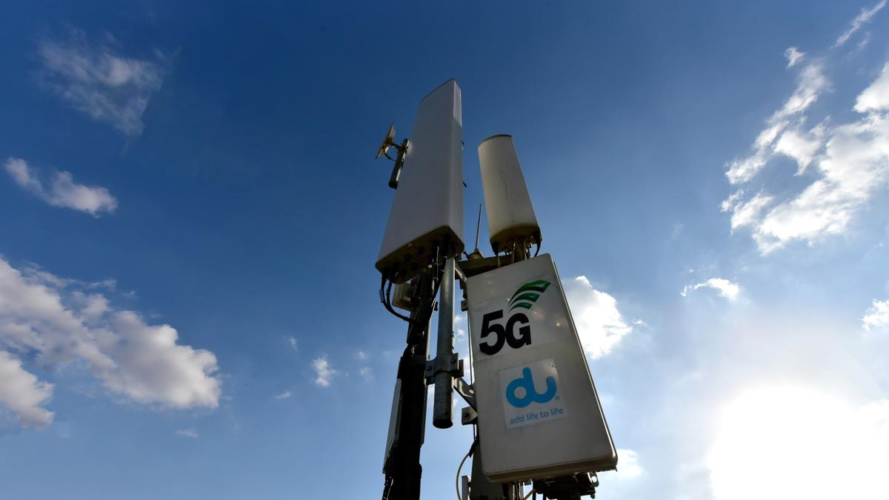
Classification of 5G base stations
Josef Pecka, Dmitrii Semenov
6. 5. 2025
This Photo by Unknown Author is licensed under CC BY-ND

Slide 2
Task description
Classify radio signal sources to detect potential attacker base stations operating within a building.
Class 0 – legitimate T-Mobile base station
Class 1 – unauthorised base station at location 1
Class 2 – unauthorised base station at location 2

Slide 3

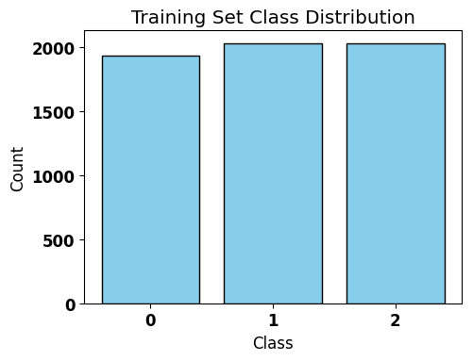
Solution
Loading and preprocessing data
Loaded data matching the order of labels
Z-score normalization
Augmentation of class 1 and 2 data
Larger dataset
Equal sample distribution
Augmenting input data with Gaussian noise

Slide 4
Solution
CNN model architecture
Input layer
Up to three 2D Convolutional NN followed by MaxPooling2D
Flatten
1st and 2nd Dense layer
Dropout
Output layer
Keras Tuner parameters:
Filters, kernel size, number of hidden layers, number of neurons in hidden layers, learning rate

Slide 5

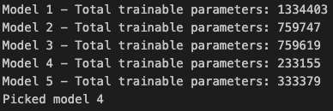
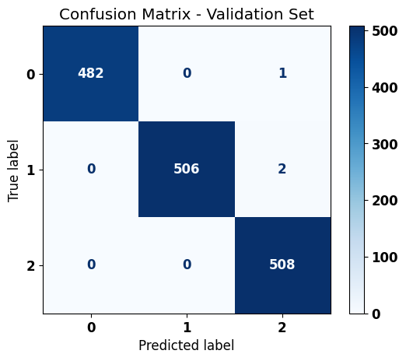
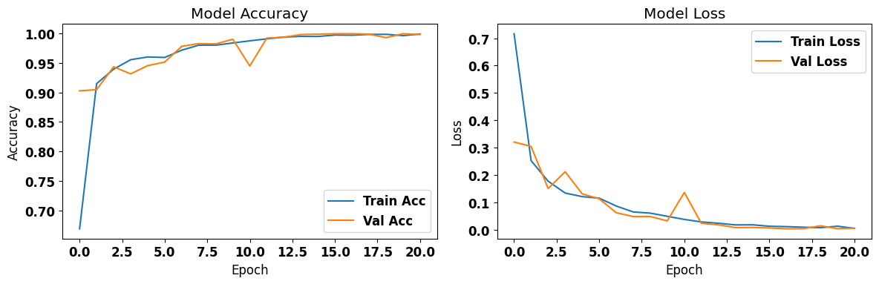
Results
Model validation
The best 5 Keras Tuner models were picked (based on validation accuracy), and the one with the least trainable parameters was chosen
Memory optimization
Preventing overlearning

Slide 6
Results
Final model accuracy of 99.116 % (119 out of 120 test samples)
By choosing between several best models, it is guaranteed that the picked model is the simplest one (memory efficient)

