Slide 1
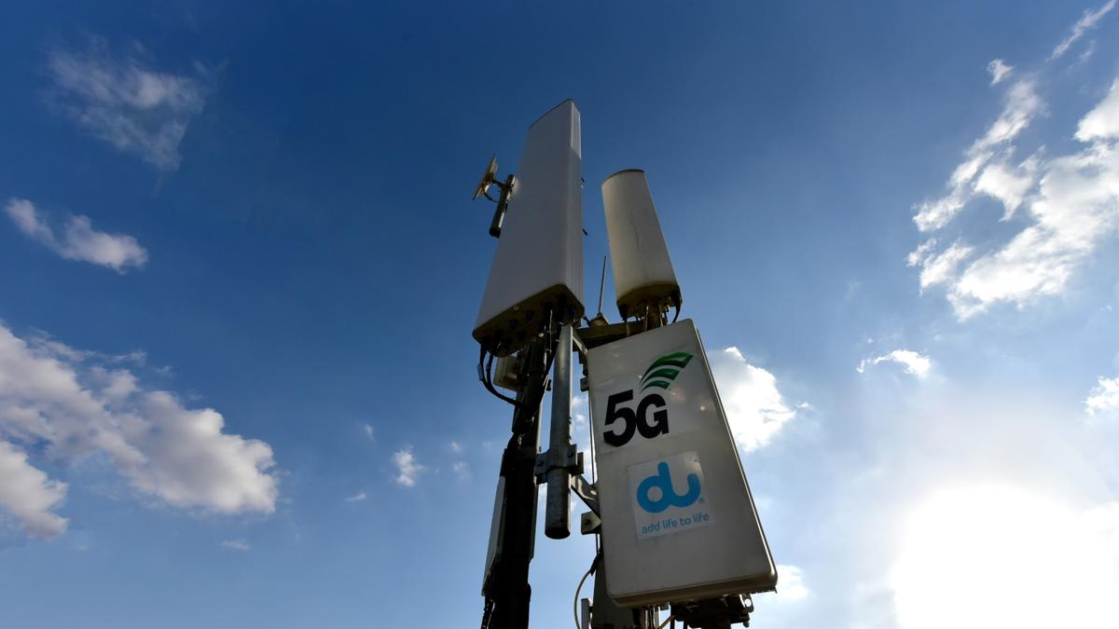
Classification of 5G base stations
Josef Pecka, Dmitrii Semenov
3. 5. 2025
This Photo by Unknown Author is licensed under CC BY-ND

Slide 2
Task description
Classify radio signal sources to detect potential attacker base stations operating within a building.
Class 0 – legitimate T-Mobile base station
Class 1 – unauthorised base station at location 1
Class 2 – unauthorised base station at location 2

Slide 3
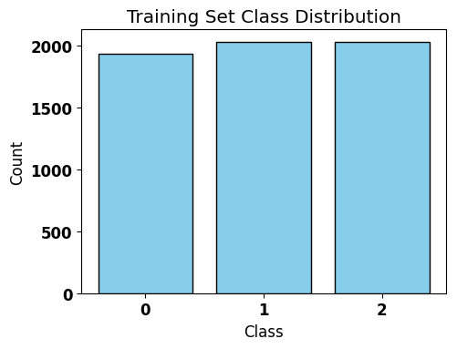
Solution
Loading and preprocessing data
Loaded data matching the order of labels
Z-score normalization
Augmentation of class 1 and 2 data
Larger dataset
Equal sample distribution
Augmenting input data with Gaussian noise

Slide 4
Solution
CNN model architecture
Input layer
Up to 3 2D Convolutional NN followed by MaxPooling2D
Flatten
1st and 2nd Dense layer
Dropout
Output layer
Parameters and enabling layers based on Keras Tuner result
Filters, kernel size

Slide 5
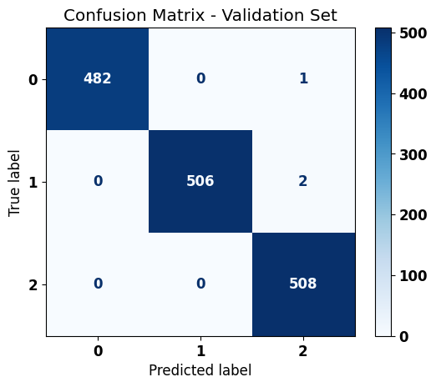
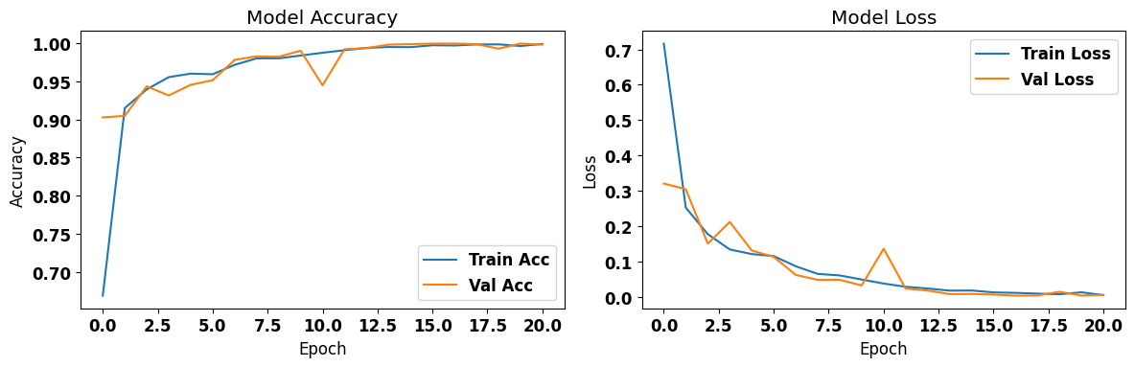
Results
Model validation
Keras Tuner model with least trainable parameters was chosen
Memory optimalization
Preventing overlearning

Slide 6
Results
Final model accuarcy of 99.116% (119 out of 120 test samples)

