Slide 1
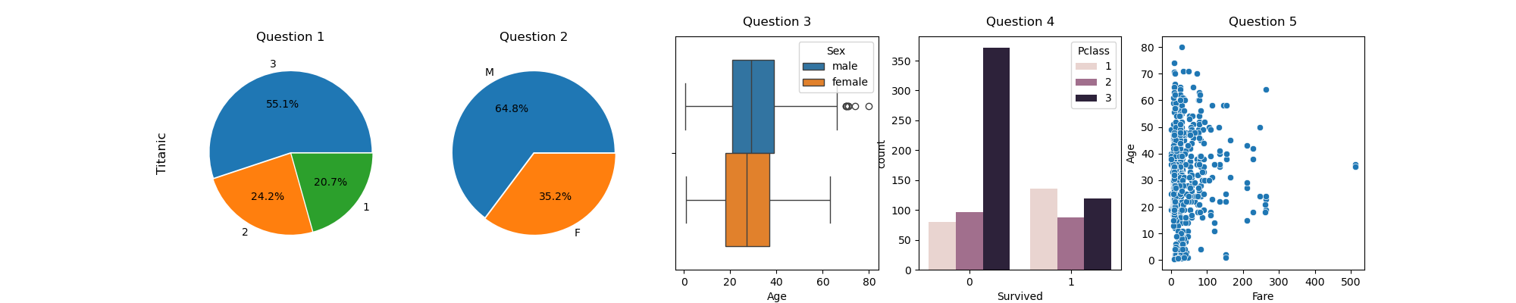
Titanic
No correlation
Variables are categorical
Alternatively : barplots
Variables are numerical and categorical (use hue)

Slide 2
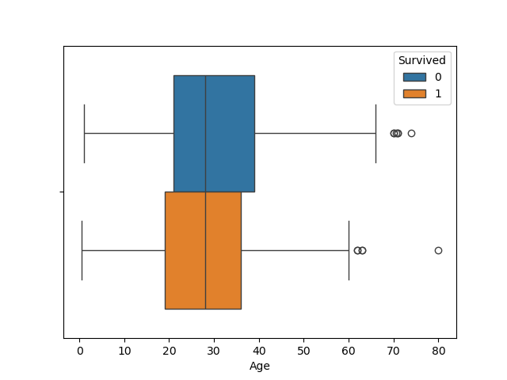
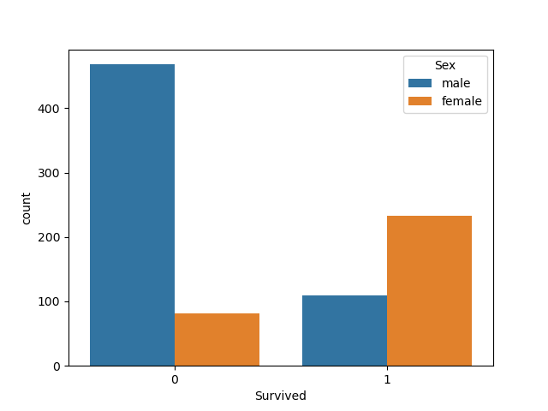
Q4 (more)

Slide 3
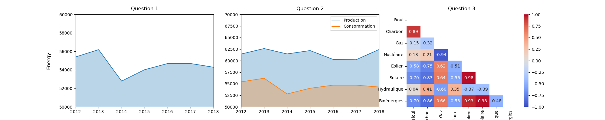
Energy

