Slide 1


EXOSKY CRYSTAL CASTLES
OUR GITHUB
ANTLIA
1998
ORION
1998
https://github.com/dmitriyd21/exosky

Slide 2
Challenge : Exosky
What would the night sky look like if you were standing on one of the many exoplanets discovered by astronomers and space missions? The list of 5500+ exoplanets at the NASA Exoplanet Archive can be combined with the latest star catalogs to translate the location and brightness of millions or even billions of stars to another perspective. From that perspective, anyone could use their imagination to draw constellations, much like our ancestors did on Earth thousands of years ago. Your challenge is to develop an app or interface for students that allows them to choose an exoplanet and then either display an interactive star chart or export a high-quality image for printing or viewing on a computer or virtual reality display, where they can draw and name constellations.

Slide 3
IDEA
Using 3D visualization of exoplanets and stars.

Slide 4

Technologies
01.
02.
03.
04.
HTML 5
CSS 3
JavaScript
Three.js + WebGL

Slide 5
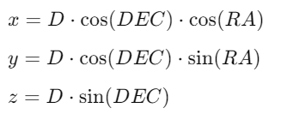
Data
Stars data
[286.7169128963743,0.27619460064099405,15.244129,1.08492385925788]
Exoplanets data
{"pl_name": "OGLE-2016-BLG-1227L b",
"ra": 265.5971250,
"dec": -33.7597778,
"sy_dist": null,
"pl_rade": 13.900,
"sy_name": "OGLE-2016-BLG-1227L",
"x": -0.06382385973040276,
"y": -0.82892132044581557,
"z": -0.55571211921234853},

Slide 6
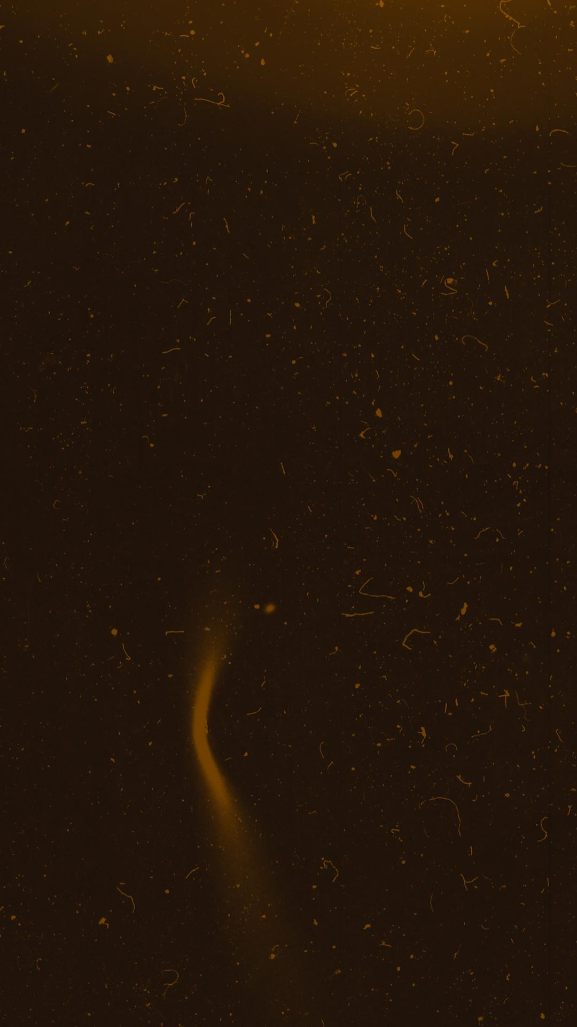
Data sources
Exoplanets – NASA Exoplanet Archive
Stars – Gaia Archive

Slide 7
“
In this project we are using open-source data from NASA Exoplanet Archive (~5000 planets) and GAIA Archive (~50000 stars approximately)
T
1

