Slide 1



True Review A Personalized Restaurant Recommender

Slide 2
Scope
Problem
Explore the Data
Modeling
Results

Slide 3

Problem
What are users in Yelp reviews saying?
Why should I trust Yelp reviewers, I’m different!?
There are thousands of reviews for many restaurants

Slide 4

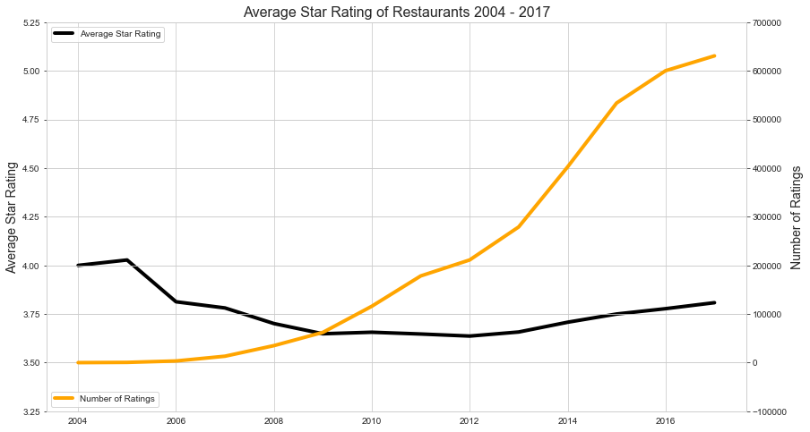
Explore the Data – Reviews Over Time
Average star rating and number of reviews over the years

Slide 5
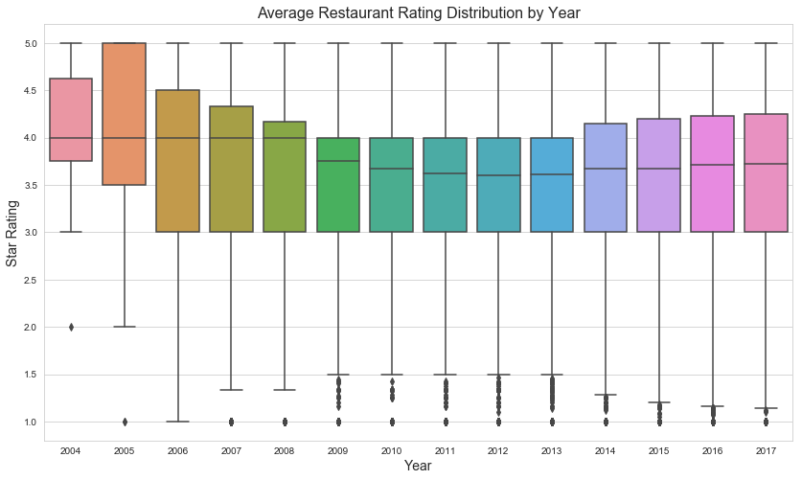
Explore the Data – Distribution of Ratings

Slide 6
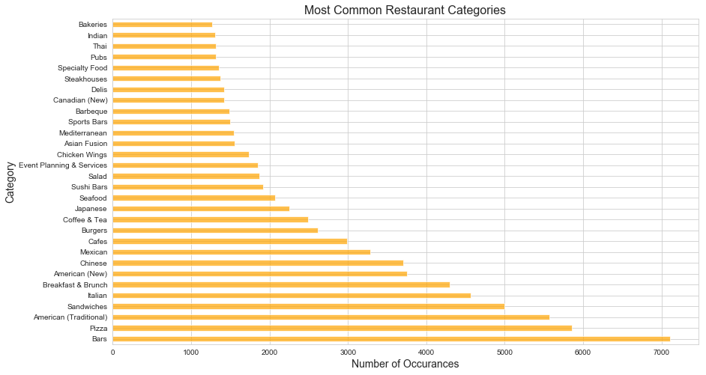
Explore the Data – Common Categories

Slide 7
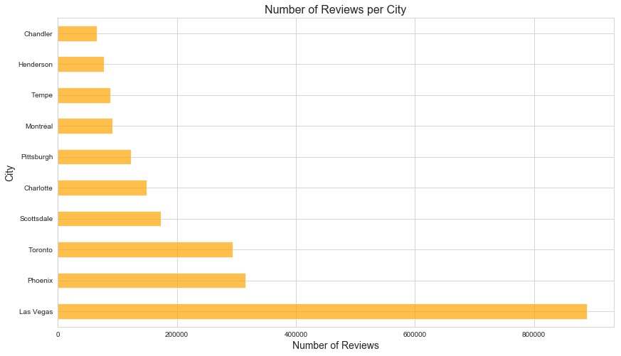
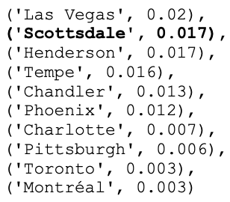
Explore the Data – Number of Reviews

Slide 8
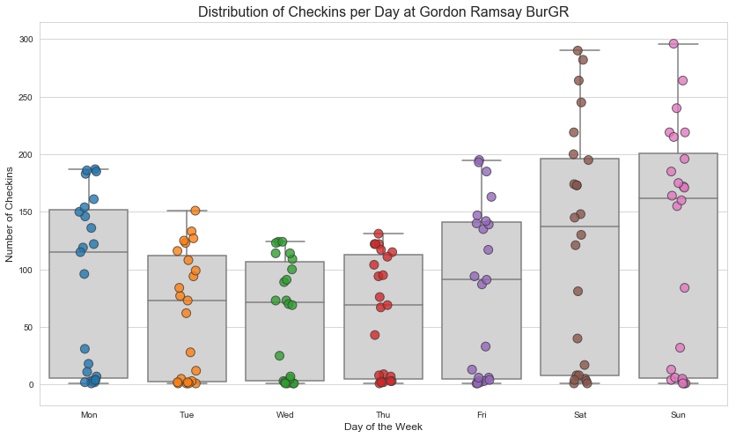
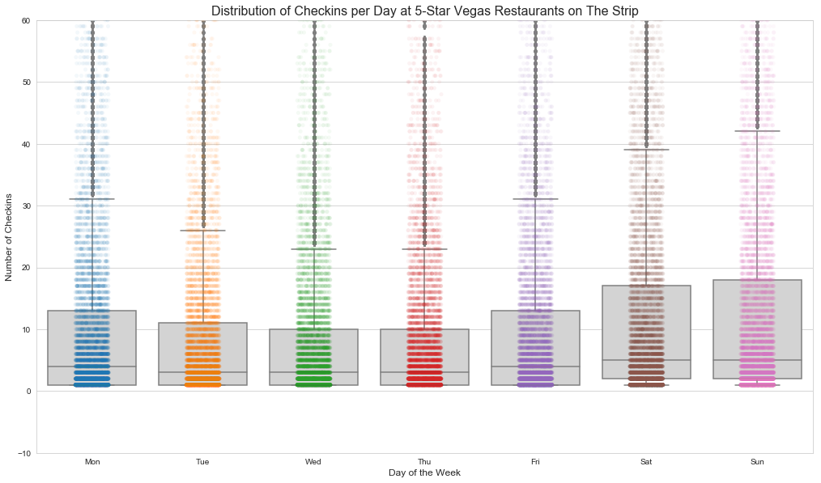
Explore the Data – Check-in Distribution
Gordon Ramsay BurGR vs Other Vegas Strip Restaurants

Slide 9
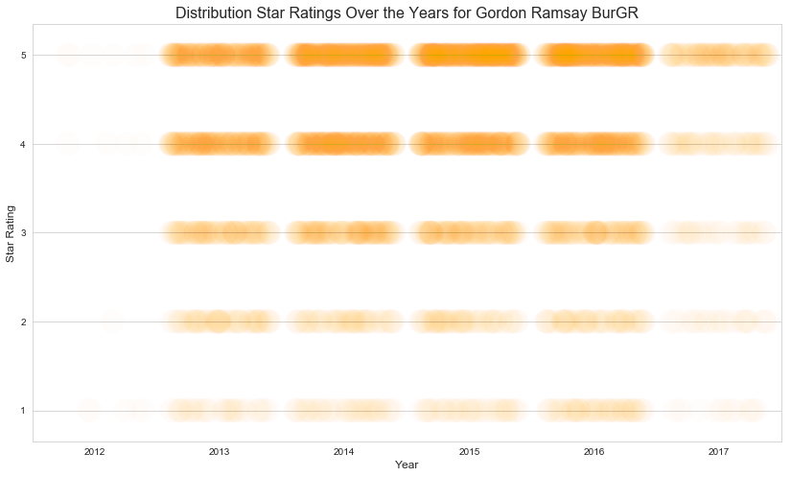
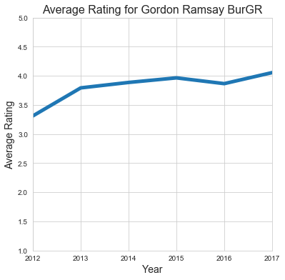
Explore the Data – Ratings Over Time

Slide 10
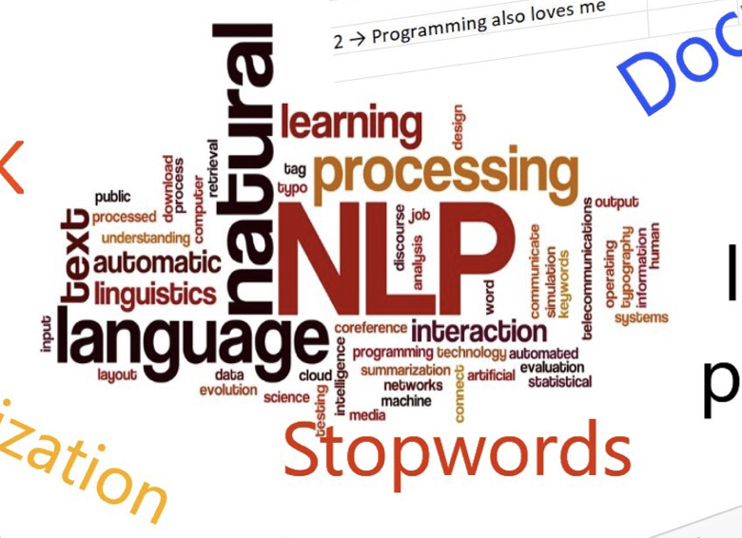

Explore the Data – NLP
Random review for Eddie’s House in Scottsdale, AZ:
'I really like this place. I have been numerous amt of times and I keep wanting more. The friendly bartenders, the exciting chef (Eddie). The best part of this place besides the good food and comfort level is their ALL Night Happy Hour. Yes All night $5 dollar specialty cocktails like an espresso martini or wines of the day. All first courses (apps) are half off too. The apps includes, lambchops ($19), Tuna tartar with wonton chips ($9) and so much more. Great s[ot and yearning for more since last night.’
Remove symbols, characters, etc.
Remove small words
Form bigrams and trigrams
'numerous amt time keep want friendly bartender exciting chef good_part comfort level night dollar specialty_cocktail espresso_martini wine day first_course app half app include lambchop tartar wonton_chip much great yearning last_night'

Slide 11
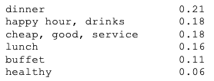
Explore the Data – LDA
Random review for Eddie’s House in Scottsdale, AZ:
'I really like this place. I have been numerous amt of times and I keep wanting more. The friendly bartenders, the exciting chef (Eddie). The best part of this place besides the good food and comfort level is their ALL Night Happy Hour. Yes All night $5 dollar specialty cocktails like an espresso martini or wines of the day. All first courses (apps) are half off too. The apps includes, lambchops ($19), Tuna tartar with wonton chips ($9) and so much more. Great s[ot and yearning for more since last night.’
LDA Topics Extracted

Slide 12

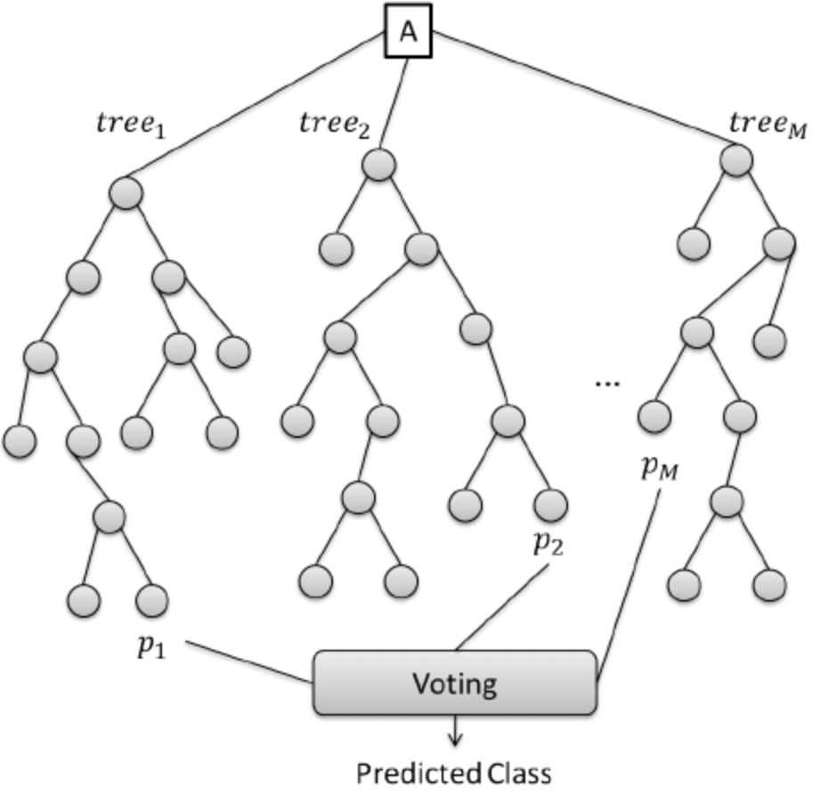
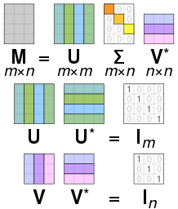
Modeling – Objective
SVD
Classifier
Regressor
+
+
Voting
Averaging
Prediction
Final Rating

Slide 13
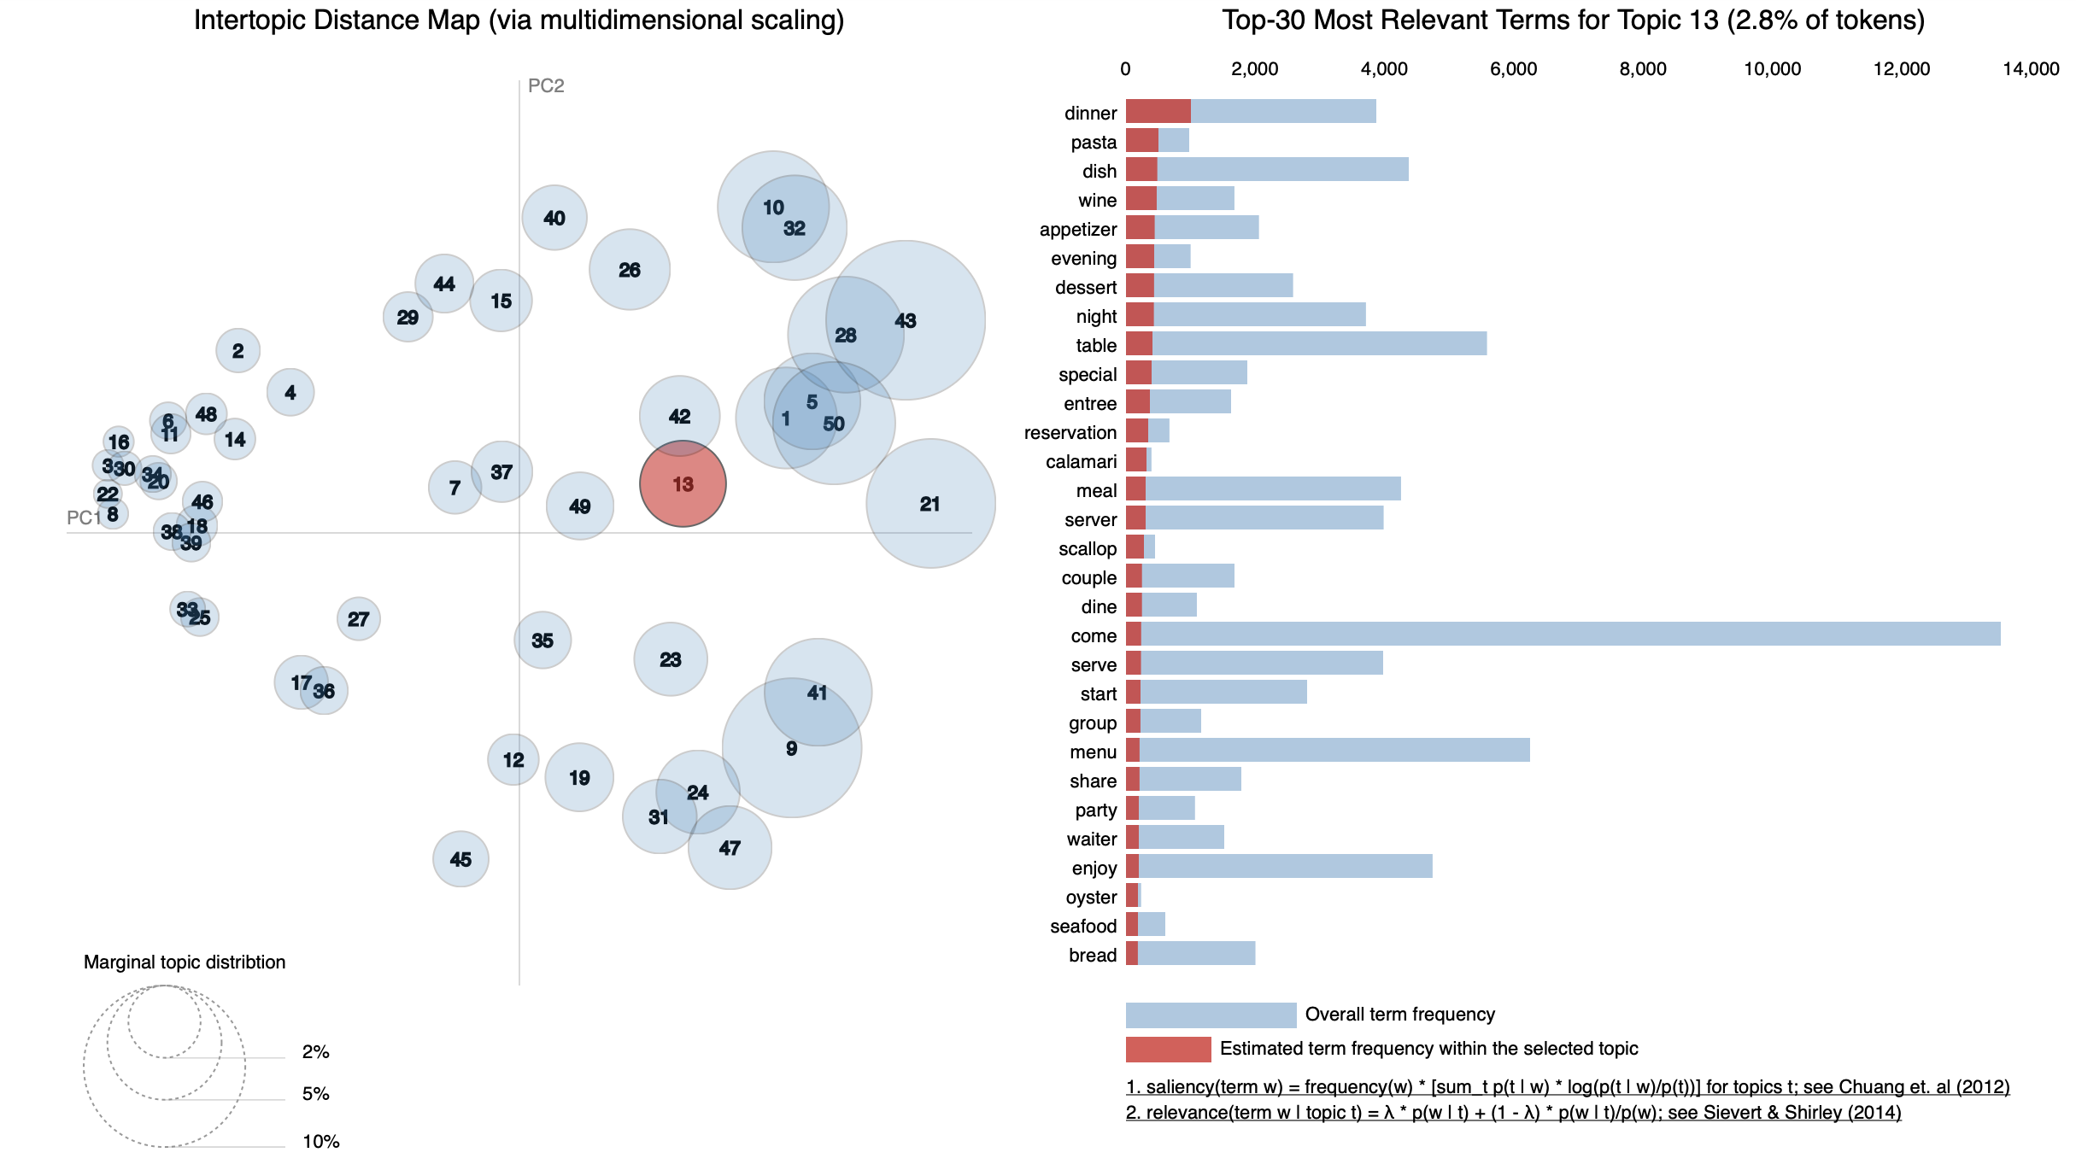

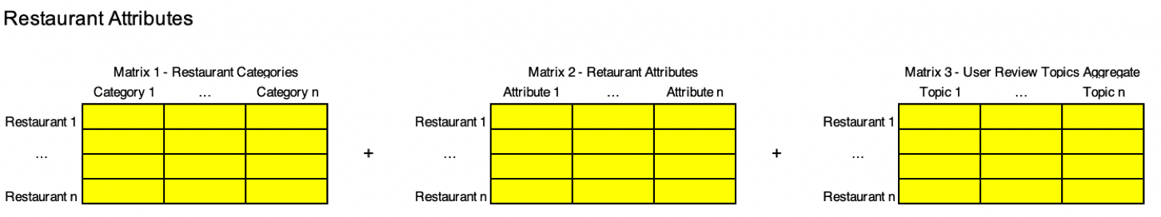
Modeling – LDA Topic Modeling

Slide 14
Modeling – RF Classifier and Regressor
Random Forest |  | Actual
 |  | dislike | like
Predicted | dislike | 299 | 870 | 1,169
 | like | 179 | 2,364 | 2,543
 |  | 478 | 3,234
Random Forest Tuned Weight 1:2.7 |  | Actual
 |  | dislike | like
Predicted | dislike | 855 | 1,169 | 1,169
 | like | 847 | 2,543 | 2,543
 |  | 1,702 | 2,010
Random Forest Regressor
RMSE | Initial | 0.94
 | Tuned | 0.89
AUC: 0.7486

Slide 15
Modeling – Improving Random Forest
Initial Model
Imbalanced Weighting
Tuned
Final Weighting

Slide 16

Results – Combined Predictor
RMSE Improvement |  | RMSE
RF Reg. | Initial | 0.94
 | Tuned | 0.89
SVD |  | 1.01
SVD + RF CLF |  | 0.91
SVD + RF CLF + RF Reg. |  | 0.74

Slide 17
Results – Next Steps
Add Features – LDA Topic Model on entire dataset
Add Classifier / Regression models (XGBoost, LightGBM, AdaBoost, etc.)
Tune model ensemble through GridSearch
Extract latent features from SVD model
Create user profile vectors to compare to restaurant profile vectors

