Slide 1
Why customers leave, and what to do about it
Senior ML Engineer case study. RavenStack subscription data: 500 customers across 5 tables.
The short version: no model here beats a coin flip, the one pattern that looked like a cause comes from how the file was written, and three actions still follow.
Notes:
Thirty to forty minutes, five parts, following the brief. I say the headline up front because the value of this work is in proving the negatives properly and in what we do anyway.
The second clause is the part to sit on if there is only time for one thing. The strongest result I had — churn accelerating through 2024, p = 2e-16 — is reproduced exactly by a simulation containing nothing but a random number generator. Slide 10 is that test. Finding it is the piece of work I would most want to be judged on.

Slide 2
PART 1 · PROBLEM FRAMING
The business problem, and a target I had to rebuild
This work supports two decisions. Who should the success team call this quarter? What should the product team fix?
By the churn event log, seven out of ten customers leave in the end. The typical customer pays $931 a month and is worth about $7,300 in total. Churn is the largest cost we can actually control.
The churn flag in the data cannot be used.
It has no date on it. So we cannot tell whether a customer had already left on any given day.
It agrees with the churn event log for 188 of the 500 customers. Two unrelated columns would agree for about 193. So the flag is not a rough version of the truth. It tells us nothing at all about who left.
The other two records do not line up either. A churn date and a subscription ending fall on the same day 2% of the time. The usual gap is two months.
So I rebuilt the target as a question with a date in it:
On 30 June 2024, using only what we knew that day, will this customer leave within the next 90 days?
That gives 177 customers who could still leave. 54 of them did, which is 31%.
Features use only data dated before that day. Anything still unresolved on that day is blanked out.
I found this by counting, not by modelling. No algorithm recovers a fact the source data never recorded the same way twice.
Notes:
Lead with the target problem. Along with slide 10 it is the most valuable thing here, and it shows the instinct to check the label before fitting anything.
If challenged on the 188: the point is not that agreement is low, it is that it is exactly what chance produces. The flag fires for 22% of customers and the event log for 70%, so two unrelated columns agree 38.6% of the time. We observe 37.6%. Cohen's kappa is -0.02, where 0 means unrelated, and chi-square gives p = 0.56.
Pre-empt the obvious follow-up: 'so invert the flag and you get 62%'. No. Inverted it scores 62.4% against 61.4% expected by chance, kappa +0.03. There is no information in it either way round.
The subscription line is the strongest part because it never touches the flag: 386 churn events can be compared to a subscription ending, and only 6 land on the same day. Median gap 62 days. All three recordings of 'this customer left' are mutually unrelated.
Computed in src/audit.py by label_source_agreement and churn_date_coherence, and shown in notebooks 01 and 10.

Slide 3
PART 1 · PROBLEM FRAMING
How we would judge success
For the model
ROC-AUC measures how well the model sorts customers by risk. 0.5 means it is guessing. I always report a range around it, never a single number.
I also report precision and recall, because they say what the CS team actually experiences when they work the list.
The headline number comes from nested cross-validation. That is the only version that accounts for the fact that I also chose the model.
For the business
Retention 180 days after any change we make.
Money kept, so that a saved customer who needed a large discount is not counted as a win.
Value of the campaign compared with calling everyone. Zero is the wrong thing to compare against.
Limits I set before starting
The model has to beat guessing at the bottom of its range, not just on average. It also has to beat simply calling every customer.
Scores order a call list. They never trigger an action on their own.

Slide 4
PART 1 · PROBLEM FRAMING
Risks and assumptions, said out loud
Two of the five tables are not joined to their customers in time.
Usage and support ticket dates are spread at random across the whole two years. They line up with their own customer's signup date at r = 0.002 and r = 0.014, where 0 means no connection at all.
That is what produces the numbers people quote: 19,128 of 24,979 usage rows are dated before the subscription they belong to, and 1,077 of 2,000 tickets before the customer signed up.
Nothing links inside those tables either. Ticket priority does not predict how fast we answered. Plan tier does not predict how much people used.
Satisfaction is documented as a 1 to 5 score, but only ever takes the values 3, 4 and 5.
There are three ways to say a customer churned. All three agree for only 20% of customers.
Subscriptions is the one table built with rules, and the only one I lean on. Price follows the plan and the seat count, ARR is exactly 12 times MRR, and no subscription starts before its customer did.
There is very little to learn from: 54 customers who left, against 73 features. Well under one example per feature, so every result carries a wide range.
Assumptions I am making
A 90 day window and a 30 June 2024 cutoff. I picked both before testing anything, so they are not chosen to flatter the result.
Customers still active when the data ends are treated as unknown, not as successes.
This is a generated dataset, so every finding is tested against a null that imitates the generator — including the findings I liked. Slide 10 is that test, and it is the one that changed the answer.

Slide 5
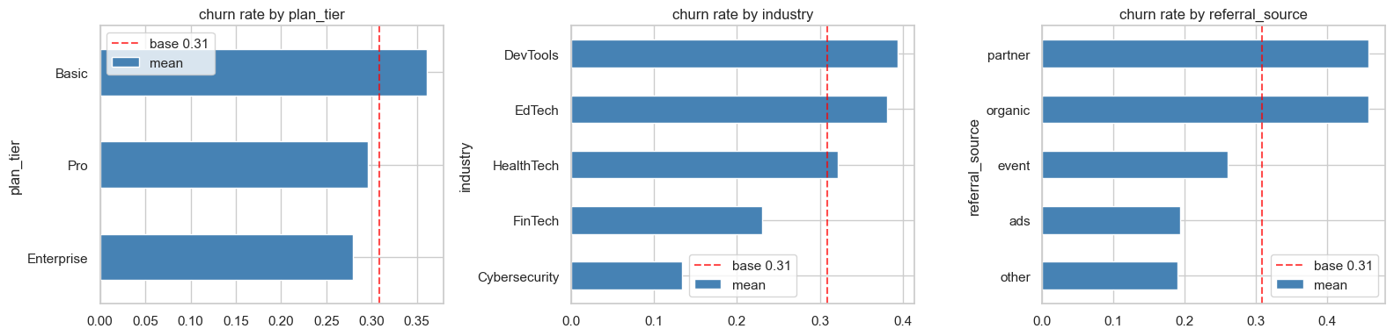
PART 2 · DATA EXPLORATION
What the data does and does not contain
No group of customers stands out. I checked industry, country, plan, how they found us, and whether they started on a trial. None of them separates the customers who leave from the ones who stay.
I explored the relationship with churn on a held out slice of the data. That way the data I modelled on did not influence what I chose to look at.

Slide 6
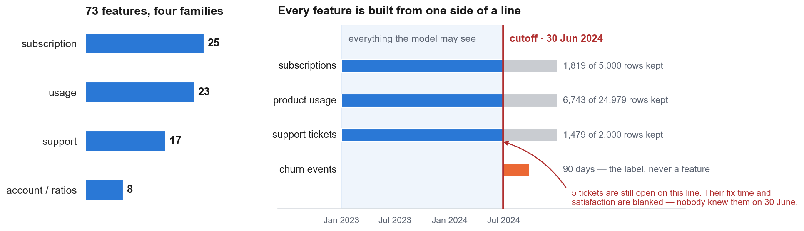
PART 2 · FEATURE ENGINEERING
73 features, and the reason for each one
What each family measures.
Subscription: what they pay, how steady it is, upgrades, downgrades, how long they have been a customer. Usage: activity over 30 to 180 days, and whether it is speeding up or slowing down. Support: ticket load, how fast we answered, how long fixes took, satisfaction, escalations. Account and ratios: industry, country, how they found us, plan, and per-seat versions of usage and tickets so a 10 seat and a 500 seat customer sit on the same scale.
The same code builds these in training and in production.
Training passes 30 June 2024, production passes today, so the two cannot drift apart. The blanking on the right is the part that reading the code misses: an automatic check found those 5 tickets, I did not.
Being honest about what worked: the 21 extra features I engineered made the score slightly worse, not better. I kept them anyway, because swapping to the smaller set just because it scored higher is the exact mistake I warn about later. None of them could have helped, for the reason slide 8 gives.

Slide 7
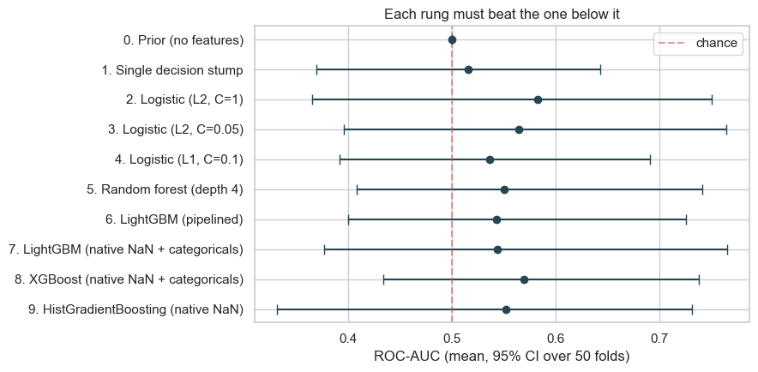
PART 3 · MODELLING
Choosing an algorithm: make it earn the complexity
I start with a model that uses no features at all. It has to score 0.5. Without that floor you cannot tell whether a real model is doing anything. Then I add complexity one step at a time: a single rule, then logistic regression, then a random forest, then three gradient boosting models.
Every model is tested on exactly the same splits, so the comparison is fair. The boosting models get their preferred treatment of missing values and categories. With only 177 customers, the simple regularised model still wins.

Slide 8
PART 3 · MODELLING
How it performs, and why the number is low
Best single model, taken at face value: AUC 0.583, range 0.37 to 0.75
The honest score: AUC 0.534, give or take 0.016
Guessing: AUC 0.500
The gap between those two numbers is the point.
Picking the best of ten models is itself a form of fitting. Once you measure that properly, 0.049 of AUC disappears. That is most of what looked like signal.
Across 25 test rounds, eight of the ten models won at least once. A genuinely better model wins nearly every time. Eight different winners is what noise looks like.
Why the score is low. Each cause is measured, not guessed at.
The inputs hold nothing. Usage and ticket dates are scattered at random across the two years and match their own customer's signup date at r = 0.002 and r = 0.014. Inside those tables, priority does not predict how fast we answered and plan does not predict how much people used.
The target is a random date. Every churn date is a coin toss between the day the customer joined and the last day of the file. Slide 10 is that test.
Subscriptions is the one table with real rules, and none of it relates to churn.
Sample size is real but secondary: 54 churners against 73 features.
It is not leakage, not the feature build, and not tuning. I checked all three.
Scores are ROC-AUC: 0.50 is guessing, 1.00 is perfect. I confirmed the pipeline works by planting targets of known strength — a strong one scores AUC 0.965, a deliberately weak one 0.584, a meaningless one 0.494. The method works. AUC 0.534 is the right answer to the question this data can be asked.

Slide 9
PART 3 · MODELLING
Imbalance, leakage and interpretability
Class imbalance
31% of customers left, so the classes are uneven but not badly so. I weight the rare class rather than inventing synthetic customers. With only 54 real examples, synthetic ones are copies of copies and they flatter the score.
I set the cut-off to favour catching leavers, because missing one costs far more than a wasted phone call. That gives 75% of leavers caught, and 1 in 3 of the flagged customers actually leaving.
I report ROC-AUC because its baseline stays 0.50 at any class balance, which keeps the twelve horizon cells comparable when their churn rates run 11% to 45%. Precision-recall and F1 agree, so the metric is not choosing the answer.
Data leakage
I do not rely on reading the code. A set of automatic checks runs before any result is reported, and it blocks the result if anything fails.
The checks look for dates after the cutoff, for banned columns by name, and for any single feature that predicts too well.
Columns that only exist after a customer leaves are worth 0.37 of extra AUC. They push the model to AUC 0.79, which looks like a good model rather than a broken one. That is exactly why they are dangerous.
Interpretability, and how it can mislead you
SHAP gives a clean, confident chart of what drives the prediction. I checked it against shuffled data, where by definition there is nothing to find. The chart looked just as convincing.
The top feature beats random labels only 3 times in 4. Twelve different features take first place across 25 reruns. These tools never tell you when they have nothing to say, so I pair every one with a random baseline.

Slide 10
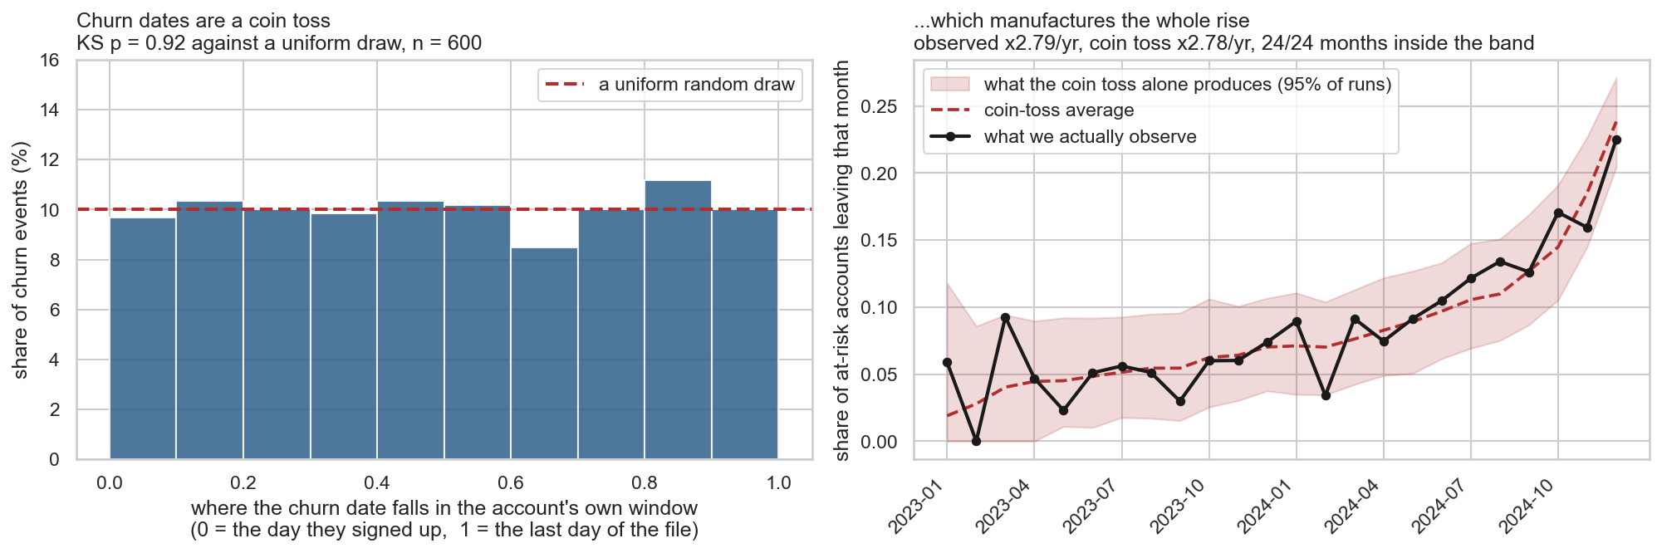
PART 4 · RECOMMENDATION 1
Do not go looking for what changed in 2024
Churn looks like it is accelerating. About 5 in every 100 customers left each month in 2023, rising to 22 in 100 by December 2024 — a 2.8x rise per year, p = 2e-16. It was by far the strongest number in this study.
It is not a fact about customers. Every churn date in this file is a random date between the day the customer joined and the last day of the extract. A random date has nowhere to go but the end of the file, so the rate climbs on its own, with nothing happening in the business.
Rebuilding the data from that one rule gives the same answer: a 2.78x rise per year, all 24 months inside the range chance produces, and our result sitting at the 52nd percentile of pure noise. So there is nothing here to investigate, and that is the recommendation.
The test that mattered was not "is this bigger than noise" — it was, comfortably. It was "would the file produce this on its own". On generated data that is the only null worth testing, and it is the one I had not run.
Notes:
This is the slide I would want to be asked about.
How the artefact works: no churn date can land after 2024-12-31. If each is drawn uniformly between signup and that boundary, the hazard is 1/(END - t), which rises without limit as t approaches the end. Pooled across accounts that signed up over two years, that is indistinguishable by eye from a business problem.
The evidence, in order. Rescale each churn date to its position in the account's own window: uniform, KS p = 0.92 on 600 events, mean position 0.503, and uniform inside every signup quarter. Then the simulation — keep each account's real signup date and real number of churn events, redraw only the dates, run the same survival.calendar_hazard used to produce the original claim, 400 times. Observed rate ratio 1.0893, null 1.0885 with a 95% band of [1.072, 1.106].
The p-value is the part worth dwelling on. p = 2e-16 felt like the most secure number I had. The null rule produces a median p of 2.8e-16 — very slightly more significant than the real data. A p-value tells you nothing about whether the null it tests is the one that matters.
If asked what I would have done differently: run this before writing the recommendation, not after. On any generated or vendor-supplied extract, simulate the file before trusting a time trend in it.
src/generator.py, notebook 16.

Slide 11
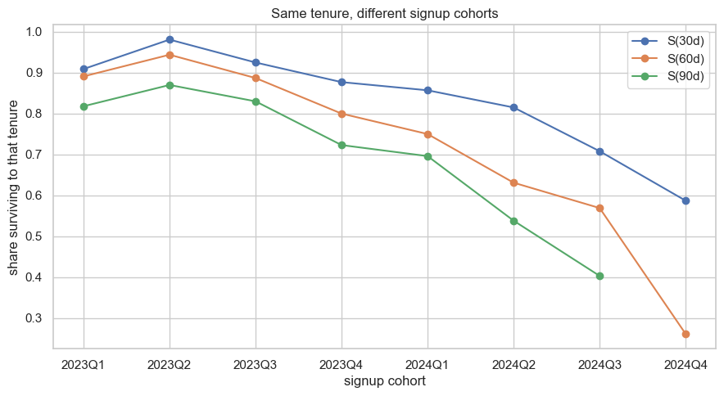
PART 4 · RECOMMENDATION 2
Do not build the onboarding programme
New customers look fragile, and risk looks like it falls with age. That is the usual reason to fund onboarding, and the evidence for it looks strong: 30-day survival drops from 0.98 for the 2023 intake to 0.59 for the 2024 one, measured at the same age.
It is the same random date. A customer who joined recently has a shorter window for that date to land in, so a larger share of their draws fall inside any 90-day question we ask. They look worse at every age without anything about them being worse.
Simulated data with no tenure effect in it at all clears the significance bar in 93% of runs, and does so more strongly than the real data does (p = 0.002 against 0.006). Within one joining month there is nothing left: a day-300 customer leaves as often as a day-10 one.
The recommendation does not change; the reason for it gets one layer deeper. This is the same finding as slide 10, applied to a spending decision instead of an investigation.

Slide 12
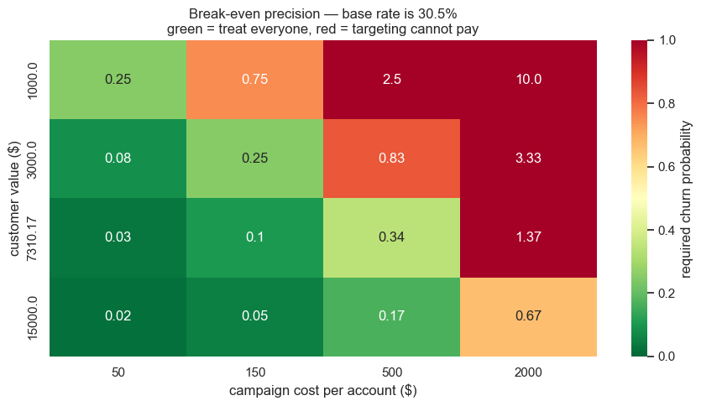
PART 4 · RECOMMENDATION 3
Call every at-risk customer, do not rank them
A call costs about $150. A customer is worth about $7,300. If the call works one time in five, it pays for itself on any customer with more than a 10% chance of leaving. In this group, 31% leave.
So calling everyone already makes money, and no ranking can improve on a decision that is right for every customer. Using the model adds $600 on top of $52,400. That is a 1% gain, and even that is generous.
This is one division. Had I run it first, it would have shown that a working model was never the thing standing between us and the decision.

Slide 13
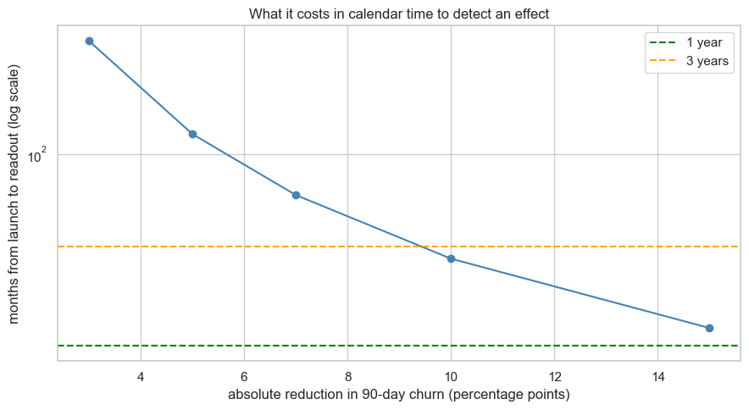
PART 4 · TESTING APPROACH
How I would test this, and what is worth testing
Recommendation 1 is not an experiment. It is a data request.
Nothing in this extract can say why customers leave, because the timestamps were never recorded against the customers they belong to. Ask for an export where they are, then rerun this pipeline and compare against the score written down today.
Recommendation 3 is a proper experiment.
Split the at-risk customers in half at random. One half gets a call, one half does not. Measure retention after 180 days, and measure money kept as well, so a costly save is not mistaken for a win.
But be realistic about what we can detect.
At about 21 new customers a month, only a very large effect can be proved:
Halving churn takes about 15 months to show.
A 5 point improvement would take over 10 years.
Two separate methods agree on this. A standard power calculation and a simulation both say we cannot detect anything smaller than about a 15 point change.

Slide 14
PART 5 · MENTORSHIP
What I would teach a junior engineer
I would hand them my own worst mistake on this project, because that is where the judgement that transfers to other work lives.
1. Be hardest on the finding you like.
I had one positive result and a page of nulls, and I checked the nulls. The positive one was manufactured by the file. Ask of any finding: what else could have produced this, and can I generate it from nothing?
2. A small p-value is not evidence. It is evidence against one null.
p = 2e-16 felt unarguable. Random dates gave p = 3e-16. If the null is the wrong one, no amount of significance rescues it.
3. Start with the target, not the model.
My first version modelled a flag unrelated to the event log. Counting rows found it. Then check your own check: I first called 38% agreement ‘worse than a coin flip’, and it is not — for two columns this different in size, chance agreement is 39%, not 50%.
4. Ask of every column: would I really have this on the day I predict?
Then write the check down so a machine runs it. Reading caught the obvious problem; the automatic check caught the one I missed.
5. Find the floor, and report the range.
Always run the model with no features first. A range that includes guessing says something the average hides.
6. Choosing a model is part of fitting it.
Here the gap between the best model and the honest score was the entire apparent signal.
I would teach all of it as experiments rather than lectures. Switch off the banned column list and watch AUC jump from 0.58 to 0.79. Then simulate a dataset with nothing in it and watch it produce a publishable-looking trend.

Slide 15
PART 5 · SCALABILITY
How I would run this in production
Sources: billing and CRM, product usage, support desk
| runs once a night
Feature build (THE SAME CODE USED IN TRAINING)
· every calculation takes a date and looks only before it
· blanks out anything not yet known on that date
· the leakage checks run here and stop the job if they fail
|
Scoring (once a day is plenty for a 90 day question)
· writes the customer, the score, and the main reasons
|
Use (a call list for the success team)
· scores also written back to the CRM for context
· nothing is ever triggered automatically
What I would watch
Whether the incoming data still looks like the data we trained on. Checked weekly.
Whether columns have gone missing or empty. Checked daily, and the job fails if the shape changes.
The leakage checks. Run every single time, and they stop the job.
Whether the scores themselves have drifted. Checked weekly.
Whether the model is still accurate. Checked every quarter, once we know who actually left.
We only learn if we were right 90 days later. So accuracy checks are always late. Watching the incoming data is the early warning, and accuracy confirms it afterwards.
The part I would argue for hardest is running the leakage checks in production. The bug in this project was in the pipeline, and pipeline bugs come back every time someone adds a feature.
This is what I would build if the model were worth shipping. On these results it is not, and this extract cannot be repaired into one — the timestamps have to be collected against the right customers, not corrected. Once they are, the pipeline takes a date, so re-measuring is one command.

