Slide 1
Customer churn: what we found
Executive summary. You asked three questions. Here are the three answers, each with the evidence behind it.
Why are customers leaving?
This data cannot tell us. The one pattern that looked like an answer — churn climbing through 2024 — is produced by the way the file was built, and we can show that directly.
Can we predict who will leave?
No, and a better algorithm is not the missing piece. Most of what we hold about customer behaviour is not connected to the customers it is supposed to describe.
What actions will improve retention?
Contacting every at-risk customer already pays for itself on the cost arithmetic alone. Beyond that we cannot yet prove what works, because no retention action has ever been recorded.
Each answer carries its numbers on its own slide. The first two are limited by the data we hold, not by the analysis — and knowing that is what stops us spending money on either of them.
Notes:
One minute. Give all three answers immediately, then one slide each. Two of the three are negative and I say so here rather than building up to it.
The first answer changed late in the work, and that is the part worth being open about if asked. We had a strong result — churn accelerating 2.8x a year, p = 2e-16 — and it is reproduced exactly by a simulation that contains nothing but a random number generator. Slide 2 shows the overlay. Catching it is worth more than the finding was, because acting on it would have cost a quarter of somebody's time.
The third answer is untouched by any of this. It rests on cost arithmetic we can check, not on the model.

Slide 2
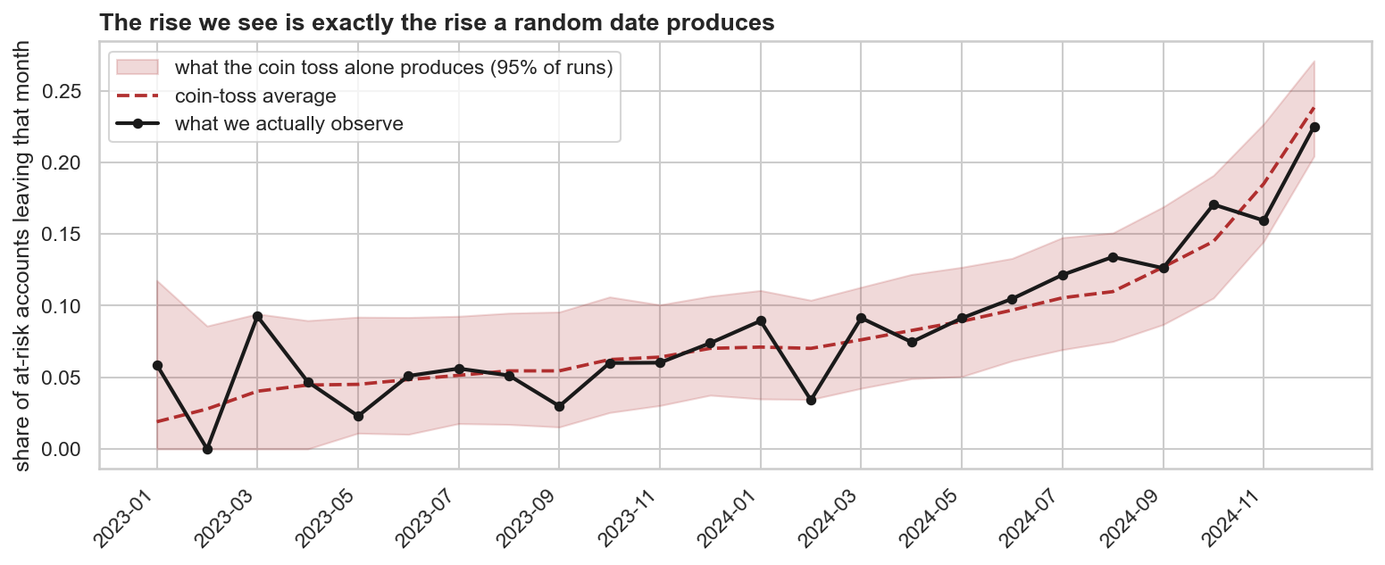
QUESTION 1
Why are customers leaving?
This data cannot tell us — and the pattern that looked like an answer is not one.
Churn looks like it climbed from 5 in every 100 customers a month to 22 in 100 by December 2024. That was our strongest number by a distance.
It is manufactured. Every churn date in the file is a random date between the day the customer joined and the last day of the file. Random dates crowd towards the end of a file, which makes churn look like it is speeding up when nothing has happened. Rebuilding the data from that one rule reproduces the black line exactly — that is the red band.
We also tested every customer characteristic we hold: industry, country, plan, size, how they found us, usage and support history. None separates the customers who left from those who stayed.
What this is worth: it stops us spending a quarter hunting for a 2024 price change, outage or competitor move that did not happen. Slide 6 says what would actually let us answer the question.
Notes:
Expect: 'you showed us a rising chart last time — what changed?'
What changed is the test. The original one asked whether the rise was bigger than random noise. It was, comfortably: rate ratio 1.089 a month, p = 2e-16. The right question on a data extract is different — would the file produce this on its own. Nothing can be recorded after the last day of the file, so if churn dates are assigned at random they pile up at the end and the rate appears to climb.
We tested that by rebuilding the data: same customers, same joining dates, same number of departures each, only the dates redrawn at random. That gives a 2.78x annual rise against the 2.79x we observe, with all 24 months inside the band. Our result sits at the 52nd percentile of pure chance.
If pressed on the flat cross-section: Cox over 21 characteristics returns global p = 0.57 and concordance 0.571; log-rank across 7 segments has a smallest adjusted p of 0.39.
The honest summary is that we now have a proven negative rather than an unproven positive, and the proven negative saves money.

Slide 3
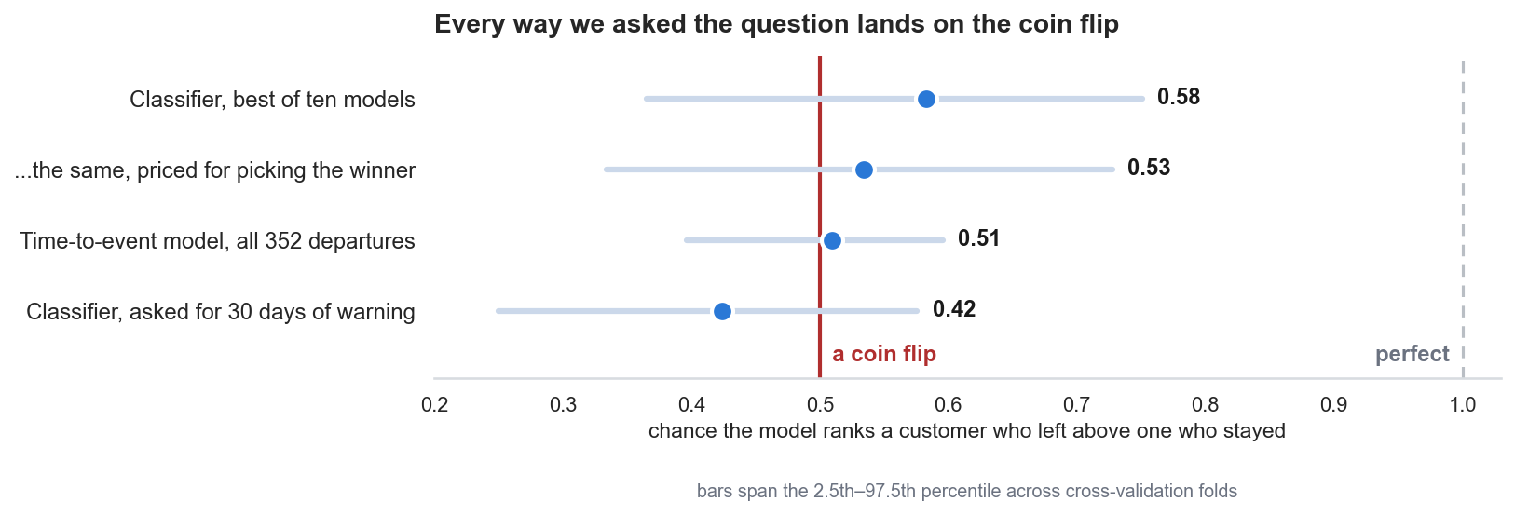
QUESTION 2
Can we predict churn before it happens?
Not from this data as it stands, and a better algorithm is not the missing piece.
The reason is the data, and it is now specific.
Product usage and support tickets are not tied to the customers they describe. Their dates are scattered at random across the whole two years, which is why three-quarters of usage rows are dated before the subscription they belong to and half the tickets before the customer existed.
The thing we are predicting is a random date too, as slide 2 shows. And three sources disagree on who churned: they agree on about one account in five, which is what two unrelated columns would do.
How firm is this? Firmer for some parts than others.
For usage and support we can say there is nothing there: those records were never linked to the customer in the first place. For customer characteristics — industry, plan, size — the honest claim is that we could not detect anything with 54 churners, not that nothing exists.
Practically: do not buy or build churn scoring on this. It needs a different export, not a better model — see slide 6.
The scale: pick one customer who left and one who stayed — the number is the chance the model scored the leaver as riskier. 0.50 is a coin toss, 1.00 is always right. The faint bars are how far the score moves between test splits. The bottom row is the one that matters operationally: ask for 30 days of warning, so somebody can act, and it lands below a coin toss. Precision-recall and F1 agree, and on F1 the model beats a no-model policy by less than the optimism in its own tuned threshold. Ladder and null tests in the technical deck.
Notes:
Two challenges to expect on this slide.
1. 'But AUC 0.58 is above 0.50, so there is something there.' The answer is that 0.583 is the maximum of a 15-model search, not a measurement of one model. Nested cross-validation, which prices in that search, gives AUC 0.534 +/- 0.016. The same search on shuffled labels averages AUC 0.566 and clears 0.583 in 7 of 20 trials. Permutation p = 0.076.
2. 'Is AUC the right metric at 31% positives, or should this be F1 or precision-recall?' AUC is right here because its null is 0.50 at any base rate, which is what makes the twelve horizon/buffer cells comparable when their positive rates run 11% to 45%. But it does not matter which we use: average precision is 0.378 against a base-rate null of 0.305, permutation p = 0.070, against p = 0.076 on AUC. And F1 is 0.497 against 0.467 for contacting everyone -- a lift of 0.029, which is smaller than the 0.049 optimism in its own tuned threshold. F1 is the weakest of the three for this claim precisely because it is threshold-dependent and has no natural null.
The three approaches are the cross-sectional classifier, a Cox survival model (concordance 0.509) and the horizon sweep.
Be precise about how strong the negative is, because it differs by source. For usage and support it is flat: those timestamps correlate with their own account's signup date at r = 0.002 and r = 0.014, so there was never anything to find. For customer characteristics it is an underpowered null rather than an absence — the planted weak-signal control scores AUC 0.584 against our 0.583, so at 54 churners the two are indistinguishable. The slide separates them deliberately.

Slide 4
QUESTION 3
What actions will improve retention?
One action pays for itself today. Beyond that, we cannot yet prove what works.
Do this now: contact every at-risk customer, and do not rank them.
A call costs around $150 and an average customer is worth around $7,300. If one call in five succeeds, it pays for itself on anyone with more than a 10% chance of leaving. In this group 31% left within 90 days, so the margin is wide.
This rests on the cost arithmetic rather than on the model, which is why the prediction result does not hold up the decision.
Hold off on this: the structured onboarding programme.
New customers look more fragile, which is the usual reason to invest here. It is the same random date as slide 2: a customer who joined recently has a shorter window for that date to land in, so they look worse at every age without anything about them being worse. Within a single joining month, a ten-month customer is as likely to leave as a ten-day one.
Everything else we might try is currently untestable, not disproven.
No call, discount or campaign is recorded anywhere in the data. Without a record of what we did there is no way to measure what worked, so the other retention ideas are opinions for now, including the good ones.
Costs and save rates are our estimates and should be replaced with finance's figures. The conclusion holds across a wide range of them: break-even would have to rise past 31% to reverse it.
Notes:
The first action is the one thing on this deck that does not depend on the modelling, or on slide 2. Break-even is 10.3% against a base rate of 30.5%, a factor of three, so it survives large errors in the cost assumptions.
On onboarding: the pooled hazard genuinely does fall, rho = 0.737 with p = 1.7e-13, which is why the obvious analysis funds the programme. Simulated data with no tenure effect in it at all clears the significance bar in 93% of runs, and more strongly than the real data does — p = 0.002 against 0.006. Within each signup cohort rho comes back to about 1 (range 0.87 to 1.25, none significant). This reverses a recommendation an earlier pass of this work made.

Slide 5
THE ECONOMICS
Why calling everyone is the right call today
$7,300
Average customer value, 3 years, discounted
31%
Of this at-risk group left within 90 days (54 of 177)
10%
Break-even chance of leaving for one call
$52,400
Value of calling all 177, at a 1-in-5 save rate
1%
What a perfect ranking would add on top
15 months
To prove a halving of churn; smaller gains take years
Customers here leave about three times as often as the break-even point, so contacting all of them makes money without any model involved. A perfect ranking would add roughly 1% on top. That is why the prediction result does not block this decision.
The call cost and the 1-in-5 save rate are our assumptions rather than finance's, and should be replaced. We varied both widely and the treat-everyone conclusion held: break-even would have to rise past 31% to reverse it.
Notes:
Every figure here is arithmetic on quantities we can check, not model output. Net value at the model's best threshold is $53,000 against $52,400 for treating everyone, hence the 1%, and that 1% is itself optimistic because the threshold was chosen on the same data. The 15 months comes from a minimum detectable effect of 17.2pp at 88 per arm; a 5pp improvement would need about ten years.

Slide 6
WHAT WE NEED
Three data requests, and what each one unlocks
An export we can trust (unlocks Questions 1 and 2 together)
Every usage record and support ticket carried with the customer and the date it actually happened. Today those dates are unrelated to the customer they are filed against, which is the single reason both questions are unanswerable.
One definition of churn, applied everywhere, with a date on it. The three we currently have agree on about one account in five.
This is the request to push. Nothing else on this page matters without it, and re-running our analysis afterwards is one command.
Then, and only then, the business timeline (Question 1)
Price changes, release dates, outages, competitor moves. This is the right request, but it is worth nothing against the current export — we would be matching real events to random dates.
To learn which actions work (Question 3)
Start logging every call, discount and campaign with a date and an account attached. Then run one deliberate trial where half the at-risk customers are contacted and half are not.
Worth setting expectations on what a trial of our size can settle: roughly halving churn would show up in about 15 months, while a 5-point improvement would take years.
None of these is a modelling problem. All three are data collection, none of them is expensive, and none asks for a decision on tooling yet.
Notes:
Close on the ask rather than on the negative results.
The ordering is the message. The obvious request after slide 2 is 'give us the 2024 event timeline', and it is the wrong one to lead with: joining real business events onto timestamps that were assigned at random produces confident nonsense. Fix the export first.
Request three is independent of the other two and can start on Monday. It costs a field in the CRM.

