Slide 1
SaaS Churn — Detailed Analysis
RavenStack dataset · 500 accounts · why they leave, whether we can predict it, and what to do
Headline: nothing about a customer predicts churn — but the date does.
Notes:
The deck is organised around the three questions the product team asked. Two answers are negative; the negatives are the substance.

Slide 2
THE BRIEF
Three questions, three answers
1. Why are users leaving?
– Not who — when. Churn hazard rose 2.8x per year (p = 2e-16) on a flat customer base. No attribute, segment, tenure band or stated reason explains who leaves.
2. Can we predict churn before it happens?
– No. Three independent formulations land at chance: nested CV 0.534, Cox concordance 0.509, Cox global p = 0.57.
3. What actions improve retention?
– Not identifiable — no intervention is recorded anywhere in the schema. And the economics say targeting is unnecessary.
Answers 1 and 2 are the same fact: a factor that moves every account at once leaves no cross-sectional variance for a model to fit.

Slide 3
FRAMING
The supplied label was not usable
accounts.churn_flag has no date attached and disagrees with the churn event log for 312 of 500 accounts — 37.6% agreement.
Replaced with the standard temporal formulation: given everything observable on 2024-06-30, will this account churn within 90 days?
– Eligible: signed up before the cutoff, subscription still open, not already churned -> 177 accounts
– Label: first churn event inside the window -> 54 positives (30.5%)
– Features: only rows dated before the cutoff; fields resolving after it are censored
Found by counting, not by modelling. This is the single highest-leverage finding in the project.

Slide 4
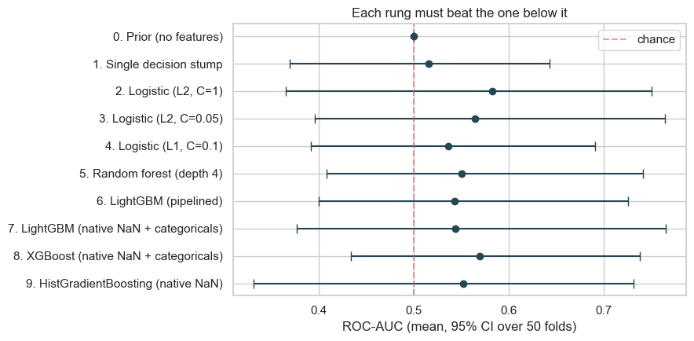
QUESTION 2 — PREDICTION
Ten models, none clears chance
Repeated stratified CV, 5 folds x 10 repeats, identical folds. No rung clears 0.5 at the lower bound of its interval.

Slide 5
QUESTION 2 — PREDICTION
Choosing the winner is itself a fitting step
Ladder maximum (optimistic): 0.583
Nested CV (honest): 0.534 ± 0.016
Chance: 0.500
Cost of selecting the winner: 0.049 — most of the apparent signal.
Across 25 outer folds, eight of the ten rungs won at least once. A genuinely better model wins consistently; eight winners is what selecting on noise looks like.
– Same effect measured independently: best-of-15 classifiers on shuffled labels scores 0.566, and the real winner's selection-corrected p is 0.300

Slide 6
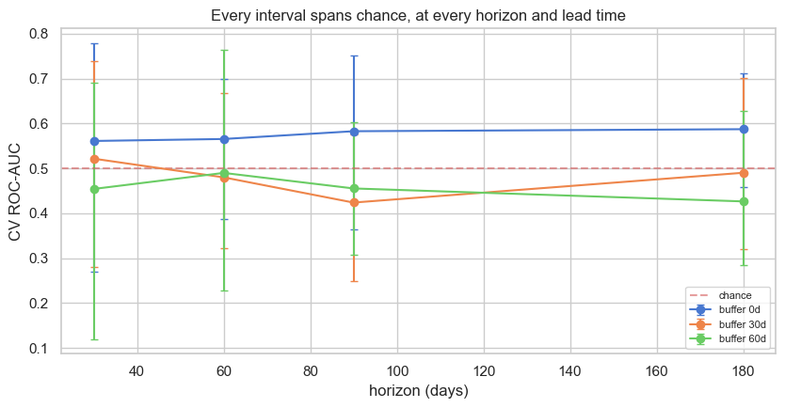
QUESTION 2 — PREDICTION
The signal does not survive a lead-time requirement
Buffer = days of warning demanded. Every zero-buffer cell scores 0.56-0.59; every cell demanding 30-60 days drops to 0.42-0.52. Accurate too late to act on.

Slide 7
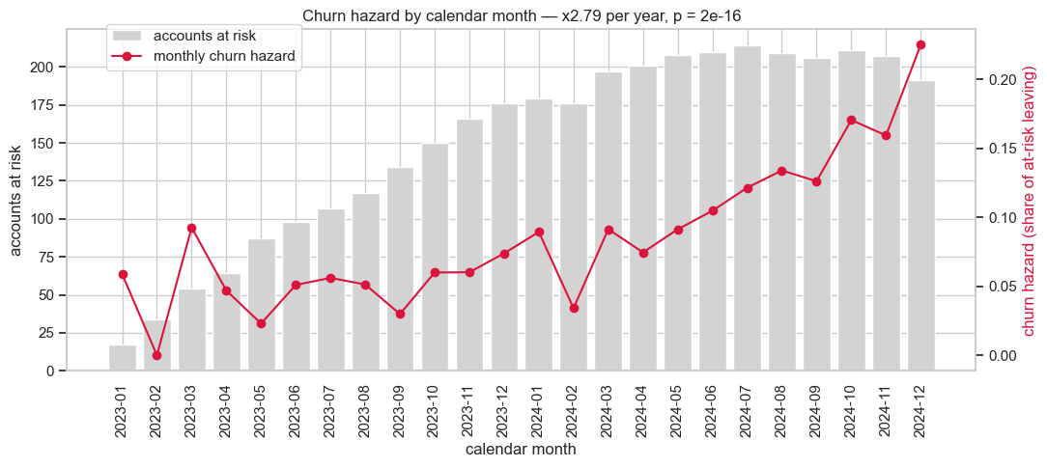
QUESTION 1 — WHY
The one large effect: calendar time
Poisson trend with log(at-risk) offset: rate ratio 1.089/month, 95% CI [1.067, 1.112], x2.8 per year, p = 2e-16. At-risk base flat at ~200 accounts, so this is not a growth artefact.
Notes:
This is the payoff slide. The same-sized customer base leaves four times faster at the end of the window than at the start.

Slide 8
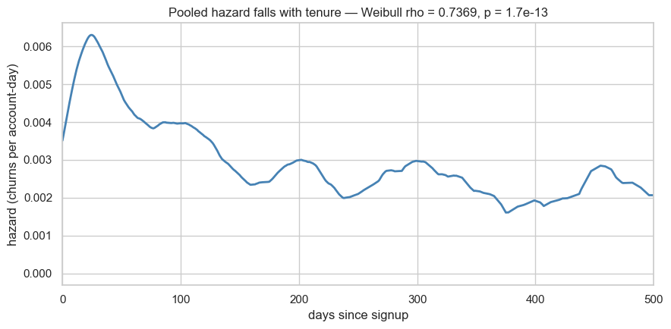
QUESTION 1 — WHY
A trap: the hazard falls sharply with tenure
Weibull rho = 0.737, 95% CI [0.673, 0.801], p = 1.7e-13 — the most emphatic result anywhere in the project. Read alone: churn is front-loaded, so fix onboarding.

Slide 9
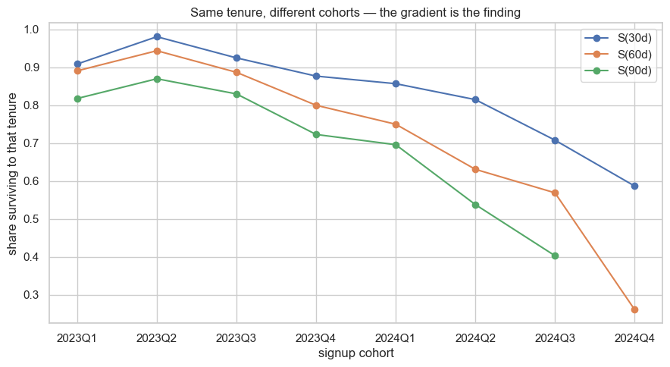
QUESTION 1 — WHY
...and it disappears under decomposition
Within each signup cohort rho returns to 1 (0.87, 1.25, 1.17, 1.06, 0.88 — none significant). At fixed tenure, 30-day survival runs 0.98 (2023Q2) to 0.59 (2024Q4). Recent cohorts churn faster at every age and supply most of the short tenures.

Slide 10
CONSEQUENCE
This reverses a recommendation
Earlier in this project: "onboard the first 6 months harder" — resting on days_since_signup being the top single feature and on a tenure-band table.
Both are the same composition artefact seen through a weaker lens.
Within any signup cohort, churn is memoryless: an account at day 300 is as likely to leave next week as one at day 10.
Do not build the structured onboarding programme.
The earlier recommendation is left in the repo rather than quietly deleted, with the reversal recorded where it was found. The sequence is the lesson.

Slide 11
QUESTION 1 — WHY
The field that records "why" is noise
churn_events carries a reason_code and free-text comment for every departure. It fails three independent tests:
– Distribution over 6 codes vs uniform: chi-square p = 0.70 (no dominant cause)
– Reason vs 9 behavioural measures, BH-corrected: min p = 0.91
– Reason code vs the customer's own free text: Cramer's V = 0.09
Accounts coded "support" have the same ticket counts and satisfaction scores as accounts coded "pricing". Accounts coded "features" used the same number of features as everyone else.
A "top churn reasons" chart from this field would be confident and entirely fictional — the most likely wrong output of this dataset.

Slide 12
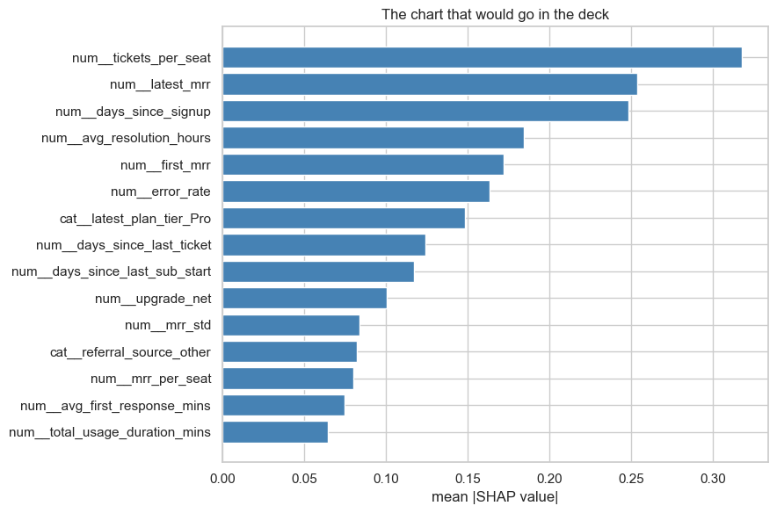
QUESTION 1 — WHY
The driver chart that would go in the deck
TreeSHAP on the gradient booster. Reads as: support load per seat drives churn, then contract size, then tenure. All three are plausible, which is the problem.

Slide 13
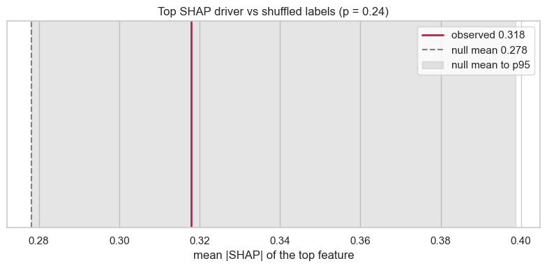
QUESTION 1 — WHY
The same chart from shuffled labels
Top feature p = 0.24 · 12 different features win across 25 bootstrap resamples · permutation importance on held-out data is beaten by noise (p = 1.0) · TreeSHAP and the logistic model share 2 of their top 10.
Explainability tooling has no failure mode: SHAP does not decline to rank when the model is worthless, and no library warns you.

Slide 14
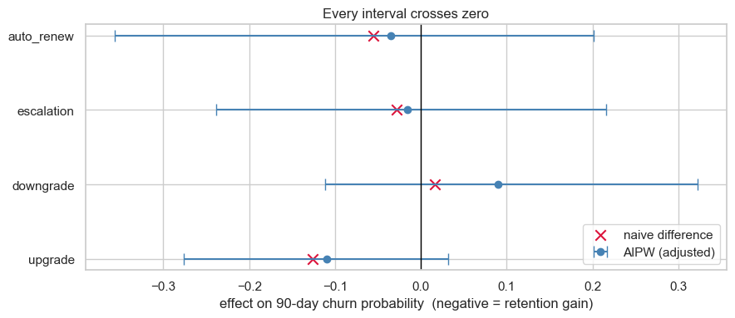
QUESTION 3 — ACTIONS
No intervention exists, so nothing is identified
Cross-fitted AIPW on four observational proxies. Every interval crosses zero; upgrade is closest at ATE -0.110, p = 0.14. Adjustment already ate part of the naive -0.126 — upgraders differ from non-upgraders by SMD 0.87 on subscription count, 0.81 on usage, 0.73 on tenure.

Slide 15
QUESTION 3 — ACTIONS
Two stress tests that end the discussion
E-values 1.3 to 2.2.
– A confounder associated with both upgrading and retention by a risk ratio of 2.2 erases the whole estimate. "The account was doing well" clears that easily — and is unmeasurable in this schema.
Placebo band ±15pp.
– Running the entire AIPW pipeline on randomly assigned treatments, where the true effect is exactly zero, produces estimates up to ±0.15. Every observed estimate sits inside it.
An independent closed-form power calculation puts the minimum detectable effect at 17.2%. Two methods, two points apart.
Uplift modelling does not rescue it: Qini p = 0.30, and treatment was self-selected, so ranked uplift mixes effect with selection.

Slide 16
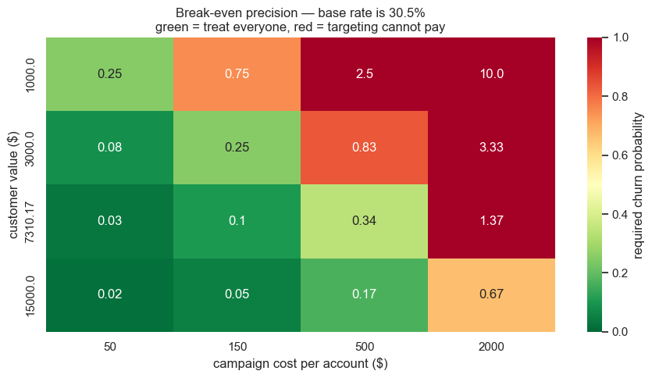
QUESTION 3 — ACTIONS
The arithmetic that should have come first
Break-even churn probability 10.3% · cohort base rate 30.5% -> contact everyone. A ranking cannot improve on a policy that is correct for everyone.
CLV $7,310 integrated from the measured survival curve. Model best threshold nets $53,000 against $52,400 for treat-all — a 1% gain, itself optimistic from in-sample threshold selection.

Slide 17
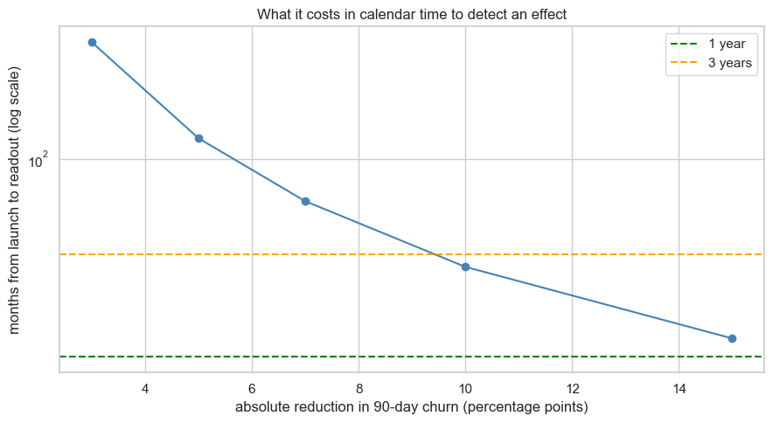
QUESTION 3 — ACTIONS
Only a churn-halving effect is testable here
At ~21 signups/month: 15pp reads out in ~15 months; 5pp needs 2,527 accounts and over ten years. A fact about having 500 customers, not about the analysis.

Slide 18
RECOMMENDATIONS
In order of leverage
1. Find what changed between 2023 and 2024.
– Hazard x2.8/yr on a flat base. An order of magnitude larger than anything account-level. The extract holds no calendar-varying covariate — no pricing log, no release history, no competitor events.
2. Fix the churn label and the usage timestamps.
– Three definitions agree on 20% of accounts; 19,128 of 24,979 usage rows predate their own subscription.
3. Contact the whole at-risk cohort. Do not rank it.
4. Instrument interventions — every CSM touch, discount and campaign.
– Without this, question 3 stays unanswerable at any sample size.
5. Do not build the onboarding programme.

Slide 19
HOW THIS WAS KEPT HONEST
Every claimed pattern has a null to beat
Automated leakage suite gates every reported number — temporal provenance, forbidden columns by name, single-feature AUC, identifier leakage. It caught a leak code review missed.
– Post-outcome columns are worth +0.37 AUC and land at a plausible 0.79, not an obviously broken 0.99 — which is what makes them dangerous
51 tests. Three pin bugs that were live and produced plausible output:
– a propensity trim that silently trimmed nothing; an AIPW estimate that left [0,1] (a -0.17 churn rate); a KM interval that disagreed with its own point estimate
Nulls throughout: shuffled-label SHAP, selection-corrected p for the classifier sweep, placebo treatments for AIPW, permutation null for segment gaps, positive controls for the pipeline itself.
15 notebooks, ~26 min end to end, all regenerated from source.

