Slide 1
Why customers leave, and what to do about it
Senior ML Engineer case study. RavenStack subscription data: 500 customers across 5 tables.
The short version: this data cannot predict who will leave. The one trend that looked real — churn rising through 2024 was invented by the dataset, not by customers. Three recommendations still follow.
Notes:
Thirty to forty minutes, five parts, following the brief. I say the headline up front because the value of this work is in proving the negatives properly and in what we do anyway.
The second clause is the part to sit on if there is only time for one thing. The strongest result I had — churn accelerating through 2024, p = 2e-16 — is reproduced exactly by a simulation containing nothing but a random number generator. Slide 11 is that test. Finding it is the piece of work I would most want to be judged on.

Slide 2
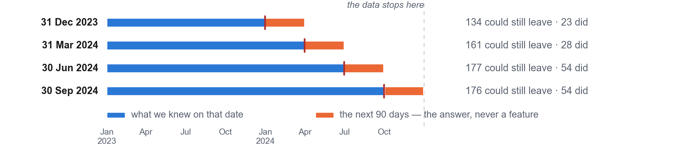
PART 1 · PROBLEM FRAMING
The business problem
This work supports two decisions. Who should the success team call this quarter? What should the product team fix?
Seven in ten customers leave in the end. The typical customer pays $931 a month and is worth about $7,300.
The churn flag accounts.churn_flag in the data cannot be used.
accounts.churn_flag has no date. So, we cannot ask whether a customer has already left by any given day.
Churn is recorded three times - accounts.churn_flag, churn_events.churn_date, subscriptions.end_date - and all three disagree.
Column accounts.churn_flag asserts churn for 22% of customers; churn_events asserts churn for 70% of customers. They agree on 188 of 500. Shuffle the accounts.churn_flag at random and you would expect 193. The real column does no better than the shuffled one.
The churn_events.churn_date and subscriptions.end_date disagree too: of 386 matched pairs, 6 land on the same day. The usual gap is two months.
So, I rebuilt the target as a question with a date in it:
On each of four quarter-end dates, using only what we knew that day, will this customer leave in the next 90 days?
That gives 648 customer-dates, 281 distinct customers, and 159 customers who churned i.e 24.5%. The rate per cutoff runs 17% to 31%
The label comes from churn_events: an eligible account is positive if its earliest churn_events.churn_date falls within the 90 days from the cutoff. Everything else is negative.
Notes:
Lead with the target problem. Along with slide 11 it is the most valuable thing here, and it shows the instinct to check the label before fitting anything.
If challenged on the 188: the point is not that agreement is low, it is that it is exactly what chance produces. The flag fires for 22% of customers and the event log for 70%, so two unrelated columns agree 38.6% of the time. We observe 37.6%. Cohen's kappa is -0.02, where 0 means unrelated, and chi-square gives p = 0.56.
Pre-empt the obvious follow-up: 'so invert the flag and you get 62%'. No. Inverted it scores 62.4% against 61.4% expected by chance, kappa +0.03. There is no information in it either way round.
The subscription line is the strongest part because it never touches the flag: 386 churn events can be compared to a subscription ending, and only 6 land on the same day. Median gap 62 days. All three recordings of 'this customer left' are mutually unrelated.
Computed in src/audit.py by label_source_agreement and churn_date_coherence, and shown in notebooks 01 and 10.

Slide 3
PART 1 · PROBLEM FRAMING
How we would judge success
For the model - measured in this work
ROC-AUC measures how well the model sorts customers by risk. 0.5 means it is guessing.
Precision and recall, because they say what the CS team experiences working the list.
For the business — these metrics are proposed, none are measurable from the data we are provided
Retention at 180 days, customers we called against a half we deliberately didn’t.
Net revenue retention, so a customer kept with a big discount counts for what they are still worth.
Incremental revenue over simply calling everyone.
Limits I set before starting:
The model must beat guessing at the bottom of its range, not just on average. It also has to beat simply calling every customer.
Scores would determine what the intervention would look like.

Slide 4
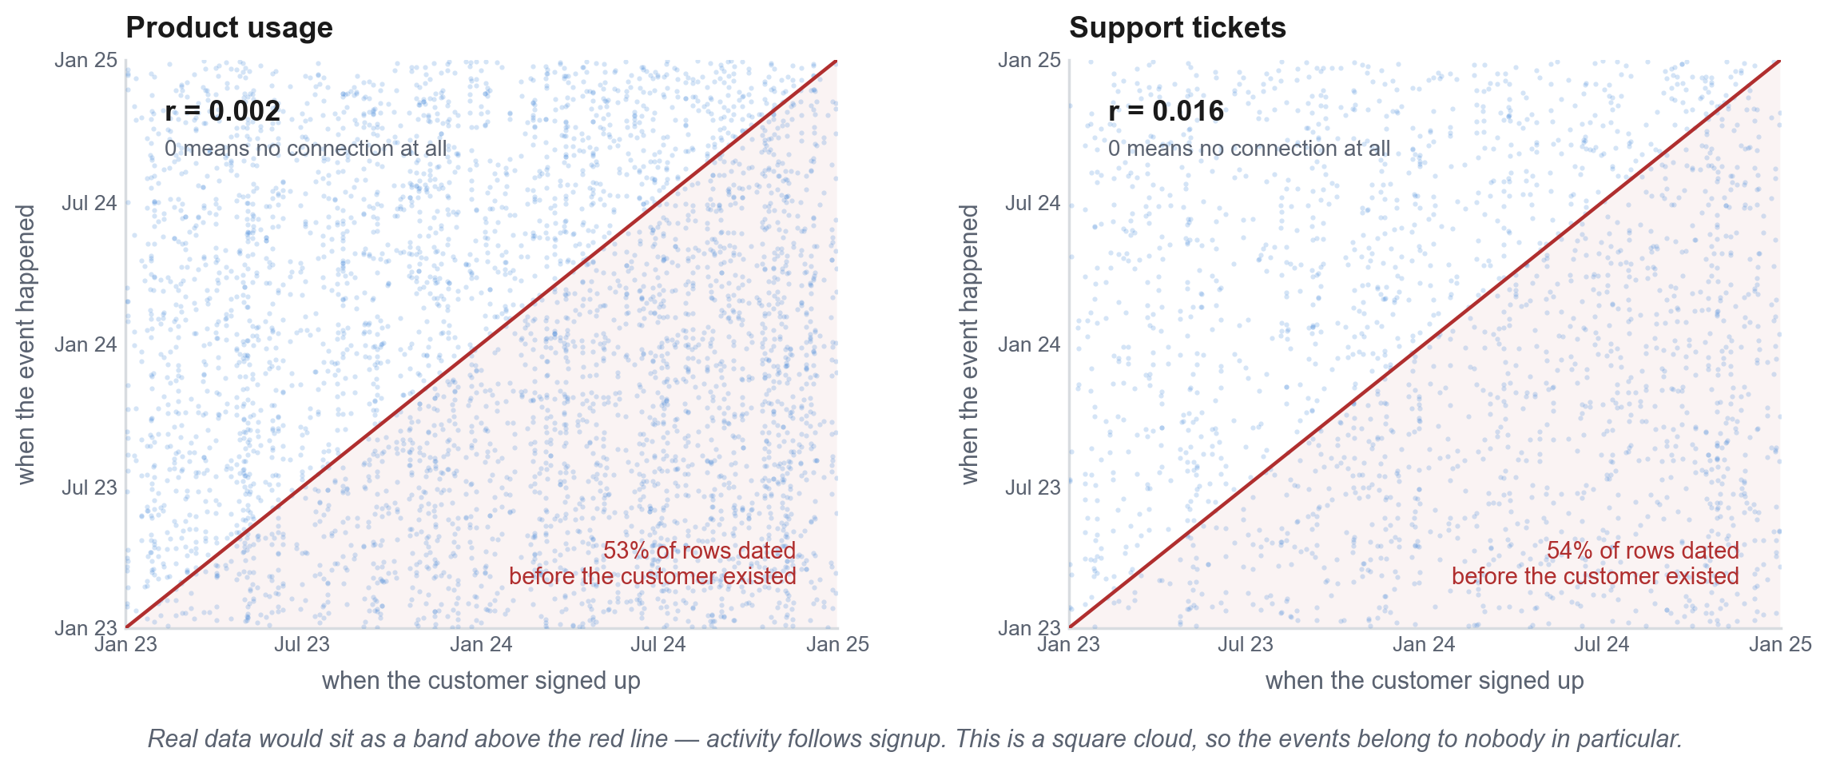
PART 1 · PROBLEM FRAMING
Risks and assumptions
Two of the five tables are not joined to their customers in time.
Usage and support events are not attached to the customers they belong to. Plotted against signup date they form a square cloud, where real data would be a band above the line. Just over half of all usage rows and support tickets are dated before the customer existed.
Nothing links inside those tables either. Ticket priority does not predict how fast we answered. Plan tier does not predict how much people used.
There are three ways to say a customer churned. All three agree for only 20% of customers.
Table | Verdict | Why
accounts | usable | Signup date is consistent, and the rest is attributes
subscriptions | usable | Price follows plan * seats, ARR = 12 * MRR, no subscription predates its customer
feature_usage | unusable | built from anyway, 16 features — dates unrelated to the customer, r = 0.002
support_tickets | unusable | built from anyway, 15 features — same, r = 0.016; satisfaction documented 1–5, only ever 3, 4, 5
churn_events | usable | The only churn record with a date, but it disagrees with the other two

Slide 5
PART 1 · PROBLEM FRAMING
Risks and assumptions
Assumptions I am making
I used churn from the churn defined by rows in churn_events. Three records claim to say who left and they disagree - I picked churn_events table because it has a usable date.
A customer is at risk if they hold an open subscription on the date we ask. Customers whose subscriptions had all ended are excluded they cannot leave again.
A 90-day window and quarter-end dates. I chose both before running anything, then swept horizons from 30 to 180 days to see if the choice mattered. It moved the AUC score by 0.026, basically noise.
We focus in this analysis on the first churn event. Some customers have reactivations. We take the earliest churn date and dispense with what happens after for simplicity.
Events dated before their customer are kept. Over half of all usage rows and tickets predate their customer's signup by a median of seven months — too far to be pre-sales evaluation, but not something I can prove wrong. Dropping them costs 43% of usage and 68% of tickets and takes AUC from 0.596 to 0.517. So I kept every row and accounted for this in feature engineering.

Slide 6
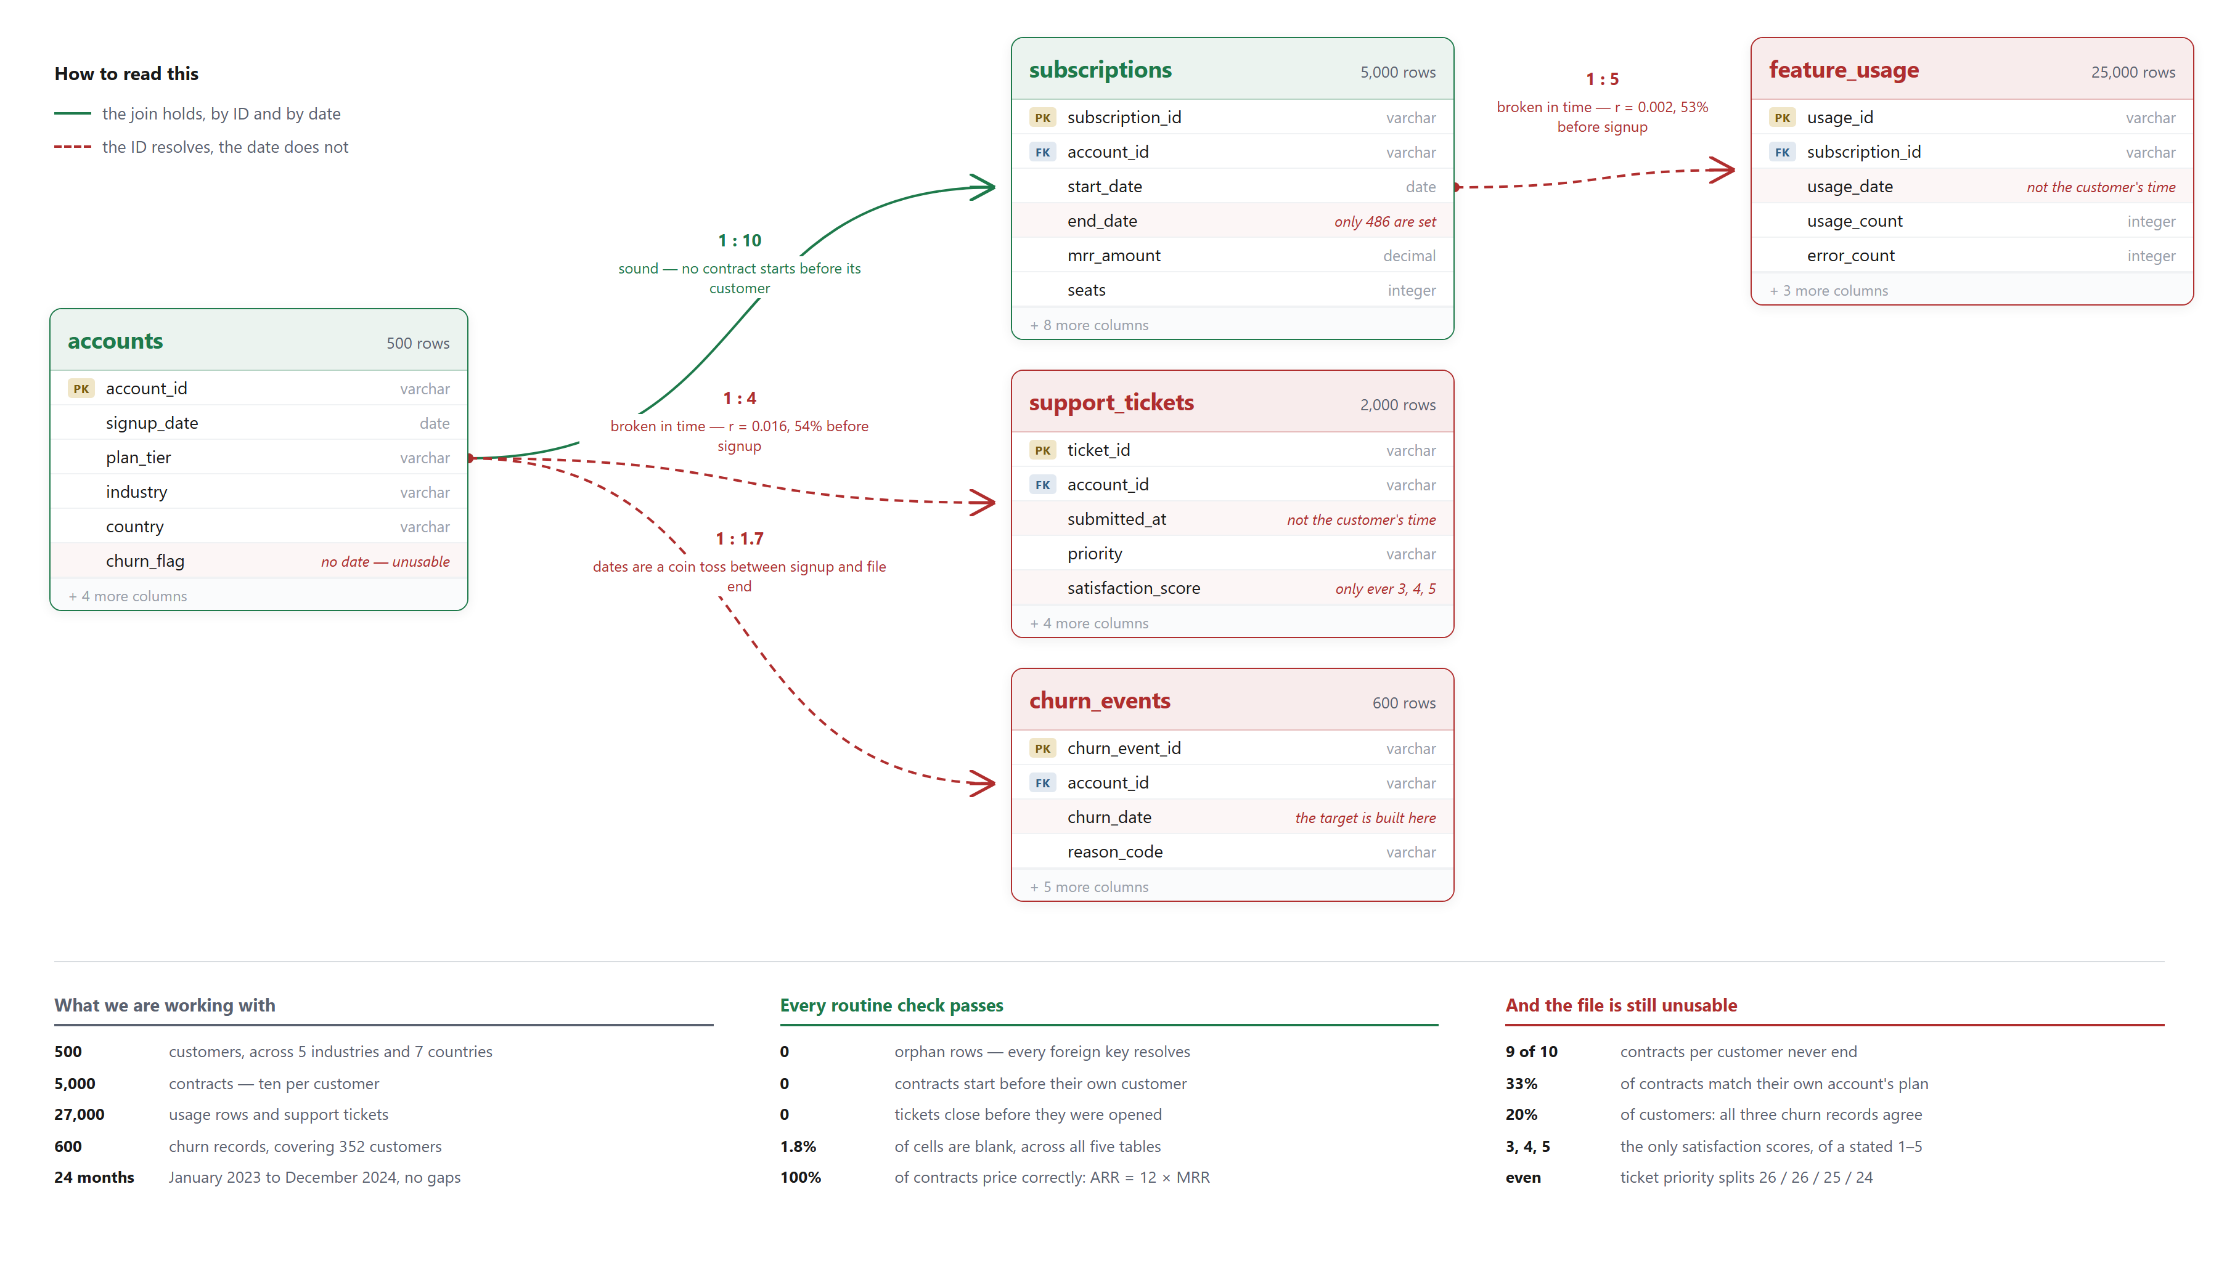
PART 2 · DATA EXPLORATION
Schema, scale and integrity
Notes:
The slide to open with if anyone asks what the data looks like.
Read the arrows, not the boxes. Referential integrity is perfect: every subscription_id in feature_usage resolves, every account_id in support_tickets and churn_events resolves, and no contract predates its account. A schema check passes cleanly, which is why a cleaning pipeline does not catch this — and the other published analysis of this dataset ran one and reported nothing.
What fails is temporal integrity, and nothing in a data dictionary tests it. 13,198 of 25,000 usage rows and 1,077 of 2,000 tickets are dated before their customer signed up. Correlation between event date and signup date is 0.002 and 0.016. Every behavioural feature in the model is built from those two tables.
The left column of the read-out is every check a reviewer would ask for. The right column is why passing them settles nothing.

Slide 7
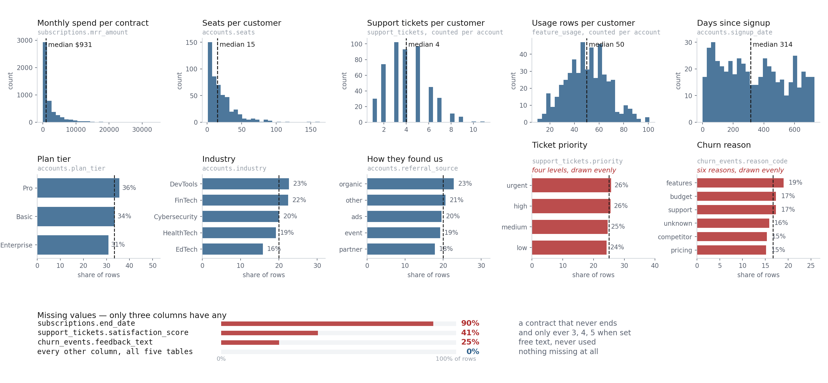
PART 2 · EXPLORATORY ANALYSIS
Basic EDA
Missingness is recorded and not imputed. A ticket with no satisfaction score has not been rated, and that is itself a feature.
Notes:
The conventional univariate pass, in the conventional order: distributions, then categorical frequencies, then missingness. Every panel names the table and column it came from.
What to point at. Spend and seats look like real billing data — right-skewed, long tail, median $931 and 15 seats. Tickets and usage do not: tickets run 1 to 11 with a median of 4, usage 10 to 101 with a median of 50. No power law, no heavy users, no dormant accounts. That shape is a per-customer draw, not behaviour.
The dashed line on each categorical is what an even split would be. Plan, industry and referral source sit near it, which is unremarkable on 500 customers. Ticket priority and churn reason sit on it exactly, and those are the two that should not — urgent tickets are rare in every support organisation, and churn reasons always have a dominant category.
Missingness: only three columns have any. end_date is missing for 90% because contracts never end. satisfaction_score is missing for 41% and takes only 3, 4 and 5 when present, so both the value and its absence are degenerate. Nothing is imputed — a missing satisfaction score means the ticket was not rated, which is information, and filling it would invent a rating.

Slide 8
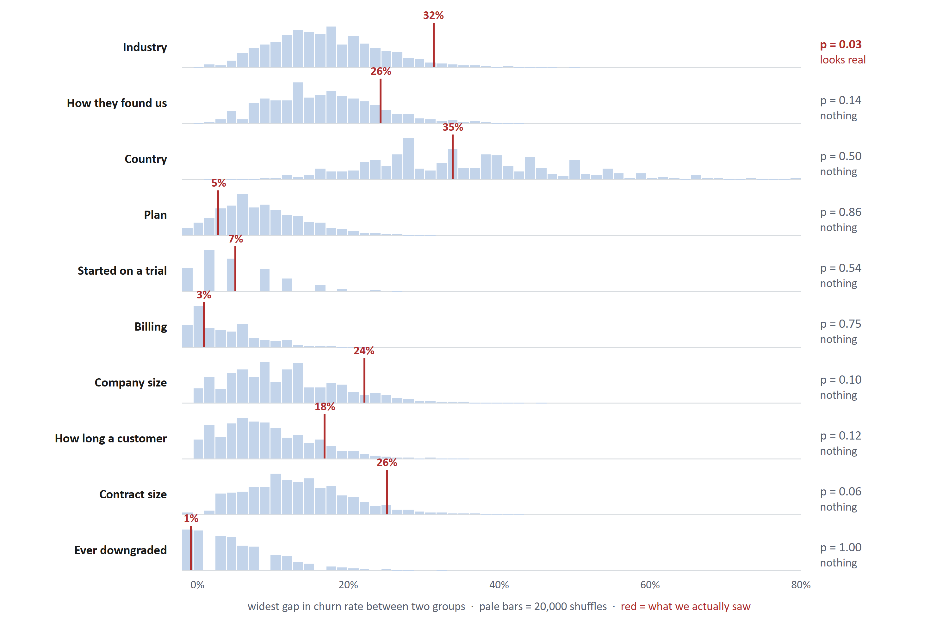
PART 2 · DATA EXPLORATION
Early Signal Evaluation
Preliminary Signal Analysis:
Method
Red lines: The gap we observed. For industry: the highest-churn industry (EdTech, 41%) minus the lowest (Cybersecurity, 9%) = 32 points.
The blue bars: To build each fake version: keep every customer in their real industry, then randomly reassign who churned. Take the difference of highest churn and lowest churn and do this 20,000 times
P value: The share of blue bars sitting at or to the right of the red line.
Findings
What we found: nothing is a strong churn predictor from these 10 variables. Ten different ways of grouping customers, none of them separates customers who churned from stayers
Industry came closest; p = 0.03. But one customer changes the answer. The result rests on Cybersecurity, where 2 of 23 customers left. I re-ran it with 3 customers who churned instead of 2 — a single customer: - As the data stands (2 of 23) p = 0.03 - One more customer who churns (3 of 23) p = 0.09
Notes:
Replaces both the bar charts and an earlier version built on confidence intervals. Intervals show precision but do not perform the test, and reading significance off whether they cross a line disagreed with the actual test — Cybersecurity's interval excluded the base rate while industry sat at p = 0.08.
This does the test directly, with no formula and no distributional assumption. Shuffle the labels, keep the group sizes, recompute the statistic, repeat.
The last row is the slide. Industry at p = 0.03 is exactly the finding I would have reported if I had stopped there, and it is the same mistake the deck later catches on the calendar-hazard result: testing against the wrong null. Volunteer it rather than waiting to be asked.
The last five variables come from subscriptions, the one table with internal rules, so a null there carries more weight than a null in the tables already known to be scrambled.
Per-variable p: industry 0.033, contract size 0.058, company size 0.098, tenure 0.118, referral 0.136, country 0.501, trial 0.543, billing 0.751, plan 0.863, downgrade 1.000. Family-wise 0.262 from 20,000 shuffles, seed 0, at the 30 June 2024 cutoff. Built by build/fig_segment_shuffle_html.py.

Slide 9
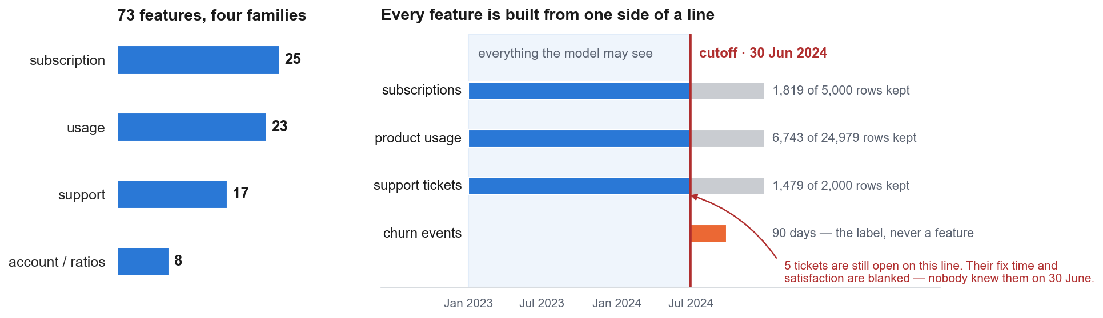
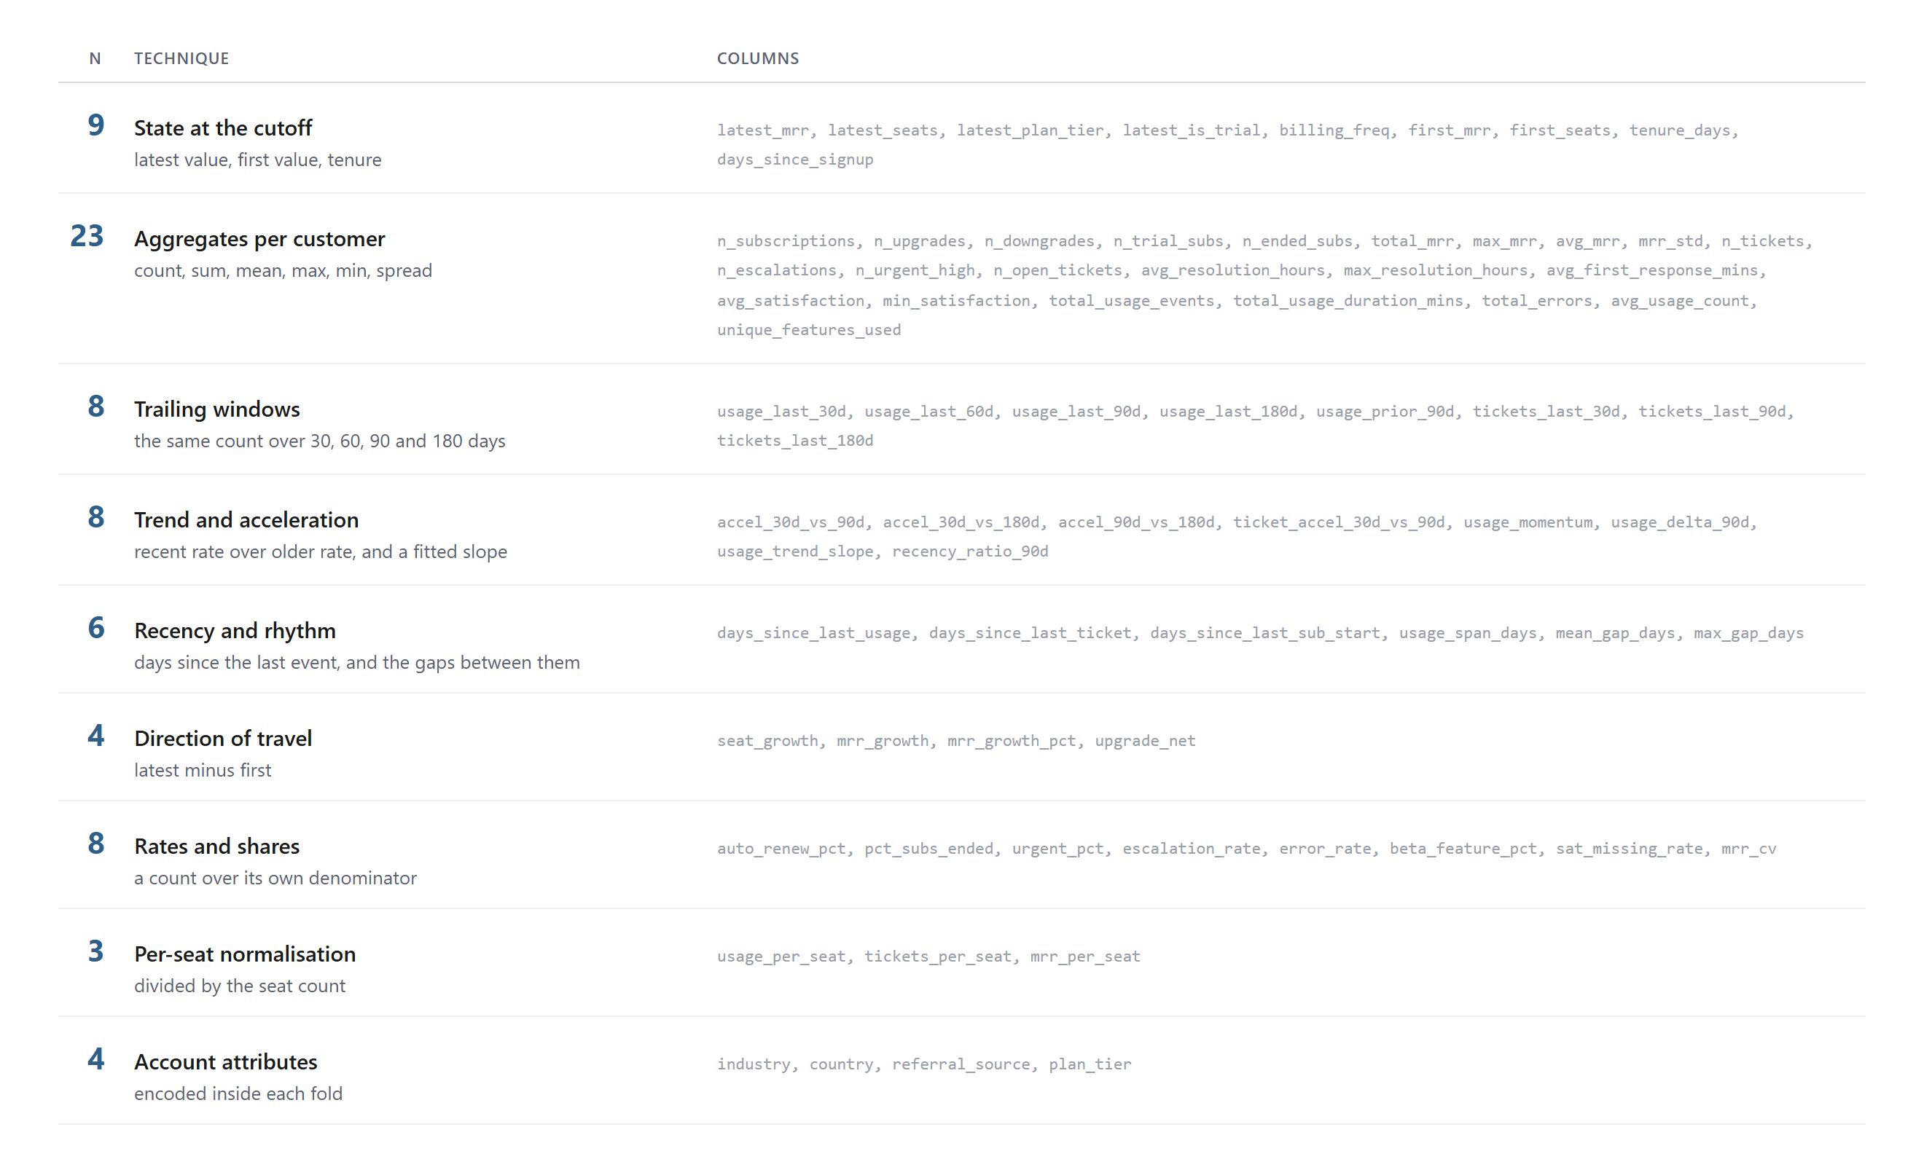
PART 2 · FEATURE ENGINEERING
73 features and rational

Slide 10
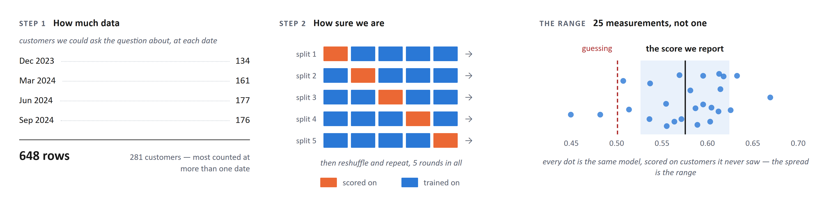
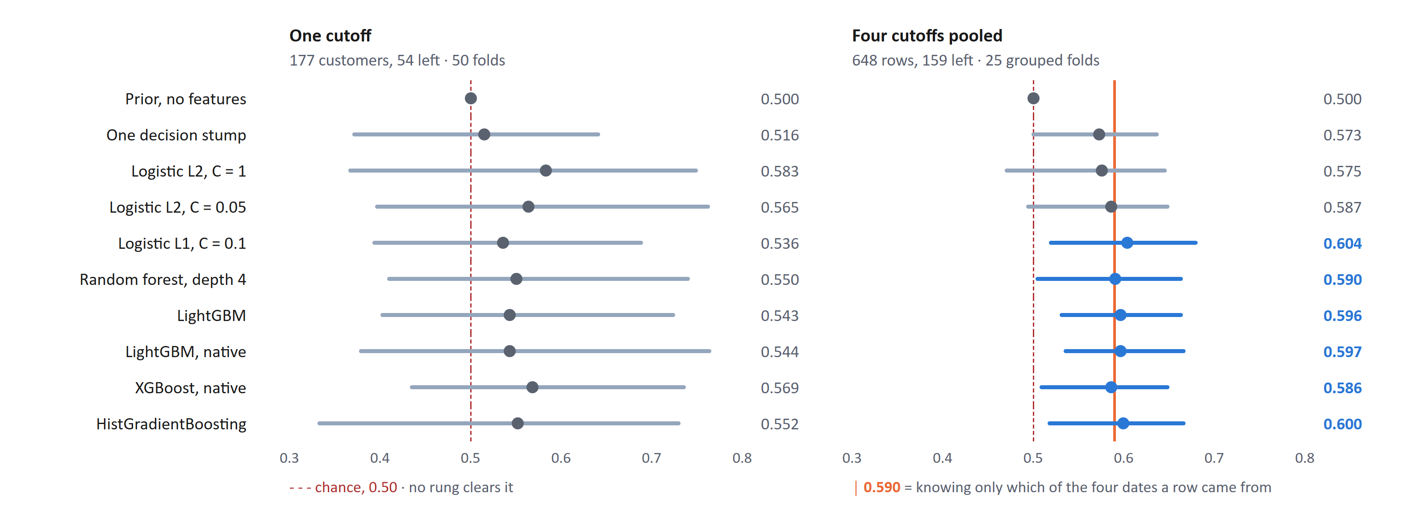
PART 3 · MODELLING
Choosing an algorithm
I start with a model that uses no features at all. It has to score ROC-AUC 0.5. Use this floor to contrast better models.
Then I add complexity one step at a time: a single decision stump rule, then logistic regression, then a random forest, then three gradient boosting models.
Every model is tested on exactly the same splits, so the comparison is fair.

Slide 11
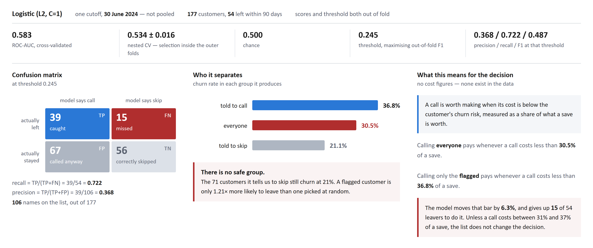
PART 3 · MODELLING
Evaluate Performance
Logistic regression, L2 penalty, C = 1. It won the ten-rung ladder on the 30 June 2024 cohort: 177 customers, 54 of whom left within 90 days.
ROC-AUC 0.583 in cross-validation. Nested CV, which puts model selection inside the outer folds, gives 0.534 ± 0.016. Chance is 0.500. The 0.049 gap is selection optimism.
Threshold 0.245, chosen to maximise F1 on out-of-fold predictions rather than at the 0.5 default.
At that operating point: precision 0.368, recall 0.722, F1 0.487. The model recovers 39 of 54 leavers and puts 106 of 177 customers on the list.
.
Notes:
The brief asks for performance, so lead with the confusion matrix and the threshold reasoning rather than with methodology.
Threshold 0.245, picked out of fold on F1. TP 39, FP 67, FN 15, TN 56. Recall 0.722, precision 0.368, 106 names on a 177-customer list. Lift over random is 1.21.
Deliberately no currency. src/economics.py carries an illustrative call cost and success rate; neither appears anywhere in the RavenStack tables, and every money figure downstream scales with them. If finance supplies real numbers the same slide takes them without changing shape. If asked for a dollar answer, say that and give the ratio.
The strongest line is the skip list. A model that cannot find a safe group cannot save anyone a phone call, which is the whole reason to rank in the first place.
One inconsistency worth owning if raised: the threshold maximises F1, which weights the two errors equally, while the argument above says they are not equal. A cost-minimising threshold needs the cost figures we do not have.
Built by build/fig_performance_html.py.

Slide 12
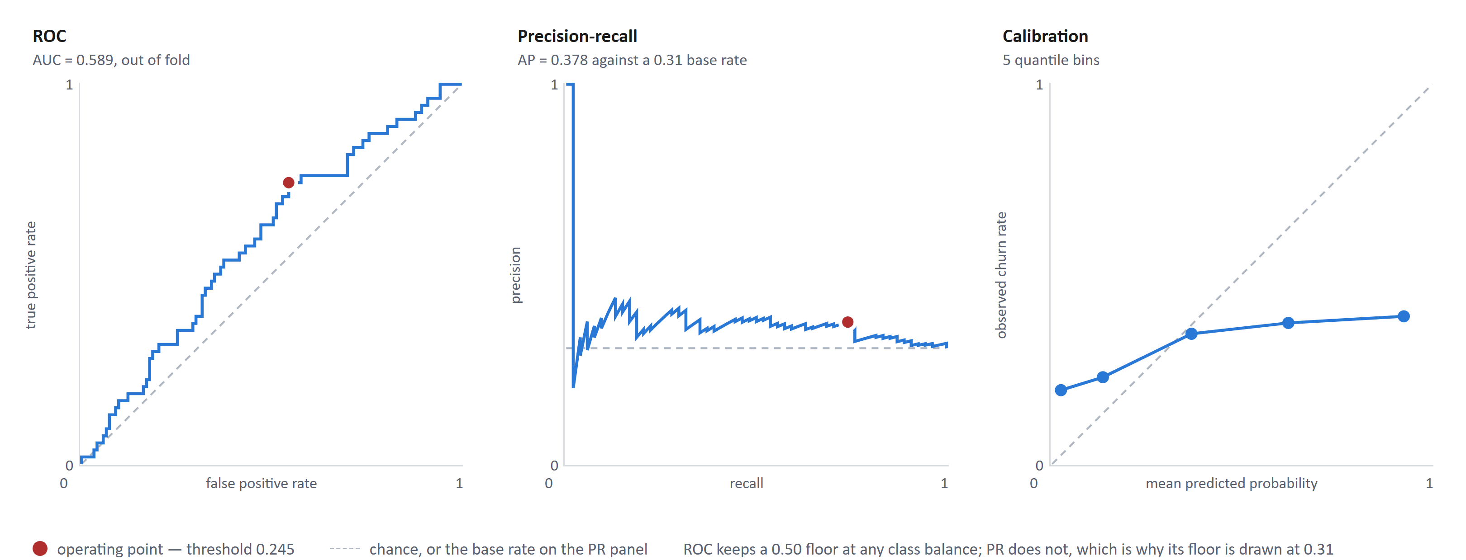
PART 3 · MODELLING
Ranking quality, three ways
ROC-AUC 0.589 out of fold. The curve sits just above the diagonal for its whole length, with no region where the model separates cleanly.
Average precision 0.378 against a 0.31 base rate.
PR is the honest picture for an imbalanced problem, because its floor moves with the class balance rather than staying at 0.50. Precision hovers just above the base-rate line at every recall, which is the same finding as the confusion matrix: flagging a customer barely raises their risk.
Calibration is the reason the break-even argument is usable.
Predicted probabilities track observed churn well enough in the middle bins to compare a score against a decision threshold. The curve is flat rather than diagonal, which is what a weak model looks like — it over-predicts at the bottom and under-predicts at the top.
The red dot on each panel is the shipped threshold of 0.245.
Notes:
Companion to the performance slide, for the reviewer who wants the curves rather than a single operating point.
AUC here is 0.589 from pooled out-of-fold predictions, against 0.583 as the mean of per-fold AUCs on the ladder slide. Same quantity, two estimators; say so if the difference is noticed.
The PR floor is the point worth making. A reviewer who only sees AP = 0.378 may read it as weak-but-real; drawn against a 0.31 base rate it is plainly near-worthless. This is also why ROC-AUC is the headline metric across the four cutoffs, where churn rates run 17% to 31% and a PR floor would move underneath the comparison.
Calibration uses 5 quantile bins because 177 rows will not support more. The flat shape is characteristic of a model with little signal: predictions are pulled toward the base rate at both ends.
Built by build/fig_curves_html.py.

Slide 13
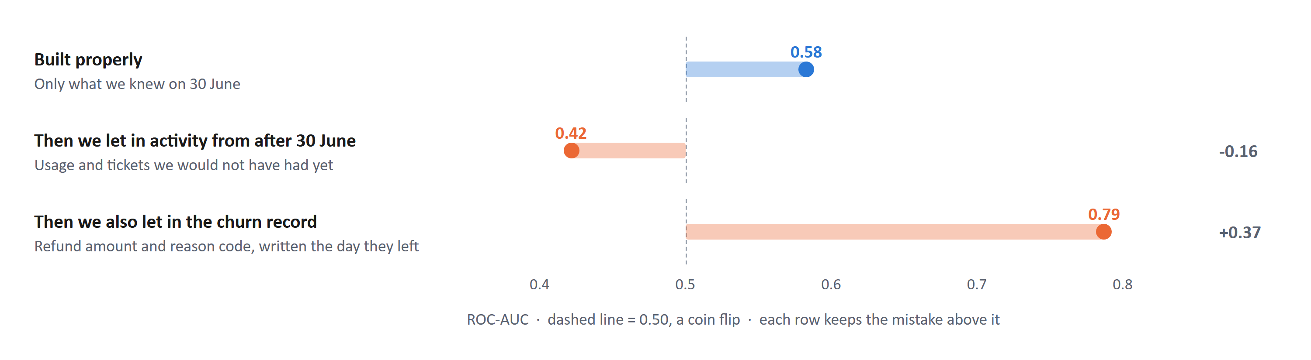
PART 3 · MODELLING
Class imbalance and leakage
Class imbalance
Class imbalance is when the classes in the target variable are unevenly distributed — one class holds a much larger share of the observations than the other.
31% of customers churned. That is uneven, but it is not a rare-event problem, and it does not need heavy handling.
I set the cut-off to favor catching customers who churned, because missing one likely costs more than unnecessary intervention. That catches 72% of the customers who churned, and 1 in 3 of the customers we flag do churn.
I report ROC-AUC because its floor stays at 0.50 whatever the class balance. That matters here: across the twelve horizon and buffer combinations the churn rate runs from 11% to 45%, and a metric that moved with the balance would make those twelve results incomparable. Precision-recall and F1 agree.
Leakage
Leakage is training the model on something we would not actually know on the day we make the prediction. It scores well in testing and then fails in production, because the thing it relied on wasn't there yet.
Every table is cut to the cutoff date before anything is built. Nothing dated 1 July onwards can reach a feature for our cut off date prediction.
Anything still unfinished on the cutoff date is blanked (E.g., a support ticket still open on 30 June has no fix time and no satisfaction score, even though the file records them, because they were filled in later)
Nothing from the churn record is ever used as a feature. Those columns exist because a customer left.
The same code builds the features in training and in production. It takes a date and looks only before it, so the two cannot drift apart.

Slide 14
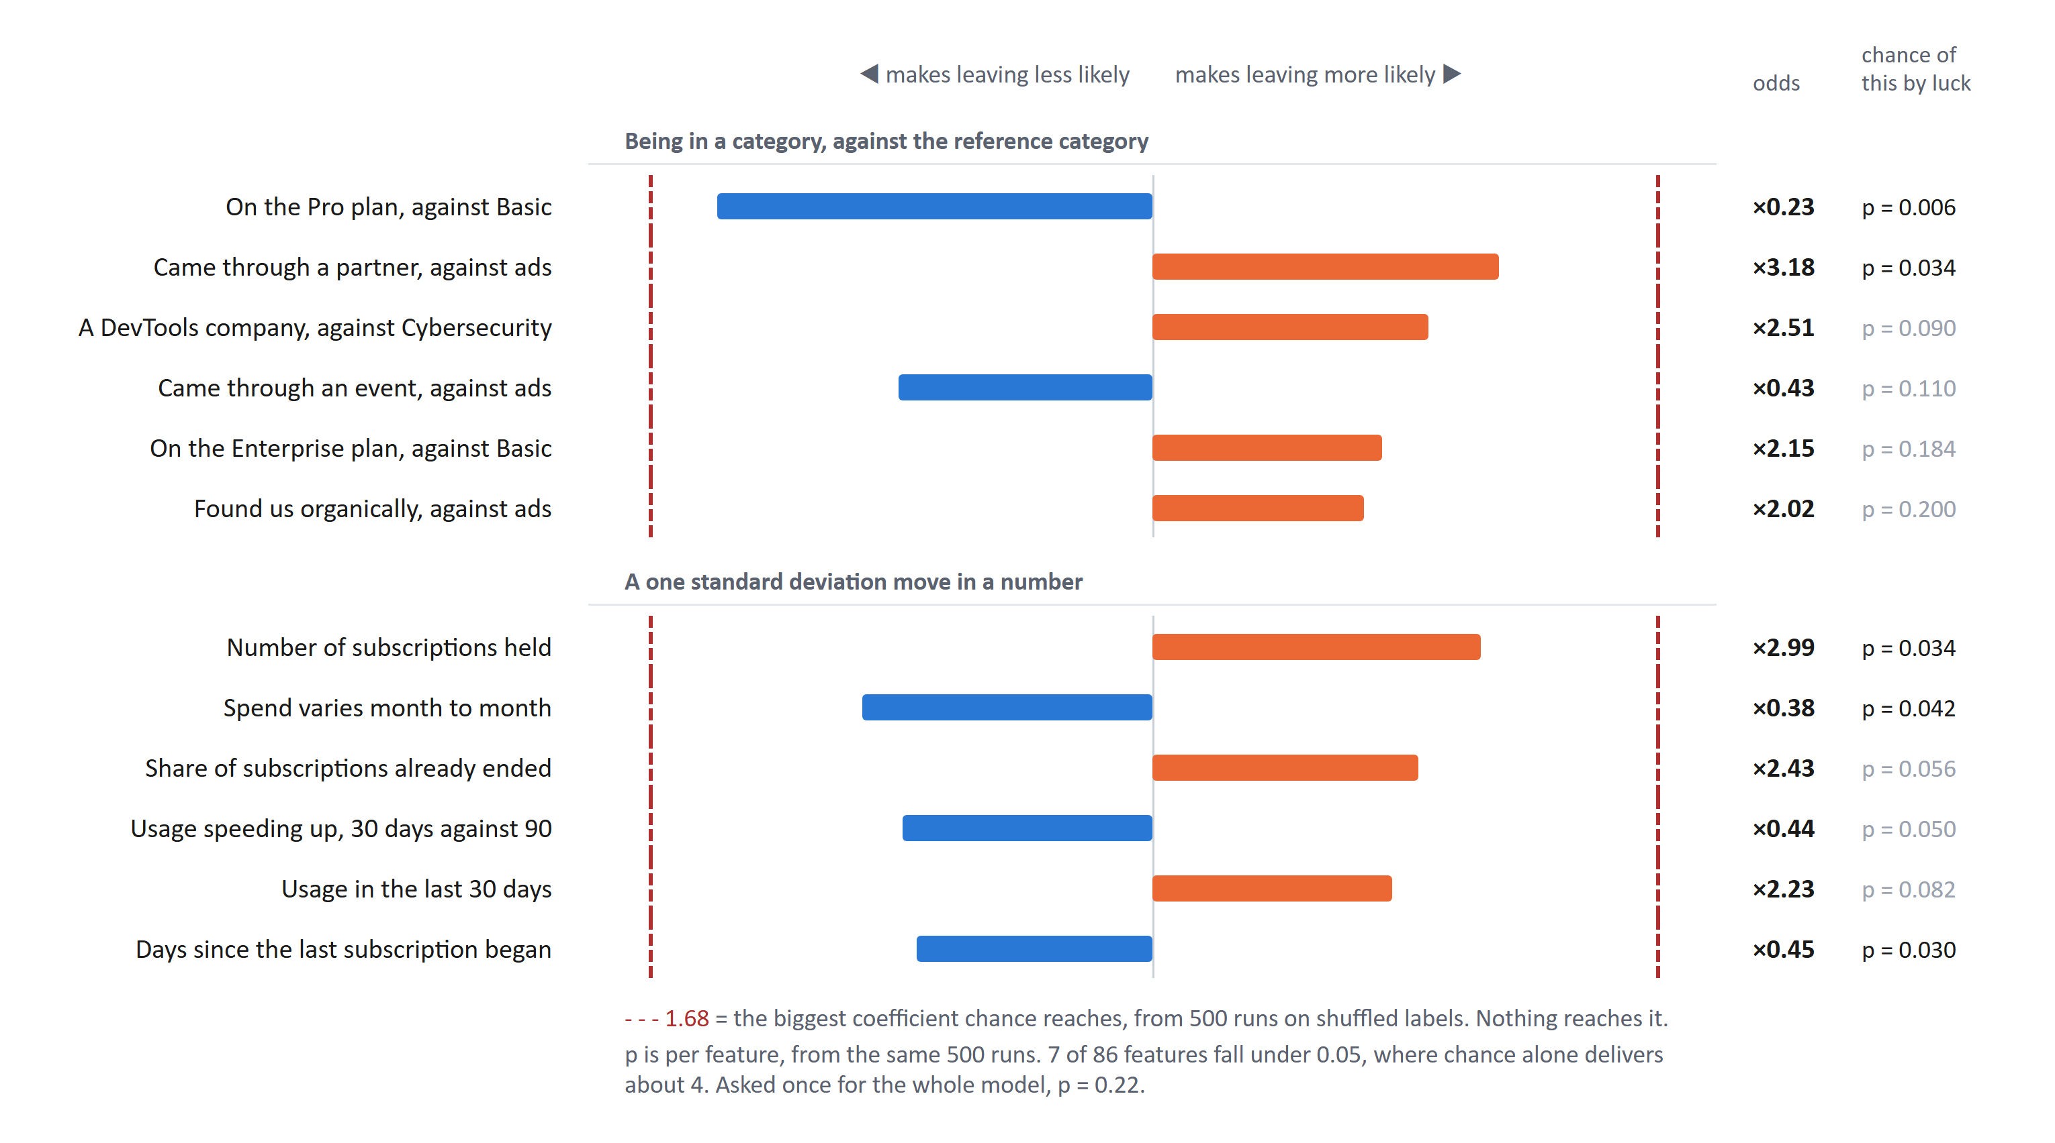
PART 3 · MODELLING
Interpretability
The shipped model is a logistic regression, so it can simply be read. Each bar is one input and the direction the model applies it.
Taken at face value it is a briefing.
Pro-plan customers stay. Partner-sourced customers leave. Customers holding several subscriptions leave.
The dashed lines are why I am not reporting any of it.
I shuffled the churn labels 500 times, refitting each time, and recorded the largest coefficient. Chance reaches 1.68. The largest real coefficient is 1.45. Not one input in the model is as strong as what chance produces from labels that mean nothing.
Seven of the 86 inputs clear p = 0.05 individually. Testing 86 inputs, chance delivers about 4. Asked properly — is any coefficient larger than chance reaches — the answer is p = 0.22.
Notes:
Replaces the SHAP slide, which answered a question nobody asked. The brief asks what the model says is important, so answer that first, then say why it cannot be reported.
Reading coefficients directly is also the honest choice here. The shipped rung is Logistic L2 C=1 on standardised inputs, so the coefficients are the explanation. SHAP would add a layer of machinery over a linear model and change nothing.
The comparison that matters is against shuffled labels, not against zero. Any fitted model produces a clean ordered ranking; the question is whether it is larger than the ranking you get from nothing. Here it is not: largest real coefficient 1.45, chance reaches 1.68 at the 95th percentile, family-wise p = 0.222 over 500 refits.
If asked why the coefficient signs look stable across refits: five-fold folds share 80% of their rows, so sign agreement across them is close to guaranteed and is not evidence. The shuffle test is the one that carries weight.
Built by build/fig_drivers_html.py, tables in outputs/reports/coef_null.csv and coef_stability.csv.

Slide 15
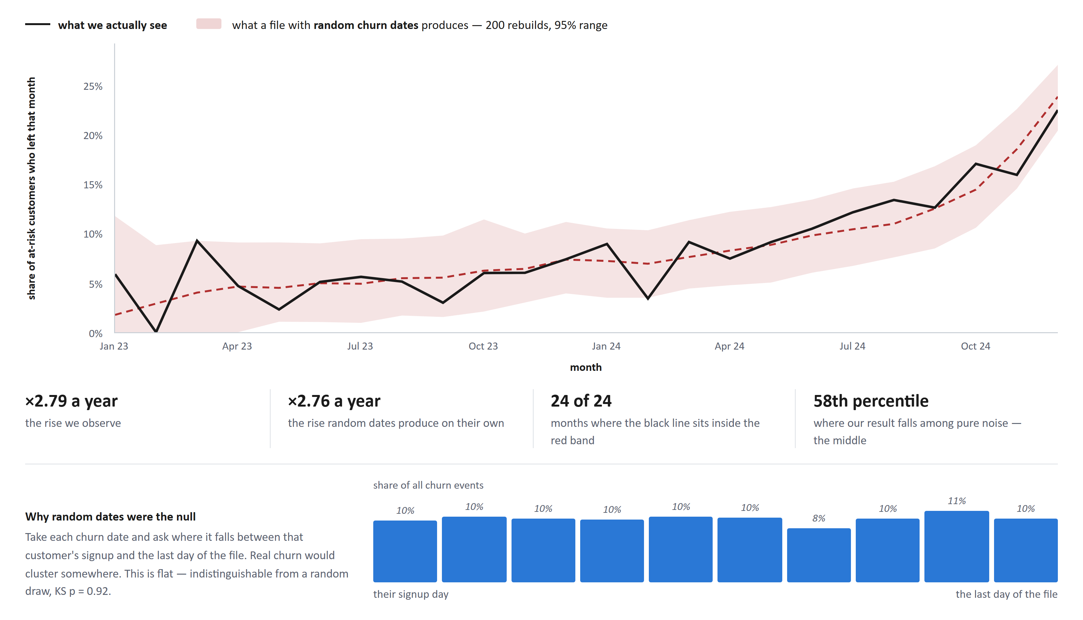
PART 4 · RECOMMENDATION 1
Insight 1: The 2024 churn rise does not appear to be real
Churn looks like it is accelerating. About 5 customers in every 100 left each month in 2023, rising to 22 in 100 by December 2024. A 2.8x rise per year, p = 2e-16, and by far the strongest number in this study.
Then the test. Take the file, throw away every churn date, and replace each with a random date between that customer's signup and the last day of the file. Change nothing else. Rebuild it 200 times. The pink band is the middle 95% of what those rebuilds produce.
x2.76 a year against our x2.79. Every one of the 24 months sits inside the range those rebuilds produce, and our result lands at the 58th percentile of pure noise.
Notes:
This is the slide I would want to be asked about.
How the artefact works: no churn date can land after 2024-12-31. If each is drawn uniformly between signup and that boundary, the hazard is 1/(END - t), which rises without limit as t approaches the end. Pooled across accounts that signed up over two years, that is indistinguishable by eye from a business problem.
The evidence, in order. Rescale each churn date to its position in the account's own window: uniform, KS p = 0.92 on 600 events, mean position 0.503, and uniform inside every signup quarter. Then the simulation — keep each account's real signup date and real number of churn events, redraw only the dates, run the same survival.calendar_hazard used to produce the original claim, 400 times. Observed rate ratio 1.0893, null 1.0885 with a 95% band of [1.072, 1.106].
The p-value is the part worth dwelling on. p = 2e-16 felt like the most secure number I had. The null rule produces a median p of 2.8e-16 — very slightly more significant than the real data. A p-value tells you nothing about whether the null it tests is the one that matters.
If asked what I would have done differently: run this before writing the recommendation, not after. On any generated or vendor-supplied extract, simulate the file before trusting a time trend in it.
src/generator.py, notebook 16.

Slide 16
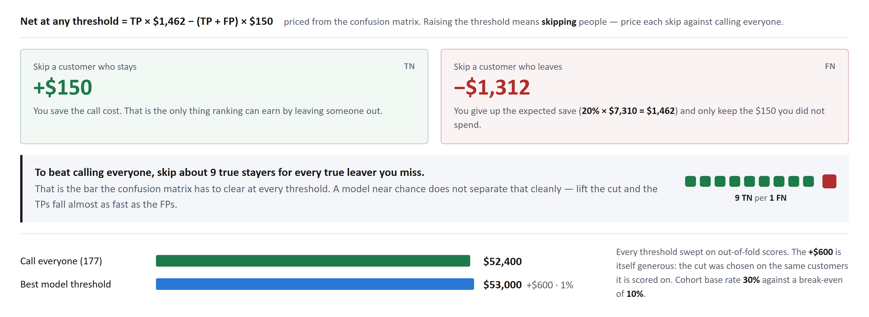
PART 4 · RECOMMENDATION 2
Call every at-risk customer, do not rank them
Price every threshold from its confusion matrix. Skipping a stayer saves $150; skipping a leaver costs about $1,310. You need roughly nine of the first for every one of the second before ranking beats calling everyone.
Call cost of $150 and save rate of 20% are assumptions, not measurements.
Notes:
TN +$150 vs FN -$1,310 → need ~9:1. Value sweep: +$600 on $52,400.

Slide 17
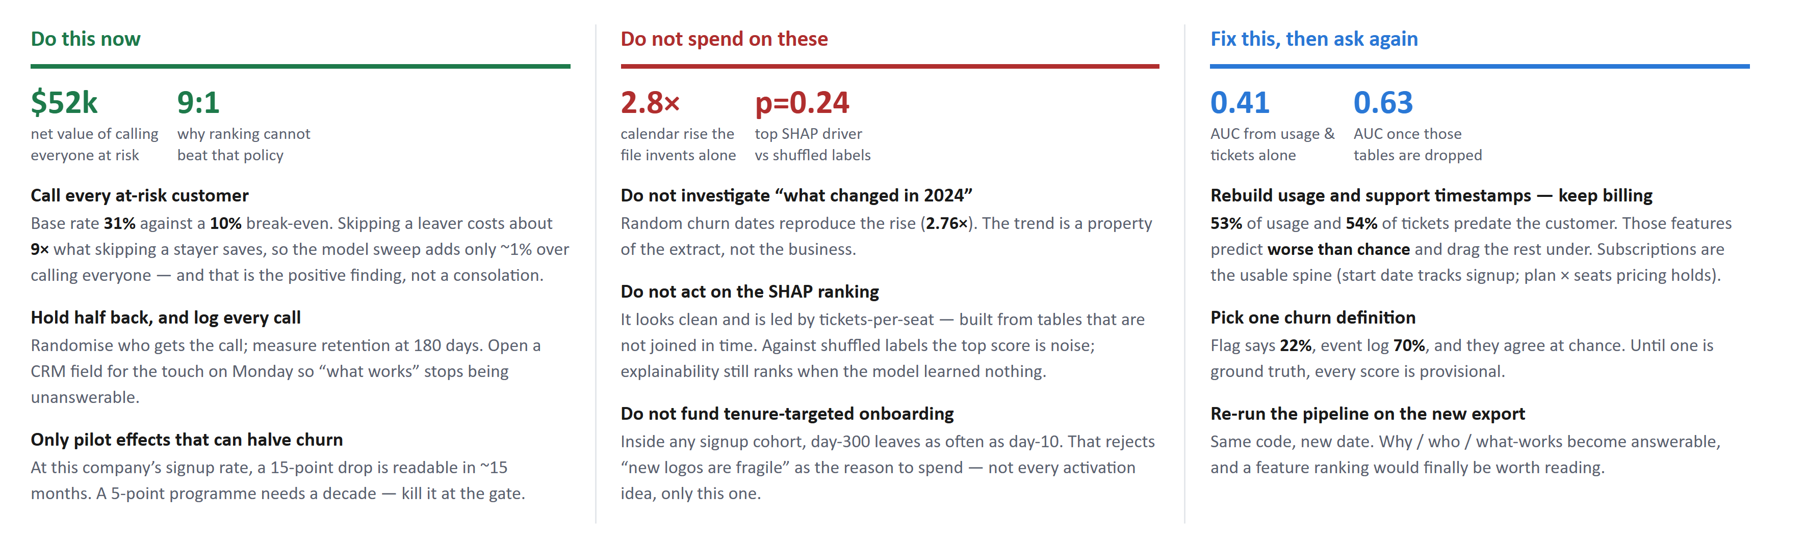
PART 4 · RECOMMENDATIONS
What to do about churn
Monday's plan is constructive, not a list of stops.
Call the at-risk list (~$52k net under the assumed economics), hold half back, and log every touch. Do not spend on the 2024 trend, the SHAP list, or tenure-targeted onboarding — those are artefacts. Ask for usage and ticket timestamps rebuilt (they alone score AUC 0.41); keep billing; then re-run.
Call cost and save rate are assumptions. The 0.41 → 0.63 contrast is a post-hoc feature-family check — directional, not a new champion model.
Notes:
Constructive reframing of the summary slide.
Do-this leads with treat-all NPV as a positive finding and the 9:1 skip bar; adds experiment sizing (15pp / 15 months).
Do-not softens onboarding to tenure-targeted only; keeps calendar + SHAP nulls.
Fix-this scopes the data ask: usage/tickets poison (AUC 0.41) vs billing usable; 0.63 when dropped is the modelling silver lining, flagged in the footnote as post-hoc.
Built by build/fig_what_to_do_html.py.

Slide 18
PART 5 · SCALABILITY
How I would run this in production
Sources: billing and CRM, product usage, support desk
| runs once a night
Feature build (THE SAME CODE USED IN TRAINING)
· every calculation takes a date and looks only before it
· blanks out anything not yet known on that date
· the leakage checks run here and stop the job if they fail
|
Scoring (once a day is plenty for a 90 day question)
· writes the customer, the score, and the main reasons
|
Use (a call list for the success team)
· scores also written back to the CRM for context
· nothing is ever triggered automatically
What I would watch
Whether the incoming data still looks like the data we trained on. Checked weekly.
Whether columns have gone missing or empty. Checked daily, and the job fails if the shape changes.
The leakage checks. Run every single time, and they stop the job.
Whether the scores themselves have drifted. Checked weekly.
Whether the model is still accurate. Checked every quarter, once we know who actually left.
We only learn if we were right 90 days later. So accuracy checks are always late. Watching the incoming data is the early warning, and accuracy confirms it afterwards.
The part I would argue for hardest is running the leakage checks in production. The bug in this project was in the pipeline, and pipeline bugs come back every time someone adds a feature.
This is what I would build if the model were worth shipping. On these results it is not, and this extract cannot be repaired into one — the timestamps have to be collected against the right customers, not corrected. Once they are, the pipeline takes a date, so re-measuring is one command.

