Slide 1
Data Analytics
Mid Bootcamp Project Analysis of Marathon training data Dmitry Andreev DAFT MAY 2022

Slide 2
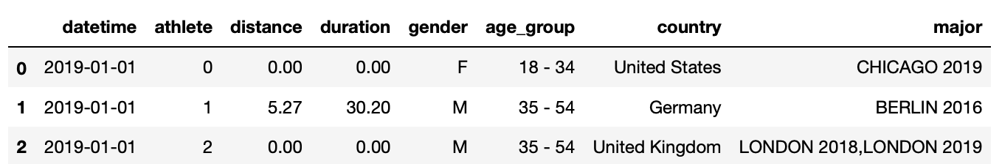
Dataset
Dataset source: materials of research article
Leonardo A. Afonseca, Renato N. Watanabe and Marcos Duarte​, ‘A worldwide comparison of long-distance running training in 2019 and 2020: associated effects of the COVID-19 pandemic’, 2022.
Dataset details:
Info scrapped from Strava website
Daily trainings for participants of various running marathons (i.e. “majors”) across the globe
365 days of year 2019
Athletes identified by unique numbers across the dataset
Date, athlete’s #, distance and duration (time), country, age group, gender, major(s)
Dataset limitations:
Not all trainings are in Strava
Only participants of majors

Slide 3
Dataset
Biggest
Majors
Trainings_DB
Aggregated data
371k
13.3m rows
36k athletes
150 mb
Filter
by
Major
Inner
join
4.7m
478k
Filter
by
Date and
Distance
3.7k
3.4k
Participants
Source DB
Exclude non-training days
Berlin
2019
major
Event_DB
Berlin 2019 actual
Berlin results + agg. training info

Slide 4
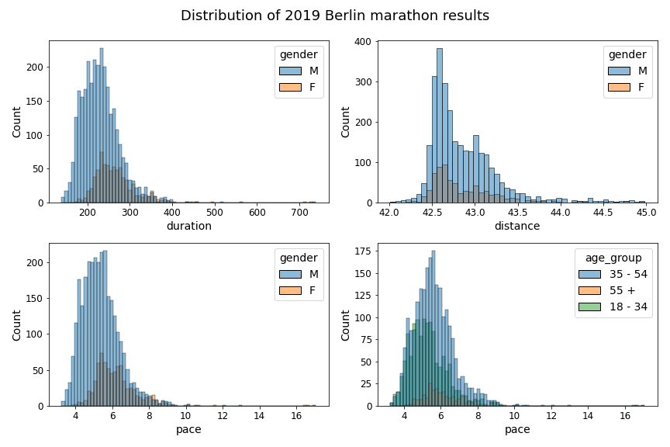
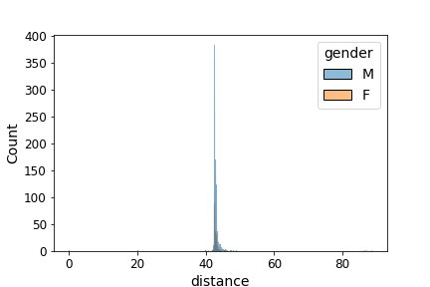
Data cleaning
Berlin marathon results
GPS
accuracy
” Anything worth doing is worth doing twice!”
Me ☹
Modal pace is almost independent of age!
Marathon distance > 42 & < 45 km
Pace < 10 min/km
Duration < 7 hours
Modal runner is a jogger:
4 hours @ sub 6 min pace

Slide 5
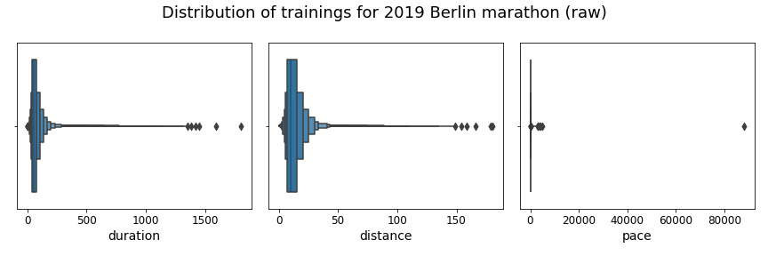
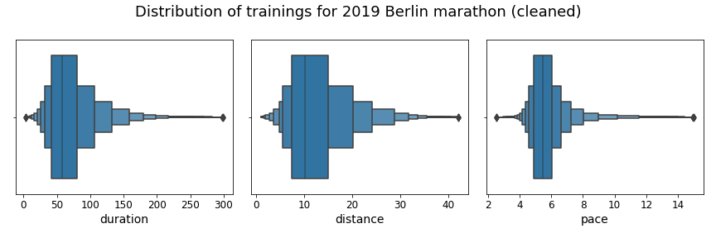
Data cleaning
Trainings results
Pace
< 15 min/km
Distance
> 1 & < 42 km
Duration
< 5 hours
3.4k athletes/371k train.:
Mean duration: 1 hour
Mean dist: 10 km
Mean pace: 5.30 min/km

Slide 6
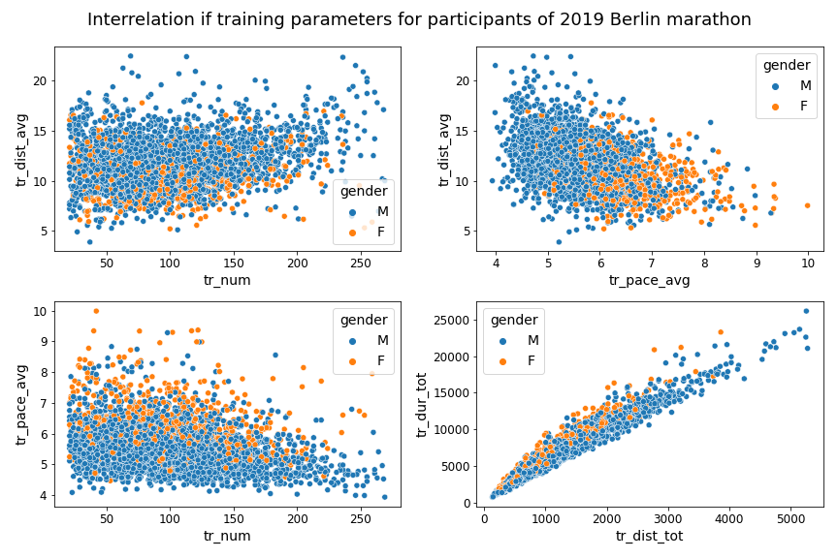
At First Glance
Athletes with low amount of trainings: no strict dependency between average distance / average pace and number of trainings
Athletes with more trainings:
Variability is decreasing!
Faster and farther
As expected
Average training distance and pace are rather negatively correlated (but this looks cloudy!)
Total distance and duration are very well correlated
‘Need to do something
to my belly’
‘10k are just aid
stations’

Slide 7
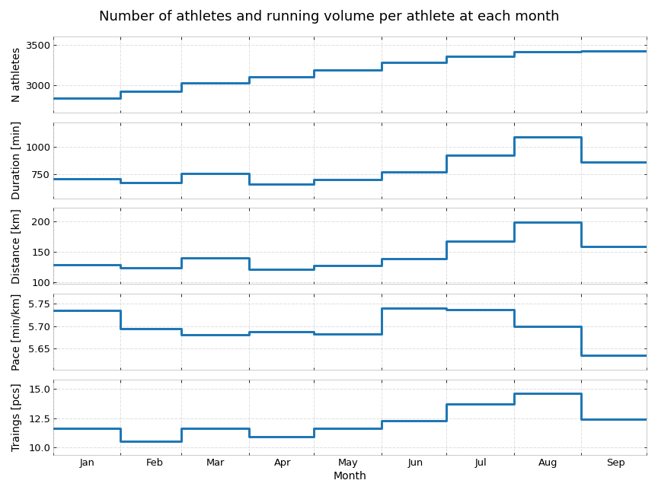
Monthly bins
2019 Berlin marathon was on Sep 29
Lets aggregate the training data by month
Gradual growth of the number of athletes (but 90% train whole year)
+ 30% increase of training volume
Rest week
Correlation between many variables is very high
Common trends are visible across the metrics
Duration and distance are highly correlated
The growth is mainly due to growth in number of training per athlete

Slide 8
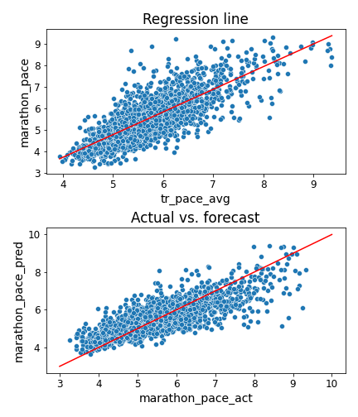
Linear regression
How well can we predict marathon pace using available data?
We have – gender, age group, total training distance, number of trainings, total duration, average training pace, average distance, number of months with trainings, trainings per actual month
The only variable with high correlation (0.8) is average training pace. The rest is below 0.5 with sometimes strong multicollinearity.
After normalization (Y-J) we got r^2 of 0.64
We can reach r^2 of 0.71 if we add average training distance and total number of trainings
The dependency does not look quite linear but KNN regressions gave us r^2 score hardly above 0.65
Overshoots at low Y
Undershoots at high Y
So our first model tells us: to run a marathon fast you need to be able 1) to run fast 2) to do it for long

Slide 9
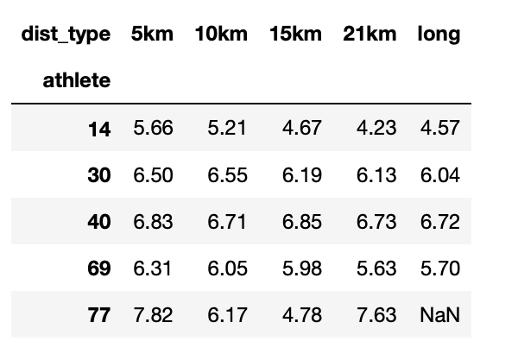
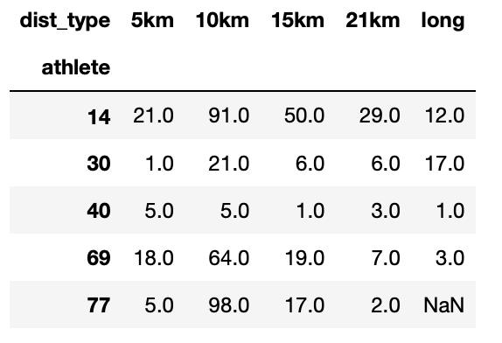
Training distance / bins
Some athletes were lazy and now we have to address NaNs ☹
Why not to use type of training instead of absolute training volume?
Pace by distance
Splitting training distances into the bins based on their lengths to see if the relative share of the longer trainings affect the performance
Also calculating: number of resting days before the event, stdev of training distance (as a measure of variability of training process)
New variables, subject to the selection, give us R^2 in the range of 0.6-0.74 (+3bp) -> no significant contribution to previous plain-vanilla model
Trainings counter

Slide 10
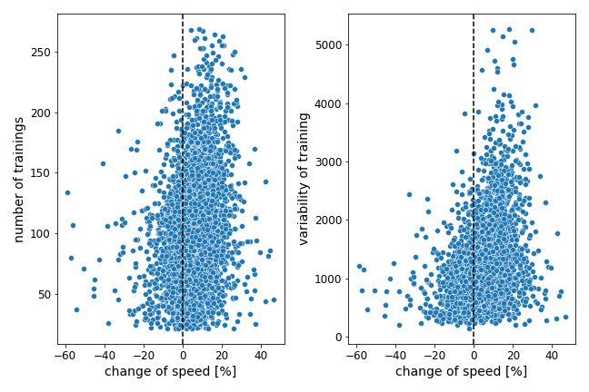
Classification
Change of pace is almost always positive
Instead of forecasting individual speed, can we forecast if athlete run marathon faster or slower then her training speed?
Ratio of marathon pace and average training pace
73% of athletes run faster
Categorical variable {faster/slower}
Logistic regression (after downsampling) metrics (accuracy, recall, F1-score) are all in the range of 60%-70%
KNN classification: same range.
Various variables of speed, pace, distance were checked iteratively
Change of pace is not clear!

Slide 11
Discussion
People
The dataset by design contain only marathoners with high volume of training
All the analysis is true only for this category
In this category we could not locate any factors that would solely or in groups define individual running ability. We can forecast (but with low accuracy) training success.
The running speed at the marathon is mostly depend on each athlete’s natural ability to run, that is expressed during training sessions. That’s why the measures of training speed contribute the most to the predictive power of machine learning models
The question of what factors (biomechanical, cardiac…) define ability to run in general population is beyond the scope of this work
?
People who run
Marathoners
Our db

Slide 12
Further steps
More clustering:
- Separate analysis of underachivers / overachivers
- Split the data by number trainings
Analysis across majors
Country analysis
Check (per modal athlete) what happens to the pace over comparable distances during the year

Slide 13
Questions?

