Slide 1


Slide 2
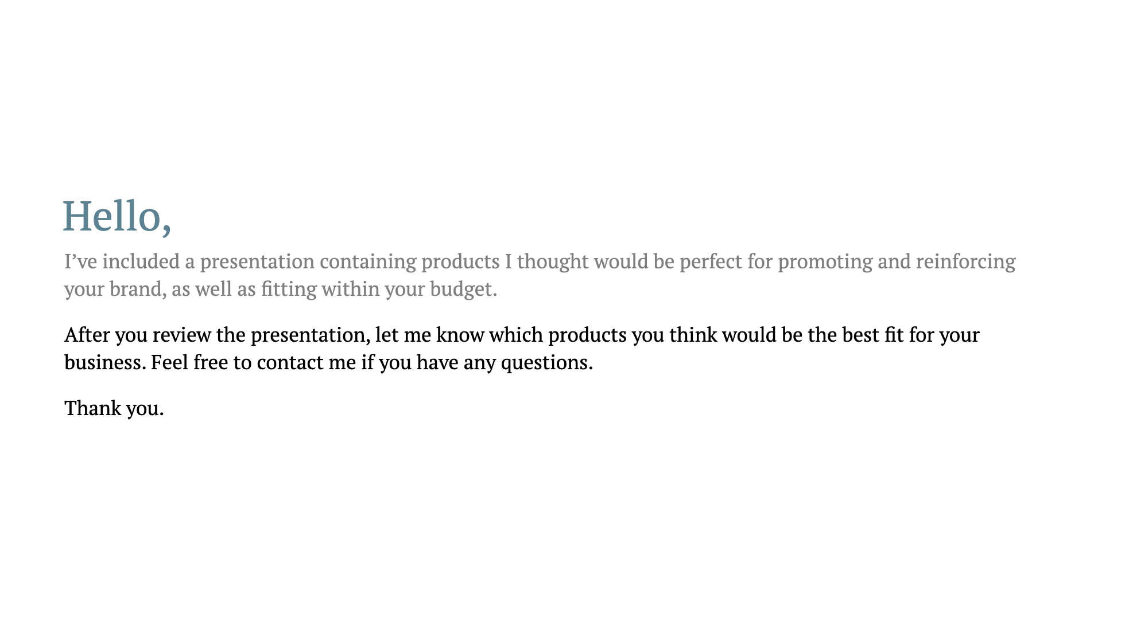

Slide 3
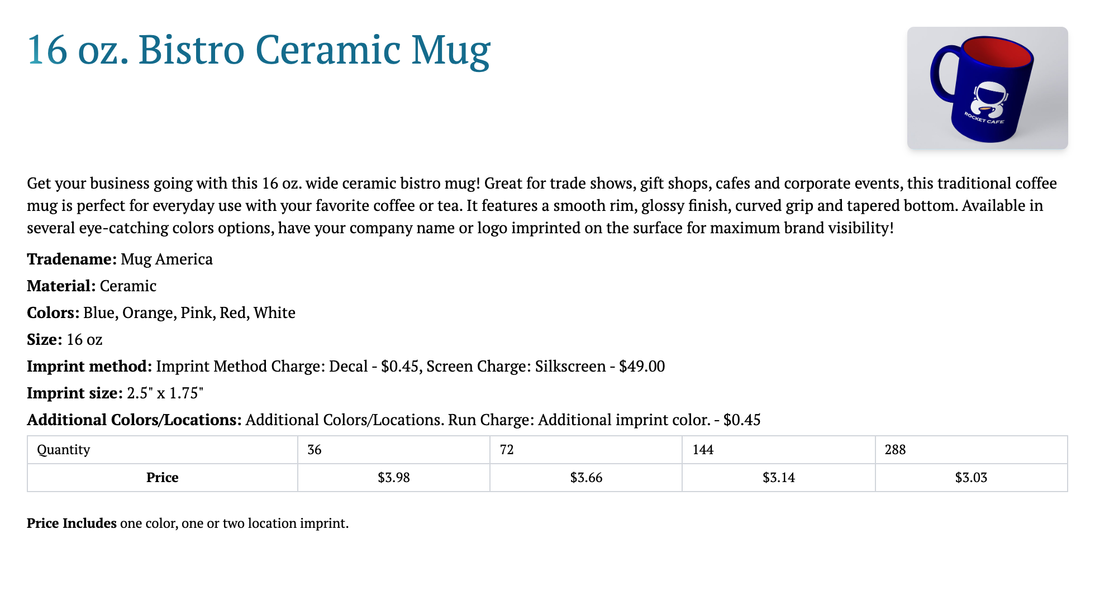
Notes:
Here is another comment.

Slide 4


Slide 5


