Slide 1




SolSnake
Play with friends.
Hold SNAKE for skins.
Live multiplayer · SNAKE integration planned
Notes:
SolSnake is a playable browser prototype. Holding SNAKE to unlock skins is the planned next product feature; the token is not claimed to be deployed.
Project evidence: https://fpc8nue4.idos.games/ (observed 2026-10-11); source src/client/js/PlatformNet.js and src/client/js/Shop.js. SNAKE plans and solo team supplied by founder. Template: https://docs.google.com/presentation/d/1V9yq8B1nLpF8vPTL2buT_nlmsMwNJ_fRuyADs_k49Sg/ (retrieved 2026-10-11).

Slide 2




A game token needs
a role in play
Today, the shop shows skins priced in game coins.
Wallet holdings are not linked to skin access yet.
The goal: holding SNAKE unlocks cosmetic choices.
SolSnake
02
Notes:
This is a design challenge and product hypothesis, not a quantified market problem. The current Shop UI displays coin prices. The browser adapter does not implement purchase persistence.
Project evidence: https://fpc8nue4.idos.games/ (observed 2026-10-11); source src/client/js/PlatformNet.js and src/client/js/Shop.js. SNAKE plans and solo team supplied by founder. Template: https://docs.google.com/presentation/d/1V9yq8B1nLpF8vPTL2buT_nlmsMwNJ_fRuyADs_k49Sg/ (retrieved 2026-10-11).

Slide 3

Skin access models
Coin shop
Current UI
Token purchase
Alternative
Hold SNAKE
Planned
Prices in game currency
Spend tokens for an item
Read the wallet token balance
Skin selection interface
Payment changes the balance
Unlock eligible cosmetic skins
Purchases need backend wiring
Not the planned SNAKE model
Tokens stay in the wallet
SolSnake
03
Notes:
The source comparison layout is adapted to cosmetic access models. No competitor shortcomings, market share or validated willingness to pay are asserted. Only the current coin-price UI is implemented.
Project evidence: https://fpc8nue4.idos.games/ (observed 2026-10-11); source src/client/js/PlatformNet.js and src/client/js/Shop.js. SNAKE plans and solo team supplied by founder. Template: https://docs.google.com/presentation/d/1V9yq8B1nLpF8vPTL2buT_nlmsMwNJ_fRuyADs_k49Sg/ (retrieved 2026-10-11).

Slide 4

Play first.
Hold SNAKE for skins.
Live: open SolSnake and invite friends with a room code.
Planned: connect a wallet and verify its SNAKE balance.
Planned: the balance determines which cosmetic skins are available.
SolSnake
04
Notes:
Room-code multiplayer is working and was tested with two distinct guest clients. Wallet proof and balance-based eligibility remain planned. No uptime guarantee or security certification is claimed.
Project evidence: https://fpc8nue4.idos.games/ (observed 2026-10-11); source src/client/js/PlatformNet.js and src/client/js/Shop.js. SNAKE plans and solo team supplied by founder. Template: https://docs.google.com/presentation/d/1V9yq8B1nLpF8vPTL2buT_nlmsMwNJ_fRuyADs_k49Sg/ (retrieved 2026-10-11).

Slide 5

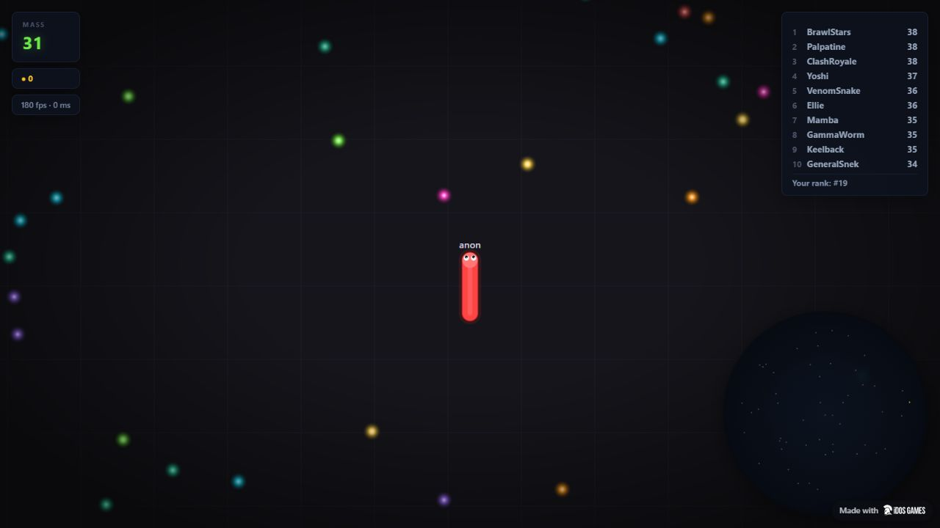

Live demo
SolSnake
SolSnake
05
Notes:
Demo: open https://fpc8nue4.idos.games/ . Play starts a local arena with bots. Play Online opens room creation and code joining. The screenshot is real gameplay from the deployed version, not a wallet-feature mockup.
Project evidence: https://fpc8nue4.idos.games/ (observed 2026-10-11); source src/client/js/PlatformNet.js and src/client/js/Shop.js. SNAKE plans and solo team supplied by founder. Template: https://docs.google.com/presentation/d/1V9yq8B1nLpF8vPTL2buT_nlmsMwNJ_fRuyADs_k49Sg/ (retrieved 2026-10-11).

Slide 6


From playable game to holder skins
Live
Next
Later
Play against bots
Connect a wallet
Recheck token holdings
Verify SNAKE balance
Invite friends by code
Test community events
Unlock eligible skins
SolSnake
06
Notes:
Live items are local bot play and room-code invitations. Wallet connection, token verification, unlock logic and rechecks are future work. Community events are a possible later experiment, not an announced partnership or scheduled launch.
Project evidence: https://fpc8nue4.idos.games/ (observed 2026-10-11); source src/client/js/PlatformNet.js and src/client/js/Shop.js. SNAKE plans and solo team supplied by founder. Template: https://docs.google.com/presentation/d/1V9yq8B1nLpF8vPTL2buT_nlmsMwNJ_fRuyADs_k49Sg/ (retrieved 2026-10-11).

Slide 7

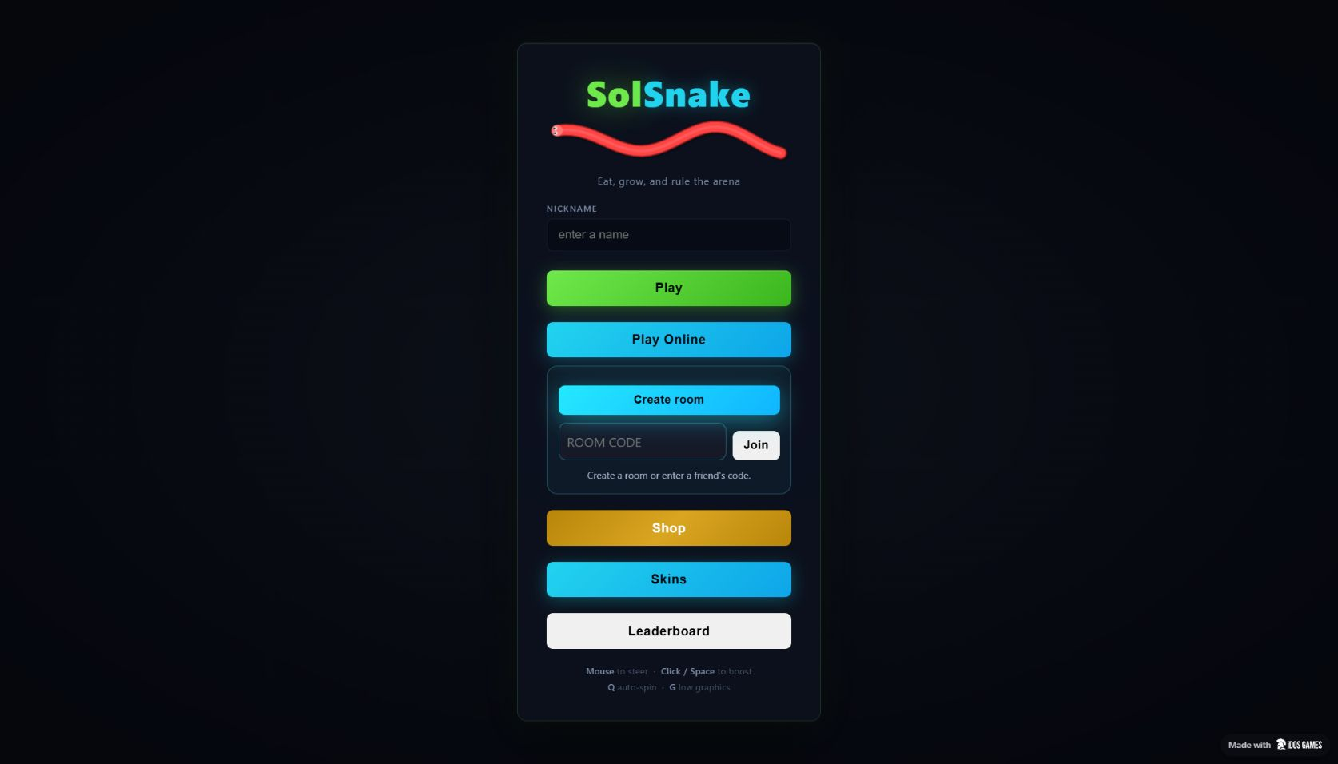
What works today
Capacity and test evidence — not audience metrics
8
players per room
configured limit
2
guest clients tested
20 Hz
world simulation
configured rate
SolSnake
07
Notes:
Eight is the SDK/config room cap, not verified concurrent-player throughput. Two clients were observed in one arena. Twenty Hz is the simulation tick configuration, not a latency measurement. Invalid codes, code copying, leaving and rejoining were checked. No MAU, retention or revenue data were supplied.
Project evidence: https://fpc8nue4.idos.games/ (observed 2026-10-11); source src/client/js/PlatformNet.js and src/client/js/Shop.js. SNAKE plans and solo team supplied by founder. Template: https://docs.google.com/presentation/d/1V9yq8B1nLpF8vPTL2buT_nlmsMwNJ_fRuyADs_k49Sg/ (retrieved 2026-10-11).

Slide 8
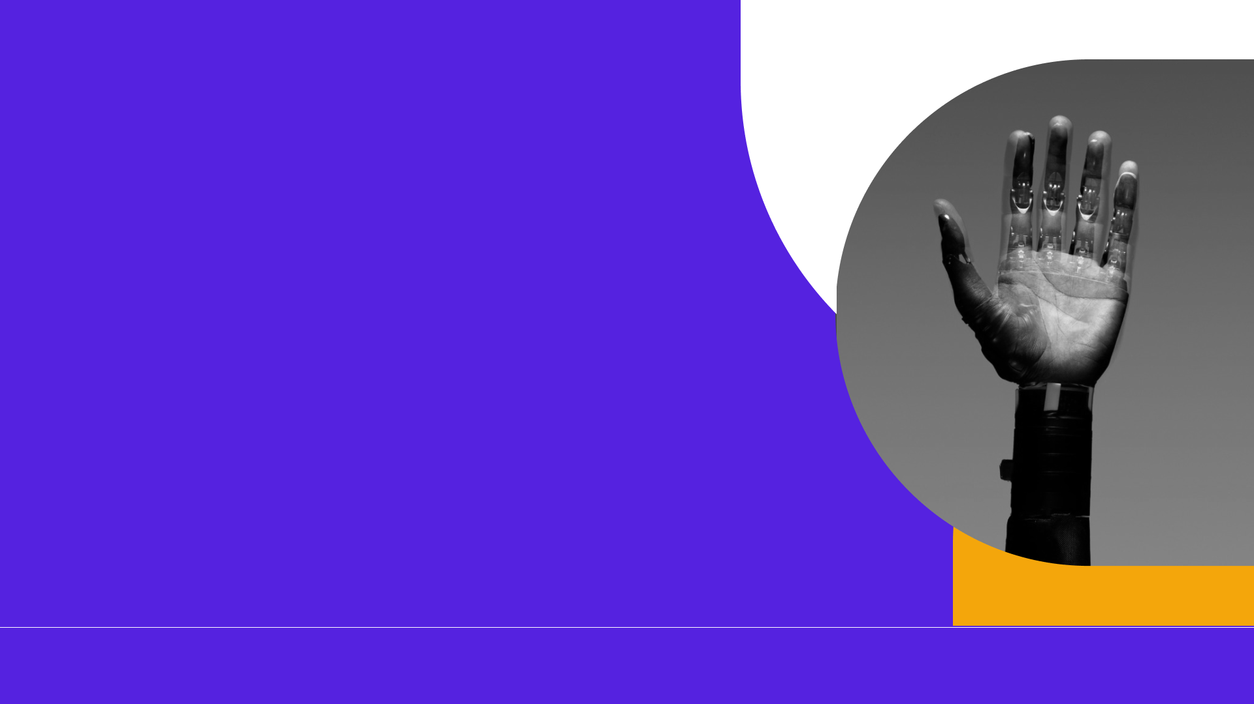
SNAKE utility
and monetization
Hold
Unlock
Keep
SNAKE
SNAKE in
your wallet
skins by
balance tier
tokens in
your wallet
Planned game token
Planned cosmetic access. Mint address and balance thresholds are not set.
Holding does not itself generate project revenue. The revenue model is still to be defined.
SolSnake
08
Notes:
The founder plans an own SNAKE token linked to the game on iDos Games. No issuance date, mint, thresholds, staking yield, token-price appreciation, transaction fees or revenue forecast has been agreed. Cosmetic eligibility is token utility rather than evidence of business income.
Project evidence: https://fpc8nue4.idos.games/ (observed 2026-10-11); source src/client/js/PlatformNet.js and src/client/js/Shop.js. SNAKE plans and solo team supplied by founder. Template: https://docs.google.com/presentation/d/1V9yq8B1nLpF8vPTL2buT_nlmsMwNJ_fRuyADs_k49Sg/ (retrieved 2026-10-11).

Slide 9


Why Solana
Verify SNAKE holdings.
Unlock cosmetic access.
Planned wallet proof and SPL token balance reads.
Real-time gameplay stays off-chain.
SolSnake
09
Notes:
Proposed technical route: prove wallet control with a signed message and query the selected SNAKE mint balance. This is not implemented yet. Official references retrieved 2026-10-11: https://solana.com/docs/rpc/http/gettokenaccountsbyowner and https://docs.phantom.com/solana/signing-a-message . No throughput, fee or ecosystem-demand claims are inferred from those docs.
Project evidence: https://fpc8nue4.idos.games/ (observed 2026-10-11); source src/client/js/PlatformNet.js and src/client/js/Shop.js. SNAKE plans and solo team supplied by founder. Template: https://docs.google.com/presentation/d/1V9yq8B1nLpF8vPTL2buT_nlmsMwNJ_fRuyADs_k49Sg/ (retrieved 2026-10-11).

Slide 10

One founder.
One working prototype.
Dmitry
Browser game deployed on iDos Games.
Solo founder and builder
Room-code multiplayer is the current MVP.
SolSnake
Next milestone: SNAKE-based skins.
SolSnake
10
Notes:
Team details supplied by the founder: one person, name Дмитрий (Dmitry). No former employers, prior companies, awards or investment credentials were supplied or invented. The game adapts the supplied slither.clone codebase.
Project evidence: https://fpc8nue4.idos.games/ (observed 2026-10-11); source src/client/js/PlatformNet.js and src/client/js/Shop.js. SNAKE plans and solo team supplied by founder. Template: https://docs.google.com/presentation/d/1V9yq8B1nLpF8vPTL2buT_nlmsMwNJ_fRuyADs_k49Sg/ (retrieved 2026-10-11).

Slide 11










The next development milestones
Read SNAKE balances
Publish holder beta
Connect wallets
Apply skin eligibility
Test with player groups
Stage 1
Stage 2
Stage 3
Stage 4
SolSnake
11
Notes:
These are proposed milestones without committed dates or an agreed budget. Choose a mint and thresholds; verify wallet control; implement trusted eligibility and balance rechecks; test with players; publish a holder beta after the checks pass. Host reliability and cheating risks remain separate gameplay work.
Project evidence: https://fpc8nue4.idos.games/ (observed 2026-10-11); source src/client/js/PlatformNet.js and src/client/js/Shop.js. SNAKE plans and solo team supplied by founder. Template: https://docs.google.com/presentation/d/1V9yq8B1nLpF8vPTL2buT_nlmsMwNJ_fRuyADs_k49Sg/ (retrieved 2026-10-11).

Slide 12
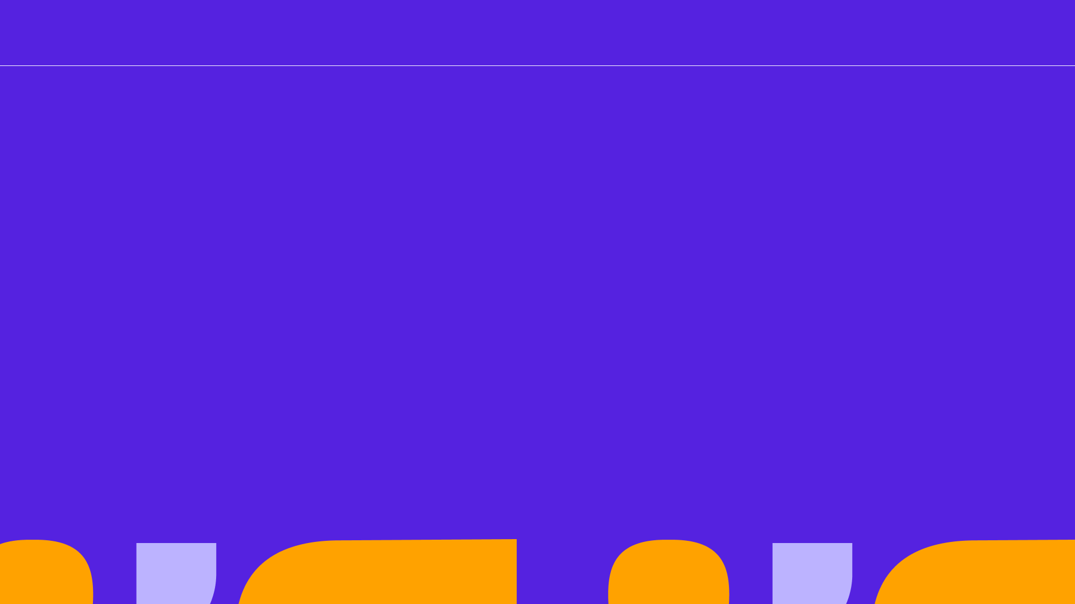


Template: Superteam / Spacekayak
Dmitry
Solo founder
SNAKE integration planned
SolSnake
Play with friends.
Hold SNAKE for skins.
Try the live prototype
https://fpc8nue4.idos.games/
Notes:
Live game: https://fpc8nue4.idos.games/ . Founder: Дмитрий (Dmitry), solo. A GitHub repository is being prepared; no unverified email, phone, token mint or social profile is included.
Project evidence: https://fpc8nue4.idos.games/ (observed 2026-10-11); source src/client/js/PlatformNet.js and src/client/js/Shop.js. SNAKE plans and solo team supplied by founder. Template: https://docs.google.com/presentation/d/1V9yq8B1nLpF8vPTL2buT_nlmsMwNJ_fRuyADs_k49Sg/ (retrieved 2026-10-11).

