Slide 1
Testing
Why, What and How

Slide 2
Why Testing
Find a problem EARLY in development cycle
Reduce development effort on fixing bugs, improved velocity for each release
Assists complex solutioning
Reduced testing effort on bugs increases testing effort on the whole of the application
Bugs in Production are
Causing disruption to customers
Costly to fix e.g. prepare and deploy hotfix
Damaging to the company’s reputation

Slide 3
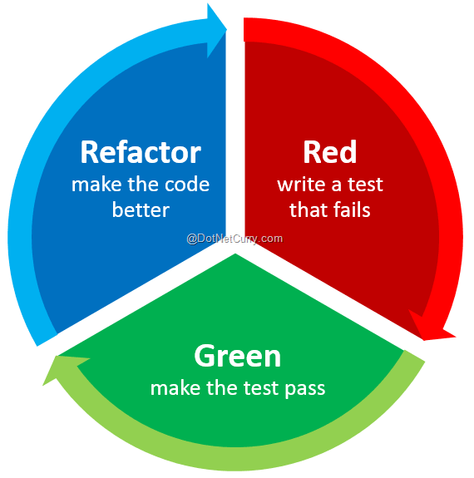
Why Testing
Making code change safe
Instead of don’t touch this code… no one knows what it is doing
The approach is: it is safe to touch. If you break it, our tests will indicate what’s wrong

Slide 4
Why Testing
Make Production deployment more frequent aka continuous deployment (CD)
Benefits:
Features are delivered faster
Bug fixes are delivered faster
The code in development matches the code in Production
Improved understanding of the functional and development solution
New customer will not have the same detailed understanding of the systems and functionality
We own the application - we will make functional improvements without a customer to test

Slide 5

Types of Tests
Manual
Involves humans - either QA or developers
Time-consuming if you want to test all possible cases
Humans are expensive
Tedious
Humans are bored when doing repetitive tasks. Their performance and morale degrades and they start looking for a new job :)
Automated
The mindset: automate tedious and repetitive tasks
QA become programmers: they code tests scenarios. No more tediousness!
Automated tests are FUN

Slide 6
Types of Automated Software Testing
Unit
Integration
End to end
Load (Stress) test
Each type is important as it is checking different things

Slide 7

Automation: Integration Tests
Test interaction between multiple components and services
Do actual service calls
E.g. AmadeusAdapter calls DCS with a test PNR
Written by architects and developers PROs
Test that each party implements agreed interface
Test multiple components
CONs
Require environment and setup (databases with data, pre-configured services etc)
Slow (communication overhead)
May fail because of timeouts or if one of the services are unavailable

Slide 8
Automation: End to End (E2E) Tests
Tests the whole application flow (start to end)
Usually written by QA (tests analysts)
Often have custom DSL scripting language e.g. Gherkin
Often UI-driven and simulate end user interaction
Browser automation, tools like Selenium PROs
Tests the entire application
CONs
Require environment and setup (databases with data, pre-configured services etc)
Slow
Effort to write and maintain

Slide 9
Unit Tests
Test “unit” of code (class, module, or function) in isolation
Great to assert correctness of
Algorithms
Business logic

Slide 10
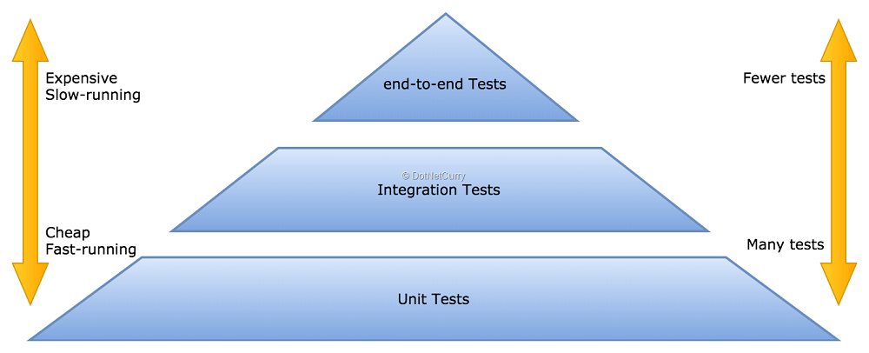
The Test Pyramid
The higher layers are
Slower
Harder to write and maintain
Require complex setup - environments, databases with certain data, running services etc
Less deterministic (e.g. fail on timeouts)

Slide 11
Unit Tests
Unit tests DO
Given specific input, assert correct output or correct behavior.
Unit tests DO NOT
Call other services like ServiceFabric etc.
Open connection to database
Make network requests, open sockets etc.

Slide 12
Unit Tests (cont.)
PROs:
Run in memory, blazing fast, suitable for CI / CD pipeline
Deterministic, do not time out or fail because of permissions, communication errors or timeouts
Need no setup - dedicated environment, installation, databases
CONs:
Do NOT test the whole system
each component may be correct, but the whole system could be broken

Slide 13
Test Driven Development (TDD)
WRITE! TESTS! FIRST!
Advantages
Makes developer think of edge cases BEFORE writing the actual code
Example: check-in eligibility
Infant without parent => fail …
Needs and does not have visa => fail
Plane departs in 1 minute => fail

Slide 14
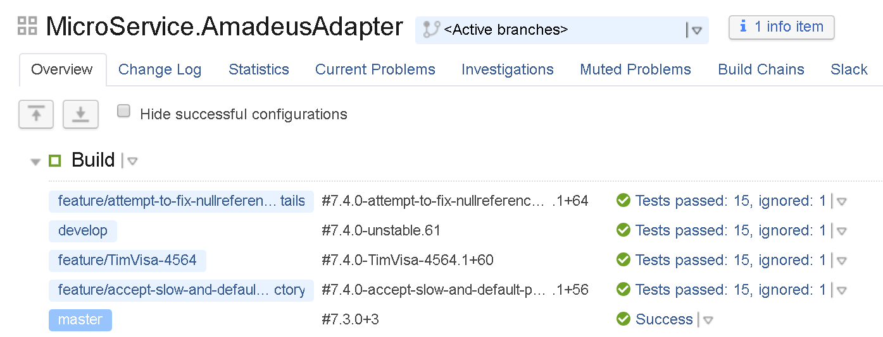
Why Running Tests in CI / CD Pipeline?
The goal: continuously assert correctness of algorithms and business logic
Each change triggers build
Each build runs unit test set
When a test fails
The build fails as a result
The tests result are appended to build log
The failure is tracked to particular code change (commit)

Slide 15
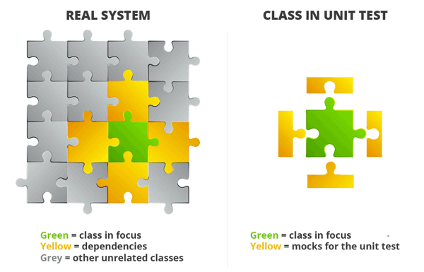
Unit Testing
The approach
Inject dependencies (other services, connections, etc.)
Real system uses real dependencies
Unit test uses mocked dependencies

Slide 16
Examples of NOT Unit Testable Code
If your class
Creates Service Fabric proxy or any other dependency
Always talks to external service e.g. Amadeus DCS
Opens database connection i.e. talks to real database
It is NOT unit testable. You must inject dependencies so that dependencies can be mocked / stubbed

Slide 17
Writing Unit Testable Code
public double GetWageFactor()
{
var now = DateTime.Now;
switch (now.DayOfWeek)
{
// Weekend pays more:
case DayOfWeek.Saturday:
case DayOfWeek.Sunday:
return 1.5;
// Regular wage
default:
return 1.0;
}
}
What’s wrong with this code?

Slide 18
Extracting and Isolating Dependencies
public interface IClock
{
DateTime TimeNow();
}
public class SystemClock : IClock
{
public DateTime TimeNow() => DateTime.Now;
}
public class UtcClock : IClock
{
public DateTime TimeNow() => DateTime.UtcNow;
}
// For testing
public class WeekendClock : IClock
{
public DateTime TimeNow() => new DateTime(2018, 10, 28);
}
What’s wrong with this code?

Slide 19
Injecting Dependencies
public double GetWageFactor(IClock clock)
{
// The injection of clock makes this function unit-testable
var now = clock.TimeNow();
switch (now.DayOfWeek)
{
// Weekend pays more:
case DayOfWeek.Saturday:
case DayOfWeek.Sunday:
return 1.5;
// Regular wage
default:
return 1.0;
}
}
What’s wrong with this code?

Slide 20
Writing Unit Testable Code: Specification
public interface INameMatchService
{
/*
* True if and only if the customer is flying on that flight
* The name must match name parts in any order and be case-insensitive
* Example: "DMITRY NOVIK" matches "NOVIK DMITRY" matches "Novik Dmitry" …
Depends on: CustomerService
*/
bool IsFlying(Customer customer, string flightNumber);
}

Slide 21
Writing Unit Testable Code: Separating Dependencies
public interface ICustomerService
{
IEnumerable<Customer> GetCustomers(string flightNumber);
}
public class CustomerService : ICustomerService
{
// Get customers from database
public IEnumerable<Customer> GetCustomers(string flightNumber)
{
return _context.Customers.Where(c => c.Name == flightNumber);
}
}

Slide 22
Writing Unit Testable Code: Injecting Dependencies
public class NameMatchService : INameMatchService
{
// returns customers from database:
private readonly ICustomerService _customerService;
public NameMatchService(ICustomerService customerService)
{
// inject dependency via constructor:
_customerService = customerService;
}
public bool IsFlying(Customer customer, string flightNumber)
{
if (customer == null) throw new ArgumentNullException(nameof(customer));
var nameParts = customer.Name.Split(new[] {' '}, StringSplitOptions.RemoveEmptyEntries)
.Select(c => c.ToUpperInvariant())
.OrderBy(x => x)
.ToArray();
foreach (var other in _customerService.GetCustomers(flightNumber))
{
var namePartsOther = other.Name.Split(new[] {' '}, StringSplitOptions.RemoveEmptyEntries)
.Select(c => c.ToUpperInvariant())
.OrderBy(x => x);
if (nameParts.SequenceEqual(namePartsOther))
return true;
}
return false;
}
}

Slide 23
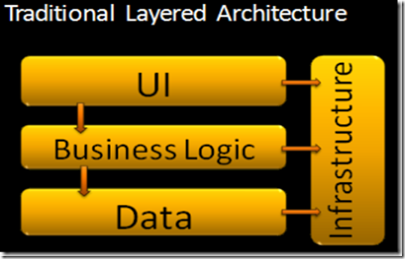
Old Layered Architecture
Higher layers depend on lower layers
Coupled
NOT unit-testable

Slide 24
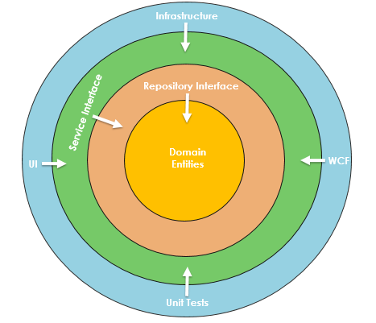
Onion Architecture
Dependencies (services, infrastructure) are injected into domain entities (business logic)
This allows mocking and stubbing dependencies for tests purpose

Slide 25
Three Steps of a Unit Test or AAA
Arrange
Setup - construct the object and all pre-conditions;
Mock dependencies; set expectations
Act
Execute the method (action) being tested
Assert
Assert the result

Slide 26
Unit Test Tools
Great open source libraries are there; Do not reinvent the wheel
Existing common libraries integrate well into DevOps (TeamCity etc.)
Testing libraries - the drivers that run your tests
NUnit
XUnit
Mocking libraries
Moq
Misc
Fluent assert is great for
Fluent interface
Capturing expression of lvalue so that once expectations fail it produces meaningful errors

Slide 27
Mocking
Purpose: quickly stub dependencies and their method call results
My favorite library: Moq
Powerful but elegant and easy to use;
https://github.com/Moq/moq4/wiki/Quickstart

Slide 28
Unit Test: Arrange.
public class NameMatchServiceTest
{
private readonly INameMatchService _matchService;
public NameMatchServiceTest()
{
// Create dependency mock:
var customerServiceMock = new Mock<ICustomerService>();
// Setup return value of the method we need:
customerServiceMock
.Setup(c => c.GetCustomers(It.IsAny<string>))
.Returns(new[] { new Customer("Dmitry Novik") });
// Inject mock object as dependency:
_matchService = new NameMatchService(customerServiceMock.Object);
}
}

Slide 29
Unit Test: Mocking Setup - Advanced Options
// any value
mock.Setup(service => service.GetCustomers(It.IsAny<string>()))
.Returns(new[] { new Customer("Donald Trump") });
// matching Func<string>, lazy evaluated
mock.Setup(service => service.GetCustomers(It.Is<string>(s => s == null)))
.Returns(new[] { new Customer("UNKNOWN") });
// matching ranges
mock.Setup(foo => foo.Add(It.IsInRange<int>(0, 10, Range.Inclusive)))
.Returns(true);

Slide 30
Unit Tests - Assert Expected Success
using FluentAssertions;
using Xunit;
[Fact]
public void Customers_Containing_Dmitry_Novik_Must_Match_Dmitry_Novik()
{
_matchService.IsFlying(new Customer("DMITRY NOVIK"), "QF147").Should().Be(true);
}
[Fact]
public void Customers_Containing_Dmitry_Novik_Must_Match_Novik_Dmitry()
{
_matchService.IsFlying(new Customer("NOVIK DMITRY"), "QF147").Should().Be(true);
}

Slide 31
Unit Tests - Assert Expected Failure
using FluentAssertions;
using Xunit;
[Fact]
public void Customers_Containing_Dmitry_Novik_Must_Not_Match_Dimitri_Novick()
{
_matchService.IsFlying(new Customer("DIMITRI NOVICK"), "QF147")
.Should().Be(false);
}

Slide 32
Unit Tests - Assert Expected Error
using Xunit;
[Fact]
public void Has_Match_Throws_On_Null()
{
// we expect ArgumentNullExceptuion here:
Assert.Throws<ArgumentNullException>(() => _matchService.IsFlying(null, ""));
}

Slide 33
Traits of a Good Unit Test
A meaningful, self-describing name
e.g. When_0_Is_Passed_DivisionByZeroException_IsThrown
If test fails, you should not debug it to understand why
Have meaningful errors
Ideally one assert per test method;
That is, a test can only fail because of one reason;
Better have many tests with one assertion than a single test with too many assertions

Slide 34
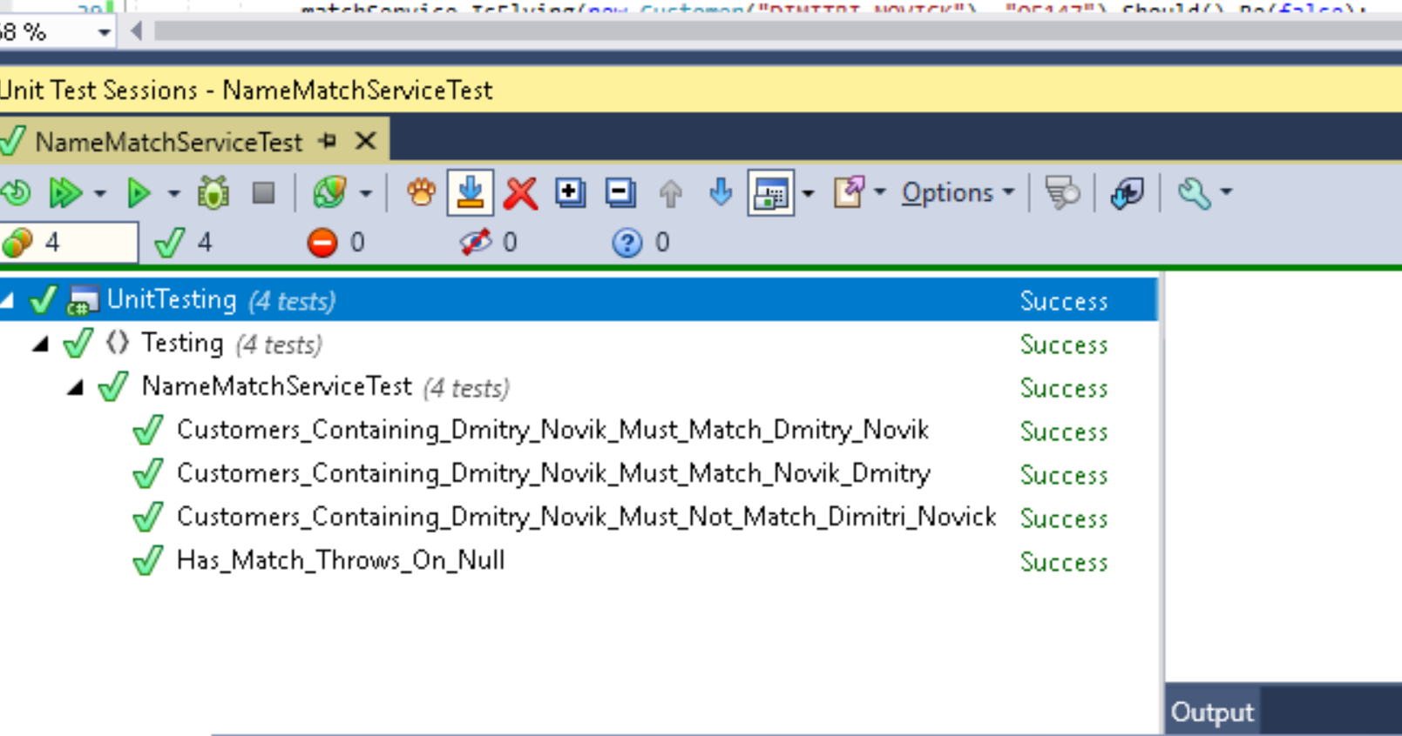
Traits of a Good Unit Test - Descriptive Name

Slide 35
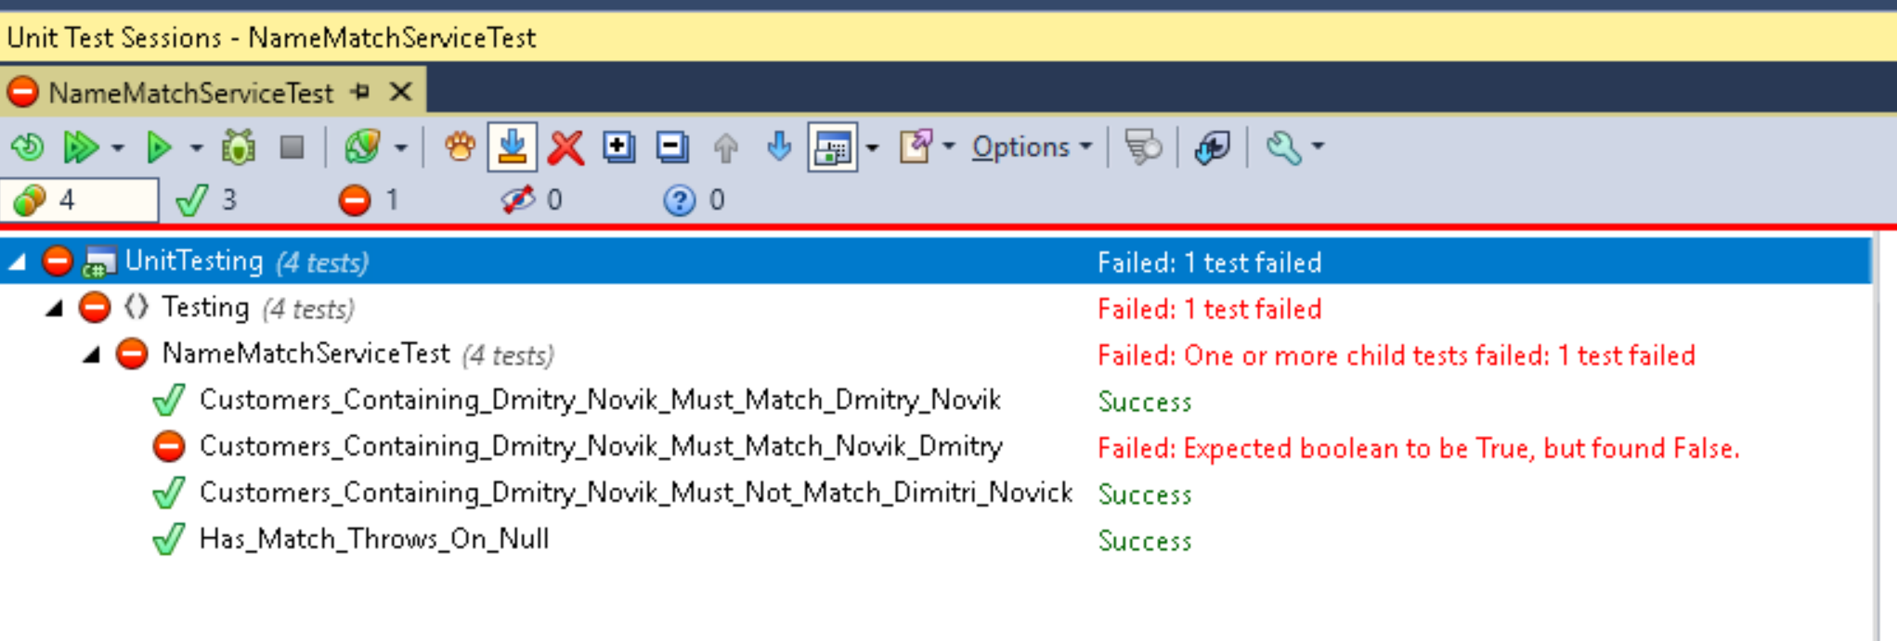
Traits of a Good Unit Test - Meaningful Errors
So that you do not need to scratch your head or debug to understand why the failure
Get meaningful errors from CI / CD build

Slide 36
Multiple assertions per test are bad
void SomeTest()
{
result.IsError.Should().BeTrue();
result.ErrorString.Should().Be("Timatic proxy is currently unavailable. No connection to [http://timaticdown.com]");
result.ErrorStackTrace.Should().Contain(@"System.ArgumentException: The provided URI scheme 'http' is invalid; expected 'https'.");
result.CheckVisaResponse.ErrorMessage.Should().Be("Timatic proxy is currently unavailable. No connection to [http://timaticdown.com]");
result.CheckVisaResponse.ErrorStackTrace.Should().Contain(@"System.ArgumentException: The provided URI scheme 'http' is invalid; expected 'https'.");
result.CheckVisaSuccess.Should().Be(Enums.CheckVisaResponseType.No);
result.CheckVisaSuccessString.Should().Be(Enums.CheckVisaResponseType.No.ToString());
...

Slide 37
Single Assertion per test: assert whole object graph at once
Problem: writing test method testing every single property
But writing a test method is sooo tedious!
Solution: compare whole objects by using object graph comparison
You may assert the structural equality of two object graphs with FluentAssertions:
expected.Should().BeEquivalentTo(actual);

Slide 38
Object graph assertion (.BeEquivalentTo)
[Fact]
public void Will_Not_Err_If_Parents_Do_Not_Match()
{
var expected = new Person { Id = 1, Name = "Matt", Father = new Person { Id = 7, Name = "Steve" } };
var actual = new Person { Id = 1, Name = "Matt", Father = new Person { Id = 7, Name = "Steve" } };
expected.Should().BeEquivalentTo(actual);
}
[Fact]
public void Will_Err_If_Parents_Do_Not_Match()
{
var expected = new Person { Id = 1, Name = "Matt", Father = new Person { Id = 7, Name = "Steve" } };
var actual = new Person { Id = 1, Name = "Matt", Father = new Person { Id = 8, Name = "Steve" } };
expected.Should().BeEquivalentTo(actual);
}

Slide 39
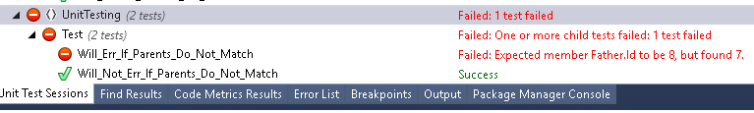
Object graph assertion

Slide 40
Advanced Moq: Verify
mock.Verify(foo => foo.DoSomething("ping"));
// Verify with custom error message for failure
mock.Verify(foo => foo.DoSomething("ping"), "When doing operation X, the service should be pinged always");
// Method should never be called
mock.Verify(foo => foo.ReportError(It.IsAny<Exception>, Times.Never());
// Called at least once
mock.Verify(foo => foo.Save(), Times.AtLeastOnce());
// Verify getter invocation, regardless of value.
mock.VerifyGet(foo => foo.Name);
// Verify setter invocation, regardless of value.
mock.VerifySet(foo => foo.Name);
// Verify setter called with specific value
mock.VerifySet(foo => foo.Name ="foo");
// Verify setter with an argument matcher
mock.VerifySet(foo => foo.Value = It.IsInRange(1, 5, Range.Inclusive));
// Verify that no other invocations were made other than those already verified (requires Moq 4.8 or later)
mock.VerifyNoOtherCalls();

Slide 41
The End
Questions?

