Slide 1
RL Driven Code Prompt Compression
Final Course Project: Reinforcement Learning
Course Director: Masha Fridin
Author: Strizhak Dmitry
(Afeka College of Engineering)

Slide 2
Introduction & Motivation

Slide 3
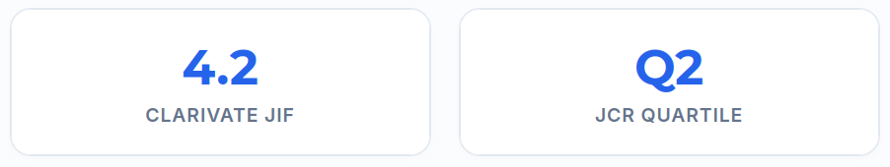
Literature Foundation & Baseline Study
Scientific Passport
FOUNDATIONAL REFERENCE STUDY
Discrete Prompt Compression with Reinforcement Learning
Authors: Hyeongchan Jung, Kyung-Joong Kim
Institution: Gwangju Institute of Science and Technology (GIST)
Journal: IEEE Access (Volume 12, 2024)
Contribution & Bridge
WHY IT WAS CHOSEN FOR ADAPTATION
First Discrete Prompt RL Framework
Introduced the concept of editing textual instructions via a policy network trained using trial-and-error rewards.
Gradient-Free & Black-Box Compatible
Can be trained without access to the internal weights or likelihood distributions of target generative models.
The Code Domain Limitation
The Gap: Tested exclusively on general summarization, ignoring the fragile structural and syntactic constraints of code.

Slide 4
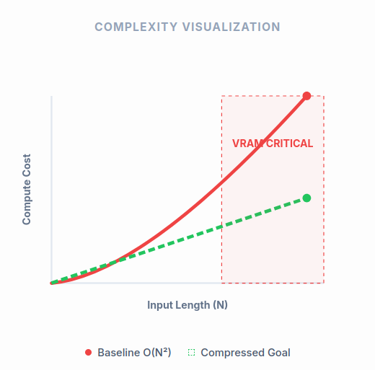
The Hidden Cost of Context: Computational Bottlenecks
Quadratic Complexity: Transformer self-attention complexity scales at O(N²), where N represents the input prompt token length.
VRAM Footprint: Long instructions expand the Key-Value (KV) cache size exponentially, severely capping operational batch sizes.
Inference Latency: Processing redundant conversational syntax increases Time-to-First-Token (TTFT).
The Deployment Challenge: Excessive system prompts in RAG pipelines introduce massive financial and computational overhead for local environments.

Slide 5
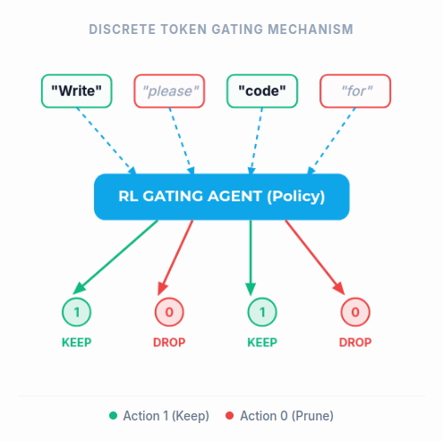
Baseline Architecture: Discrete Prompt Compression
Foundational Study: Based on the framework "Discrete Prompt Compression with Reinforcement Learning" (DOI: 10.1109/ACCESS.2024.3403426).
Core Concept: Employing a lightweight, discrete language model as a token gating mechanism.
Mechanism: The agent evaluates the prompt token-by-token and outputs a binary action: Keep (1) or Remove (0).
Original Scope: Tailored exclusively for general-purpose conversational texts, summary generation, and basic chat dialogs.

Slide 6
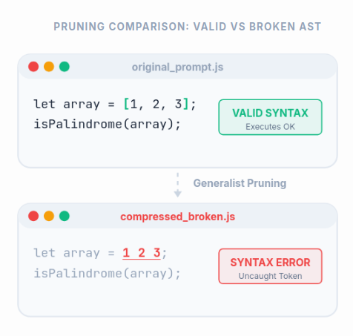
Domain Challenges: The Fragility of Code Prompts
High Semantic Density: Software engineering instructions are deeply sensitive to structural and punctuation arrangements.
Syntax Fragility: Removing single characters like commas, brackets, or variable types completely corrupts code generation intent.
Generalist Failure: General-purpose text compressors treat technical symbols as linguistic noise or irrelevant stop-words.
The Objective: Adapt the RL compression policy to recognize the strict semantic boundaries of technical constraints.

Slide 7
System Architecture & RL Environment

Slide 8
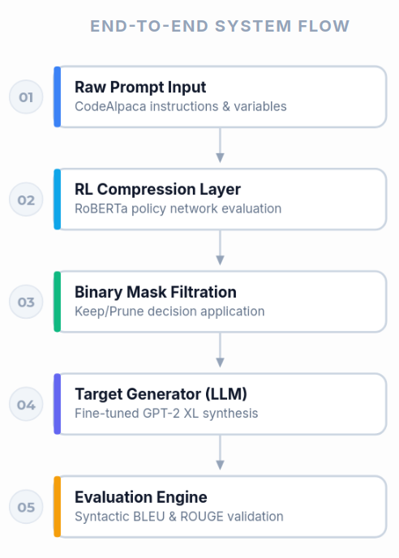
Proposed Prompt Compression Pipeline
Raw Prompt Input: Human-authored technical instruction from the CodeAlpaca dataset.
RL Compression Layer: A lightweight RoBERTa policy network processes input text streams.
Binary Mask Application: Selective filtration yields a minimized prompt string by MaskMG algorithm.
Target Generator: The compressed text is passed directly into a fine-tuned GPT-2 XL model.
Evaluation Engine: Code outputs are compiled and cross-validated using a multi-metric scoring system.

Slide 9
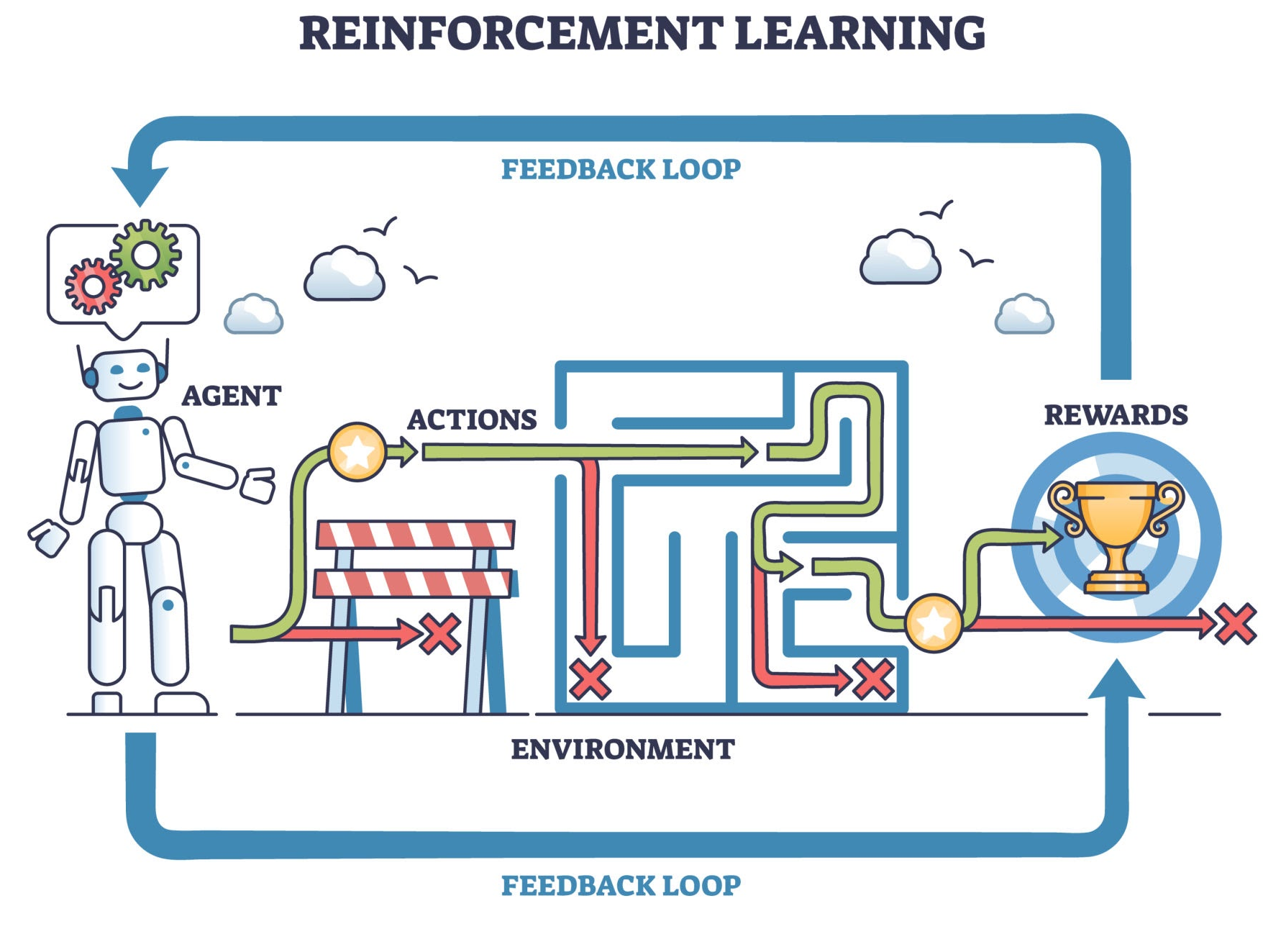

RL Architecture: Policy & Action Spaces
The Backbone: Utilizing a pre-trained RoBERTa model adapted for sequence labeling tasks.
State Space: Contextual token hidden-state embeddings generated dynamically by the encoder network.
Action Space: Discrete binary choice executed for every single token:
Action = 1: Retain the token in the prompt string.
Action = 0: Prune the token from the prompt string.
Policy Optimization: Optimized via Policy Gradient tracking sequence-level downstream rewards.

Slide 10
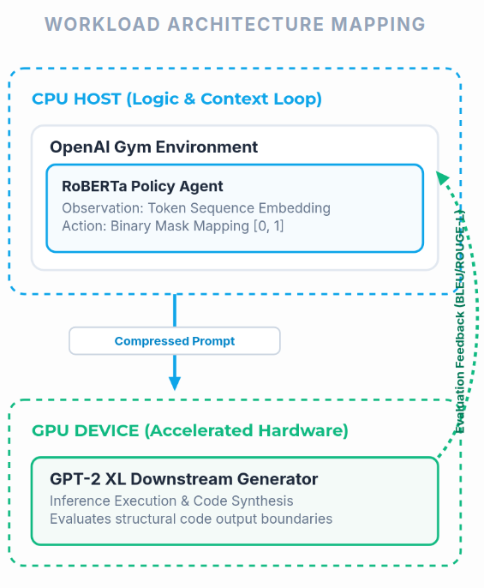
Environment Design: State Tracking & Token Processing
Framework: Built on a customized OpenAI Gym environment tracking sequence generation steps.
Observation Space: Managed via tokenized data arrays mapping strings to specific vocabulary indices.
Syntactic State Alignment: Token processing is optimized to preserve exact positional n-gram structures, directly feeding local syntax features into the downstream BLEU reward loop.
Isolation: Isolates token properties to guarantee that observation matrices feed accurately into policy evaluation loops.

Slide 11
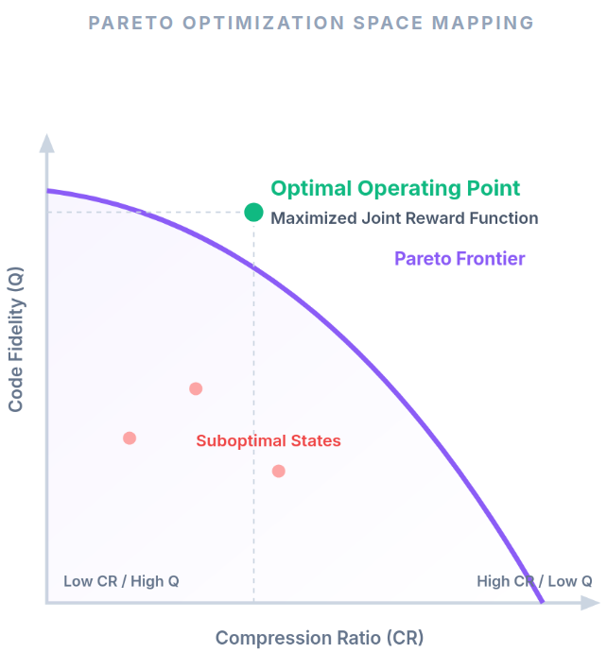
Optimization Goal: The Reward Mechanics
The Trade-off: The policy network must minimize prompt length while maximizing code fidelity.
Compression Metric: Tracking the Compression Ratio (CR):
CR=N(original)​/N(dropped)​​
Fidelity Metric: Downstream generation quality scored by evaluation algorithms (Q).
Reward Equation Structure: Balancing compression and quality using hyperparameter weights:
Reward=α⋅CR+β⋅Q

Slide 12
Validation Metrics: ROUGE vs. BLEU

Slide 13
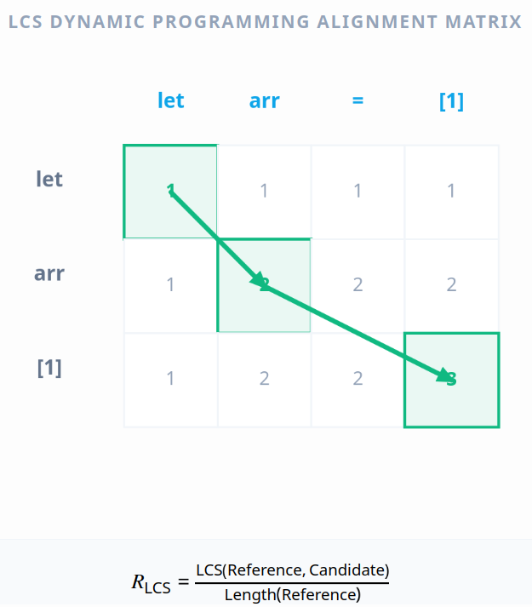
Evaluating Text Similarity: The ROUGE-L Baseline
Metric Definition: Recall-Oriented Understudy for Gisting Evaluation.
Focus: Measures the Longest Common Subsequence (LCS) between the generation and the ground-truth text.
Strength: Excellent for summarizing raw information, text extraction, and conversational flows.
Limitation: Blind to strict sequence arrangements, formatting shifts, and syntax structure logic.

Slide 14
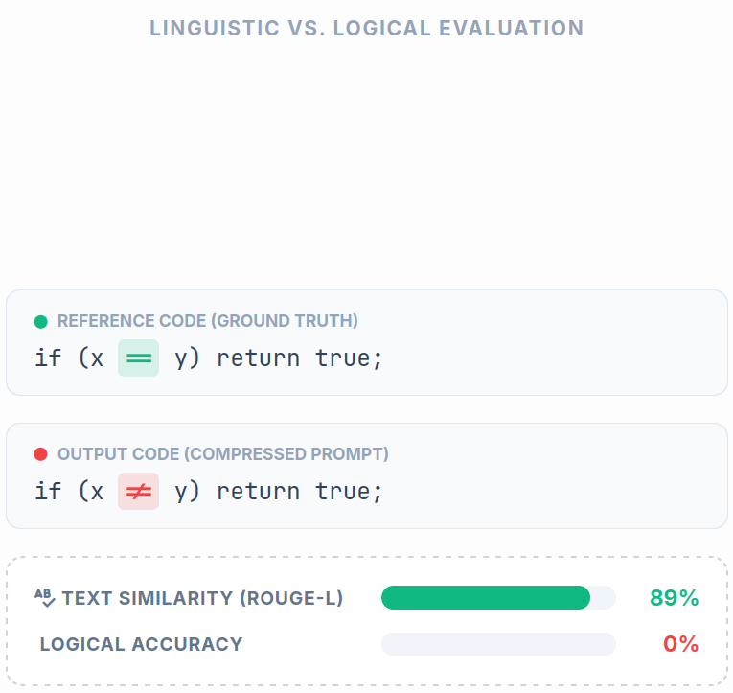
The Blind Spot of Semantic Text Metrics in Code
Code Fragility: Code can have a high text overlap but be completely broken.
The ROUGE-L Failure Example:
Ground Truth: if (x == y) return true;
Model Output: if (x != y) return true;
Metric Blindness: ROUGE-L scores this example near 90% due to identical words, ignoring that the logic is completely inverted.
Conclusion: Purely semantic text metrics fail to capture devastating syntax or logical errors.

Slide 15
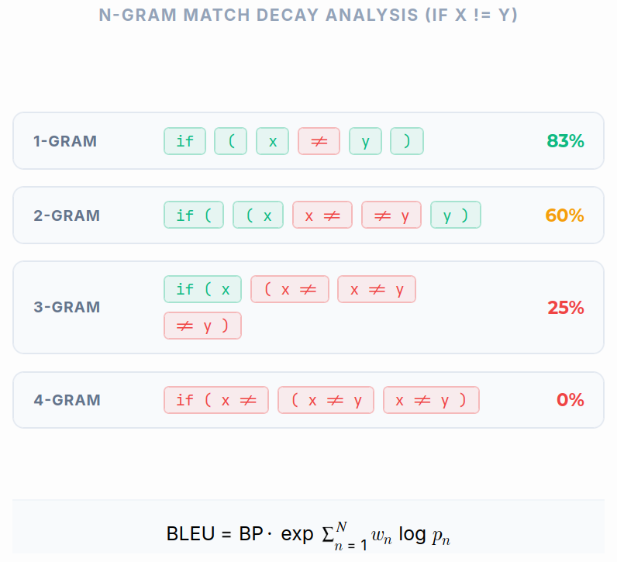
Enhanced Validation: BLEU Metric Integration
Metric Definition: Bilingual Evaluation Understudy (BLEU).
Core Feature: Calculates precision via overlapping n-grams (combinations of consecutive tokens).
Value for Code: Enforces strict local sequence ordering, successfully capturing broken syntax and logic shifts.
System Integration: Injected BLEU directly into both the evaluation validation pipeline and the downstream reward feedback loops.

Slide 16
Experimental Results & Case Study

Slide 17
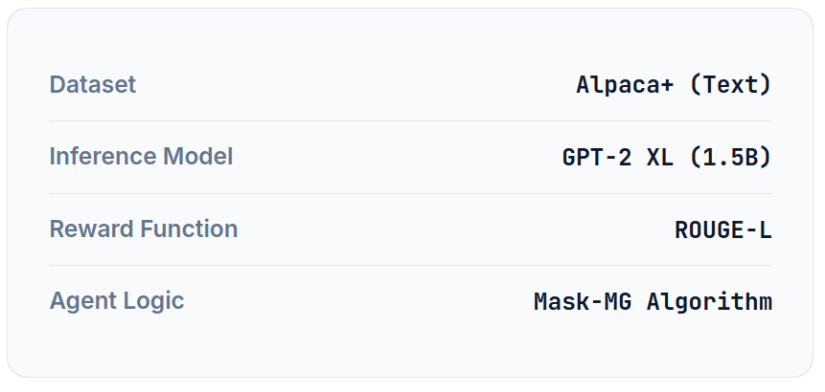
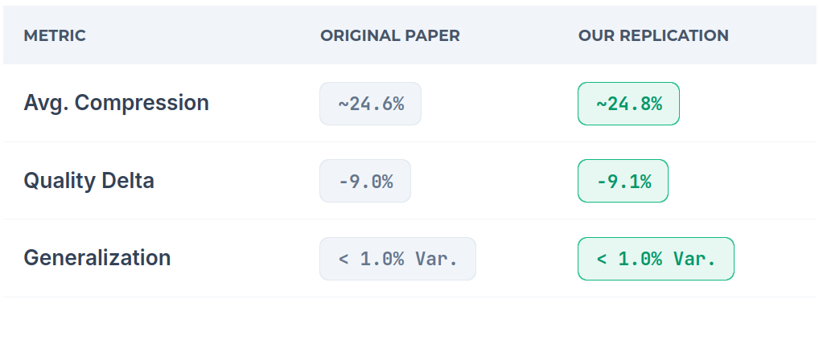
Replicating the Original Baseline
Experimental Environment
Data Alignment Matrix
Framework Verified
My implementation yields results nearly identical to the peer-reviewed baseline. This confirms the system's repeatability and provides a secure foundation for Stage 2: Code Domain Adaptation.
Before introducing syntactic extensions for code, I performed a rigorous replication of the authors' original work to verify the stability of the RL framework.

Slide 18
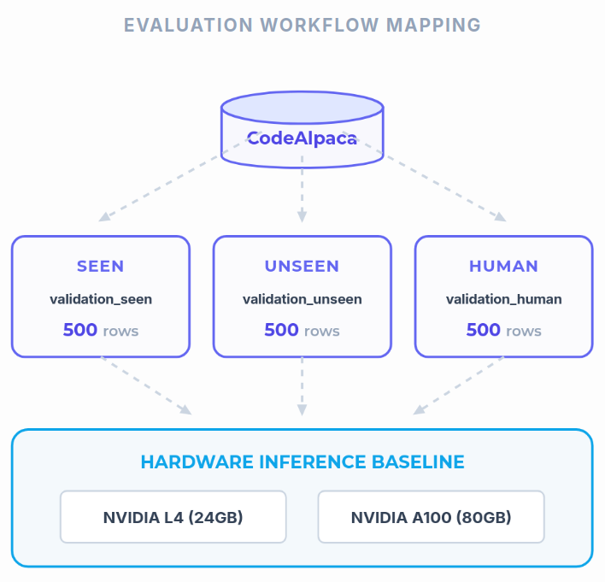
Experimental Setup & Data Splits
Evaluation Dataset Size: 500 rows per tracking split block.
Data Categorization Engine: Evaluated across three distinct test splits:
validation_seen: Performance on problems encountered during the training phase.
validation_unseen: Performance on entirely new programming tasks.
validation_human: Hard test samples designed to check complex edge cases.
Hardware Baseline: Automated batch executions conducted on NVIDIA L4/A100 GPU instances.

Slide 19
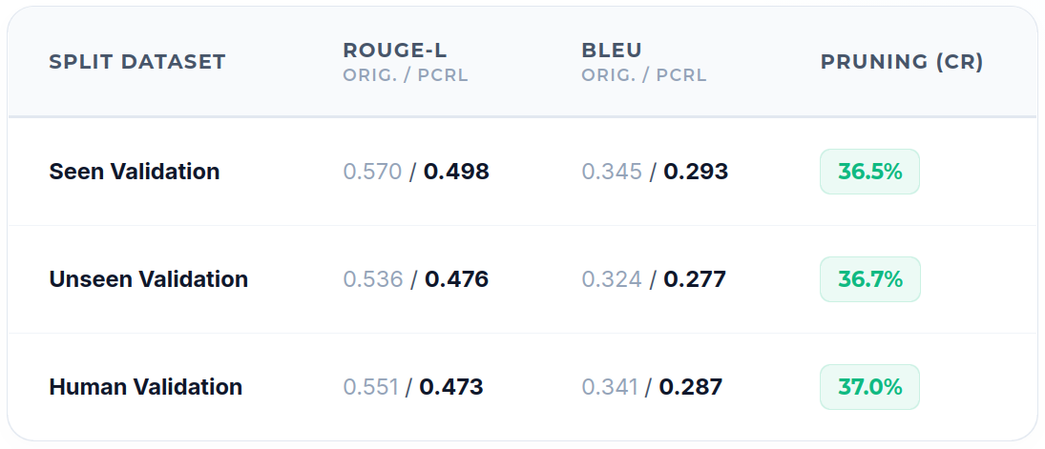
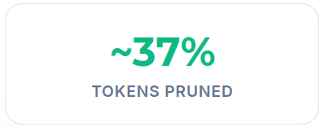
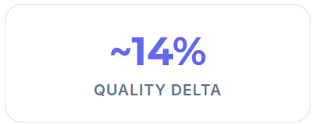
Quantitative Analysis: Resource Savings vs. Quality Loss
Core Performance Insight
My Prompt Compressor (PCRL) model demonstrates stable, near-identical token compression margins across seen, unseen, and human-crafted datasets while preserving algorithmic syntax.

Slide 20
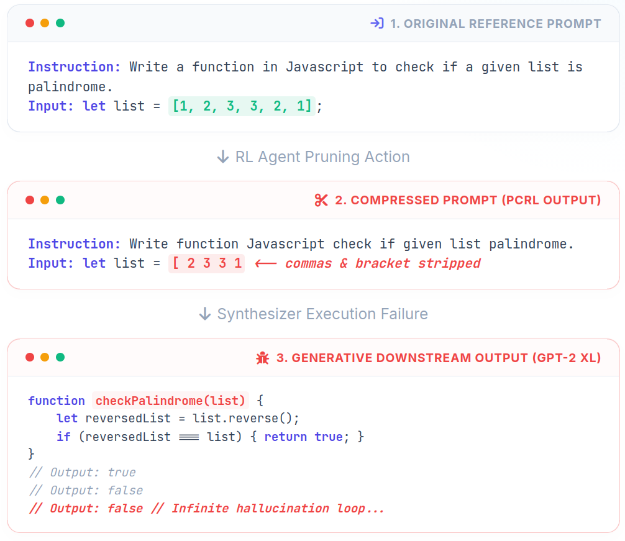
Qualitative Deep Dive: JavaScript Palindrome Test Case
Original Instruction: Request to write a JavaScript palindrome function with a sample array input.
PCRL Compressed Prompt: Successfully stripped conversational words like "a" and "in".
The Structural Bug: The agent mistakenly stripped the array commas and the closing bracket.
Downstream Collapse: GPT-2 XL lost context due to the broken array syntax and hallucinated infinite loop comments.

Slide 21
Future Work & Master's Thesis Vision

Slide 22
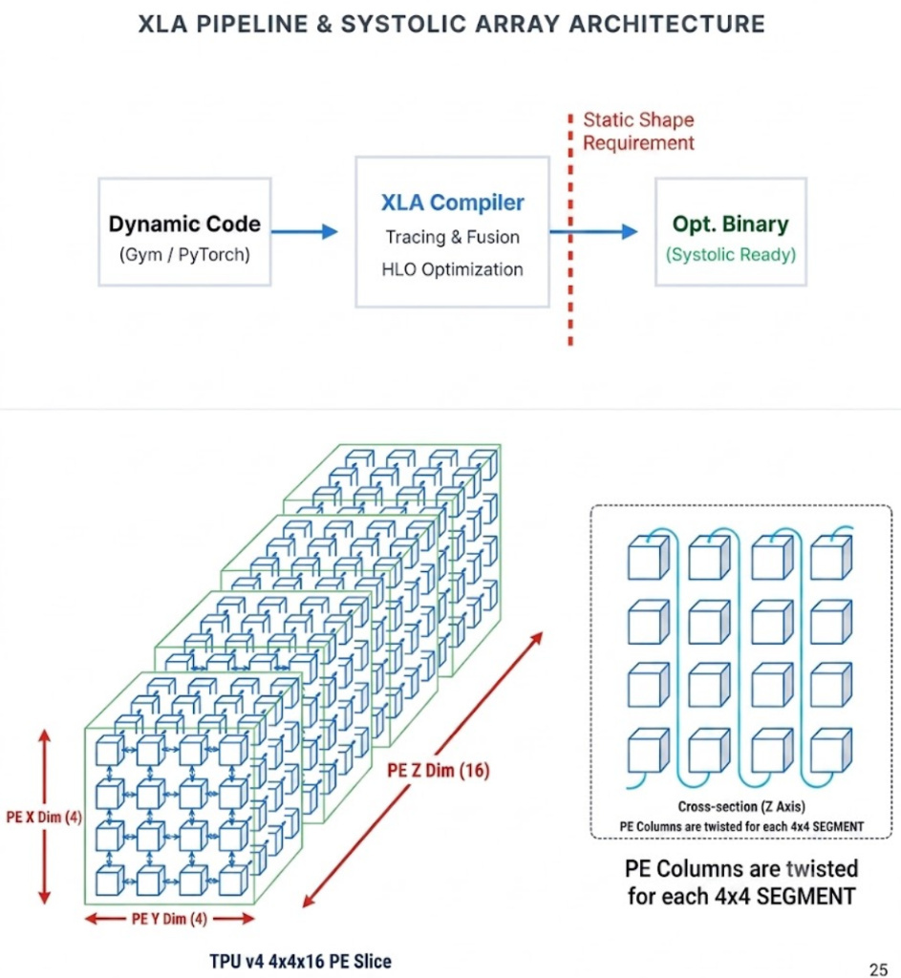
Strategic Outlook: Native Google TPU Acceleration
The Next Frontier: Migrate the entire PCRL training and evaluation ecosystem from GPU to Google Cloud TPU hardware nodes.
The Architectural Wall: TPUs rely on strict XLA (Accelerated Linear Algebra) graph compilation graph frameworks.
No Simple Compilation: Code bases built on dynamic shapes, dynamic padding, and variable gym loops cannot simply be compiled; they must be rewritten from scratch.
Research Dimensions: Evaluate development overhead vs. execution scaling, hardware cost-efficiency, and matrix operation speeds.
Thesis Scope: This native TPU rewrite and optimization study forms the foundational proposal for my upcoming Master's Final Project.

Slide 23
Conclusion & Q&A
Domain Adaptation: Successfully adapted an RL prompt compressor to handle fragile software engineering contexts.
Fidelity Tracking: Integrated the BLEU metric to create a validation engine sensitive to code syntax.
Operational Metrics: Achieved a 37% reduction in prompt size, optimizing local LLM resource management profiles.
Infrastructure: Stabilized and debugged the legacy codebase for modern MLOps environments.
Thank you for your time. Open for questions.

Slide 24
Engineering Challenges & Infrastructure MLOps

Slide 25
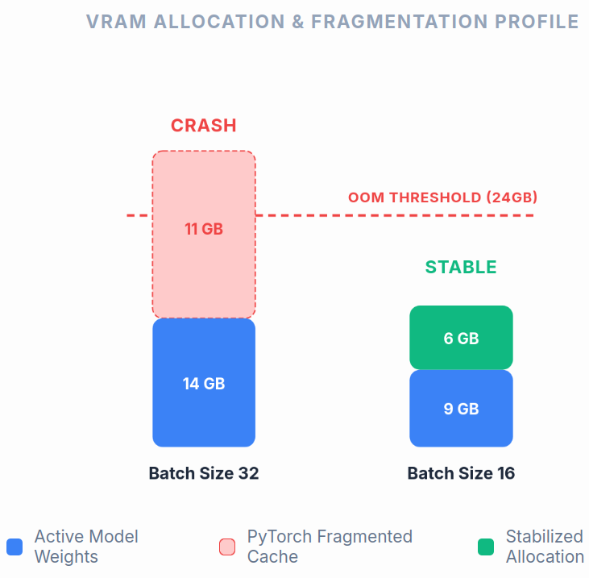
Engineering Challenges: Memory Saturation & Caching
The Hardware Wall: Running RoBERTa and GPT-2 XL concurrently peaked past VRAM allocations at batch size 32.
The Culprit: PyTorch's native caching allocator holding memory blocks fragmentation states during rapid evaluation steps.
The Mitigation: Optimization down to a batch size of 16 stabilized memory footprint.
The Insight: Batch constraints on inference evaluations do not alter the policy learning weights or generation quality profiles.

Slide 26
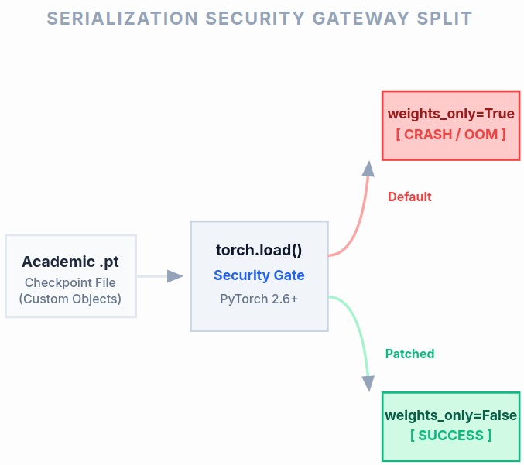
Engineering Challenges: Overcoming Object Serialization Restrictions
The Error: System failure occurred during model checkpoint restoration on newer PyTorch targets.
The Cause: PyTorch 2.6+ enforces weights_only=True by default inside torch.load() to prevent security vulnerabilities.
The Conflict: Legacy academic model checkpoints contain custom object configurations that trip this guardrail.
The Solution: Patched scripts to explicitly bypass serialization checking via weights_only=False wrappers.

Slide 27
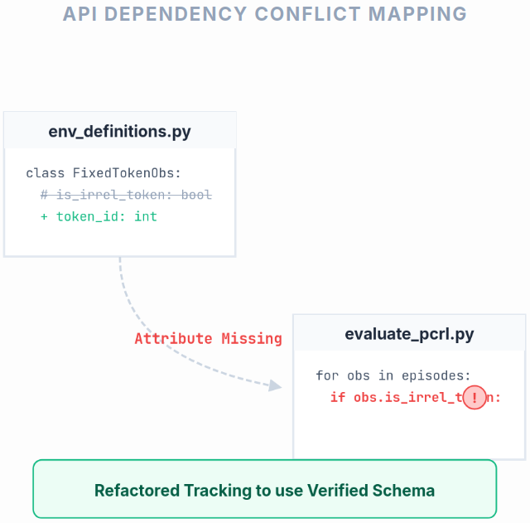
Engineering Challenges: Eliminating Legacy API Debt
The Error:
AttributeError: 'FixedTokenObservation' object has no attribute 'is_irrel_token'.
The Structural Root Cause: Code duplication inside the environment source files where a second definition overrode active methods.
The Legacy Debt: The training environment had commented out experimental features but left active dependencies inside evaluation modules.
The Solution: Cleaned out obsolete API tracking structures from evaluate_pcrl.py to match core environment definitions.

