Slide 1
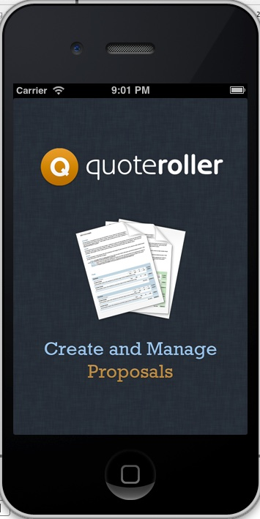
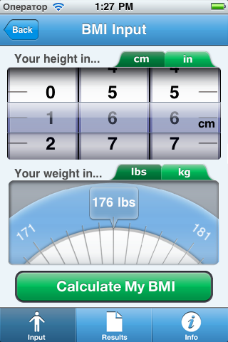
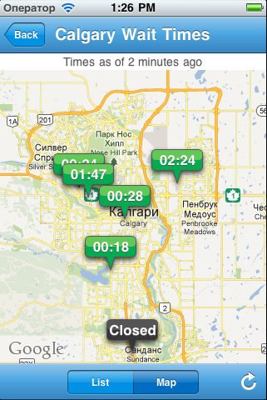
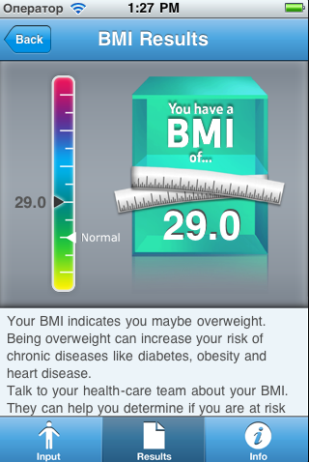
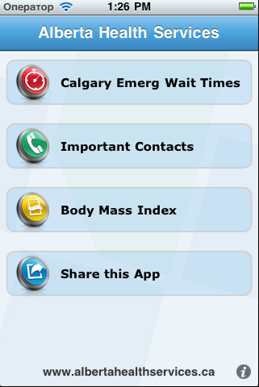
AHS
Description:
The ArtInSheffield App is an innovative guide and interpretive tool for all exhibitions and events in the Art in Sheffield 2011 programme which include some of the most prominent
Technologies:
XCode, Versions, TouchXML, QuartzCore Framework, CoreData, MediaPlayer, MapKit, Security, CoreLocation, EventKit

Slide 2
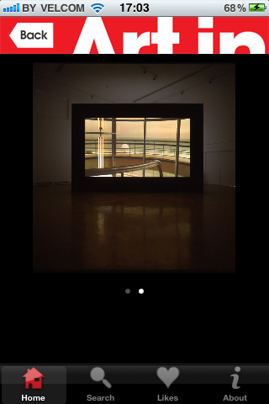
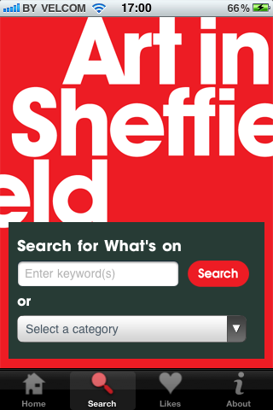
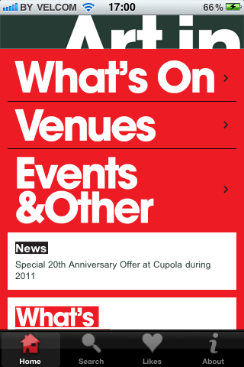
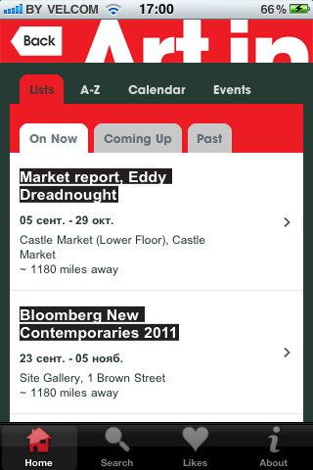
ARTInSheffield
Description:
The ArtInSheffield App is an innovative guide and interpretive tool for all exhibitions and events in the Art in Sheffield 2011 programme which include some of the most prominent
Technologies:
XCode, Versions, TouchXML, QuartzCore Framework, CoreData, MediaPlayer, MapKit, Security, CoreLocation, EventKit

Slide 3
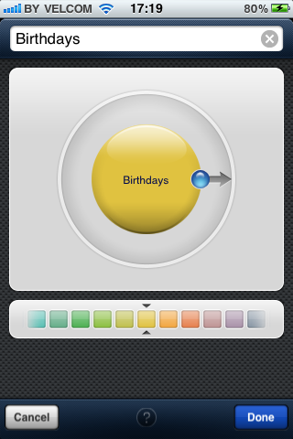
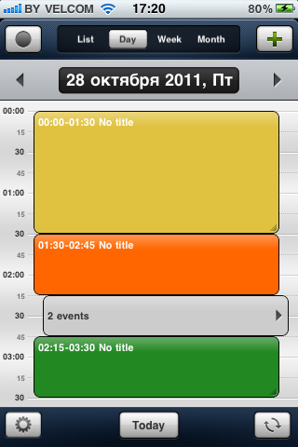
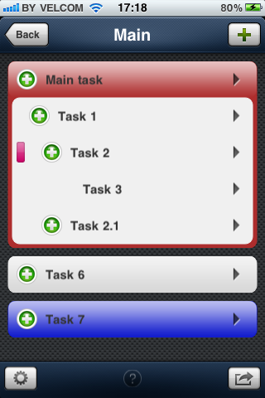
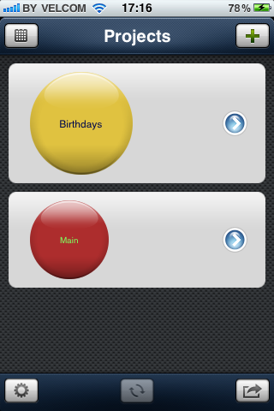
BubbleDo
Description:
It's a calendar and task manager application. Includes email tasks and events, easy to add task features, sub-task capabilities. Set agendas by day, week, and even month with alerts so you don’t miss important dates or events. Calendars and events could be synchronized with Google Calendars
Technologies:
TouchXML, MessageUI Framework, Mobile Core Services Framework, CoreLocation Framework, CoreGraphics Framework, Objective-C/Cocoa, Framework, QuartzCore Framework, Security, MapKit, Google Services, AddressBook

Slide 4
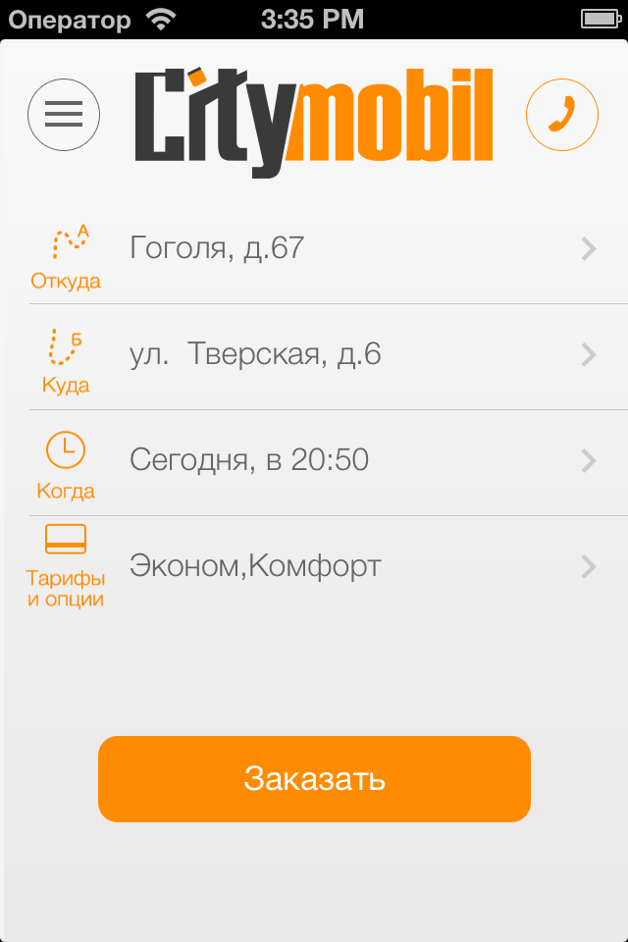
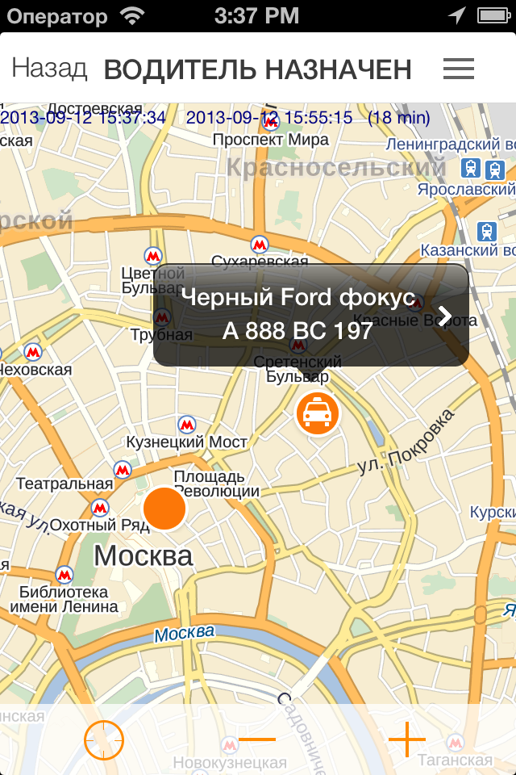
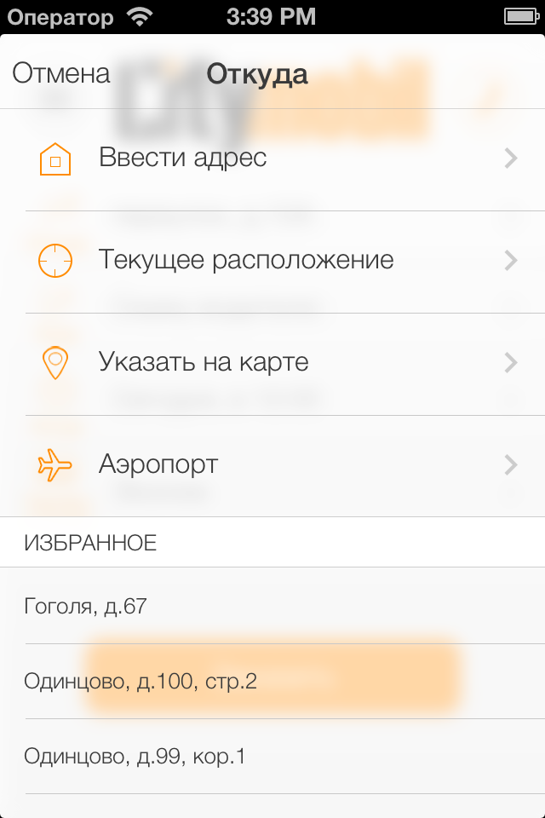
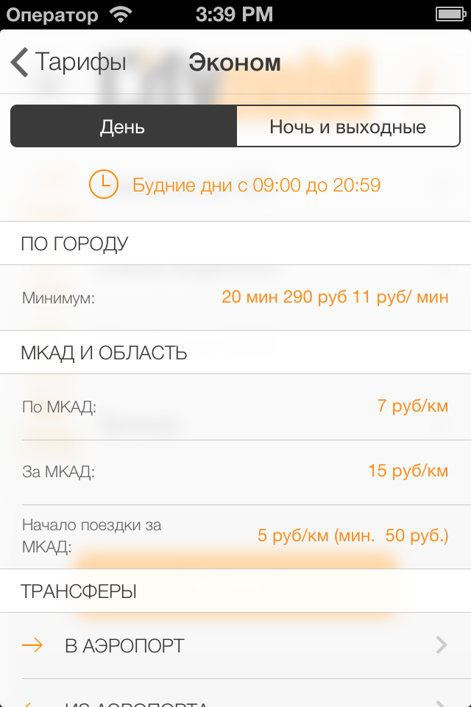
CityMobil
Description:
The ArtInSheffield App is an innovative guide and interpretive tool for all exhibitions and events in the Art in Sheffield 2011 programme which include some of the most prominent
Technologies:
XCode, Versions, TouchXML, QuartzCore Framework, CoreData, MediaPlayer, MapKit, Security, CoreLocation, EventKit

Slide 5
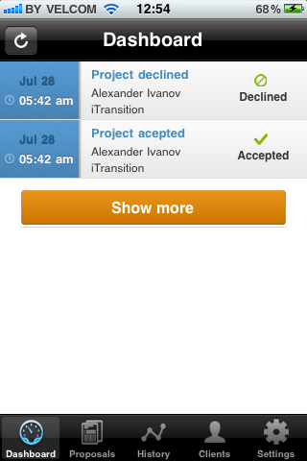
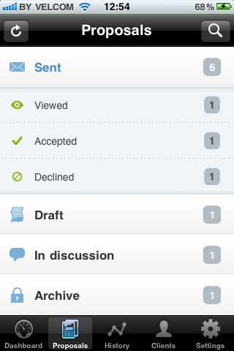
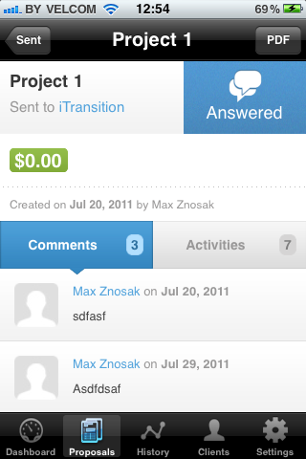
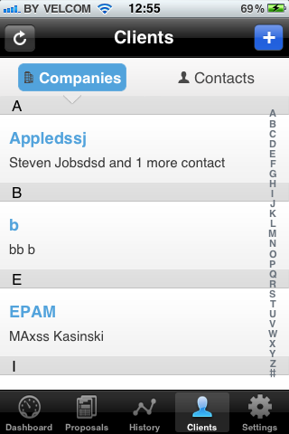
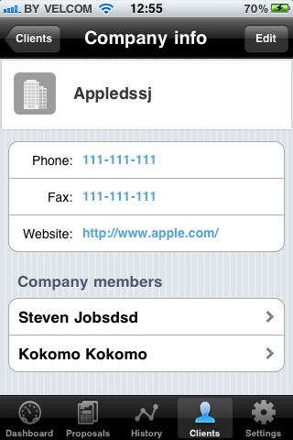
QuoteRoller
Description:
This mobile application provides an easy way to create and manage proposal оn www.quoterroller.com
Technologies:
XCode, Versions, TouchXML, QuartzCore Framework, CoreData, MessageKit, MediaPlayer, EventKit

