Slide 1
Conception
Presented by Dmitri Shuralyov

Slide 2
My personal development history
Game development Tools
BASIC C++ Go
2000 2013
2000 2013
Notes:
- Got interested in game development
- A few weeks of BASIC
- 10+ years of C++

Slide 3
The goals
Make software development more awesome!
Faster
Why require 3 steps when 1 will do?Why require any action at all when 0 steps will do?
Easier
For beginners and pros
Make software more soft (malleable)
Notes:
Get rid of the tedious stuff, leave the fun stuff

Slide 4
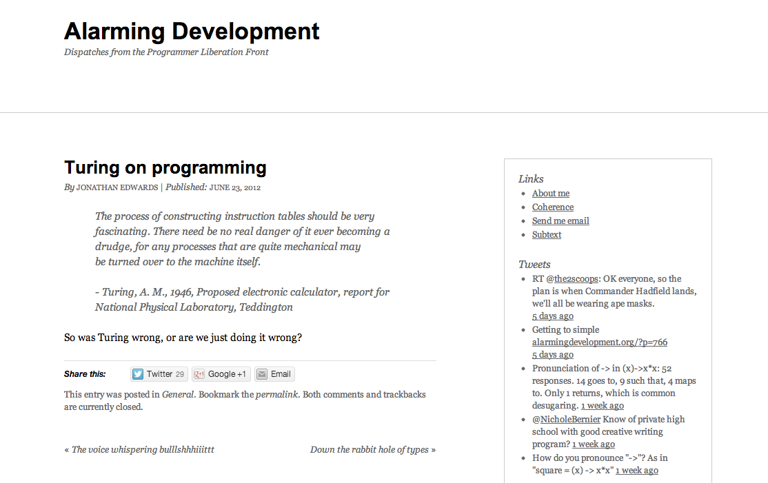
alarmingdevelopment.org/?p=711
Notes:
There's no reason creating apps should be any harder than it would be to describe what you want to a very competent programmer

Slide 5
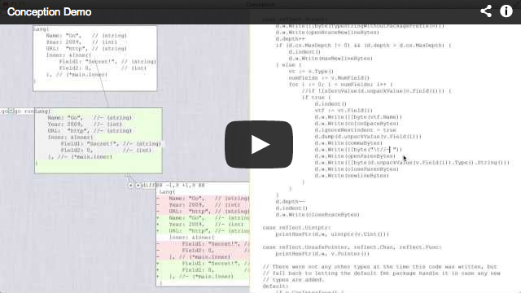
What is Conception?
github.com/shurcooL/Conception#demonstration
Notes:
Open source, simple IDE that anyone can change. Tries to combine best of IDEs and command-line tools.

Slide 6
Design vs. Implementation
Design
The main thing that matters
It specifies the look, feel, behaviour of your app
Implementation
It makes your design run on the computer
It shouldn't be important nor hard

Slide 7
What Conception really is
An evolving set of guiding principles that I believe will get us closer to the goal
One key guiding principle
Implementing Conception is about finding out whether certain ideas work or not

Slide 8
What's great about software?
Ability to create
Capacity and ease of change
Any downside is an opportunity to improve
Notes:
"When things are written in stone in software" I get really sad.

Slide 9
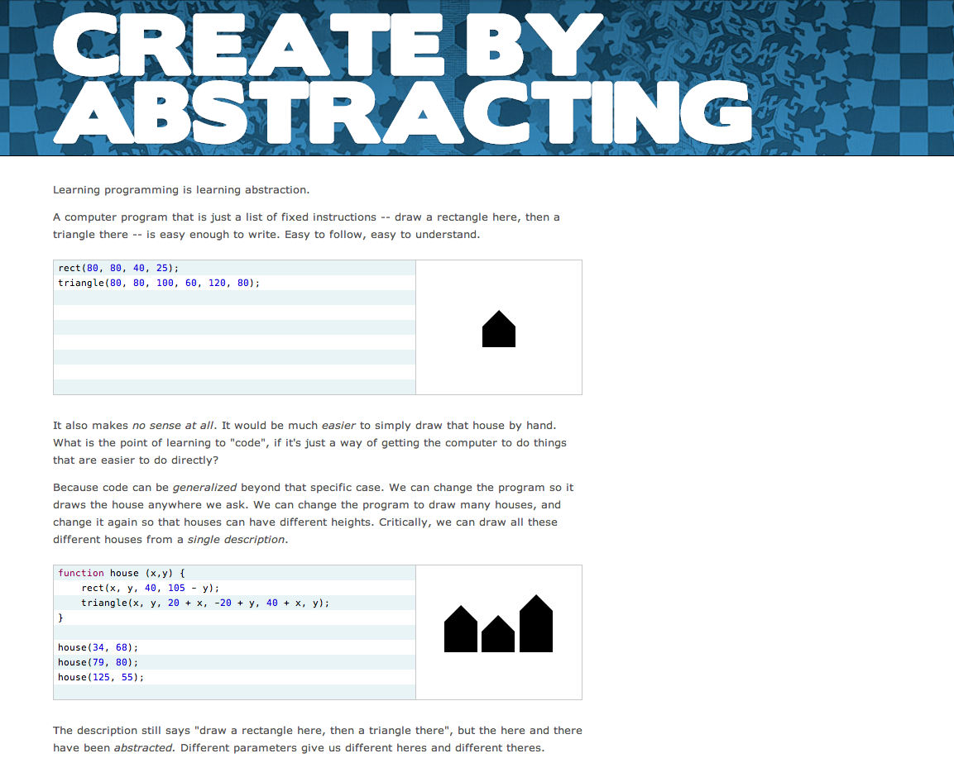
worrydream.com/LearnableProgramming/
Notes:
Create by rapid prototyping first, abstracting second
- "Start constant, then vary"
- "Start with one, then make many"

Slide 10
Blank slate
Progress
Capacity for change

Slide 11
After rapid prototyping
Progress
Capacity for change

Slide 12
Enter refactoring!
Progress
Capacity for change

Slide 13
A hurdle to tackle
Imagine you have a function that does the same thing in multiple projects
You decide to improve it
Notes:
" I really dislike doing the same work more than once"

Slide 14
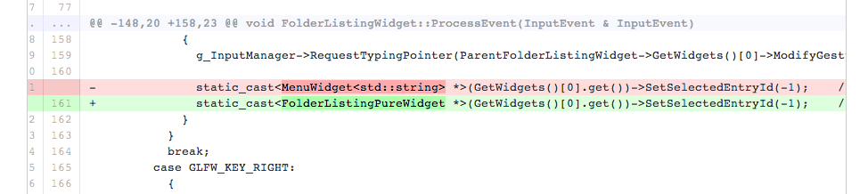
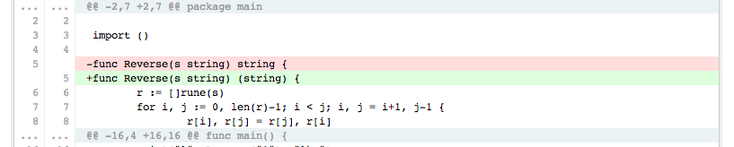
github.com
gist.github.com

Slide 15
Code duplication is bad
To improve X, you have to improve it in multiple places
If you forget to change all instances of X, you'll create inconsistency bugs
When you see duplicated code, you will not even want to touch it, so it will remain unimproved

Slide 16
DRY

Slide 17
Don't Repeat Yourself
Duplication of efforts
I really dislike having to do the same work more than once
Duplication of code
I really dislike having to manually change the value of one decision in more than one place
(Automatic duplication is fine: backups, cache)
Notes:
Some repetition is okay, as long as it's automated (backups, cache, etc.).
Manual duplication is bad.

Slide 18
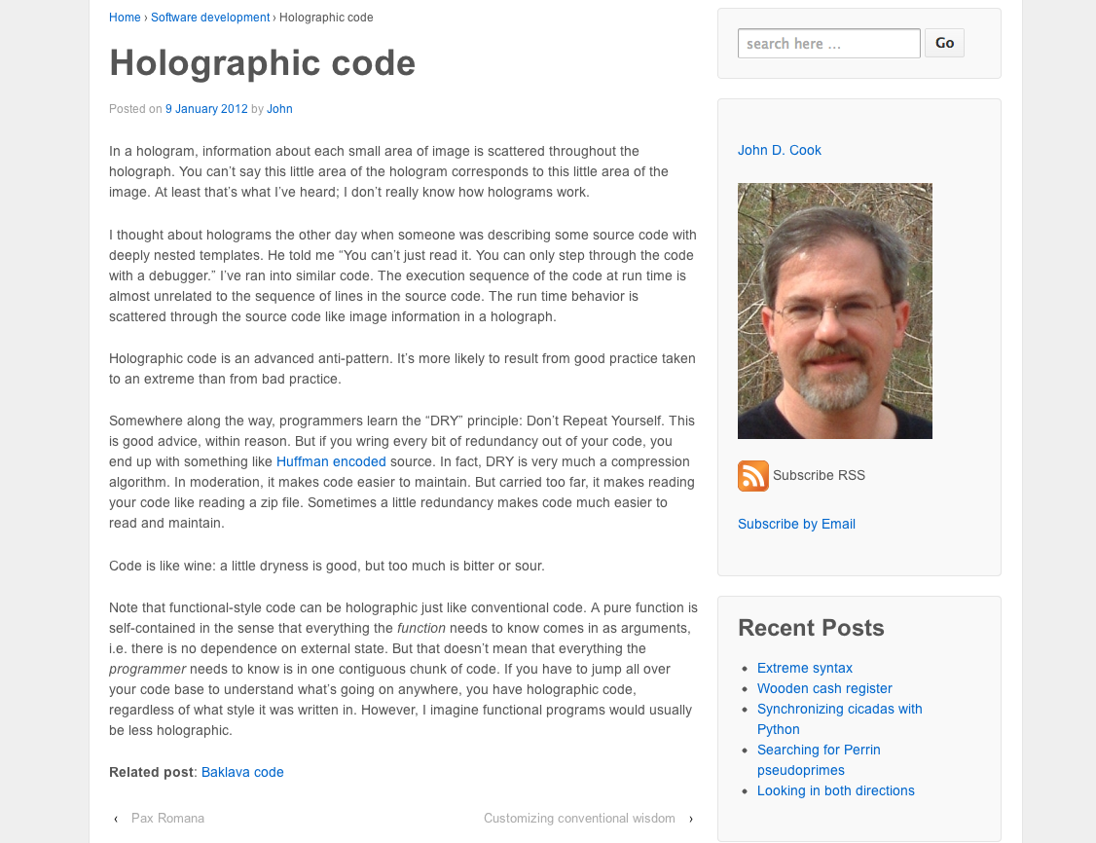
www.johndcook.com/blog/2012/01/09/holographic-source-code/
Notes:
"A little dryness is good, but too much is bitter"

Slide 19
Tools
Tools can enable one to work in a fundamentally different way
Create fundamentally new things
Notes:
Bret Victor has shown great examples of this

Slide 20
Transformative tools
Text editors (with copy and paste)
Version control systems (git)
Compilers

Slide 21
Insight
Everything of value is made up of other things of value
Value can be represented as composition of dependencies
(There's value in your private helper code, expose it!)

Slide 22
Pure functions
They make their dependencies and side-effects explicit
Any non-pure function can be rewritten as pure

Slide 23
Software as Lego
Software can be made up of pure functions that are reused across projects

Slide 24
Dependencies
Dependents
Code
Notes:
Live feedback is possible. See how your changes propogate to dependents.

Slide 25
Live view
Live view
Live view
Stored truth

Slide 26
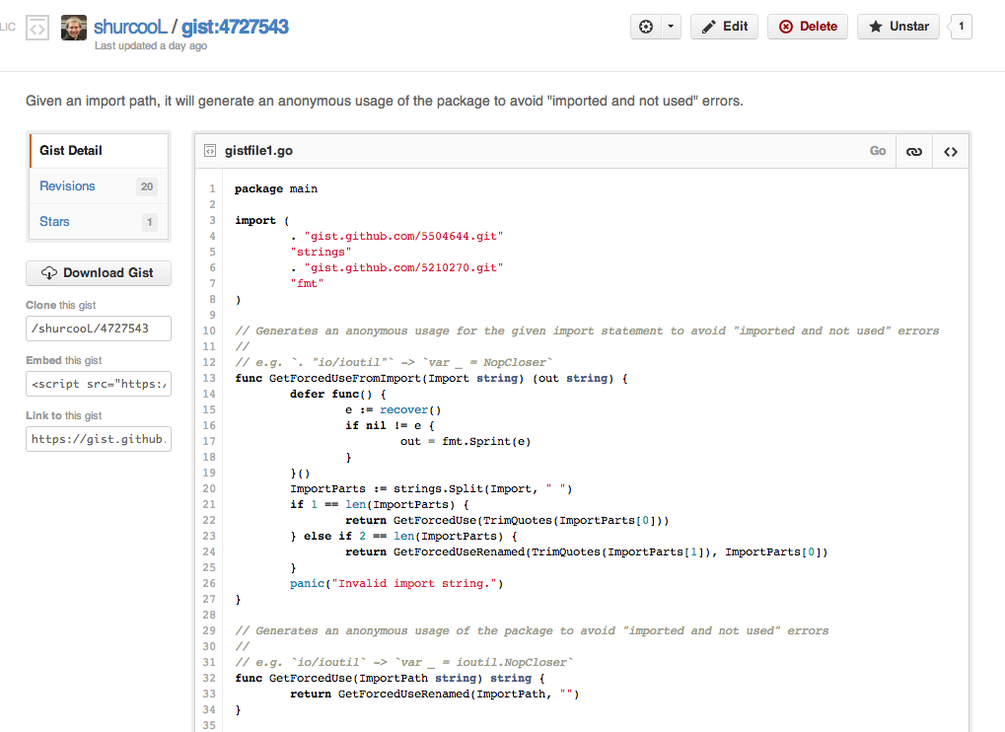

Slide 27
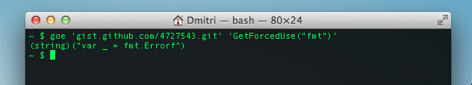

Slide 28
The dream
Wikipedia-like home for pure functions; software uses them
Improve any function and you're making all software that relies on it (directly or indirectly) better
(Make a function worse, and there's no harm to others)

Slide 29
Thank you!
github.com/shurcooL/Conception
Dmitri Shuralyov
twitter.com/shurcooL
github.com/shurcooL
shurcooL@gmail.com

