Slide 1

ROCKBUSTER Data Analysis
File created on: 4/5/2024
Kasun Daundasekara

Slide 2
Project Overview
Rockbuster Stealth LLC is a movie rental company that used to have stores around the world. Facing stiff competition from streaming services such as Netflix and Amazon Prime, the Rockbuster Stealth management team is planning to use its existing movie licenses to launch an online video rental service in order to stay competitive.
Tools Used: PostgreSQl, Tableau
URL to Tableau Public : ROCKBUSTER | Tableau Public

Slide 3

Key Questions and Objectives:
Revenue Impact by Movie: Identify the movies that have had the greatest and least impact on revenue generation. This includes examining factors contributing to their performance.
Rental Duration Insights: Determine the average rental duration across all video titles in our inventory, and identify any significant patterns or outliers in rental behavior.
Customer Geographic Distribution: Map out the geographic distribution of Rockbuster customers, pinpointing the countries where our customer base is concentrated.
High-Value Customer Locations: Ascertain the geographic locations of customers who have demonstrated high lifetime value, focusing on identifying potential high-value market regions.
Geographic Sales Variation Analysis: Analyze how sales figures differ across various geographic regions, aiming to understand regional market dynamics and potential areas for strategic focus.

Slide 4
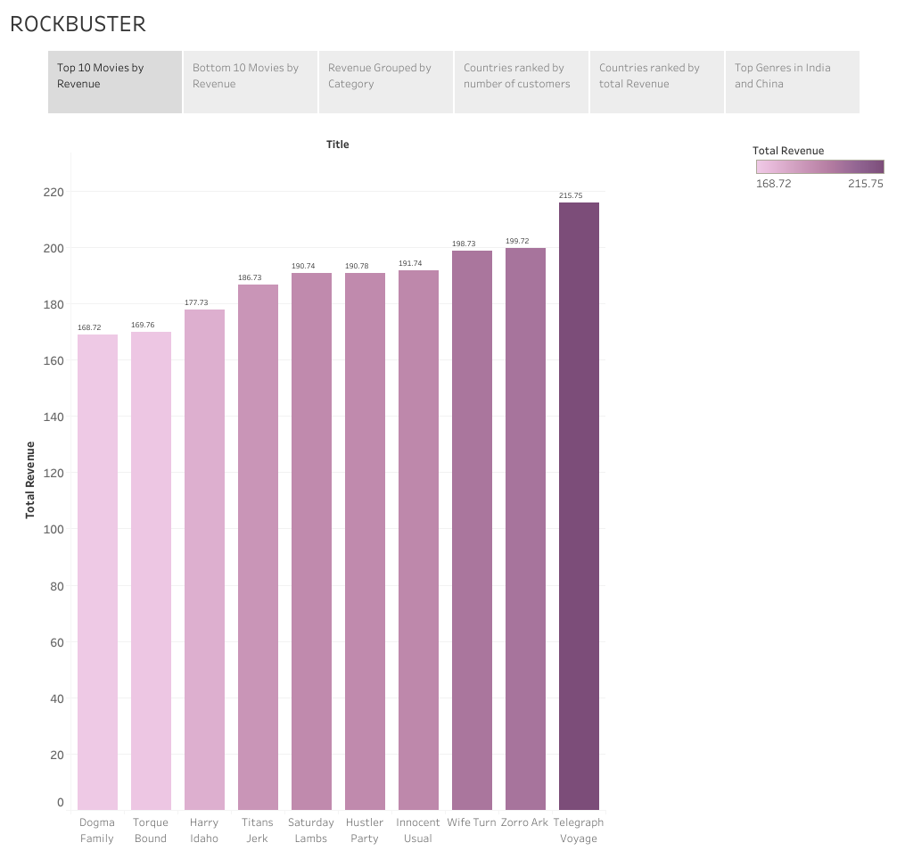
Top 10 Movies with the Greatest Impact on Revenue Generation
Title | Revenue
Telegraph Voyage | $ 215.75
Zorro Ark | $ 199.72
Wife Turn | $ 198.73
Innocent Usual | $ 191.74
Hustler Party | $ 190.78
Saturday Lambs | $ 190.74
Titans Jerk | $ 186.73
Harry Idaho | $ 177.73
Torque Bound | $ 169.72
Dogma Family | $ 168.72

Slide 5
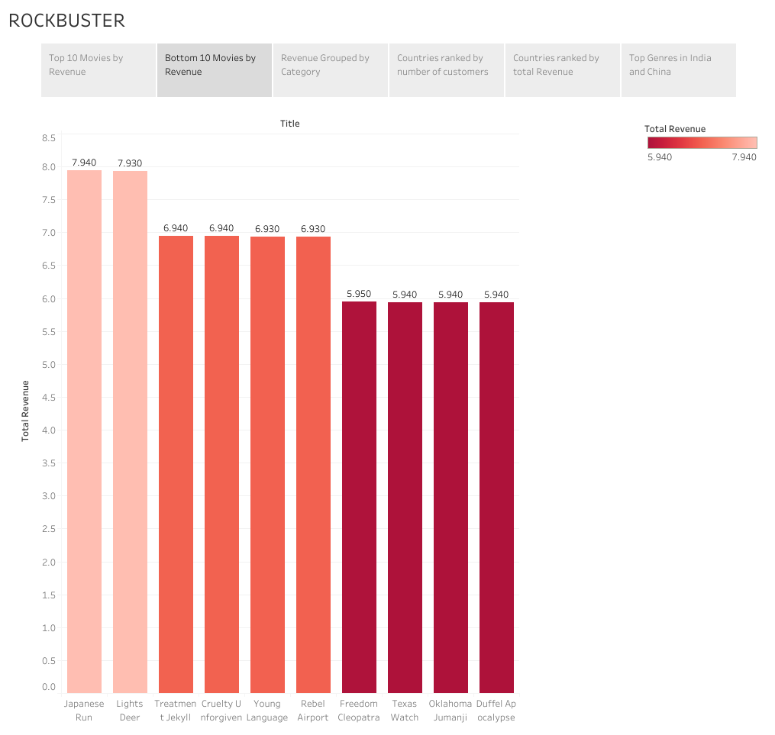
Bottom 10 Movies with the Least Impact on Revenue Generation
Title | Revenue
Duffel Apocalypse | $ 5.94
Oklahoma Jumanji | $ 5.94
Texas Watch | $ 5.94
Freedom Cleopatra | $ 5.95
Young Language | $ 6.93
Rebel Airport | $ 6.93
Treatment Jekyll | $ 6.94
Cruelty Unforgiven | $ 6.94
Lights Deer | $ 7.93
Japanese Run | $ 7.94

Slide 6
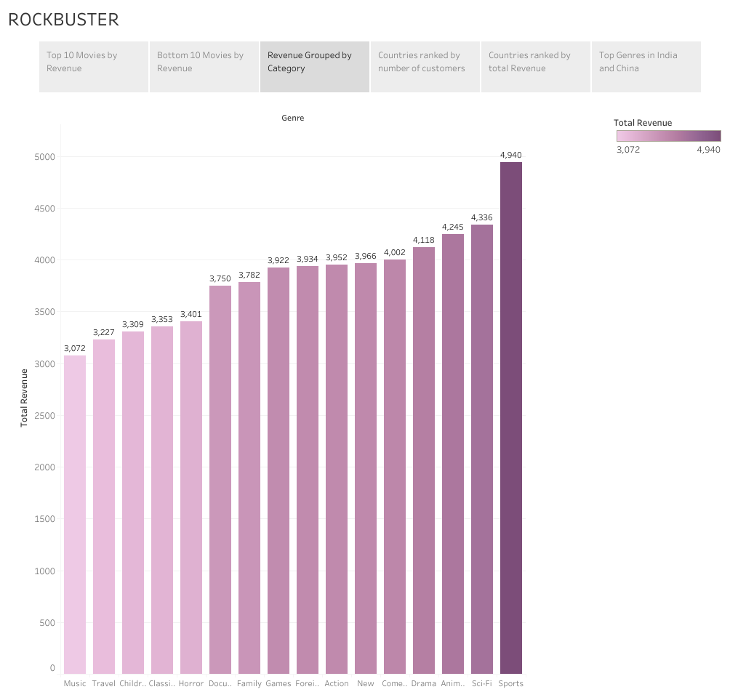
Total Revenue Grouped by Category
Top 5
Sports
Sci- Fi
Animation
Drama
Comedy
New
Action

Slide 7
Average,Maximum,and Minimum
Avg rental duration | 5 Days
Avg rental rate | $ 2.98
Avg length | 115.27
Avg replacement cost | $ 19.98
Min rental duration | 3 Days
Min rental rate | $ 0.99
Max rental duration | 7 Days
Max rental rate | $ 4.99

Slide 8
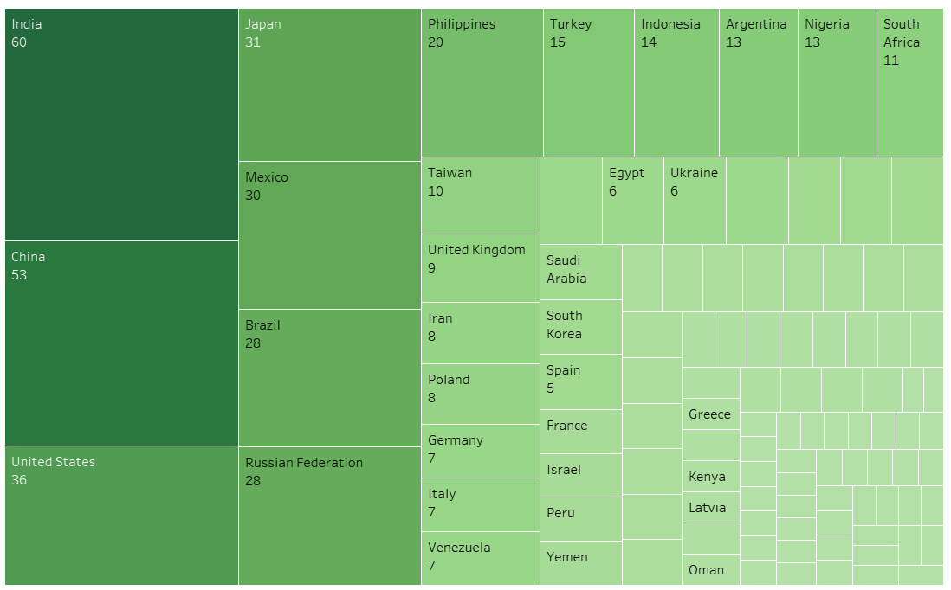
Countries ranked by Number of customers
Country | Number of Customers
India | 60
China | 53
United States | 36
Japan | 31
Mexico | 30
Brazil | 28
Russian Federation | 28
Philippines | 20
Turkey | 15
Indonesia | 14

Slide 9
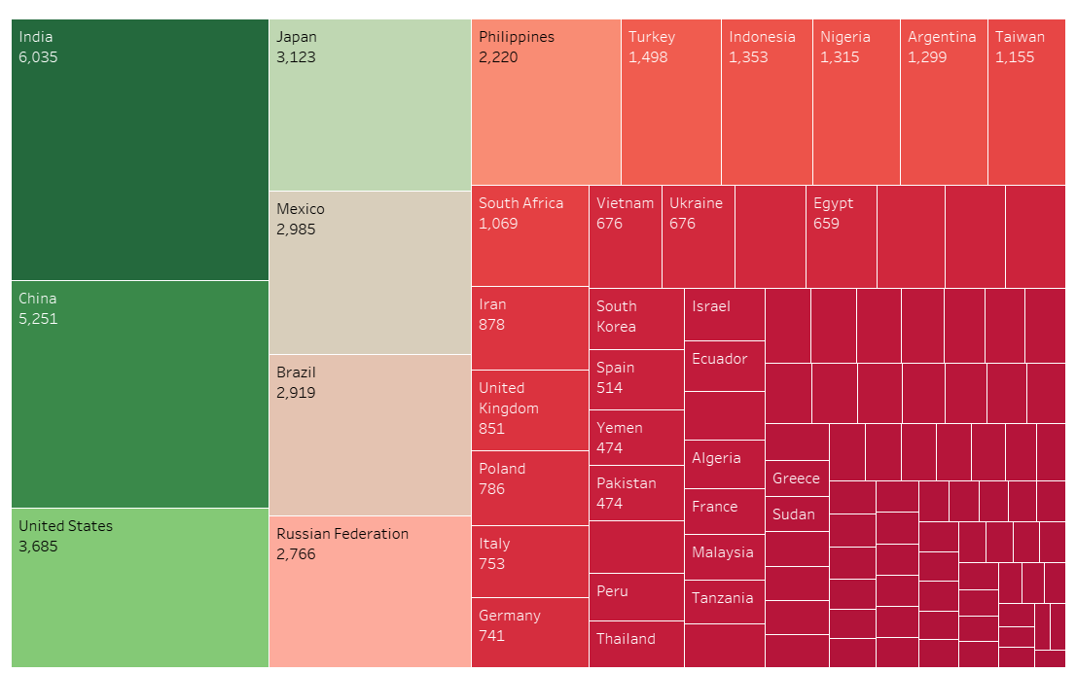
Countries ranked by Total Revenue
Country | Revenue
India | 6,035
China | 5,251
United States | 3,685
Japan | 3,123
Mexico | 2,985
Brazil | 2,919
Russian Federation | 2,766
Philippines | 2,220
Turkey | 1,498
Indonesia | 1,353

Slide 10
Top Customers from the Top 10 Cities, Sorted by Payment Amount
city | country | Customer Name | Total payments
Apeldoorn | Netherlands | Rhonda Kennedy | $ 191.62
Cape Coral | United States | Karl Seal | $ 208.58
London | United Kingdom | Cecil Vines | $ 115.74
London | United Kingdom | Mattie Hoffman | $ 58.8
Memphis | United States | Ana Bradley | $ 167.67
Molodetno | Belarus | Clara Shaw | $ 189.6
Qomsheh | Iran | Tommy Collazo | $ 183.63
Richmond Hill | Canada | Curtis Irby | $ 167.62
Saint-Denis | Runion | Eleanor Hunt | $ 211.55
Santa Brbara dOeste | Brazil | Marion Snyder | $ 194.61
Tanza | Philippines | Marcia Dean | $ 166.61

Slide 11
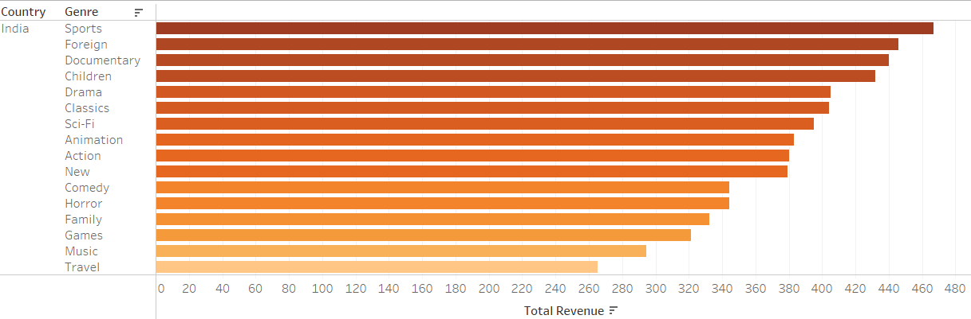
Top Genres in India

Slide 12
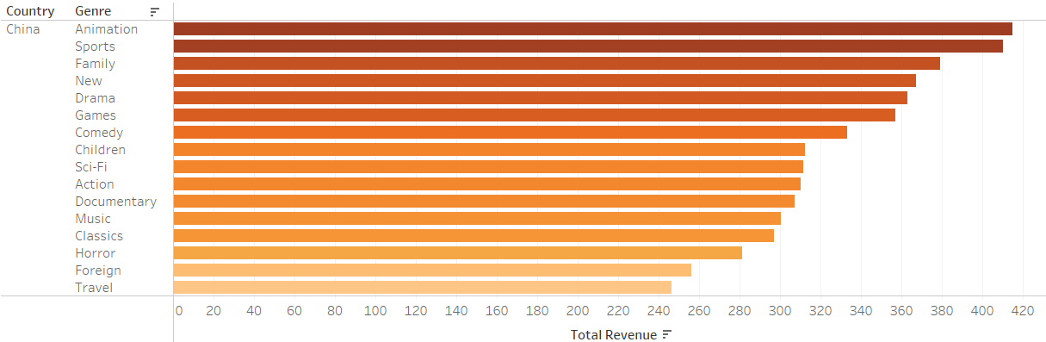
Top Genres in China

Slide 13
Recommendations
Targeted Marketing: Use the data to focus marketing efforts on high-value customers or regions that show a higher payment volume.
Customer Relationship Management: Develop personalized strategies for maintaining and enhancing relationships with top customers to ensure loyalty and continued business.
Expansion Opportunities: Identify potential for growth in regions that have top customers with significant payment amounts.
Product and Service Development: Understand customer preferences in terms of payments to tailor products and services accordingly.
Performance Benchmarks: Set benchmarks for other cities or customers based on the performance of the top customers.

Slide 14
Recommendations
Market Focus and Investment: Concentrate investment and marketing efforts in countries with the highest revenues, such as India and China, as they seem to be your biggest markets.
Competitive Analysis: Perform a detailed competitive analysis in the top revenue-generating countries to understand your market position and to identify opportunities for gaining market share.
Local Partnerships: In countries where local regulations or cultural nuances are significant, consider partnerships with local movies, and TV series to enhance market penetration.

Slide 15
Summary
As Rockbuster Stealth LLC contends with the rise of streaming services, the company is pivoting from its traditional store-based movie rental model to launch an online video rental service. This strategic shift aims to leverage Rockbuster's extensive movie license library to tap into the growing demand for digital media consumption. The focus is on understanding customer behaviors and preferences, such as rental durations and preferred genres, especially in key markets like India and China, which have emerged as major customer hubs. Through data-driven insights, Rockbuster plans to refine its content offerings, tailor marketing approaches, and enhance user experiences to secure a competitive position in the online entertainment market.

