Slide 1
Data –> Dashboards
By David Lurth

Slide 2
Example from Nature
https://www.youtube.com/watch?v=bsCaFSVRls8

Slide 3
What I learned:
It’s a lot farther down than I thought
I had no chance of “flying” on my first try
A whole new world opened up
I’m in a better position to reach my potential

Slide 4
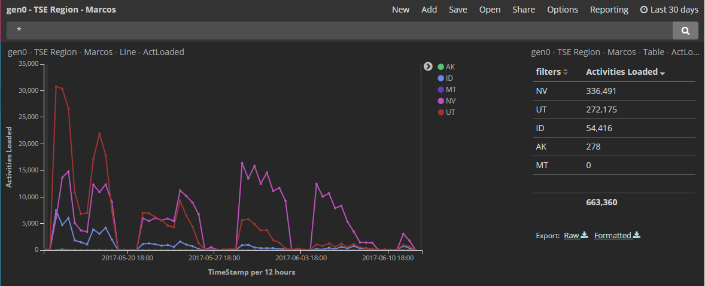

Slide 5
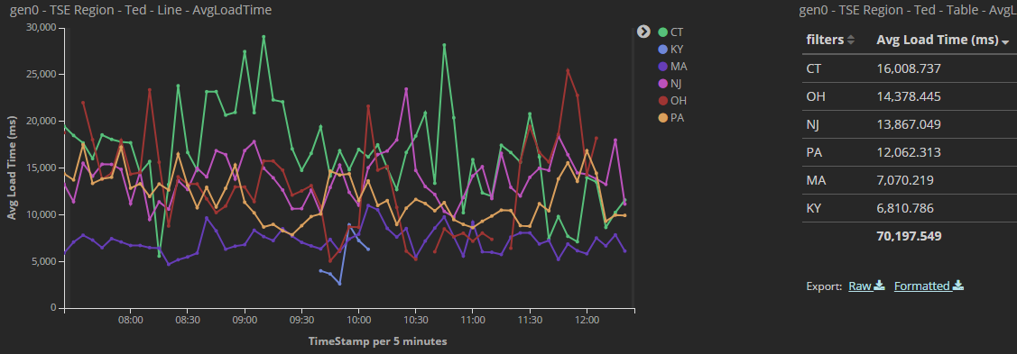

Slide 6
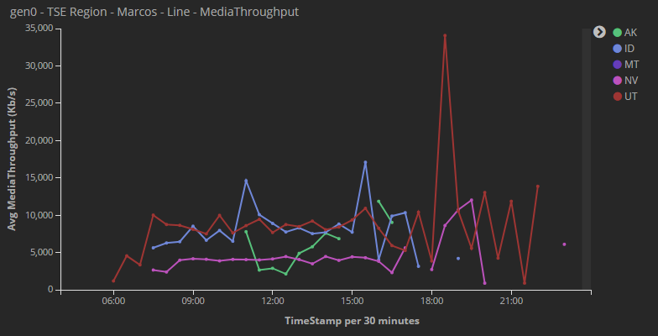

Slide 7
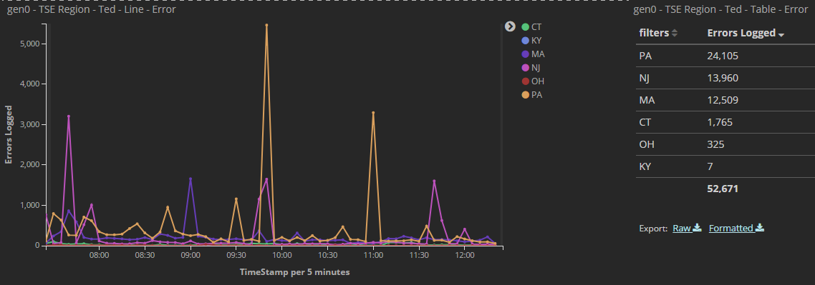

Slide 8
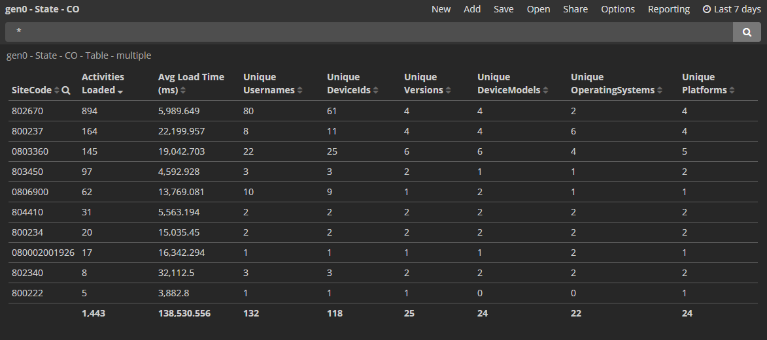

Slide 9
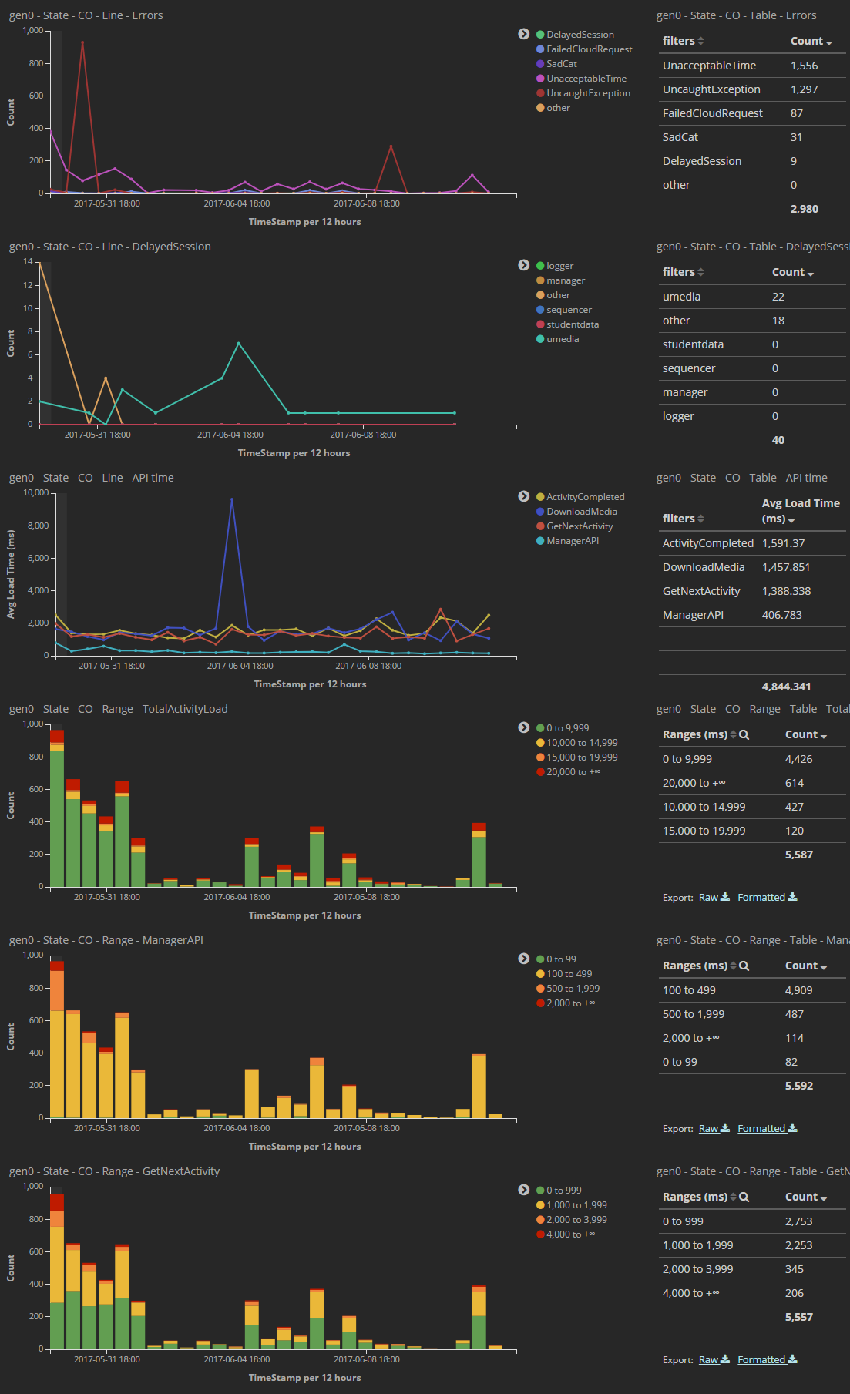

Slide 10
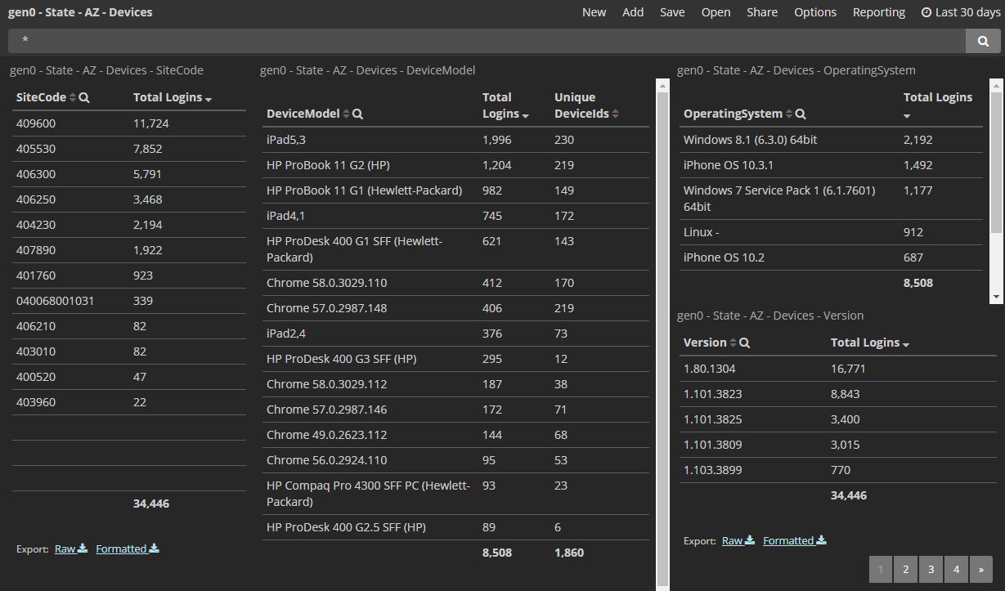

Slide 11
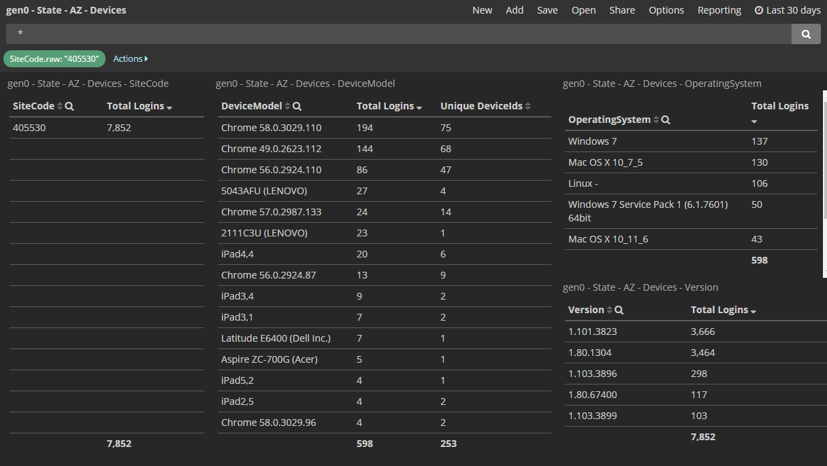

Slide 12
Have fun exploring the data!!!

