Slide 1
Disaster Recovery Program Overview
Devon Manelski

Slide 2
Agenda
Overview
Use Cases
Metrics
Lifecyle
Design
Documentation
Infrastructure Standup
Prep Tasks
Exercise
Roadmap

Slide 3
| Overview
Applications
Application 1
Application 2
App Owner: R Matthews Architect: J Smith TPM: K Long
Application | App Lead | DevOps | DBA
Application 1
Application 2
* A WKDR Program Representative is required to observe DR Exercise Execution (specifically UC2/3 and UC4.)
3
Notes:
3

Slide 4
| Use Cases
Use Case 1 (High Availability) | Use Case 2 (Site Disaster Recovery) | Use Case 3 (Alternate Hosting) | Use Case 4 (Data Corruption) | Use Case 5 (Volumetric Attack)
App & DB Layer | Same Hosting Site (AWS) | Cross Cloud Hosting Site (AWS->Azure) | App & DB Layer | WAF Documentation Only
Use Case 1 is the testing of High Availability application and database systems by bringing down the primary and switching over to the secondary.
Use Case 2 is the Failover/Failback use case where the application is moved from the primary hosting site to the DR hosting site when the hosting sites are with the same hosting provider: AWS Virginia -> AWS Ohio. Only Failover timing is recorded for RTA.
Use Case 3 is the Failover use case where the application is moved from the primary hosting site to the DR hosting site when the hosting sites are provided by different providers: AWS -> Azure. This is sometimes referred to as cross cloud hosting sites. Only Failover timing is recorded for RTA.
Use Case 4 is the Data Corruption Use Case where data is deleted or corrupted on the application server and in the application database. The restoration of that data from backups is tested and timed.
Use Case 5 is the requirement to provide evidence of security defense against a volumetric (DDOS) attack.
4
Notes:
4

Slide 5
| Metrics
Recovery Point Objective (RPO) - Recovery Point Objective is the maximum amount of data loss that would be acceptable to an organization in a Failover, Failback, Data Corruption event.
Recovery Time Objective (RTO) - Recovery Time Objective is the maximum length of time a computer, system, network, or application can be down following a failure, i.e. Failover, Failback, Data Corruption.
Recovery Point Achieved (RPA) - Recovery Point Actual measures the real data loss when this happens, which is usually based on the data lost between the failure and when the last backup was made.
Recovery Time Achieved (RTA) - Recovery Time Actual is the recorded amount time in which a given Disaster Recovery Event is executed, i.e. Failover, Failback, Data Corruption.
The metrics are the measure of pass or fail for your DR Exercise. RPO & RTO are the thresholds that you have agreed upon with the business. RPA & RTA are the actual recorded times during your DR Exercise. RPA & RTA cannot exceed RPO & RTO in order to receive approval from the WKDR Governance Program.
5
Notes:
5

Slide 6
| Disaster Recovery Lifecycle
Identify 3 Dates and Confirm Resources
Complete DR Design
Conduct Tabletop Exercise
Go-No Go Meeting
Conduct DR Exercises
Submit Post Exercise Report
Complete DR Documentation
Standup Infrastructure
Complete Prep Tasks
6
Notes:
6

Slide 7
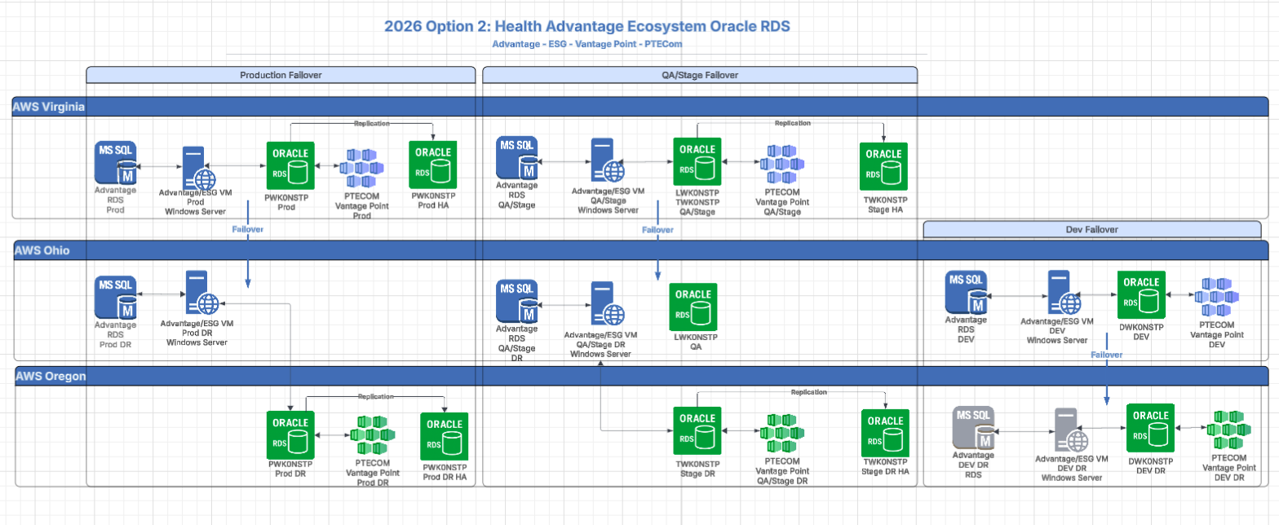
| Disaster Recovery Design (Advantage Ecosystem Example)
7
Notes:
7

Slide 8
| Documentation
Generic Templates
Document | Owner
Technical Recovery Procedure | DevOps + App Leads
Application Recovery Procedure | App Leads
Application Verification Procedures | QA
Business Impact Assessment | App Owner/App Manager
Disaster Recovery Plan | App Owner/App Manager?
Solution Design Document | Architect/App Leads
Hour By Hour Plan | TPM + Team
Disaster Recovery Questionnaire* | App Owner/App Manager
Data Corruption Procedure | Business Analyst + App Leads
¹ For DRQ, close out last years questionnaire observations and then respond to this year’s questions. ² There are some generic templates located here (you will most likely have to request access). Generic DR Templates
8
Notes:
8

Slide 9
| Infrastructure Standup and configuration
Standup of Required Application Infrastructure: VM, CaaS Node, etc
Standup of Required DB Infrastructure
Deployment of Application Code to DR Infrastructure
Deployment of Database Schema’s to DR Infrastructure
Configure Servers and Databases as Required, i.e. backups and replication of backups.
Network Configuration, i.e. Firewall Rules
9
Notes:
9

Slide 10
| prep Tasks
Confirm App and DB Backups are Working, On Schedule and Replicating
Confirm Load Balancer Configuration and Post Failover/Failback Recovery
Validate Application to DB Connectivity, If Possible
Refresh Databases If Required
Create Any Rainier Tickets for Any Exercise Support Required, i.e. CMS Wintel
Confirm All Credentials Will Be Available Such As Breakglass Accounts
Test Automation Scripts
Confirm That All DNS’s Can Be Repointed Post-Failover/Failback
10
Notes:
10

Slide 11
| DR Exercise
Task | Owner
Execute Hour By Hour Plan | Team
Collect Evidence and Upload | Team
Track Time in Clicktime | Team
Record RTA & RPA For The Exercise | TPM
11
Notes:
11

Slide 12
| Roadmap (Boilerplate Example)
i.e. Cross Cloud Failover/Failback
?
?
Approximate Timing: Q1 2026 – Q2 2028
12
Notes:
12

Slide 13
Thank you
13
Notes:
13

