Slide 1
iMaterialist Fashion Challenge
Ryan Thangavelu, Diego Magdaleno,
Mattheo Ioannou, Emmett Greenberg
Notes:
This is the opening slide, just say what our group is and who is in it

Slide 2
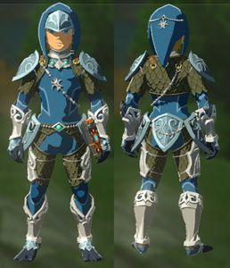
What Did We Do?
We wanted to take an image of a piece of clothing
And try to provide labels describing it.
Blue
Armor
Fishy
Waterproof
Notes:
We want to take a picture of clothing *click*. Then determine what it is,*click* so we can label it

Slide 3
Why Are We Doing This?
To Quote the Kaggle competititon
  As shoppers move online, it would be a dream come true to have products in photos classified automatically. But, automatic product recognition is tough because for the same product, a picture can be taken in different lighting, angles, backgrounds, and levels of occlusion. Meanwhile different fine-grained categories may look very similar, for example, royal blue vs turquoise in color. Many of today’s general-purpose recognition machines simply cannot perceive such subtle differences between photos, yet these differences could be important for shopping decisions.
  In Layman's terms, this project has broad commercial applications
Notes:
DO NOT READ OFF THIS SLIDE
In simple terms labeling clothing is slow and we don't want to do it, but labeling clothing with computers is hard.
On a more serious note labels are difficult to generate (as right now the most reliable way is to just use a human) And having a computer do it opens up several uses, such as taking a picture of clothing to find the keywords you need to search for it, of having an online marketplace that automatically classifies clothing making it easy for shoppers to find.

Slide 4
Problems
We need to find an arbitrary number of labels.
Differences are not always obvious, even to a human.
Backgrounds can change how things appear.
Lighting conditions can change how things are perceived.
The data-set is unbalanced
  All clothing is for women? Sounds about right
Our dataset is huge (366 mB text, 65G picures)
Notes:
There are a series of problems for our little classifier that could though *click*
1) Not all things have the same number of labels, a plain black shirt should have two (Black and Shirt) while Some high fashion could have dozens (sparkly, silver, blue striped, currently on fire ect.) *click*
2) Sometimes even human would have problems, on of these colors is sky blue, can you tell which? (it's the first, the others are cyan)*click*
3) The background make it harder to look at things
*click* there, that's much better, but we lost our bullet point *click*
4) So can lighting, all the gray in this sentence is the same, the first half just has shadows*click*
5) Our dataset is unbalanced, lets be honest, women have fashion, men just have clothes*click*
6) Out dataset is huge, just the urls and labels for the training set is 366 megs, not even counting the pictures, and we had training time measured in weeks*click*

Slide 5
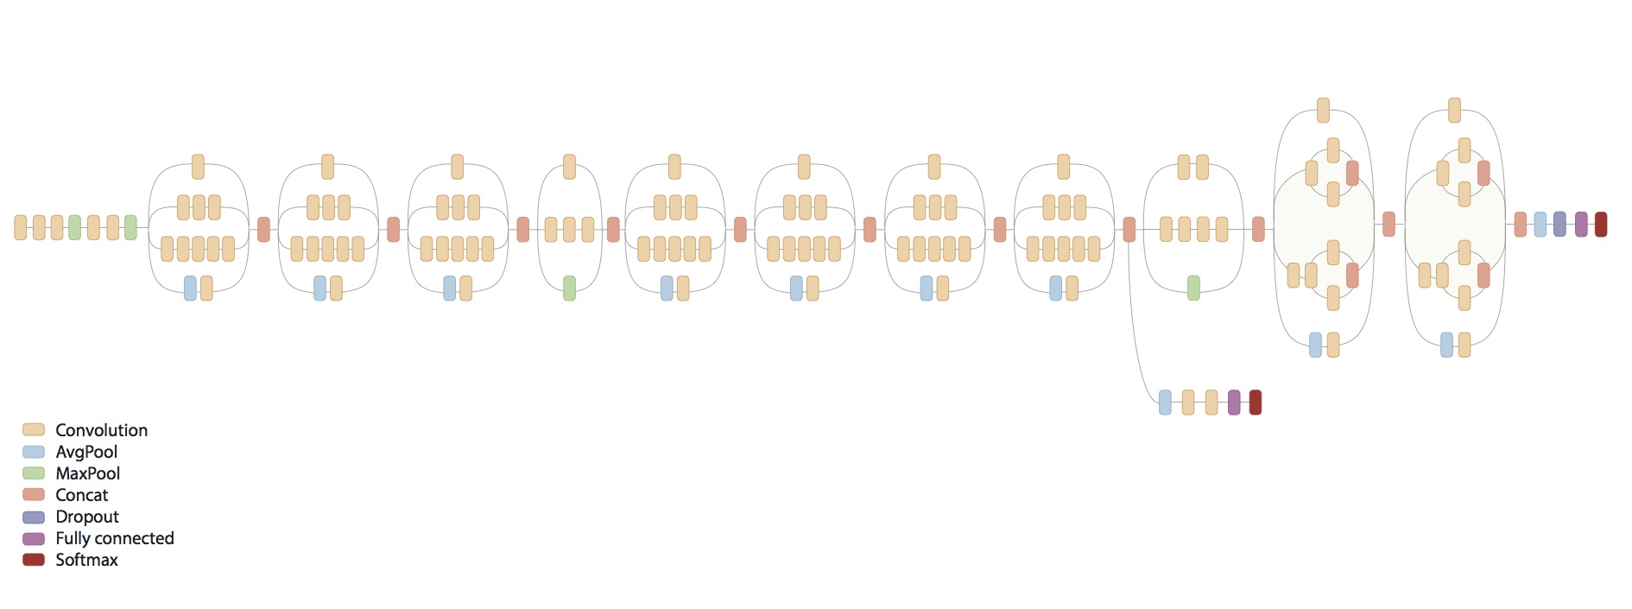
Inception Net V3
*BWWORRRRM*
Notes:
We used a convolution neural network for image recognition called Inception Net V3

Slide 6
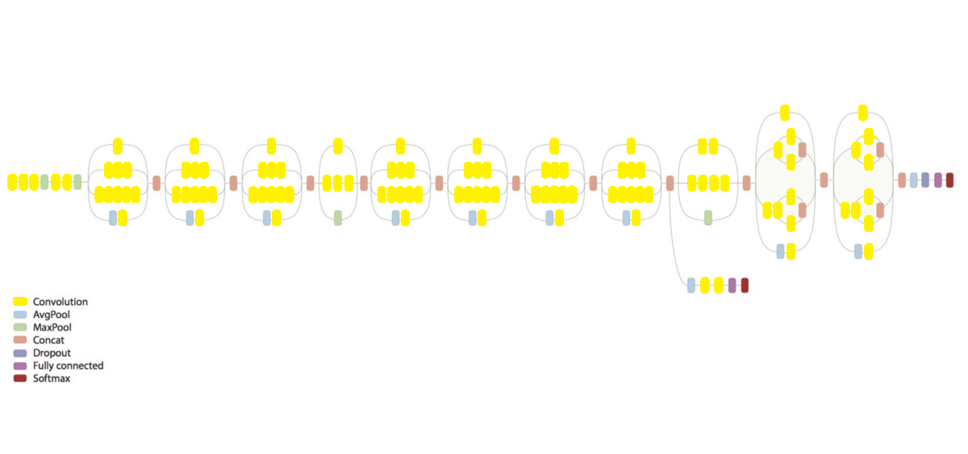
Convolutional

Slide 7
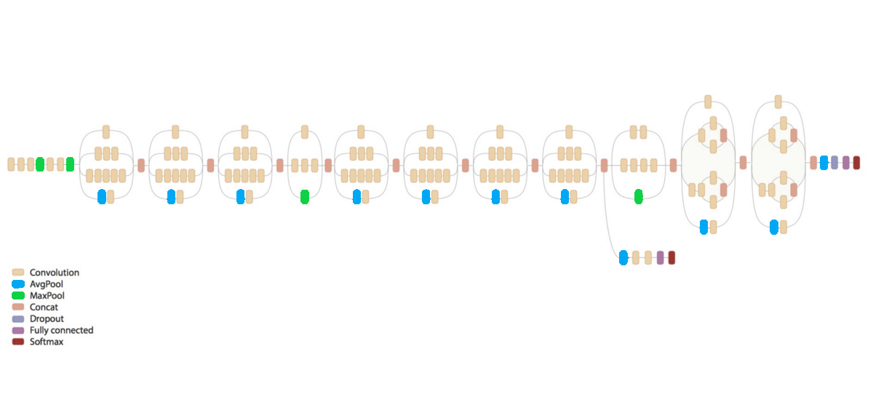
Pooling

Slide 8
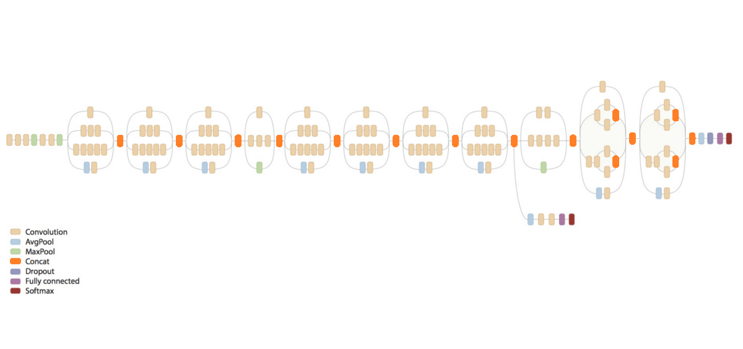
Concatenation

Slide 9
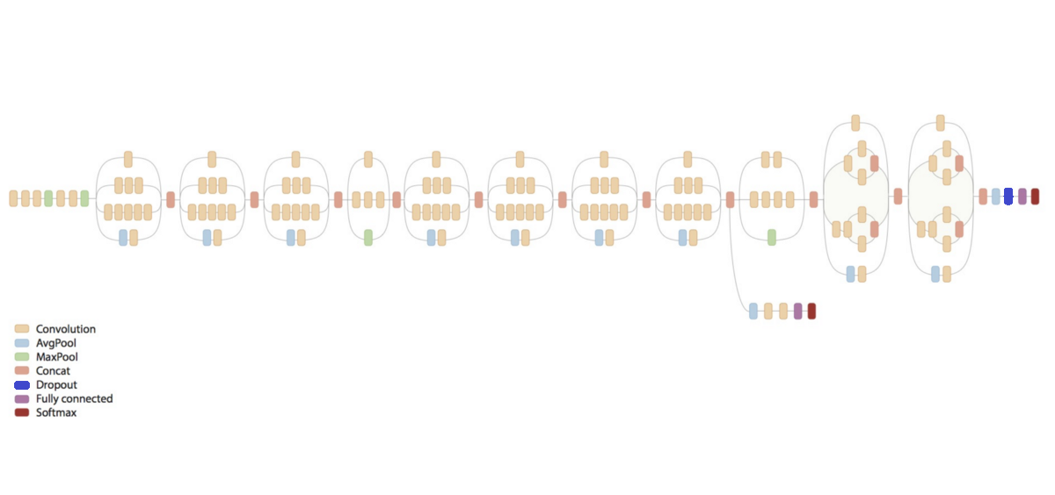
Dropout

Slide 10

Fully Connected

Slide 11
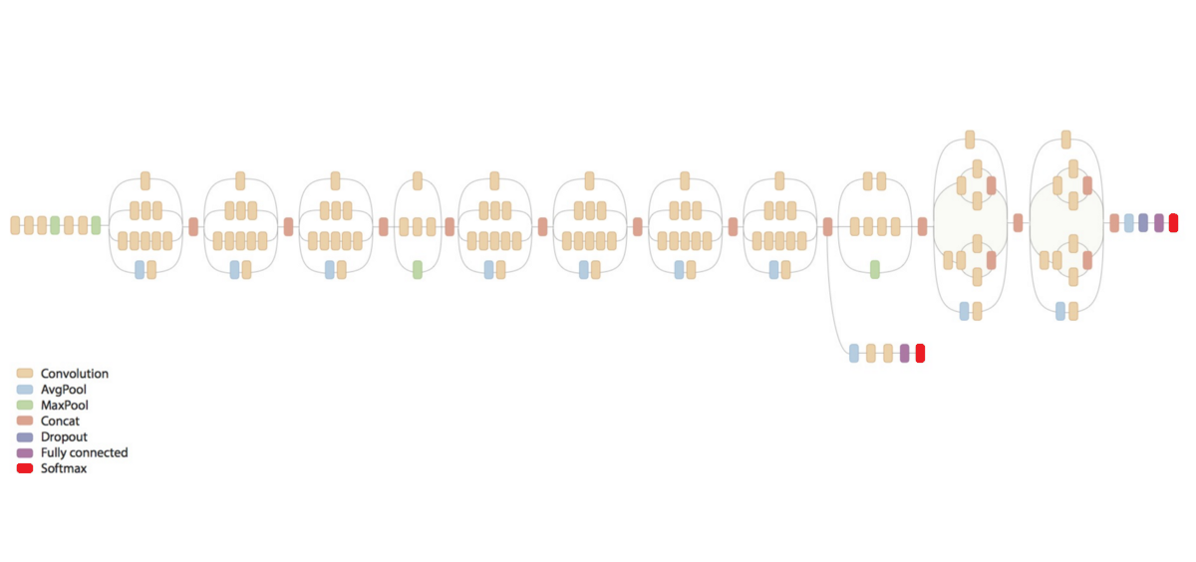
SoftMax

Slide 12
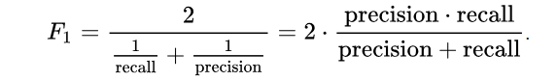
Model evaluation
Used F1 means score to compute our accuracy
Precision = number of correct labels / total labels
Recall = number of correct labels / total correct labels (all the labels that should have been identified)

Slide 13
Results
Iteratively trained multiple graphs with inception net
  Graphs were trained with:
  10K images at 40x40 pixel quality
  10K images at 40x40 pixel quality
  100K images at 299x299 pixel quality
  200K images at 299x299 pixel quality
  300K images at 299x299 pixel quality
  400K images at 299x299 pixel quality
  500K images at 299x299 pixel quality
  1M images at 40x40 pixel quality
  1M images at 299x299 pixel quality (Full, raw, train
  ing set)
  Label accuracy between graphs varied minimally
  10K at 299x299 had an F1 means score of 34% while the 1M at 299x299 had an accuracy of 36%
Graph Trained by # Images (299x299 pixels) | Total Accuracy
10,000 | 34.12%
100,000 | 34.52%
200,000 | 35.52%
300,000 | 35.36%
400,000 | 35.97%
500,000 | 35.81%
1,000,000 | 36.03%
Notes:
We ranked in approximately the top 50% on the Kaggle competition.

Slide 14
What did we learn?
Inception net was not the best model for this project
It was the most readily available model we found for multi-label image labelling
ResNet would have been a potentially better model to use
The training data given was very unbalanced
Attempting to rebalance the data would be a project in itself
Notes:
Inception net was the best thing available to us to use
Data – the distribution of labels was unbalanced, and two of the labels were found in every sample so they were converted to constants

Slide 15
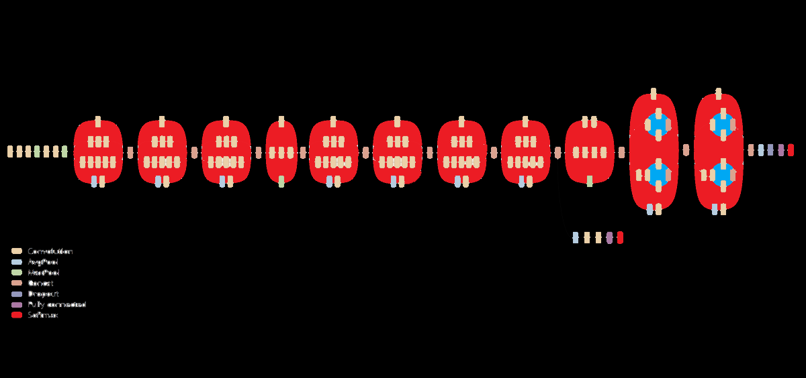
Questions?

