Slide 1


Content analysis with Apache Tika
paolo@apache.org or p.mottadelli@sourcesense.com
Paolo Mottadelli -

Slide 2




















Main challenge
Lucene
index

Slide 3
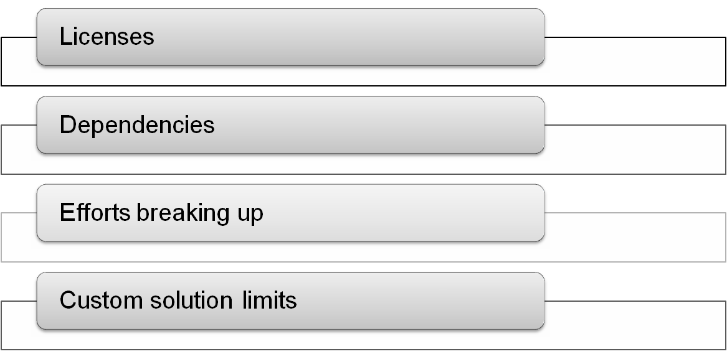
Other challenges

Slide 4
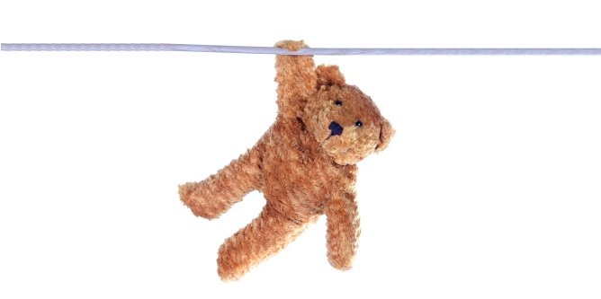
What is Tika?
Another Indian Lucene project? No.

Slide 5
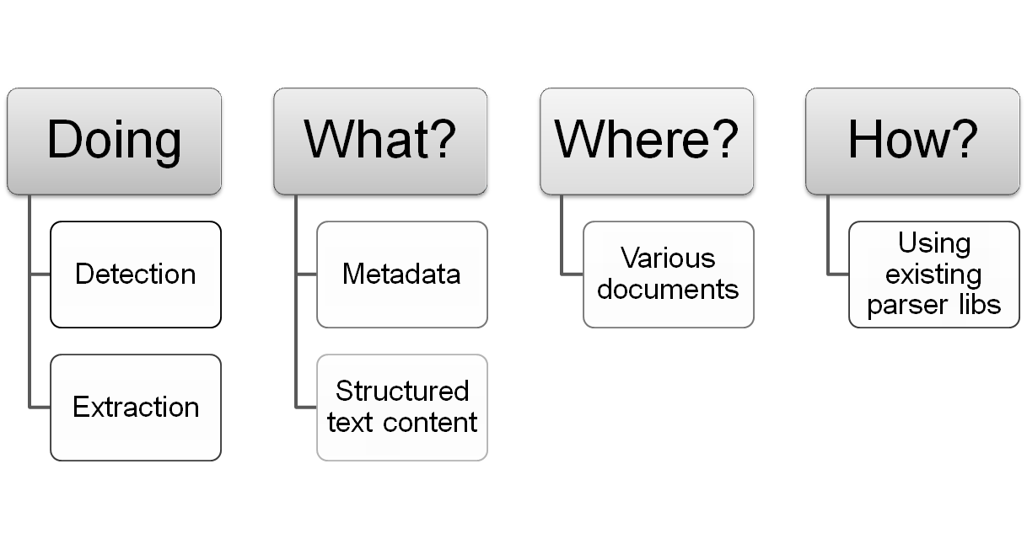
What is Tika?
It is a Toolkit

Slide 6
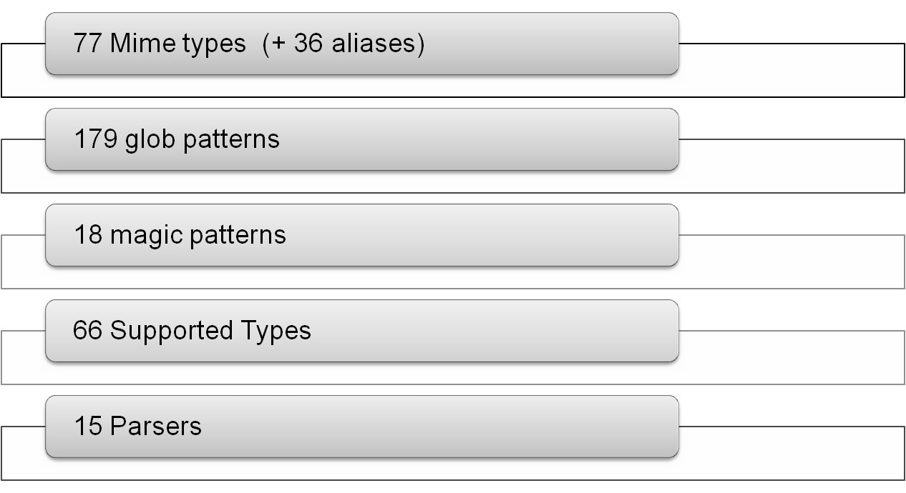
Current coverage

Slide 7
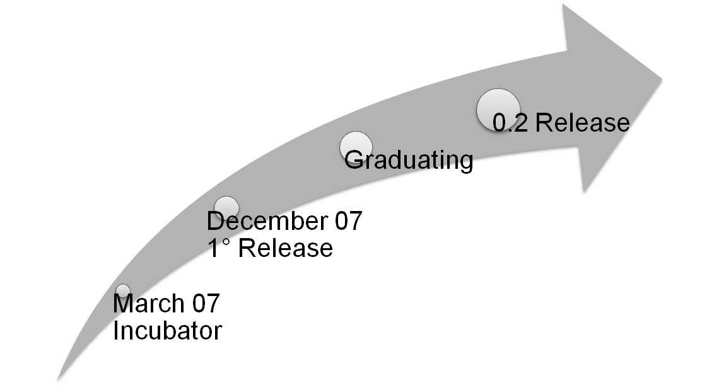
A brief history of Tika
Sponsored by the Apache Lucene PMC

Slide 8
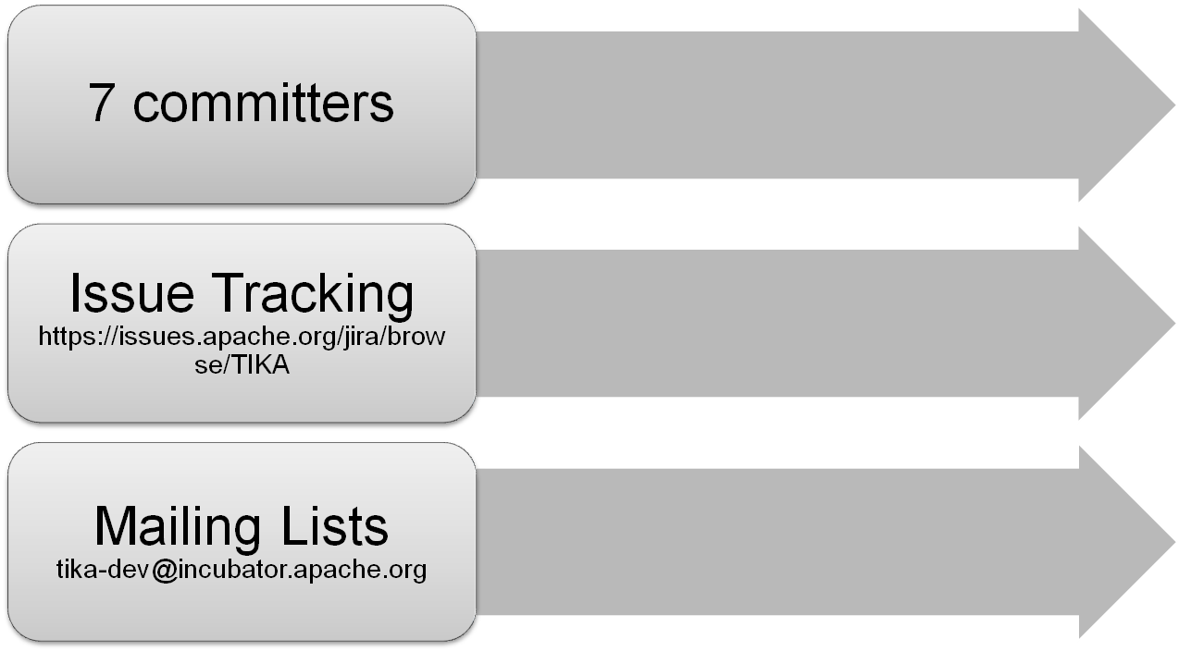

Tika organization
Changing after graduation

Slide 9
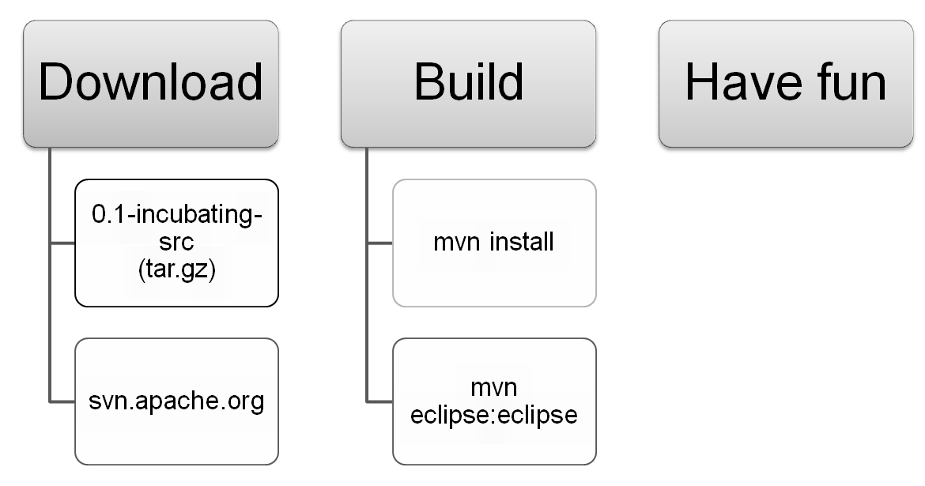
Getting Tika
… and contributing

Slide 10
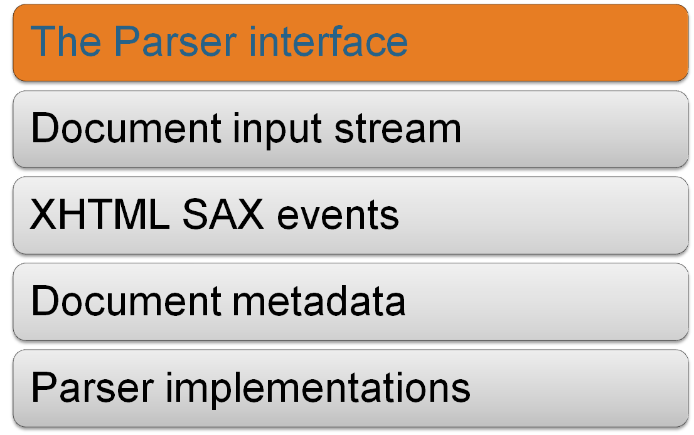
Tika Design

Slide 11
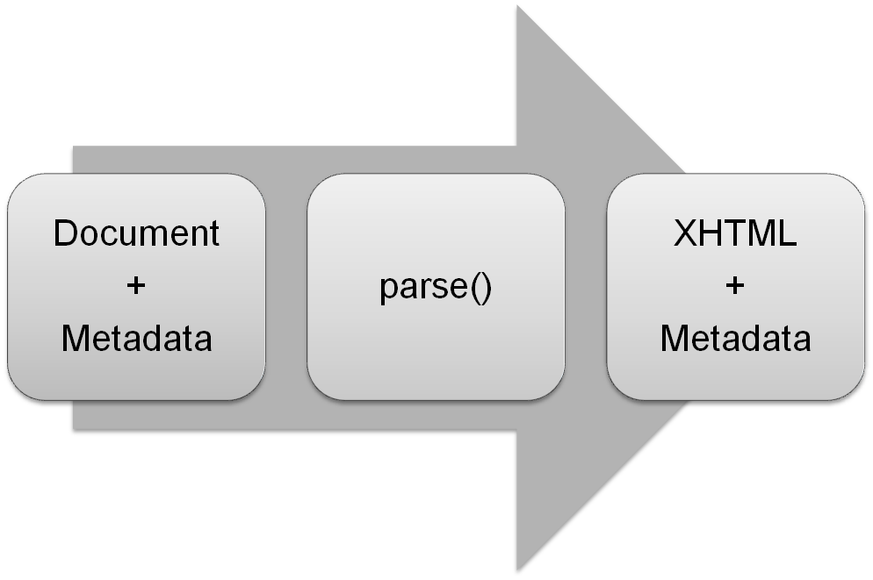
The Parser interface
void parse(InputStream stream, ContentHandler handler, Metadata metadata) throws IOException, SAXException, TikaException;

Slide 12
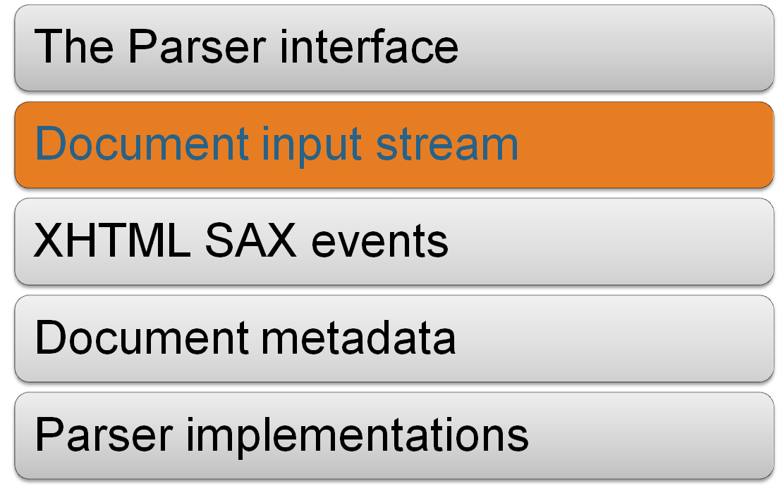
Tika Design

Slide 13
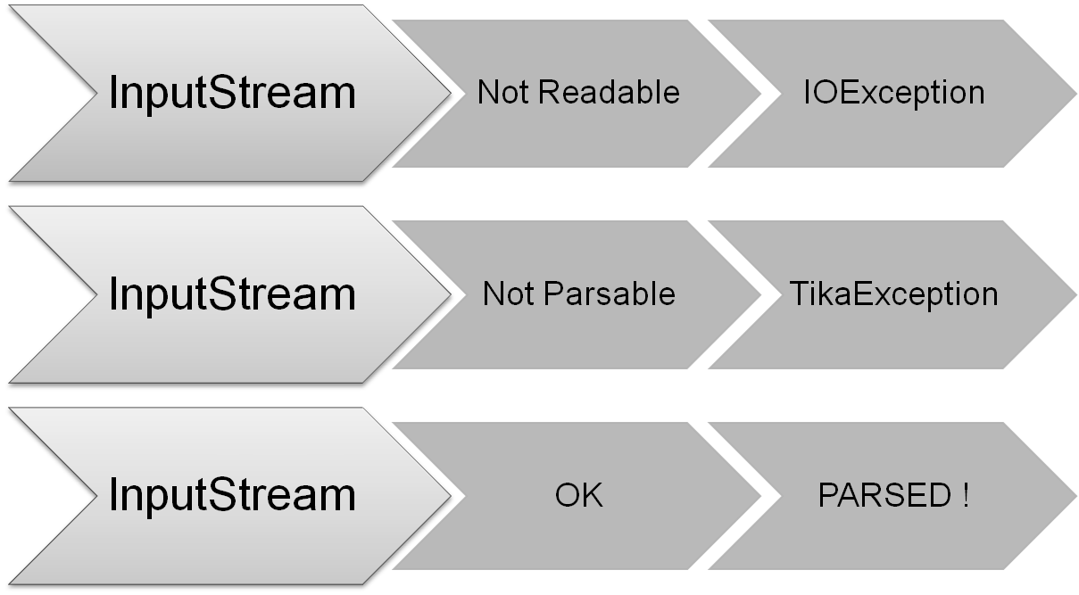
Document input stream

Slide 14
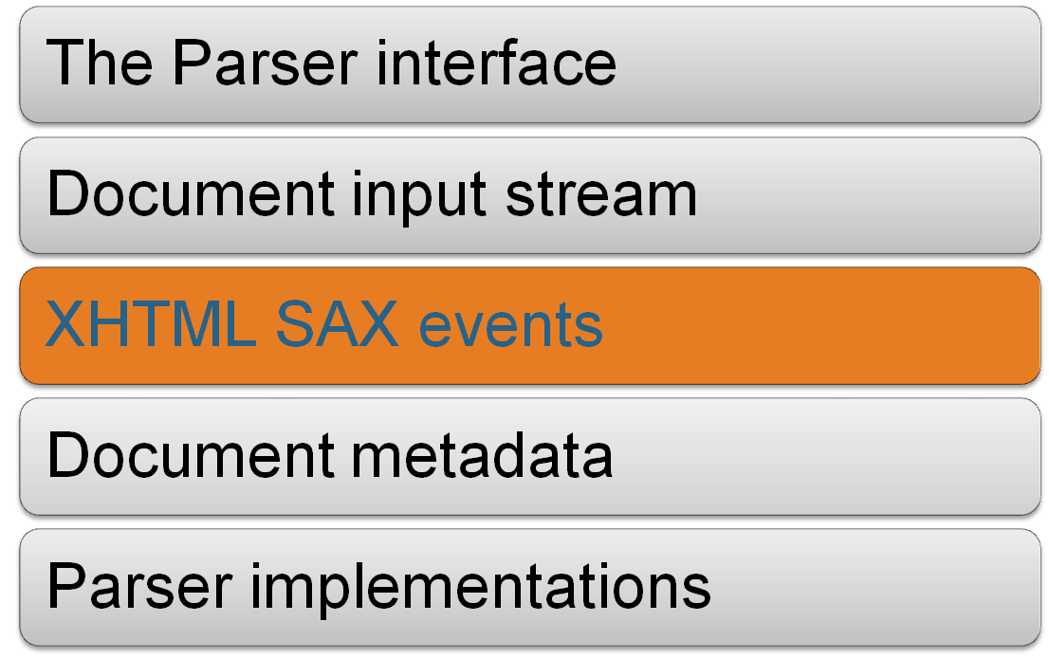
Tika Design

Slide 15
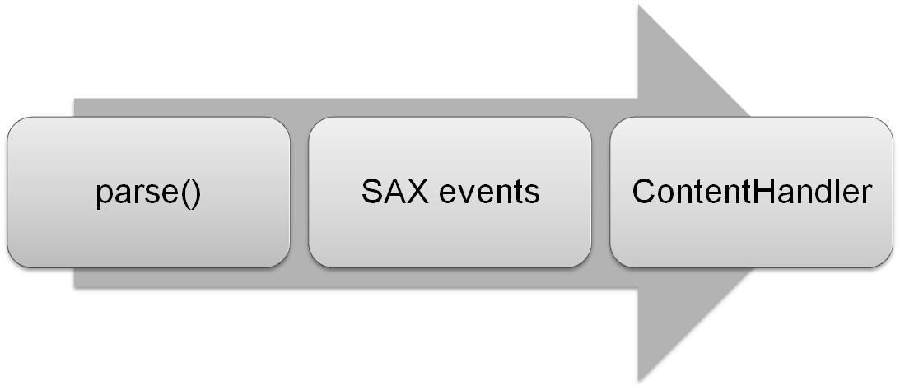
XHTML SAX events
<html xmlns="http://www.w3.org/1999/xhtml">
<head>
<title>...</title>
</head>
<body> ... </body>
</html>

Slide 16
Why XHTML?
Reflect the structured text content of the document
Not recreating the low level details
For low level details use low level parser libs

Slide 17
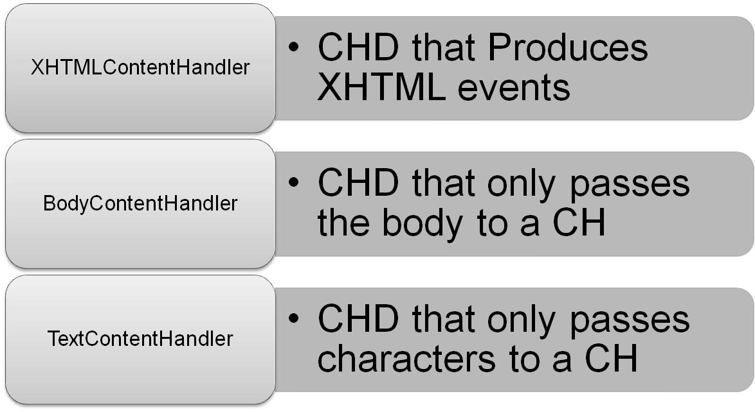
ContentHandler (CH) and Decorators (CHD)

Slide 18
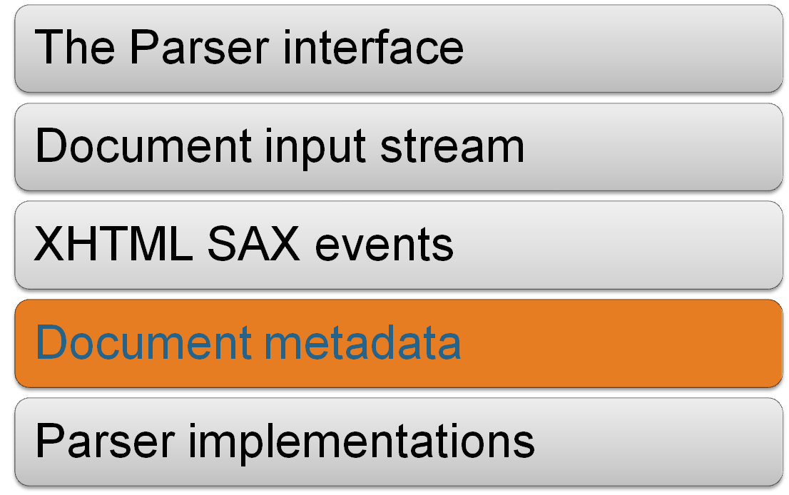
Tika Design

Slide 19
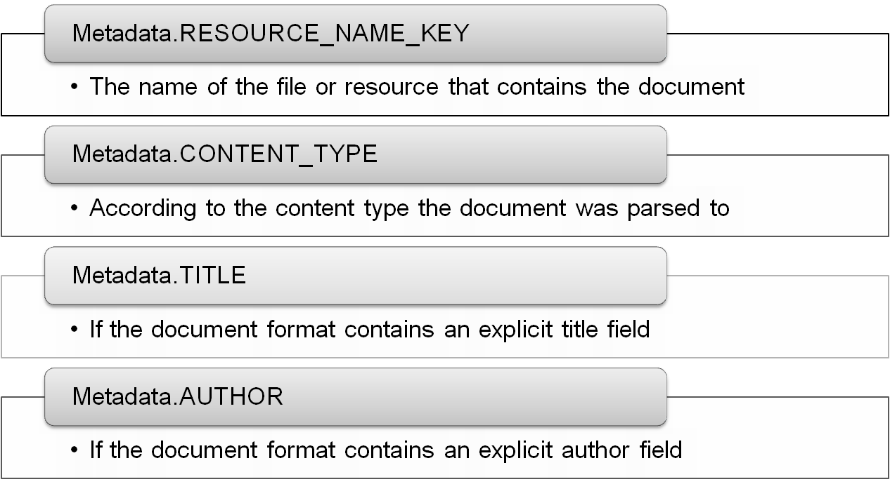
Document metadata

Slide 20
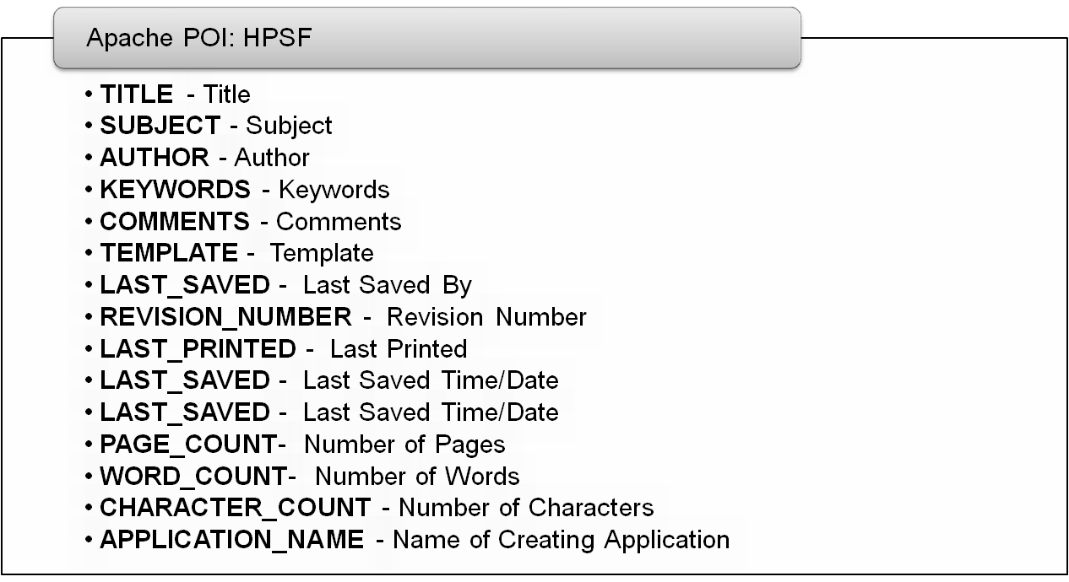
… more metadata: HPSF

Slide 21
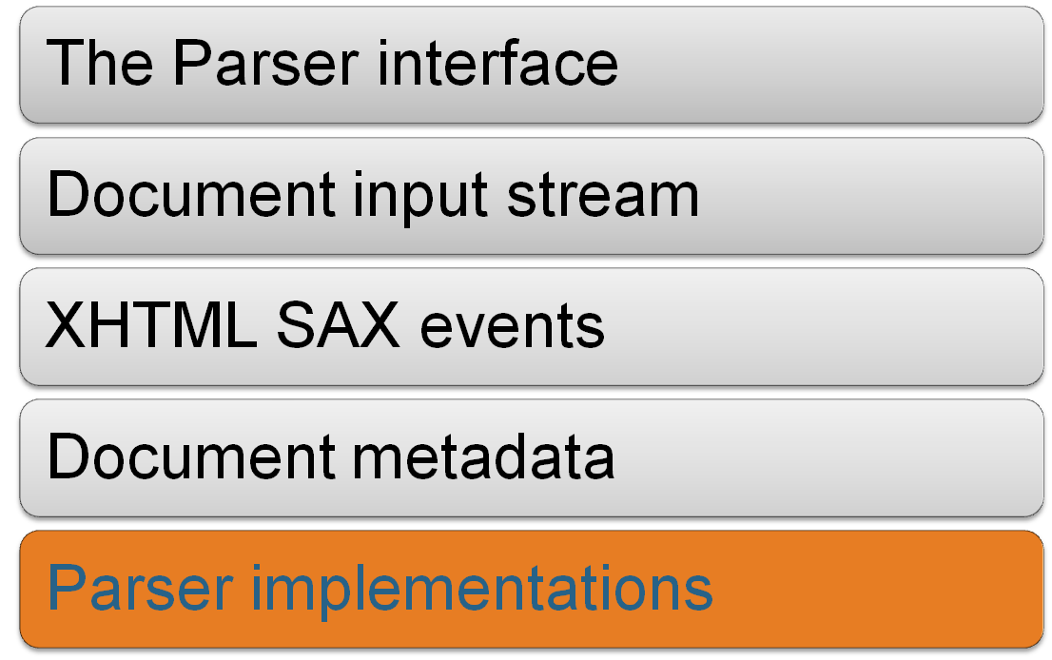
Tika Design

Slide 22
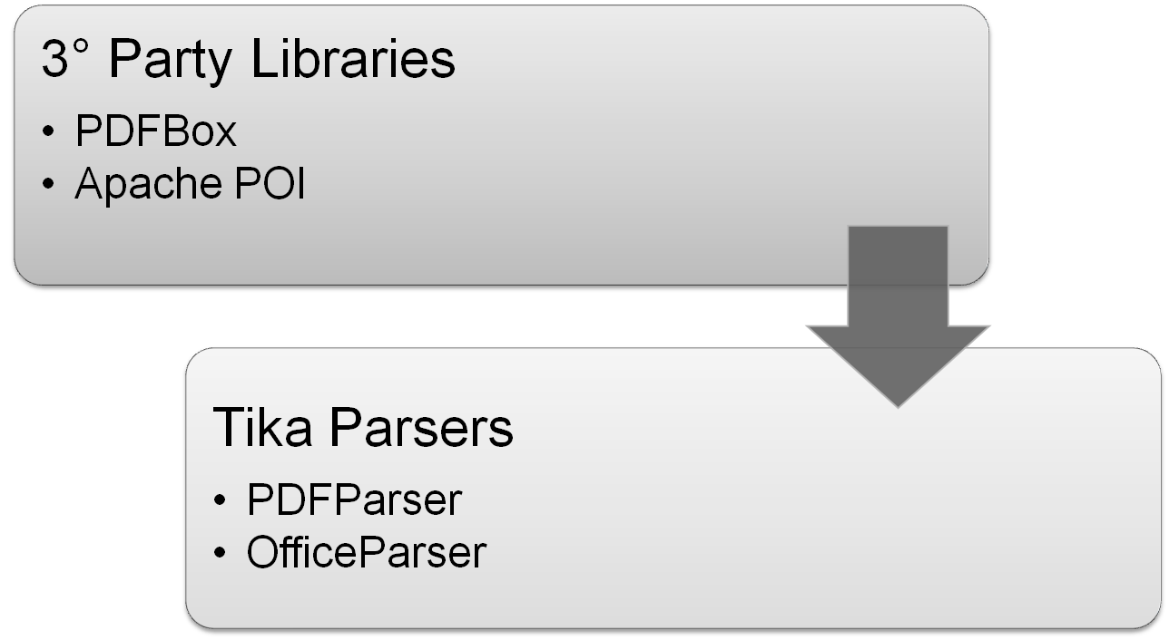
Parser implementations

Slide 23
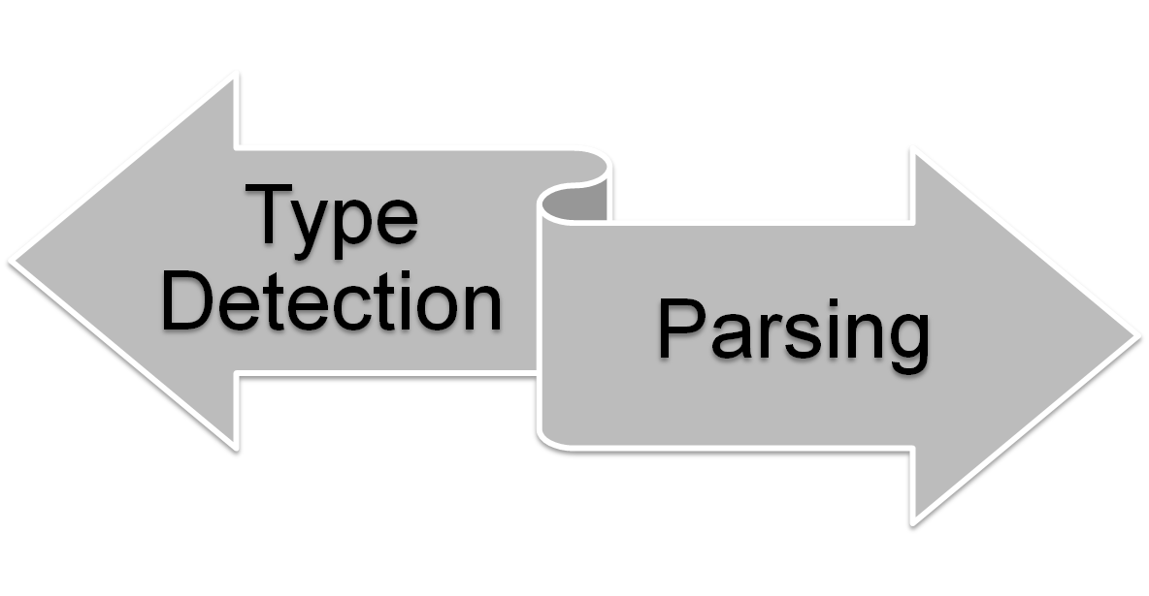
The AutoDetectParser
Encapsulates all Tika functionalities
Can handle any type of document

Slide 24
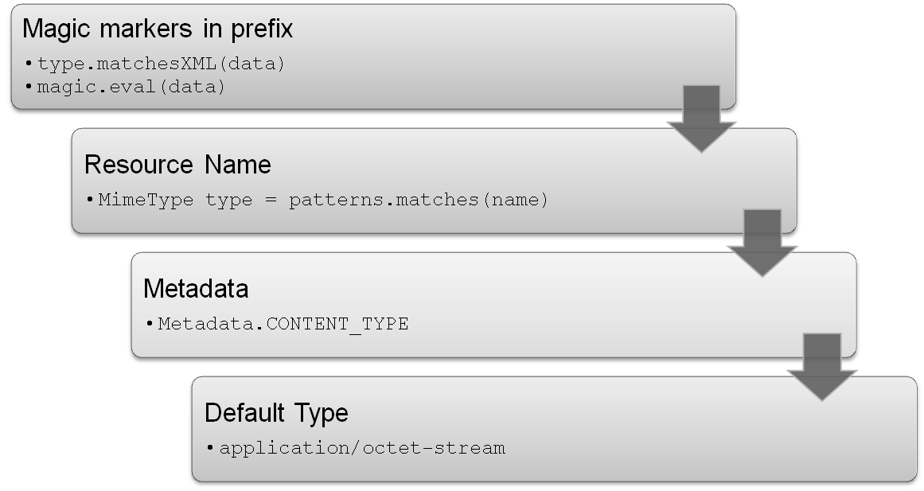
Type Detection
MimeType type = types.getMimeType(…);

Slide 25
tika-mimetypes.xml
An example: Gzip
<mime-type type="application/x-gzip">
<magic priority="40">
<match value="\037\213" type="string“ offset="0" />
</magic>
<glob pattern="*.tgz" />
<glob pattern="*.gz" />
<glob pattern="*-gz" />
</mime-type>

Slide 26
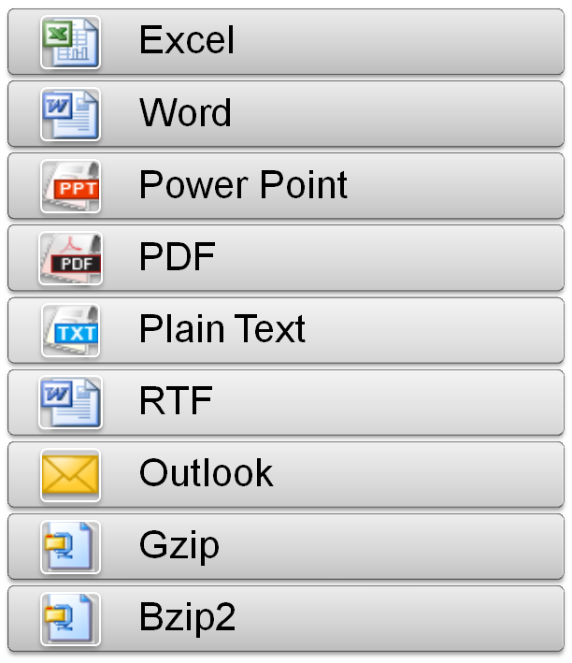
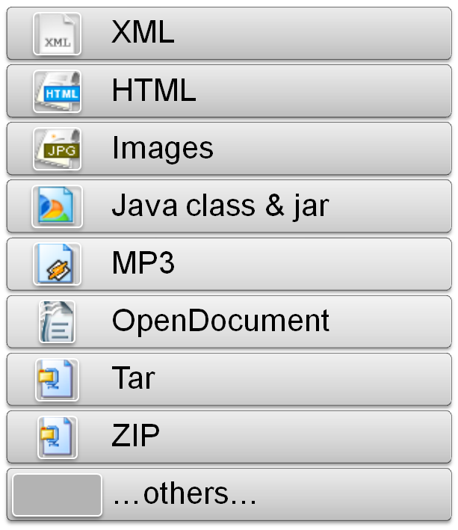
Supported formats

Slide 27
A really simple example
InputStream input = MyTest.class.getResourceAsStream("testPPT.ppt");
Metadata metadata = new Metadata();
ContentHandler handler = new BodyContentHandler();
new OfficeParser().parse(input, handler, metadata);
String contentType = metadata.get(Metadata.CONTENT_TYPE);
String title= metadata.get(Metadata.TITLE);
String content = handler.toString();

Slide 28
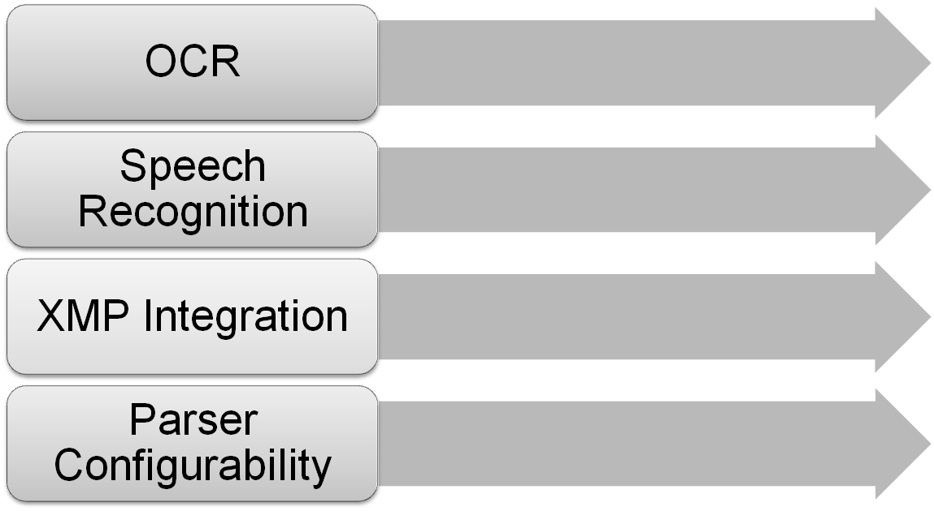
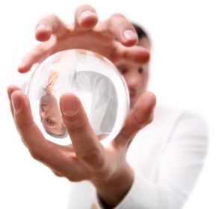
Future Goals

Slide 29
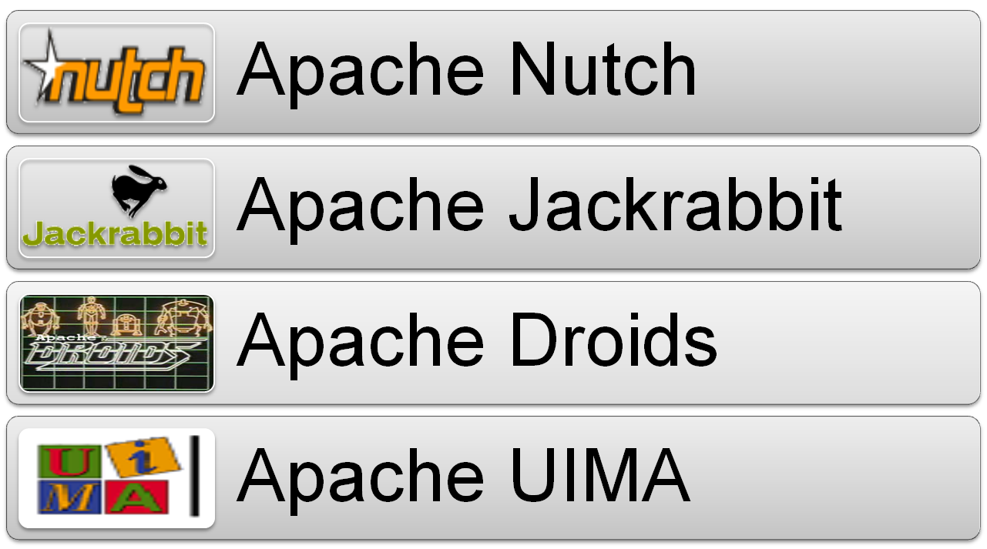
Who uses Tika?

