Slide 1
The September 11th Fund – Implications for Distribution Strategy
CONFIDENTIAL
November 28, 2001
This report is solely for the use of client personnel. No part of it may be circulated, quoted, or reproduced for distribution outside the client organization without prior written approval from McKinsey & Company. This material was used by McKinsey & Company during an oral presentation; it is not a complete record of the discussion.

Slide 2
CONTENTS
Executive summary
Overview of available funds
Description of victims and needs
4. Needs and gap assessments
      Individuals
      Small businesses
      Non-profits
5. Donor expectations
6. Lessons from Oklahoma City
7. High-level distribution options

Slide 3
BACKGROUND
The September 11 Fund is one of the largest recipients of donations to meet the needs of the victims of the events of September 11. The Fund now faces the daunting task of deciding how to distribute the funds and answering the following questions:
Which victims should the Fund support? Individuals only? Or also non-profit groups and small businesses? How should funds be apportioned across these groups?
How should funds be apportioned to the sub-classes within each of these groups? For example, which individuals should be supported? Families of the deceased? The injured? Displaced tenants? Those who lost their jobs? Those suffering emotional distress? Undocumented workers?
Which needs of each of these classes of victim should the Fund meet? Should the Fund focus on immediate relief (e.g. providing cash for mortgage payments and utility bills)? Should it make cash payments as a form of compensation for loss of a loved one (even though significant money has been set aside for this purpose)? Or should it help to rebuild the lives of victims and renew communities by providing counseling, job retraining, childcare, legal and financial advice, and community education?

Slide 4
EXECUTIVE SUMMARY
Key findings
1. The September 11 Fund is very important because it can fill funding gaps
  The September 11 Fund, with pledges in excess of $335 million, accounts for 2% of the total $16 billion likely to be available to the victims (primarily in the form of private insurance dollars, government payments, and compensation available through the federal airline bill)
  Nevertheless, it accounts for a third of all monies raised by private charities and is thus important both because it can fill gaps uncovered by other funding sources, and has the power to influence decisions relating to federal compensation and the distribution decisions of other major funds
2. Many classes of victims will need help for a very wide range of needs important
  While the families of the deceased are the most obvious victims, there are many others, including the injured, those who lost their jobs, rescue workers, visitors to the WTC, those displaced from their homes, and those who suffered hate crimes, indirect economic or physical impact; not to mention small businesses and non-profits that were affected
  The needs of these victims are very broad: they will need immediate help to make ends meet, they require compensation for their losses (particularly since many of the deceased had little or no life insurance), and they will need help to rebuild their lives by getting counseling, job training (if they lost their jobs), and child care (if they have to go back to work)
3. There are likely to be significant funding gaps in meeting needs
  Estimates of the cost of meeting the full range of needs of individual victims vary from $5-30 billion (against the roughly $16 billion available to meet these needs)
  When the estimated needs are mapped against the available funds, three clear findings emerge: (1) immediate needs (e.g. family mortgage payments) are likely to be fully covered by the Red Cross, Safe Horizon and government relief agencies; (2) compensation needs (e.g. death compensation) are likely to be met in full by a combination of private insurance benefits and payouts from the airline bill for all but a handful of victims (e.g. undocumented workers); and (3) very limited funds are available to meet longer term needs that fall under the heading of “renewing and rebuilding” victims’ lives and the city (e.g. counseling, job training, child care), areas in which the United Way of New York City has particular expertise

Slide 5
EXECUTIVE SUMMARY
Key findings, continued
4. Donors have a very broad definition of which victims should be helped and how
  Foundations, corporate donors, high net-worth individuals, and the general public all support a very broad definition of victims, ranging from families of the deceased to residents of the affected areas who lost wages as a result of the attacks, as well as those who suffered from hate crimes
5. Oklahoma City showed that needs will be long-term
  It took 3-4 years to distribute most of the funds raised for victims of the Oklahoma City event, but funds are still being disbursed today
6. There are two non-exclusive distribution options that the September 11 Fund should consider for individuals (in addition to the immediate relief the September 11th Fund is already providing)
  Given likely funding gaps, donor expectations, and the lessons from Oklahoma City, 2 main options are worth consideration for individuals
  Option 1: Provide significant cash compensation to primary victims
    Regardless of need to all victims
    Regardless of need only to those victims (e.g., undocumented workers) not eligible for cash compensation under major programs like the airline bill
    Only in cases of need (proven through means testing) to cover the period between immediate relief payments from disaster agencies and getting a compensation payout from, for example, the airline bill
  Option 2: Fund longer-term services required to rebuild victims’ lives and renew communities (e.g. counseling, job training, childcare) – these are services for which currently there are limited funds allocated, but which will be critical to rebuild lives, as the experience after the Oklahoma City bombing showed
  After considering the various high-level options, the September 11th Fund should adopt a decision-making framework that makes explicit which victims to fund and over what period – this will allow the Fund to focus on programmatic decisions about which specific needs to meet and which agencies to fund

Slide 6
CONTENTS
Executive summary
Overview of available funds
Description of victims and needs
4. Needs and gap assessments
      Individuals
      Small businesses
      Non-profits
5. Donor expectations
6. Lessons from Oklahoma City
7. High-level distribution options

Slide 7
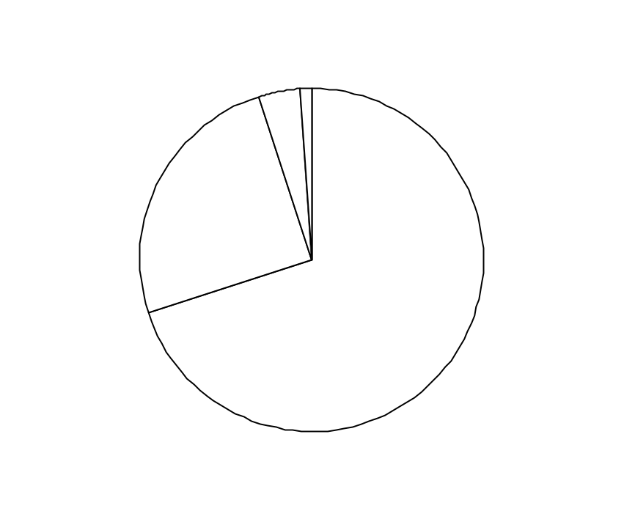
ESTIMATE OF AVAILABLE FUNDS FOR HUMAN VICTIMS
AS OF NOVEMBER 1
$ Millions (percent)
General purpose
charitable funds
  Largely
  unrestricted funds
  Specific designation in most cases yet to be decided
Special purpose
charitable funds
  Funds restricted either to specific classes of victim or specific needs
100% = $16,200 million
$300 (1%)
$900
(6%)
$4,000
(25%)
Private insurance
  Claims by individuals to private insurance companies
~$11,000
(68%)
Government funds
and agencies
  Includes estimates of amount committed to date by federal, state, and local governments
Source: Robin Hood Foundation; FEMA; OMB; Hevesi report; Dow Jones Interactive; literature search
Notes:
Over $16 billion in funds is likely to be available to human victims of September 11th, with the majority coming from government sources and only 5 percent from charitable funds.

Slide 8
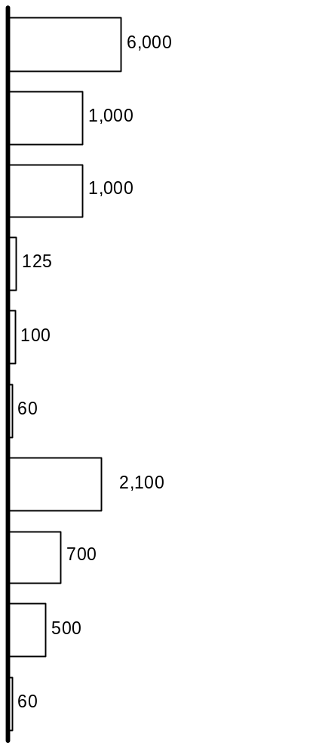
DETAIL OF AVAILABLE GOVERNMENT FUNDS
AS OF NOVEMBER 1
Estimated amount*
$ Millions
Target population
Need addressed
Comments
Federal
Airline bill
  Families of
  deceased
  Compensation
  Only human victim portion of bill included
Social Security Administration
  Families of deceased
  and severely injured
  Compensation
  Unspecified cap
  Unprecedented amount of federal funding earmarked for September 11th
    Federal government expected to give $1 million to each deceased victim’s family
    Traditional benefit requirements have been waived or extended
    High degree of ambiguity around government assistance – most legislation not finalized
FEMA
  Families of deceased, injured, and those displaced from homes
  Immediate relief
  $2 billion cap on
  total support; adjusts to meet needs
Department of Health and Human Services
  Injured and other health-related needs of affected areas
  Rebuild and renew
  Unspecified cap
Small Business Administration
  Those who were directly affected economically
  (e.g., homeowners, renters)
  Rebuild and renew
  Low interest loan support
Department of Justice
  Families of deceased “first responders” (e.g., police, firefighter, EMS)
  Compensation
  N/A
State**
Department of Labor
  Those who lost job due to tragedy
  Compensation
  Waived waiting period
  and extended benefit period
Crime Victims Board***
  Families of deceased
  Immediate relief; compensation
  Removed limit on size
  of compensation
Workers Compensation***
  Families of deceased
  Compensation
  N/A
Local
Police/Firefighter’s Pensions
  Families of deceased NYC Police and Firefighters
  Compensation
  Other local funds allocated are targeted for clean-up
* Estimated amount that will be distributed to victims for immediate relief, compensation, and rebuild and renew, not necessarily total amount available
** Majority of state costs will be reimbursed by federal government and is therefore captured in federal budget
*** New York State figures only
Source: FEMA; OMB; Hevesi report; Dow Jones Interactive; literature search
Notes:
Government funding combines special funds earmarked for September 11th victims (e.g., airline bill) with traditional, need-based funds (e.g., Social Security, unemployment insurance).

Slide 9
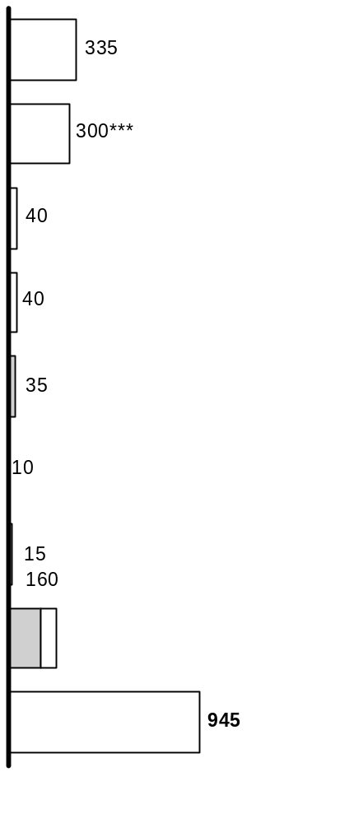
DETAIL OF AVAILABLE GENERAL PURPOSE CHARITABLE FUNDS
AS OF NOVEMBER 1
Amount raised*
$ Millions
Unrestricted**
Target population
Need addressed
September 11th Fund
  Victims and families;
  affected communities
  TBD
American Red Cross
  Victims and families
  Immediate relief
New York Times September 11th Neediest Fund
  Victims and families
  Compensation
  ~20% of funds earmarked for immediate relief
  ~5% of funds earmarked for compensation
  ~75% of funds unrestricted
  or TBD
Robin Hood Foundation
  Unrestricted
  Unrestricted
Salvation Army
  Victims and families; rescue workers
  Immediate relief
Goldman Sachs
  Victims and families
  TBD
Newsday Disaster Relief Fund
  Majority of funds unrestricted
  Majority of funds unrestricted
Other
170
  Majority of funds unrestricted
  Majority of funds unrestricted
Total
* Includes dollars pledged
** Specific designations yet to be decided
*** This is the designated portion of American Red Cross funds. Total funds raised is approximately $547 million
Source: Robin Hood Foundation; Dow Jones Interactive; literature search
Notes:
While small relative to government fund sources, the September 11th Fund and American Red Cross comprise over 2/3 of general purpose charitable funds.

Slide 10
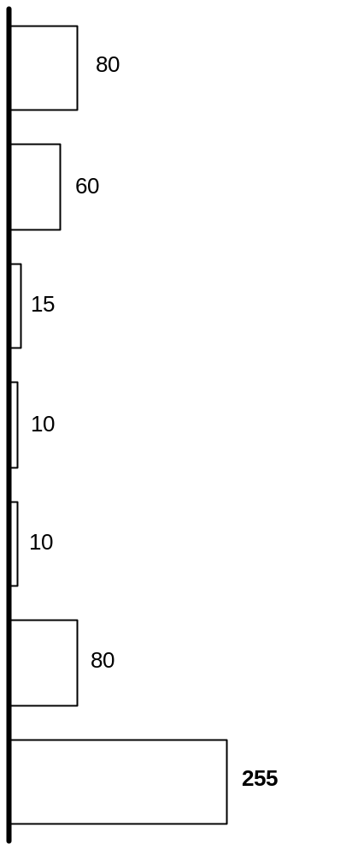
DETAIL OF SPECIAL PURPOSE CHARITABLE FUNDS
AS OF NOVEMBER 1
Amount raised
$ Millions
Target population
Need addressed
Twin Towers Fund*
  Families of uniformed services
  Compensation
NY Police and Firefighter Widow’s and Children’s Benefit Fund
  Families of NYC fallen firefighters and police officers
  Compensation
  Children of those who died during WTC attack
  Scholarships
  ~90% of funds earmarked for compensation
  ~10% of funds earmarked for rebuilding and renewal
Citigroup Relief Fund
  Employees of affected organizations
  Compensation
Morgan Stanley
  Employees of affected organizations
  Compensation
AXA
  Employees of affected organizations; uniformed services; immigrants/
  ethnic groups; etc.
  Compensation
Other
Total
* May expand their charter
Source: Robin Hood Foundation; Dow Jones Interactive; literature search
Notes:
Over 20% of charitable funds are targeted for special purposes, with the largest of these funds established to support the families of uniformed victims.

Slide 11
DETAIL OF SEPTEMBER 11TH FUND RESTRICTIONS
AS OF NOVEMBER 1
Admin fee restrictions
Benefits
Telethon –
$150 million
Networks
& UW
  Victims
  Families
  No UWNYC/
  NYCT fees
  No agency admin fees--TBD
Total September 11th Fund –
$340 million*
More than 2/3 of funds restricted to “victims and families”
Pre 4 p.m.
September 15
– $90 million
  Victims
  Families
  No UWNYC/ NYCT fees
Non-Telethon –
$190 million
NYCT & UW
Post 4 p.m.
Sept. 15 –
$100 million
  Victims
  Families
  Communities
  No UWNYC/ NYCT fees
* Pledges are included in these amounts
Source: United Way New York City Chapter
Notes:
Although the September 11th Fund is a general purpose fund, more than 2/3 of funds are restricted to “victims and families,” a phrase yet to be defined.

Slide 12
CONTENTS
Executive summary
Overview of available funds
Description of victims and needs
4. Needs and gap assessments
      Individuals
      Small businesses
      Non-profits
5. Donor expectations
6. Lessons from Oklahoma City
7. High-level distribution options

Slide 13
PRELIMINARY NEEDS ASSESSMENT – CLASSES OF VICTIMS
Definition
  Those who were physically harmed at the World Trade Center or Pentagon as a result of the attacks on September 11th and their families
Primary
  Those who did not suffer physical harm but were at WTC/Pentagon or had economic interests there
Secondary
Tertiary
  All others adversely affected by the events of September 11th
Notes:
NY-ZWC698/011101YamorHR2
There are three broad categories of victims, categorized based on their physical and economic proximity to the events of September 11th.

Slide 14
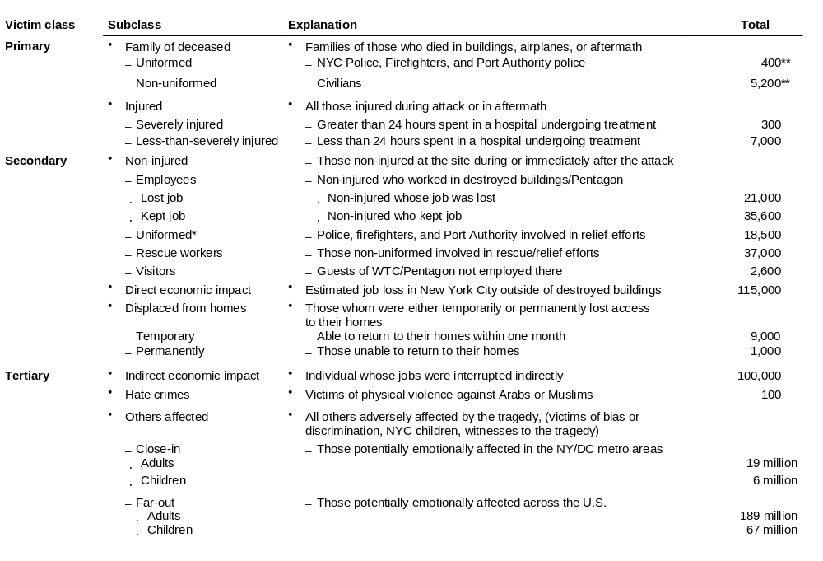
SIZING VICTIM CLASSES – HUMAN VICTIMS
ESTIMATES AS OF NOVEMBER 1
* Includes police, firefighter, and Port Authority only
** While this reflects Police department estimates as of Nov 1, sources continue to look into these figures (e.g. NY Times survey) and it has since dropped. This figure is a “moving target”
Source: CNN; NY Post; Pentagon Public Affairs; FDNY/NYPD Affairs; FEMA; Hevesi report; Fiscal Policy Institute; BPC association; FBI hate crimes statistics; NY Times; McKinsey analysis
Notes:
When each of the specific sub-classes of victim are identified and sized it becomes clear that “victims” extend far beyond those who perished or were injured.

Slide 15
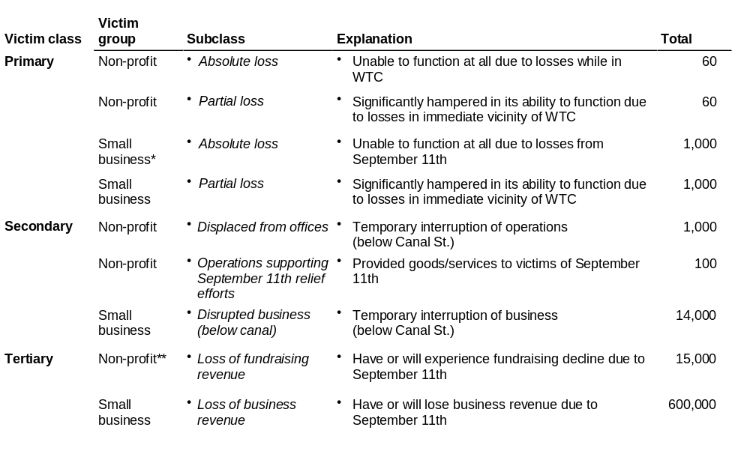
SIZING VICTIM CLASSES – NON-HUMAN VICTIMS
ESTIMATES AS OF NOVEMBER 1
* Small business defined as having fewer than 500 employees
** Estimates are for entities in NYC only
Source: Hevesi report; Guidestar; U.S. Census; Small Business Administration; NY Business Development Corporation; Office of the NY Attorney General
Notes:
Similarly, there is a range of non-human victims, in particular non-profit entities and small businesses.

Slide 16
CATEGORIES OF NEED
Immediate relief
Compensation
Renew and rebuild
Definition
  Helping victims meet pressing, basic needs such as shelter, food, clothing, and immediate healthcare
  Offering financial remuneration for losses experienced during or directly related to the September 11th attacks
  Providing support to victims (including non-profits and small businesses), families, and their communities in order to help them cope with the medium and long-term effects of the events of September 11th
Notes:
NY-ZWC698/011101YamorHR2
Just as there is a range of victims there is also a range of needs, divided here into: (1) short-term immediate relief; (2) financial compensation; and (3) long-term support for victims in order for them to renew and rebuild their lives and/or entities.

Slide 17
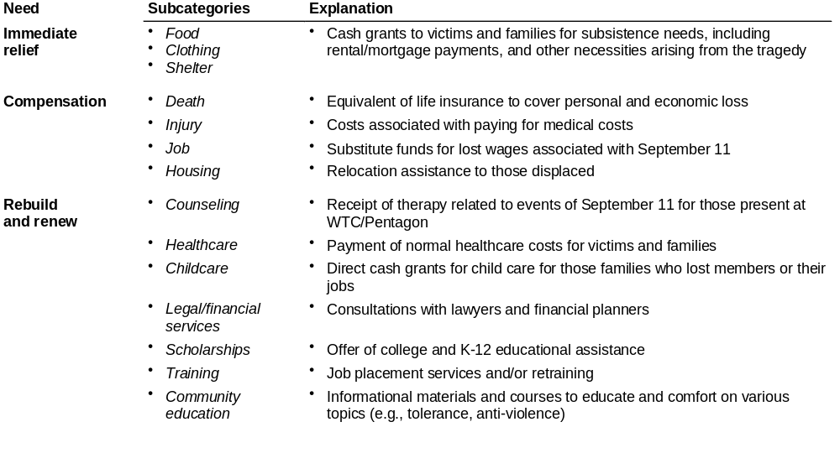
CATEGORIES OF NEED – HUMAN VICTIMS
Notes:
NY-ZWC698/011101YamorHR2
The needs discussed most often in the press are those relating to the provision of immediate relief and compensation; however, many longer-term needs must be met to rebuild the community and renew peoples’ lives.

Slide 18
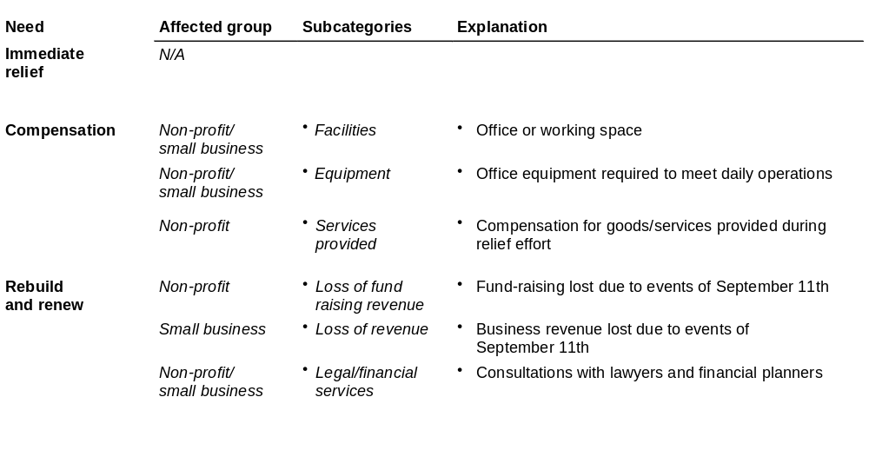
CATEGORIES OF NEED – NON-HUMAN VICTIMS
Notes:
NY-ZWC698/011101YamorHR2
Non-profits and small businesses have their own specific needs in the wake of September 11.

Slide 19
CONTENTS
Executive summary
Overview of available funds
Description of victims and needs
4. Needs and gap assessments
      Individuals
      Small businesses
      Non-profits
5. Donor expectations
6. Lessons from Oklahoma City
7. High-level distribution options

Slide 20
DECISION CRITERIA FOR FUND DISTRIBUTION STRATEGY
Analysis about likely gaps in meeting victim needs
Overall fund distribution strategy
+
How should funds be apportioned between individuals, non-profits, and small businesses?
Within each group of victims (e.g., individuals) how should support be divided among sub-classes (e.g., families of deceased, injured, displaced)?
For each victim sub-class what specific needs should be provided for? Focus on immediate relief, cash compensation, or support of longer-term efforts to renew/rebuild lives and communities?
Market research about donor expectations
+
Lessons from Oklahoma City
Notes:
In order to determine an appropriate distribution strategy for the September 11th Fund, it is first necessary to understand where funding gaps exist in meeting victim needs.

Slide 21
PROCESS FOR ESTIMATING VICTIM NEEDS AND IDENTIFYING GAPS
Step 1
Step 2
Step 3
Step 4
Identified classes of victims and types
of needs
Estimated dollar amount for each need using victim classification
Created summary roll-up of estimates for individuals, non-profits, and small business
Mapped available funds against estimated needs to identify areas where needs potentially not met
Etc.
Victims
Counseling
Categories of need
Primary
  Deceased
  Injured
Job compensation
Injury compensation
  Imme-diate
  relief
  Comp-ensa-
  tion
  Renew and rebuild
  Imme-diate
  relief
  Comp-ensa-
  tion
  Renew and rebuild
Death compensation
Secondary
  Etc.
Immediate relief
Low
  Low
  Low
High
  Primary
Needs
  Primary
  Immediate relief
  Compensation
  Etc.
Victim A
Victim B
Victim C
--
--
--
  High
  High
  Secon-dary
  Secon-dary
  Tertiary
  Tertiary
Classes of victims
Gaps
Notes:
In order to determine where funding gaps lay, a 4-step analytic process was used to identify unmet needs.

Slide 22
PRELIMINARY ESTIMATE OF HUMAN NEEDS*
Low estimate
High estimate
Number of victims
Needs
$ Millions
Immediate relief
Compensation
Rebuild & renew
Total
Primary
  13,000
  100
  900
  500
  200
  15,900
  2,900
  1,500-19,000
Victim class
  240,000
Secondary
  200
  900
  2,100
  3,200-7,400
  500
  1,800
  5,100
Tertiary
  281,000,000
  -Indirect econ: 100,000
  -Children: 6 million
  -Adults: 20 million
  200
  400
  N/A
  600-3,000
  500
  2,500
Total
  300-700
  2,000-18,200
  3,000-10,500
  5,300-29,400
Estimates** include money for
  Food
  Clothing
  Shelter
  Death compensation
  Injury compensation
  Job compensation
  Childcare
  Healthcare
  Community education
  Counseling
  Scholarships
* Represents the low and high of our estimates of needs using benchmarks from the Oklahoma City, Lockerbie or TWA 800 tragedies when available; in all other cases, reasonable estimates of needs were calculated
** Needs listed represent ~80% of category costs
Source: Oklahoma City United Way; Safe Horizon; Lockerbie bombing analysis; Hevesi report; NYS Department of Health; UWNYC; DeVry Institute; Rotary Club; Magazine Publishers of America; McKinsey analysis
Notes:
Specifically, estimates indicate that between $5 and $30 billion is required to address all the needs of individual victims.

Slide 23
ESTIMATED GAPS IN MEETING HUMAN NEEDS*
ESTIMATED
Extent of gap
<20% met
September 11th Fund’s support of Safe Horizon has helped to meet immediate needs
20-70% somewhat
>70% substantially
Needs
$ Millions
Number of victims
Immediate relief
Compensation
Rebuild & renew
  13,000
  100
  900
  500
Primary
  200
  15,900
  2,900
  200
  900
  2,100
Secondary
Victim class
  240,000
  500
  1,800
  5,100
  200
  400
Tertiary
  281,000,000
  N/A
  500
  2,500
Immediate needs likely to be met irrespective of estimates
Compensation needs likely to be met except in highest estimate
Rebuilding and renewal likely to be substantially unmet
* Identified gaps based only on funds with specific designations. This does not included general funds such as September 11th Fund.
Source: McKinsey analysis
Notes:
When estimated needs are mapped against available funds three clear conclusions emerge: (1) immediate relief of needs are likely to be met; (2) compensation needs are also likely to be met (except at high-end of estimates); and (3) a significant shortfall will likely occur in meeting needs associated with rebuilding and renewing lives and the community.

Slide 24
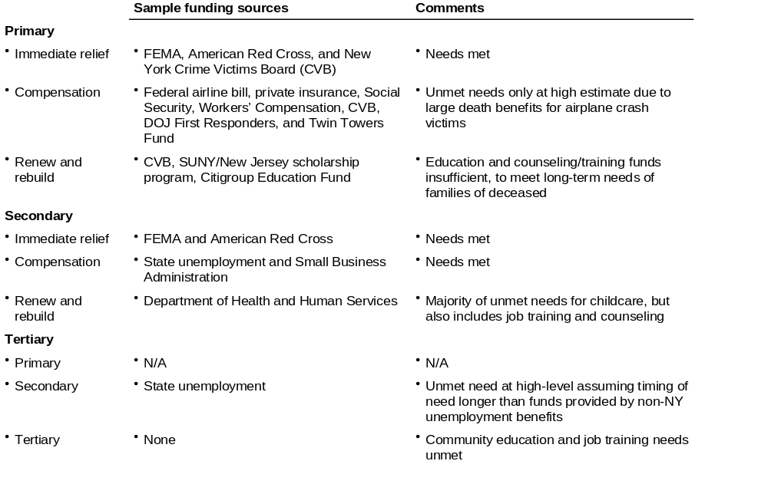
FUNDING SOURCES FOR HUMAN NEEDS
Notes:
Federal funding sources and charities will be able to meet the immediate relief and compensation needs of primary and secondary victims; little funding is available to meet the longer-term needs described here as renewal and rebuilding lives of individuals and communities.

Slide 25
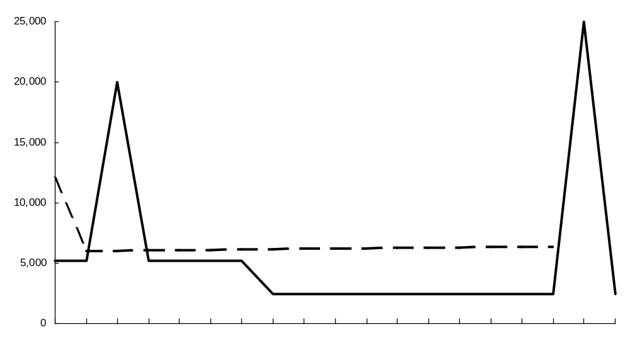
POTENTIAL FINANCIAL GAP OVER TIME FOR PRIMARY
INDIVIDUAL VICTIMS
ILLUSTRATIVE
Potential gap
Family expenses**
Funds available***
For families of deceased without life insurance
Dollars per month
FEMA support for burial, legal, and material costs
Over 85% of survey respondents view interest-free loans as appropriate response to the delay in government funding
Compensation from federal airline bill uncertain in timing or amount*
Airline bill ~ $1 million per victim or more
End of crime victim board support
Jan 2002
Jan 2003
Jan 2004
Jan 2005
* While the federal government has promised swift distribution of compensation, historical experience does not support that claim
** Family expenses have been defined from a cash flow perspective. Since the average U.S. household does not save any money, we assumed that income equaled expenses. Accordingly to the NYC Comptroller report, the average salary for a WTC employee was $100,000, which we grew at 5% annually and tax affected at 31%.
*** Funding as supplied by CVB ($2,400 per month), SSA ($1,400 per month), worker’s compensation ($1,600 per month), and FEMA ($14,400). Does not include any private insurance or charity.
Note: Assumes no funding from insurance
Source: McKinsey analysis
Notes:
Although it appears that there are sufficient funds available to meet the immediate needs (e.g., mortgage, rent, utilities, food) of primary victims, there could be significant cash-flow shortfalls because of the timing of funding availability – this problem is likely to be heightened by the fact that compensation from the federal airline bill is uncertain in both timing and amount.

Slide 26
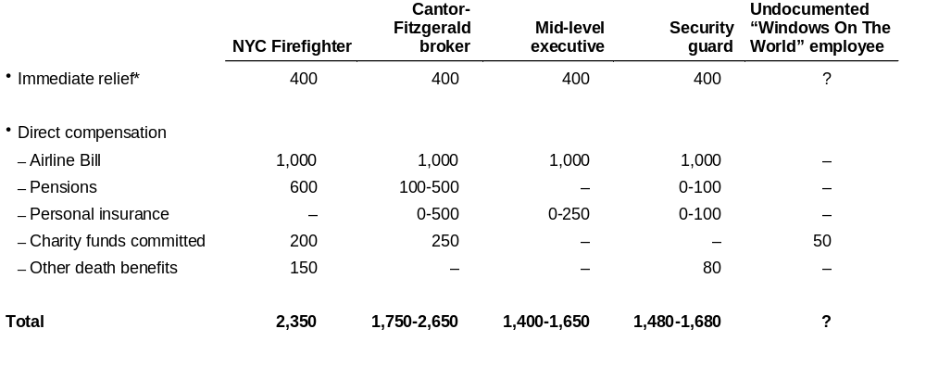
CASH COMPENSATION DISPARITY
ILLUSTRATIVE
$ Thousands
For victims who died in the WTC/Pentagon, direct compensation excluding the airline bill could range between $50,000-$2.65 million
* Immediate relief includes, but is not limited to, funds provided by the following agencies – Crime Victims Board ($30,000), Social Security ($160,000 NPV or 30 years), Workers Comp. Board ($180,000 lump sum), and FEMA ($14,000). Other non-governmental entities (e.g., September 11th Fund through Safe Horizons) have provided emergency funds to individuals, including undocumented workers, on a case-by-case basis
Source: CVB; SSB; WCB; FEMA; NY Times; Hevesi report; McKinsey analysis
Notes:
In addition to a timing problem, large funding disparities could occur based on individual circumstances.

Slide 27
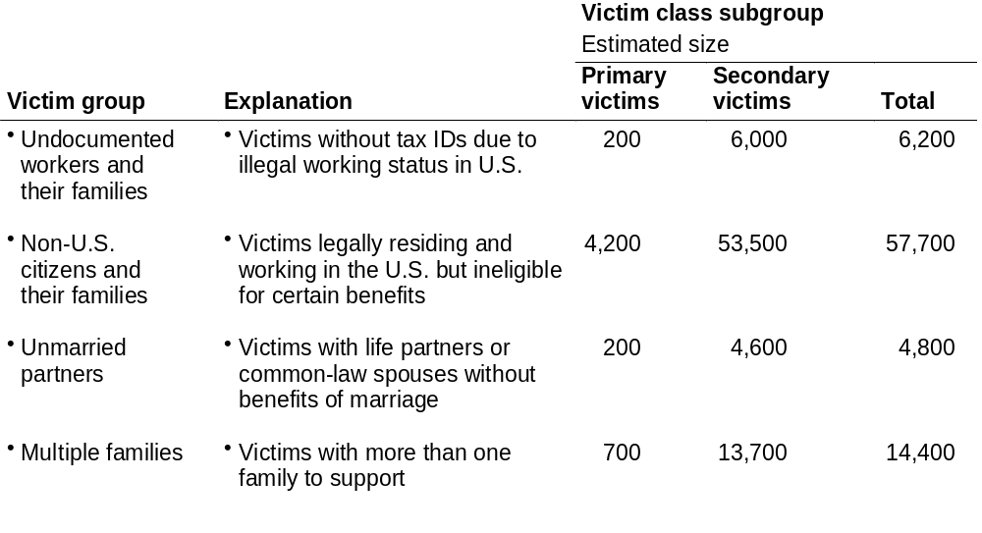
VICTIM GROUPS WITH POTENTIALLY UNDERSERVED NEEDS
While overall needs of victim classes may be satisfied, large subgroups within these broad classes may
“fall through the cracks”
Note: Number different from September 11 Fund board presentation because of differences in definitions of primary and secondary victim classes
Source: McKinsey analysis
Notes:
Specific groups of victims within each victim class may go underserved based on immigration status or legal treatment of family relationships.

Slide 28
CONTENTS
Executive summary
Overview of available funds
Description of victims and needs
4. Needs and gap assessments
      Individuals
      Small businesses
      Non-profits
5. Donor expectations
6. Lessons from Oklahoma City
7. High-level distribution options

Slide 29
PRELIMINARY ESTIMATE OF SMALL BUSINESS NEEDS
Low estimate
High estimate
Needs
$ Millions
Number
of victims
Immediate relief
Compensation
Rebuild & renew
Total
Primary
  300
  600
  2,000
  N/A
  900-2,000
  1,000
  1,000
  14,000
Victim class
Secondary
  900
  900-2,200
  N/A
  N/A
  2,200
  600,000
  3,400
Tertiary
  3,400-37,500
  N/A
  N/A
  37,500
Total
  N/A
  300-1,000
  4,900-40,700
  5,200-41,700
Estimates include money for
  Facilities
  Equipment
  Legal and financial services
  Lost revenue
* Note that the New York City GCP (Gross City Product) in 2000 was approximately $440 billion
Source: McKinsey analysis
Notes:
A similar analysis was conducted for small businesses. Estimates of small business needs are the largest of all victim types at $5 billion to $42 billion* and the vast majority is due to projected revenue loss due to New York’s (September 11th-related) economic slowdown.

Slide 30
ESTIMATED GAPS IN MEETING SMALL BUSINESS NEEDS
Extent of gap
<20% met
20-70% somewhat
>70% substantially
Needs
$ Millions
Number
of victims
Immediate relief
Compensation
Rebuild & renew
Primary
  300
  600
2,000
  N/A
  1,000
  1,000
Gap analysis
includes grant funding – does not include significant loan funding for small business*
Secondary
  900
Victim class
14,000
  N/A
  N/A
  2,200
  3,400
Tertiary
600,000
  N/A
  N/A
  37,500
Major gaps in grant funding exist for small businesses in New York City
* Grant funding available to small businesses is extremely limited (<$5 million available from SEEDCO, Catholic Charities, and New York Times 9/11 Neediest Fund). Sources of loan funds include NY Small Business Development Corporation, SBA disaster loans, NYC + NYS WTC relief fund, FEMA, and Fleet “Emergency loan fund.” Note that very small businesses (e.g., <100 employees) are particularly uninsured and have limited access to capital for renewal and rebuilding efforts
Source: McKinsey analysis
Notes:
Most current funding available to small businesses is in the form of loans; very little grant funding exists to meet any of the needs of small businesses.

Slide 31
CONTENTS
Executive summary
Overview of available funds
Description of victims and needs
4. Needs and gap assessments
      Individuals
      Small businesses
      Non-profits
5. Donor expectations
6. Lessons from Oklahoma City
7. High-level distribution options

Slide 32
PRELIMINARY ESTIMATE OF NON-PROFIT NEEDS
Low estimate
High estimate
Needs
$ Millions
Number of victims
Immediate relief
Compensation
Rebuild & renew
Total
Primary
Tertiary victim class only includes New York City non-profits; non-profits across the country may also experience fundraising losses due to Sept 11th, which would make any national figure much larger
100
  2
  6
  N/A
  8-43
  7
  36
Victim class
Secondary
1,000
  8
  53
  N/A
  61-370
  45
  320
Tertiary
15,000
  640
  N/A
  N/A
  640-4,000
  4,000
Total
  N/A
  10-52
  700-4,400
  710-4,400
Estimates include money for
  Facilities
  Equipment
  Funds laid out for Sept 11th relief efforts
  Legal and financial services
  Lost fundraising revenue
Source: McKinsey analysis
Notes:
The non-profit analysis shows that the major dollar impact of September 11 was the loss of fundraising revenue for non-profits across the country.

Slide 33
ESTIMATED GAPS IN MEETING NON-PROFITS NEEDS
Extent of gap
<20% met
20-70% somewhat
>70% substantially
Needs
$ Millions
Number
of victims
Immediate relief
Compensation
Rebuild & renew
Primary
Primary sources of funding***
  Private insurance
  Grant funding
    FCNY
    SEEDCO
    Non-profit finance fund
100
  2
  6
  N/A
  7
  36
Secondary
  8
Victim class
1,000
  N/A
  53
  45
  320
Tertiary
  640
15,000
  N/A
  N/A
  4,000
Compensation likely met except for higher estimates*
Rebuilding and renewal likely to be unmet**
* Gaps primarily in compensating NPO’s for emergency goods/services provided. Does not include estimate of revenue loss reported by some NYC hospitals
** Largely experienced and projected declines in fundraising revenue
*** Funding does not include loans (e.g., SBA)
Notes:
Funding does appear likely to cover direct losses incurred by those non-profits close to ground-zero, however, it is unlikely that non-profits will find a ready substitute for funds lost because of September 11’s impact on fundraising.

Slide 34
CONTENTS
Executive summary
Overview of available funds
Description of victims and needs
4. Needs and gap assessments
      Individuals
      Small businesses
      Non-profits
5. Donor expectations
6. Lessons from Oklahoma City
7. High-level distribution options

Slide 35
DECISION CRITERIA FOR FUND DISTRIBUTION STRATEGY
Analysis about likely gaps in meeting victim needs
Overall fund distribution strategy
+
  How should funds be apportioned between individuals, non-profits, and small businesses?
Within each group of victims (e.g., individuals) how should support be divided among sub-classes (e.g., families of deceased, injured, displaced)?
For each victim sub-class what specific needs should be provided for? Focus on immediate relief, cash compensation, or support of longer-term efforts to renew/rebuild lives and communities?
Market research about donor expectations
+
Lessons from Oklahoma City
Notes:
Understanding donor expectations is the second key consideration to take into account when determining the appropriate distribution strategy.

Slide 36
DONOR EXPECTATIONS – FOUNDATIONS, CORPORATIONS,
AND HIGH NET WORTH INDIVIDUALS
“We split a $3 million donation equally between 3 funds in order to address 3 different types of victims. We gave to the Twin Towers Fund for firefighters and police, the Star Ledger Fund for NJ victims, and the September 11th Fund for everyone else.”
“We are confident that you are best suited to provide immediate support to the most trusted non-profit organizations that are serving the most urgent needs.”
Foundations
“This is a time that requires our community to join together . . .
to help sustain those who have suffered most and to help rebuild our city. We have great respect for the expertise that your organizations bring to this most difficult task.”
“We contributed to you because we trust your expertise. We’re confident you’ll put the funds to their best use, however you choose to distribute them.”
Corporations
“I worry about the ‘invisible victim’. The September 11th Fund is casting a wider net than just the high publicity areas, which in my mind is a positive. If I only wanted to donate money to firefighters,
I would have donated to the Fireman’s Fund.”
“I know you will get the victim classes right. My concern is that with so many funds out there, certain groups will get too much while others will be overlooked.”
High net worth
individuals
Source: Phone interviews
Notes:
Donor expectations are a critical factor to consider in determining which victims to serve and which specific needs to meet. Foundation, corporation, and high net worth donors have indicated that they donated to the September 11 fund because they trusted it to reach a broad set of the right victims.

Slide 37
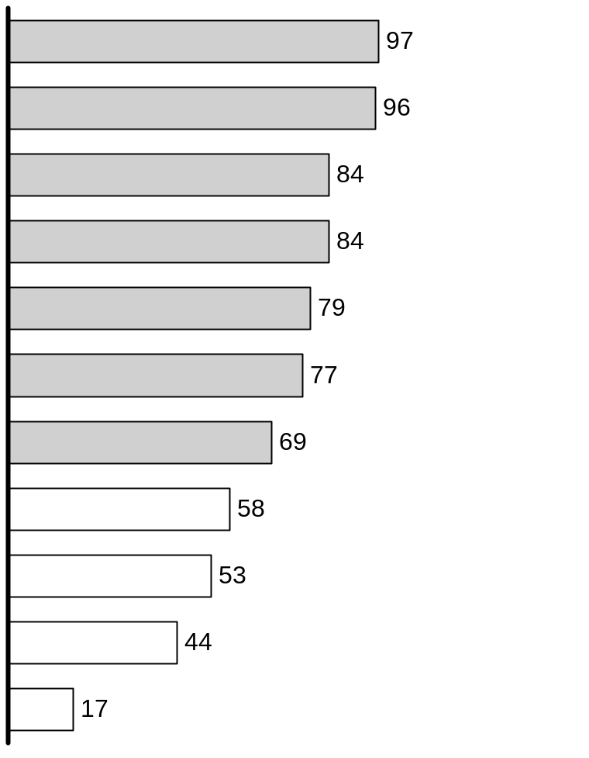
GENERAL PUBLIC EXPECTATIONS – WHICH VICTIMS SHOULD
RECEIVE SUPPORT?
OCT. 1 SURVEY
Response >2/3
Respondents stating group should receive donor support*
Percent
Victim class
Subclass
Primary
Spouse and children of those who lost their lives
Suffered physical harm as result of direct attacks
Secondary
Displaced from home as result of collapse
Rescue workers involved in aftermath
Lost jobs in collapsed/evacuated buildings
Escaped from collapse and need support and counseling
Residents of affected areas who lost wages as result of attacks
Tertiary
Children in need of help in dealing with tragedy
All those in need of support or counseling
Support for hate crime victims increased to 58% by Nov. 1 survey
Those who suffered from hate crimes as result
of attacks
Those afraid to continue to work at job
* Interviews were conducted with the general public and may not reflect the opinion of other donors
Source: Lightspeed online survey (10/1), n = 1,182 nationwide respondents
Notes:
NY-ZWC698/011101YamorHR2
Surveys of the general public (including donors) indicate that the public believes a broad range of victims should receive support, including anyone physically harmed and those who were in close proximity (e.g., displaced residents, rescue workers, and those whose jobs were lost).

Slide 38
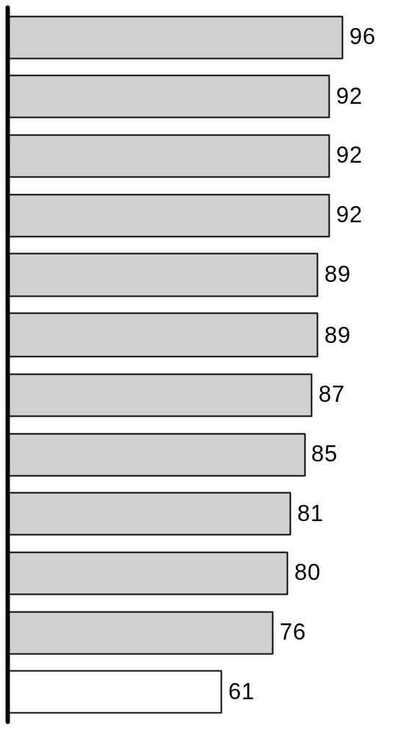
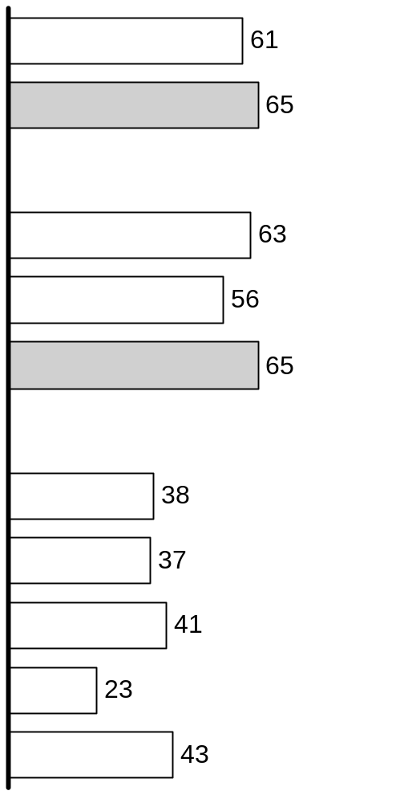
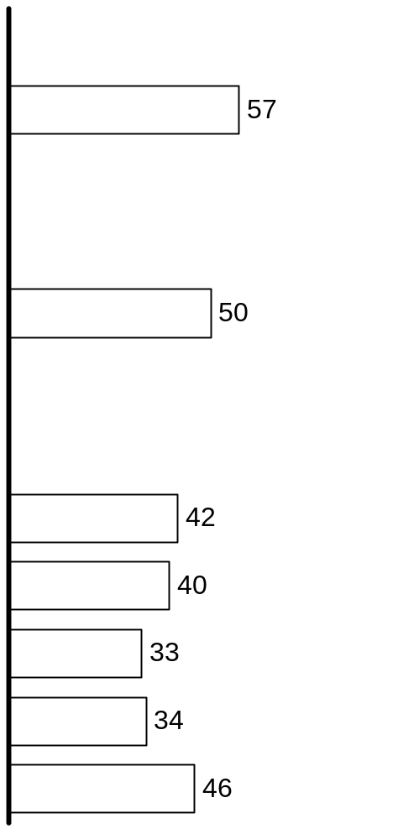
GENERAL PUBLIC EXPECTATIONS – SUPPORT TYPES BY VICTIM CLASS
Percent of respondents strongly or somewhat agreeing with support method
NOV. 1 SURVEY
Responses >2/3
Emotionally or financially affected in NY/DC
Emotionally or financially affected outside NY/DC
Injured or deceased
Immediate relief
N/A
Counseling
Cash comp. for injuries
N/A
N/A
Cash comp. for lost jobs
N/A
Job training and placement
Cash comp. for displaced residents
N/A
Cash comp. for death
N/A
N/A
Childcare
Healthcare
Legal and financial advice
Scholarships
Education on tolerance
Note: N = 202 for the first two charts, N = 500 for the third chart; first two questions were asked separately from third question due to market research firm oversight – only 202 of original 500 respondents were reached
Source: Alliance survey
Notes:
Those surveyed overwhelmingly feel that families of the deceased or injured should receive a broad range of support and services. Sentiment is mixed, however, as to what type of support or services should be provided to other victims.

Slide 39
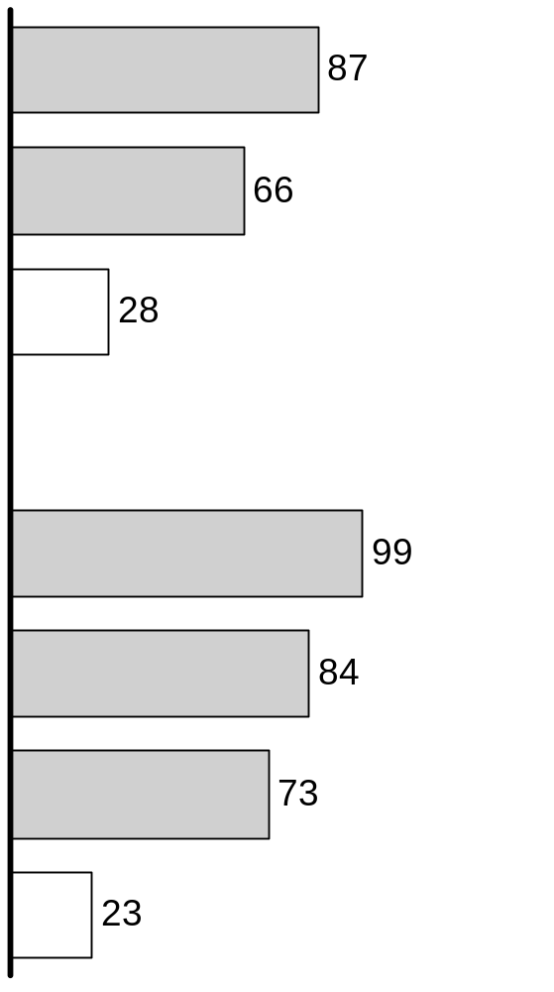
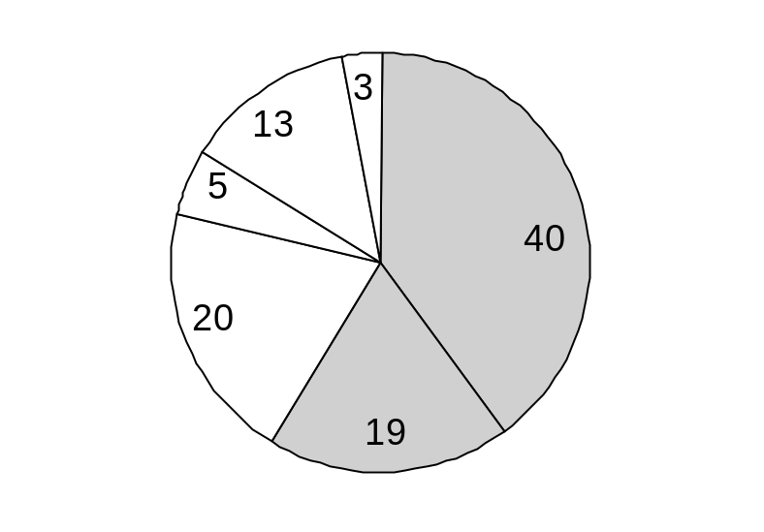
GENERAL PUBLIC EXPECTATIONS – NON-TRADITIONAL VICTIM CLASSES
Response >2/3
Should funds be used for victims needs not met by Federal, State, or private charities?
Percent
Percent favoring donor support for group
Percent
NOV. 1 SURVEY
NOV. 1 SURVEY
All families supported by the victims*
Indicates agreement
Unmarried partners of the victims
Don’t know
Strongly disagree
Roommates sharing only rent with the victim
Somewhat disagree
Strongly agree
OCT. 1 SURVEY
Neither agree nor disagree
U.S. citizens
U.S. permanent residents
Somewhat agree
Foreigners who are legally in the U.S.
Foreigners who not legally in the U.S.
* Such as children and spouse from previous marriage, parents
Source: Alliance survey
Notes:
NY-ZWC698/011101YamorHR2
While two-thirds of those surveyed agreed funds should be set aside for most victim groups that “fall through the cracks,” very few supported giving money to victims that may be illegal immigrants.

Slide 40
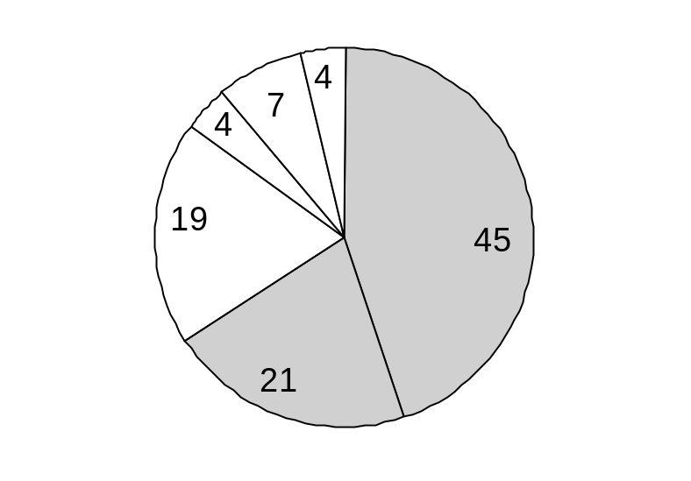
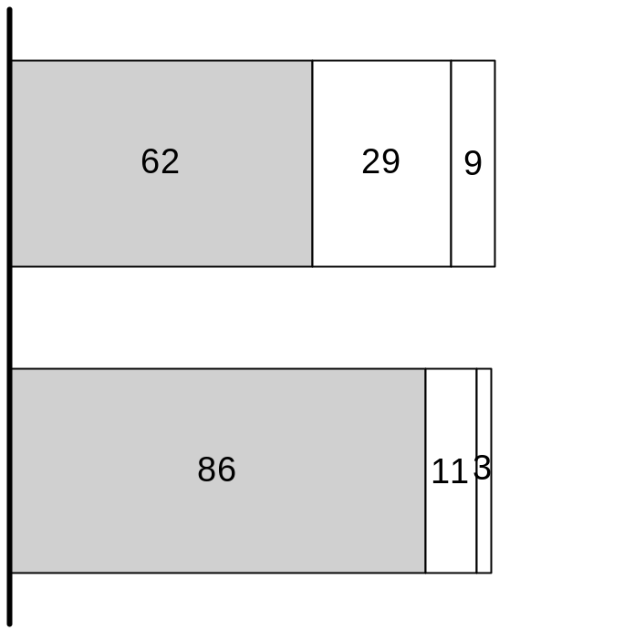
GENERAL PUBLIC EXPECTATIONS – TEMPORAL FOCUS OF DISTRIBUTION
Percent of respondents in agreement that some funds should be set aside to meet long-term needs
Percent of respondents in agreement after learning that government funding may not be immediate
NOV. 1 SURVEY
NOV. 1 SURVEY
Strongly disagree
Don’t know
Don’t know
Should public donations be used to provide funds to victims, recognizing these funds may duplicate government support?
Yes
No
Somewhat disagree
Neither agree nor disagree
Strongly agree
Should donor support be used to provide short-term interest-free loans until victims receive government funds?
Somewhat agree
Source: Alliance survey
Notes:
NY-ZWC698/011101YamorHR2
Most respondents think funds should go to both long-term and short-term needs, and that some funds should be used to bridge the gap between immediate needs and future government support.

Slide 41
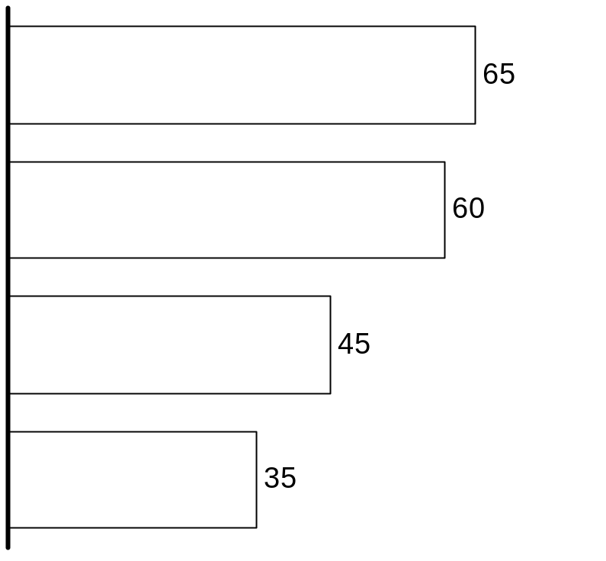
GENERAL PUBLIC EXPECTATIONS – NON-PROFITS
Percent of respondents favoring support
50%
Provided services to victims of Sep. 11th outside their normal course of business
Lost property as a result of the attacks
Did not lose property, but could not operate properly because of ties to the WTC
Lost opportunities to raise money due to events of September 11th
Source: Alliance survey
Notes:
NY-ZWC698/011101YamorHR2
Most respondents felt that directly affected non-profits should receive support.

Slide 42
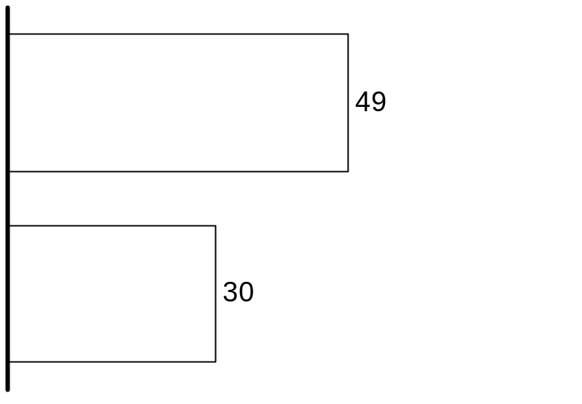
GENERAL PUBLIC EXPECTATIONS – BUSINESSES
Percent of respondents favoring support
50%
Companies that lost property as a result of the attacks
Compared to national respondents, New Yorkers are more sympathetic to affected businesses*
Companies that lost business only as a result of the attacks
* ~10% of New York pool favored each support method compared to national pool
Source: Alliance survey
Notes:
NY-ZWC698/011101YamorHR2
Most respondents felt that small businesses should not be receiving support.

Slide 43
CONTENTS
Executive summary
Overview of available funds
Description of victims and needs
4. Needs and gap assessments
      Individuals
      Small businesses
      Non-profits
5. Donor expectations
6. Lessons from Oklahoma City
7. High-level distribution options

Slide 44
DECISION CRITERIA FOR FUND DISTRIBUTION STRATEGY
Analysis about likely gaps in meeting victim needs
Overall fund distribution strategy
+
  How should funds be apportioned between individuals, non-profits, and small businesses?
Within each group of victims (e.g., individuals) how should support be divided among sub-classes (e.g., families of deceased, injured, displaced)?
For each victim sub-class what specific needs should be provided for? Focus on immediate relief, cash compensation, or support of longer-term efforts to renew/rebuild lives and communities?
Market research about donor expectations
+
Lessons from Oklahoma City
Notes:
Additional insights about the appropriate fund distribution strategy can be gained by learning from the experience of Oklahoma City.

Slide 45
LESSONS FROM THE OKLAHOMA CITY BOMBING EXPERIENCE
Carey Williams, Director of OKC National Memorial
Bob Spinks, United Way of OKC
“While it took 3-4 years to distribute most funds raised for victims of the OKC tragedy, we are still dispersing funds.”
“We are still supporting the victims of OKC. We recently funded counseling for a reporter who covered the tragedy. His support was six years in the making.”
Dan Kurtenbach, Resource Coordination Committee, OKC
Nancy Anthony, Director, OKC Community Foundation
“The majority of our work and our value to the community has been supporting long-term needs. You will not know what those needs are for at least a year.”
  “This is not about dishing out money; it’s about helping people rebuild their lives, and that takes time.”
  “End the ‘divide the pot’ mentality.”
  “We don’t bring calculators and checkbooks; we bring expertise.”
Notes:
Those individuals involved in Oklahoma City fund distribution stressed the importance of taking a long-term approach to serving victims’ needs.

Slide 46
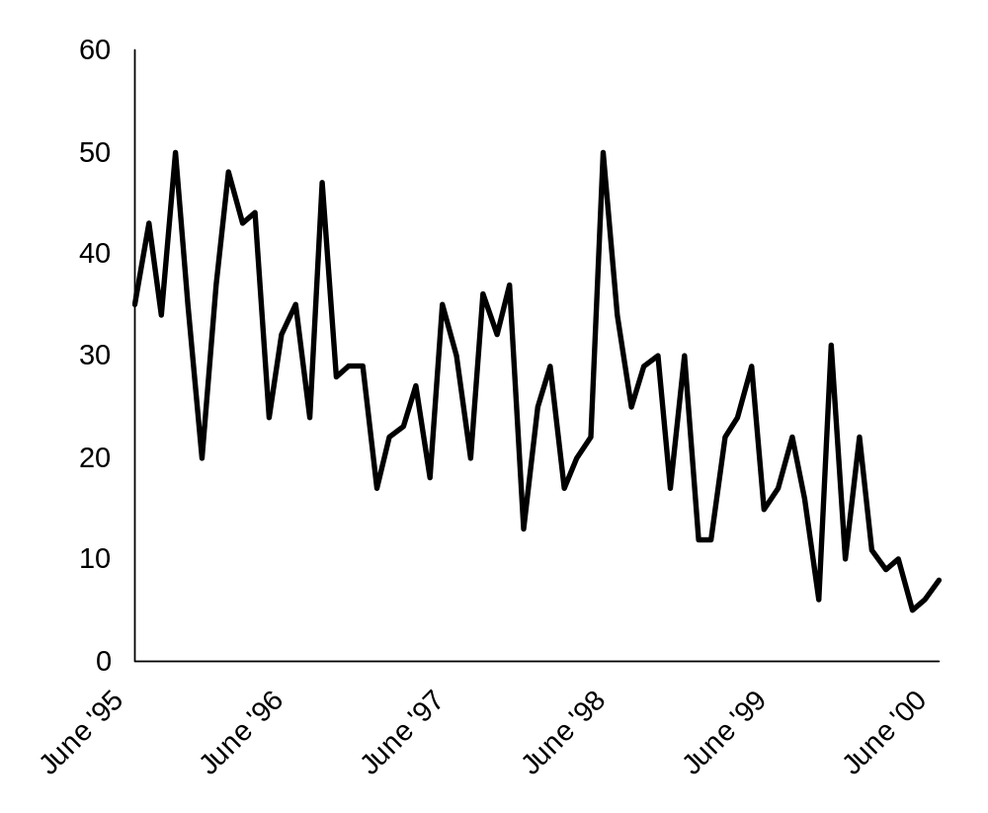
CASE VOLUME OF OKLAHOMA CITY BOMBING DISASTER RELIEF
Number of cases served monthly
Highest monthly volume
occurred within 3 months of attack (50 cases), and then again 3 years later
Victims of Oklahoma City Bombing continued to require significant assistance long after April 1995
Case volume
Source: Interviews with Dan Kurtenbach, Director, Oklahoma City Resource Coordination Committee
Notes:
NY-ZWC698/011101YamorHR2
The consistent case volume in Oklahoma City supports the official view there that disaster relief efforts are long-term.

Slide 47
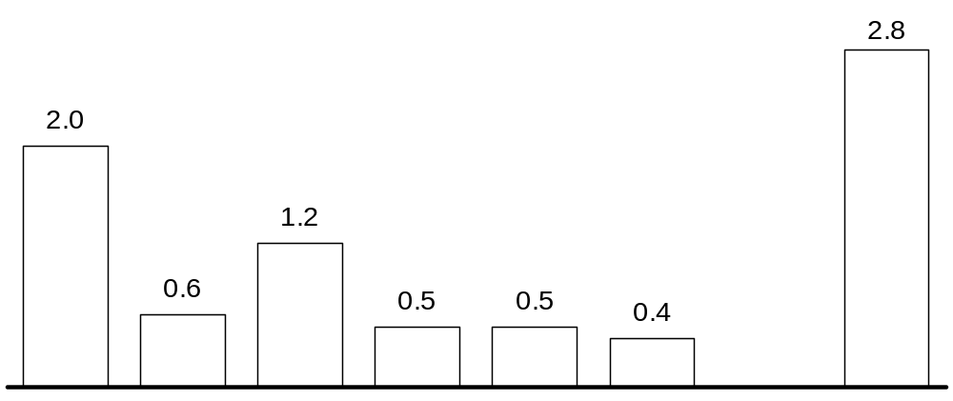
DISTRIBUTION OF OKLAHOMA CITY COMMUNITY FOUNDATION FUND
$ Millions
Focus of funds – long-term needs of community
(e.g., mental health, medical care, scholarships)
Year 1
Year 2
Year 3
Year 4
Year 5
Year 6
Funds remaining
Percent of total $8 million raised
25%
8
15
6
6
5
35
* Does not include $7 million earmarked for college scholarships for children of deceased
Source: OKC Community Foundation
Notes:
NY-ZWC698/011101YamorHR2
The Oklahoma City Community Foundation Fund chose to take a long term approach to distribution and still has a third of the funds remaining after six years.

Slide 48
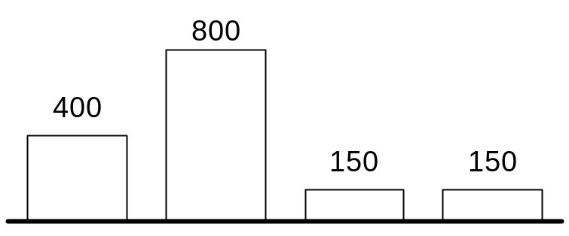
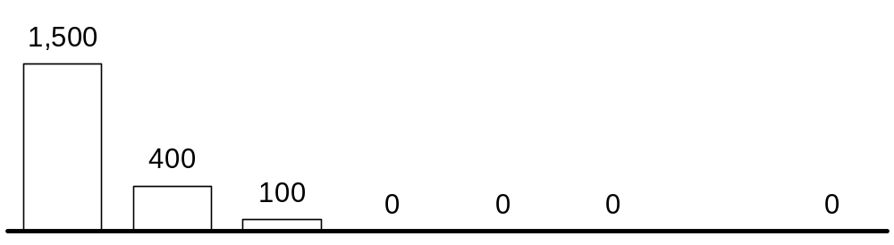
DISTRIBUTION OF FUNDS BY UNITED WAY OF OKLAHOMA CITY
$ Thousands
UWOKC fund = $2 million
United Way funds were dispersed over 3 years
  Only 20% disbursed in the first 3 months
  25% distributed after first year
Q1
Q2
Q3
Q4
Year 1
Year 2
Year 3
Year 4
Year 5
Year 6
Funds remaining
Percent of total
75%
20
5
–
–
–
–
Source: Interviews with United Way of OKC
Notes:
NY-ZWC698/011101YamorHR2
Although the United Way of Oklahoma City distributed over the half the funds in six months, it still took three years to distribute all funding.

Slide 49
CONTENTS
Executive summary
Overview of available funds
Description of victims and needs
4. Needs and gap assessments
      Individuals
      Small businesses
      Non-profits
5. Donor expectations
6. Lessons from Oklahoma City
7. High-level distribution options

Slide 50
DECISION CRITERIA FOR FUND DISTRIBUTION STRATEGY
Analysis about likely gaps in meeting victim needs
Overall fund distribution strategy
+
  How should funds be apportioned between individuals, non-profits, and small businesses?
Within each group of victims (e.g., individuals) how should support be divided among sub-classes (e.g., families of deceased, injured, displaced)?
For each victim sub-class what specific needs should be provided for? Focus on immediate relief, cash compensation, or support of longer-term efforts to renew/rebuild lives and communities?
Market research about donor expectations
+
Lessons from Oklahoma City
Notes:
Having examined funding gaps, donor expectations, and the lessons of Oklahoma City, fund distribution strategy questions can now be addressed.

Slide 51
SUMMARY OF FUNDING GAPS
Extent of gap
<20% met
20-70% somewhat
>70% substantially
Individuals
Small businesses
Non-profits
Needs
Needs
Needs
Immediate relief
Compen-sation
Rebuild & renew
Immediate relief
Compen-sation
Rebuild & renew
Immediate relief
Compen-sation
Rebuild & renew
Primary
Primary
N/A
Primary
N/A
Secondary
Secondary
N/A
Secondary
Victim class
Victim class
N/A
Victim class
N/A
Tertiary
Tertiary
N/A
Tertiary
N/A
N/A
N/A
N/A
Met needs
  Immediate relief needs largely met
  Direct compensation needs have not yet been met, likely to be met in future
  None
  Direct compensation for loss/damage of facilities and equipment and funds expended on 9/11 relief efforts
Unmet needs
  Large gap in meeting needs required to rebuild victims lives and review communities (e.g., job training, counseling, child care)
  Specific unmet needs for compensation
    Underserved demographic groups
    Bridging gaps between immediate relief payments and later compensation payout
  Small business funding gap for those who lost office space or equipment and all businesses who lost revenue
  Non-profits need to bridge fundraising gap to renew and rebuild
Notes:
There are significant unmet needs in every victim group – individuals, small businesses, and non-profits.

Slide 52
KEY CONSIDERATIONS BY VICTIM CLASS
Individuals
Small businesses
Non-profits
  Clear public demand for support for individual victims
  Despite significant public monies, clear shortfall exists in meeting the needs (particularly longer-term) of individual victims
  Oklahoma City case study shows that longer-term cost of rebuilding victims lives (by providing child care, job training, counseling, etc.) is significant and should not be underestimated
  Less public appetite for funding entities
  Needs arising from lost revenue because of slow-down in business may seem too indirect
  Significant loan funding available, however, may not be easily accessible for all small businesses (since personal guarantees are generally required where there is limited collateral)
  Less public appetite for funding entities
  While loan funding is available it may not be easily accessible for all non-profits
  Needs of non-profits directly disrupted (e.g., destroyed offices) likely to be met
  Most of the remaining impact is in the form of lost fundraising opportunities and may be seen as too indirectly related to the events of September 11th
Notes:
It is clear that funding should be provided for individual victims, it is less clear how much should be spent to help small businesses and non-profits.

Slide 53
OPTIONS BASED ON FUNDING GAPS AND DONOR EXPECTATIONS
Option 1
Provide significant cash compensation to all without means testing
Provide significant cash compensation to those ineligible for other programs
Provide significant cash compensation to primary victims with means testing
Current process: Provide immediate relief to primary and secondary victims
Needs
Immediate relief
Compensation
Renew and rebuild
Funding gap: low
Donor
expectation: high
Funding gap: medium
Donor
expectation: high
Funding gap: med/high
Donor
expectation: med/high
  Which options should be supported?
  How much should be allocated for each option?
  When should the funds be disbursed?
Primary
Victims
Funding gap: low
Donor
expectation: high
Funding gap: low
Donor
expectation: medium
Funding gap: high
Donor
expectation: med/high
Secondary
Tertiary
Funding gap: n/a
Donor
expectation: low
Funding gap: medium
Donor
expectation: low
Funding gap: high
Donor
expectation: medium
Option 2: Focus efforts on renewing and rebuilding lives and communities
Notes:
In addition to current practice two non-exclusive distribution options exist where either funding gaps or donor expectations are high.

Slide 54
CURRENT PROCESS
Current process: Provide immediate relief to primary and secondary victims
  Meets most pressing needs
  Focuses on primary and secondary victims
  Funding currently exists for most immediate relief, e.g., provided by September 11th Fund through Safe Horizon
  Satisfies public outcry for immediate assistance
Notes:
Immediate relief for individuals is already being provided to those in need, including through the September 11th Fund’s grants to Safe Horizon.

Slide 55
OPTION 1
Option 1A: Provide significant cash compensation to all primary victims without means testing
Option 1B: Provide cash compensation to victims ineligible for other programs
Option 1C: Significant cash compensation to primary victims with means testing
  Presents an easy way to get money out quickly and meet public expectations
  Serves primary victims
  Government money will likely eventually meet the needs of these victims so funding may be duplicative
  May not meet IRS 501(c)(3) requirements if not means-tested; IRS appears ready to waive
  Not all victims will be eligible for all benefits, and while some victims may be fully taken care of, others may fall through the cracks
  Serves primary and secondary victims
  Meets compensation needs
  Support to some of these victims may not be popular with donors
  While victims are receiving emergency assistance and will most likely get large compensation payouts at some point, some victims may experience financial hardship in the interim and require funds to bridge the gap
  Means-testing ensures that actual financial hardships due to timing of compensation are identified and duplications is minimized
  Serves primary victims
  Meets compensation needs
  Could be in form of loans or grants
  May take considerable time and infrastructure to introduce means- testing mechanism
Giving large cash payments to all primary victims would be easy and equitable, but would likely duplicate other funding sources and may jeopardize 501(c)(3) status
Providing direct compensation to victims who are ineligible for other funding addresses real needs but may not always be popular
Providing bridge funding for primary victims could alleviate financial hardships and address real needs
Notes:
Three possible ways exist to provide significant cash compensation for primary victims. The issue of cash compensation is one of particular public concern.

Slide 56
OPTION 2
Option 2:
Focus efforts to renew and rebuild lives and communities
  Largest area of need for individual victims; limited money committed so far specifically for addressing these needs
  Serves primary, secondary, and tertiary victims
  Could fill needs in counseling, community education, job training, legal and financial services
  Core competency of United Way and New York Community Trust
  Longer term investments don’t meet public demand for immediate and visible support
Notes:
Providing funding to meet the longer-term needs to renew victims’ lives and rebuild communities is in line with the work that the United Way and NYCT traditionally perform. However, this longer term indirect approach to aid may not meet public demands for quick and clear action.

Slide 57
SAMPLE FRAMEWORK FOR FUND DISTRIBUTION
ILLUSTRATIVE
Proportion of funds spent
2001-2003
Beyond 2003
Individuals
  Current practice: immediate relief
25%*
0%
  Option 1: direct cash compensation
    A: without means-testing
    B: victims who are ineligible for compensation under other programs
    C: with means testing
15% / 0%**
0%
5%
0%
15% / 0%**
0%
  Option 2: rebuild and renew victims’ lives
25%
20%
Small businesses
5%
0%
Non-profits
5%
0%
* Includes funds already dispensed
** Need to understand whether IRS will waive means-testing requirement and how difficult it will be to implement means testing
Notes:
A decision-making framework that makes explicit which victims to fund and over what period will allow the September 11th Fund to focus on programmatic decisions about which specific needs to meet and which agencies to fund.

Slide 58
OTHER IMPORTANT POLICY CONSIDERATIONS
Issue
  How should we distribute funds (directly or indirectly)?
  How should we designate funds to geographies outside of NY?
  How should recipient agencies pay for their administrative expenses?
  How will the timing of distribution affect governance and infrastructure requirements?
Notes:
Once a high-level fund distribution strategy is decided, the September 11th Fund needs to address a range of policy issues.

