Slide 1
Chinatown Tourism Marketing Campaign

Slide 2
Chinatown Team
Marketing Communications Experts
  NYC & Company
  Asian Women in Business
  Dentsu Communications
  M. Silver Associates
  Soury Communications
Chinatown Businesses & Community Leaders
Funded by LMDC & September 11th Fund
Notes:
NYC & Co.: NY’s official tourism agency, formerly Convention & Visitors Bureau. Vast outreach. Instant access to millions through pubs, events, Website
AWIB: not-for-profit org providing tech assistance for small biz owners
2 years w/ Empire State Dev. Corp.
Dentsu: wholly-owned subsidiary of world’s largest ad agency
proj. mgmt & adv.. Pearl River.
M. Silver Assoc.: 30 yrs. Travel & tourism PR & mktng
Aspen to Thailand, 250 industry awards
Soury: Metro market, Chinatown, Gov’t relations
6 years w/ Asian Americans for Equality, GM Harlem
Advisory Committee: Chinatown leaders in cross-section of businesses and cultural organizations

Slide 3
Challenge & Mission
Chinatown has suffered severely as a result of 9/11
Tourism most promising area for short- to mid-term relief
Explore Chinatown is a self-sustaining program for increasing the number of tourists visiting Chinatown, and spending money there, from local, national and international regions, thereby improving Chinatown’s economy by generating revenue and jobs

Slide 4
Target Audiences
Visitors to New York City each year: 35 million
  Visitor spending in New York City each year: $14 billion
Visitors to Lower Manhattan each year: 8.1 million
Visitors to Ground Zero in 2002: 3.2 million
  Projected visitors to Ground Zero annually upon completion of memorial: 5 - 10 million
Visitors to Chinatown each year: 1 million
Establishing metrics with NYC & Co. and Chinatown businesses to track success
    Sources: Lower Manhattan Development Corporation, NYC & Company, Port Authority of NY & NJ, Downtown Alliance, Asian American Federation of New York

Slide 5
Explore Chinatown

Slide 6
Positioning and Branding
As the largest and most authentic Chinese community outside China, and as part of the most exciting city in the world, New York City’s Chinatown is a uniquely rewarding travel destination to explore

Slide 7

Notes:
Perfect example of Advisory Committee’s role
Tradition meets modern: name, graphic, font

Slide 8
Strategies
Awareness
  Raise awareness of what Chinatown offers today as a destination by “bringing Chinatown to the people”
Guide
  Provide tourists with tools to guide them to and through Chinatown
Partner
  With the Chinatown community for unprecedented access
Notes:
Unexpected: Silk Road, Take Out Comedy

Slide 9
Core Tactics
        Public Relations
        Website
        Collateral
        Event Marketing
        Sponsorships

Slide 10
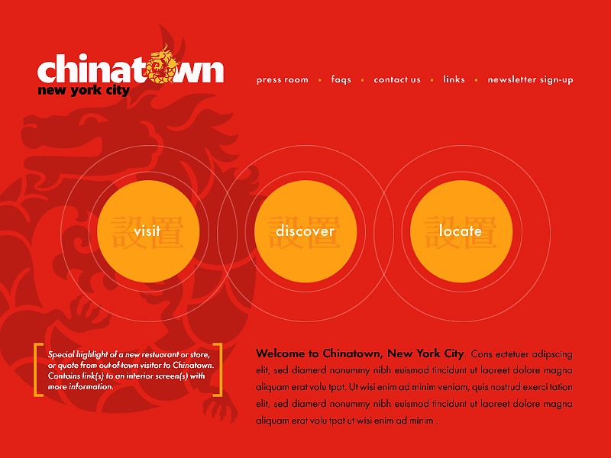
ExploreChinatown.com
Notes:
Invaluable resource based on unprecedented access
Tools for guiding visitors to and through Chinatown
Link to NYC & Co. site

Slide 11
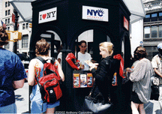
From Kiosk to Visitors’ Center
Similar to kiosk at PATH station near the WTC site
“Info oasis” and meeting place

Slide 12
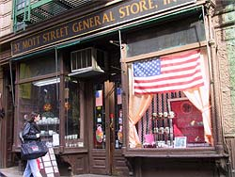
Chinatown Visitors Center
32 Mott Street: a cultural treasure in the heart of Chinatown
Opened in 1891 as a general store. The longest continuously-run store in Chinatown until its closure in 2003, its contents are largely preserved intact

Slide 13
Zagat’s Chinatown Guide
Special Zagat’s guide to Chinatown, to combine Zagat’s-rated restaurants with additional content, listings and maps

Slide 14
In Development - Sponsorship & Sustainability
Chinatown Summer Festival
Dragon Express Trolley Bus
TV Food Network Program Produced in Chinatown

Slide 15
Explore Chinatown

