Slide 1
(Revised) Universal Soil Loss Equation (RUSLE)
An empirical model for estimating soil erosion

Slide 2
Aims
Background
Factors controlling soil erosion
The RUSLE model for approximating soil loss rates
Implementing RUSLE model in a programming language

Slide 3
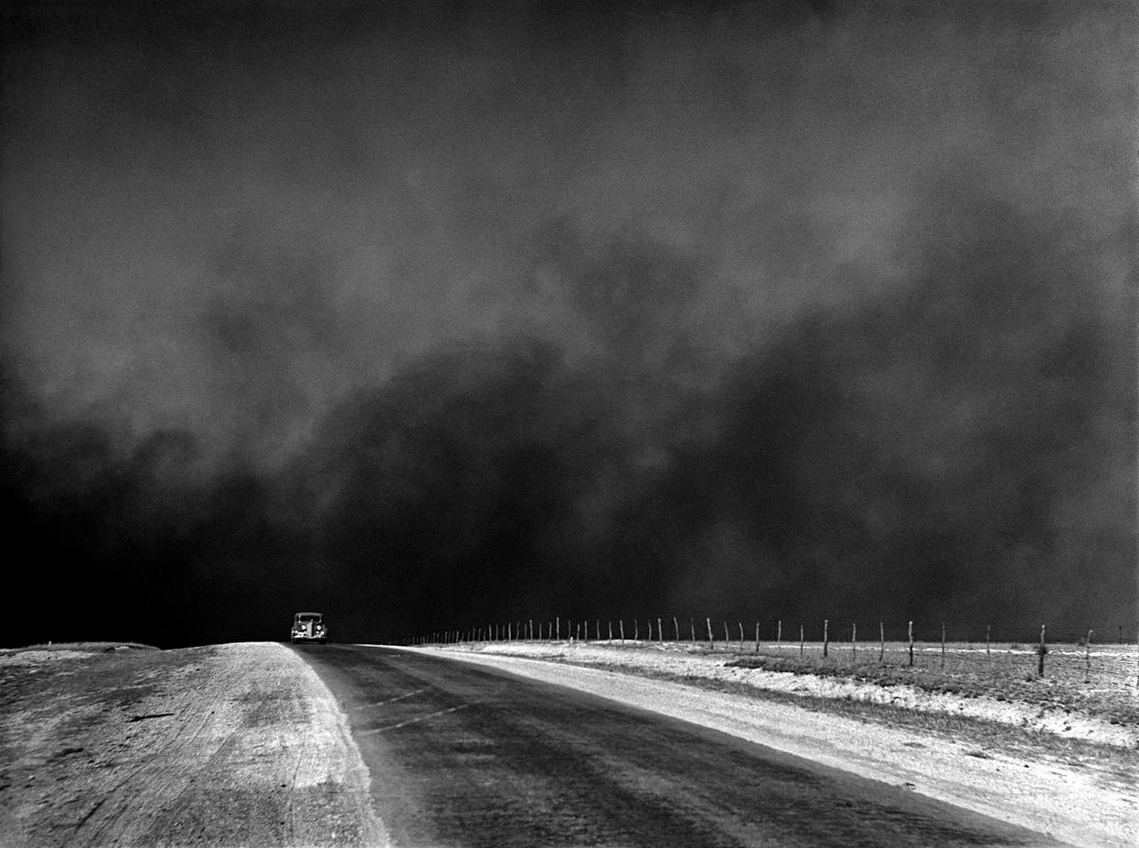
Soil Erosion
The transport of soil particles from one location to another
Occurs naturally but is often made worse by management
Average soil loss rates Europe: 17 t ha⁻¹
Average soil loss rates Natural Forest: 0.004-0.05 t ha^{-1 *}
Soil erosion greater than rates of paedogenesis => will run out of well-developed soil
Nutrient loss/pollution (P), siltation of rivers
Dust Bowl, Texas, 1936 (Arthur Rothstein/Wikipedia)
*https://doi.org/10.1126/science.267.5201.1117

Slide 4
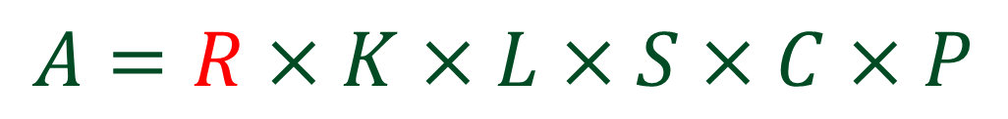
Main RUSLE equation
Slope steepness factor [-]
Soil erodibility factor [t hour MJ⁻¹ mm⁻¹]
Mean annual soil loss [t (ha year)⁻¹]
Support practice factor [-]
$$A=R×K×L×S×C×P$$
Rainfall and runoff [MJ mm ha⁻¹ year⁻¹ hour⁻¹ ]
Slope length factor [-]
Cover and management factor [-]
Does not account for soil loss from landslides or soil loss from gullies
https://doi.org/10.5194/hess-22-6059-2018

Slide 5
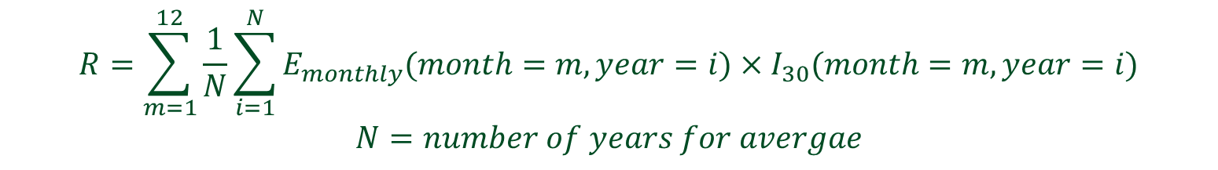
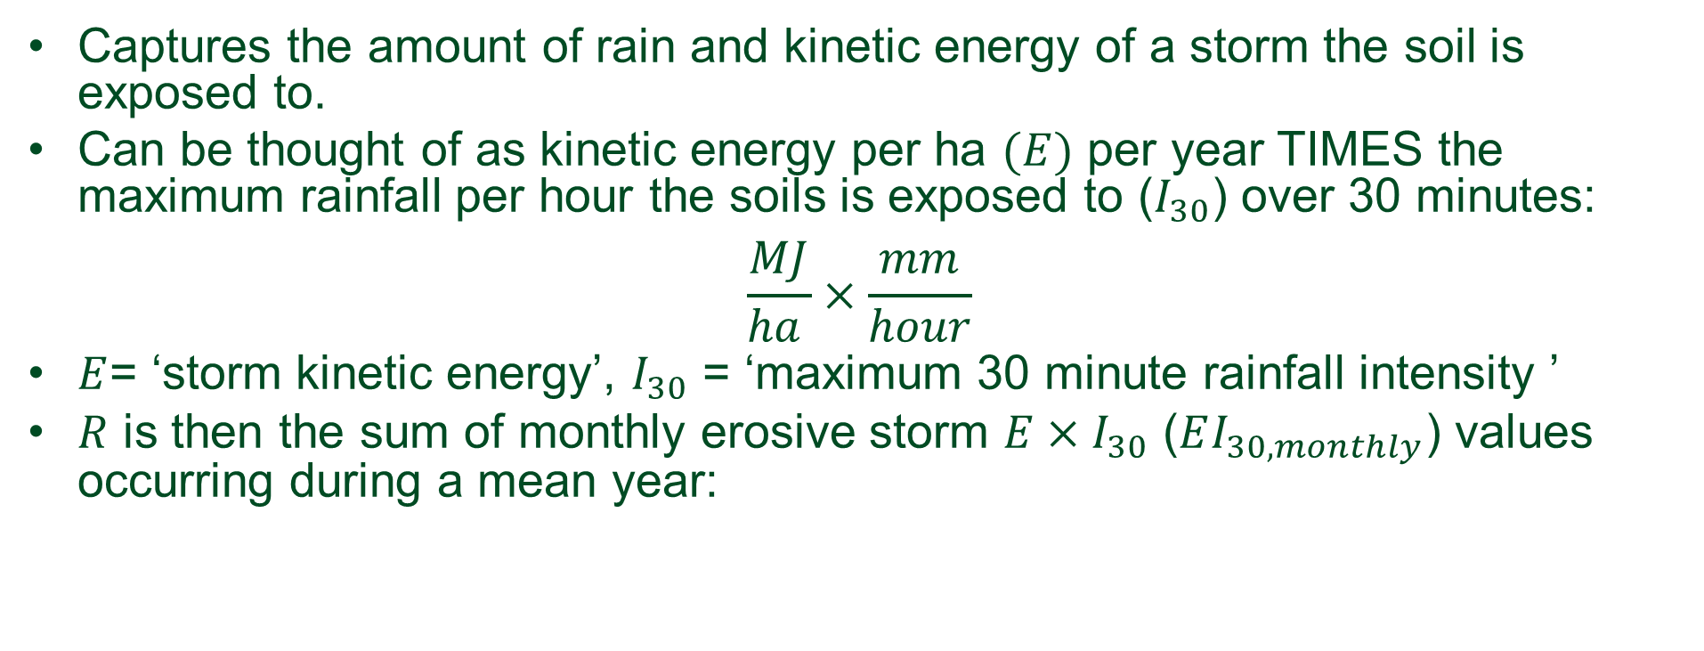
R – Rainfall and Runoff Factor
Captures the amount of rain and kinetic energy of a storm the soil is exposed to.
Can be thought of as kinetic energy per ha $(E)$ per year TIMES the maximum rainfall per hour the soils is exposed to ($I_{30}$) over 30 minutes:
$$\frac{MJ}{ha }×\frac{mm}{hour}$$
$E$= ‘storm kinetic energy’, $I_{30}$ = ‘maximum 30 minute rainfall intensity ’
$R$ is then the sum of monthly erosive storm $E×I_{30}$ ($EI_{30,monthly}$) values occurring during a mean year:
$$R=\sum_{m=1}^{12}{\frac{1}{N}\sum_{i=1}^{N}{E_{monthly}(month=m,year=i)×I_{30}(month=m,year=i)}}$$
$$N=number of years for avergae$$

Slide 6
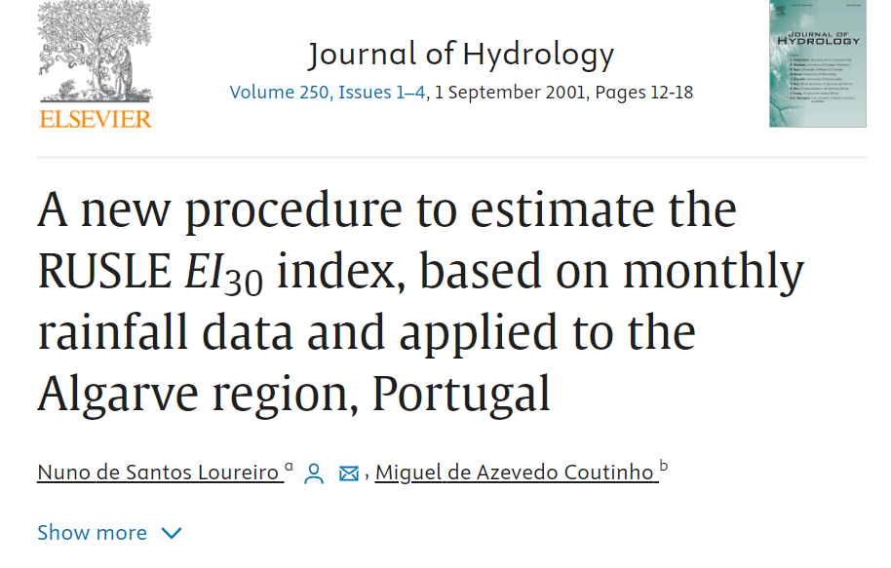

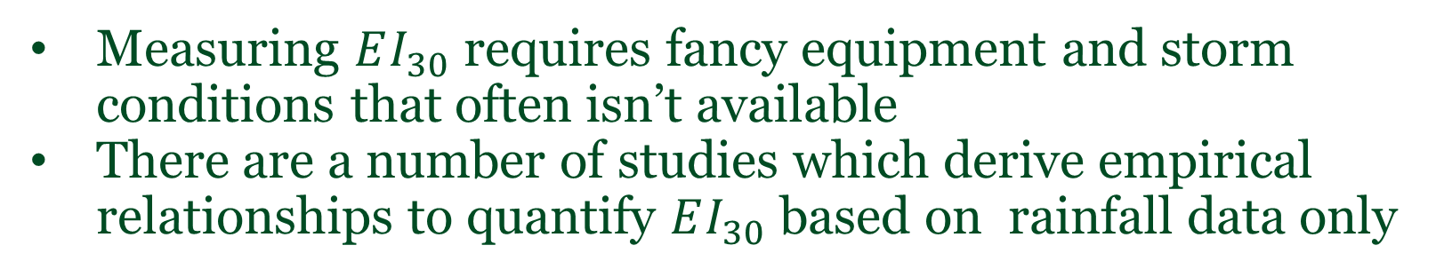
Computing $EI_{30}$
Measuring $EI_{30}$ requires fancy equipment and storm conditions that often isn’t available
There are a number of studies which derive empirical relationships to quantify $EI_{30}$ based on rainfall data only

Slide 7
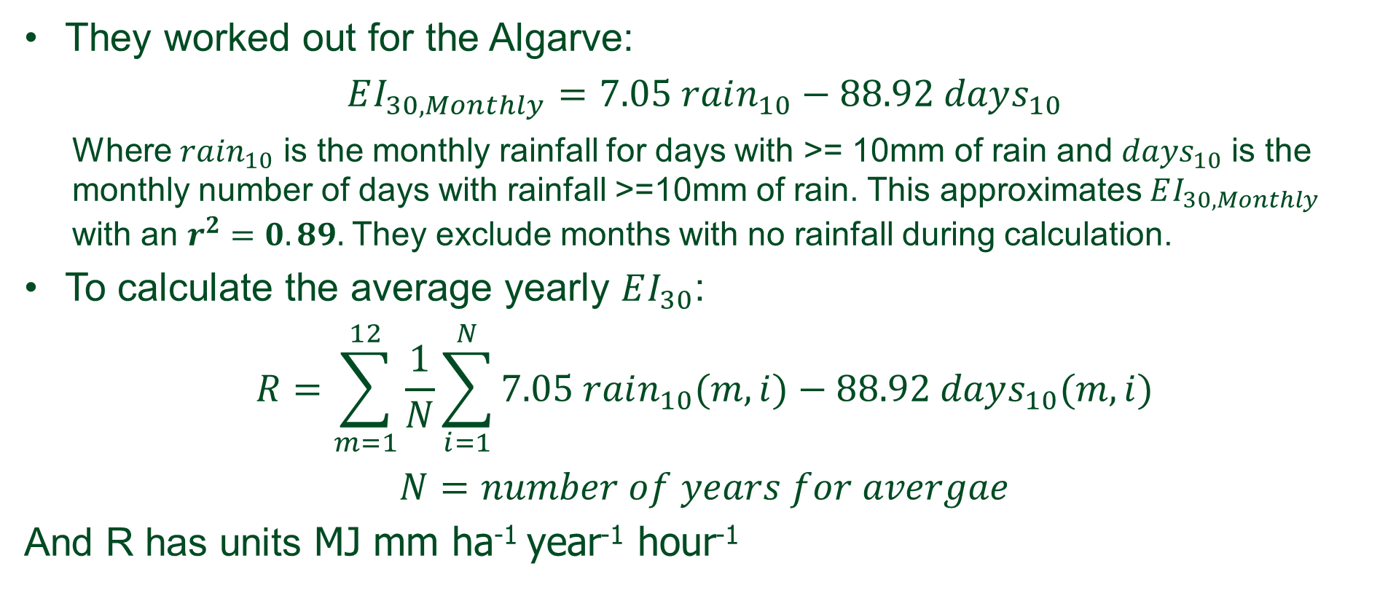

Computing $EI_{30,monthly}$
They worked out for the Algarve:
$$EI_{30,Monthly}=7.05 rain_{10}−88.92 days_{10}$$
Where $rain_{10}$ is the monthly rainfall for days with >= 10mm of rain and $days_{10}$ is the monthly number of days with rainfall >=10mm of rain. This approximates $EI_{30,Monthly}$ with an $r^{2}=0.89.$ They exclude months with no rainfall during calculation.
To calculate the average yearly $EI_{30}$:
$$R=\sum_{m=1}^{12}{\frac{1}{N}\sum_{i=1}^{N}{7.05 rain_{10}(m,i)−88.92 days_{10}(m,i)}}$$
$$N=number of years for avergae$$
And R has units MJ mm ha⁻¹ year⁻¹ hour⁻¹

Slide 8

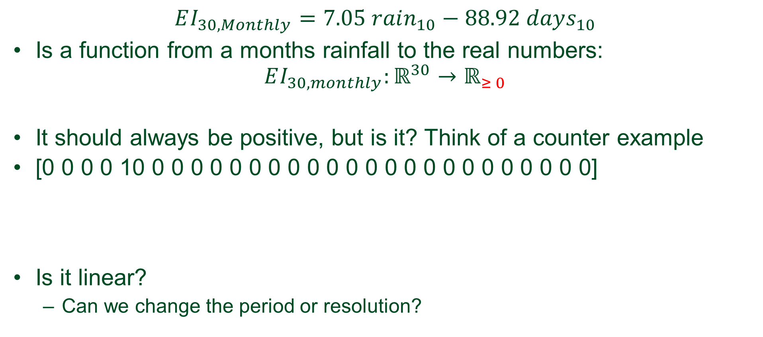
Be careful, our $EI_{30,monthly}$ apporximation is empirical
$$EI_{30,Monthly}=7.05 rain_{10}−88.92 days_{10}$$
Is a function from a months rainfall to the real numbers: $EI_{30,monthly}:ℝ^{30}→ℝ_{≥ 0}$
It should always be positive, but is it? Think of a counter example
[0 0 0 0 10 0 0 0 0 0 0 0 0 0 0 0 0 0 0 0 0 0 0 0 0 0 0 0]
Is it linear?
Can we change the period or resolution?
Notes:
A function $f:R^{n}→R$ is linear if and only if :
$f\left(x+y\right)=f\left(x\right)+f\left(y\right) for all x,y∈ℝ^{n}$
$f\left(λx\right)=λf\left(x\right) for all x∈ℝ^{n} and λ∈ℝ$

Slide 9
Jupyter NOTEBOOK: Section 𝑅 - Rainfall and Runoff Factor

Slide 10
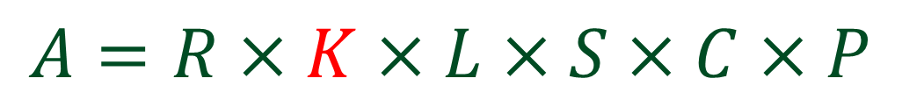
Main RUSLE equation
Slope steepness factor [-]
Soil erodibility factor [t hour MJ⁻¹ mm⁻¹]
Mean annual soil loss [t (ha year)⁻¹]
Support practice factor [-]
$$A=R×K×L×S×C×P$$
Rainfall and runoff [MJ mm ha⁻¹ year⁻¹ hour⁻¹ ]
Slope length factor [-]
Cover and management factor [-]
https://doi.org/10.5194/hess-22-6059-2018

Slide 11
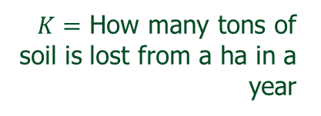




Soil erodibility factor -$K$
Captures the influence of soil properties (e.g. soil texture, OM% etc) on susceptibility to erosion:
“mean annual soil loss per unit of rainfall erosivity for a standard condition of bare soil, recently tilled up-and-down slope with no conservation practice at a 9% slope of length 22m”
$$R$$
1 unit of $R$
$22$ m of tilled soil
9
$K=$ How many tons of soil is lost from a ha in a year
100

Slide 12
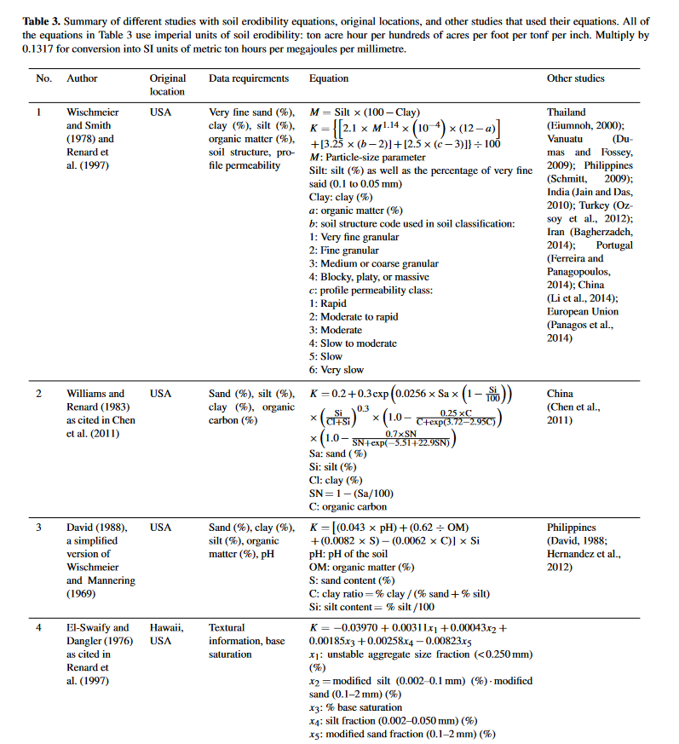
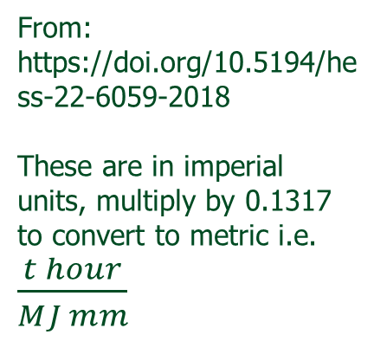
Soil erodibility factor -$K$
From: https://doi.org/10.5194/hess-22-6059-2018
These are in imperial units, multiply by 0.1317 to convert to metric i.e. $\frac{t hour}{MJ mm}$

Slide 13
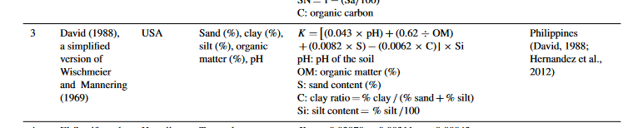
Soil erodibility factor -$K$
From: https://doi.org/10.5194/hess-22-6059-2018
These are in imperial units, multiply by 0.1317 to convert to metric i.e. $\frac{t hour}{MJ mm}$

Slide 14
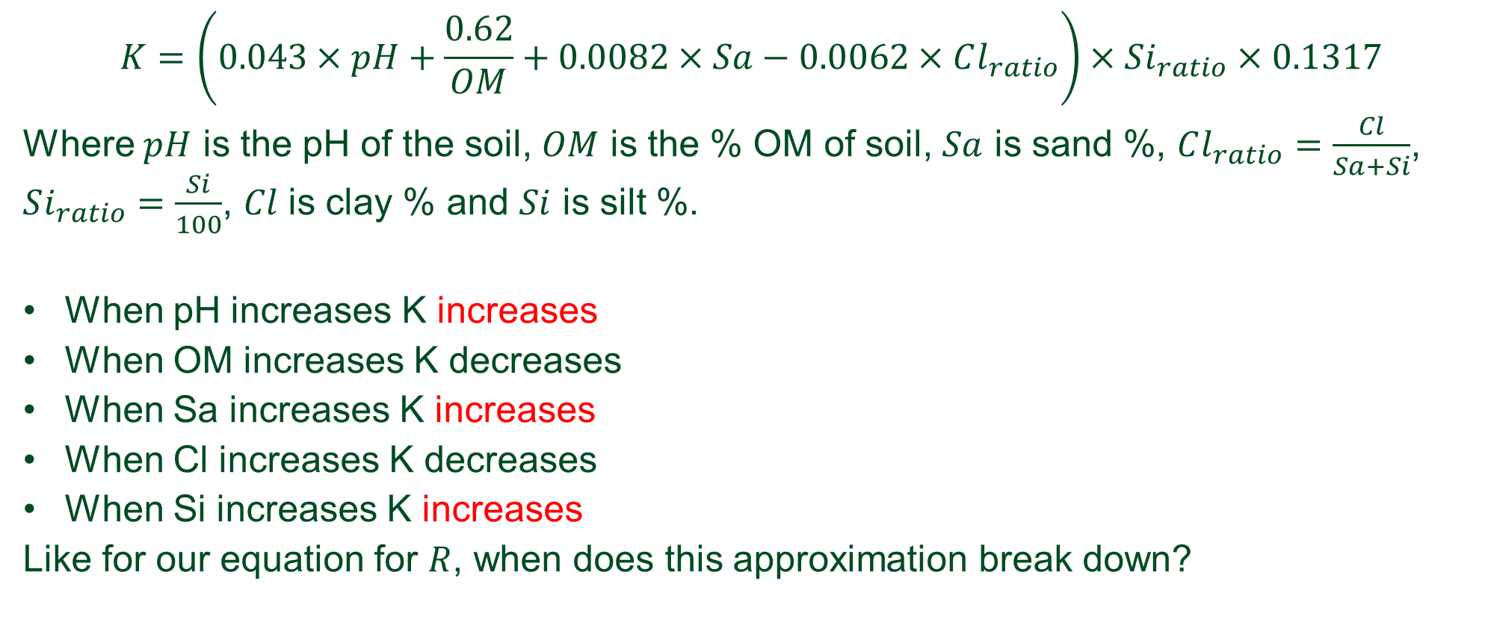

Analysis of equation for -$K$
$$K=\left(0.043×pH+\frac{0.62}{OM}+0.0082×Sa−0.0062×Cl_{ratio}\right)×Si_{ratio}×0.1317$$
Where $pH$ is the pH of the soil, $OM$ is the % OM of soil, $Sa$ is sand %, $Cl_{ratio}=\frac{Cl}{Sa+Si}$, $Si_{ratio}=\frac{Si}{100}$, $Cl$ is clay % and $Si$ is silt %.
When pH increases K increases
When OM increases K decreases
When Sa increases K increases
When Cl increases K decreases
When Si increases K increases
Like for our equation for $R$, when does this approximation break down?

Slide 15
Jupyter NOTEBOOK: Section K - Soil erodibility factor

Slide 16
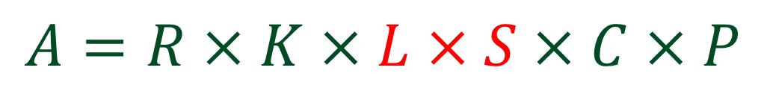
Main RUSLE equation
Slope steepness factor [-]
Soil erodibility factor [t hour MJ⁻¹ mm⁻¹]
Mean annual soil loss [t (ha year)⁻¹]
Support practice factor [-]
$$A=R×K×L×S×C×P$$
Rainfall and runoff [MJ mm ha⁻¹ year⁻¹ hour⁻¹ ]
Slope length factor [-]
Cover and management factor [-]
https://doi.org/10.5194/hess-22-6059-2018

Slide 17
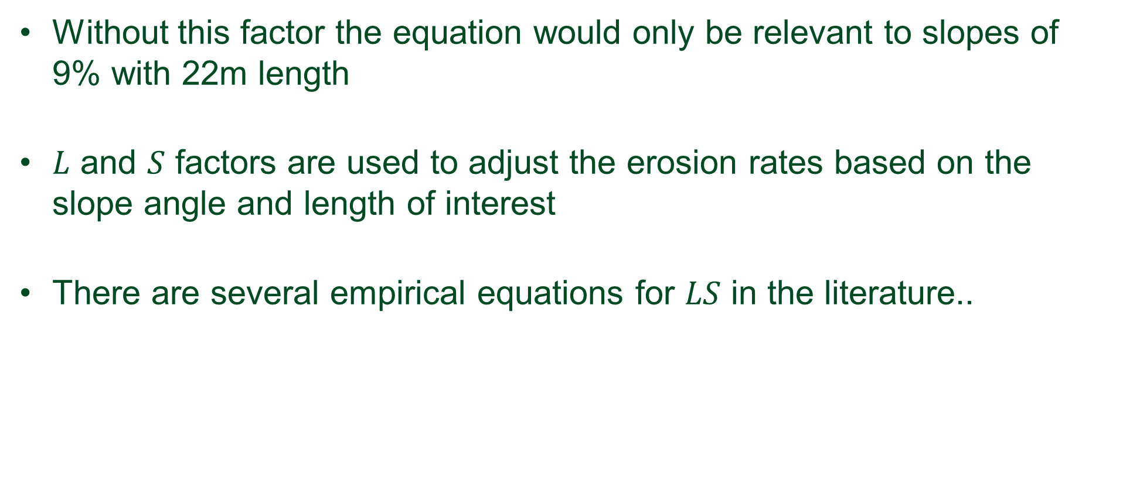

Slope length and steepness factor- $LS$
Without this factor the equation would only be relevant to slopes of 9% with 22m length
$L$ and $S$ factors are used to adjust the erosion rates based on the slope angle and length of interest
There are several empirical equations for $LS$ in the literature..

Slide 18
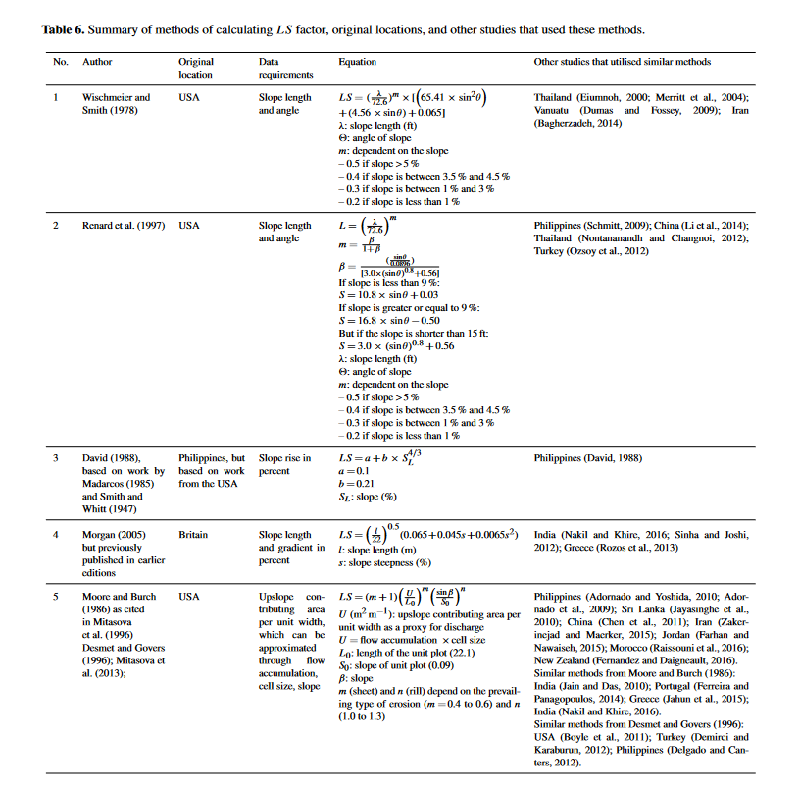
Slope length and steepness factor- $LS$
From: https://doi.org/10.5194/hess-22-6059-2018

Slide 19
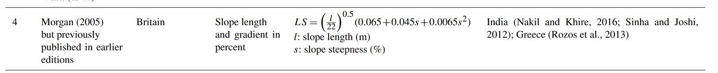


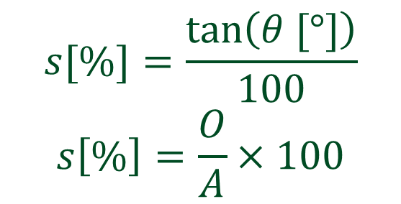


Slope length and steepness factor- $LS$
$$l$$
$$s[\%]=\frac{tan\left(θ [°]\right)}{100}$$
$$s\left[\%\right]=\frac{O}{A}×100$$
$$O$$
$$θ$$
$$A$$

Slide 20
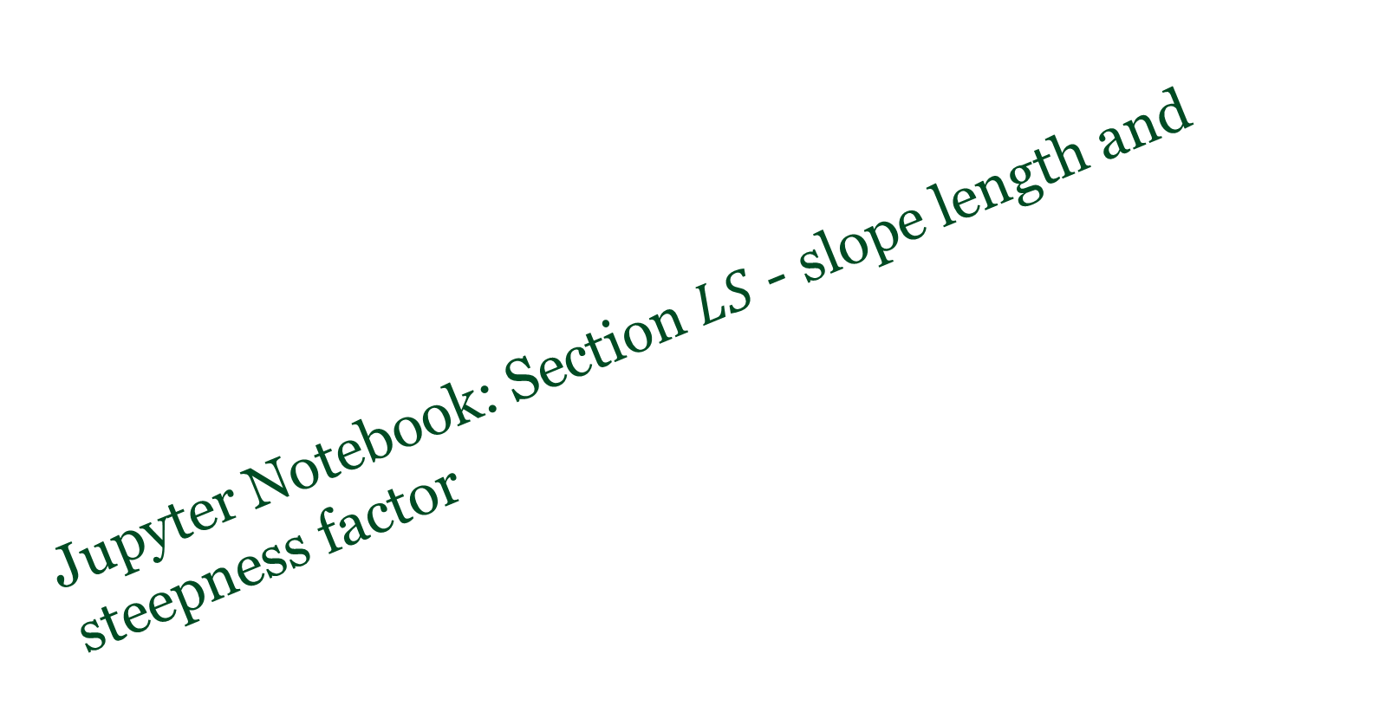
Jupyter Notebook: Section $LS$ - slope length and steepness factor

Slide 21
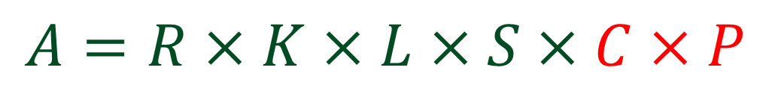
Main RUSLE equation
Slope steepness factor [t h MJ⁻¹ mm⁻¹]
Soil erodibility factor [t h MJ⁻¹ mm⁻¹]
Mean annual soil loss [t (ha year)⁻¹]
Support practice factor [-]
$$A=R×K×L×S×C×P$$
Rainfall and runoff [MJ mm ha⁻¹ year⁻¹ hour⁻¹ ]
Slope length factor [-]
Cover and management factor [-]
https://doi.org/10.5194/hess-22-6059-2018

Slide 22
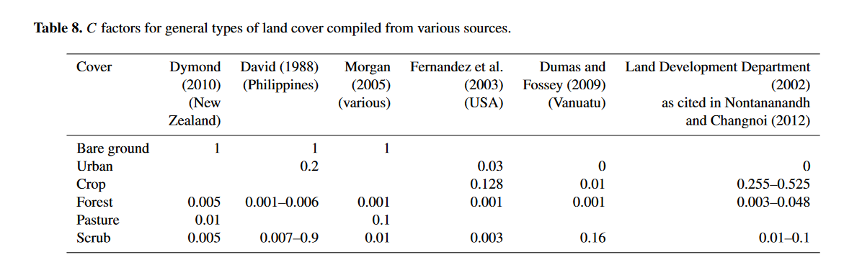

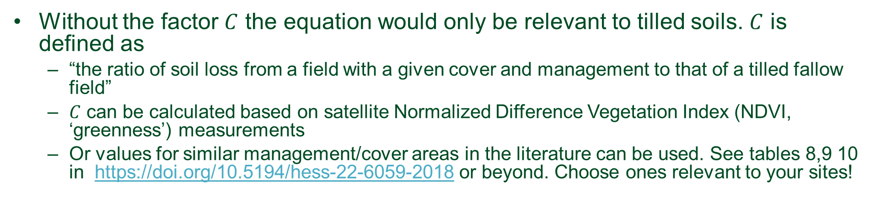
Cover and management factor - $C$
Without the factor $C$ the equation would only be relevant to tilled soils. $C$ is defined as
“the ratio of soil loss from a field with a given cover and management to that of a tilled fallow field”
$C$ can be calculated based on satellite Normalized Difference Vegetation Index (NDVI, ‘greenness’) measurements
Or values for similar management/cover areas in the literature can be used. See tables 8,9 10 in https://doi.org/10.5194/hess-22-6059-2018 or beyond. Choose ones relevant to your sites!

Slide 23
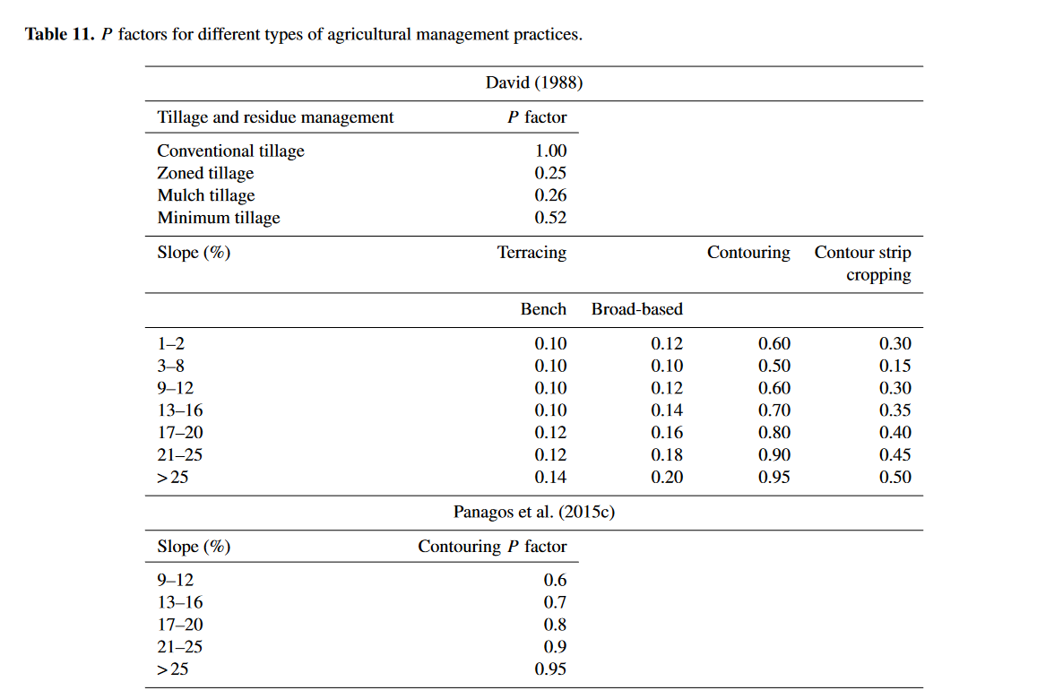
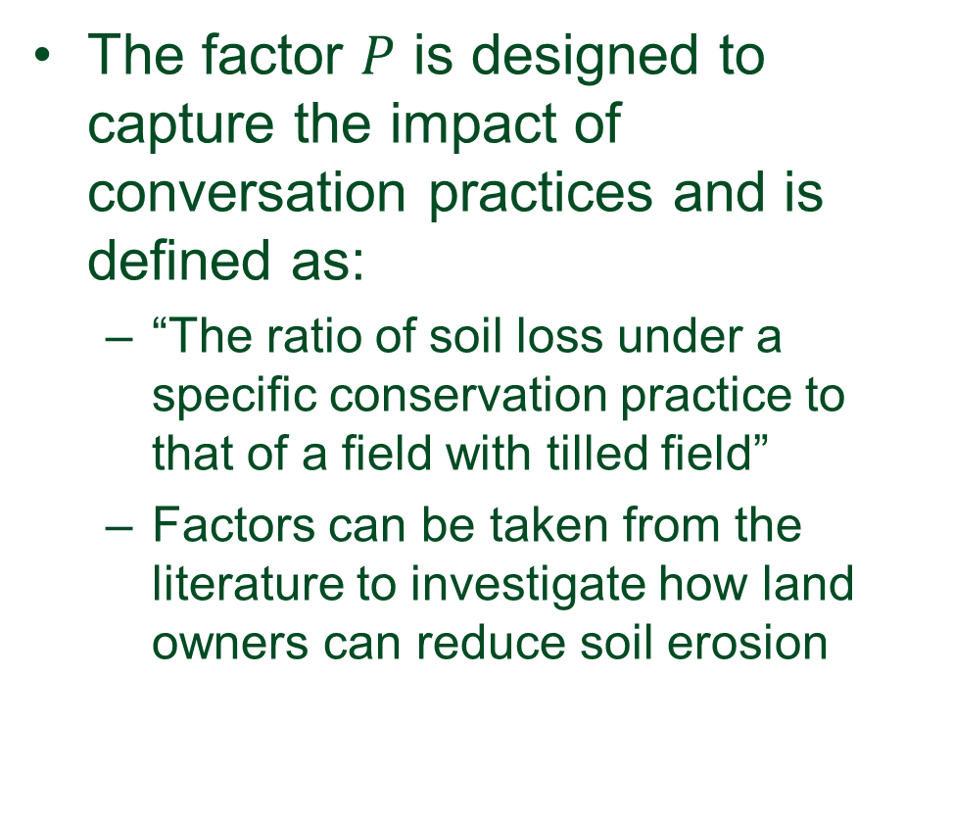

Support practice factor $− P$
The factor $P$ is designed to capture the impact of conversation practices and is defined as:
“The ratio of soil loss under a specific conservation practice to that of a field with tilled field”
Factors can be taken from the literature to investigate how land owners can reduce soil erosion
https://doi.org/10.5194/hess-22-6059-2018

Slide 24

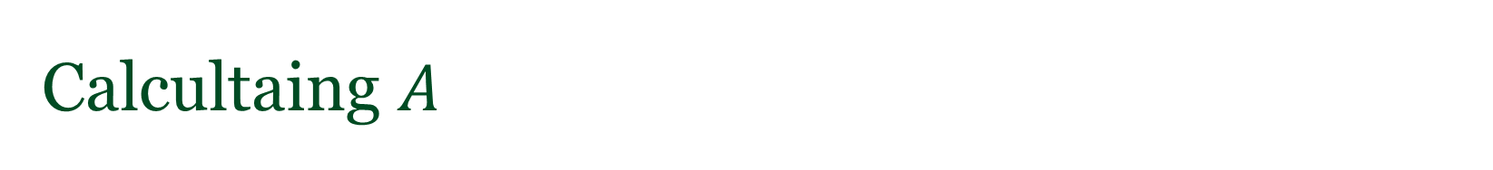
Calcultaing $A$
Jupyter Notebook: Section $A$ – putting it all together

