Slide 1
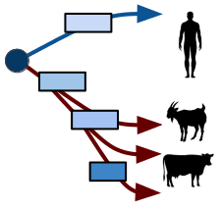
Region of difference detection in MTBC species
Damien Farrell

Slide 2
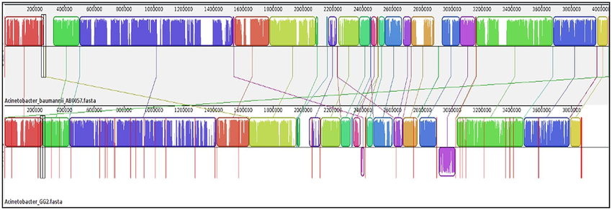
Whole genome comparisons
There are multiple ways to compare genomes:
Whole genome pairwise alignment (needs assembly)
Alignment of reads to a reference and variant calling (no assembly)
BLAST searches of target sequences to one or more of the genomes and comparing the results
Annotate proteins and compare the proteome

Slide 3
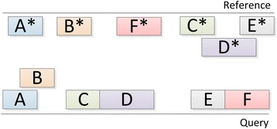
MUMmer
MUMmer is a program for rapidly aligning pairs of entire genomes. They can be complete or draft assemblies (made up of contigs or scaffolds). Can handle 1000s of contigs and will align them to another genome/assembly.
Performs many local alignments between matching segments.
Subject to the quality of the assemblies due to presence of mobile repeat elements.
Sequencing errors also play a role.
local deletion
matching segments

Slide 4
NucDiff
MUMmer - output may be hard to make sense of with many alignments.
NucDiff runs MUMmer and uses the output to locate and categorize differences between two closely related genomes.
Can detect large sequence polymorphisms.
It will categorize changes as deletions, insertions, duplications etc.
Also produces detects snps.
Produces gff files which can be visualised in a genome browser like IGV.
Genomes
Genomes
MUMmer
Parse Results
Struct
SNP

Slide 5
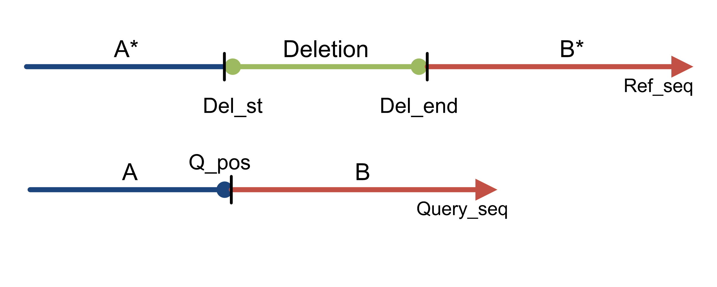
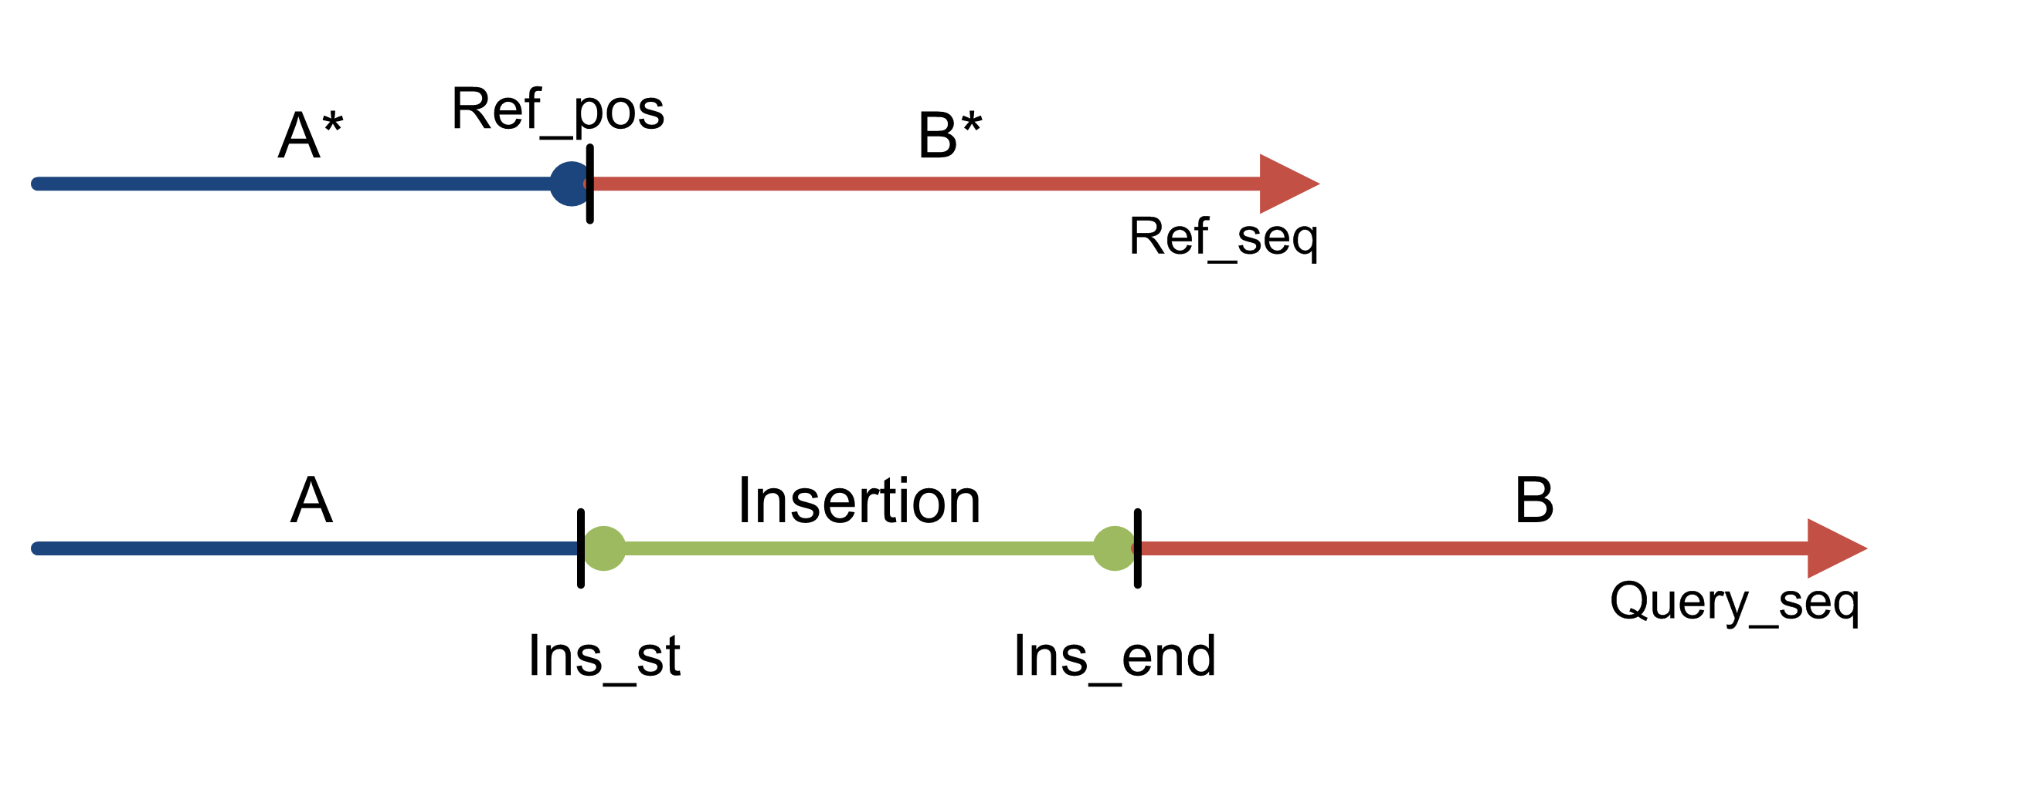
NucDiff
Deletion - a deletion of some bases present in the reference sequence from a query sequence.
Insertion - an insertion of bases in the query sequence that were not present anywhere on the reference genome.

Slide 6
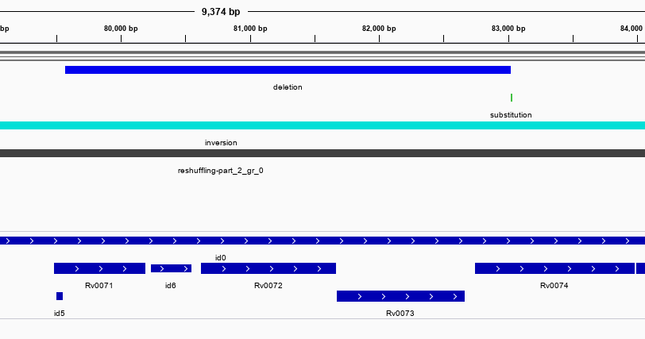
Example: H37Rv vs Beijing
RD10: 79567-83034 (Rv0071-Rv0074)

Slide 7
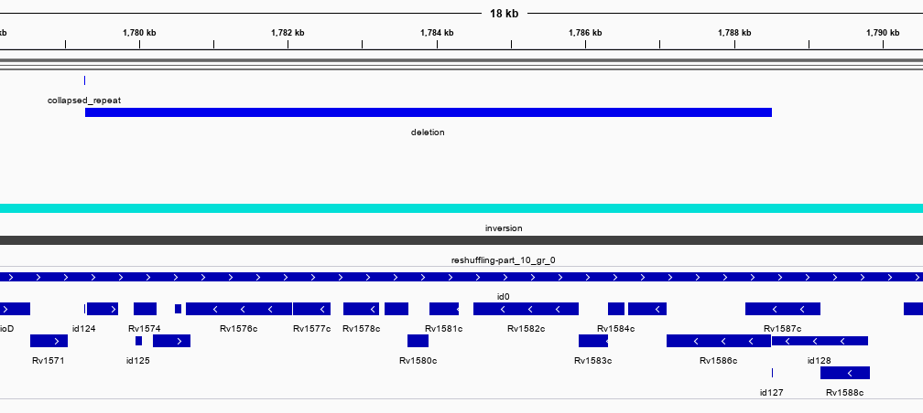
Example: H37Rv vs Beijing
RD149: 1779264-1788512 (Rv1572c-Rv1586c)
Detects all four common deletions (RD105, RD149, RD152, and RD207) found in all Beijing/W strains

Slide 8
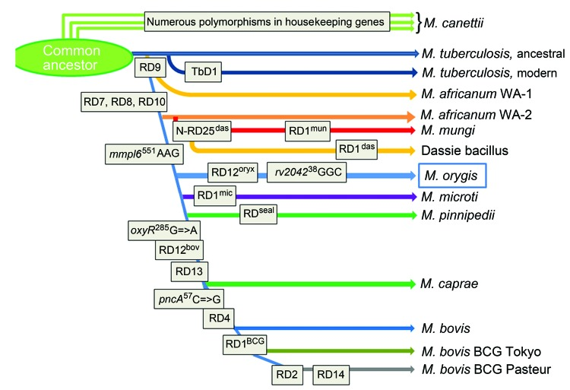
MTB Complex and Regions of Difference
Mycobacterium tuberculosis complex comprises tubercle bacilli of 8 distinct subgroups
All highly similar in sequence
Identified by key Regions of Difference (RD) – mostly deletions
Deletions are ordered in terms of their locations within the H37Rv genome
M. orygis, ‘oryx bacillus’

Slide 9
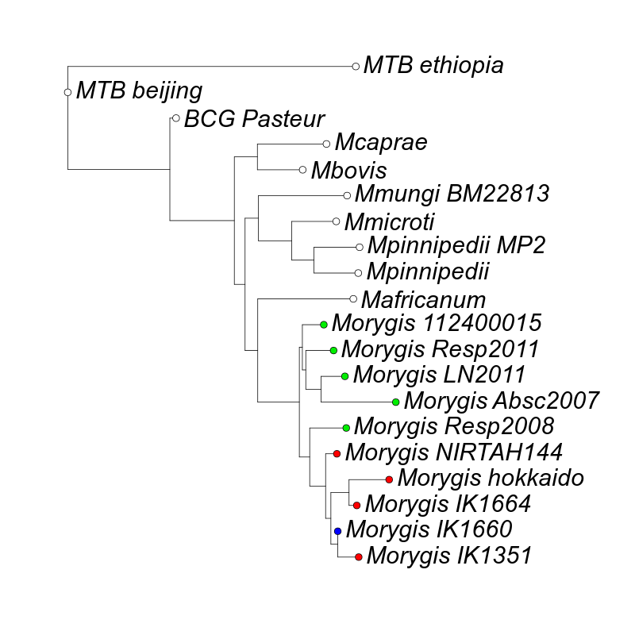
M. Orygis isolates
Only two assemblies for Mycobacterium orygis available on genbank
Strain NIRTAH144, isolated from cattle in Chennai, India
Strain 112400015 is a human clinical isolate
Other samples available on SRA and a subset were assembled
No complete assemblies available
BioProject | Center Name | Country | Samples
PRJNA389109 | NEW YORK STATE DEPARTMENT OF HEALTH | USA | 8
PRJNA575883 | THE PENNSYLVANIA STATE UNIVERSITY | Bangladesh | 1
PRJNA575883 | THE PENNSYLVANIA STATE UNIVERSITY | India | 25
PRJNA576656 | ICAR-INDIAN VETERINARY RESEARCH INSTITUTE | India | 19

Slide 10
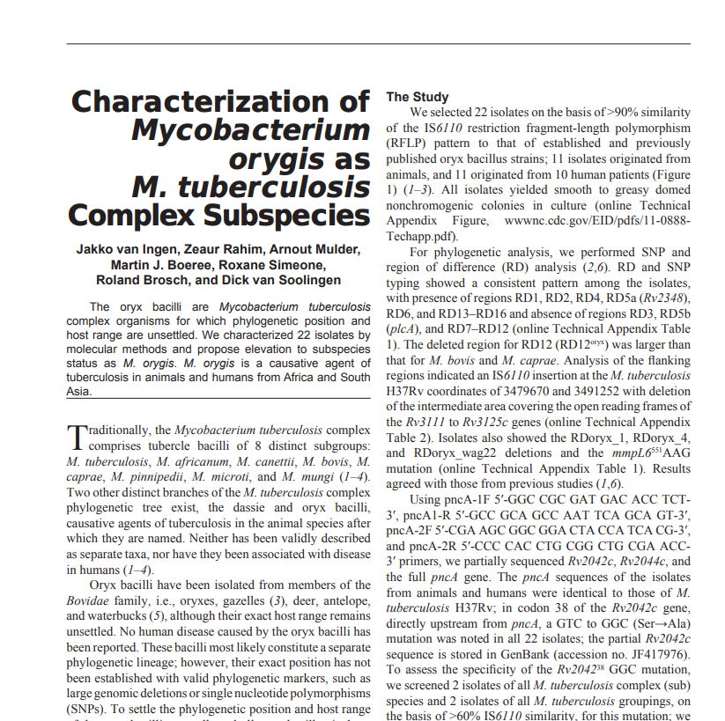
M. Orygis specific differences
RD3, RD5b (plcA), and RD7-RD12 deleted in Orygis
deleted region for RD12 (RD12oryx) is larger than that for M. bovis and M. caprae.
IS6110 insertion at the M. tuberculosis H37Rv coordinates of 3479670 and 3491252 with deletion of the intermediate area covering the open reading frames of the Rv3111 to Rv3125c genes
Rv2042³⁸ GGC (Ser→Ala) mutation
gyrB¹⁴⁵⁰ G→T mutation (shared with M. africanum, M. microti, and M. pinnipedii)
mmpL6⁵⁵¹ AAG mutation

Slide 11
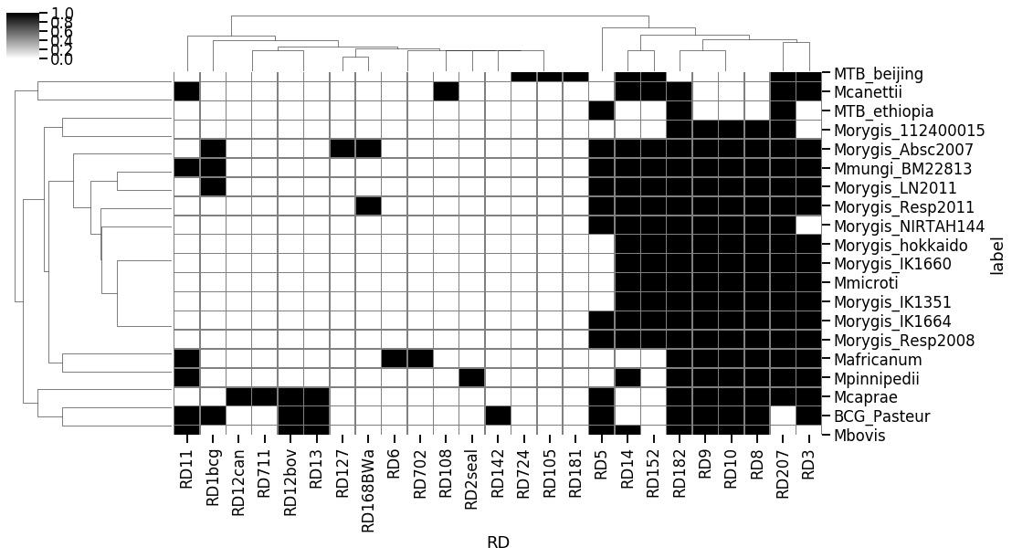
Results – Known RDs

Slide 12
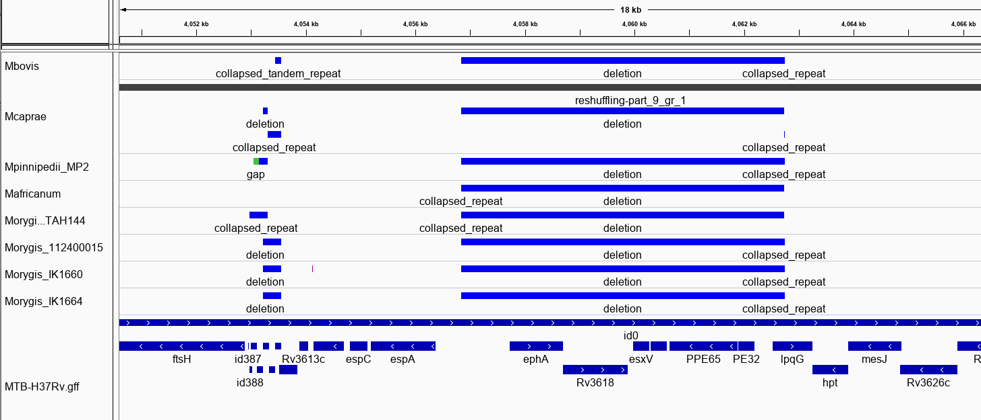
RD8
RD8 present in all animal adapted species

Slide 13
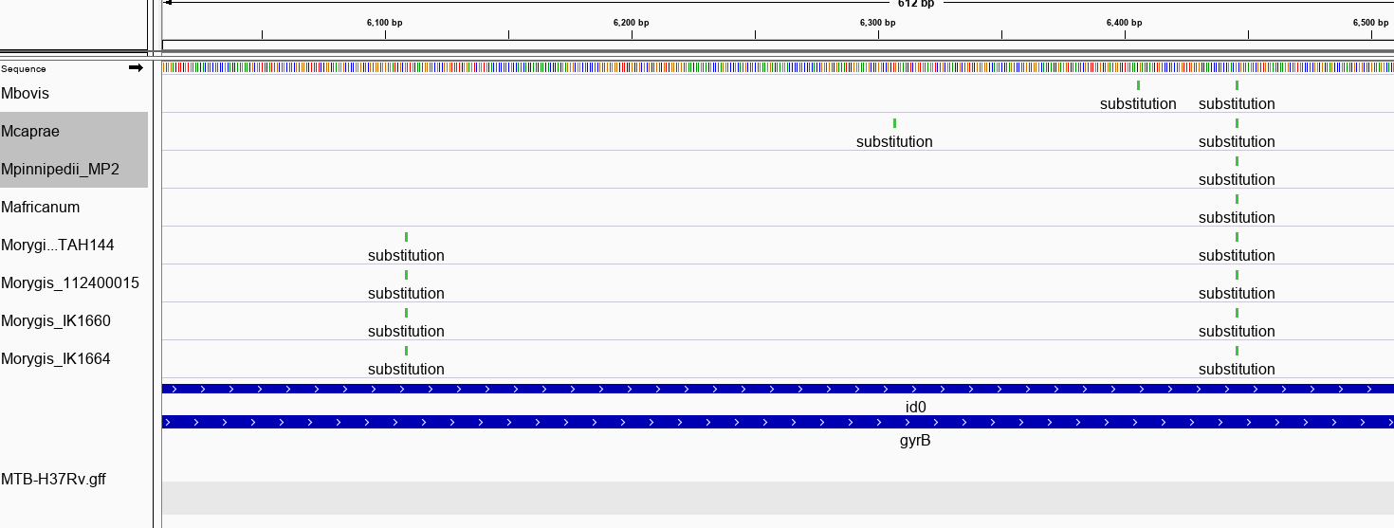
gyrB mutations
G→A
G→T

Slide 14
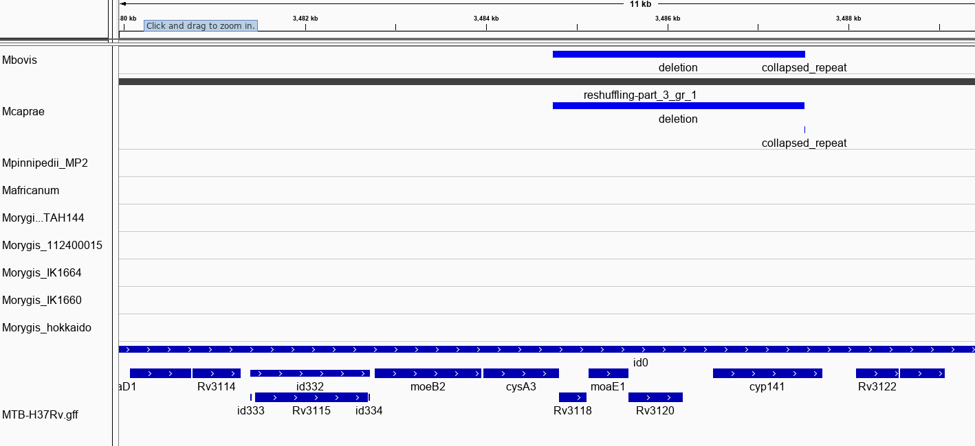
RD12oryx
Deleted region for RD12 (RD12oryx) is larger than that for M. bovis.
Not detectable in orygis samples?
RD12 bovis

Slide 15
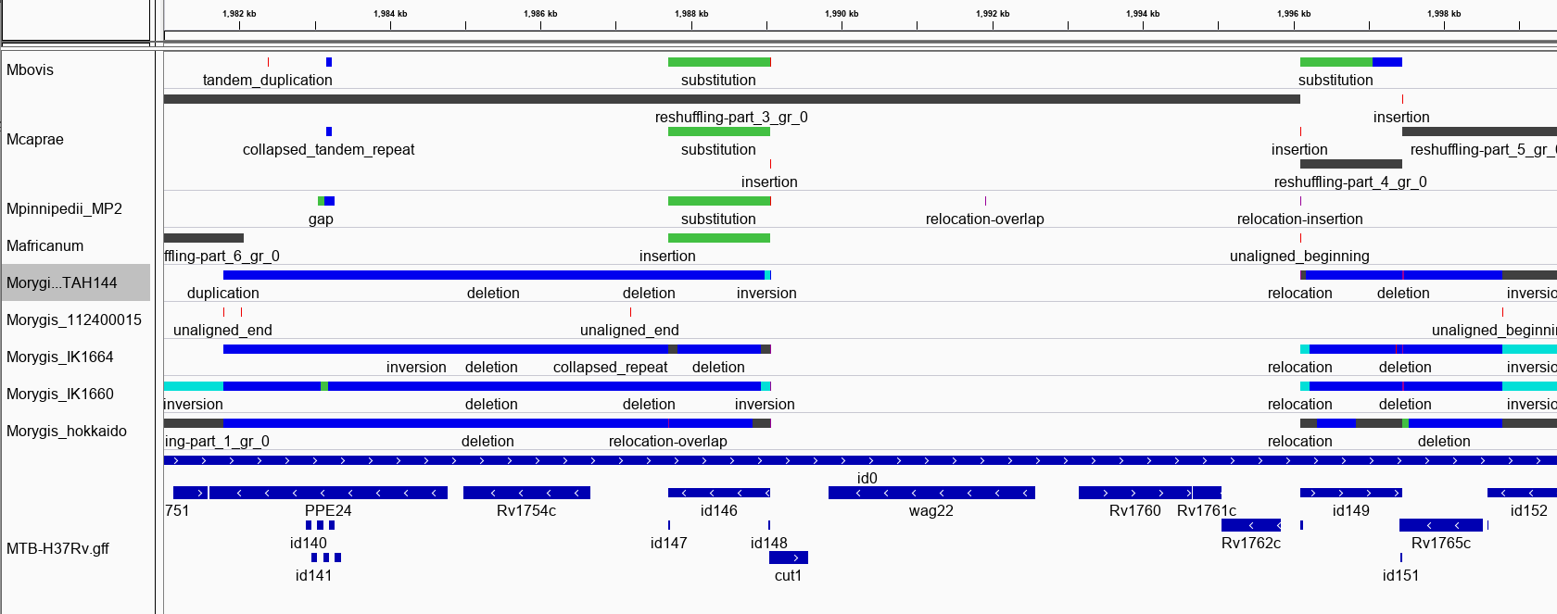
RDoryx_wag22
RDoryx_wag22 region is split into two?

Slide 16
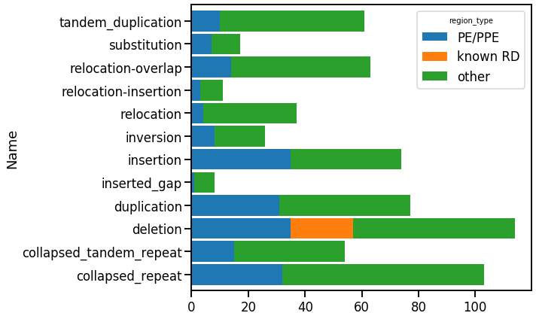
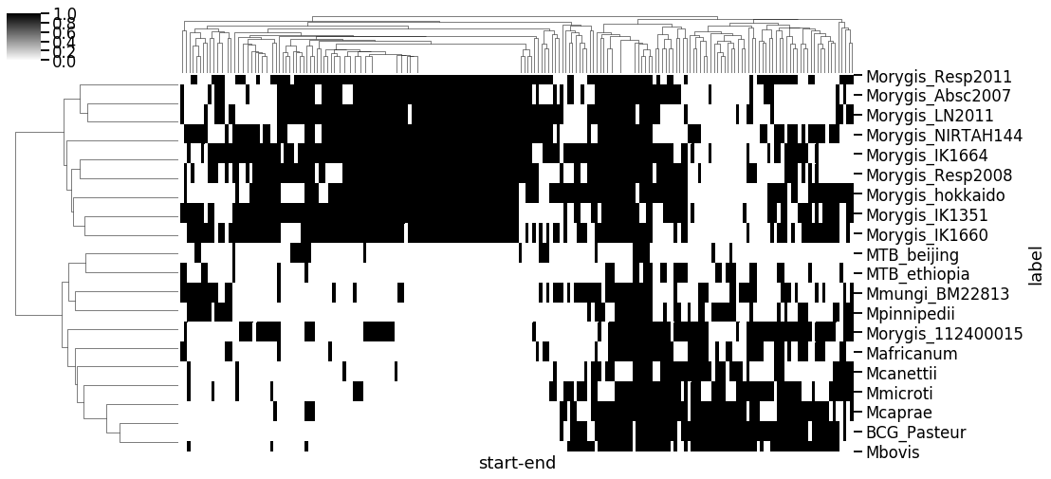
Results
All common sites (in >4 samples)
Most of those present in M.orygis AND M.bovis are also common to other species
Some changes in PE/PPE proteins may be sequence artifacts

Slide 17
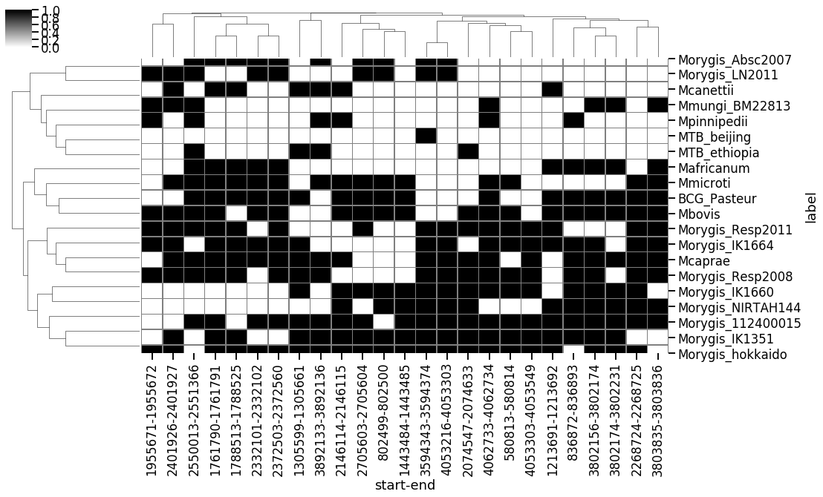
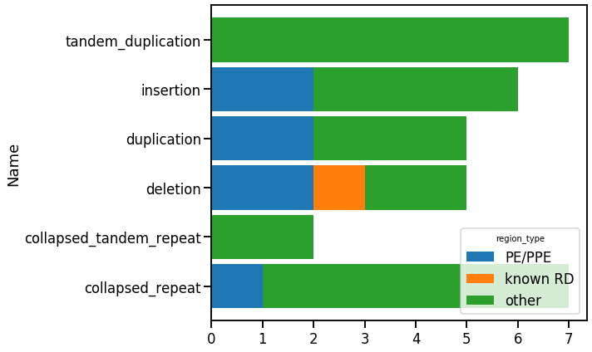
Results
Small number common to M.bovis and M.orygis.

Slide 18
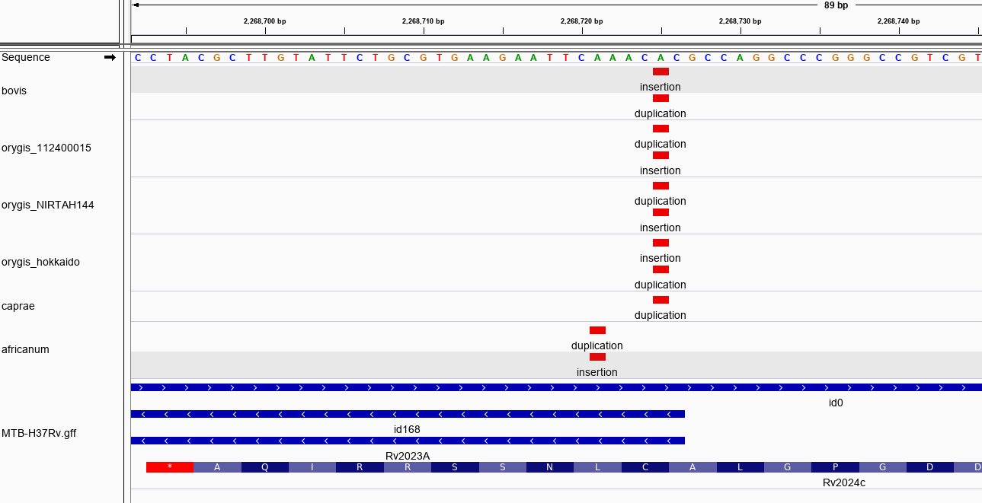
Results
4995 nt insertion in Rv2023A, 2268724-2268725

Slide 19
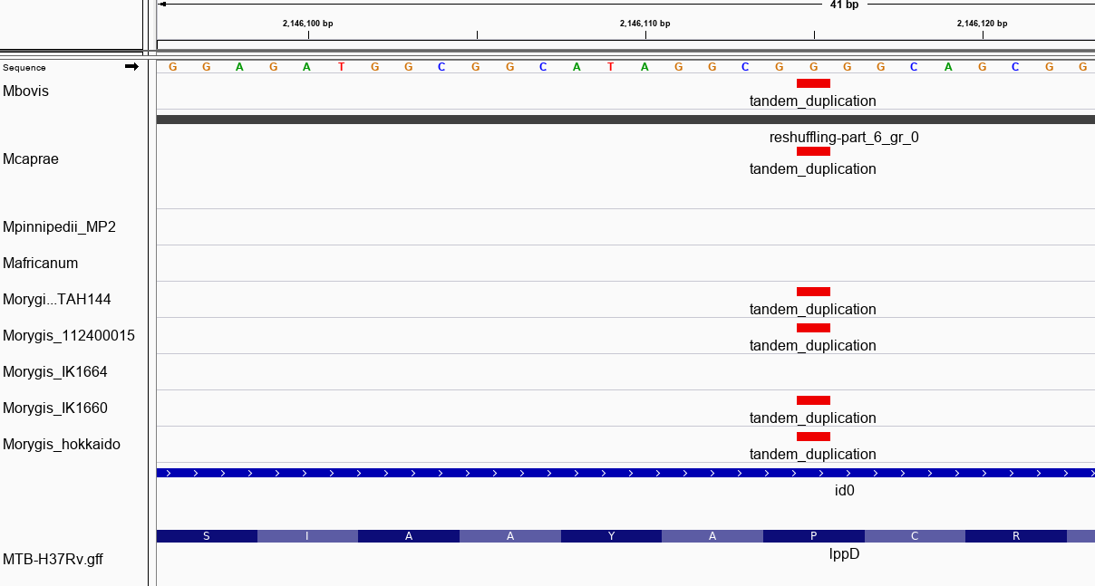
Results
44 nt Tandem duplication in lppD, 2146114

Slide 20
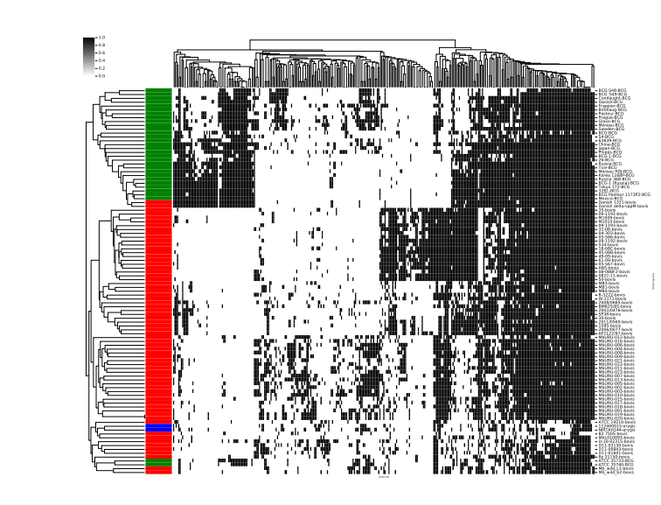
Applications
Find SNPs and large changes not possible with variant calling
Discover novel polymorphisms common across multiple strains
Could be used for strain identification from assemblies using known sequence differences
May miss certain regions in assemblies vs complete genomes
MTBDiff – wraps NucDiff for application to MTBC
https://github.com/dmnfarrell/mtbdiff
M. bovis and BCG

