Slide 1
RNA-seq
Purpose:
Measure gene expression.
Discover and annotate complete transcripts.
Characterize alternative splicing and polyadenylation.

Slide 2
RNA-seq
Annotation: identify genes and genic architecture by analyzing short-sequence reads derived from expressed RNA. Thus, the most important parameter is that the sequence reads evenly cover each transcript, including both ends.
Differential expression: Count the expressed RNA in each gene to compare between samples

Slide 3
RNA-seq Requirements
Criteria | Annotation | Differential expression
Biological replicates | Not compulsory but useful | Essential
Coverage across transcript | Important for identifying isoforms | Not as important
Sequencing Depth | High enough to cover rare transcripts | High enough for accurate counting statistics
Length of reads | Important for de Novo assembly | Not that important
Paired end | Important for de Novo assembly | Not important

Slide 4
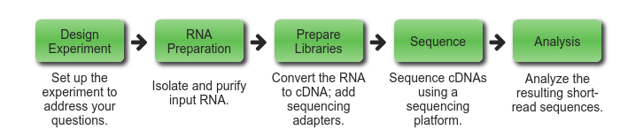
RNA-seq Workflow
https://rnaseq.uoregon.edu/

Slide 5
RNA-seq Workflow
Select cell population.
Annotation
file
Read
counts
Quantification. Count reads in each gene.
Extract total RNA
Statistical test for differences between genes in groups of samples
Map/Align reads to reference genome
small RNA
mRNA
Size select
poly(A) select
Ribosome depletion
Quality check. e.g. remove adapter sequence
fastq
fastq
Convert to cDNA
Construct library
Sequencing

Slide 6
Sequencing
RNA-seq has replaced microarrays:
It doesn’t require prior knowledge of genes like for prope sets in arrays.
Better dynamic range.
Now cheaper
Types:
Sanger sequencing (first gen)
NGS (Ilumina current standard) ~150-300bp
PacBio – very long reads, good for assembly >20,000bp
MinION – portable sequencers ~10,000-100000bp

Slide 7
Bacterial RNA-seq
Difference from eukyarotes
No exons – no need to account for reads across splice junctions when aligning back to genome
Gene 1
Gene 2
Gene 3
transcript
Exon 1
Exon 2
Exon 3
Exon 1
Exon 2
Exon 3
reads

Slide 8
Genome Annotation
Describing the coding and non-coding features in the entire genome. These have varying levels of evidence and curation.
e.g. Mycobacterium bovis AF2122/97 is the reference genome and is manually curated. Lots of others are automatic.
Annotations are stored in a few different file formats:
genbank
gff
Confusing..

Slide 9
Genbank format
feature
gene 3140421..3141083
/locus_tag="Mb2898"
/gene="mpt83"
CDS 3140421..3141083
/product="cell surface lipoprotein mpt83 (lipoprotein p23)"
/codon_start=1
/locus_tag="Mb2898"
/transl_table=11
/note="Mb2898, mpb83, len: 220 aa. Equivalent to
Rv2873,len: 220 aa, from Mycobacterium tuberculosis strain
H37Rv,(100.0% identity in 220 aa overlap). mpt83 (alternate
gene name: mpb83), cell surface lipoprotein (see citations
below). Also similar to upstream ORF
Q50769|MP70_MYCTU|MPT70|MPB70|Rv2875|MT2943|MTCY274.06
which is also known as MAJOR SECRETED IMMUNOGENIC PROTEIN
MPT70 PRECURSOR from Mycobacterium tuberculosis (193
aa),FASTA scores: opt: 806, E(): 2.7e-38, (70.25% identity
in 185 aa overlap). BELONGS TO THE MPT70 / MPT83 FAMILY.
ATTACHED TO THE MEMBRANE BY A LIPID ANCHOR."
/standard_name="mpt83"
/experiment="experimental evidence, no additional details
recorded"
/translation="MINVQAKPAAAASLAAIAIAFLAGCSSTKPVSQDTSPKPATSPAA
PVTTAAMADPAADLIGRGCAQYAAQNPTGPGSVAGMAQDPVATAASNNPMLSTLTSALS
GKLNPDVNLVDTLNGGEYTVFAPTNAAFDKLPAATIDQLKTDAKLLSSILTYHVIAGQA
SPSRIDGTHQTLQGADLTVIGARDDLMVNNAGLVCGGVHTANATVYMIDTVLMPPAQ"
/gene="mpt83"
/protein_id="CDO44165.1"
feature qualifiers

Slide 10
gff (General feature format)
Tab-separated file with 9 fields per line
First 7 fields always the same
You may see files called .gff, .gtf or .gff3
seqname - name of the chromosome or scaffold
source - name of the program that generated this feature, or the data source
strand - defined as + (forward) or – (reverse)
attribute - a semicolon-separated list of tag-value pairs, providing additional information about each feature.
seqname source feature start end score strand frame attribute
NC_002945.4 RefSeq gene 3280 4437 . + . ID=gene2;Dbx…..

Slide 11
fastq format
FASTQ format is a text-based format for storing both a biological sequence and its corresponding quality scores.
de facto standard for storing the output of high-throughput sequencing
@SEQ_ID
GATTTGGGGTTCAAAGCAGTATCGATCAAATAGTAAATCCATTTGTTCAACTCACAGTTT
+
!''*((((***+))%%%++)(%%%%).1***-+*''))**55CCF>>>>>>CCCCCCC65
Line 1 - begins with a '@' character and is followed by a sequence identifier and an optional description
Line 2 - the raw sequence letters
Line 3 - begins with a '+' character and is optionally followed by the same sequence identifier (and any description) again
Line 4 - encodes the quality values for the sequence in Line 2, and must contain the same number of symbols as letters in the sequence

Slide 12
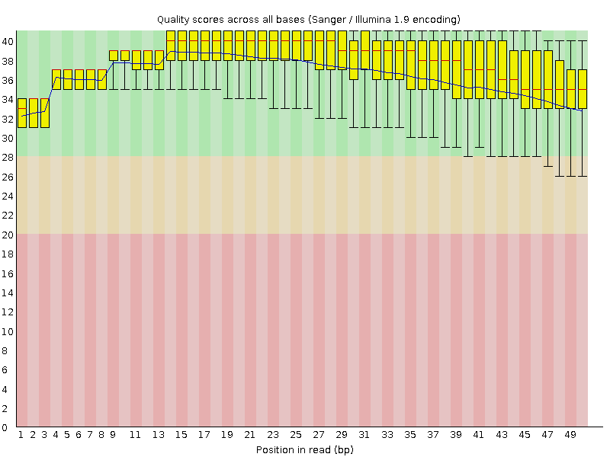
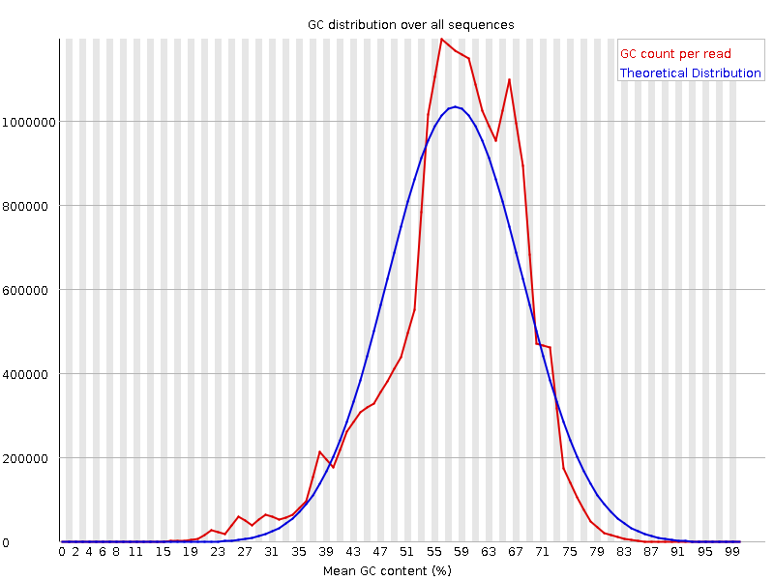
fastq quality checks
Typically you would check for:
presence of adaptors
overrepresented k-mers
duplicated reads
GC content
software: fastqc

Slide 13
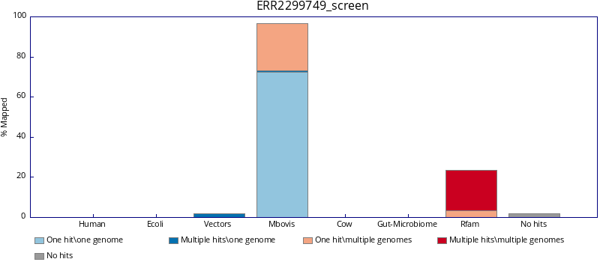
contamiation checks
fastq screen can check against known sequences

Slide 14
Read Alignment
The reference genome is really big. Typical run will contain 5-10 million reads. The trick is to figure out a way to search for matches with a method that doesn’t require exhaustively going through every near-match.
Other difficulties due to:
repeat regions longer than the read
sequencing biases (non-uniform coverage and sequencing errors)
multi-mappers (reads mapping to more than one position)
Software for short read alignment:
Bowtie
STAR
stampy
BWA

Slide 15
Read Alignment
CGCTTTGAGTGGGGGCTGATCACTGACGTACAACCACCCGAGCTGGAGACCCGCATCGCCATCTTGCG :reference
GCTTTGAGTGGGGGCTGATCACTGA
TTTGAGTGGGGGCTGATCACTGACGTA
TTGAGTGGAGGCTGAACACTGACTTACAA 3 mismatches – won’t map
TGAGTGGGGGCTGATCACTGACGTACACCCA
GTGGGGGCTGATCACTGACGTACACCCACCCG
GTGGGGGCTGATCACTGACGTACACCCACCCGAGA
GGGGCTGATCACTGACGTACACCCACCCGAGCTGGAGA
CGCTTTGAGTGGGGGCTGATCACTGACGTACACCCACCCGAGCTGGAGACCCGCATCGCCATCTTGCG :consensus
Alignment dependant on many parameters e.g.:
allowed mismatches
seed region
usage of quality scores
allow gaps

Slide 16
Malone et al. Paper
K. M. Malone et al., Microb. Genomics, 2018.
“Computational analyses were performed on a 32-node Compute Server with Linux Ubuntu (version 12.04.2). Briefly,adapter sequence contamination and paired-end reads of poor quality were removed from the raw data. At each step, read quality was assessed with FastQC (version 0.10.1) [30]. Single-end reads were aligned to the M. bovis AF2122/97 or M. tuberculosis H37Rv reference genomes with the aligner Stampy in hybrid mode with the BWA algorithm [31]. Read counts for each gene were calculated using featureCounts, set to unambiguously assign uniquely aligned single-end reads in a stranded manner to gene exon annotation [32]. ..”
ENA bioproject: PRJEB23469

