Slide 1

RNA-seq analysis
Example: Malone et al. 2018
RNA-seq of 6 M.bovis and 6 MTB replicates, single time point.
Align to appropriate genomes
Count genes with annotations
Compare counts with corresponding genes

Slide 2
Analysis Steps
Reference
genome
Annotation
file
index and sort bam
fastq
Alignment to reference
sam
file
bam
file
Count reads in each gene.
Read
counts
differential expression
bwa mem
bowtie
samtools
htseq-count
featureCounts
edgerR
DESeq2

Slide 3
Alignment
Alignment does approximate string matching. When we index a reference genome, the aligner typically constructs a compressed data structure to make string queries fast.
Making in index:
bwa index -p <name> <ref sequence>
produces several files, you should place these in a folder together where they can be re-used if needed.

Slide 4
Alignment settings
We can use many parameters. Use defaults unless you have a reason not to.
e.g:
bwa mem /storage/genomes/bwa_index/<ref> <name>.fastq.gz > <name>.sam
Can also redirect output to samtools directly (saves making intermediate files):
bwa mem /storage/genomes/bwa_index/<ref> <name>.fastq.gz | samtools view -bt <ref> - | samtools sort - <name>.bam

Slide 5
Sam and Bam files
Sequence Alignment Map (SAM) is a text-based format for storing biological sequences aligned to a reference sequence. SAM format consists of a header and an alignment section.
Not ideal for using with other programs, since searching through it is not efficient
Large file sizes
The binary representation of a SAM file is a Binary Alignment Map (BAM) file, which is a compressed SAM file.
smaller and much easier to automatically search through.
can be sorted based on different criteria (read name, genomic position, etc.) and indexed (to create a corresponding *.bai file) for ease of use.

Slide 6
Sam and Bam files
Samtools is used to manipulate these files.
To extract the original SAM file from BAM, we can use samtools view.
Header:
@HD VN:1.3 SO:coordinate
@SQ SN:NC_000962.3 LN:4411532
@PG ID:bwa PN:bwa VN:0.7.17-r1188 CL:bwa mem /storage/genomes/bwa_index/MTB-H37Rv ERR2299755.fastq.gz
Typical alignment line:
ERR2299755.9430 16 NC_000962.3 1 60 16S34M * 0 0 CCAGGGAGATACGTCGTTGACCGATGACCCCGGTTCAGGCTTCACCACAG HHHGHJJIJJJIJIIHIGJIJIJJIIHJJJJJJJJJJGGHHHDDDFFCCC NM:i:0 MD:Z:34 AS:i:34 XS:i:0

Slide 7
Sam and Bam files
Get stats from sam/bam file
samtools flagstat <name>.bam
12706243 + 0 in total (QC-passed reads + QC-failed reads)
0 + 0 secondary
11 + 0 supplementary
0 + 0 duplicates
12249607 + 0 mapped (96.41% : N/A)
0 + 0 paired in sequencing
0 + 0 read1
0 + 0 read2
0 + 0 properly paired (N/A : N/A)
.
.

Slide 8
Feature counting
Count reads in genomic features, e.g. genes, cds, promoter regions.
In featureCounts you select the features to use and how to group the counts together (e.g. by exon, locus_tag, gene_id).
Command:
featureCounts -g locus_tag -t gene -T 4 -a ../Mbovis.gff -o feature_counts.txt ERR*.bam
Annotation file example:
NC_002945.4 RefSeq gene 1 1524 . + . ID=gene0;Dbxref=GeneID:1090743;Name=dnaA;gbkey=Gene;gene=dnaA;gene_biotype=protein_coding;locus_tag=Mb0001

Slide 9
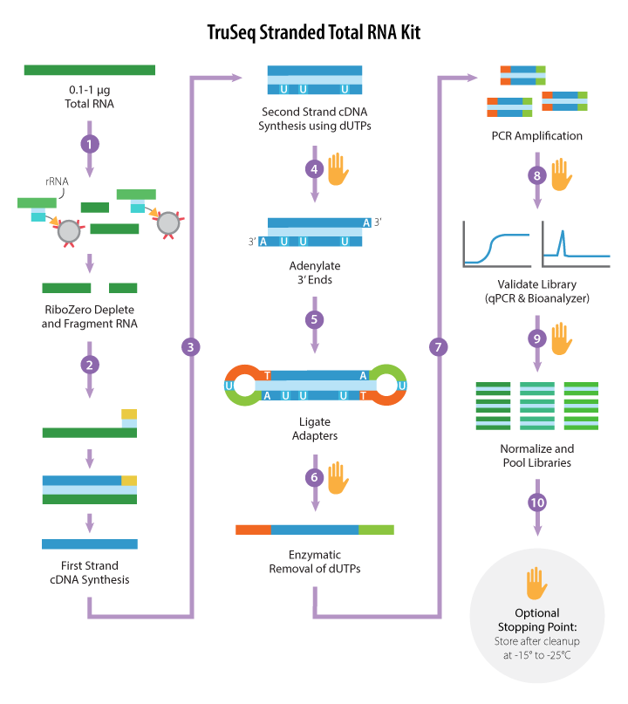
Strand specific setting
“Sequencing libraries were prepared at the Genomics Core, Michigan State University, Michigan, USA, using the Illumina Truseq Stranded Total RNA Library Prep Kit LT and the Epicenter RiboWZero Magnetic Bacteria kit to deplete rRNA. Single-end, strand-specific 50 bp read data were produced with base calling performed by using Illumina Real Time Analysis (RTA) v1.18.64 (Illumina HiSeq 2500).”
Conclusion:
Requires we use strand specific=2 setting in featurecounts.

Slide 10
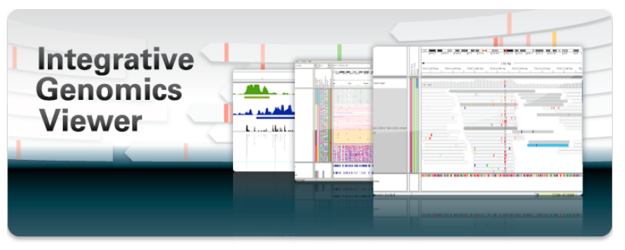
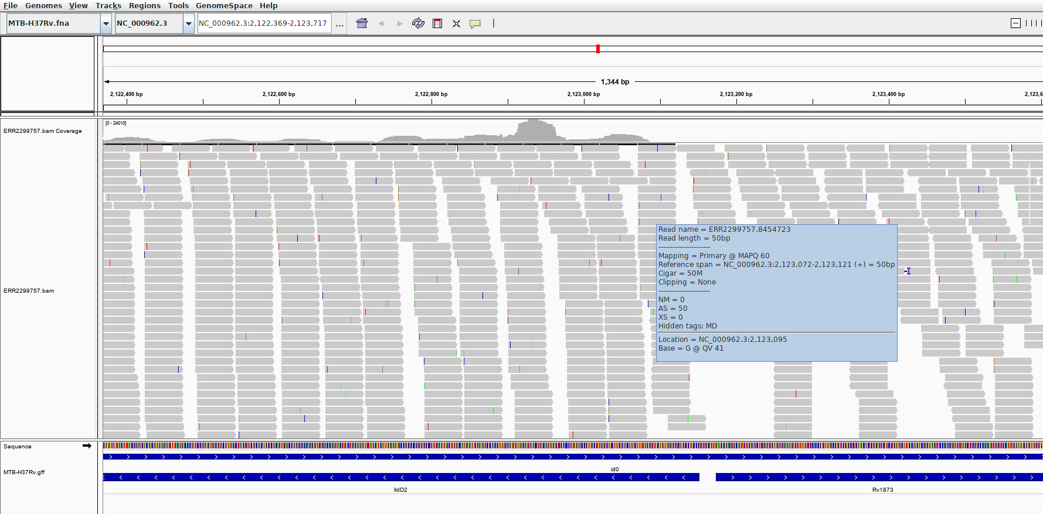
Viewing results with IGV
View any genome coordinate related data
Runs on desktop, can read genome data from a server or locally
Each ‘track’ is a separate element of data.
Why view results
Human interpretation sometimes better for spotting errors
Check individual genes of interest
Examine read patterns
https://software.broadinstitute.org/software/igv/

Slide 11
Viewing results with IGV
Example: Locate and view read mappings for gene with most counts in M.bovis results.
Find name of gene in counts file
Load ref genome file (.fa)
Load annotation file (.gff)
Use search bar to find the gene by name e.g. ‘Mb3614c’
Zoom in to region if needed.

Slide 12
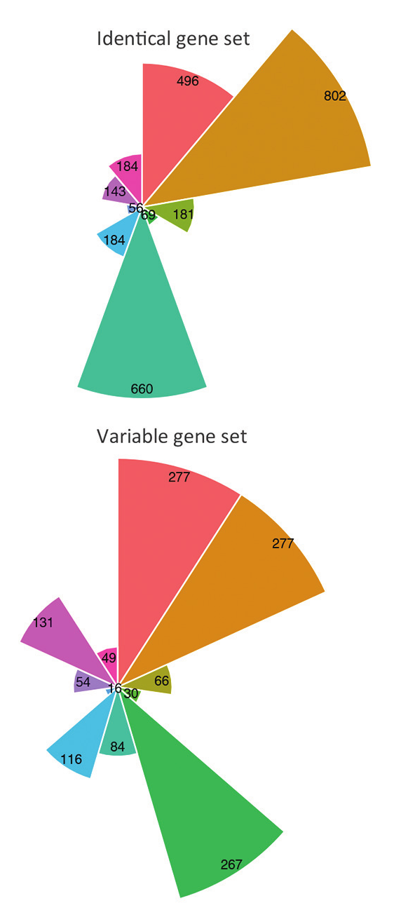
Differential Expression
Find statistically significant differences between groups for any genes.
Usually comparing same gene between conditions. In this case we are comparing genes between very similar species.
Two problems:
some genes are different length
genes have different names in count files
Solution: use a name mapping to get corresponding genes and use only genes with same lengths. Other genes have to be normalised by length to compare.
“Prior to cross-species differential expression analysis, an Identical/Variable gene dataset was constructed for M. tuberculosis H37Rv and M. bovis AF2122/97 where orthologous genes were separated into those whose protein products are of equal length and 100 % conserved at the amino acid level (Identical, n=2775) from those that are not (Variable, n=1224)”

Slide 13
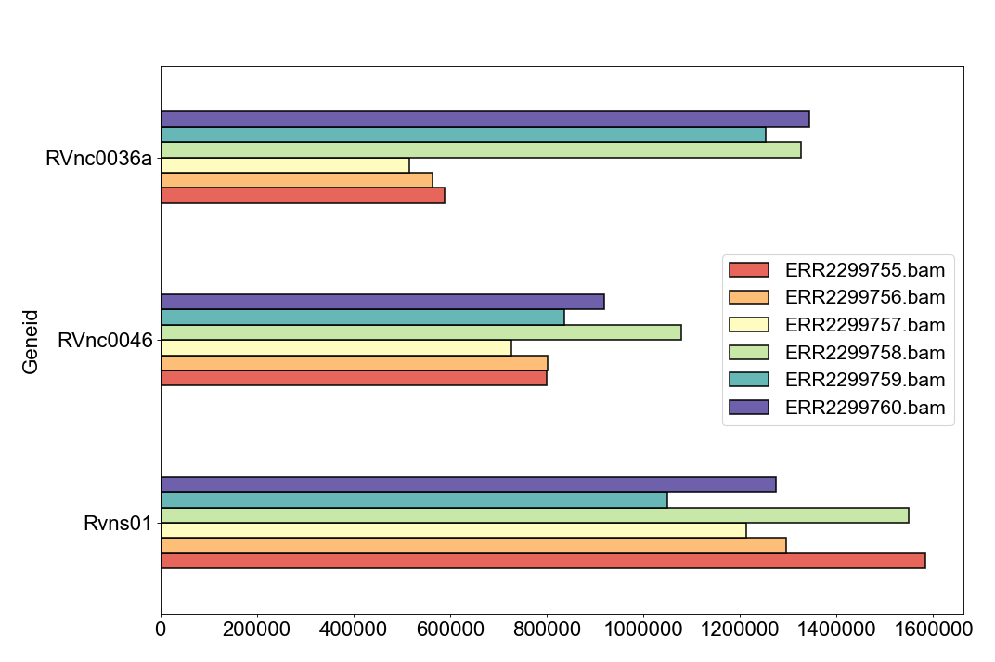
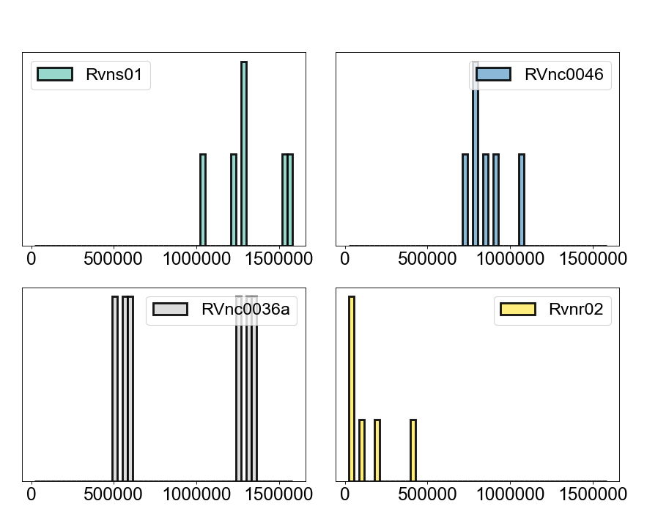
Differential Expression
RNA-seq count data is treated in specific way to get statistical differences.
Normalization for RNA composition
Normalise genes to total library size BUT there are cases when a small number of genes are very highly expressed in one sample, but not in another. The highly expressed genes can consume a substantial proportion of the total library size, causing the remaining genes to be under-sampled in that sample. We find scaling factors per sample and normalise by effective library size.
Read counting is an approximately poisson process. But variance can differ between genes for multiple reasons (overdispersion). So a ‘dispersion parameter’ for each gene is used to account for this – called the negative binomial model.

Slide 14
Differential Expression with edgeR
Minimal edgeR Workflow
load the library: library(edgeR)
Read in the count matrix file: data <- read.table("count_matrix.txt")
Specify the groups: grps <- c(rep("case", 3), rep("cont", 3))
Put the counts and other information into a DGEList object to be passed to the edgeR functions:
data <- DGEList(counts=data, group=grps)
Compute effective library sizes that adjust for RNA composition: data <- calcNormFactors(data)
An MDS plots shows "distances" between the samples, in terms of biological coefficient of variation (BCV): plotMDS(data)
The common dispersion estimates the overall dispersion of the dataset, averaged over all genes:
data <- estimateCommonDisp(data, verbose=TRUE)
Now estimate gene-specific dispersions: data <- estimateTagwiseDisp(data)
Compute exact genewise tests for differential expression between groups: res <- exactTest (data)
Report the most significant genes: topTags (res)

Slide 15
Differential Expression with edgeR
Features of using the edgeR package:
edgeR and DESeq create custom containers/objects which are used to perform the tasks. These have properties like specific data structures.
  example: dge <- DGEList(counts)
  This object has a property called samples: dge$samples
Uses fishers exact test for differences in the means between two groups of negative-binomially distributed counts.
exactTest(dge) returns another object with the log fold changes etc.
Works pairwise or with more than 2 groups
If you don’t know R this is a ‘black box’ process.

Slide 16
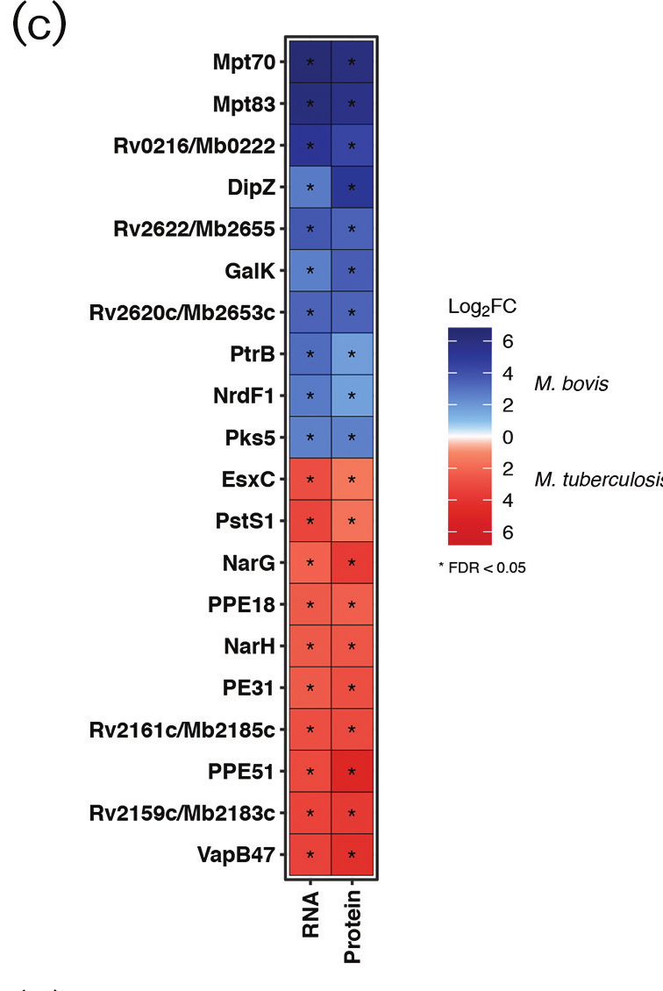
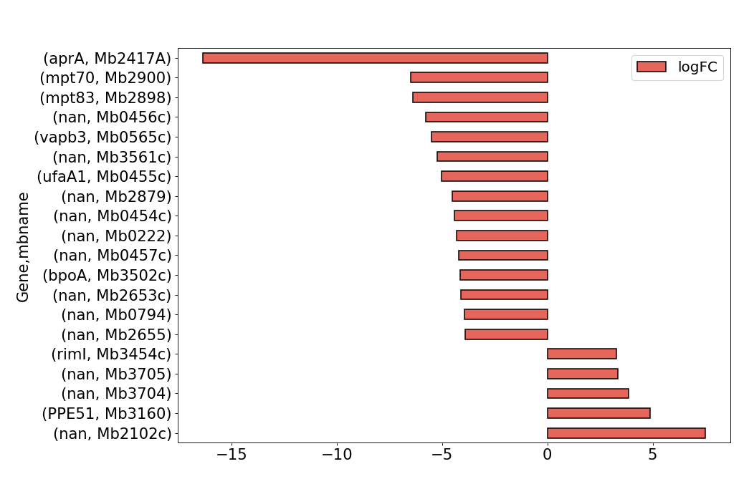
Differential Expression
Compare results to paper...

Slide 17
read duplicates or over-expressed genes?
“Observing high rates of read duplicates in RNA-seq libraries is common. It may not be an indication of poor library complexity caused by low sample input or over-amplification. It might be caused by such problems but it is often because of very high abundance of a small number of genes (usually ribosomal or mitochondrial house keeping genes). ...Sometimes 75% of all reads map to the top 0.1% of expressed genes. The result of such heavy sampling of these genes is a high number of duplicate reads.
..Some RNA samples really do have such a skewed distribution of expression values. If the highly expressed genes are non-coding RNA genes, an efficient polyA selection before library construction will often dramatically improve the situation. Other options include a variety of library normalization techniques or simply ignoring the phenomenon. Since you have a finite number of reads in the library, if you are burning most of them on a small number of highly abundant genes you may need to sequence deeper to get good representation of the rest of the transcriptome...”

