Slide 1
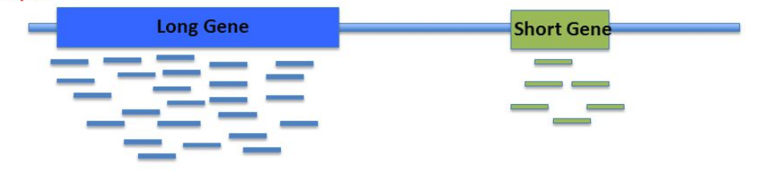
RNA-seq Differential Expression
Find statistically significant differences between groups for any genes.
Transcript counts do not directly correlate to protein expression in the cell. But much easier to measure so we use RNA-seq.
We are concerned with relative changes, not absolute quantification.
Often comparing same gene between conditions. If comparing different genes then we should normalise counts by gene length and get TPM (transcripts per million). Why? Long genes create more reads when fragmented and amplified. Not needed for same genes between conditions.
Gene counts are high dynamic range (typically 10⁵), so log scales often used.

Slide 2
Properties of RNA-seq data
High rates of read duplicates in RNA-seq libraries is common.
May not be an indication of poor library complexity caused by low sample input or over-amplification. But is often simply because of very high abundance of a small number of genes (usually ribosomal or mitochondrial house keeping genes). Sometimes 75% of all reads map to the top 0.1% of expressed genes. The result of such heavy sampling of these genes is a high number of duplicate reads.
If the highly expressed genes are non-coding RNA genes, an efficient polyA selection before library construction will often dramatically improve the situation. Since you have a finite number of reads in the library, if you are burning most of them on a small number of highly abundant genes you may need to sequence deeper.

Slide 3
Library normaliz ation
A small number of genes are very highly expressed in one sample, but not in another. The highly expressed genes can consume a substantial proportion of the total library size, causing the remaining genes to be under-sampled in that sample
Naive solution: normalise genes to total library size.
Better solution: find scaling factors by comparing total rna between samples and using this to normalise.
See https://www.slideshare.net/jakonix/part-1-of-rnaseq-for-de-defining-the-goal
normalized

Slide 4
Library normaliz ation
 | sample1 | sample2 | sample1 | sample2
gene1 | 10000 | 28320 | 0.5847 | 0.801
gene2 | 6700 | 6600 | 0.391 | 0.186
gene3 | 400 | 400 | 0.0233 | 0.0113
 | 17100 | 35320

Slide 5
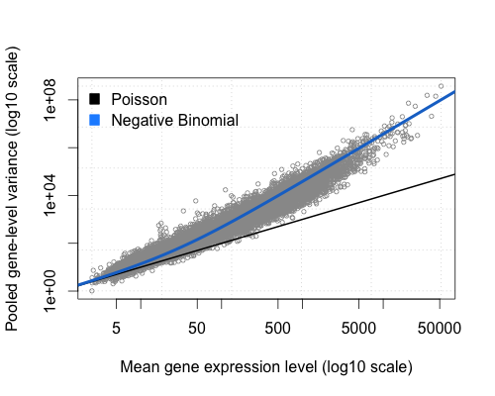
Overdispersion
Read counting is an approximately poisson process. More counts – lower relative variance.
But variance is actually higher than expected by this model in read data for higher expressed genes. This is called overdispersion. So a ‘dispersion parameter’ for each gene is used to account for this – called the negative binomial model.
For low counts – uncertainty more due to counting noise (poisson)
For high counts uncertainty more due to natural biological variance caused by regulation in cell.
https://bioramble.wordpress.com/2016/01/30/why-sequencing-data-is-modeled-as-negative-binomial/

Slide 6
Using edgeR
R package (from bioconductor) for diff expression analysis.
Minimal edgeR Workflow
load the library: library(edgeR)
Read in the count matrix file: data <- read.table("count_matrix.txt")
Specify the groups: grps <- c(rep("treatment", 3), rep("control", 3))
Put the counts and other information into a DGEList object to be passed to the edgeR functions:
data <- DGEList(counts=data, group=grps)
Compute effective library sizes that adjust for RNA composition: data <- calcNormFactors(data)
The common dispersion estimates the overall dispersion of the dataset, averaged over all genes:
data <- estimateCommonDisp(data, verbose=TRUE)
Now estimate gene-specific dispersions: data <- estimateTagwiseDisp(data)
Compute exact genewise tests for differential expression between groups: res <- exactTest (data)
Report the most significant genes: topTags (res)

Slide 7
Differential Expression with edgeR
Features of using the edgeR package:
edgeR (and DESeq2) create custom containers/objects which are used to perform the tasks. These have properties like specific data structures.
  example: dge <- DGEList(counts)
  This object has a property called samples: dge$samples
Uses fishers exact test for differences in the means between two groups of negative-binomially distributed counts.
exactTest(dge) returns another object with the log fold changes etc.
Works pairwise or with more than 2 groups
If you don’t know R or understand the statistics this is a ‘black box’ process.

Slide 8
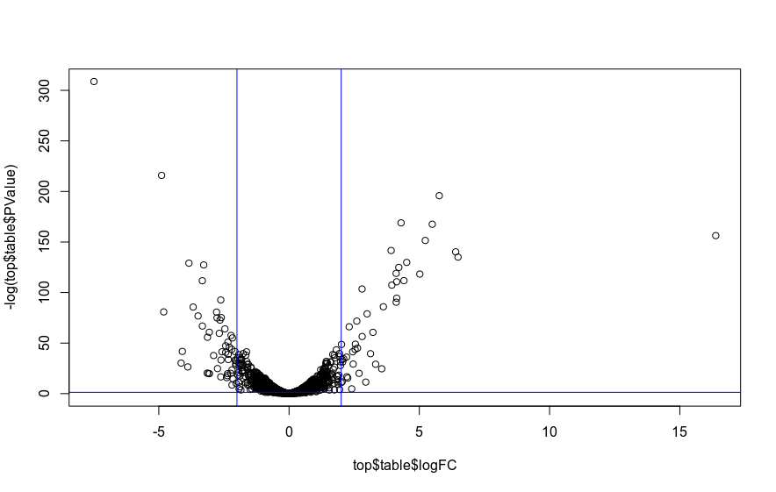
Selection of DE genes
Log Fold Change
fold change is expr gene A/gene B
easier to intepret the ratio
expression changes can be over a large range so log used to linearise scale – easier to plot
e.g. a doubling in the original scaling is equal to a log2 fold change of 1
FDR, false discovery rate
an adjusted p-value
P-value measures chance you would see effect by chance if you repeat the test.
FDR is
Volcano plot

Slide 9
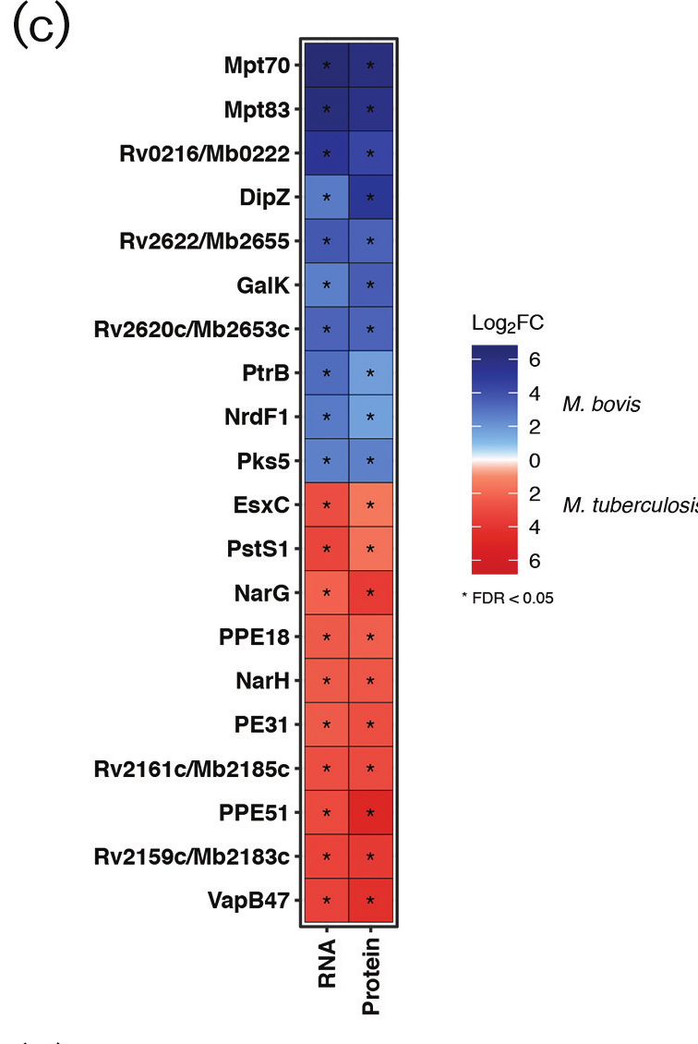
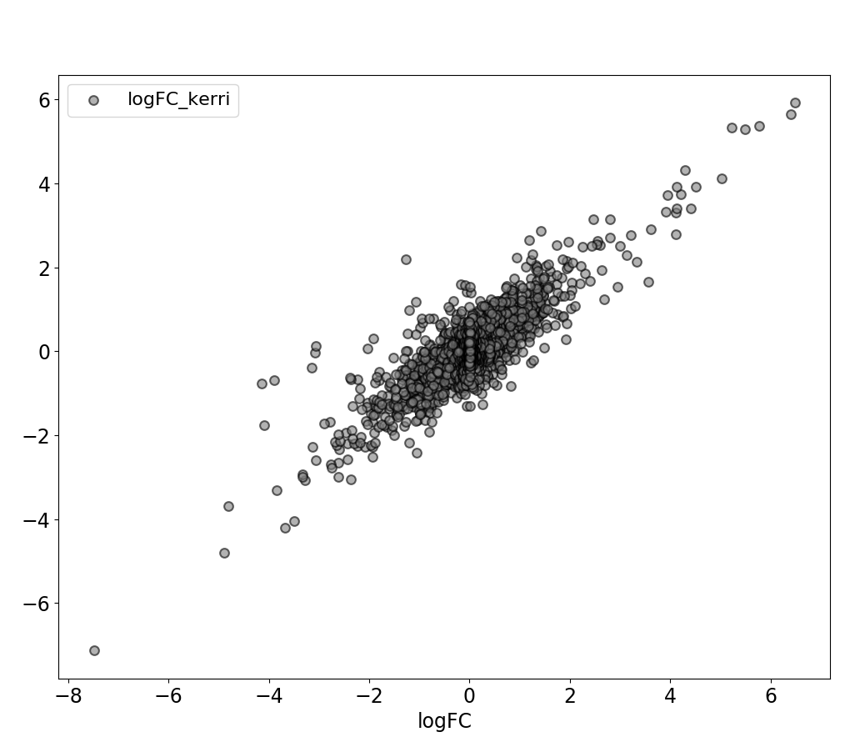
Why results don’t exactly match
Reasons:
Alignment tools differ
Alignment parameters
Feature counting parameters
Difference in DE analysis tool, eg. P-value adjustment
Cutoffs for significance
No single rules for gene selection.

