Slide 1

AirBnB Dublin
Statistical Learning Seminar
Lars Knieper, Dominik Becker
Explainable data-driven Price Prediction using Deep Learning Models

Slide 2
Content
Data
SHAP values
Feature Selection
Models and their results
Munich
Conclusion

Slide 3
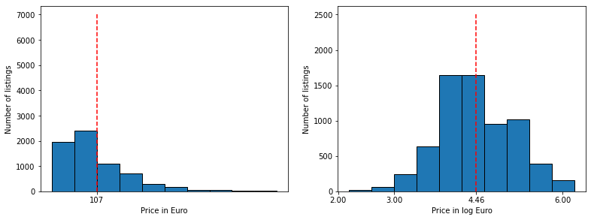
Data Dublin
Data
SHAP Values
Feature Selection
Models
Munich
Conclusion
Process
Numerical variables
Categorical variables (amenities)
Text variables
Spatial variables
Images
What did we have to deal with?
6976 listings
74 variables
86.899 images
214.934 reviews
Tidy up:
hotels, hostels
non-informative variables
unrealistic prices

Slide 4
Data Dublin – Text variables
Data
SHAP Values
Feature Selection
Models
Munich
Conclusion
text variables: name, host_name, description, neighbourhood_overview, host_about, reviews (grouped by id)

Slide 5
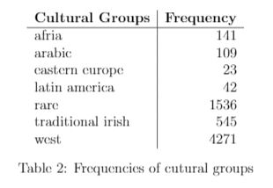
Data Dublin – Text variables
Data
SHAP Values
Feature Selection
Models
Munich
Conclusion
text variables: name, host_name, description, neighbourhood_overview, host_about, reviews (grouped by id)

Slide 6
Data Dublin – Text variables
Data
SHAP Values
Feature Selection
Models
Munich
Conclusion
text variables: name, host_name, description, neighbourhood_overview, host_about, reviews (grouped by id)
+ english host
+ amount of english reviews
took the length

Slide 7
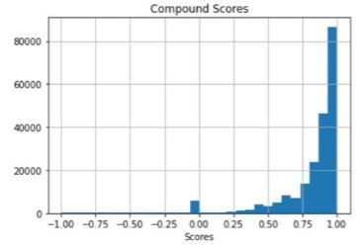
Data Dublin – Text variables
Data
SHAP Values
Feature Selection
Models
Munich
Conclusion
text variables: name, host_name, description, neighbourhood_overview, host_about, reviews (grouped by id)
Sentiment Analysis with NLTK
NLTK
VADER method
get scores for negativity, neutrality, positivity and compound score
considers athmosphere as well
for reviews: most negative/positive compound and proportion of negative compound

Slide 8
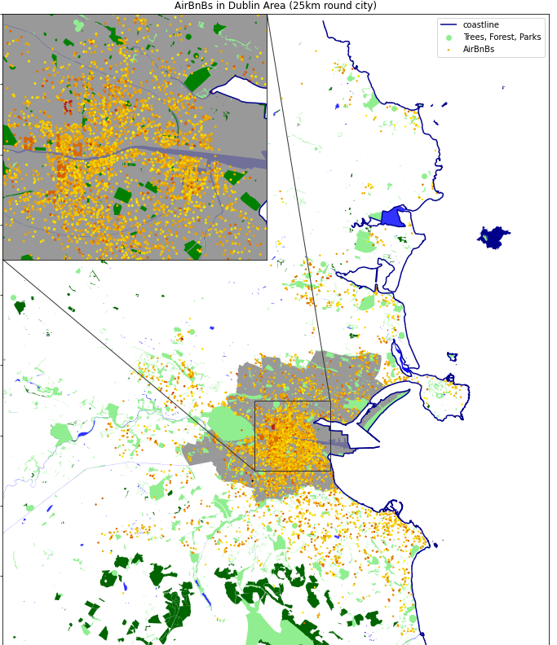
Data Dublin - Spatial
Data
SHAP Values
Feature Selection
Models
Munich
Conclusion
→ OSM
Gaussian Process Regression not reasonable
1km
Distance to Sights:
Tripadvisor‘s Top10 + Temple Bar
Distance to travel options:
Airport, Station, Harbour
no. of objects in 1km radius:
Restaurants, cafes, library, bus stops, malls, nightclubs
only means, nearest travel option and three nearest sights

Slide 9
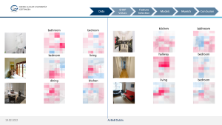
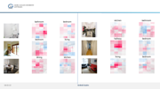
Room Classification
Data
SHAP Values
Feature Selection
Models
Munich
Conclusion
ResNet50* feature extraction + dense layer + generalization
7 room classes (bath, bed, hall, living, kitchen, dining, others)
Extract labels from image descriptions using regex
*He et al. 2016

Slide 10
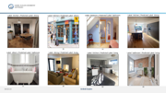
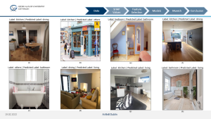
Room Classification
Data
SHAP Values
Feature Selection
Models
Munich
Conclusion
ResNet50* feature extraction + dense layer + generalization
7 room classes (bath, bed, hall, living, kitchen, dining, others)
Extract labels from image descriptions using regex
Model generalization increases label quality
No unique labeling possible - hard classification task
Robustness against ”outside” pictures difficult
*He et al. 2016

Slide 11


Room Classification
Data
SHAP Values
Feature Selection
Models
Munich
Conclusion
ResNet50* feature extraction + dense layer + generalization
7 room classes (bath, bed, hall, living, kitchen, dining, others)
Extract labels from image descriptions using regex
Model generalization increases label quality
No unique labeling possible - hard classification task
Robustness against ”outside” pictures difficult
Good results on average
Results:
*He et al. 2016

Slide 12
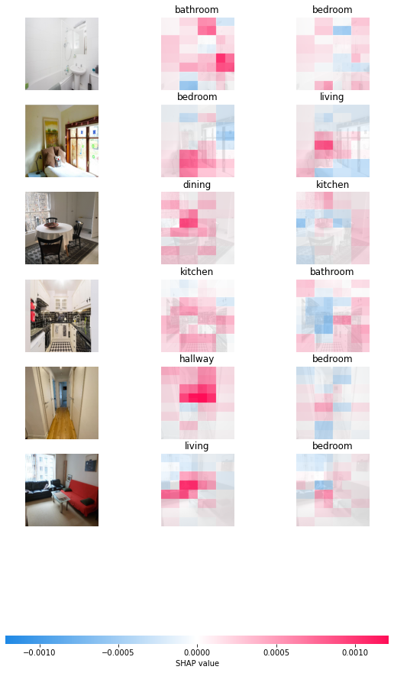
Data
SHAP Values
Feature Selection
Models
Munich
Conclusion

Slide 13
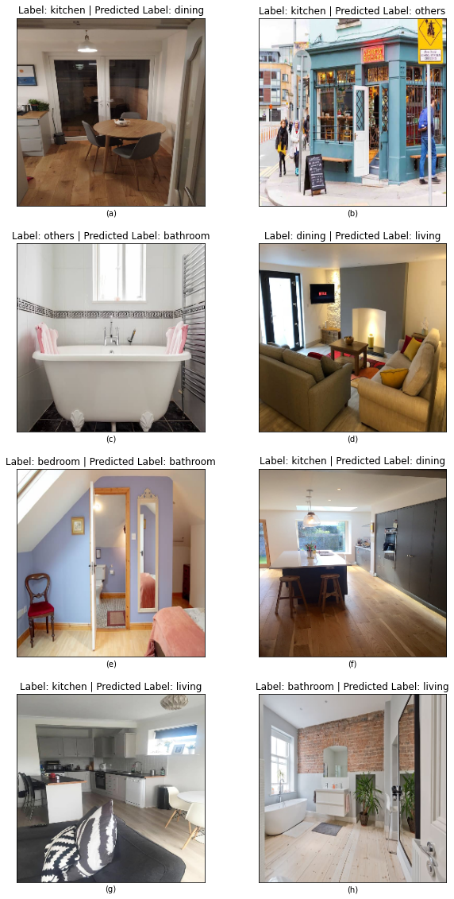
Data
SHAP Values
Feature Selection
Models
Munich
Conclusion

Slide 14
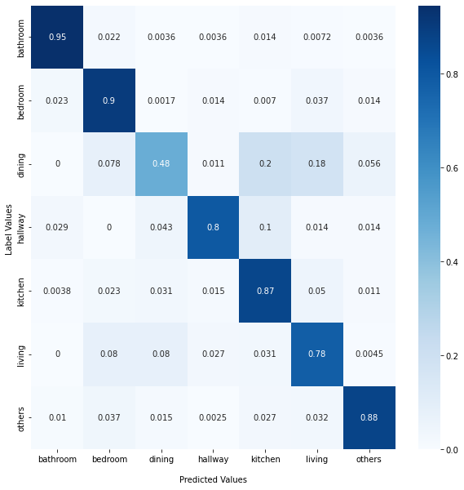
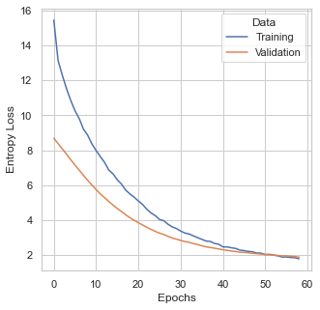
Data
SHAP Values
Feature Selection
Models
Munich
Conclusion

Slide 15
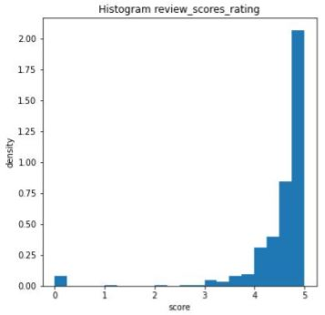
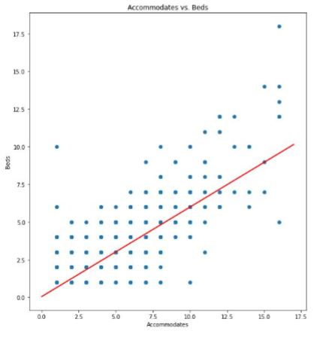

Data Dublin – Imputations (examples)
Data
SHAP Values
Feature Selection
Models
Munich
Conclusion
equal to another variable
name, description = room_type
neigbourhood_overview = neighbourhood_cleansed
first_review, last_review = last_scraped
random draws from distributions
binary variables -> Bernoulli distribution
review scores -> manipulated halfnormal
simple OLS regression
${beds}_{t}= β_{1}+ β_{2}{accommodates}_{t}+e_{t}$
${bedrooms}_{t}= β_{1}+ β_{2}{beds}_{t}+e_{t}$
further…
host_name | web-scraped
host_location_country | „Ireland“
host_listings_count | counted by host_id
review sents, brightness | mean

Slide 16
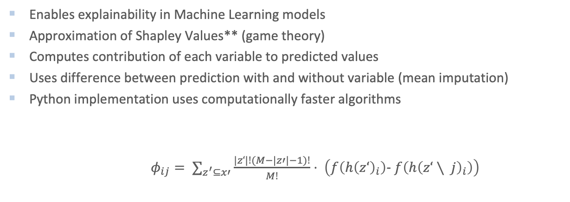
SHAP Values*
Data
SHAP Values
Feature Selection
Models
Munich
Conclusion
Enables explainability in Machine Learning models
Approximation of Shapley Values** (game theory)
Computes contribution of each variable to predicted values
Uses difference between prediction with and without variable (mean imputation)
Python implementation uses computationally faster algorithms
$φ_{ij}= ∑_{z^{′}⊆x′}\frac{|z‘|!(M−|z′|−1)!}{M!}⋅ \left(f\left(h{\left(z‘\right)}_{i}\right)− f\left(h{\left(z‘∖ j\right)}_{i}\right)\right)$
* Lundberg and Lee 2017
** Nowak and Radzik 1994

Slide 17
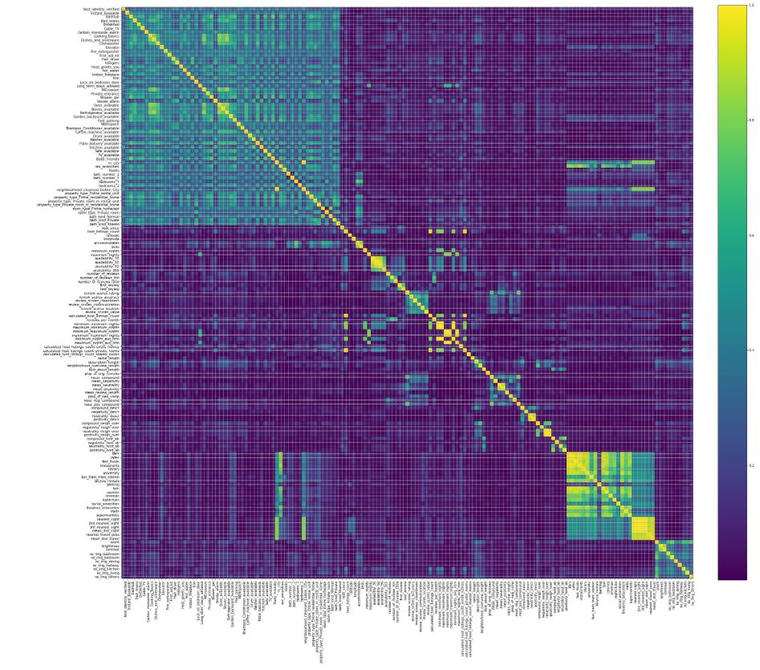
Feature Selection - Correlations
Data
SHAP Values
Feature Selection
Models
Munich
Conclusion
dropped 58 amenitites and 61 binary variables due to no variance
dropped 8 binaies due to insignificant
Welch tests
149 variables
→ 92 numeric
→ 57 binary
Correlation coefficients
Pearson for numeric
Jaccard for binary
Point-Biserial for numeric vs. binary

Slide 18
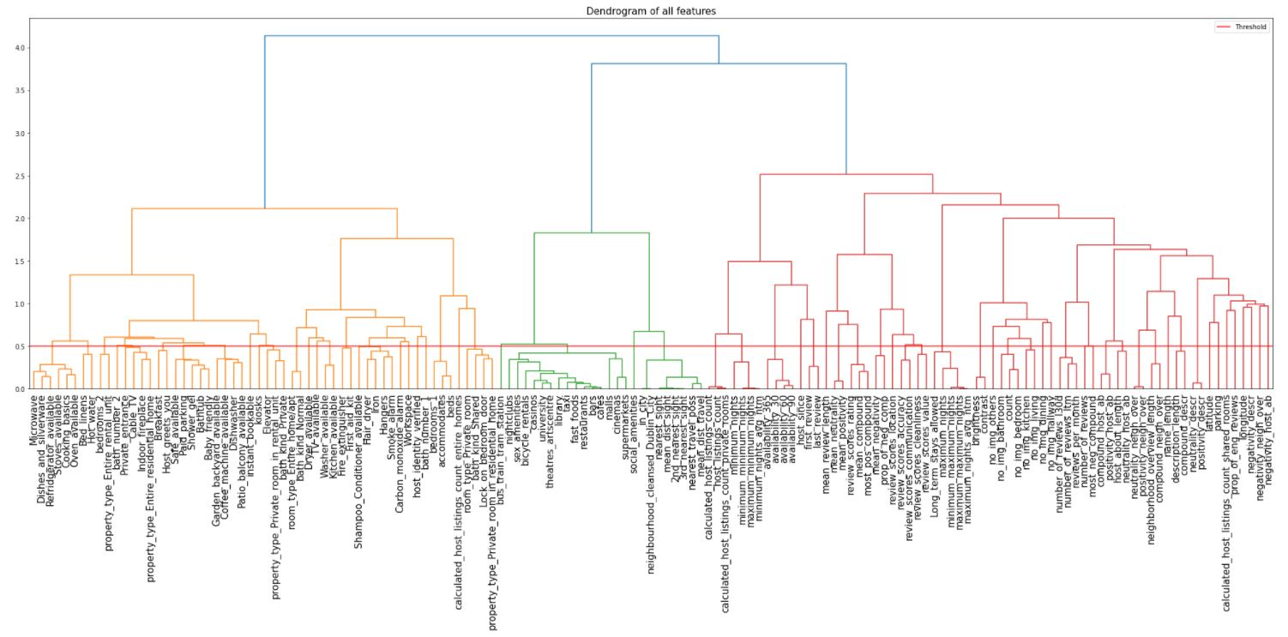

Feature Selection - Dendrogram
Clustering by Ward’s linkage:
$D\left(X, Y\right)=ESS\left(XY\right)−\left(ESS\left(X\right)+ESS\left(Y\right)\right)$
$$ESS:error sum of squares$$
$$X, Y:clusters$$
ESS calculated by Euclidean Distance
set ESS = 0.5 as threshold for variable selection (red line)

Slide 19
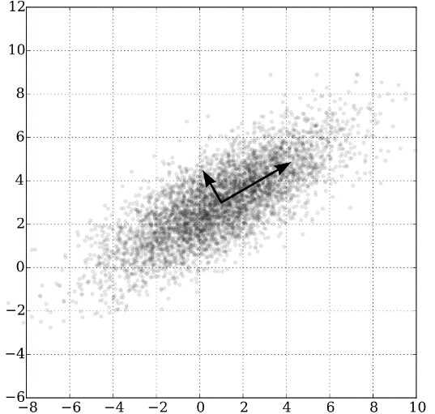
Feature Selection - Selection
Data
SHAP Values
Feature Selection
Models
Munich
Conclusion
choose between at least two variables
→ dropped 26 variables
computed PCAs for thematically related variables
→ 14 PCAs
→ 96 variables to 42 components

Slide 20
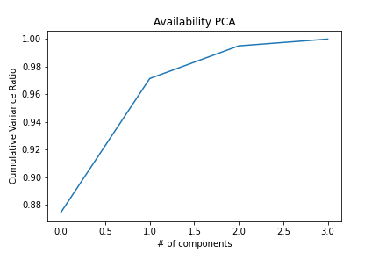
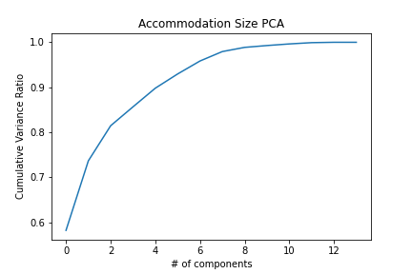
Feature Selection - PCas
Data
SHAP Values
Feature Selection
Models
Munich
Conclusion
room_type_Private_room
room_type_Entire_home/apt
bath_number_1
bath_number_2
bath_kind_Shared
bath_kind_Private
bath_kind_Normal
bedrooms_1
bedrooms_2
Accommodates
Beds
property_type_Private_room_in_residential_home
property_type_Entire_rental_unit
property_type_Private_room_in_rental_unit
property_type_Entire_residential_home
availability_365
availability_30
availability_60
availability_90
kept 7 components
kept 1 component

Slide 21
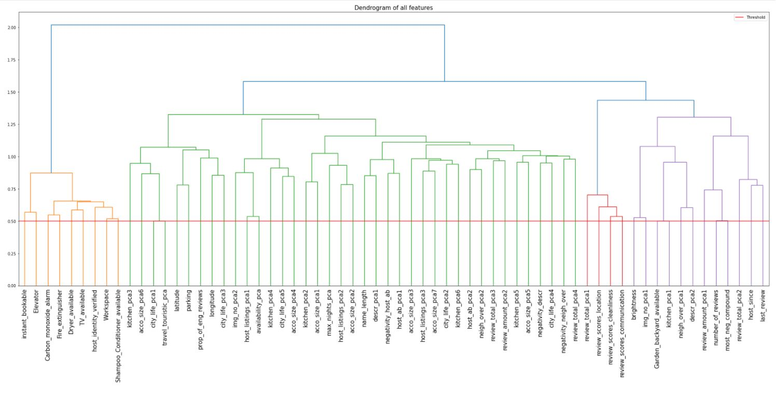
64 features

Slide 22
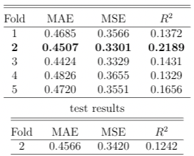
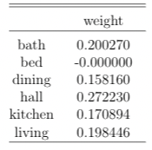
Image Model
Data
SHAP Values
Feature Selection
Models
Munich
Conclusion
Feature extraction with ResNet50
Utilizes room classification model
Different room different focuses
Constraint weights for Dense Layer 3: sum up to 1, greater than 0
Caution:
Depends highly on correct room classification;
Many imputations with black images

Slide 23
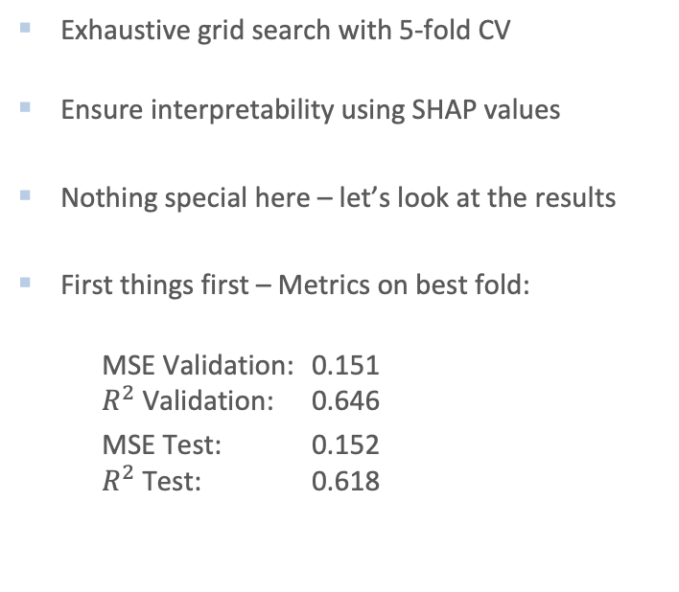
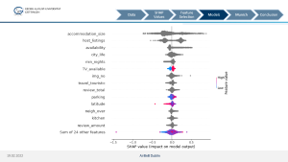
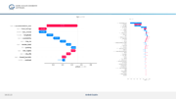
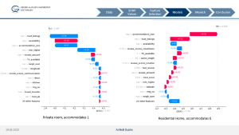
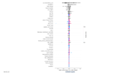
XGBoost* Model
Data
SHAP Values
Feature Selection
Models
Munich
Conclusion
Exhaustive grid search with 5-fold CV
Ensure interpretability using SHAP values
Nothing special here – let’s look at the results
First things first – Metrics on best fold:
MSE Validation: 0.151 $R^{2}$ Validation: 0.646
MSE Test: 0.152 $R^{2}$ Test: 0.618
* Chen and Guestrin 2016

Slide 24
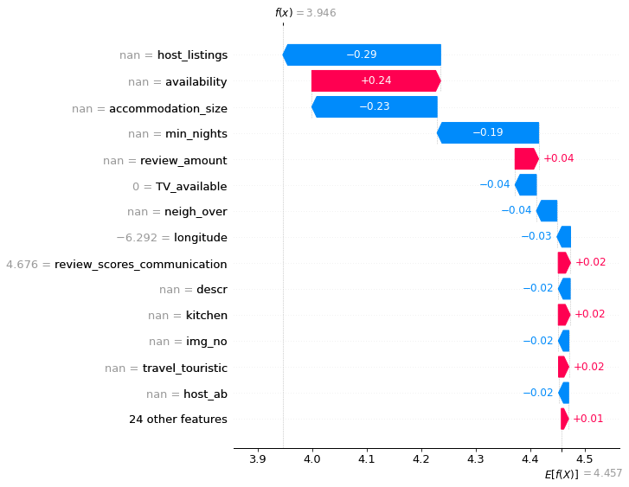
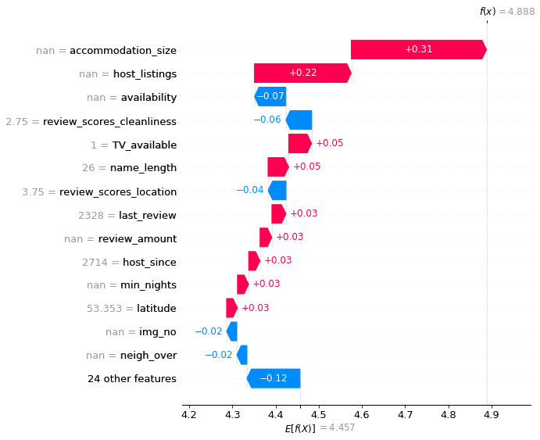
Data
SHAP Values
Feature Selection
Models
Munich
Conclusion
Private room, accommodates 1
Residential Home, accommodates 6

Slide 25
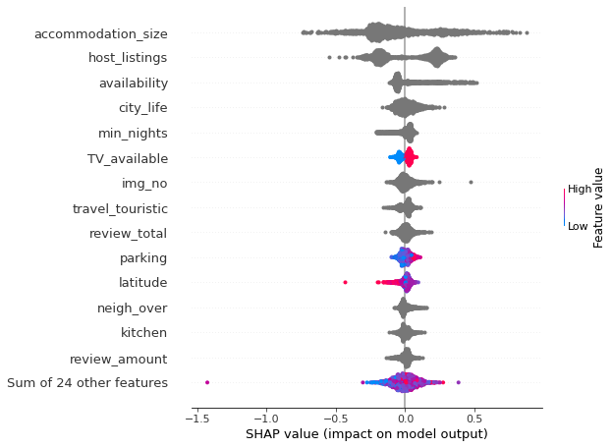
Data
SHAP Values
Feature Selection
Models
Munich
Conclusion

Slide 26
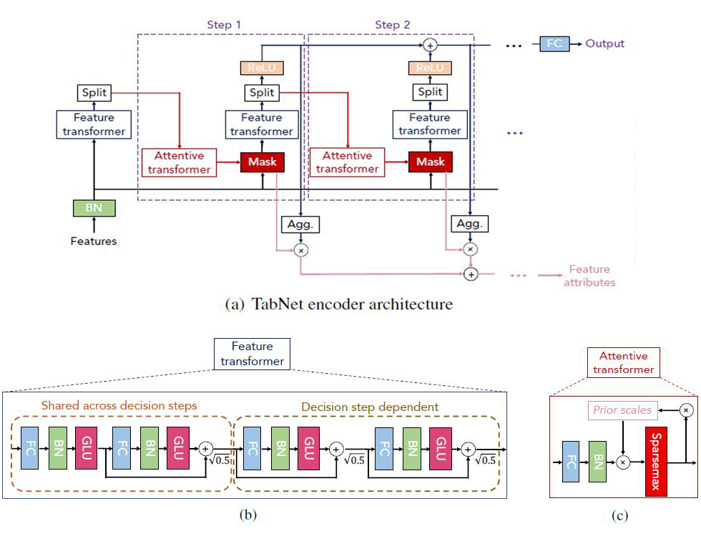
TabNet Model
Data
SHAP Values
Feature Selection
Models
Munich
Conclusion
DT algorithms outperform DL for tabular data
TabNet performs as least as good or even outperforms
Dataset size used 10k – 10M

Slide 27
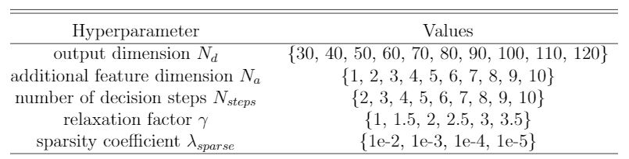
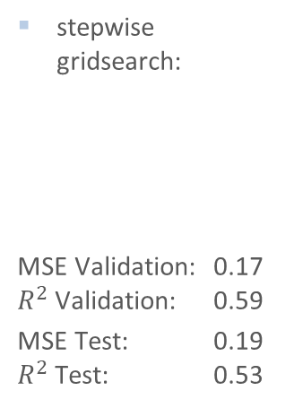
TabNet Model - Results
Data
SHAP Values
Feature Selection
Models
Munich
Conclusion
stepwise gridsearch:
MSE Validation: 0.17 $R^{2}$ Validation: 0.59
MSE Test: 0.19 $R^{2}$ Test: 0.53
Interpretability again by SHAP values

Slide 28
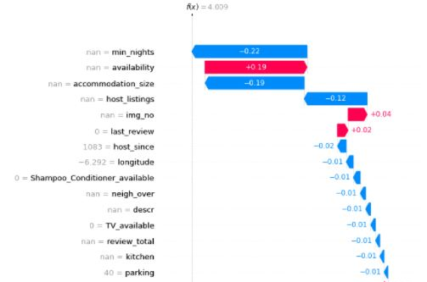
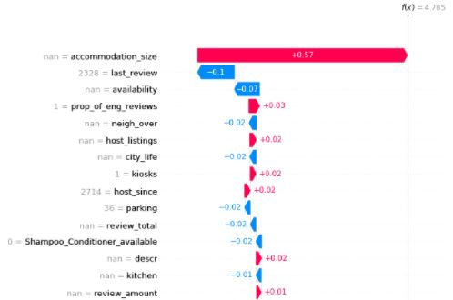
TabNet Model – SHAP for single listings
Data
SHAP Values
Feature Selection
Models
Munich
Conclusion

Slide 29
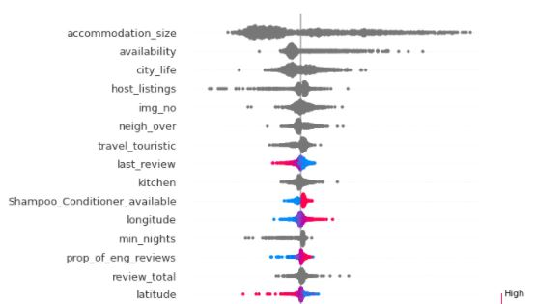
TabNet Model – SHAP aggregated
Data
SHAP Values
Feature Selection
Models
Munich
Conclusion

Slide 30
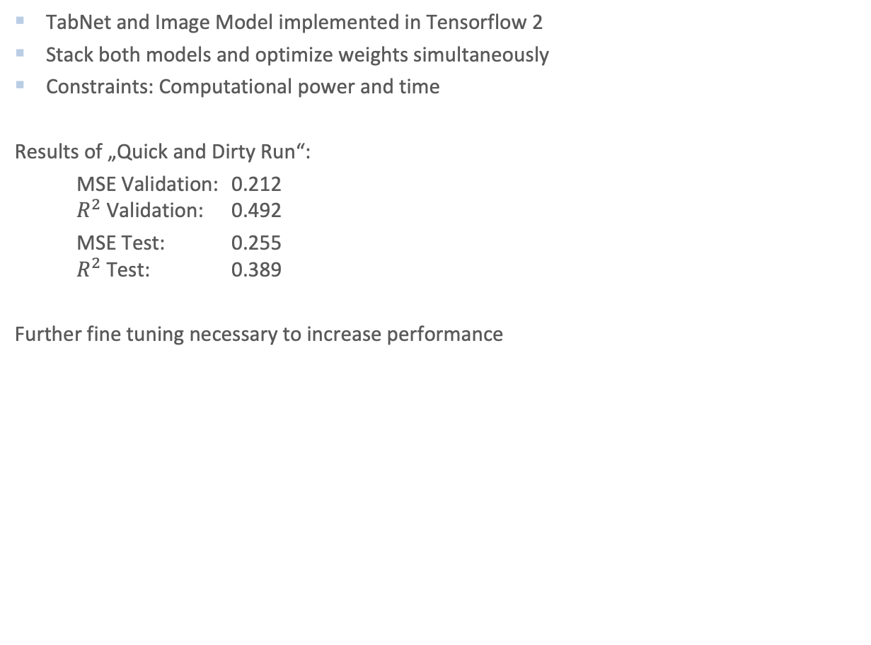
Images and Tabular Data
Data
SHAP Values
Feature Selection
Models
Munich
Conclusion
TabNet and Image Model implemented in Tensorflow 2
Stack both models and optimize weights simultaneously
Constraints: Computational power and time
Results of „Quick and Dirty Run“:
MSE Validation: 0.212 $R^{2}$ Validation: 0.492
MSE Test: 0.255 $R^{2}$ Test: 0.389
Further fine tuning necessary to increase performance

Slide 31
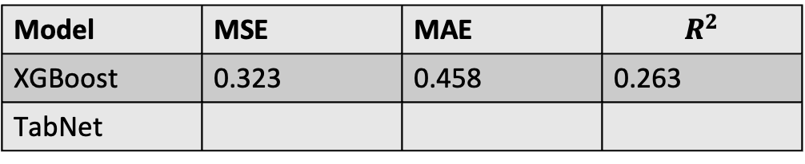
Munich
Data
SHAP Values
Feature Selection
Models
Munich
Conclusion
Results:
Some words of caution:
Predictions not reasonable as many variables depend on the characteristics of Dublin
No images scraped – imputed with average values obtained in Dublin
Model | MSE | MAE | $$R^{2}$$
XGBoost | 0.323 | 0.458 | 0.263
TabNet

Slide 32
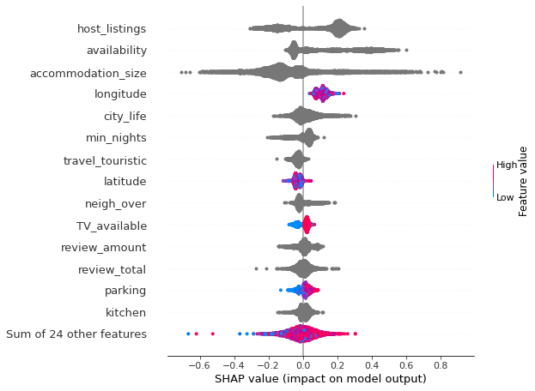
Munich
Data
SHAP Values
Feature Selection
Models
Munich
Conclusion

Slide 33
Problems and Learnings
Data
SHAP Values
Feature Selection
Models
Munich
Conclusion
Avoid data leak in validation, test data to training data Implementation of data load class
Remove variables on basis of whole listings
Fit variable transformations on basis of training data only
Transform variables for validation and test accordingly

Slide 34
Summary
Data
SHAP Values
Feature Selection
Models
Munich
Conclusion
TabNet as a DL-approach gets outperformed by XGBoost → small sample size
images do not contain enough information
the accommodation size, the host‘s knowledge (host_listings), the availability and being near to relevant city objects are the most relevant features in both models
Outlook
better infrastructure/more time might increase TabNet performance slighty
compound model might need more finetuning or achitecture

Slide 35
Core References
Data
SHAP Values
Feature Selection
Models
Munich
Conclusion
Lundberg, S. M. and Lee, S.-I. (2017). A unified approach to interpreting model predictions. Advances in neural information processing systems, 30.
Nowak, A. S. and Radzik, T. (1994). The shapley value for n-person games in generalized characteristic function form. Games and Economic Behavior, 6(1):150–161.
He, K., Zhang, X., Ren, S., and Sun, J. (2016). Deep residual learning for image recognition, Proceedings of the IEEE conference on computer vision and pattern recognition, pages770–778
Chen, T. and Guestrin, C. (2016). Xgboost: A scalable tree boosting system. Proceedings of the 22nd acm sigkdd international conference on knowledge discovery and data mining, pages 785–794.
Sercan, A. and Pfister, T. (2019). Tabnet: Attentive interpretable tabular learning.
Hutto, C. and Gilbert, E. (2014). Vader: A parsimonious rule-based model for sentimentanalysis of social media text.Proceedings of the International AAAI Conference on Weband Social Media, 8(1), pages 216–225

