Slide 1
AirBnB Dublin
Lars Knieper, Dominik Becker
Explainable Data-Driven Price Prediction using Deep Learning Models

Slide 2
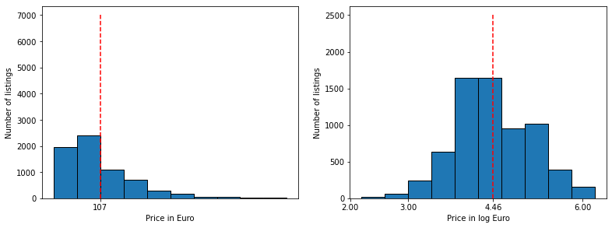
Data Dublin
6976 listings
74 variables
86.899 images

Slide 3
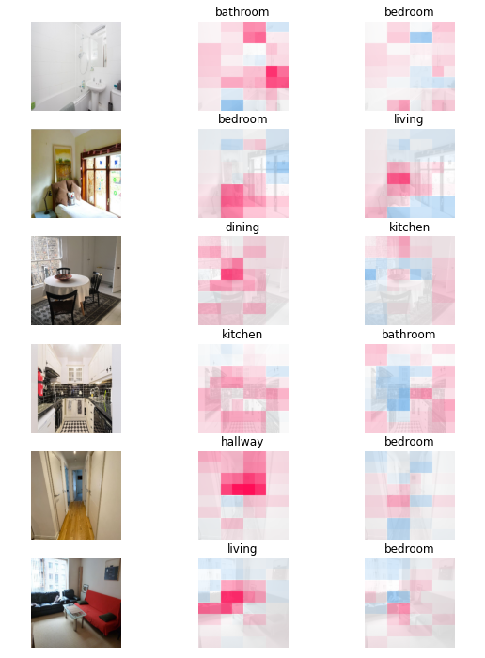
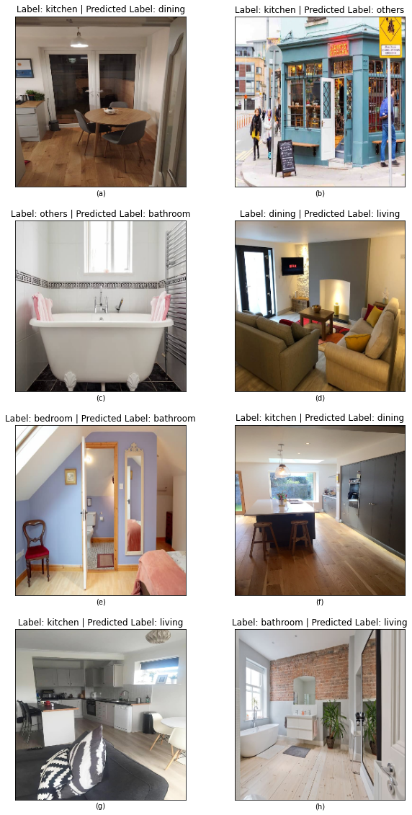
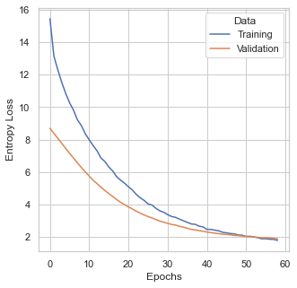
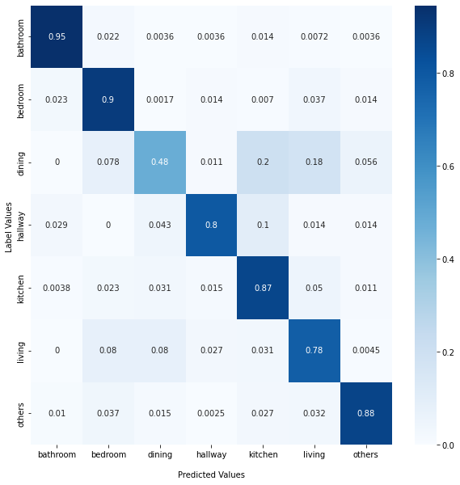
Room Classification
6976 listings
74 variables
86.899 images

Slide 4

SHAP Values (Lundberg and Lee 2017)
Enables explainability in Machine Learning models
Computes contribution of each variable to predicted values
Uses difference between prediction with and without variable (mean imputation)
Python implementation uses computationally faster algorithms

Slide 5
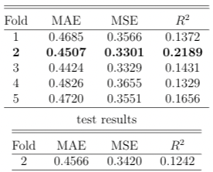
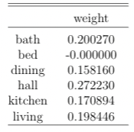
Image Model
Feature extraction with ResNet50
Utilizes room classification model
Different room different focuses
Constraint weights for Dense Layer 3: sum up to 1, greater than 0
Caution:
Depends highly on correct room classification;
many imputations with black images

Slide 6
References
Lundberg, S. M. and Lee, S.-I. (2017). A unified approach to interpreting model predictions.Advances in neural information processing systems, 30.

