Slide 1

AirBnB Dublin
Statistical Learning Seminar
Lars Knieper, Dominik Becker
Explainable data-driven Price Prediction using Deep Learning Models

Slide 2
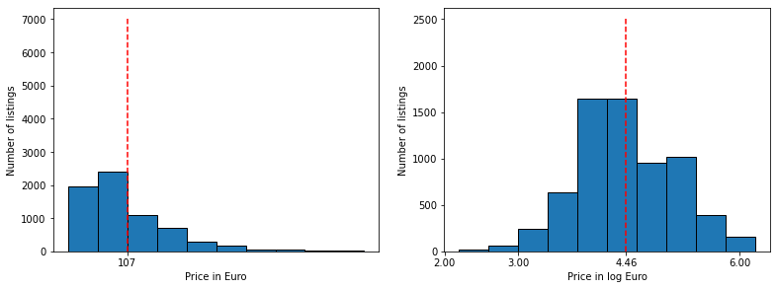
Data Dublin
Process
Numerical variables
Categorical variables (amenities)
Text variables
Spatial variables
Images
What did we have to deal with?
6976 listings
74 variables
86.899 images
214.934 reviews
Tidy up:
hotels, hostels
non-informative variables
unrealistic prices

Slide 3
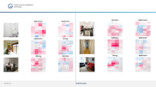

Room Classification
ResNet50* feature extraction + dense layer + generalization
7 room classes (bath, bed, hall, living, kitchen, dining, others)
Extract labels from image descriptions using regex
*He et al. 2016

Slide 4


Room Classification
ResNet50* feature extraction + dense layer + generalization
7 room classes (bath, bed, hall, living, kitchen, dining, others)
Extract labels from image descriptions using regex
Model generalization increases label quality
No unique labeling possible - hard classification task
Robustness against ”outside” pictures difficult
*He et al. 2016

Slide 5


Room Classification
ResNet50* feature extraction + dense layer + generalization
7 room classes (bath, bed, hall, living, kitchen, dining, others)
Extract labels from image descriptions using regex
Model generalization increases label quality
No unique labeling possible - hard classification task
Robustness against ”outside” pictures difficult
Good results on average
Results:
*He et al. 2016

Slide 6
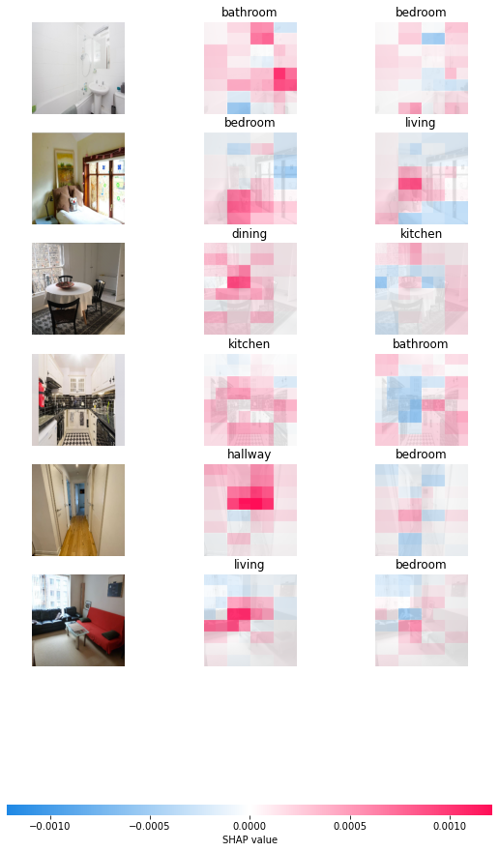

Slide 7
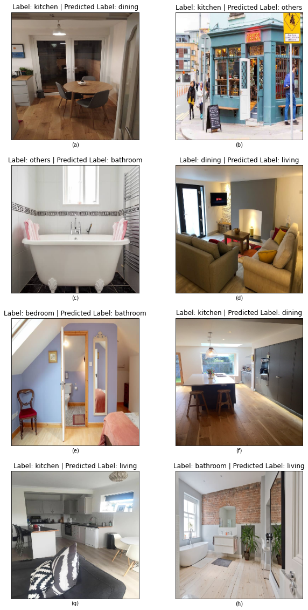

Slide 8
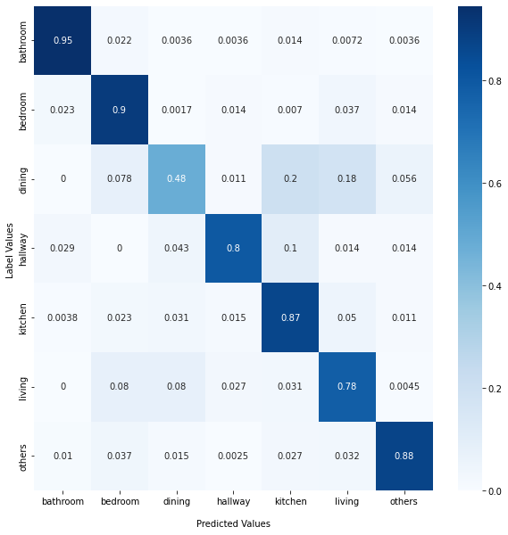
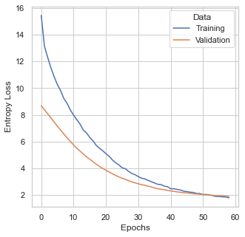

Slide 9
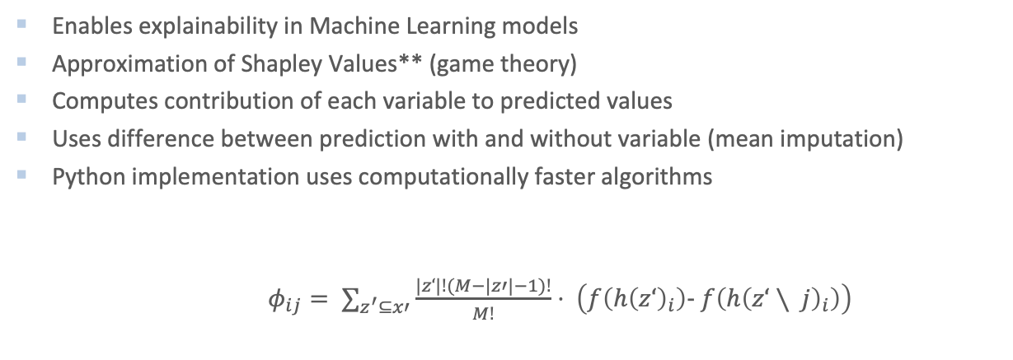
SHAP Values*
Enables explainability in Machine Learning models
Approximation of Shapley Values** (game theory)
Computes contribution of each variable to predicted values
Uses difference between prediction with and without variable (mean imputation)
Python implementation uses computationally faster algorithms
$φ_{ij}= ∑_{z^{′}⊆x′}\frac{|z‘|!(M−|z′|−1)!}{M!}⋅ \left(f\left(h{\left(z‘\right)}_{i}\right)− f\left(h{\left(z‘∖ j\right)}_{i}\right)\right)$
* Lundberg and Lee 2017
** Nowak and Radzik 1994

Slide 10
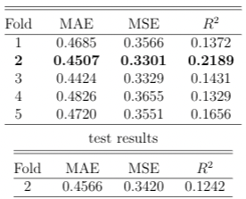
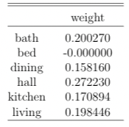
Image Model
Feature extraction with ResNet50
Utilizes room classification model
Different room different focuses
Constraint weights for Dense Layer 3: sum up to 1, greater than 0
Caution:
Depends highly on correct room classification;
Many imputations with black images

Slide 11
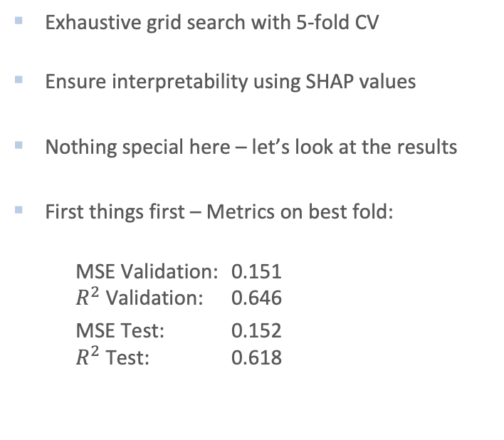
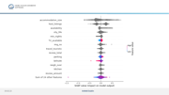
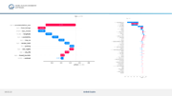
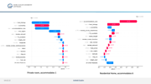
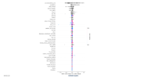
XGBoost* Model
Exhaustive grid search with 5-fold CV
Ensure interpretability using SHAP values
Nothing special here – let’s look at the results
First things first – Metrics on best fold:
MSE Validation: 0.151 $R^{2}$ Validation: 0.646
MSE Test: 0.152 $R^{2}$ Test: 0.618
* Chen and Guestrin 2016

Slide 12
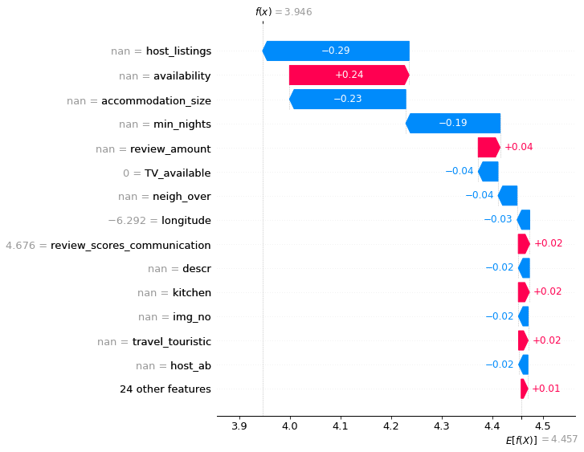
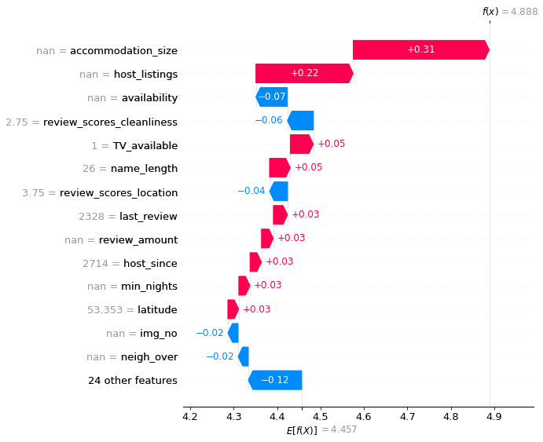
Private room, accommodates 1
Residential Home, accommodates 6

Slide 13
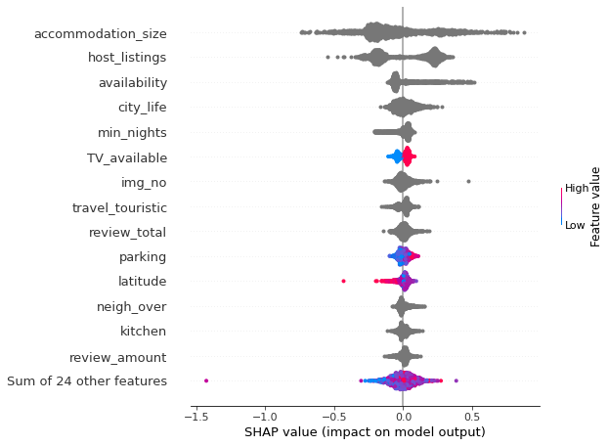

Slide 14
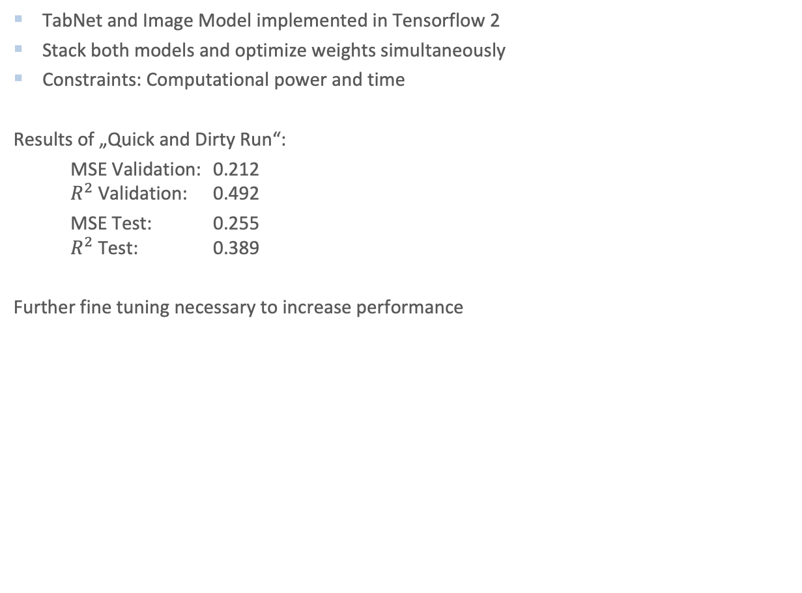
Images and Tabular Data
TabNet and Image Model implemented in Tensorflow 2
Stack both models and optimize weights simultaneously
Constraints: Computational power and time
Results of „Quick and Dirty Run“:
MSE Validation: 0.212 $R^{2}$ Validation: 0.492
MSE Test: 0.255 $R^{2}$ Test: 0.389
Further fine tuning necessary to increase performance

Slide 15
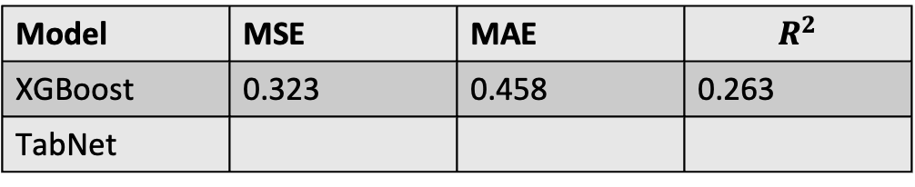
Munich
Results:
Some words of caution:
Predictions not reasonable as many variables depend on the characteristics of Dublin
No images scraped – imputed with average values obtained in Dublin
Model | MSE | MAE | $$R^{2}$$
XGBoost | 0.323 | 0.458 | 0.263
TabNet

Slide 16
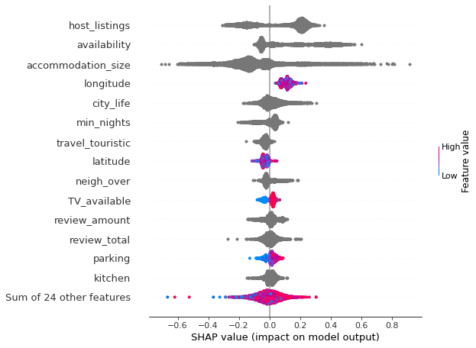
Munich

Slide 17
Problems and Learnings
Avoid data leak in validation, test data to training data Implementation of data load class
Remove variables on basis of whole listings
Fit variable transformations on basis of training data only
Transform variables for validation and test accordingly

Slide 18
References
Lundberg, S. M. and Lee, S.-I. (2017). A unified approach to interpreting model predictions.Advances in neural information processing systems, 30.
Nowak, A. S. and Radzik, T. (1994). The shapley value for n-person games in generalized characteristic function form.Games and Economic Behavior, 6(1):150–161.
He, K., Zhang, X., Ren, S., and Sun, J. (2016). Deep residual learning for image recognition.In Proceedings of the IEEE conference on computer vision and pattern recognition, pages770–778
Chen, T. and Guestrin, C. (2016). Xgboost: A scalable tree boosting system. InProceedingsof the 22nd acm sigkdd international conference on knowledge discovery and data mining,pages 785–794.

