Slide 1
I like dogs
By Dog Mc Dog

Slide 2
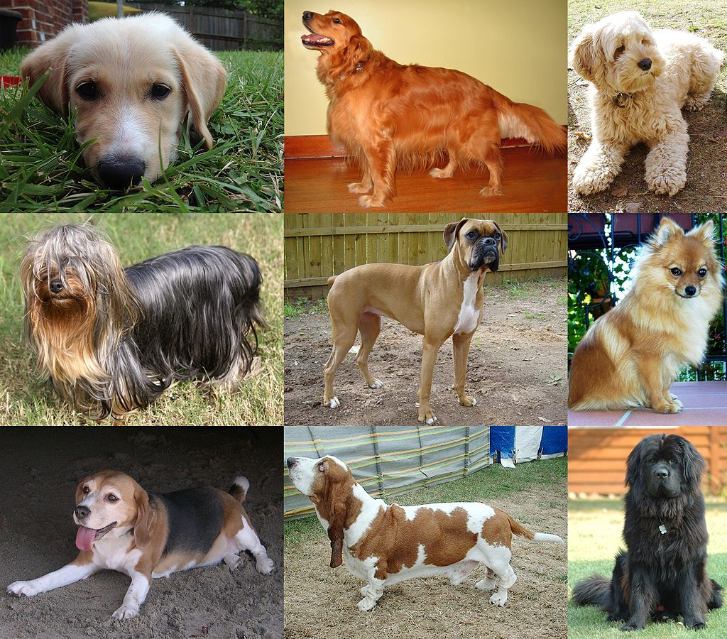
Dog are cool!
- reason 1
- dog! where?!

Slide 3
this is cool, slide 3!
- do you know what else is cool? Dogs!
- wow dogs
- omg dogs
- nice, dogs!

