Slide 1
Chapter 3:
Decision Structures
Starting Out with Java:
From Control Structures through Objects
Fifth Edition
by Tony Gaddis

Slide 2
Chapter Topics
The if Statement
The if-else Statement
Nested if statements
The if-else-if Statement
Logical Operators
Comparing String Objects
Variable Declaration and Scope
The Conditional Operator
The switch Statement
The printf Method
The DecimalFormat Class
3-<number>

Slide 3
The if Statement
The if statement uses a boolean to decide whether the next statement or block of statements executes.
  if (boolean expression is true)
  execute next statement.
3-<number>

Slide 4
Flowcharts
If statements can be modeled as a flow chart.
if (coldOutside)
wearCoat();
Is it cold
outside?
Yes
Wear a coat.
3-<number>

Slide 5
Flowcharts
A block if statement may be modeled as:
if (coldOutside)
{
wearCoat();
wearHat();
wearGloves();
}
Is it cold
outside?
Yes
Wear a coat.
Wear a hat.
Wear gloves.
Note the use of curly
braces to block several
statements together.
3-<number>

Slide 6
Relational Operators
In most cases, the boolean expression, used by the if statement, uses relational operators.
Relational Operator | Meaning
> | is greater than
< | is less than
>= | is greater than or equal to
<= | is less than or equal to
== | is equal to
!= | is not equal to
3-<number>

Slide 7
Boolean Expressions
A boolean expression is any variable or calculation that results in a true or false condition.
Expression | Meaning
x > y | Is x greater than y?
x < y | Is x less than y?
x >= y | Is x greater than or equal to y?
x <= y | Is x less than or equal to y.
x == y | Is x equal to y?
x != y | Is x not equal to y?
3-<number>

Slide 8
if Statements and Boolean Expressions
if (x > y)
  System.out.println("X is greater than Y");
if(x == y)
  System.out.println("X is equal to Y");
if(x != y)
{
  System.out.println("X is not equal to Y");
  x = y;
  System.out.println("However, now it is.");
}
Example: AverageScore.java
3-<number>

Slide 9
Programming Style and if Statements
An if statement can span more than one line; however, it is still one statement.
  if (average > 95)
  grade = ′A′;
is functionally equivalent to
  if(average > 95) grade = ′A′;
3-<number>

Slide 10
Programming Style and if Statements
Rules of thumb:
  The conditionally executed statement should be on the line after the if condition.
  The conditionally executed statement should be indented one level from the if condition.
  If an if statement does not have the block curly braces, it is ended by the first semicolon encountered after the if condition.
    if (expression)
    statement;
No semicolon here.
Semicolon ends statement here.
3-<number>

Slide 11
Block if Statements
Conditionally executed statements can be grouped into a block by using curly braces {} to enclose them.
If curly braces are used to group conditionally executed statements, the if statement is ended by the closing curly brace.
  if (expression)
  {
  statement1;
  statement2;
  }
Curly brace ends the statement.
3-<number>

Slide 12
Block if Statements
Remember that when the curly braces are not used, then only the next statement after the if condition will be executed conditionally.
  if (expression)
  statement1;
  statement2;
  statement3;
Only this statement is conditionally executed.
3-<number>

Slide 13
Flags
A flag is a boolean variable that monitors some condition in a program.
When a condition is true, the flag is set to true.
The flag can be tested to see if the condition has changed.
  if (average > 95)
  highScore = true;
Later, this condition can be tested:
  if (highScore)
  System.out.println("That′s a high score!");
3-<number>

Slide 14
Comparing Characters
Characters can be tested with relational operators.
Characters are stored in memory using the Unicode character format.
  Unicode is stored as a sixteen (16) bit number.
Characters are ordinal, meaning they have an order in the Unicode character set.
  Since characters are ordinal, they can be compared to each other.
  char c = ′A′;
  if(c < ′Z′)
  System.out.println("A is less than Z");
3-<number>

Slide 15
if-else Statements
The if-else statement adds the ability to conditionally execute code when the if condition is false.
  if (expression)
  statementOrBlockIfTrue;
  else
  statementOrBlockIfFalse;
See example: Division.java
3-<number>

Slide 16
if-else Statement Flowcharts
No
Yes
Is it cold
outside?
Wear shorts.
Wear a coat.
3-<number>

Slide 17
Nested if Statements
If an if statement appears inside another if statement (single or block) it is called a nested if statement.
The nested if is executed only if the outer if statement results in a true condition.
See example: LoanQualifier.java
3-<number>

Slide 18
Nested if Statement Flowcharts
No
Yes
Is it cold
outside?
Wear shorts.
No
Is it
snowing?
Yes
Wear a jacket.
Wear a parka.
3-<number>

Slide 19
Nested if Statements
if (coldOutside)
{
if (snowing)
{
wearParka();
}
else
{
wearJacket();
}
}
else
{
wearShorts();
}
3-<number>

Slide 20
if-else Matching
Curly brace use is not required if there is only one statement to be conditionally executed.
However, sometimes curly braces can help make the program more readable.
Additionally, proper indentation makes it much easier to match up else statements with their corresponding if statement.
3-<number>

Slide 21
Alignment and Nested if Statements
if (coldOutside)
{
if (snowing)
{
wearParka();
}
else
{
wearJacket();
}
}
else
{
wearShorts();
}
This if and else
go together.
This if and else
go together.
3-<number>

Slide 22
if-else-if Statements
if (expression_1)
{
statement;
statement;
etc.
}
else if (expression_2)
{
statement;
statement;
etc.
}
Insert as many else if clauses as necessary
else
{
statement;
statement;
etc.
}
If expression_1 is true these statements are executed, and the rest of the structure is ignored.
Otherwise, if expression_2 is true these statements are executed, and the rest of the structure is ignored.
These statements are executed if none of the expressions above are true.
3-<number>

Slide 23
if-else-if Statements
The if-else-if statement makes certain types of nested decision logic simpler to write.
Nested if statements can become very complex.
Care must be used since else statements match up with the immediately preceding unmatched if statement.
See example: TestResults.java
3-<number>

Slide 24
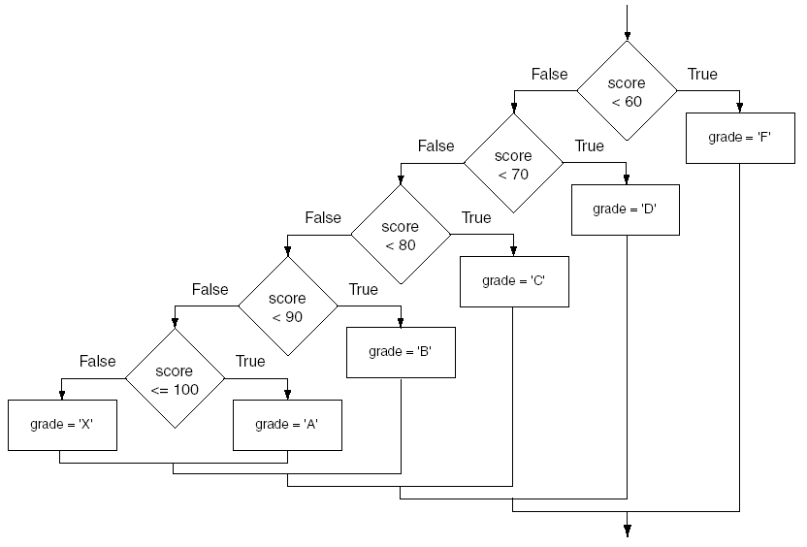
if-else-if Flowchart
3-<number>

Slide 25
Logical Operators
Java provides two binary logical operators (&& and ||) that are used to combine boolean expressions.
Java also provides one unary (!) logical operator to reverse the truth of a boolean expression.
3-<number>

Slide 26
Logical Operators
Operator | Meaning | Effect
&& | AND | Connects two boolean expressions into one. Both expressions must be true for the overall expression to be true.
|| | OR | Connects two boolean expressions into one. One or both expressions must be true for the overall expression to be true. It is only necessary for one to be true, and it does not matter which one.
! | NOT | The ! operator reverses the truth of a boolean expression. If it is applied to an expression that is true, the operator returns false. If it is applied to an expression that is false, the operator returns true.
3-<number>

Slide 27
The && Operator
The logical AND operator (&&) takes two operands that must both be boolean expressions.
The resulting combined expression is true if (and only if) both operands are true.
See example: LogicalAnd.java
Expression 1 | Expression 2 | Expression1 && Expression2
true | false | false
false | true | false
false | false | false
true | true | true
3-<number>

Slide 28
The || Operator
The logical OR operator (||) takes two operands that must both be boolean expressions.
The resulting combined expression is false if (and only if) both operands are false.
Example: LogicalOr.java
Expression 1 | Expression 2 | Expression1 || Expression2
true | false | true
false | true | true
false | false | false
true | true | true
3-<number>

Slide 29
The ! Operator
The ! operator performs a logical NOT operation.
If an expression is true, !expression will be false.
  if (!(temperature > 100))
  System.out.println("Below the maximum temperature.");
If temperature > 100 evaluates to false, then the output statement will be run.
Expression 1 | !Expression1
true | false
false | true
3-<number>

Slide 30
Short Circuiting
Logical AND and logical OR operations perform short-circuit evaluation of expressions.
Logical AND will evaluate to false as soon as it sees that one of its operands is a false expression.
Logical OR will evaluate to true as soon as it sees that one of its operands is a true expression.
3-<number>

Slide 31
Order of Precedence
The ! operator has a higher order of precedence than && and the && operator has higher precedence than the|| operator.
In general, the arithmetic operators have higher precedence than the relational operators. And, the relational operators have higher precedence than the logical operators.
Parenthesis can be used to force the precedence to be changed.
3-<number>

Slide 32
Order of Precedence
Order of Precedence | Operators | Description
1 | (unary negation) ! | Unary negation, logical NOT
2 | * / % | Multiplication, Division, Modulus
3 | + - | Addition, Subtraction
4 | < > <= >= | Less-than, Greater-than, Less-than or equal to, Greater-than or equal to
5 | == != | Is equal to, Is not equal to
6 | && | Logical AND
7 | || | Logical NOT
8 | = += -= *= /= %= | Assignment and combined assignment operators.
3-<number>

Slide 33
Comparing String Objects
In most cases, you cannot use the relational operators to compare two String objects.
Reference variables contain the address of the object they represent.
Unless the references point to the same object, the relational operators will not return true.
See example: StringCompare.java
See example: StringCompareTo.java
3-<number>

Slide 34
Ignoring Case in String Comparisons
In the String class the equals and compareTo methods are case sensitive.
In order to compare two String objects that might have different case, use:
  equalsIgnoreCase, or
  compareToIgnoreCase
See example: SecretWord.java
3-<number>

Slide 35
Variable Scope
In Java, a local variable does not have to be declared at the beginning of the method.
The scope of a local variable begins at the point it is declared and terminates at the end of the method.
When a program enters a section of code where a variable has scope, that variable has come into scope, which means the variable is visible to the program.
See example: VariableScope.java
3-<number>

Slide 36
The Conditional Operator
The conditional operator is a ternary (three operand) operator.
You can use the conditional operator to write a simple statement that works like an if-else statement.
3-<number>

Slide 37
The Conditional Operator
The format of the operators is:
  BooleanExpression ? Value1 : Value2
This forms a conditional expression.
If BooleanExpression is true, the value of the conditional expression is Value1.
If BooleanExpression is false, the value of the conditional expression is Value2.
3-<number>

Slide 38
The Conditional Operator
Example:
  z = x > y ? 10 : 5;
This line is functionally equivalent to:
  if(x > y)
  z = 10;
  else
  z = 5;
3-<number>

Slide 39
The Conditional Operator
Many times the conditional operator is used to supply a value.
  number = x > y ? 10 : 5;
This is functionally equivalent to:
  if(x > y)
  number = 10;
  else
  number = 5;
See example: ConsultantCharges.java
3-<number>

Slide 40
The switch Statement
The if-else statement allows you to make true / false branches.
The switch statement allows you to use an ordinal value to determine how a program will branch.
The switch statement can evaluate an integer type or character type variable and make decisions based on the value.
3-<number>

Slide 41
The switch Statement
The switch statement takes the form:
  switch (SwitchExpression)
  {
  case CaseExpression:
  // place one or more statements here
  break;
  case CaseExpression:
  // place one or more statements here
  break;
  // case statements may be repeated
  //as many times as necessary
  default:
  // place one or more statements here
  }
3-<number>

Slide 42
The switch Statement
  switch (SwitchExpression)
  {
  …
  }
The switch statement will evaluate the SwitchExpression, which can be a byte, short, int, long, or char. If you are using Java 7, the SwitchExpression can also be a string.
If there is an associated case statement that matches that value, program execution will be transferred to that case statement.
3-<number>

Slide 43
The switch Statement
Each case statement will have a corresponding CaseExpression that must be unique.
  case CaseExpression:
  // place one or more statements here
  break;
If the SwitchExpression matches the CaseExpression, the Java statements between the colon and the break statement will be executed.
3-<number>

Slide 44
The case Statement
The break statement ends the case statement.
The break statement is optional.
If a case does not contain a break, then program execution continues into the next case.
  See example: NoBreaks.java
  See example: PetFood.java
The default section is optional and will be executed if no CaseExpression matches the SwitchExpression.
See example: SwitchDemo.java
3-<number>

Slide 45
The printf Method
You can use the System.out.printf method to perform formatted console output.
The general format of the method is:
System.out.printf(FormatString, ArgList);
3-<number>

Slide 46
The printf Method
System.out.printf(FormatString, ArgList);
FormatString is a string that contains text and/or special formatting specifiers.
ArgList is optional. It is a list of additional arguments that will be formatted according to the format specifiers listed in the format string.
3-<number>

Slide 47
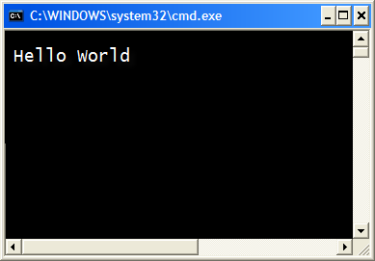
The printf Method
A simple example:
System.out.printf("Hello World\n");
3-<number>

Slide 48
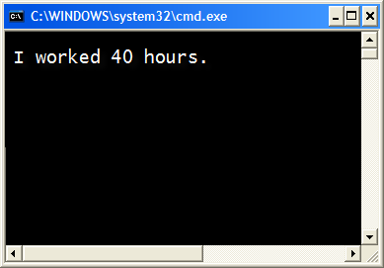
The printf Method
Another example:
int hours = 40;
System.out.printf("I worked %d hours.\n", hours);
3-<number>

Slide 49
The printf Method
int hours = 40;
System.out.printf("I worked %d hours.\n", hours);
The %d format specifier indicates that a decimal integer will be printed.
The contents of the hours variable will be printed in the location of the %d format specifier.
3-<number>

Slide 50
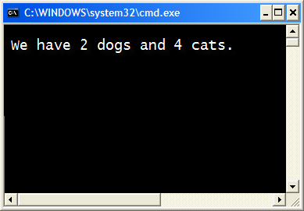
The printf Method
Another example:
int dogs = 2, cats = 4;
System.out.printf("We have %d dogs and %d cats.\n",
dogs, cats);
3-<number>

Slide 51
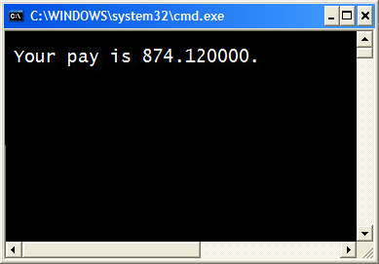
The printf Method
Another example:
double grossPay = 874.12;
System.out.printf("Your pay is %f.\n", grossPay);
3-<number>

Slide 52
The printf Method
Another example:
double grossPay = 874.12;
System.out.printf("Your pay is %f.\n", grossPay);
The %f format specifier indicates that a floating-point value will be printed.
The contents of the grossPay variable will be printed in the location of the %f format specifier.
3-<number>

Slide 53
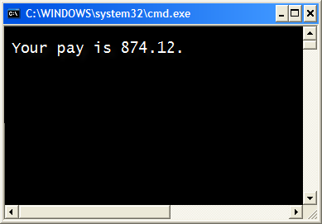
The printf Method
Another example:
double grossPay = 874.12;
System.out.printf("Your pay is %.2f.\n", grossPay);
3-<number>

Slide 54
The printf Method
Another example:
double grossPay = 874.12;
System.out.printf("Your pay is %.2f.\n", grossPay);
The %.2f format specifier indicates that a floating-point value will be printed, rounded to two decimal places.
3-<number>

Slide 55
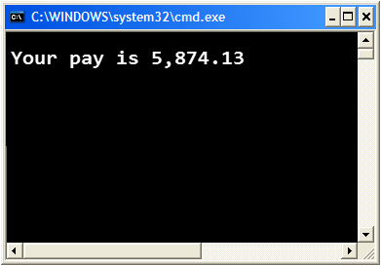
The printf Method
Another example:
double grossPay = 5874.127;
System.out.printf("Your pay is %,.2f.\n", grossPay);
The %,.2f format specifier indicates that a floating-point value will be printed with comma separators, rounded to two decimal places.
3-<number>

Slide 56

The printf Method
Another example:
String name = "Ringo";
System.out.printf("Your name is %s.\n", name);
The %s format specifier indicates that a string will be printed.
3-<number>

Slide 57
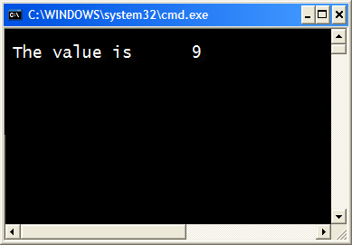
The printf Method
Specifying a field width:
int number = 9;
System.out.printf("The value is %6d\n", number);
The %6d format specifier indicates the integer will appear in a field that is 6 spaces wide.
3-<number>

Slide 58

The printf Method
Another example:
double number = 9.76891;
System.out.printf("The value is %6.2f\n", number);
The %6.2f format specifier indicates the number will appear in a field that is 6 spaces wide, and be rounded to 2 decimal places.
3-<number>

Slide 59
The DecimalFormat Class
When printing out double and float values, the full fractional value will be printed, which is usually more than what we need.
  15 digits for double
  6 digits for float
The DecimalFormat class can be used to format these values.
In order to use the DecimalFormat class, the following import statement must be used at the top of the program:
import java.text.DecimalFormat;
See examples:
  Format1.java, Format2.java, Format3.java, Format4.java
3-<number>

Slide 60
The DecimalFormat Class
To use the DecimalFormat class, you create an object:
DecimalFormat formatter = new DecimalFormat(“#0.00”);
“#0.00” is called a format pattern, where each character in the format pattern corresponds with a position in a number.
# a single digit (if no digit at that position, nothing shown)
0 a single digit (if no digit at that position, 0 will be displayed)
.00 display 2 digits after decimal point
Note that if the number of characters before the decimal point is not enough size to display to value, Java will automatically expand the area.
3-<number>

Slide 61
The DecimalFormat Class
If format pattern is “#0.00”
0.1666 will be displayed as 0.17
166.6666 will be displayed as 166.67
If format pattern is “#.00”
0.1666 will be displayed as .17
166.6666 will be displayed as 166.67
If format pattern is “000.00”
0.1666 will be displayed as 000.17
166.6666 will be displayed as 166.67
3-<number>

Slide 62
The DecimalFormat Class
Now call the format method on the DecimalFormat object and pass the number you want to format as a parameter.
double n1 = 0.1666;
double n2 = 1.666;
double n3 = 16.666;
double n4 = 166.666;
System.out.println(formatter.format(n1));
System.out.println(formatter.format(n2));
System.out.println(formatter.format(n3));
System.out.println(formatter.format(n4));
3-<number>

Slide 63
The DecimalFormat Class
If format pattern is “#,##0.00” with grouping separator
123.899 will be displayed as 123.90
1233.899 will be displayed as 1,233.90
1234567.899 will be displayed as 1,234,567.90
If format pattern is “$#,##0.00” with $ at the beginning of the pattern
12345.67 will be displayed as $12,345.67
If format pattern is “0%” with % at the end of the pattern
0.12 will be displayed as 12%
0.05 will be displayed as 5%
0.005 will be displayed as 0%
3-<number>

Slide 64
Summary
The if Statements
Logical Operations
The switch Statement
Output Format
  The DecimalFormat Class

