Slide 1

Word2Vec for Movie Reviews
Deepa Mohan
CS410 Text Information Systems Final Project
Fall 2016
Notes:
In this project, we dig a little "deeper" into sentiment analysis. We use Google's Word2Vec which is a deep-learning inspired method that focuses on the meaning of words. Word2Vec attempts to understand meaning and semantic relationships among words. Recent times has seen Deep Learning approaches achieve breakthrough results in image recognition, speech processing and NLP. Here we focus on Word2Vec for sentiment analysis on movie reviews on IMDB dataset
Inspired by the Kaggle Competition – Bag of Words meets Bag of Popcorn https://www.kaggle.com/c/word2vec-nlp-tutorial

Slide 2
Agenda
Sentiment Analysis techniques – Bag of Words
Word2Vec, Doc2Vec architectures
Related Work
Data exploration, pre-processing
Algorithms, parameter tuning, performance metrics
Comparison of different techniques
Future Work
Link to the demo -

Slide 3
Sentiment Analysis techniques
Also called Opinion Mining, Classifies the polarity of a text
Bag of Words Model
Supervised Learning technique, ignores word order
  Sentence 1: "The cat sat on the hat"
  Sentence 2: "The dog ate the cat and the hat“
  Vocabulary: { the, cat, sat, on, hat, dog, ate, and }
  Sentence 1: { 2, 1, 1, 1, 1, 0, 0, 0 }
  Sentence 2 are: { 3, 1, 0, 0, 1, 1, 1, 1}
N-gram model – Co-occurrences and spatial probabilistic model
["John likes", "likes to", "to watch", "watch movies", "Mary likes", "likes movies", "movies too",]
Both models are simple and scalable –, enabling small experiments to scale up efficiently.
Notes:
http://www.cs.cornell.edu/home/llee/omsa/omsa.pdf
https://en.wikipedia.org/wiki/N-gram
http://www.ijser.org/paper/Twitter-Sentiment-Analysis-A-Review.html

Slide 4
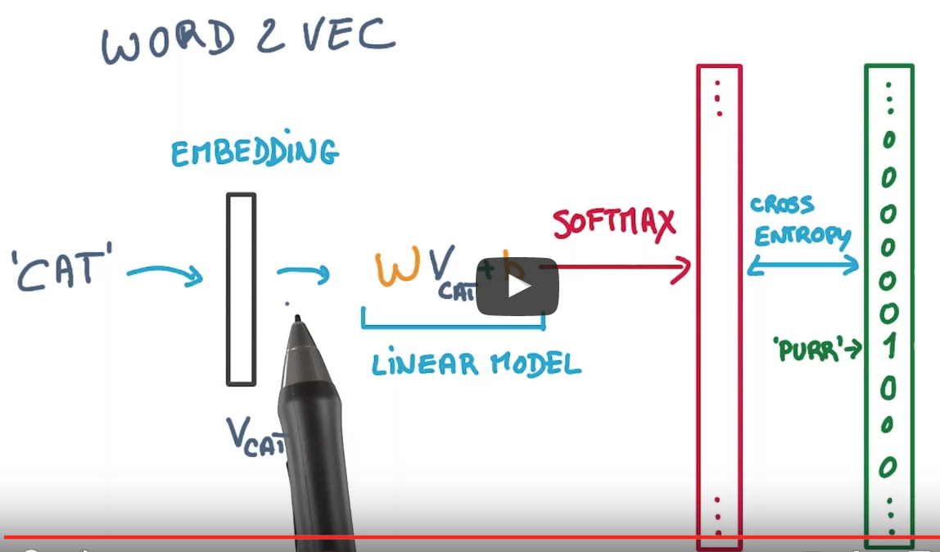
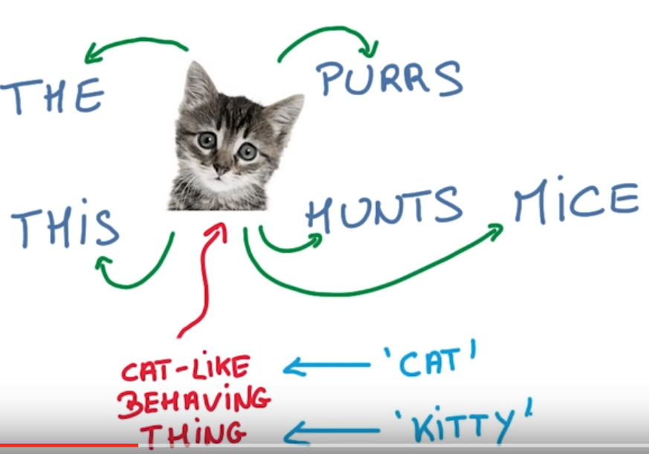
Word2Vec
Deep Learning Technique that attempts to understand meaning and semantic relationships among words.
Unsupervised Learning technique, Computationally efficient
Words with similar meanings appear in clusters or in the same context
Notes:
https://www.udacity.com/course/deep-learning--ud730

Slide 5
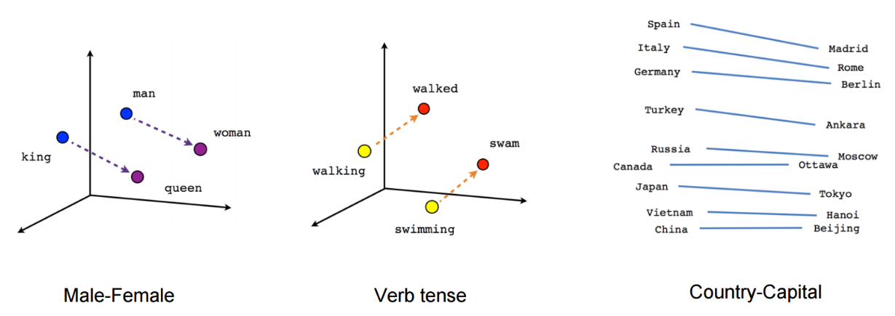
Word2Vec
Some word relationships, such as analogies, can be reproduced using vector math.

Slide 6
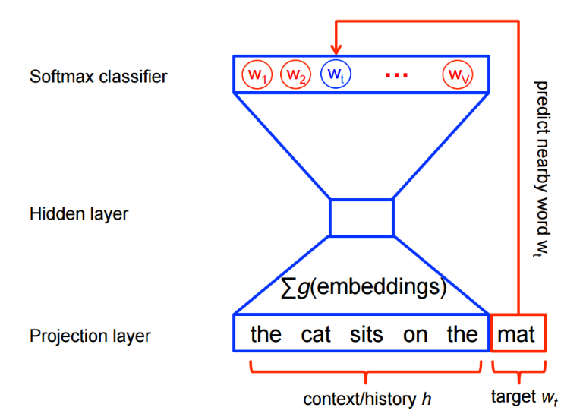
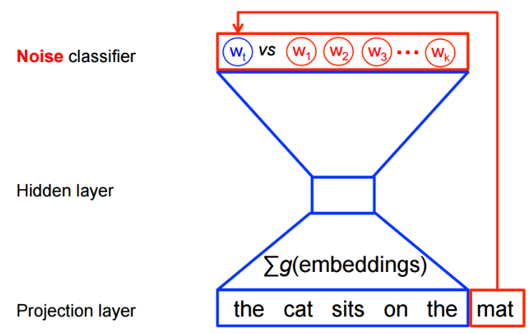
Word2Vec Architectures
Skip-gram
Predict context given the word
Continuous Bag of Words
Predicting the word given its context
Notes:
http://www-personal.umich.edu/~ronxin/pdf/w2vexp.pdf
https://www.tensorflow.org/versions/r0.12/tutorials/word2vec/index.html

Slide 7
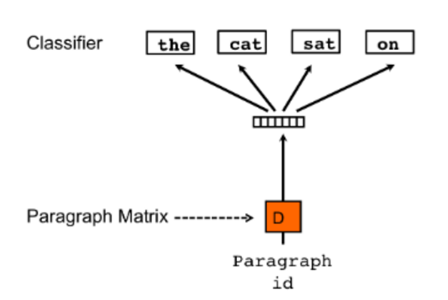
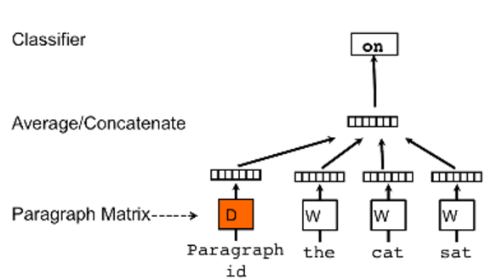
Doc2Vec
Paragraph Vector is maintained for the document in addition to the word vector
Distributed Memory Model
Distributed Bag Of Words Model
Notes:
http://cs.stanford.edu/~quocle/paragraph_vector.pdf

Slide 8
Related Work on different datasets
Word2Vec was introduced by Google in 2013 [Mikolov et al] -C implementation
Word2Vec has an excellent python implementation by Gensim
Recent work out of Stanford has also applied deep learning to sentiment analysis; their code is available in Java.
There is a paper on Distributed Representations of Sentences and Documents by Mikolov et al which describes the Paragraph Vector
Gensim has doc2vec implementation also, however it hasn’t been tested by very many and hence not very usable on datasets
Notes:
https://www.tensorflow.org/versions/r0.12/tutorials/word2vec/index.html

Slide 9
Dataset Preprocessing
Kaggle IMDB dataset
  25000 labeled training set [id, review, sentiment label]
  25000 test set [id, review]
  50000 unlabeled training set [id, review] – Used to train Word2Vec model
Preprocessing – Beautiful Soup, NLP kit
  Remove html markup
  Convert to lower case
  Remove non-text
  Remove stopwords [optional]
  Remove punctuations
  Use sets for faster search
  Word2vec needs sentences instead of words [NLTK punkt tokenizer for sentence splitting]
  Stemming
Notes:
List of packages – beautifulsoup for html, ntlk, re for regular expressions,

Slide 10
Feature Extraction, Supervised learning
Bag of Words
  Count Vectorizer {sklearn)
  TF-IDF Vectorizer with n-grams used for feature extraction
vectorizer = CountVectorizer(analyzer = "word", \
tokenizer = None, \
preprocessor = None, \
stop_words = None, \max_features = 5000)
vectorizer = TfidfVectorizer( min_df=2, max_df=0.95, max_features = 200000, ngram_range = ( 1, 4 ),
sublinear_tf = True )
Notes:
# fit_transform() does two functions: First, it fits the model
# and learns the vocabulary; second, it transforms our training data
# into feature vectors. The input to fit_transform should be a list of
# strings.

Slide 11
Feature Set Extraction – Word2Vec
Use genism word2Vec API
  Architecture – Skip Gram or Continuous Bag of Words
  Training Algorithm – Hierarchical Softmax or Negative Sampling
  Downsampling of frequent words
  Word Vector Dimensionality
  Context-Window Size – 10 seemed to work well
  Worker threads – 4-6 [speeds up training]
  Minimum word count – 40 worked well, increase this to reduce training time
Notes:
Although Word2Vec does not require graphics processing units (GPUs) like many deep learning algorithms, it is compute intensive. Both Google's version and the Python version rely on multi-threading (running multiple processes in parallel on your computer to save time). ln order to train your model in a reasonable amount of time, you will need to install cython (instructions here). Word2Vec will run without cython installed, but it will take days to run instead of minutes.

Slide 12
Exploring Word2Vec functions
model.doesnt_match("man woman child kitchen".split())
kitchen
model.doesnt_match("france england germany berlin".split())
berlin
model.doesnt_match("paris berlin london austria".split())
paris
model.most_similar("queen")
  [(u'princess', 0.6588068604469299),
  (u'bride', 0.6255064010620117),
  (u'stepmother', 0.6235610246658325),
  (u'victoria', 0.6051034331321716),
  (u'belle', 0.5921131372451782),
  (u'maid', 0.58580082654953),
  (u'showgirl', 0.5739357471466064),
  (u'mistress', 0.5737190246582031),
  (u'prince', 0.5710747838020325),
  (u'goddess', 0.5690412521362305)]

Slide 13
Using Word2Vec Model
WordVector Averaging
  Average all the word vectors of a review to derive the sentiment
TF-IDF Vectorizer on the Word Vectors instead of averaging
Word Clustering
  Have n clusters such that each cluster has 5-7 semantically related words gave good results
  Compute Intensive

Slide 14
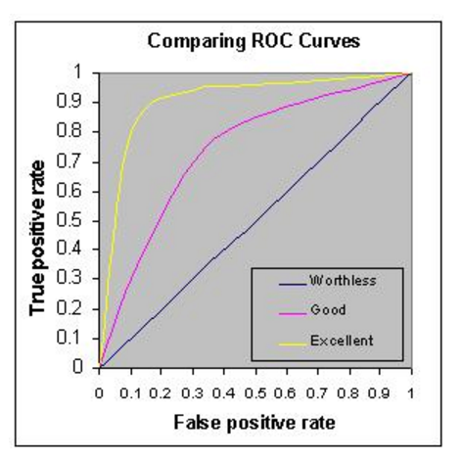
Performance Metric
AUC – Area under Curve
  Plot of True Positives vs False Positives
  Kaggle evaluation metric
  Cross-validation by splitting labeled training dataset for test set

Slide 15
Results
Model | Classifier | Vocabulary | Max_features | Time(s) | AUC
Bag Of Words - Count Vectorizer | Random Forest | 5000 | 5000 |  | 0.92307
Bag Of Words - TFIDF | SGDClassifier | 5000 | 200000 |  | 0.96817
Bag Of Words - TFIDF | Multinomial Naïve Bayes | 5000 | 200000 |  | 0.9523
Bag Of Words - TFIDF (n-gram 1-4) | SGDClassifier + Multinomial Naïve Bayes | 5000 | 200000 | 711.84773612(tf-idf vectorizer) | 0.96907
Word2Vec Average Vectors | Random Forest | 16490 | 5000 | 1540.38(train word2vec) + 69.01137(vector averaging) | 0.91772
Word2Vec TF-IDF | SGDClassifier | 16490 | 5000 |  | 0.95384
Word2Vec TF-IDF (Skip Gram, CBOW Model) | SGDClassifier + Multinomial Naïve Bayes | 16490 | 5000 |  | 0.95608
Word2Vec Bag of Centroids | K Means for Word clustering, Random Forest | 16490 | 5000 |  | 0.92195
Doc2Vec Average Vectors (Distributed Memory, Distributed Bag Of Words Model) with 10min words | Random Forest | 38664 | 5000 | 501s*10epochs(train doc2vec) | 0.81412
Doc2Vec Average Vectors (Distributed Memory) stacked with BOW, 40 min words | Logistic regression | 19271 | 5000 for doc2vec, 50000 for BOW | 501s*5epochs | 0.96355
Time measured on a Google Cloud Platform VM instance 8vCPUS, 30GB memory
Notes:
If C extension for genism is not loaded correctly, it takes days to train the word2vec and doc2vec models instead of minutes/hours

Slide 16
Observations/Conclusions
Bag Of Words with TF-IDF weighting performs surprisingly well on the movie reviews – effect of varying Num_features well understood.
Word2Vec TF-IDF could achieve similar performance with less num_features, Word2Vec averaging and clustering, skip-gram and CBOW model resulted in similar results
Kmeans clustering with Word2Vec very slow
Doc2vec does well when stacked with a BOW model
In terms of time and computational complexity Doc2Vec is the costliest, Word2Vec training time is quite fast because of multi-threading, but once trained, time is similar to BOW.

Slide 17
Future Work
Word2Vec with Deep convolutional Networks
Doc2Vec training on larger datasets with more memory
Investigate fasttext from Facebook and compare it with Word2Vec

Slide 18
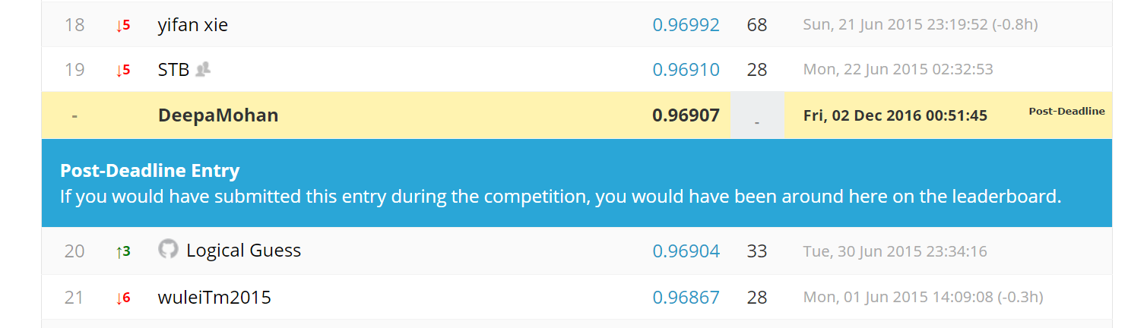
Kaggle leaderboard

Slide 19
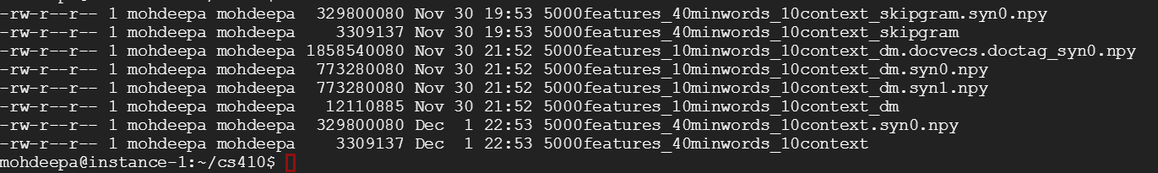
Space requirements
Model space requirements

Slide 20
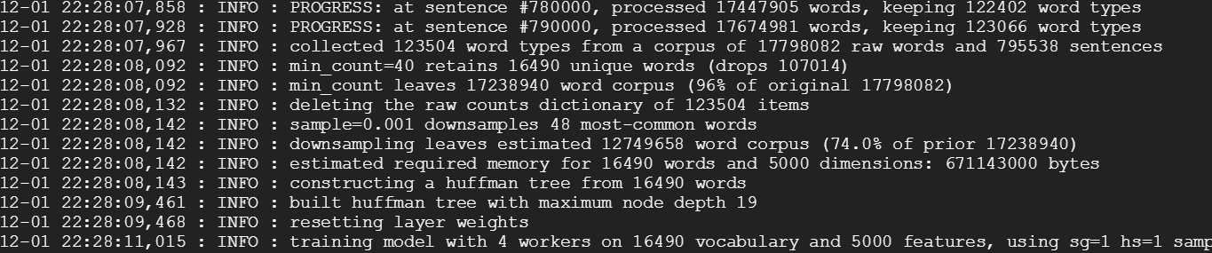
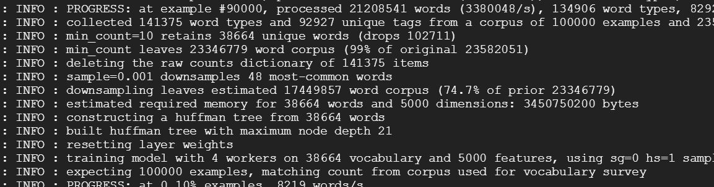
Word2Vec Model generation
Word2Vec model training
Doc2Vec model training

