Slide 1
Transfer Learning for NLP
Rise of the Transformers!
David Molony
January 13th Atlanta Deep Learning Meetup

Slide 2
Overview
Transfer Learning
Word Vectors
Recurrent Neural Networks
Attention
Transformer Architecture
Tour de Transformers

Slide 3
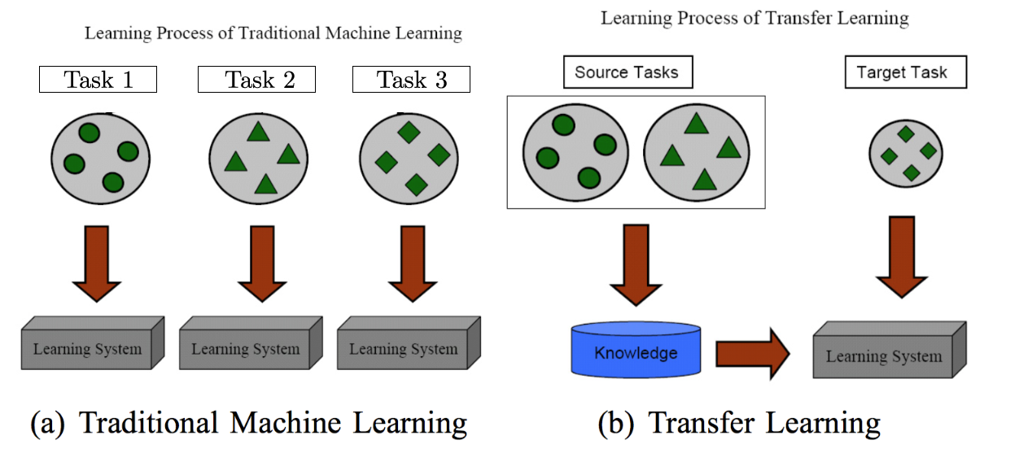
What is transfer learning?
Transfer Learning
Word Vectors
Recurrent Neural Networks
Attention
Transformer Architecture
Tour de Transformers
A Survey on Transfer Learning, 2009

Slide 4
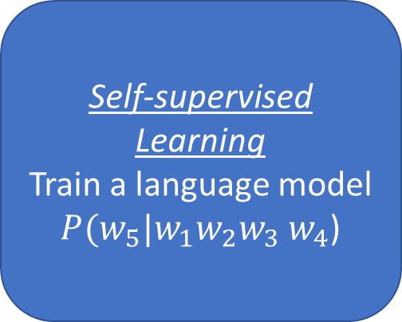
Transfer learning in NLP
Transfer Learning
Word Vectors
Recurrent Neural Networks
Attention
Transformer Architecture
Tour de Transformers
Apply to target domain
Use pretrained model as feature extractor
Data Collection
Gather large corpus of text e.g. Books, Wikipedia, reddit
Self-supervised Learning
Train a language model
$P(w_{5}|w_{1}w_{2}w_{3}$ $w_{4}$)
Supervised Fine-tuning
Fine-tune on target task using domain specific text
Notes:
Probability of a sequence of words P($w_{1}w_{2}w_{3}$ $w_{4}$) = $\sum_{k=1}^{N}{P(w_{k}|w_{1},w_{2},…w_{k−1})}$

Slide 5
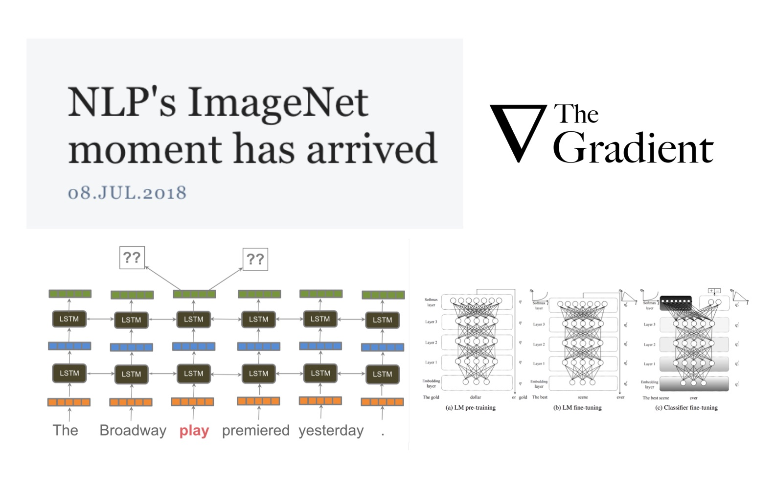
Significance of NLP Transfer Learning?
Transfer Learning
Word Vectors
Recurrent Neural Networks
Attention
Transformer Architecture
Tour de Transformers
https://thegradient.pub/nlp-imagenet/

Slide 6
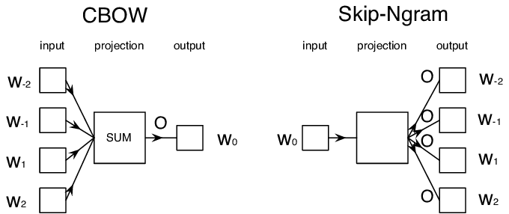
Word vectors
Transfer Learning
Word Vectors
Recurrent Neural Networks
Attention
Transformer Architecture
Tour de Transformers
a
0
1.4
Word2vec
aardvark
0
0.5
abdominal
0
1.1
abduct
0
-0.4
abet
0
0.5
absent
1
1.5
absent
zen
0

Slide 7
Word vectors
Transfer Learning
Word Vectors
Recurrent Neural Networks
Attention
Transformer Architecture
Tour de Transformers
The bank robber robbed the bank vault and afterwards went fishing by the river bank
1.4
1.4
1.4
0.5
0.5
0.5
1.1
1.1
1.1
-0.4
-0.4
-0.4
0.5
0.5
0.5
1.5
1.5
1.5

Slide 8
Recurrent Neural Networks
Transfer Learning
Word Vectors
Recurrent Neural Networks
Attention
Transformer Architecture
Tour de Transformers
h_{t}
Gated Recurrent Unit (GRU)
Long short term memory (LSTM)
Fixed length vector
pinta
de
cerveza
por
favor
</s>
Hidden State
x_{t}
Word Embedding
<s>
pinta
de
cerveza
por
favor
pint
of
lager
please
Sequence to sequence learning with neural networks, 2014

Slide 9
Transfer Learning with RNNs
Transfer Learning
Word Vectors
Recurrent Neural Networks
Attention
Transformer Architecture
Tour de Transformers
Non context aware - Word2vec, Glove, fastText
Context aware - Embedding is a function of both the word and the context
The bank robber robbed the bank vault and afterwards went fishing by the river bank
1.4
0.1
1.0
0.1
0.5
0.6
-1.1
0.1
-1.0
-0.7
0.9
0.4
-0.5
1.0
0.2
0.2
-1.5
-1.3

Slide 10
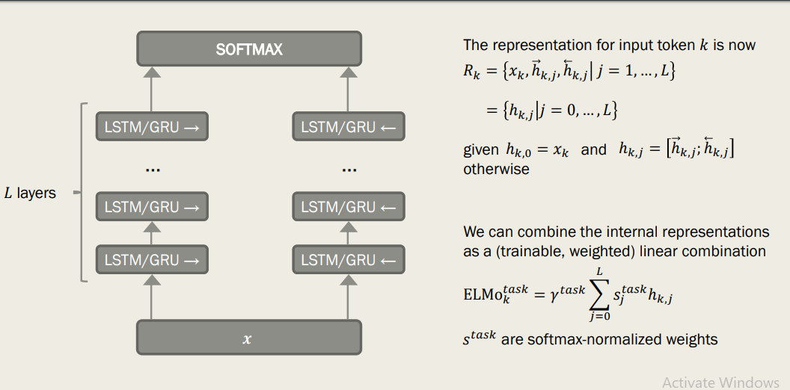
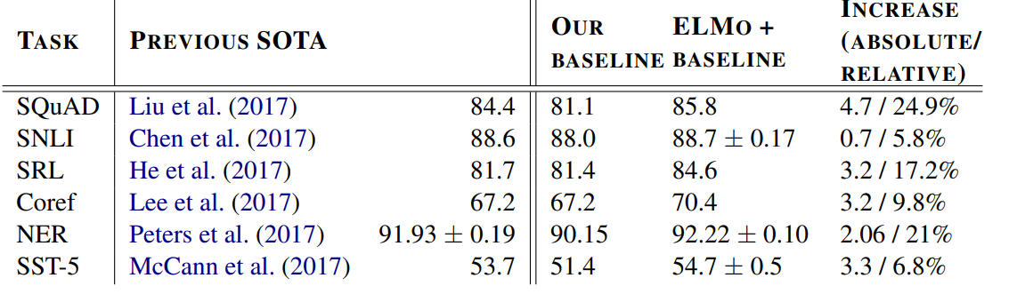
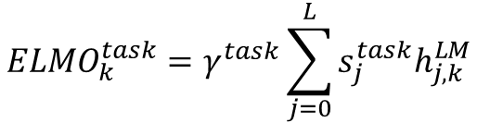
ELMo (Embeddings from Language Models)
Transfer Learning
Word Vectors
Recurrent Neural Networks
Attention
Transformer Architecture
Tour de Transformers
Train language model with bidirectional LSTM
Forward and backward LSTM learned separately. Not truly bidirectional
Multiple layers of RNNs
Learned hidden state vectors concatenated with existing word vector
Task dependent representation used in downstream model
$${{ELMO}_{k}^{task}=γ}^{task}\sum_{j=0}^{L}{s_{j}^{task}h_{j,k}^{LM}}$$
Deep Contextualized Word Embeddings, 2018

Slide 11
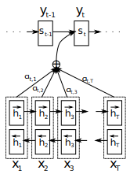


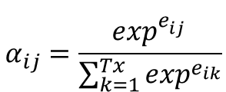
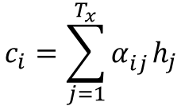
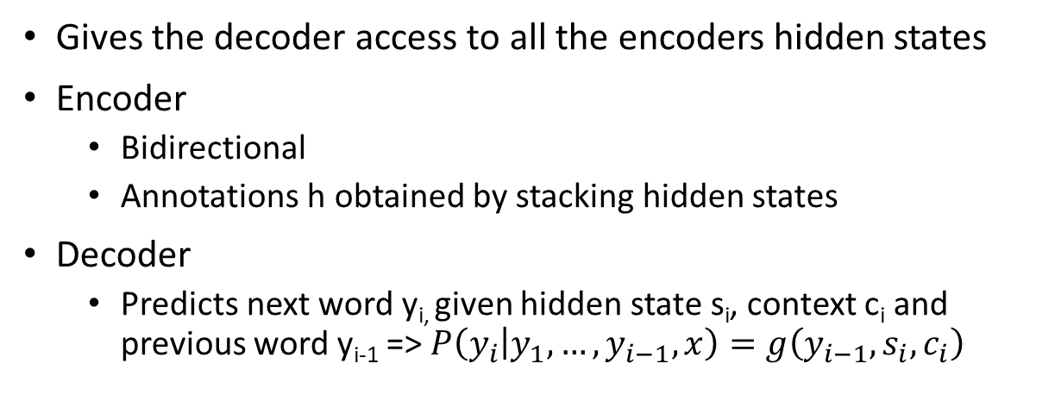
Attention
Transfer Learning
Word Vectors
Recurrent Neural Networks
Attention
Transformer Architecture
Tour de Transformers
Gives the decoder access to all the encoders hidden states
Encoder
Bidirectional
Annotations h obtained by stacking hidden states
Decoder
Predicts next word y_{i,} given hidden state s_{i}, context c_{i} and previous word y_{i-1} => $P\left(y_{i} | y_{1},…,y_{i−1},x\right)=g\left(y_{i−1},s_{i},c_{i}\right)$
$$c_{i}=\sum_{j=1}^{T_{x}}{α_{ij}^{}h_{j}}$$
$$α_{ij}=\frac{\exp^{e_{ij}^{}}}{\sum_{k=1}^{Tx}{\exp^{e_{ik}}}}$$
$$e_{ij}=a(s_{i−1}, h_{j})$$
α – probability of annotation with respect to previous hidden state s_{i-1} (alignment)
e – score that measures how well input at position j aligns with output (hidden state) at position i
$e_{ij}=v_{a}^{T}tanh(W_{a}[s_{i−1};h_{j}$])
Neural Machine Translation by Jointly Learning to Align and Translate, 2014

Slide 12



Attention
Transfer Learning
Word Vectors
Recurrent Neural Networks
Attention
Transformer Architecture
Tour de Transformers
Encoder hidden states (h)
Decoder hidden states (s)
h₁
h₂
h₃
h₄
s₁
1. Process decoder state
Ich
bin
ein
Berliner
I
2. Score encoder hidden states e_{ij}
1.1
0.3
-1.5
2.5
$e_{ij}=v_{a}^{T}tanh(W_{a}[s_{i−1};h_{j}$])
0.18
0.08
0.01
0.73
$$α_{ij}=\frac{\exp^{e_{ij}^{}}}{\sum_{k=1}^{Tx}{\exp^{e_{ik}}}}$$
3. Softmax scores α_{ij}
4. Multiply hidden states by attention score and sum c_{i}
0.18h₁
0.08h₂
0.01h₃
0.73h₄
$$c_{i}=\sum_{j=1}^{T_{x}}{α_{ij}^{}h_{j}}$$
+
+
+
Neural Machine Translation by Jointly Learning to Align and Translate, 2014
Notes:
V is a weight matrix

Slide 13
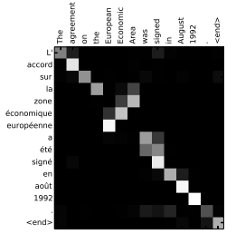
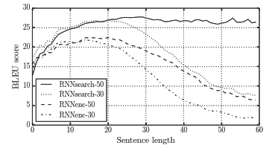
Attention
Transfer Learning
Word Vectors
Recurrent Neural Networks
Attention
Transformer Architecture
Tour de Transformers
Neural Machine Translation by Jointly Learning to Align and Translate, 2014

Slide 14


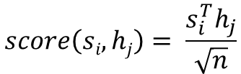
Additive attention vs Dot Product Attention
Transfer Learning
Word Vectors
Recurrent Neural Networks
Attention
Transformer Architecture
Tour de Transformers
Additive (concatenative) Attention
Dot Product Attention
$score(si, hj)=v_{a}^{T}tanh(W_{a}[s_{i−1};h_{j}$])
$score\left(si,hj\right)=$ $s_{i}^{T}h_{j}$
Dot product attention faster due to highly optimized multiplication libraries
Scaled Dot Product Attention
$$score\left(si,hj\right)= \frac{s_{i}^{T}h_{j}}{\sqrt{n}}$$
Effective Approaches to Attention-based neural machine translation, 2015

Slide 15
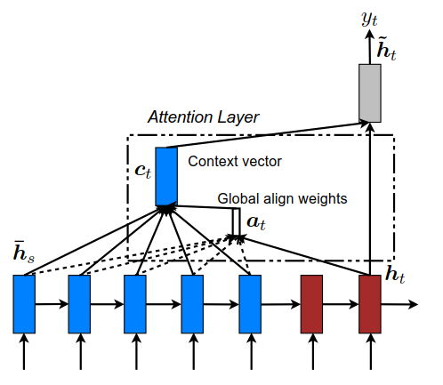
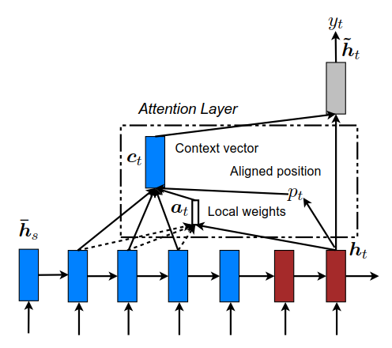

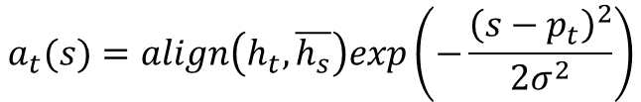

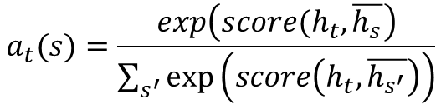

Global vs Local Attention
Transfer Learning
Word Vectors
Recurrent Neural Networks
Attention
Transformer Architecture
Tour de Transformers
Compute context vector c differently
Global attention – attend to all source words (e.g. Bahdanau et al.) i.e. considers all hidden states in encoder
Local attention – attend to subset of source words
a – alignment, p_{t} – aligned position (target word), S - source sentence length
Global Attention
Local Attention
$$a_{t}(s)=align\left(h_{t},\overline{h_{s}}\right)exp\left(−\frac{{\left(s−p_{t}\right)}^{2}}{2σ^{2}}\right)$$
$$a_{t}(s)=align\left(h_{t},\overline{h_{s}}\right)$$
$$a_{t}(s)=\frac{exp\left(score(h_{t},\overline{h_{s}}\right)}{\sum_{s^{′}}{exp⁡\left(score\left(h_{t},\overline{h_{s^{′}}}\right)\right)}}$$
Monotonic alignment
Predictive alignment
$$p_{t}=t$$
$$p_{t}=S∙sigmoid\left(v_{p}^{T}tanh⁡\left(W_{p}h_{t}\right)\right)$$
Effective Approaches to Attention-based neural machine translation, 2015

Slide 16
Transformers
Transfer Learning
Word Vectors
Recurrent Neural Networks
Attention
Transformer Architecture
Tour de Transformers
Problems with RNNs
Difficult to learn long-range dependencies (partly solved by attention)
Vanishing gradients
Slow! - Hard to parallelize due to sequential nature
Neglects source/target inter-dependency
“The animal didn’t cross the street because it was too tired”
“The animal didn’t cross the street because it was too wide”
Transformers
What is a transformer?
Any architecture that is designed to process a connected set of units – such as the tokens in a sequence or the pixels in an image – where the only interaction between units is through self-attention http://www.peterbloem.nl/blog/transformers
Key concepts
Input entire sequence at once
Self attention

Slide 17
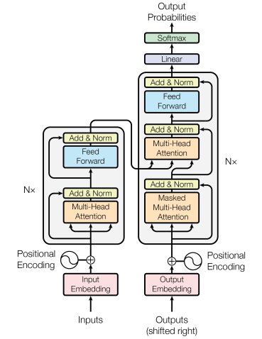
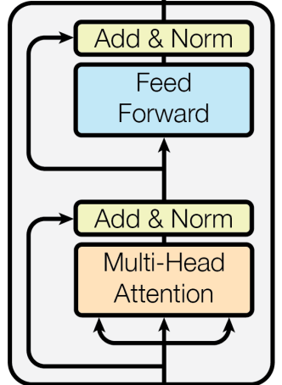
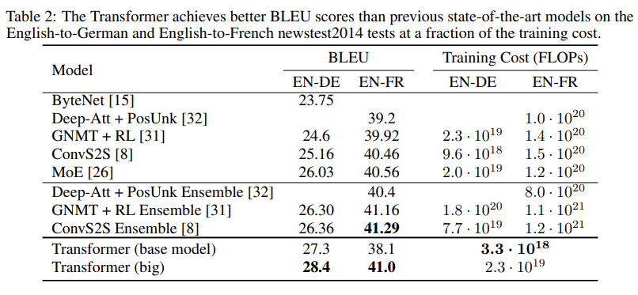
Attention is all you need
Transfer Learning
Word Vectors
Recurrent Neural Networks
Attention
Transformer Architecture
Tour de Transformers
Original transformer
Consists of Encoder and Decoder
State of the art for machine translation
Basic building block
Transformer Architecture
Attention is all you need, 2017

Slide 18
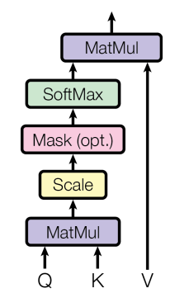
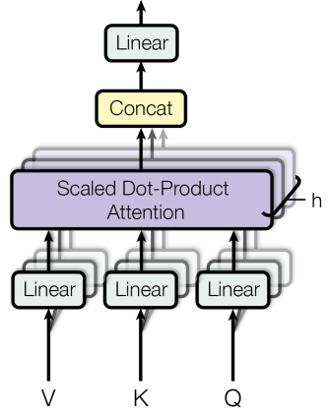
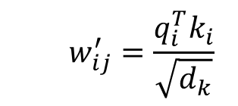



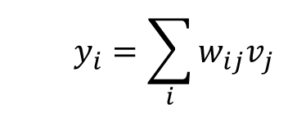

Multi-Head Attention
Transfer Learning
Word Vectors
Recurrent Neural Networks
Attention
Transformer Architecture
Tour de Transformers
q - query
k - key
v - value
$$y_{i}=\sum_{i}{w_{ij}v_{j}}$$
$$v_{i}=W_{v}x_{i};$$
Multi-Head Attention
Scaled Dot-Product Attention
$$w_{ij}=softmax(w_{ij}^{′})$$
$$w_{ij}^{′}=\frac{q_{i}^{T}k_{i}}{\sqrt{d_{k}}}$$
$$q_{i}^{T}k_{i}$$
$q_{i}=W_{q}x_{i}$; $k_{i}=W_{k}x_{i}$;
Attention is all you need, 2017

Slide 19
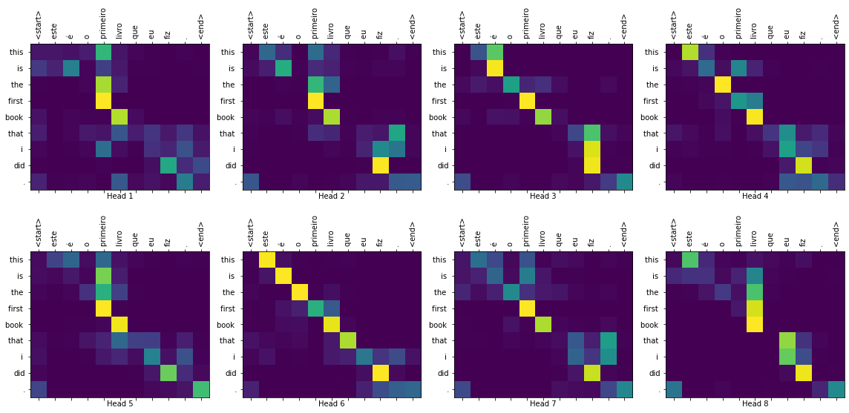
Multi-Head Attention
Transfer Learning
Word Vectors
Recurrent Neural Networks
Attention
Transformer Architecture
Tour de Transformers
https://www.tensorflow.org/tutorials/text/transformer

Slide 20
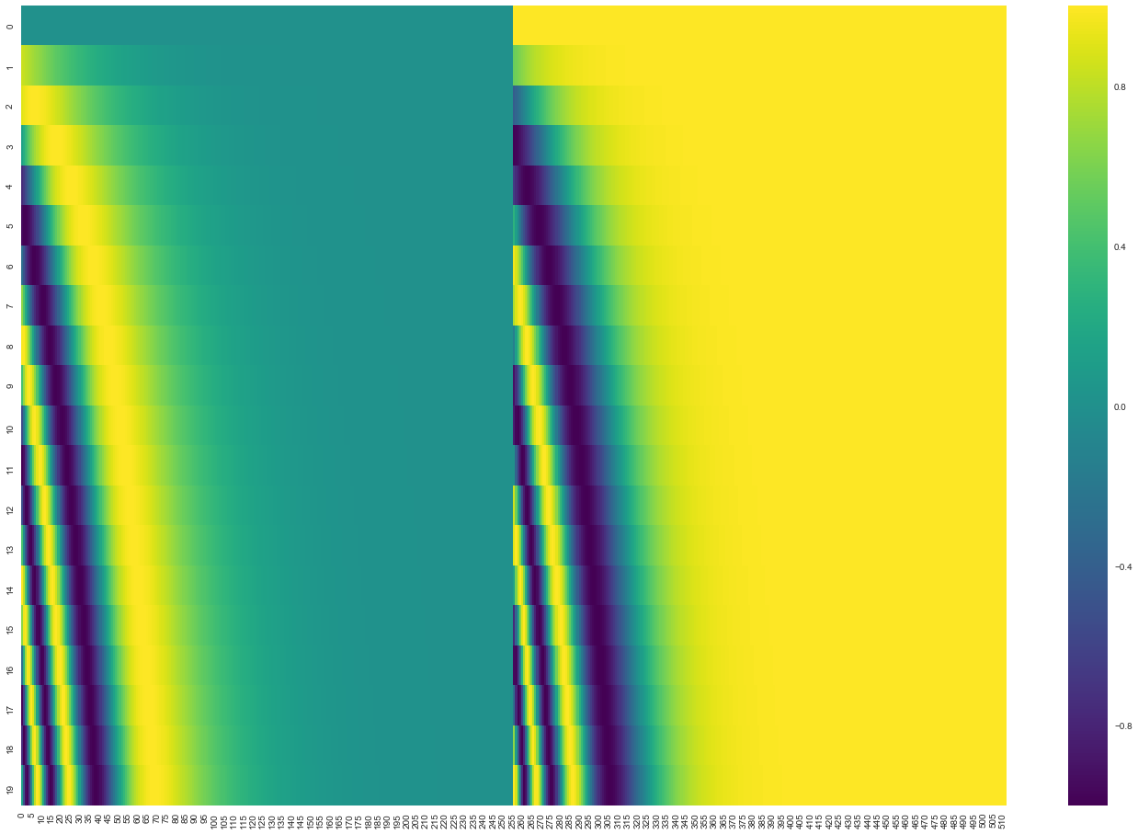
Self-attention
Transfer Learning
Word Vectors
Recurrent Neural Networks
Attention
Transformer Architecture
Tour de Transformers
Self-attention is a weighted average
y₁ = w₁v₁ + w₁v₂ + w₁v₃ + …
If we shuffle the words we get the same output
Problem with self-attention
Ignores sequential nature of input
Add positional embedding to word embedding
Positional Embedding
Word Embedding
0.4
1.8
1.4
0.9
0.7
1.5
1.1
1.4
0.5
0.7
0.2
0.1
0.8
1.5
0.1
1.5
1.1
0.1
1.5
0.9
0.5
1.1
0.9
0.1
+
0.4
0.1
0.2
1.4
0.4
0.1
0.6
1.2
0.5
1.5
0.7
1.5
0.1
0.3
0.6
0.5
1.5
1.3
0.5
0.9
0.8
1.1
1.9
0.3
x₁
x₂
x₃
x₄
x₅
x₆
x₇
x₈
p₁
p₂
p₃
p₄
p₅
p₆
p₇
p₈

Slide 21
Masked self-attention
Transfer Learning
Word Vectors
Recurrent Neural Networks
Attention
Transformer Architecture
Tour de Transformers
Lock stock and two smoking barrels
Serrure reserve et deux barils fumant
Encoder self attention
Encoder-Decoder self attention
Decoder self attention
barrels
barrels
fumant
smoking
smoking
barils
two
two
deux
and
and
et
stock
stock
reserve
Lock
Lock
Serrure
and
et
Lock
stock
two
et
deux
reserve
deux
reserve
Serrure
barils
barrels
Serrure
barils
fumant
smoking
fumant

Slide 22
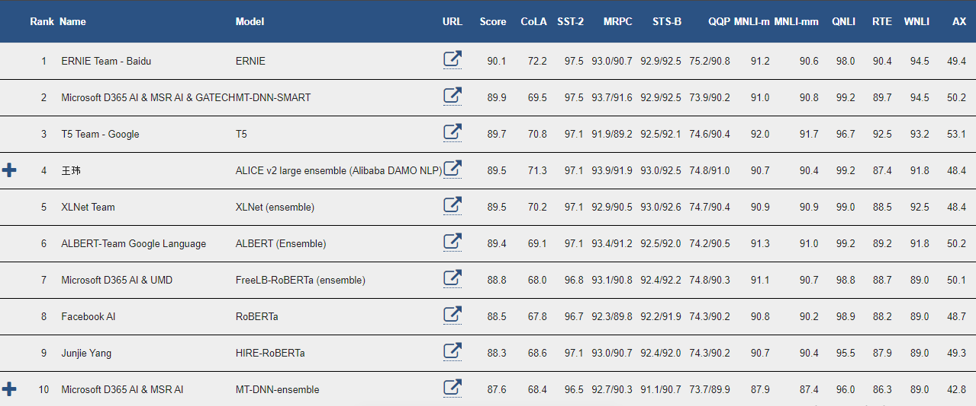
State of the art
Word Vectors
Recurrent Neural Networks
Attention
Transformer Architecture
Tour de Transformers
GLUE: Generative Language Understanding Evaluation
Benchmark test consisting of 9 tasks
https://gluebenchmark.com/leaderboard/ (accessed 1/3/2020)

Slide 23
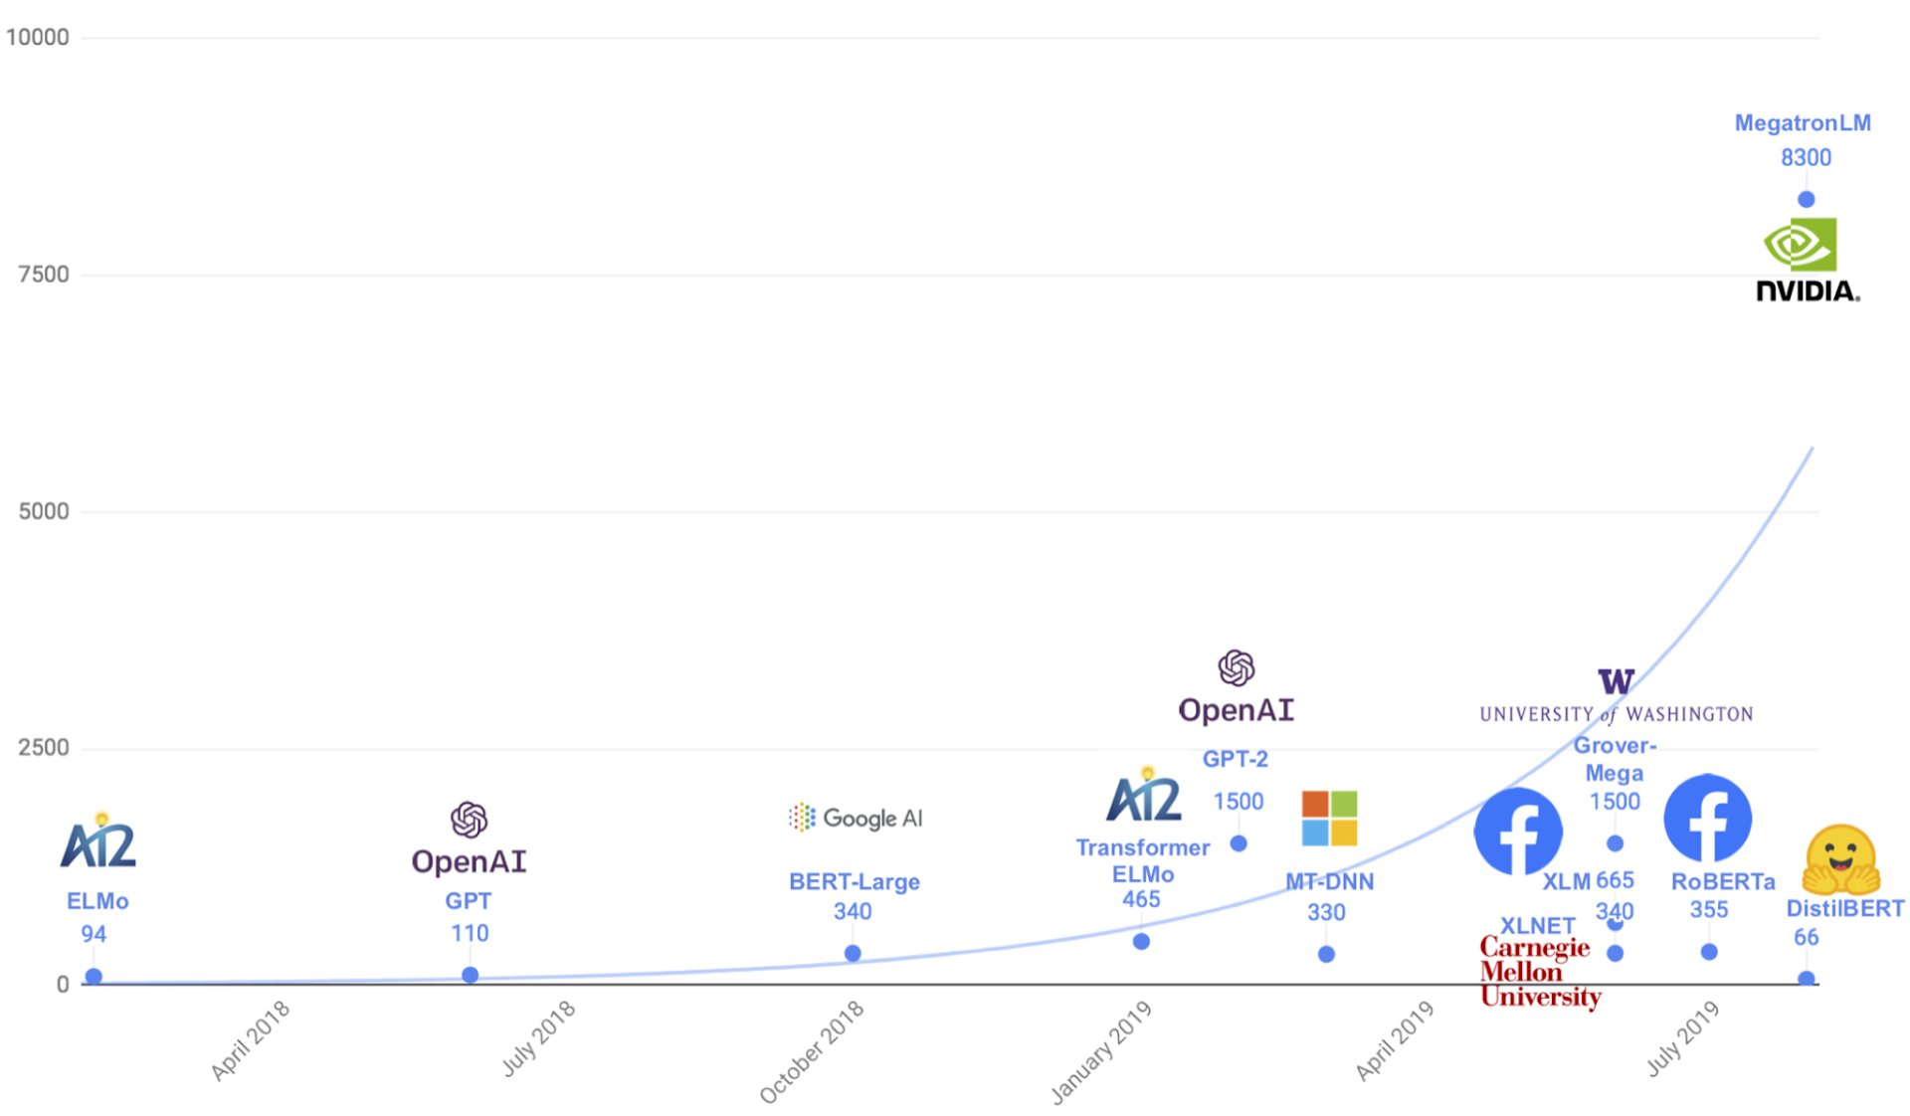

Keep Going Bigger
Word Vectors
Recurrent Neural Networks
Attention
Transformer Architecture
Tour de Transformers
T5
11000
https://medium.com/huggingface/distilbert-8cf3380435b5

Slide 24
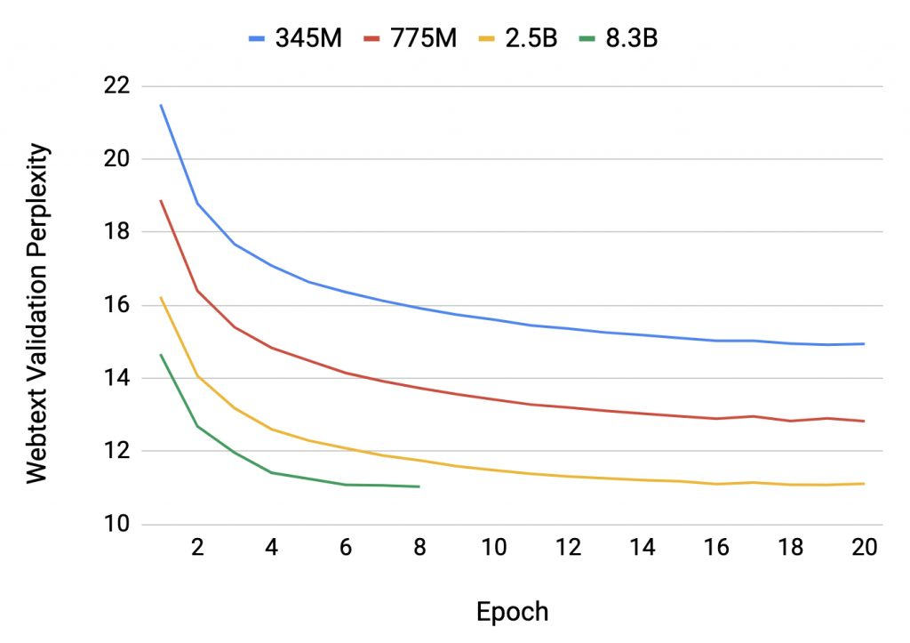
Bigger is Better
Word Vectors
Recurrent Neural Networks
Attention
Transformer Architecture
Tour de Transformers
Megatron (NVIDIA)
https://devblogs.nvidia.com/training-bert-with-gpus/

Slide 25
History of Transformers
Word Vectors
Recurrent Neural Networks
Attention
Transformer Architecture
Tour de Transformers
Character Transformer³
Transformer¹
Transformer-XL⁵
XLNet⁷
T5⁹
June 2018
October 2018
February 2019
July 2019
Dec 2019
June 2017
August 2018
January 2019
June 2019
July 2019
OpenAI GPT²
BERT⁴
OpenAI GPT-2⁶
RoBERTa⁸
PPLM¹⁰
Attention is all you need
Improved Language Understanding by Generative Pre-Training
Character Level Language Modeling with Deeper Self-Attention
BERT: Pre-training of Deep Bidirectional Transformers for Language Understanding
Transformer XL: Attentive Language Models Beyond a Fixed-Length Context
Language Models are Unsupervised Multitask Learners
XLNet: Generalized Autoregressive Pretraining for Language Understanding
RoBERTa: A Robustly Optimized BERT Pretraining Approach
Exploring the Limits of Transfer Learning with a Unified Text-to-Text Transformer
Plug and Play Language Models: A Simple Approach To Controlled Text Generation

Slide 26
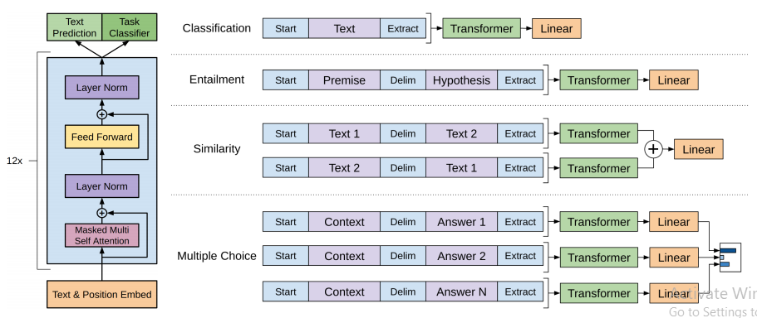
OpenAI GPT (Generative Pre-trained Transformer)
Word Vectors
Recurrent Neural Networks
Attention
Transformer Architecture
Tour de Transformers
Introduced concept of pretraining for transformers
Transformer Decoder
Two Stages
Pre-training
(Causal) language model objective function
Trained on contiguous text of book corpus dataset
64 random mini-batch of 512 tokens for 100 epochs
2. Fine-tuning
Language model objective and task classification objective
32 mini-batches for 3 epochs
Improved language understanding by generative pre-training, 2018

Slide 27
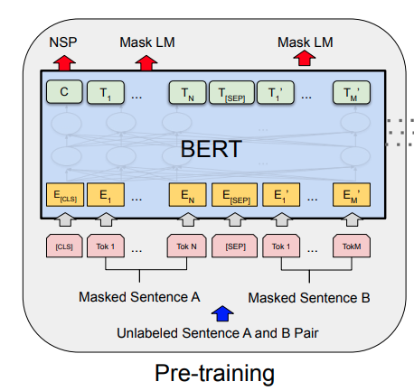
BERT (Bidirectional Encoder Representations from Transformers)
Word Vectors
Recurrent Neural Networks
Attention
Transformer Architecture
Tour de Transformers
Transformer encoder
(Masked) language model objective function
Randomly mask 15% of tokens in each sequence
With 80% probability replace masked tokens with [MASK] token
With 10% probability replace masked tokens with random token
With 10% probability keep it the same
Pre-training
Books corpus of 800M words and 2.5B words from English Wikipedia articles (≈16GB)
256 random batches of 512 tokens for 1,000,000 steps ≈ 40 epochs
Language model (next word) and next sentence prediction (NSP) objectives
Fine-tuning
Task dependent
SQuAD v1.1– 3 epochs; SQuAD v2.0 – 4 epochs
BERT: Pre-training of deep bidirectional transformers for language understanding, 2018

Slide 28

BERT
Word Vectors
Recurrent Neural Networks
Attention
Transformer Architecture
Tour de Transformers
Google employing BERT for search
https://www.blog.google/products/search/search-language-understanding-bert/

Slide 29
BERT vs GPT
Word Vectors
Recurrent Neural Networks
Attention
Transformer Architecture
Tour de Transformers
BERT
Transformer encoder
Autoencoder
Masked language model
GPT
Transformer decoder
Autoregressive
Causal language model
If I have seen further it is by standing on the [MASK] of Giants.
If I have seen further it is by standing on the [MASK] [MASK] [MASK]
If I have seen further it is by standing on the shoulder of Giants.
I have seen further it is by standing on the shoulder [MASK] [MASK]
I have seen further it is by standing on the shoulder of [MASK]
I have seen further it is by standing on the shoulder of Giants

Slide 30
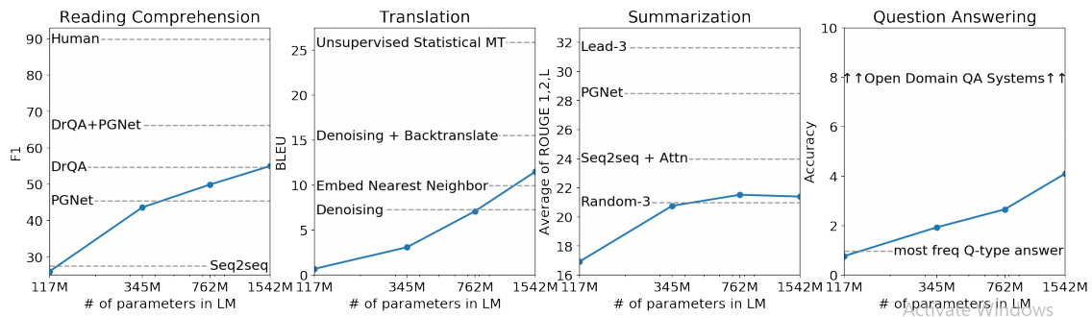
OpenAI GPT-2
Word Vectors
Recurrent Neural Networks
Attention
Transformer Architecture
Tour de Transformers
Transformer Decoder
Pre-training
Trained on WebText
Webpages linked from reddit; 40GB of text
Fine-tuning
None. Zero-shot transfer
State of the art in 7/8 language modeling tasks
Language Models are Unsupervised Multitask Learners, 2019

Slide 31
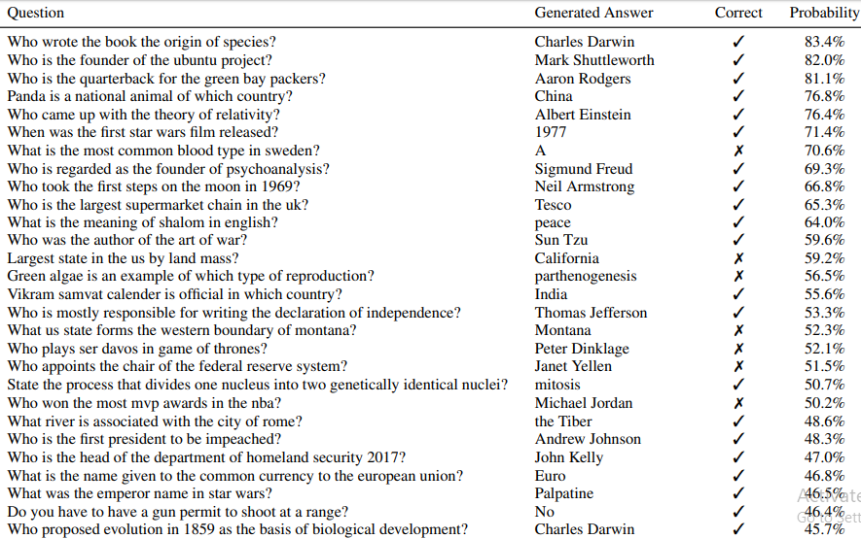
OpenAI GPT-2
Word Vectors
Recurrent Neural Networks
Attention
Transformer Architecture
Tour de Transformers
Language Models are Unsupervised Multitask Learners, 2019

Slide 32
XLNet
Word Vectors
Recurrent Neural Networks
Attention
Transformer Architecture
Tour de Transformers
BERT Problem 1
Pre-train finetune discrepancy. Fine-tuning data does not contain mask token
BERT Problem 2
Assumes the predicted (masked) tokens are independent of each other
e.g. Can’t wait for my trip to New York this summer => Can’t wait for my trip to [MASK] [MASK] this summer
Autoencoder is trying to predict New given unmasked tokens and predict York given unmasked tokens separately. Ignores the relation between New and York
Permutation language model
Allows autogressive language model to see context from both forward and backward directions
Generalized autoregressive pretraining for language understanding, 2019

Slide 33
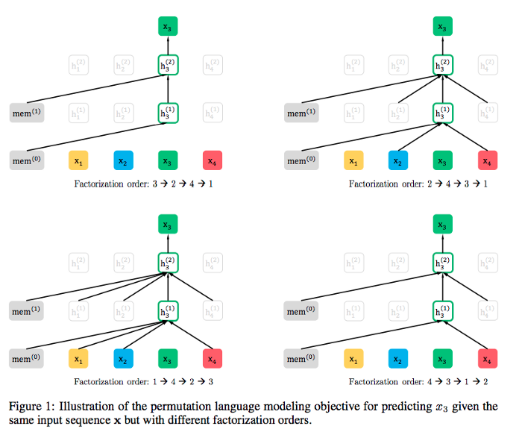
XLNet
Word Vectors
Recurrent Neural Networks
Attention
Transformer Architecture
Tour de Transformers
Input sentence: I love lamp.
Predict token 3. lamp
Permutation: None
Permutation: love .
Example:
“This is the end of the world”
Traditional language model predicts “end” based on the “This is the”
Permutation language model permutes the inputs sentence e.g. “world This the end is of the”
Predicts “end” based on “world This is the”
Hence, model learns bidirectional dependencies
Pre-training
158GB of text
8192 random mini-batch of 512 tokens for 500,000 steps
Fine-tuning
State of the art in 18 tasks
Permutation: I . love
Permutation: .
Generalized autoregressive pretraining for language understanding, 2019

Slide 34
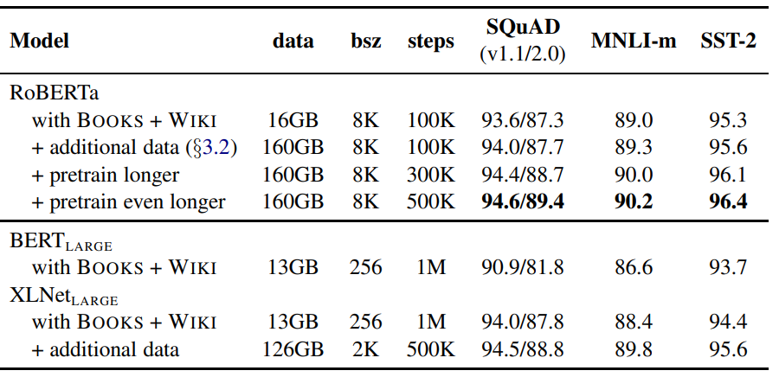
RoBERTa (Robustly optimized BERT approach)
Word Vectors
Recurrent Neural Networks
Attention
Transformer Architecture
Tour de Transformers
Modifications to BERT
Train the model for longer with bigger batches and more data
Remove next sentence prediction
Train on longer sequences
Dynamically change the masking pattern
Static masking: BERT added MASK token during data preprocessing, position never changes during training
Dynamic masking: RoBERTa adds MASK token on the fly
Pre-training
~160GB from 5 different sources (BERT 16GB)
8000 random mini-batch of 512 tokens for 500000 steps
Fine-tuning
Fine-tuned for GLUE (10 epochs), SQuAD (2 epochs), RACE (4 epochs)
State of the art results on GLUE, SQuAD, RACE
RoBERTa: An optimized method for pre-training self-supervised NLP systems, 2019

Slide 35
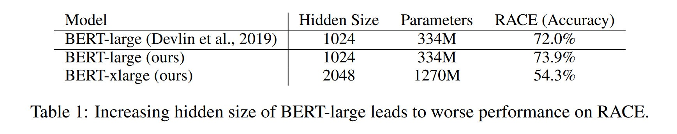
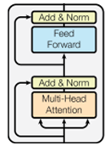
ALBERT (A Lite BERT)
Word Vectors
Recurrent Neural Networks
Attention
Transformer Architecture
Tour de Transformers
Bigger is better?
Basic building block
ALBERT
Transformer encoder and Masked Language Model
18x reduction in parameters
Pre-training
Books corpus of 800M words and 2.5B words from English Wikipedia articles (~16GB)
Fine tuning
Task dependent
State of the art (trained with additional data) on GLUE, SQuAD datasets
Factorized Embedding
Word embeddings dimension (E) is same as hidden layer dimension (H)
Huge number of weights concentrated in embedding layer (VxH)
Solution: Split embedding layer into 2 separate layers where dimension E << H
Number of parameters reduced from (VxH) to (VxE + ExH)
Cross layer parameter sharing
Weights shared across all layers
~3.5-8.5x reduction in parameters
ALBERT: A Lite BERT for self-supervised learning of language representations, 2019

Slide 36
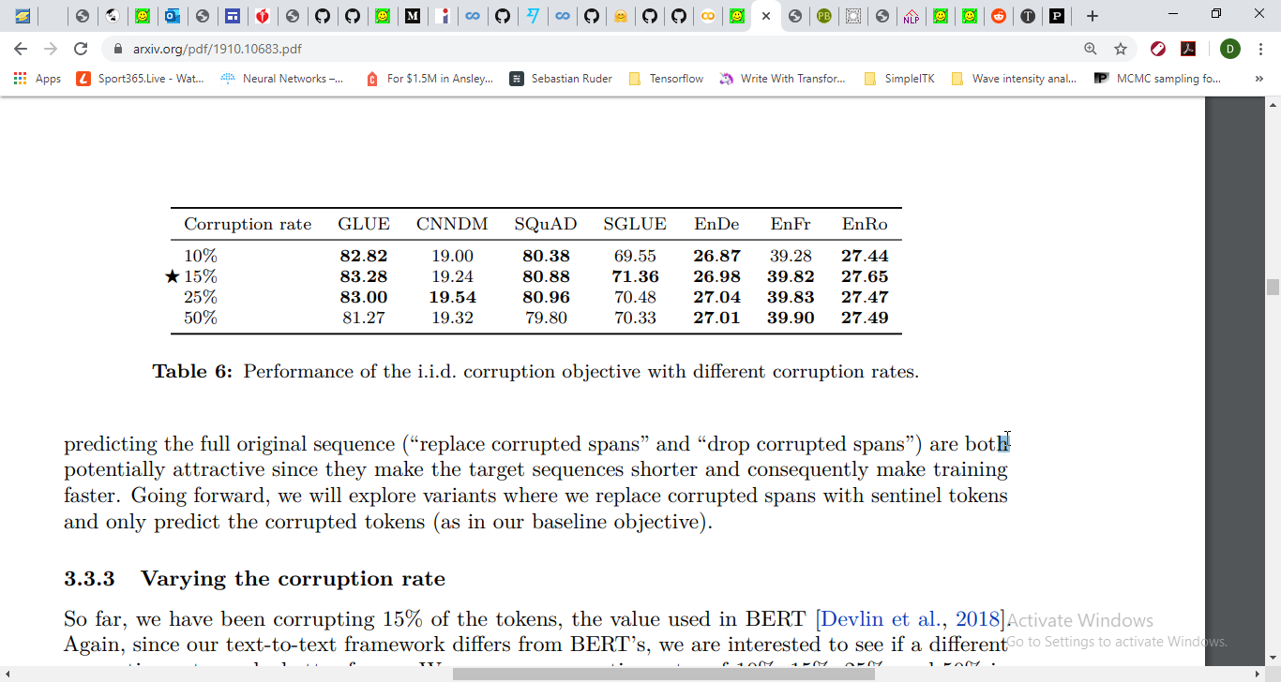
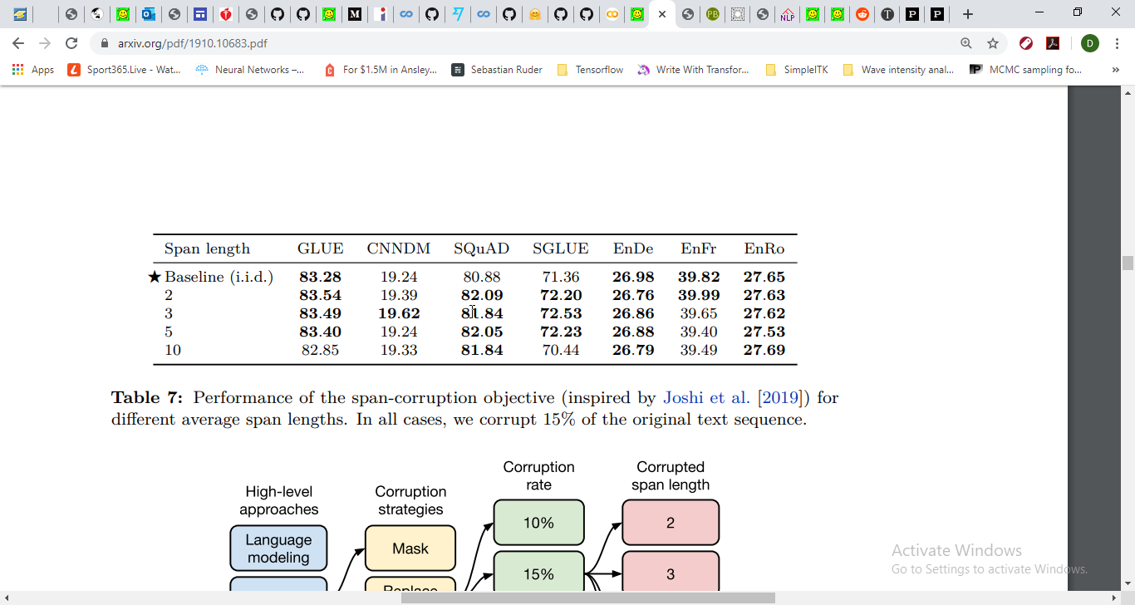
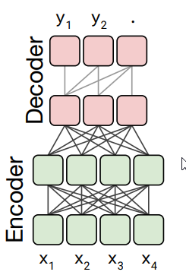
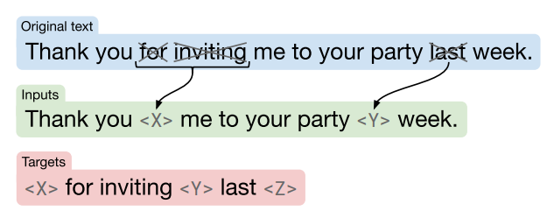
T5 (Text-to-Text Transfer Transformer)
Select architecture
Select training objective
Pre-training Dataset
Training Strategy
Scaling
Answers the question, “If giving 4x more compute power, how should you use it?”
Each span replaced by single unique token
Exploring the limits of transfer learning with unified text-to-text transformer, 2019

Slide 37
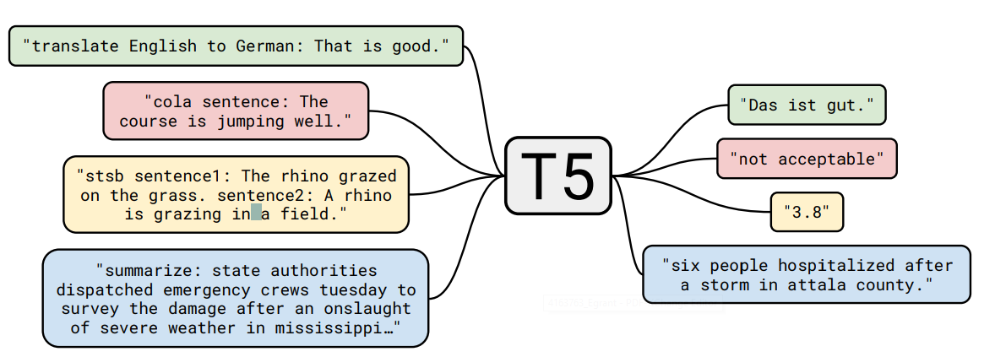
T5 (Text-to-Text Transfer Transformer)
60M, 220M, 3B and 11B parameter models
Pre-training
Uses Colossal Clean Crawled Corpus (C4) dataset
Denoising objective that corrupts contiguous spans of tokens
Multi-task mixture
Fine-tuning
State of the art in 17/24 tasks
Task specific prefix added to input sequence before feeding to model
“translate English to German: That is good” “Das ist gut”
input
output
Exploring the limits of transfer learning with unified text-to-text transformer, 2019

Slide 38
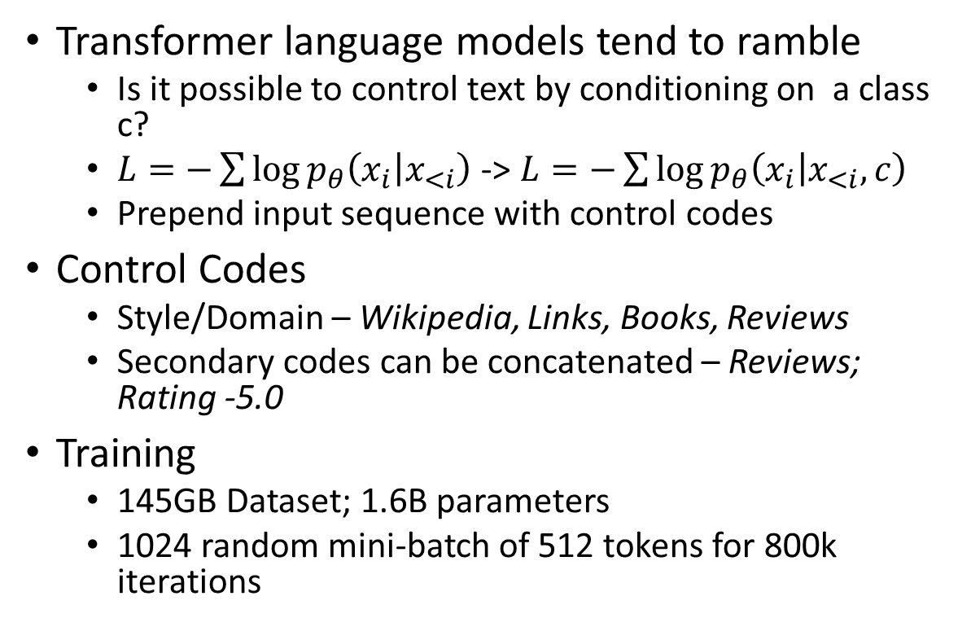
CTRL (Conditional Transformer Language Model)
Word Vectors
Recurrent Neural Networks
Attention
Transformer Architecture
Tour de Transformers
Transformer language models tend to ramble
Is it possible to control text by conditioning on a class c?
$L=−\sum{\log{p_{θ}\left(x_{i} | x_{<i}\right)}}$ -> $L=−\sum{\log{p_{θ}\left(x_{i} | x_{<i}, c\right)}}$
Prepend input sequence with control codes
Control Codes
Style/Domain – Wikipedia, Links, Books, Reviews
Secondary codes can be concatenated – Reviews; Rating -5.0
Training
145GB Dataset; 1.6B parameters
1024 random mini-batch of 512 tokens for 800k iterations
Links https://www.cnn.com/2007/09/20/us-president-meets-british-pm LONDON, England (CNN) – U.S. President George W. Bush met with British Prime Minister Tony Blair on Monday to discuss the war in Iraq, according to a statement from Blair’s office.\n\nThe meeting was held at 10 Downing Street and lasted about an hour.
CTRL: A conditional transformer language model for controllable generation, 2019

Slide 39
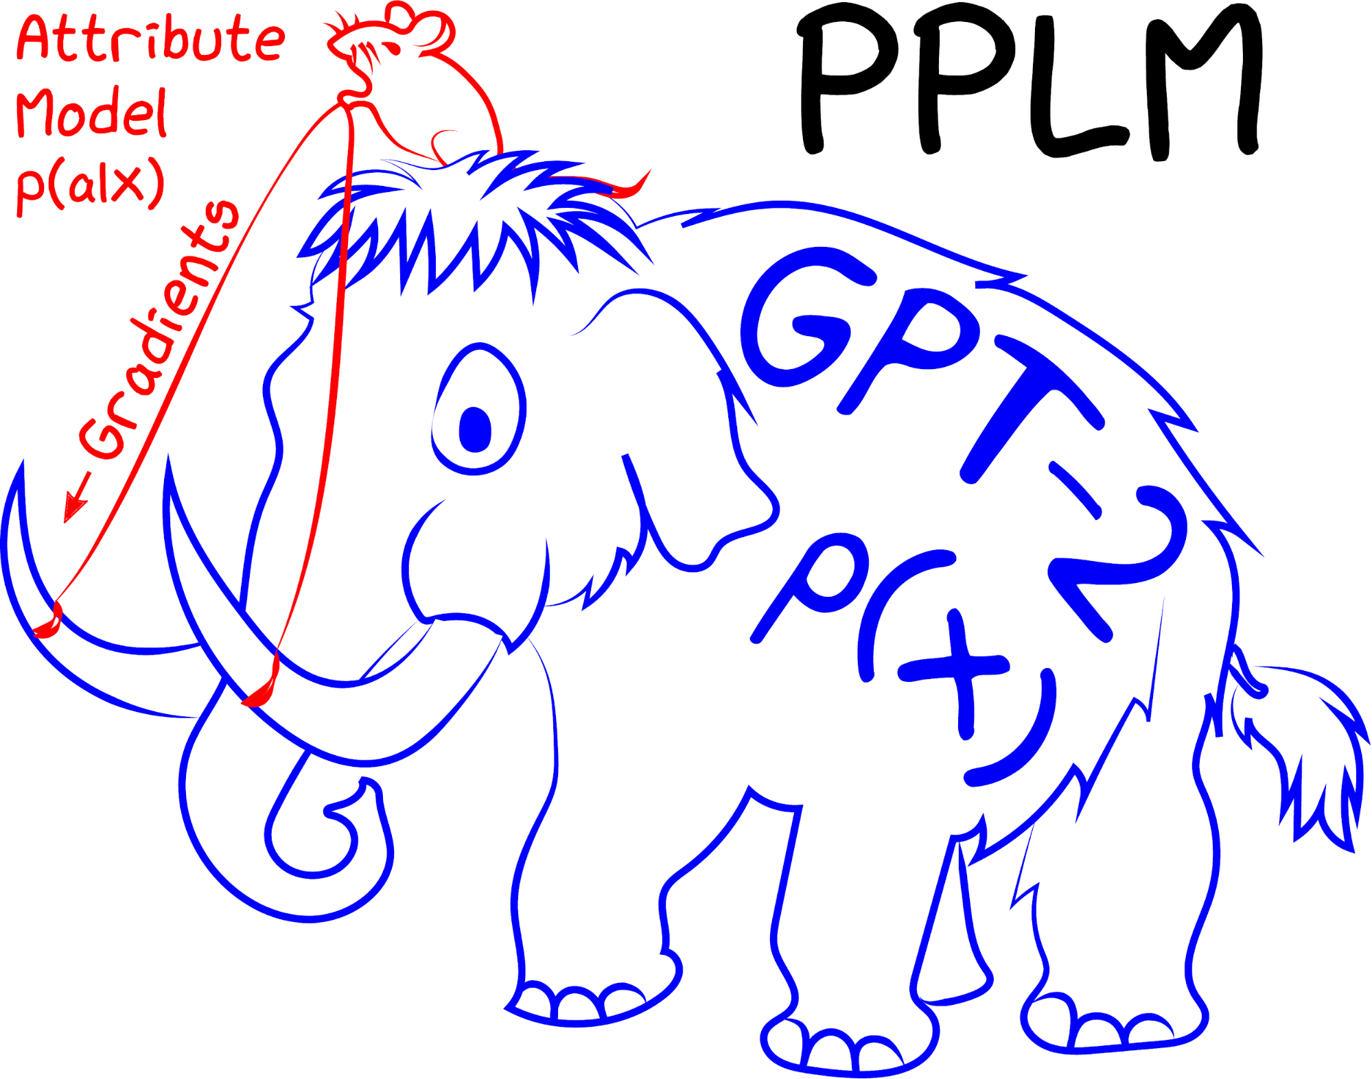
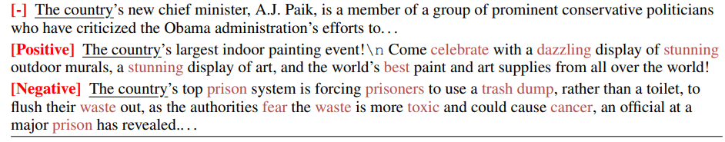
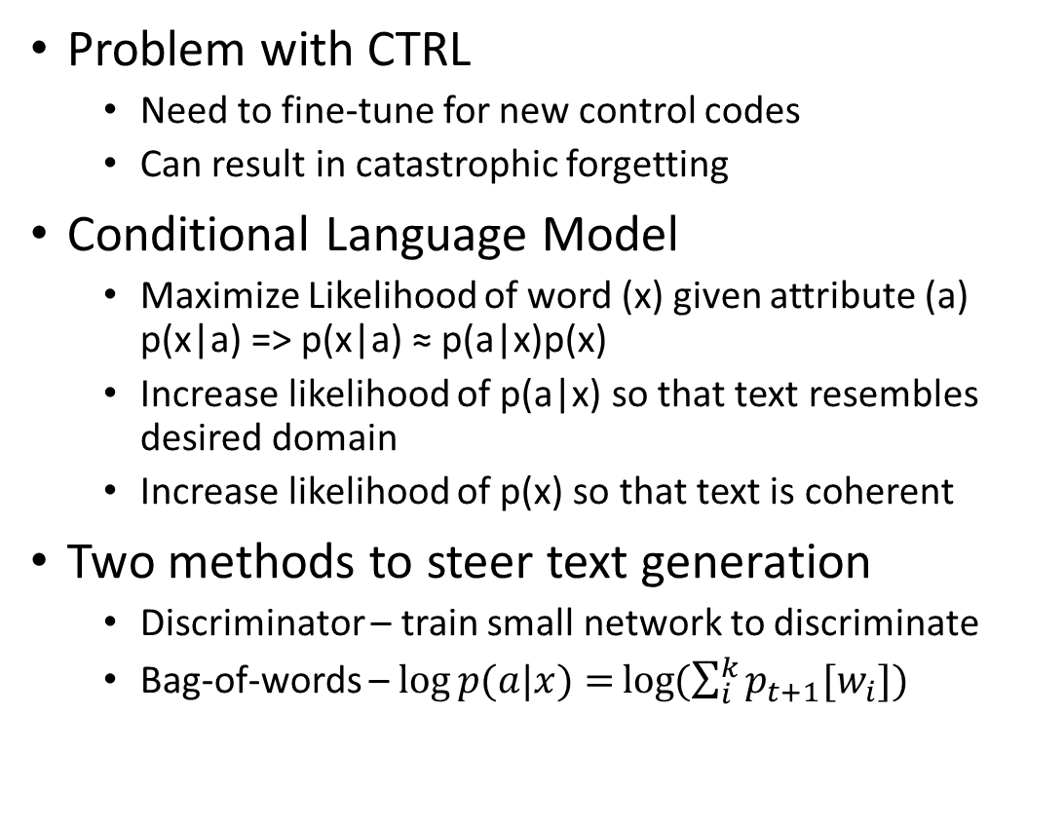
PPLM (Plug and Play Language Model)
Word Vectors
Recurrent Neural Networks
Attention
Transformer Architecture
Tour de Transformers
Problem with CTRL
Need to fine-tune for new control codes
Can result in catastrophic forgetting
Conditional Language Model
Maximize Likelihood of word (x) given attribute (a) p(x|a) => p(x|a) ≈ p(a|x)p(x)
Increase likelihood of p(a|x) so that text resembles desired domain
Increase likelihood of p(x) so that text is coherent
Two methods to steer text generation
Discriminator – train small network to discriminate
Bag-of-words – $\log{p(a|x)=}\log{(\sum_{i}^{k}{p_{t+1}[w_{i}])}}$
Example BOW
Technology – chip, computer, laptop, phone, …
Plug and play language models: A simple approach to controlled text generation, 2019

Slide 40
Model Distillation
Word Vectors
Recurrent Neural Networks
Attention
Transformer Architecture
Tour de Transformers
How do we reduce the size of these models?
Models have massive disk footprint
GPT-2 small 500MB; GPT-2 medium 1.5GB
Knowledge Distillation
A compacted model (student) learns from a trained large model (teacher)
Trained by
1. minimizing the cross-entropy between the teacher probability and the student probability
2. predicting the next word (language model loss)
DistilBERT – retains 97% of BERT performance; 1.5x speed up
DistilBERT, a distilled version of BERT: smaller, faster, cheaper and lighter, 2019

Slide 41
Summary
NLP transfer learning has transitioned from non-contextualized word vectors to massive pre-trained transformers
Pre-training requires 2 things
Lots of data
Massive compute
Unfortunately, not accessible to most organizations
Fine-tuning is very accessible
Smaller datasets and single GPU
Future Directions
Improved understanding and commonsense reasoning
Reducing model size
Language generation control
Dialogue

