Slide 1
Command-Based Control Flow

Slide 2
Title
Command-Based Control Flow
How this robot code actually runs
Demo project: testDemoBoardCommandBased
Notes:
Introduce the goal: make command-based feel like a simple control loop with organized wiring. Set expectations: no new theory, just the path from controller input to motors.

Slide 3
The Big Picture
Robot code runs in a 20ms loop
We do not write the loop; WPILib does
We wire behaviors into that loop
Notes:
Stress that the loop already exists and never stops during a match. Our job is to plug in behavior that runs inside it.

Slide 4
Three Layers
Robot = heartbeat
RobotContainer = wiring closet
Subsystems = hardware
Commands = actions
Notes:
Use a house analogy: heartbeat (robot), wiring closet (container), appliances (subsystems), actions (commands).

Slide 5
Boot Sequence
Main starts WPILib
Robot is constructed
RobotContainer builds subsystems and bindings
Notes:
Point out this only happens once at startup; it is not the 20ms loop yet.

Slide 6
The Scheduler Starts Here
Every 20ms, Robot.robotPeriodic() runs
It calls CommandScheduler.getInstance().run()
That one call drives all commands
Notes:
Show that the scheduler is invoked from the periodic loop, not magic. This is the bridge between WPILib’s loop and our commands.

Slide 7
Code Walk: The 20ms Loop
@Override
public void robotPeriodic() {
CommandScheduler.getInstance().run();
}
src/main/java/frc/robot/Robot.java
Notes:
Show them this is the only required line to make command-based run every loop.

Slide 8
What Happens Each Pass
Poll triggers and update button edges
Schedule/cancel commands based on triggers
Enforce subsystem requirements and defaults
Run command lifecycle (init/execute/end)
Run subsystem periodic updates
Notes:
Major chunks inside a pass are: input evaluation, scheduling decisions, command lifecycle, and subsystem periodic. Trigger polling covers whileTrue/onTrue/onFalse, including edge detection on transitions. Scheduling enqueues new commands, cancels ones whose triggers fell, and can interrupt existing commands that conflict on requirements. Subsystem requirements ensure only one command controls a subsystem at a time; if nothing is scheduled for a subsystem, its default command is scheduled. Lifecycle calls initialize once, execute every pass, and end on completion or interruption. Subsystem periodic methods are also run each pass so hardware outputs are updated.

Slide 9
Our Buttons Right Now
B button: run shooter while held
X button: run shooter for 0.5 seconds
Left stick: intake falcon default
Right stick: intake spark default
Notes:
Tell them: these are the actual bindings in this project, not a generic example.

Slide 10
Code Walk: Shooter Bindings
m_driverController.b().whileTrue(
new ShooterCommand(m_ShooterSubsystem, m_shooterSpeedSupplier));
m_driverController.x().onTrue(
new ShooterCommand(m_ShooterSubsystem, m_shooterSpeedSupplier)
.withTimeout(0.5));
src/main/java/frc/robot/RobotContainer.java
Notes:
whileTrue keeps the command scheduled for as long as the button is held. onTrue schedules the command once when the button transitions from not pressed to pressed. That means the whileTrue command stops immediately on release, but onTrue keeps running until it finishes or is interrupted. withTimeout(0.5) is a decorator that ends the command after 0.5 seconds, even if it is still scheduled. onTrue does not specify how the command ends; it only controls the start. Without withTimeout, this ShooterCommand would run forever because isFinished() returns false.

Slide 11
Code Walk: Intake Defaults
m_intakeFalconSubsystem.setDefaultCommand(
new IntakeFalconCommand(m_intakeFalconSubsystem, m_intakeFalconSpeedSupplier));
m_intakeSparkSubsystem.setDefaultCommand(
new IntakeSparkCommand(m_intakeSparkSubsystem, m_intakeSparkSpeedSupplier));
src/main/java/frc/robot/RobotContainer.java
Notes:
Default commands run whenever no other command is using that subsystem.

Slide 12
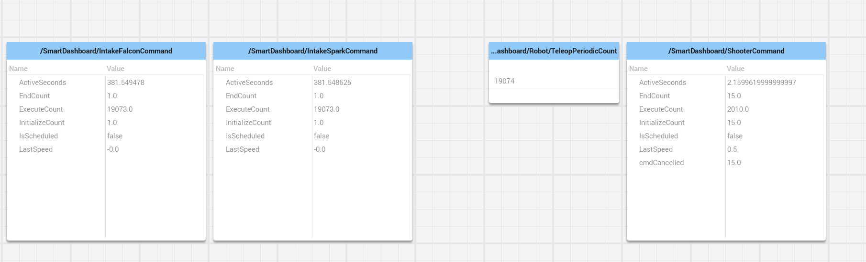
Dashboard Evidence (Run 1)

Slide 13
- Defaults run every loop (execute ~= teleop count) - Shooter runs in short bursts (15 presses) - Cancelled counts match releases/interrupts
Notes:
Use the counters to prove the mental model. Defaults: InitializeCount is 1 and ExecuteCount is almost the same as Robot/TeleopPeriodicCount, so they ran every 20ms. Shooter: InitializeCount and EndCount both read 15, meaning the button started it 15 times. CmdCancelled matches EndCount because the command ended by release/interrupt, not by isFinished. ActiveSeconds is total runtime across all presses, not one long run.

Slide 14
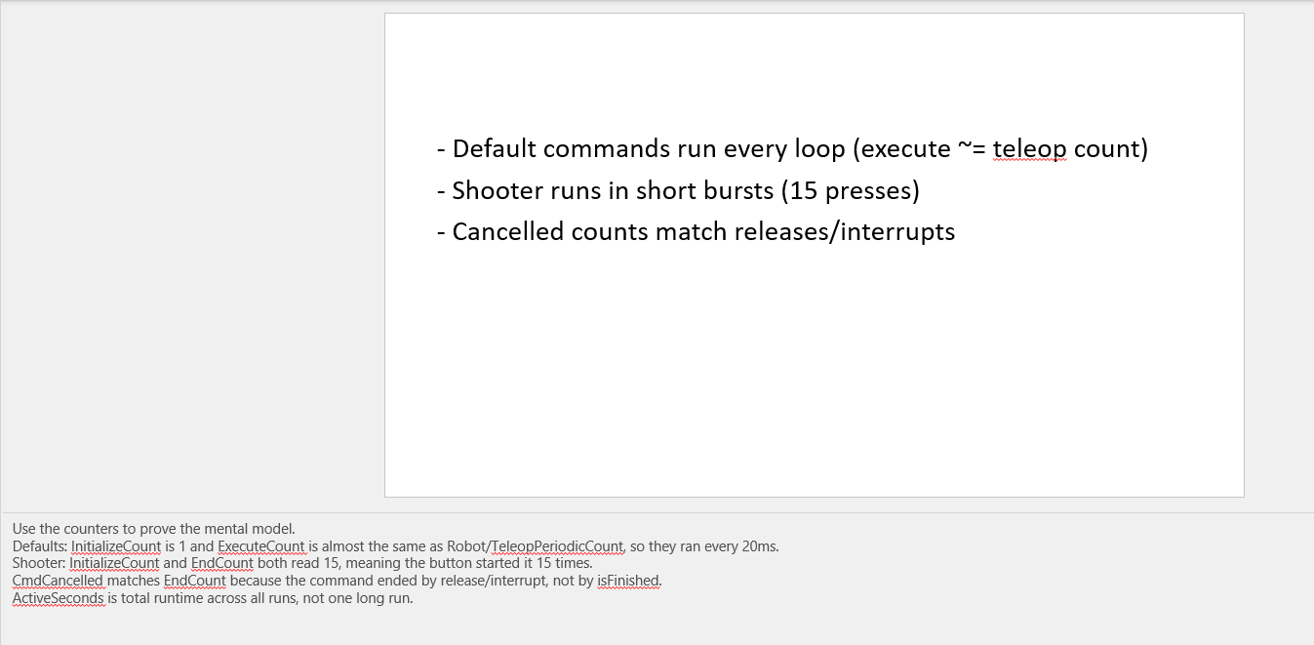
Dashboard Evidence (Run 2)

Slide 15
- Defaults run every loop (execute ~= teleop count) - Shooter runs in short bursts (button driven) - ActiveSeconds is total across presses
Notes:
Use this second run to show repeatability across tests. The exact counts will vary, but the ratios should stay the same.

Slide 16
Dashboard Takeaways
Default commands run every loop (execute ~= teleop count)
Button command like Shooter runs in short bursts (15 presses)
Cancelled counts match releases/interrupts
Notes:
Use the counters to prove the mental model. Defaults command InitializeCount is 1 and ExecuteCount is almost the same as Robot/TeleopPeriodicCount, so they ran every 20ms. Button command Shooter: InitializeCount and EndCount both read 15, meaning the button started it 15 times. CmdCancelled matches EndCount because the command ended by release/interrupt, not by isFinished. ActiveSeconds is total runtime across all presses, not one long run.

Slide 17
Subsystems Own Motors
Subsystems are the only place motor code lives
Commands ask subsystems to do work
Keeps hardware logic in one file
Notes:
This helps avoid duplicate motor control spread across files.

Slide 18
Scheduler Sequence (One Pass)
Robot.robotPeriodic calls CommandScheduler.run()
Scheduler polls triggers from RobotContainer bindings
ShooterCommand execute runs if B/X scheduled
ShooterSubsystem periodic applies mShooterSpeed
Notes:
Concrete sequence for this project: Robot.robotPeriodic calls CommandScheduler.run each 20ms. The scheduler reads trigger state from RobotContainer bindings (B whileTrue, X onTrue). If a trigger is active, it schedules ShooterCommand and calls its execute method this pass. After commands run, ShooterSubsystem periodic runs and pushes the stored speed to the motor. This is the exact timing order to remember: scheduler -> command execute -> subsystem periodic.
src/main/java/frc/robot/Robot.java src/main/java/frc/robot/RobotContainer.java src/main/java/frc/robot/commands/ShooterCommand.java src/main/java/frc/robot/subsystems/ShooterSubsystem.java

Slide 19
Code Walk: Command Gets Speed
@Override
public void execute() {
double speed = m_speedSupplier.getAsDouble();
m_subsystem.setShooterSpeed(speed);
}
src/main/java/frc/robot/commands/ShooterCommand.java
Notes:
The command execute method gets the speed value from the supplier and gives it to the subsystem by calling setShooterSpeed.

Slide 20
Code Walk: Subsystem Stores Speed
private double mShooterSpeed = 0;
public void setShooterSpeed(double motorSpeed) {
mShooterSpeed = motorSpeed;
}
src/main/java/frc/robot/subsystems/ShooterSubsystem.java
Notes:
That subsystem method saves the value.

Slide 21
Code Walk: Periodic Writes Motor
private final SparkMax mShooterMotor =
new SparkMax(Constants.ShooterCanID, MotorType.kBrushless);
public void periodic() {
mShooterMotor.set(mShooterSpeed);
}
src/main/java/frc/robot/subsystems/ShooterSubsystem.java
Notes:
The subsystem periodic routine uses the saved speed value to set the actual hardware motor speed.

Slide 22
Why This Style Helps
Buttons in one place
Hardware in one place
Commands are reusable
Multiple systems can run together safely
Notes:
This is the maintainability pitch: fewer bugs and easier testing.

Slide 23
Simple Mental Model
Command = repeated function
Subsystem = robot part
Scheduler = loop that picks functions
Notes:
Encourage them to keep this model in their head during coding.

