Slide 1
TL-SHOP
Temporal Logic Control Rules in a Hierarchal Task Network Planner
Derek Monner Nat Ayewah
dmonner@cs.umd.edu ayewah@cs.umd.edu
CMSC 722 Term Project, Spring 2007
University of Maryland, College Park

Slide 2
Hierarchal Task Network (HTN) Planning
“What you can do”
  Methods and Operators
Task:
travel(x,y)
Method: taxi-travel(x,y)
Method: air-travel(x,y)
get-taxi
ride(x,y)
pay-driver
get-ticket(a(x),a(y))
fly(a(x),a(y))
travel(a(y),y)
travel(x,a(x))
Notes:
Tasks -> Methods -> Operators

Slide 3
Temporal Logic Control Rules
“What you cannot do”
  Rules in Linear Temporal Logic (LTL)
Notes:
While these two approaches are in theory equally expressive, many constraints are easier to specify as a negative condition ("don't do this") than a positive one ("do it this way"), and vice versa.

Slide 4
Methodology
Augment JSHOP2 with TLPlan strategy
  TL-SHOP is backwards compatible with JSHOP2
Prune plans when application of an operator creates a state that violates an LTL constraint
Provide additional syntax and parsing rules for specifying LTL control rules
Implement LTL Progress function and integrate it into the HTN planning process

Slide 5
Control Rule Specification
Domain Specification
Operator…
Problem
(constraint)
Operator…
(constraint)
Constraint
Method…
3
(constraint)
Method…
Problem
(constraint)
Constraint
Constraint
Constraint
2
1

Slide 6
Control Rule Specification
(1) Domain Control Rules
  Like one would expect
(2) Problem Control Rules
  Allows easy creation of “customized subdomains”
(3) Method/Operator Postconditions
  When operator or method is applied, its postcondition is added to the set of applicable control rules for all descendant states in the search tree

Slide 7
Extending the Parser
Use the same syntax in all three locations
  (:contraint LTLExpression)
Four other new keywords:
  :next
  :always
  :eventually
  :until

Slide 8
Extending the Parser
Recursive Definition
  LTLExpression :=
  AND (LP LTLExpression RP)+
  | OR (LP LTLExpression RP)+
  | NOT LTLExpression
  | IMPLY LP LTLExpression RP LP LTLExpression RP
  | :next LTLExpression
  | :always LTLExpression
  | :eventually LTLExpression
  | :until LP LTLExpression RP LP LTLExpression RP
  | LP forall (Variables) LTLAtom LTLExpression RP
  | LP exists (Variables) LTLAtom LTLExpression RP

Slide 9
Extending the Parser
Examples
  (:contraint (:always (on ?a ?b)))
  (:contraint (:always
  (forall (?x) (isPhDStudent ?x)
  (:eventually (isRich ?x))
  )
  )

Slide 10
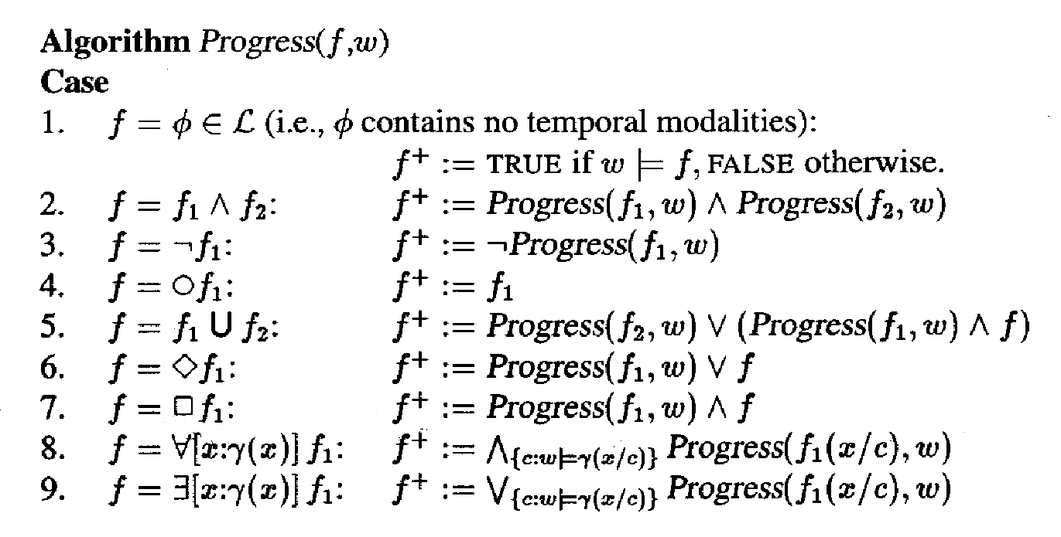
LTL Inference Engine

Slide 11
LTL Inference Engine
Progress function is called every time operator is applied
  Evaluates rules in current state
  If returns false, prune this partial plan; otherwise
  Derives rules to be applied to next state
When a plan is found, check remaining control rules for eventually clauses
  If they exist, plan might be invalid!

Slide 12
Limitations
JSHOP2 allocates no memory during planning
We found the evolution of LTL Rules via the Progress function difficult to predict
  Requires memory allocation during planning!
As a result, performance on large problems is significantly worse than JSHOP2
  Could not really test the effectiveness of TL-SHOP approach versus JSHOP2 or TLPlan themselves
  Problem could be overcome by future work

Slide 13
Conclusion
LTL Control Rules can be used in many ways to prune search space in HTN planning
Increases expressiveness and flexibility of domain and problem descriptions
Source code available at:
http://code.google.com/p/tl-shop

