Slide 1
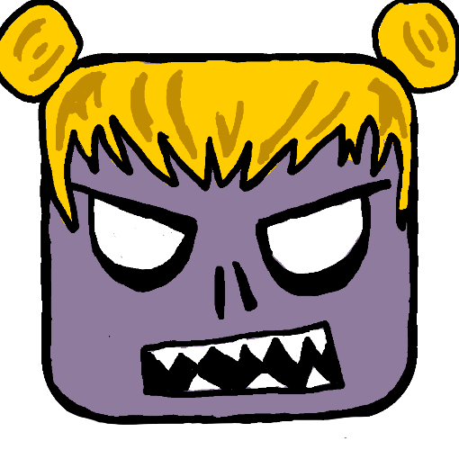
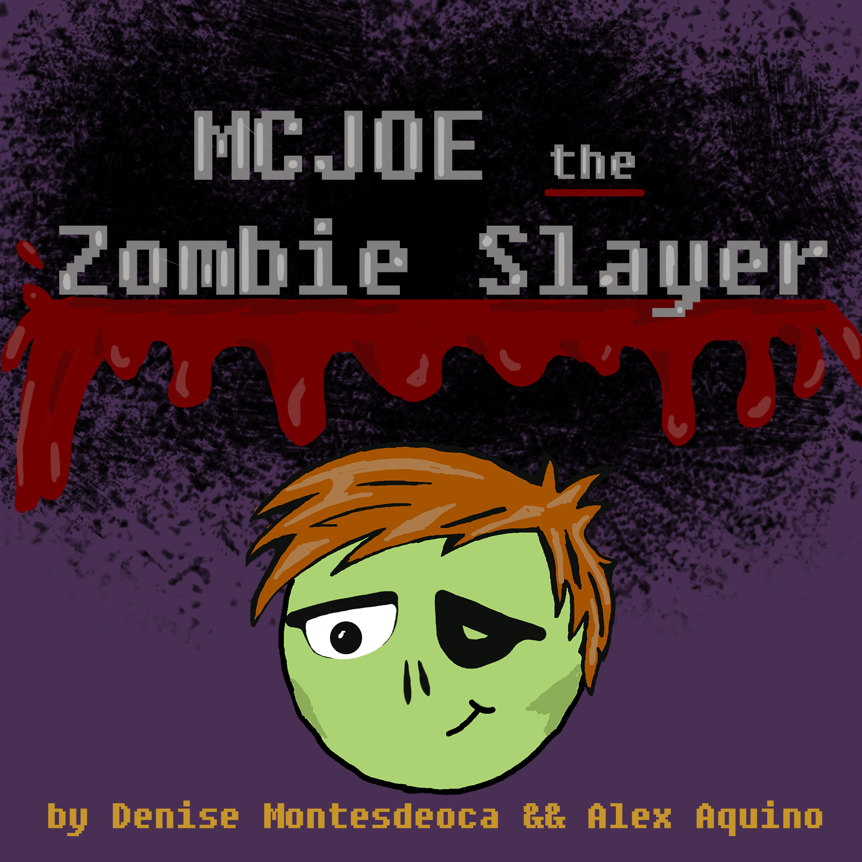
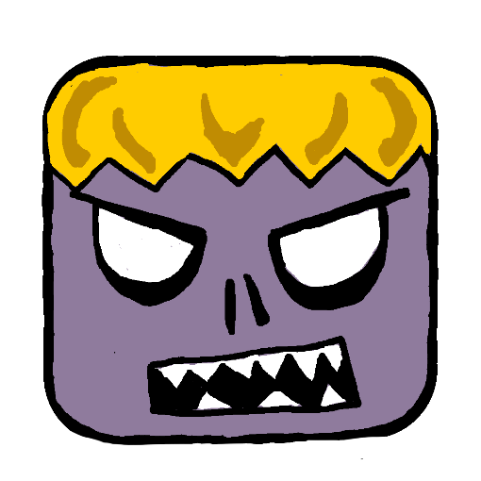
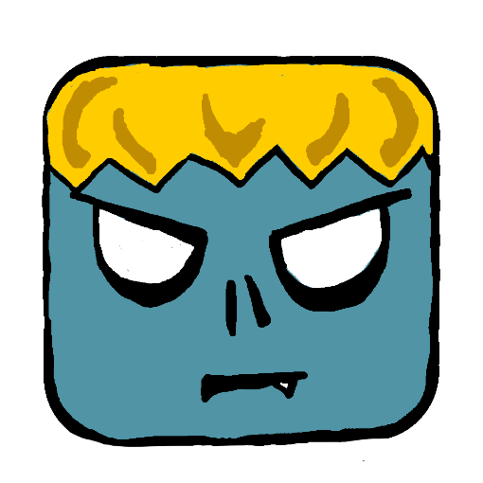
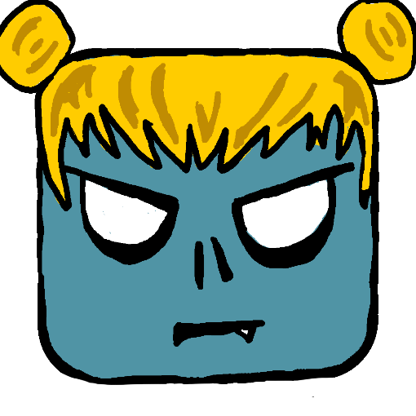
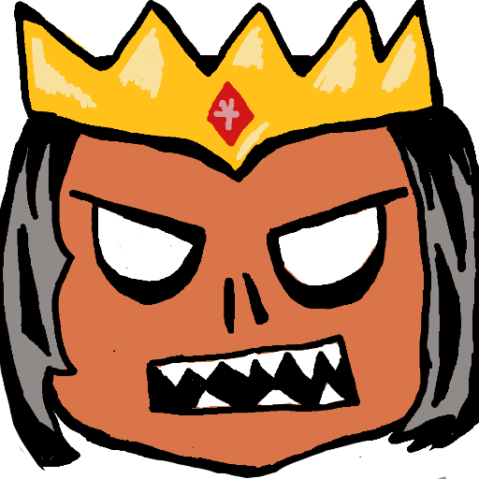



Slide 2


STORY
New York has become a wasteland invaded by zombies. The Zombie Queen was furious because her empire was taken down by an army of skeleton people. All of her zombie people were massacred in the Skeleton Zombie war, leaving her as the only survivor. So she used the rest of her Dark Magic to cast a spell on NYC to rebuild her army so that she can fight them once more. Her underground dungeon rose up and spread this plague to turn the New Yorkers into her zombie subjects, creating the current situation that NYC is in. McJoe, who is the main character, has been bitten. Even though he has the physical properties of the zombies that now plague the streets, he still has control over his body. After being half turned, he is informed that the zombie invasion came from a dungeon that rose up from beneath the Earth. Now with his new abilities that allow him to fight on par with the zombies and his weapon of choice, he will go through this dungeon to find the source of the plague and stop it before it spreads past New York and to the rest of the world.

Slide 3
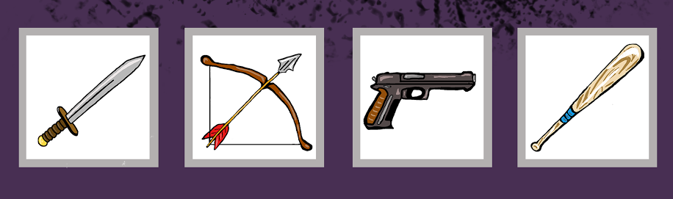
MAIN SCREEN
CHOOSE A WEAPON
The player gets to choose a weapon out of four to fight with through out the game on the main screen.
SWORD or BOW AND ARROW or GUN or BAT

Slide 4
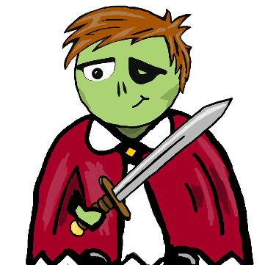
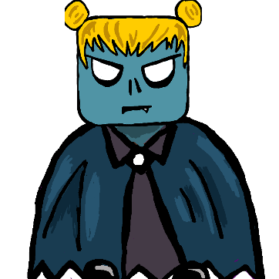
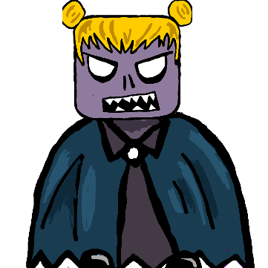
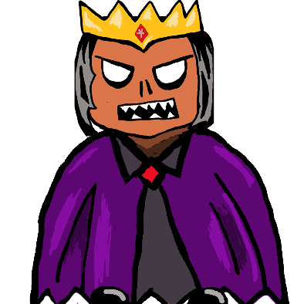
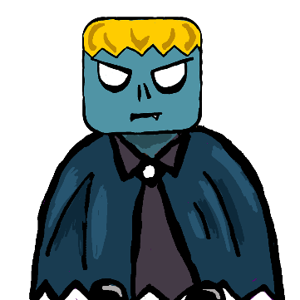
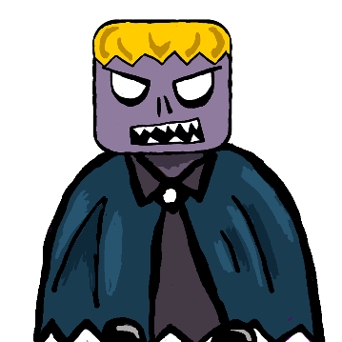
CHARACTERS
McJoe
McJoe became a zombie when he randomly got bitten during the zombie invasion, he was just a regular guy working a regular 9 to 5 job. Not really going anywhere in life, he was planning on committing suicide. His family left him, his dog walked out on him, and he just got fired, what could this man possibly live for? He finds out what his true calling is when he gets bitten, only to not turn fully into one of those undead freaks. Now with the strength and abilities of the zombies, and the heart of a New Yorker, the government wants him to take down the source of the plague and save the world!
Zombie
( Female / Male )
The residents of NYC who have turned into zombies from the initial plague spell or via bite from another zombie. Going against the common idea of a zombie, these monsters are agile and quick on their feet. They will do everything to stop McJoe from getting to the Queen.
Mutated Zombie
( Female / Male )
The zombies who have been a zombie for long enough to further mutate and gain new abilities. These zombies are even harder to kill and must be fought with caution.
Zombie Queen
The source of the plague and the final boss of the game. They say she was the queen of a civilization long forgotten who used her Dark Magic to create an immortal kingdom, which went horribly wrong. She created a kingdom of zombies instead, forcing her to move her people underground due to attacks from a Holy Alliance comprised of other kingdoms fighting under the name of God. Over time she started wars with the monsters that live underground as well, putting her in the present situation of needing new soldiers.

Slide 5
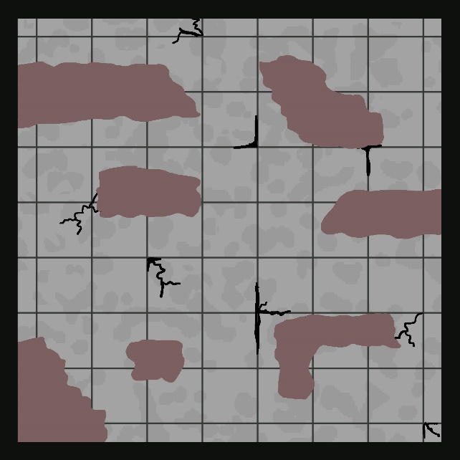
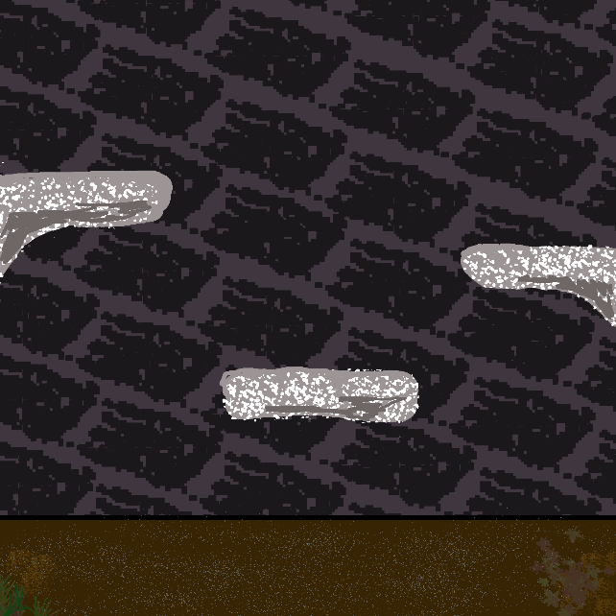
GAME MECHANICS
DUNGEON SCREEN
(PLAYER MOVEMENT)
BATTLE SCREEN
(PLAYER MOVEMENT)
Go Left - A / LEFT Key
Go Right - D / RIGHT Key
Go Up - W / UP Key
Go Down - S / DOWN Key
Go Left - A / LEFT Key
Go Right - D / RIGHT Key
Jump - W / UP Key
Attack - Left/Right MouseClick
IN DUNGEON SCREEN
Player moves around map to look for exit. Can collect coins and life boosts. Zombie chases Player (McJoe), when Player (McJoe) is in sight. When Player (McJoe) and a zombie collides Battle Screen will appear.
IN BATTLE SCREEN
Player (McJoe) moves and jumps around the battle screen to avoid taking damage from zombies. Zombies will jump around and chase player to give damage. Player (McJoe) will try and defeat zombie by damaging life points to zero.

