Slide 1

Because Good Works!
Sun City Hackathon 2019
Kim Morales
David Morales
Joseph Gutierrez

Slide 2

Quick Poll
Who likes to volunteer?

Slide 3
EVERYONE DOES!
Volunteerism improves health by strengthening the body, improving mood, and lessening stress in participants
92% of human resource executives agree that contributing to a nonprofit can improve an employee’s leadership skills
60% of hiring managers see the act of volunteerism as a valuable asset when making recruitment decisions according to a study performed by Career Builder
Those who volunteer regularly have a 27% better chance of gaining employment
Source: VolunteerHub

Slide 4
BUT!
Individuals between the ages of 35 and 54 are the most likely to volunteer their time according to The Bureau of Labor Statistics
Over 71% of volunteers work with only one organization each year
There are more than 1.8 million active nonprofits in the United States alone (the ability to volunteer is endless ).
Source: VolunteerHub

Slide 5


Everyone has AT LEAST one
Time Treasure Talent

Slide 6
Time
After School or work, weekends, vacation breaks
Time to spend whatever is needed.
Reading to kids
Cleaning Kennels
Set up/tear down
Assembling food bags
Serving plates
…

Slide 7
Treasure
Money, vehicles, physical space, storage
Resources to help accomplish the task.
Money donations for food
Space to hold items for a rummage sale
A truck to help move large Items
A venue to hold an event

Slide 8
Talent
Knowledge of Web Dev, App dev, Food Handler’s license, book keeping
Special skills that are needed to accomplish a task
Bookkeeping for a Non-Profit
Develop a website/ app for a non-profit
Wood working, plumbing, HVAC knowledge applied to building a space or home
Sewing, tailoring experience, making pillow cases for foster children

Slide 9

Quick Poll
So, where do you go to volunteer?

Slide 10




Slide 11
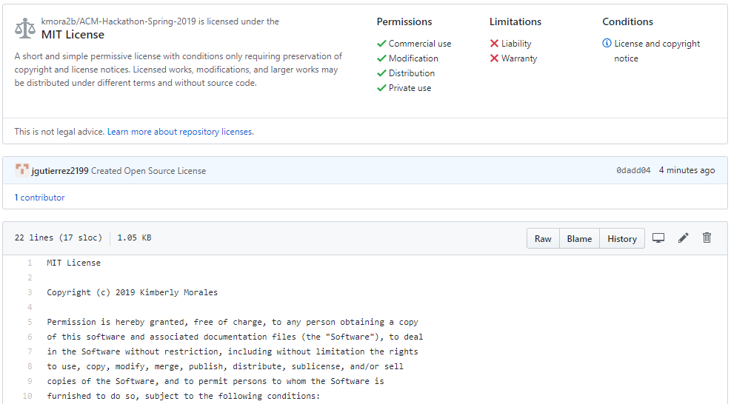
MIT License

Slide 12
From the Organization’s View
Volunteerism has a value of over $167 Billion dollars
Volunteers are worth on average $24.14 an hour according to an Independent Sector Study.
Volunteers are 66% more likely to donate financially to the organization they support than those who do not volunteer their time.
Side Note: In El Paso, most High School students are required for their diplomas to do community service hours
Source: VolunteerHub

Slide 13
A Final Thought
“
Those in need suffer less from a lack of generosity than from a lack of organization
“
-St. Vincent de Paul

