Slide 1

Because Good Works!
Sun City Hackathon 2019
Kim Morales
David Morales
Joseph Gutierrez

Slide 2

Quick Poll
Who likes to volunteer?

Slide 3
EVERYONE DOES!
Volunteerism improves health by strengthening the body, improving mood, and lessening stress in participants
92% of human resource executives agree that contributing to a nonprofit can improve an employee’s leadership skills
60% of hiring managers see the act of volunteerism as a valuable asset when making recruitment decisions according to a study performed by Career Builder
Those who volunteer regularly have a 27% better chance of gaining employment
Source: VolunteerHub

Slide 4
BUT!
Individuals between the ages of 35 and 54 are the most likely to volunteer their time according to The Bureau of Labor Statistics
Over 71% of volunteers work with only one organization each year
There are more than 1.8 million active nonprofits in the United States alone (the ability to volunteer is endless ).
Source: VolunteerHub

Slide 5


Everyone has AT LEAST one
Time Treasure Talent

Slide 6
Time
After School or work, weekends, vacation breaks
Time to spend whatever is needed.
Reading to kids
Cleaning Kennels
Set up/tear down
Assembling food bags
Serving plates
…

Slide 7
Treasure
Money, vehicles, physical space, storage
Resources to help accomplish the task.
Money donations for food
Space to hold items for a rummage sale
A truck to help move large Items
A venue to hold an event

Slide 8
Talent
Knowledge of Web Dev, App dev, Food Handler’s license, book keeping
Special skills that are needed to accomplish a task
Bookkeeping for a Non-Profit
Develop a website/ app for a non-profit
Wood working, plumbing, HVAC knowledge applied to building a space or home
Sewing, tailoring experience, making pillow cases for foster children

Slide 9

Quick Poll
So, where do you go to volunteer?

Slide 10



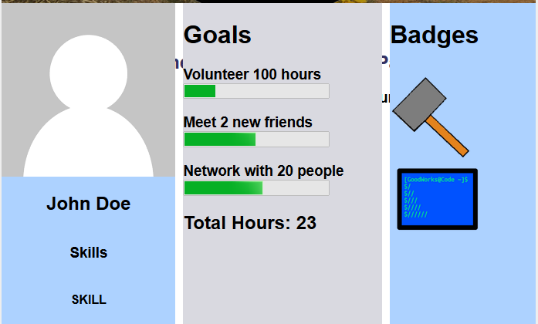
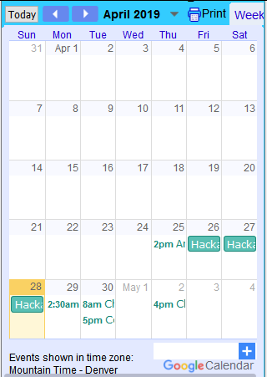


Slide 11
Coming Soon

Slide 12
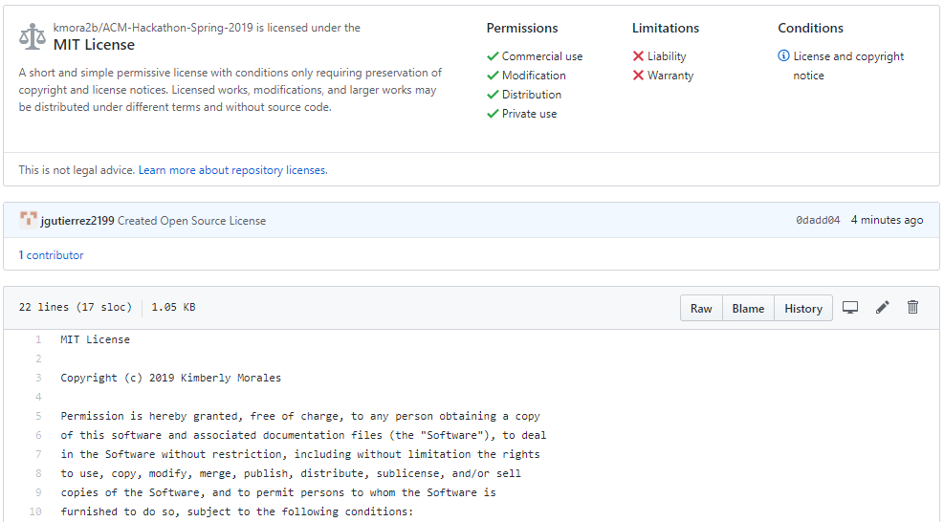
MIT License

Slide 13
From the Organization’s View
Volunteerism has a value of over $167 Billion dollars
Volunteers are worth on average $24.14 an hour according to an Independent Sector Study.
Volunteers are 66% more likely to donate financially to the organization they support than those who do not volunteer their time.
Side Note: In El Paso, most High School students are required for their diplomas to do community service hours
Source: VolunteerHub

Slide 14


Use Case Diagram
Good Works El Paso
Find Volunteer Events
Connect with organizations
Track Hours Volunteered
Get together to do good
Connect with organizations
Post Volunteer Events

Slide 15
A Final Thought
“
Those in need suffer less from a lack of generosity than from a lack of organization
“
-St. Vincent de Paul

