Slide 1
Bank
Axel Diaz and David Morales

Slide 2
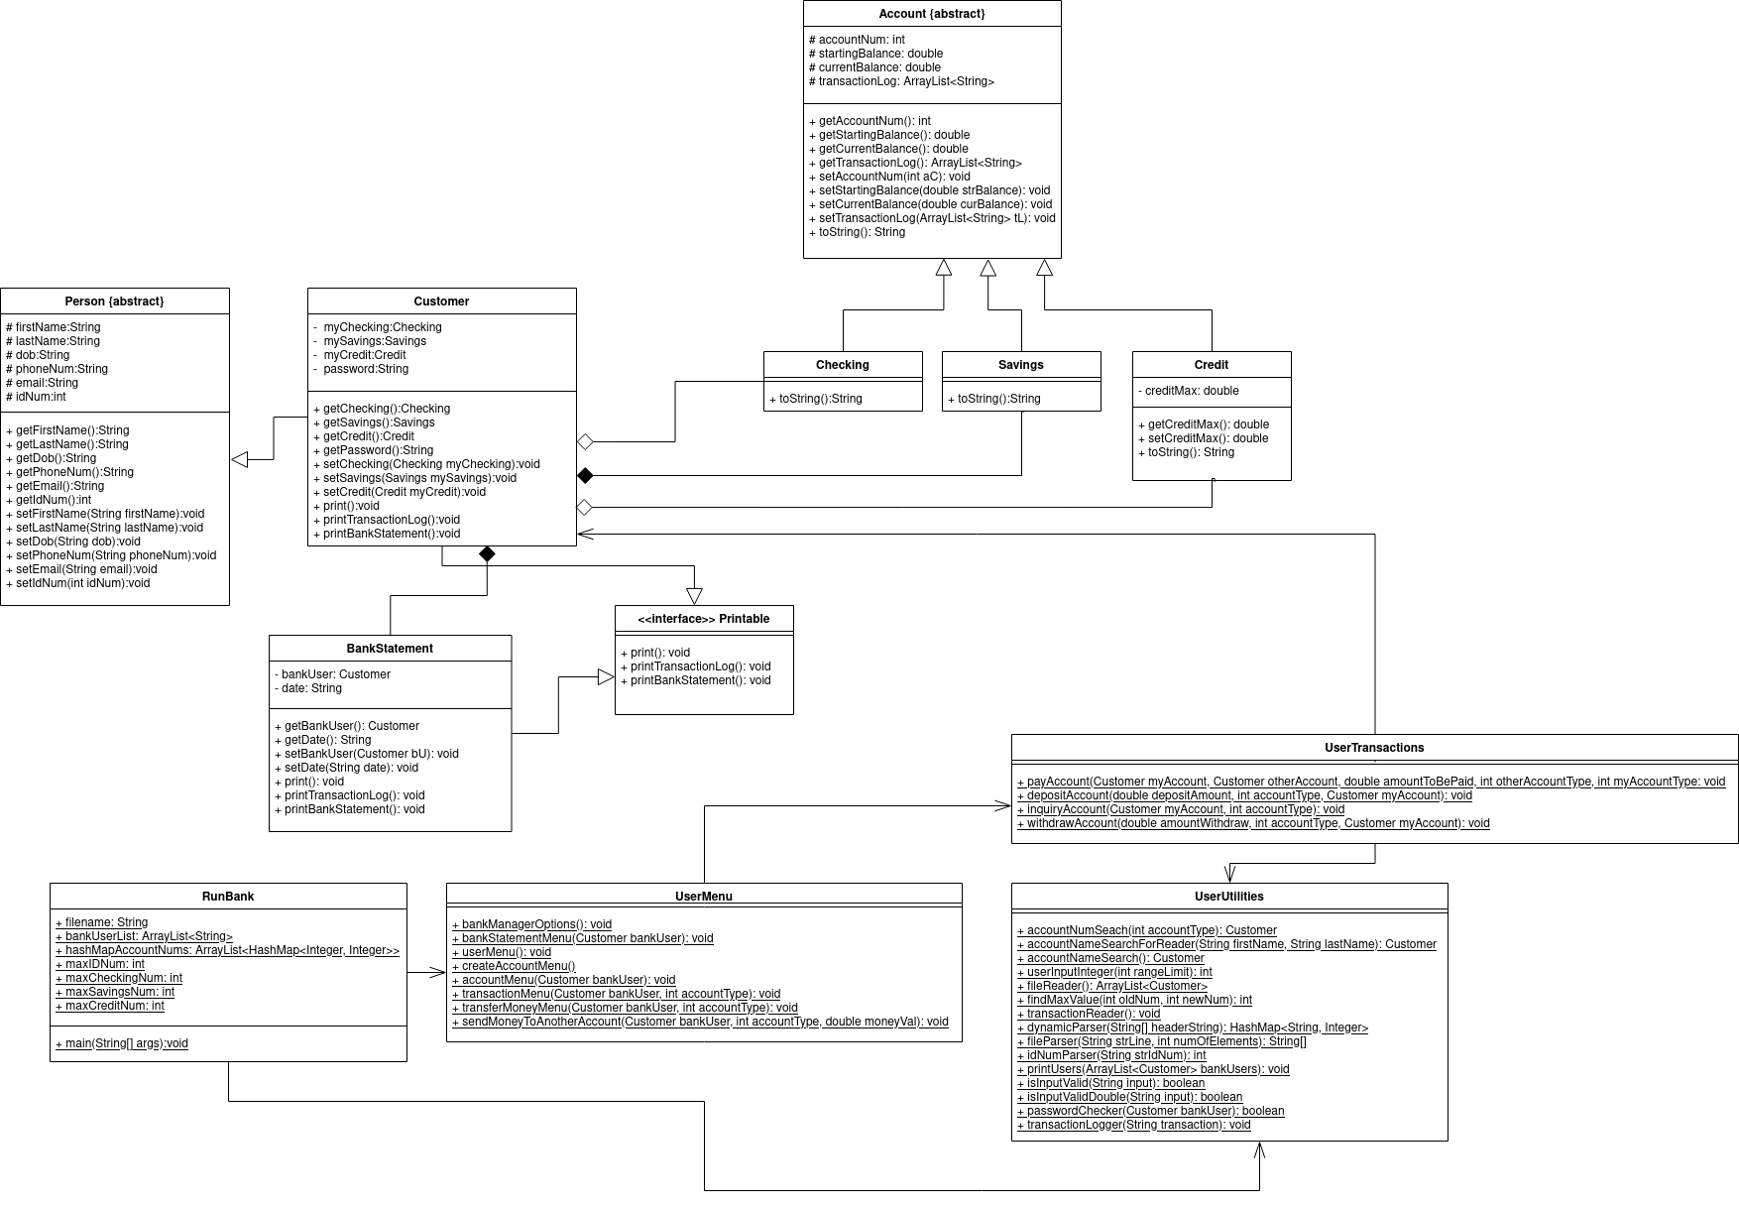
UML Class Diagram

Slide 3
How did I use Object-Oriented Programming?
We used object-oriented programming by using classes like Account, Customer, Person, Checking, Savings, Credit, and BankStatement to create objects that contain relevant information to perform banking operations.
We then have separate classes to process, view, take information (UserUtilities. , UserTransactions, UserMenu) from the user.

Slide 4
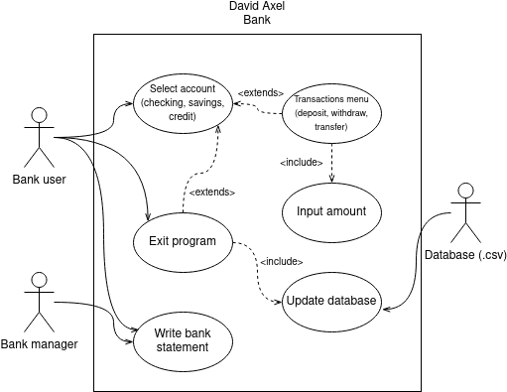
UML Use Case Diagram

Slide 5
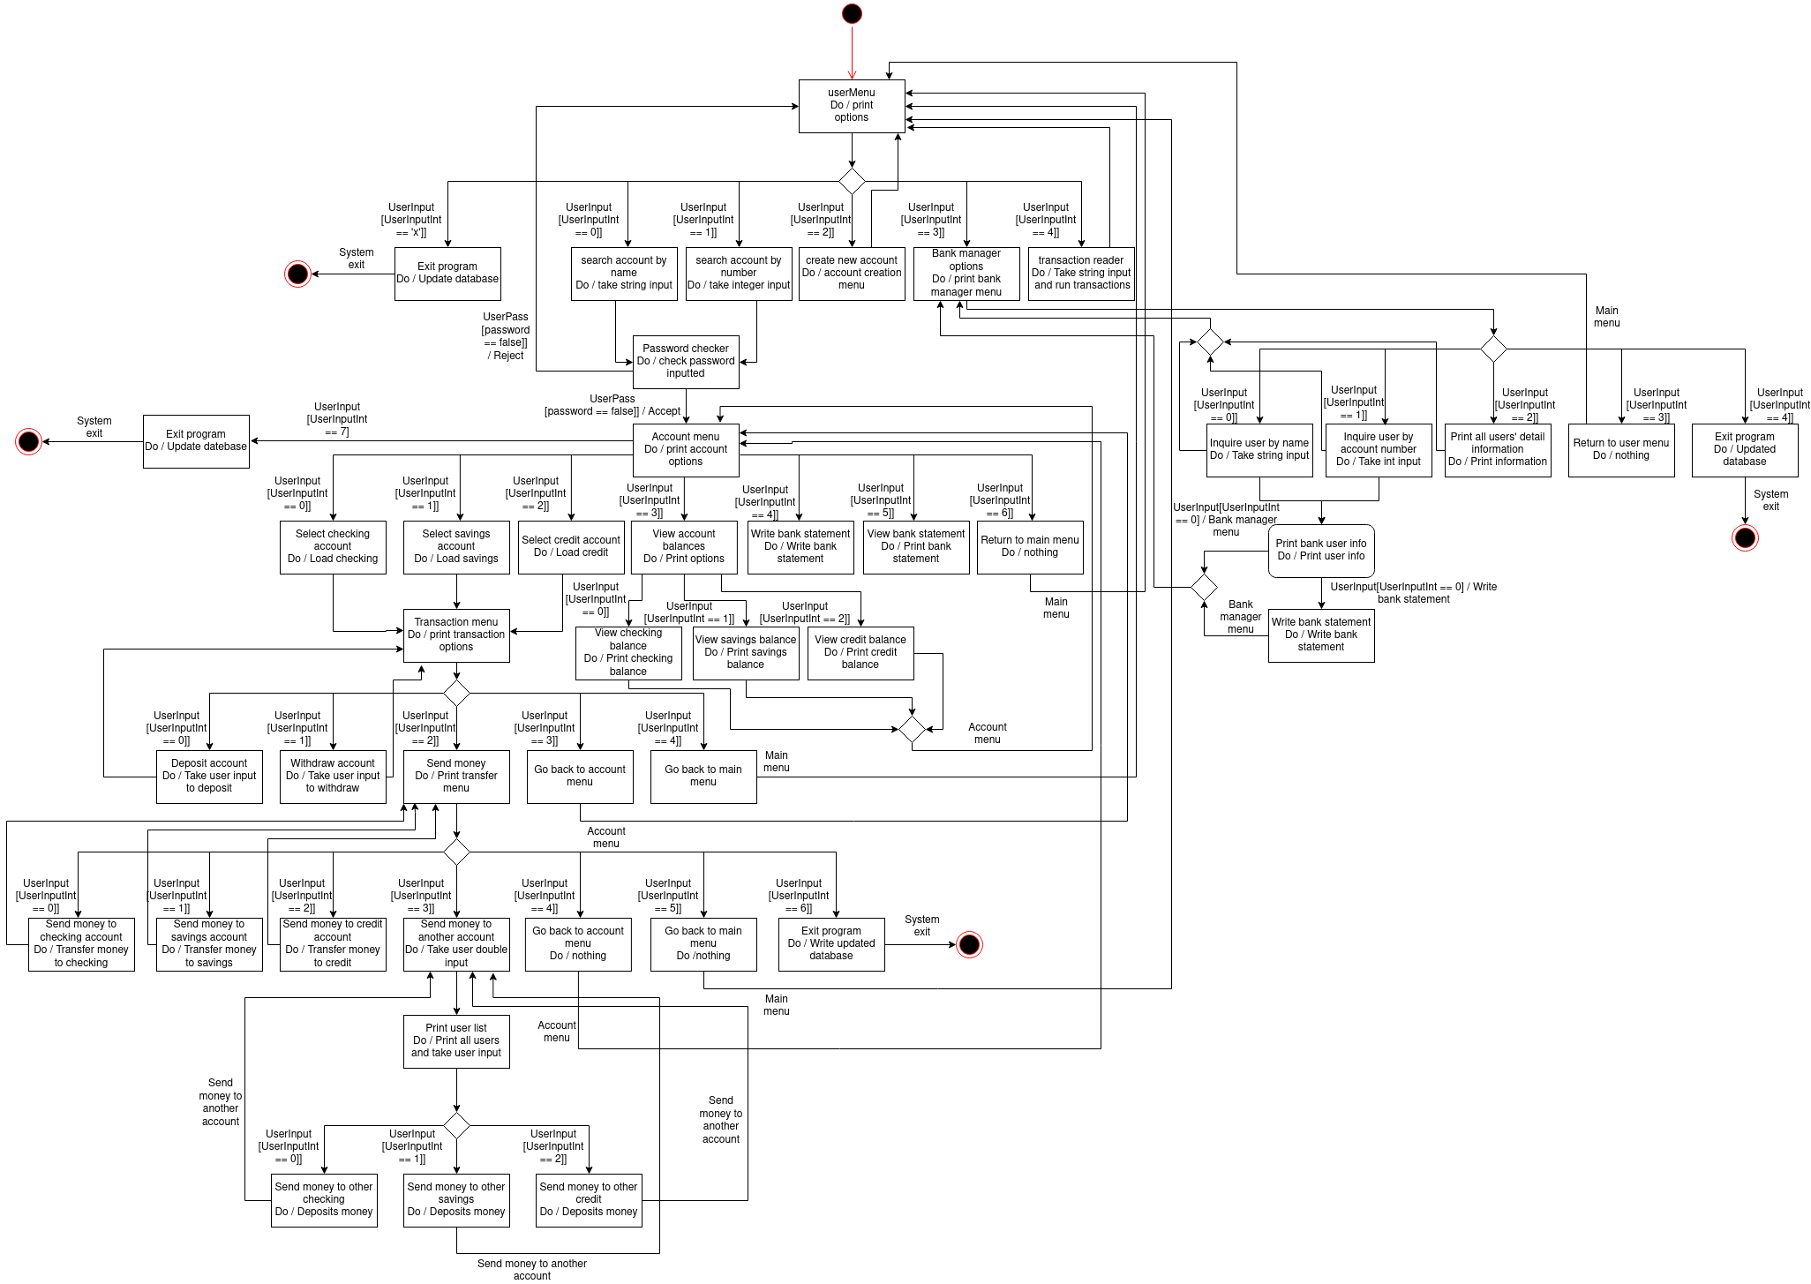
UML State Diagram

Slide 6
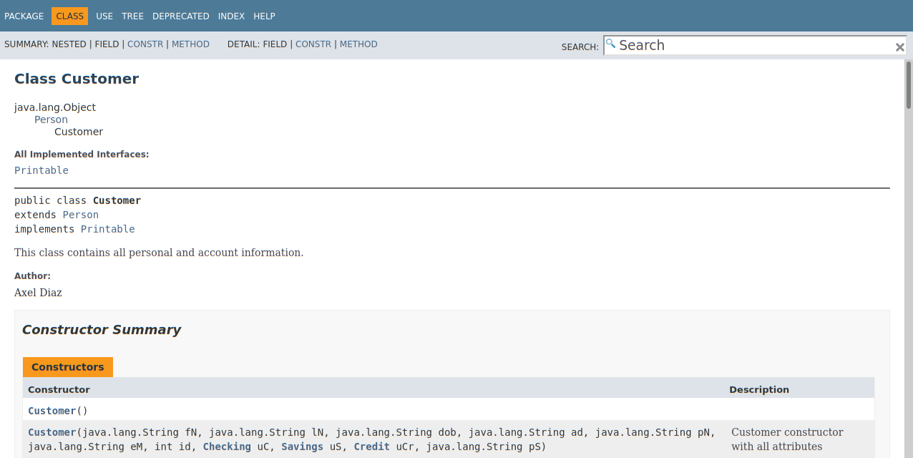
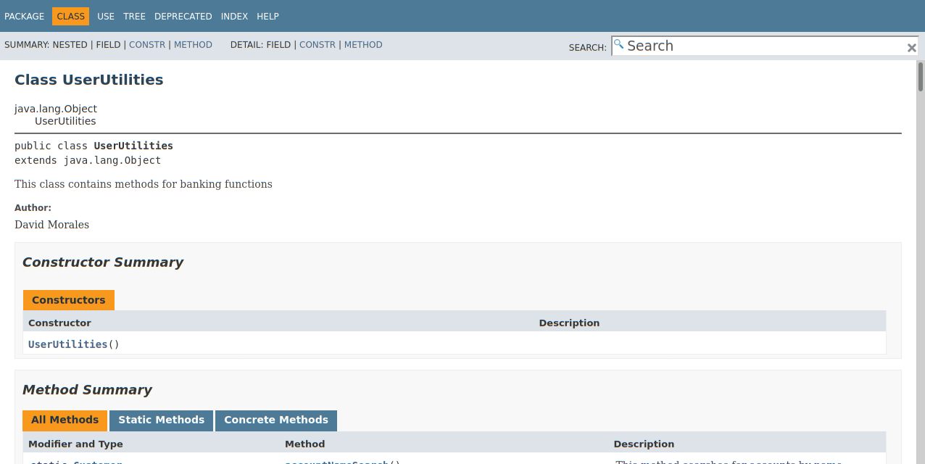
Javadoc

Slide 7
Reflections
What did we learn with the bank assignments?
-We learned how to write more robust, expandable code from these assignments.
How did we grow as a student?
-We grew as students by being challenged on our coding habits, and how to properly plan out and design software. Also taking criticism and feedback about our code more constructively.
How did we break up the problem to complete the task?
-We broke up the problem by assigning separate task between both of us. We split the workload evenly to finish the project.

Slide 8
References
https://app.diagrams.net/ (to draw diagrams)

