Slide 1
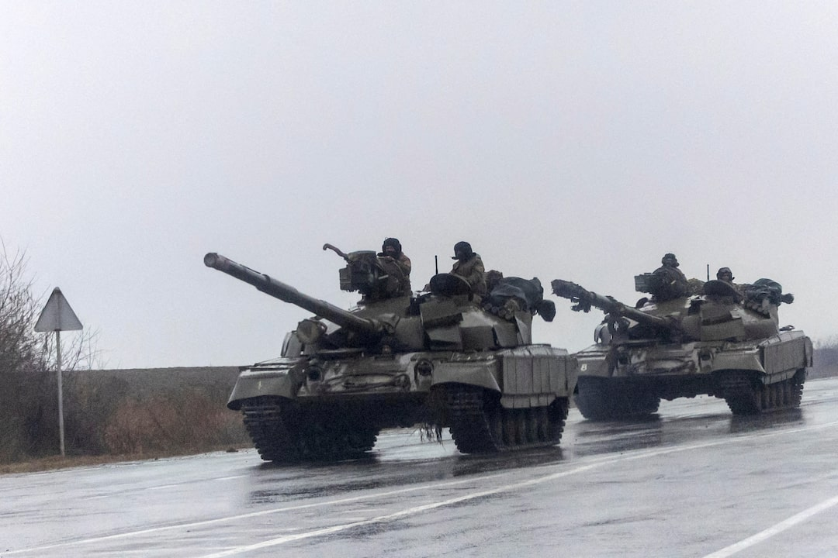
The Signaling Gap: State-Owned Media and the Strategic Management of Sentiment during the Russian Invasion of Ukraine
Donald Moratz
Political Science
Photo: REUTERS/Carlos Barria February 24, 2022
Notes:
5 seconds: The Signaling Gap… February 24, 2022. Russia invades Ukraine… I'm Donald Moratz. I'd like to start with a question.

Slide 2
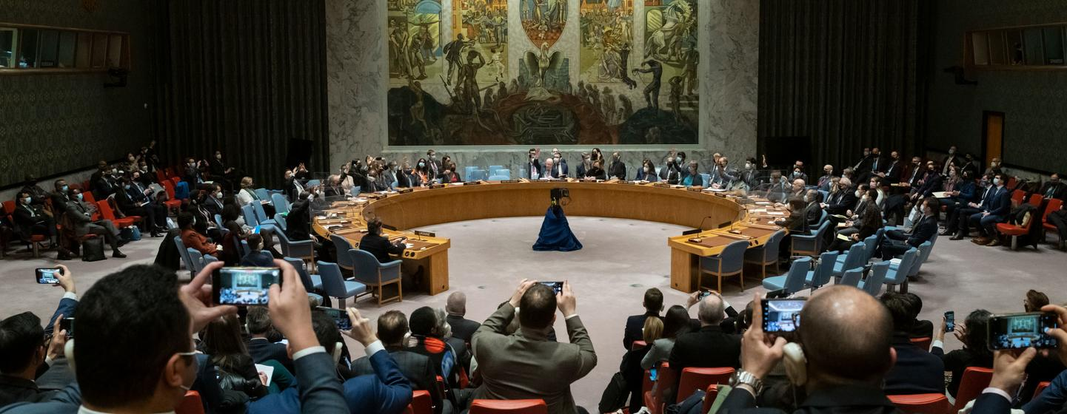
The Bind
Your treaty ally just invaded a sovereign state.
You can't condemn them — they guarantee your security.
You can't stay silent — the West is watching.
Photo: UN Photo/Mark Garten February, 25 2022
Notes:
30 seconds: Imagine you lead Kazakhstan. Russia — your treaty ally, your security guarantor — just launched the largest land war in Europe since World War II. Kazakhstan depends on Russia for its security. But nearly half its trade is with the West. It's caught between two worlds. You can't vote against Russia at the UN. You can't issue a public condemnation. But you need the West to know you're not on board with this. What do you do?

Slide 3
The Hidden Channel
1939
1941
Cold War
2024
BBC Monitoring
Established
U.S. FBIS
Established
Kremlinology
Tradition
U.S. IC OSINT
Strategy
We think state media is for the masses. The CIA thinks it's for them.
Notes:
30 Seconds: The answer is: you use your state media. Not a press conference, not a diplomatic cable — the news coverage itself. And here's the thing — this isn't a new trick. The BBC started systematically monitoring state media in 1939. The predecessor to the CIA followed suit in 1941. For the entire Cold War, Western analysts read Soviet and satellite state media not as journalism but as political text — shifts in tone meant shifts in policy. And this isn't slowing down — the U.S. Intelligence Community made state media monitoring a core part of its strategy just two years ago.

Slide 4
The Gap
Academics
Practitioners
Agenda setting & framing
Spin dictators & censorship
Domestic opinion formation
Window into regime preferences
Shifts in tone = policy signals
80+ years of institutional practice
We formalize what practitioners have known
Notes:
20 Seconds: Political science has built a huge literature on state media — and almost all of it is about domestic audiences. How governments control what their own people think. Agenda setting, framing, spin dictators. But the people whose job it is to understand what regimes actually believe — intelligence analysts — have operated on a completely different assumption. They read state media as a signal of what the regime thinks, not just what it wants the public to think. These two literatures have been sitting side by side for decades without talking to each other. We connect them.

Slide 5
Why the Signal Works
Readable
Costly
Deniable
Everyone knows state media is state-controlled. Deviation is informative.
Negative coverage of your patron risks retaliation from Moscow.
"We don't control the press." Institutional separation protects the relationship.
Notes:
45 Seconds: Why does this channel work? Three reasons. First, it's readable — everyone knows Kazakh state media is under government control, so when it shifts against Russia, foreign analysts don't read that as independent journalism. They read it as a regime choice. Second, it's costly — letting your state media go negative on the country that guarantees your security is a real risk. Moscow could notice. That cost is what makes the signal credible. And third — and this is crucial — it's deniable. If Moscow confronts you, there's an institutional off-ramp — the government didn't write the article, the newsroom did. Moscow knows what's happening, but there's nothing formal to retaliate against. That combination — visible enough to be read, costly enough to be believed, deniable enough to be sustained — is what makes state media the right channel for this kind of communication.

Slide 6
Data & Design
174K
Articles
11 countries, 62 sources
GPT-4o
Sentiment
F1 = .92 vs. human coders
RD
In Time
Feb, 24 2022 as cutoff
3
Groups
Russia-aligned, Neutral, NATO
Notes:
20 Seconds: A quick word on the data. We collected 174,000 news articles from 11 countries in Russia's near abroad — six months before and after the invasion. We used GPT-4o to score sentiment toward Russia at the article level, validated against human coding with an F1 of .92. Our identification strategy is a regression discontinuity — February 24 is our cutoff, and the sharp, unexpected nature of the full-scale invasion is what makes this work. We compare three groups: states with Russian security agreements — Armenia, Azerbaijan, Belarus, Kazakhstan. Neutral states — Georgia, Moldova, Kosovo, Serbia. And NATO members --- Albania, Hungary and Turkey as an additional reference point.

Slide 7
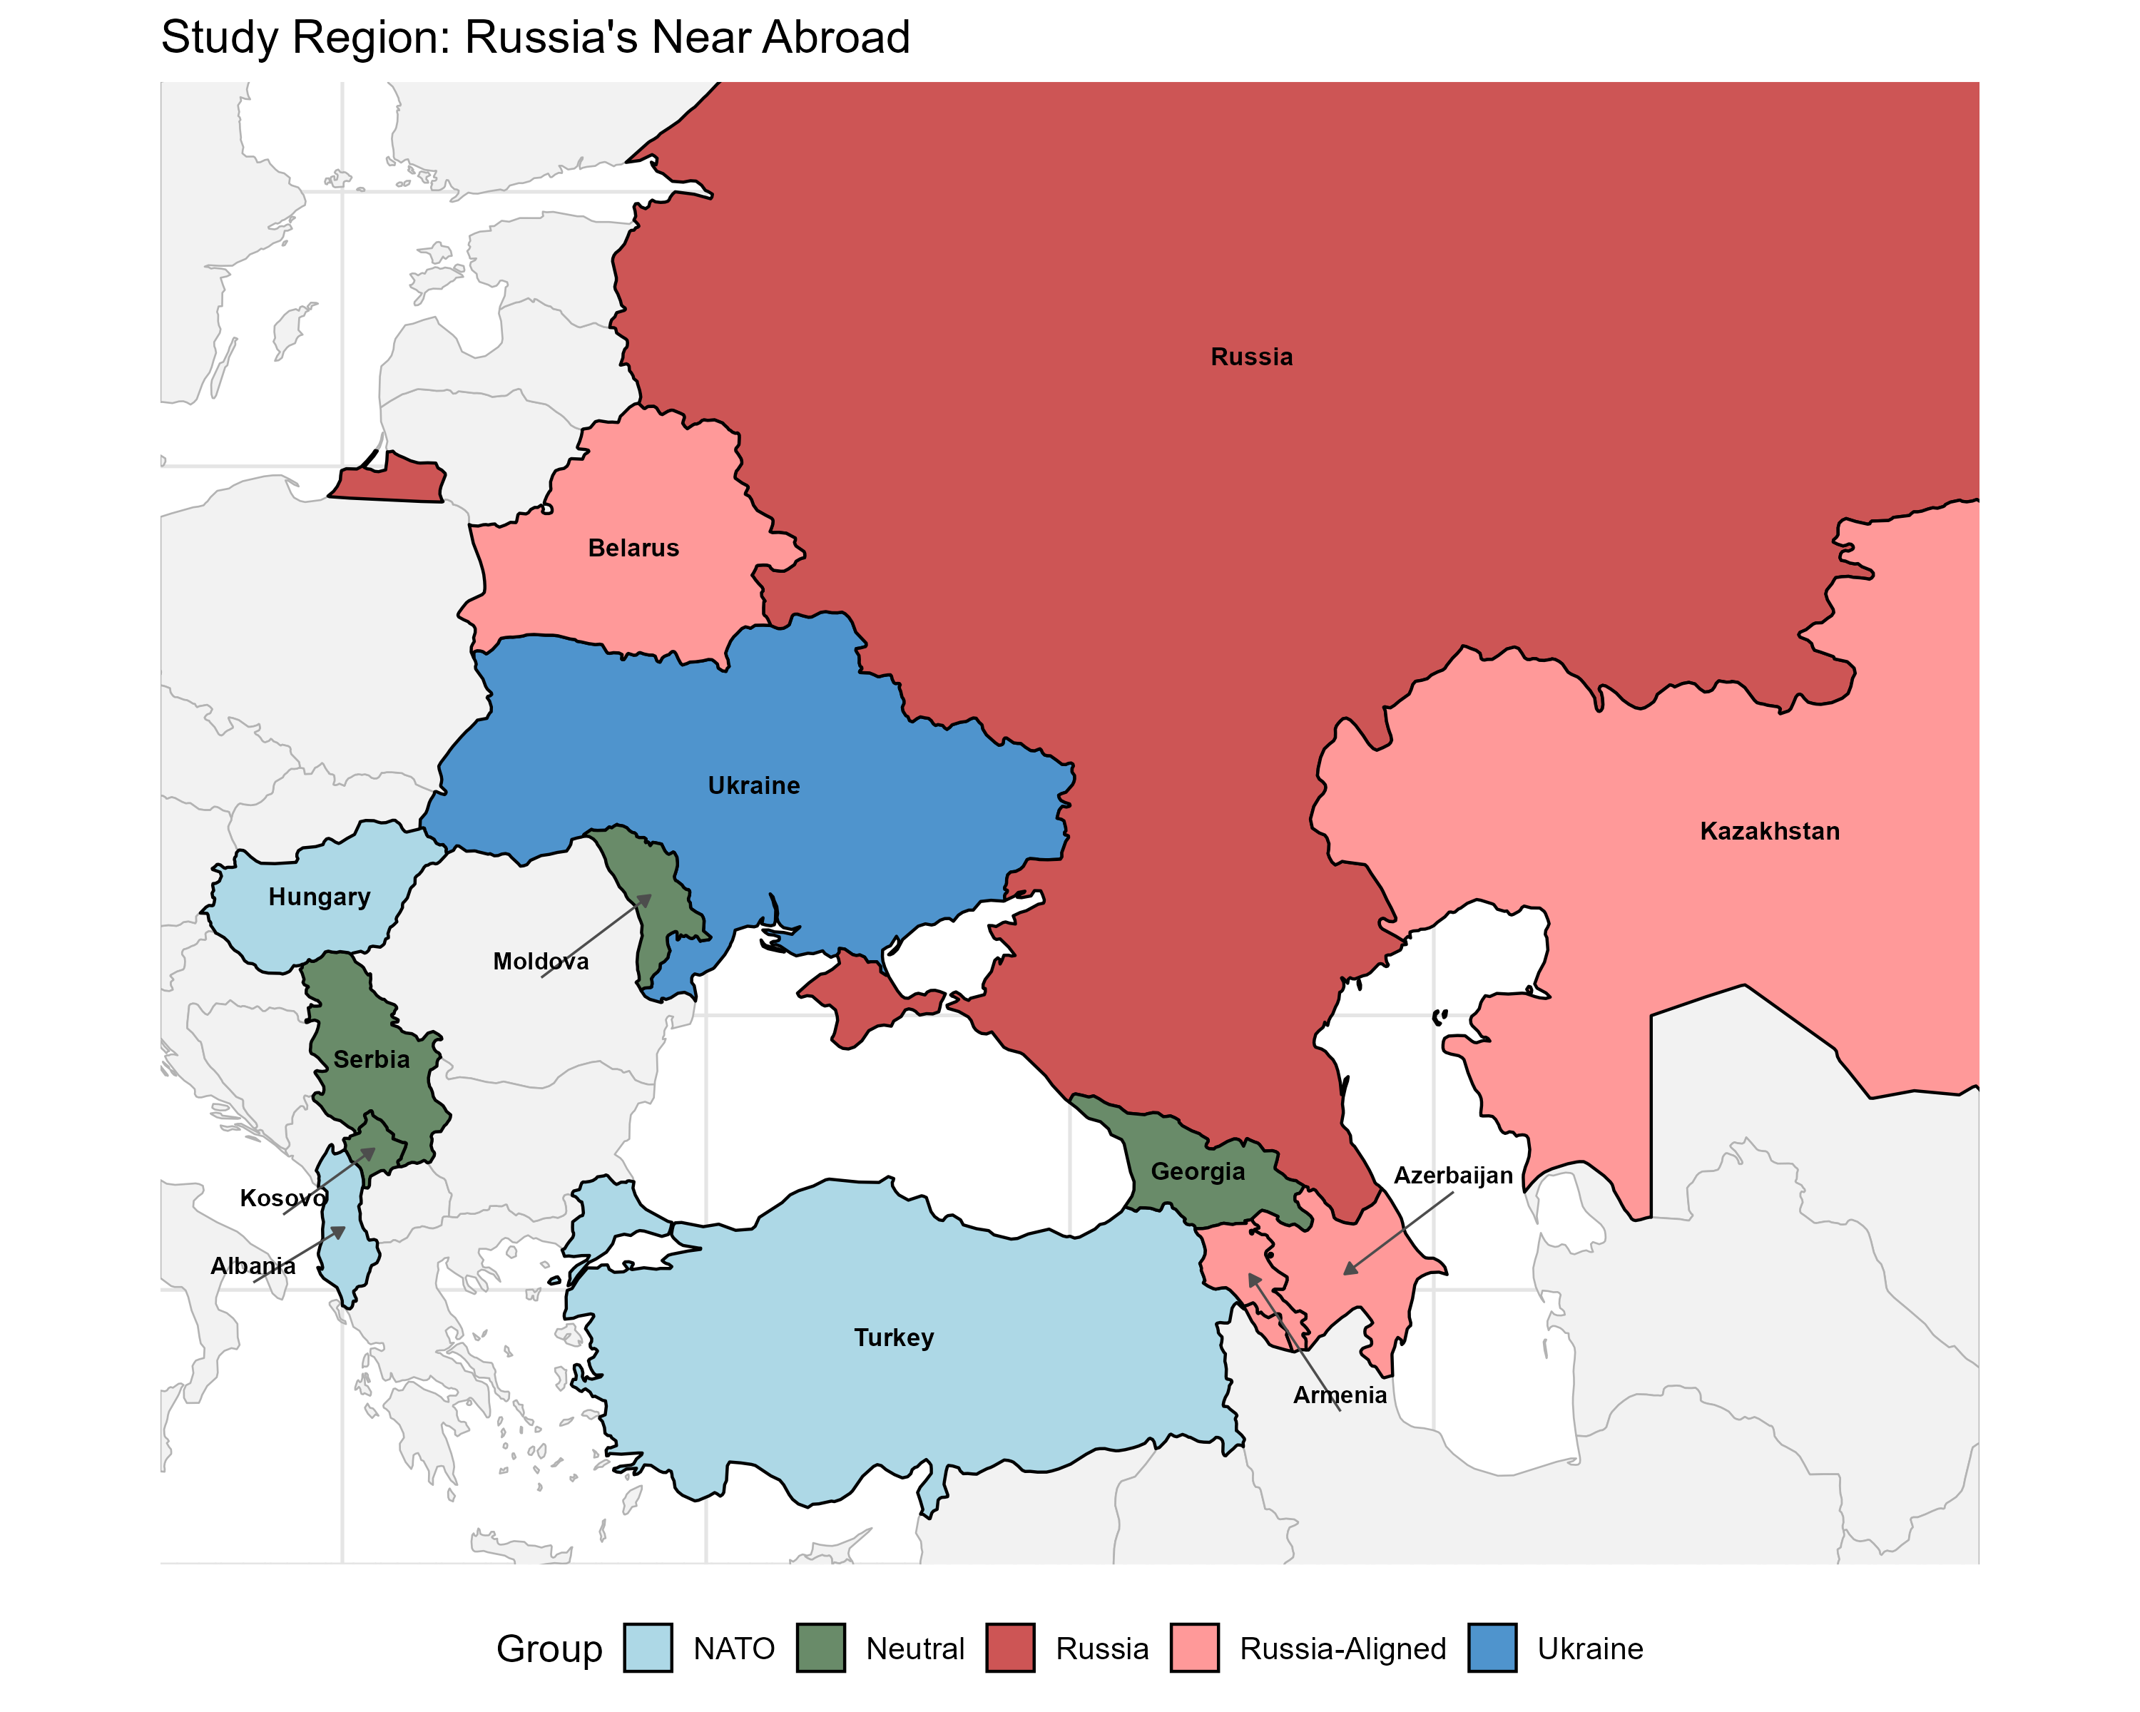
The Countries
Notes:
Here are the countries

Slide 8
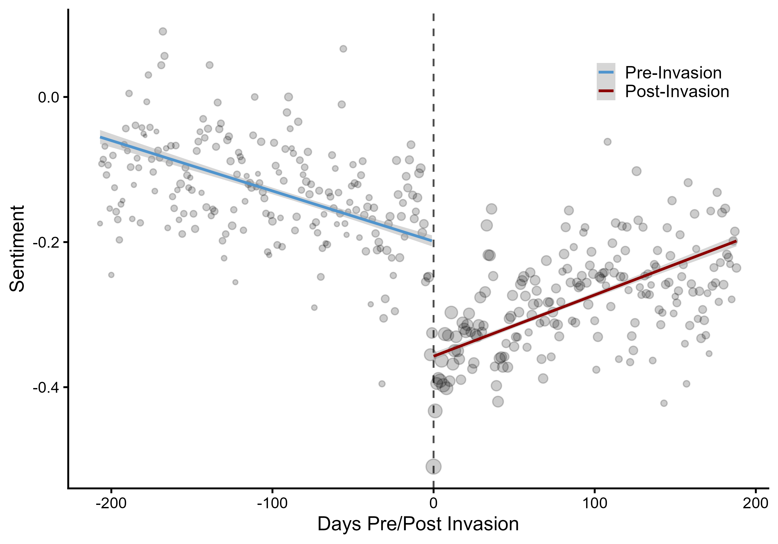
The Shock The invasion produced a sharp negative shock across all media.
Notes:
15 Seconds: First, does the invasion actually matter? Yes. Across all media — state and independent — sentiment toward Russia drops sharply on February 24. You can see the clean break at the dashed line. That discontinuity is what makes everything after this interpretable.

Slide 9
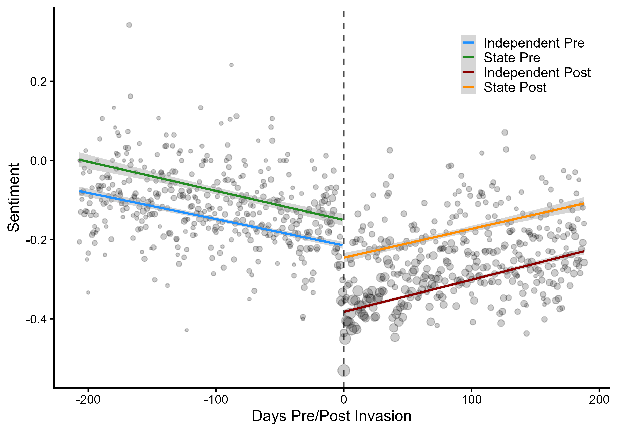
State Media is Different State media responded less negatively than independent media.
Notes:
20 Seconds: But the drop wasn't uniform. Independent media — the dark red line — fell much harder than state media — the orange line. State outlets managed their coverage. That's consistent with strategic control. But that average hides the real story.

Slide 10
Two Predictions
Domestic Propaganda
Signaling
Suppress negative coverage to protect the alliance →
Russia-aligned state media should be the least negative.
Amplify through informal channels because formal ones are locked →
Russia-aligned state media should be the most negative.
Notes:
45 Seconds: So what should we expect when we zoom in on Russia's allies versus neutral states? Two theories make opposite predictions. [click] The domestic propaganda account predicts suppression — if you're allied with Russia, you protect that relationship by keeping negative coverage out of your state media. Russia-aligned states should be the least negative." [click] "The signaling account, our account, predicts the opposite — precisely because these states can't condemn Russia through formal channels, they amplify through the informal one. Russia-aligned states should be the most negative." "So which is it?” [PAUSE] [click]

Slide 11
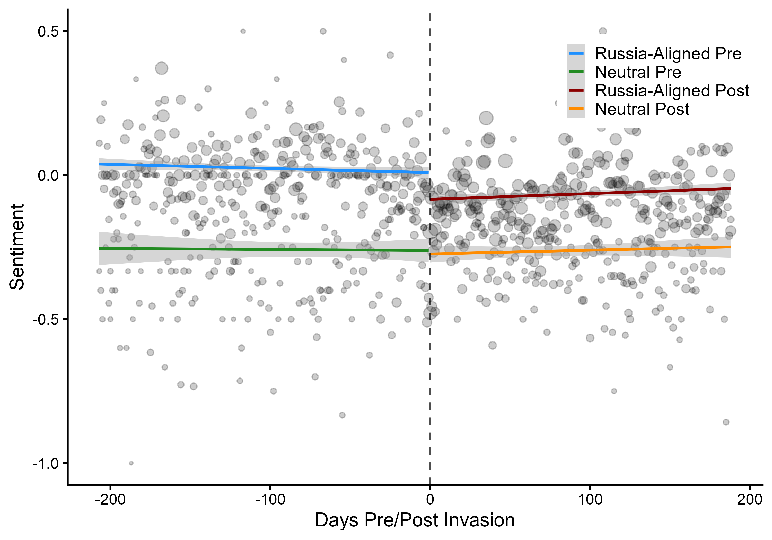
The Counterintuitive Finding Russia's allies went more negative — not less.
Russia-Aligned Drops
Neutral: No Change
Notes:
60 Seconds: Here's the answer. The blue line is state media in Russia's formal allies. Before the invasion, they're sitting right around zero — neutral coverage. After February 24, they drop to the red line. Now look at the green line — state media in neutral states. Before and after the invasion, it barely moves. No discontinuity. The states with no alliance constraint had no signaling need, and their media reflects that. But the states that were formally bound to Russia — the ones with the most reason to suppress negative coverage — produced more of it. [PAUSE] That's not propaganda. That's a signal. [PAUSE] These regimes couldn't go to the UN, couldn't issue a formal condemnation — so they opened the one channel they could control and let the coverage do the talking. These four countries — Armenia, Azerbaijan, Belarus, Kazakhstan — all refused to condemn Russia at the United Nations. None of them issued a public statement of opposition. But their state media told a different story. That gap between what they said formally and what their media said informally — that's the signaling gap. The data matches the signaling prediction.

Slide 12
Beyond International Relations
Constrained communication is universal. When formal channels are blocked, actors find informal ones — in any hierarchy, not just international relations.
The theory-practice gap is a method. What do practitioners in your field know that we haven't studied yet?
LLMs unlock questions at scale. 174K articles, one model, .92 accuracy — this wasn't possible five years ago.
Notes:
45 Seconds: Three reasons this matters beyond IR. First, the core insight — that actors signal through informal channels when formal ones are constrained — isn't unique to foreign policy. Anyone who's worked in an organization with a hierarchy knows that when you can't say something publicly, you find other ways to say it. This is a general theory of constrained communication. Second, the theory-practice gap itself is a methodological lesson. Intelligence analysts have been sitting on this insight for 80 years. Political science hadn't formalized it. That gap probably exists in your subfield too — what do practitioners in your area know that we haven't studied yet? [PAUSE] Third, the tools now exist to do this at scale. Five years ago, scoring sentiment across 174,000 articles in multiple languages was a dissertation-length coding project. We did it with one model. That changes what questions are askable.

Slide 13
Thank You Donald Moratz dmoratz@sas.upenn.edu
The Signaling Gap
Photo: REUTERS/Carlos Barria February 24, 2022
Notes:
We started with a question: what do you do when you can't say what you think? The answer, it turns out, is the same one intelligence analysts have known for 80 years — you let your media say it for you. Thank you.

