Slide 1


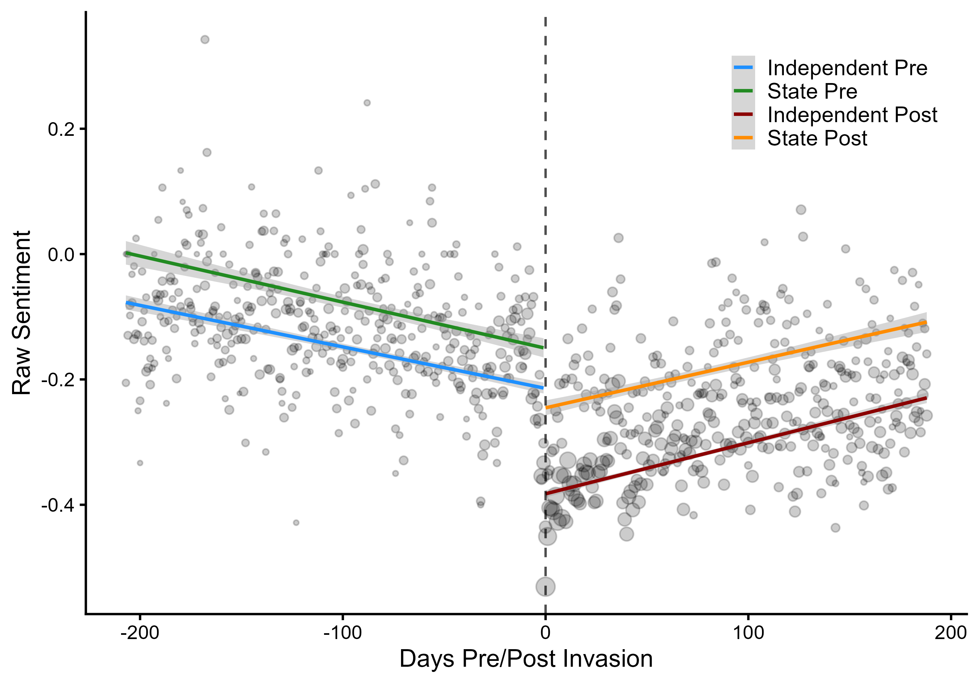
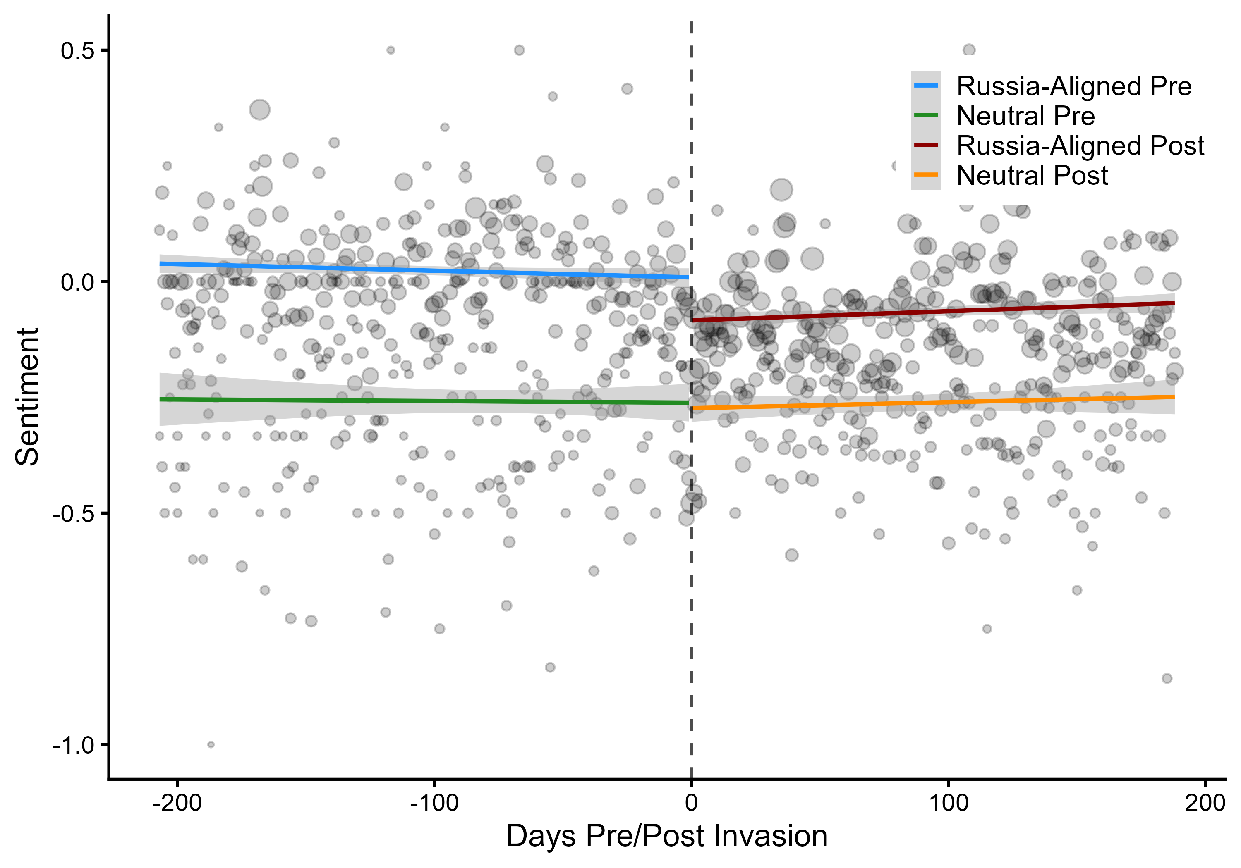
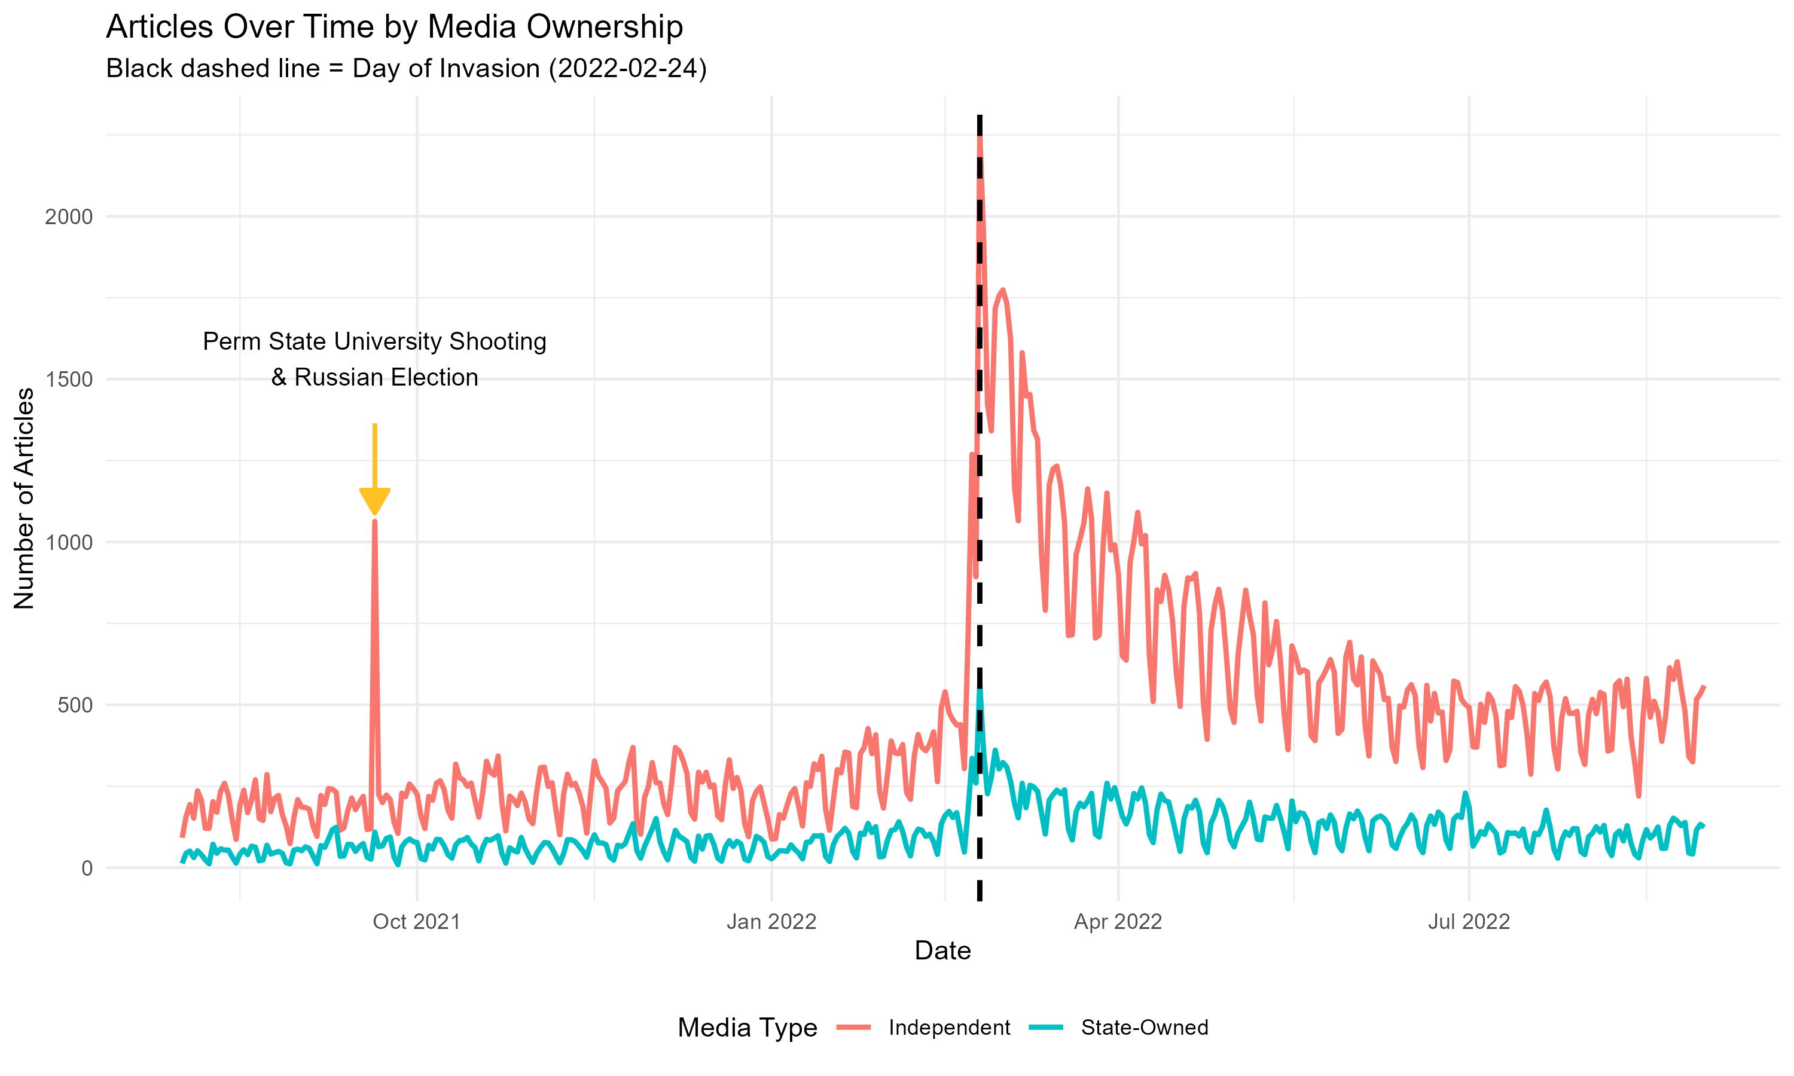
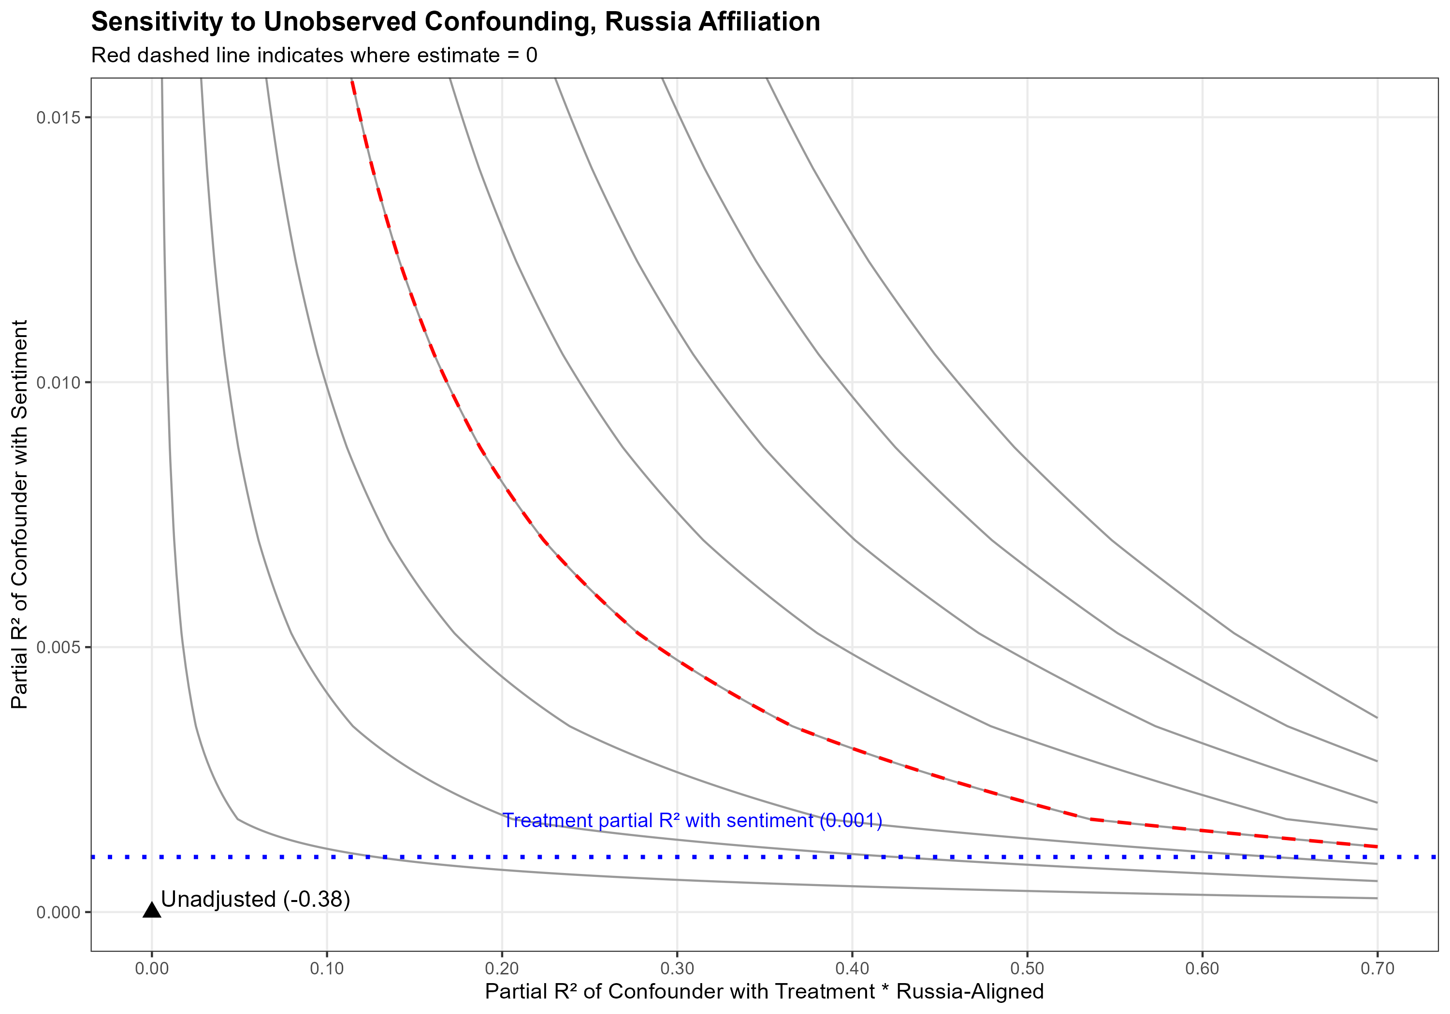
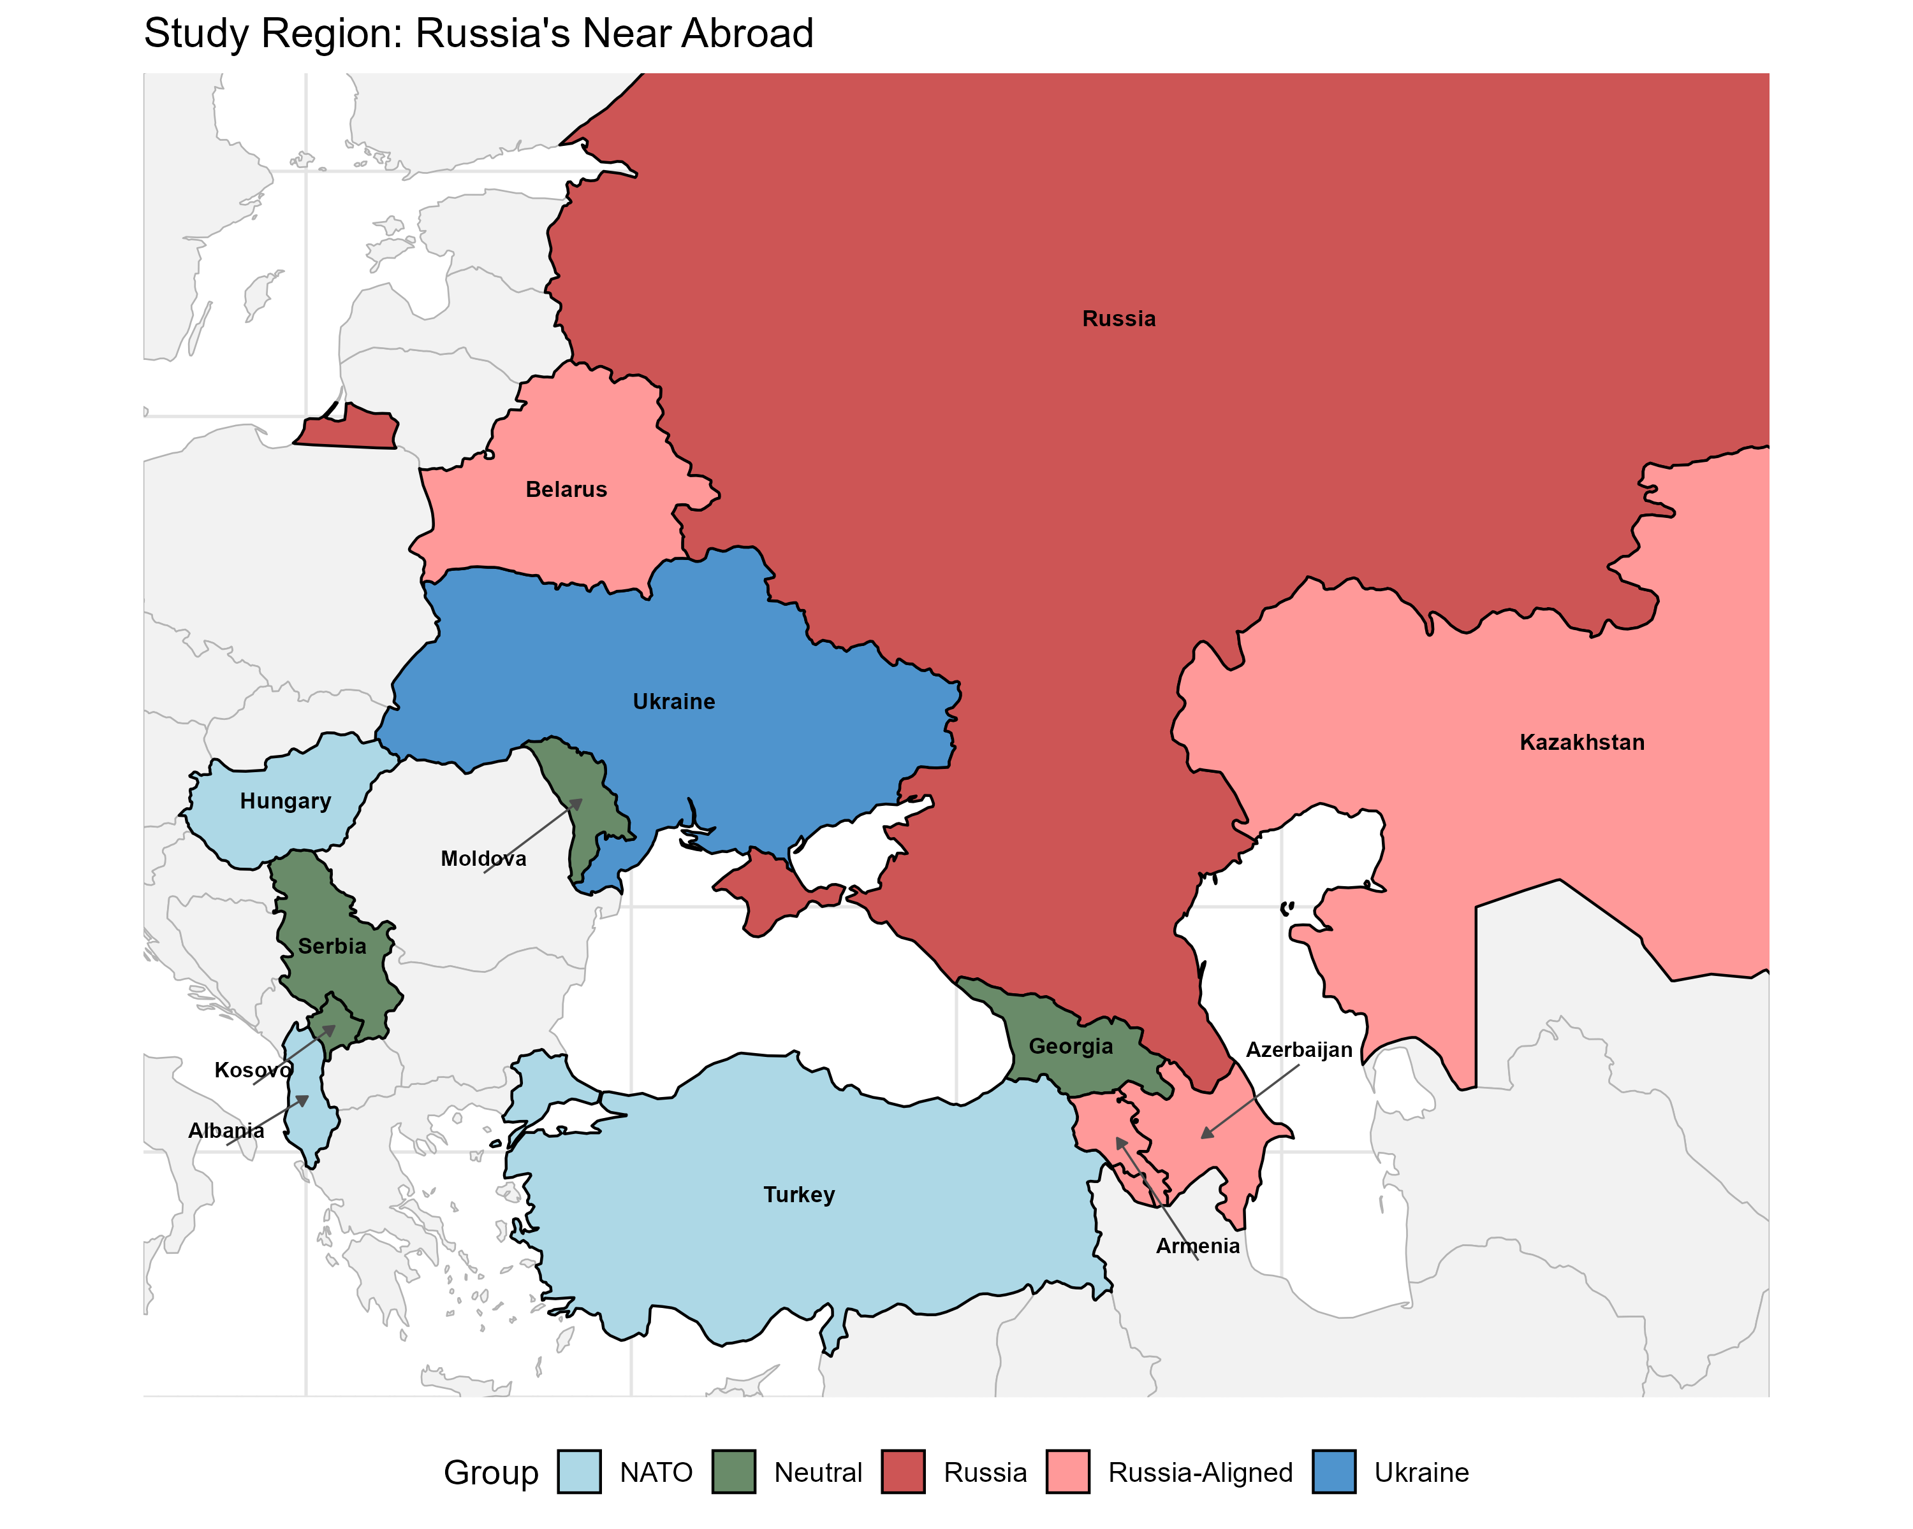
The Signaling Gap
State-Owned Media and the Strategic Management of Sentiment during the Russian Invasion of Ukraine
Donald Moratz and Sarah Gerstein · dmoratz@sas.upenn.edu
Abstract
Hypotheses
Results
Alliance commitments enable cooperation but can foreclose dissent: a state bound to a patron cannot openly break with it without risking the security guarantee it depends on. We argue that state-owned media provides an institutionally mediated channel — public enough to be read by the foreign governments that monitor it, but not a formal act of state that would force a break.
Analyzing state media coverage across 174,094 news articles from 11 countries before and after the 2022 invasion of Ukraine, we find that states with Russian security agreements shifted more negative toward Russia than neutral states — even as they refused to condemn the invasion through formal channels. We measure sentiment at scale with a prompted large language model and identify the shift with a regression discontinuity at the invasion date.
The analysis connects political science, which has largely treated state media as a tool of domestic control, with an intelligence-analytic tradition that has read it as a window into regime preferences since the Cold War.
H1 · Baseline shock — the invasion drove a region-wide negative shift in sentiment toward Russia.
H2 · Readability — state media manages coverage more carefully than independent media (a smaller shift).
H3 · The signal — Russia-aligned state media shifts more negative than neutral state media.
H1 — A real shock. Sentiment toward Russia fell 0.22 SD at the cutoff (p < 0.001), robust to dropping military coverage (0.18 SD).
H2 — State media holds the line. Independent media dropped 0.21 SD; state-owned only 0.11 SD — about half as much. The RDID interaction reaches 0.22 (p < 0.05) among non-NATO outlets.
H3 pits the two accounts head-to-head:
Domestic management
Protect the alliance → suppress coverage → predicts less negative
Signaling (our account)
Formal channels foreclosed → signal via media → predicts more negative
The Argument
Data: Russia-aligned state media shifts more negative ✓ signaling, not suppression
H3 — The constrained states signaled loudest. Russia-aligned state media shifted −0.22 SD (p < 0.05); neutral state media barely moved (−0.06, n.s.). Preferred matched estimate: −0.38 (p < 0.05) — the opposite of domestic-audience management.
The bind. States dependent on a patron for security cannot always say what they think: condemning the patron risks the guarantee they rely on; silence risks being lumped in with it.
Three channels, one gap.
Formal channels (UN votes, statements) are credible because costly — and so unusable when the patron can retaliate.
Private diplomacy is safe but unverifiable — cheap talk to its intended audience.
State media sits between: public enough to be observed, but not a formal act of state.
Why the signal is credible.
Readable — outsiders have read state media as regime preference since the Cold War, not journalism.
Costly — permitting negative coverage of a patron risks provoking it, so the shift is informative.
Buffered — the government/editorial separation keeps it below a formal break, reaching the audience without triggering retaliation.
The calculus. Signaling risks retaliation; silence risks being categorized with the aggressor. That asymmetry is what makes the signal rational — and the same logic should travel to any patron-client hierarchy.
Data & Measurement
174,094 Russia-related articles, Aug 2021–Aug 2022; 11 countries, 61 sources (Ukraine excluded). State-owned (17) vs. independent (44) by ownership review.
GPT-4o zero-shot codes sentiment toward Russia (−1 / 0 / +1) from each article's title and first two sentences. Validated against a 100-article human gold standard: F1 = 0.92, with no −1↔+1 cross-codings — a conservative measure.
Russia-aligned (blue→red) drops sharply at the cutoff; neutral (green→orange) stays flat.
In the outlet's own words. Armenia's state broadcaster, two months apart — January: Russia as an economic partner (‘rail access to Russia, Europe, Iran, China’); March: ‘Russia walks out of the Council of Europe.’ Same outlet, opposite orientation: a regime choice in what it carried, while Armenia withheld formal condemnation.
The Case: Why the 2022 Invasion
A clean test of the mechanism needs three things, and February 24, 2022 supplies all three:
A discrete shock — a sharp break in the information environment, not a slow slide.
A defined constraint structure — states bound to Russia by security agreements (CSTO plus Azerbaijan) vs. neutral states whose formal channels stayed open.
Competing predictions — domestic-management and signaling accounts disagree about which group shifts more, so the data can adjudicate.
Robustness
Sensitivity (Cinelli–Hazlett). A confounder would need to be 1.5× as strongly associated with sentiment as the invasion itself to erase the H3 differential.
Placebo + ethnic partition. No discontinuity at the Dec 7 announcement; splitting by ethnic-Russian share yields no differential — isolating the alliance-constraint mechanism.
Daily Russia-related articles by ownership; dashed line marks the Feb 24 invasion.
Research Design
H1 (within group). A regression discontinuity at Feb 24 identifies the causal effect of the invasion on sentiment toward Russia (rdrobust, MSE-optimal bandwidth).
H2 / H3 (across groups). A difference-in-discontinuities (RDID) compares how much more one group's sentiment jumped at the cutoff:
Conclusion
Connects patron–client theory and the IR literature on signaling — constrained clients use managed media to signal divergence from a patron.
Controlled-media sentiment is a deliberate signal of where a client stands toward its security partner — not a byproduct of domestic opinion.
Validates a long-standing intelligence practice — reading state media for regime preferences — that political science had left largely unexamined.
β5 — the treatment × group (T × G) term — is the differential discontinuity: causal within each group, but conditional on group membership across groups (stress-tested for confounding, not asserted as a causal effect of alignment).
Identification. Source fixed effects block the country/ownership backdoors; topic fixed effects absorb compositional shifts; z-scoring lets the group term survive demeaning. Few-cluster inference via the wild-cluster restricted bootstrap.
Key References
Cohen (1987). Theatre of Power. Longman.
Fearon (1997). Signaling Foreign Policy Interests. J. Conflict Resolution 41(1).
Grembi, Nannicini & Troiano (2016). Do Fiscal Rules Matter? AEJ: Applied 8(3).
Cinelli & Hazlett (2020). Making Sense of Sensitivity. JRSS-B 82(1).

