Slide 1


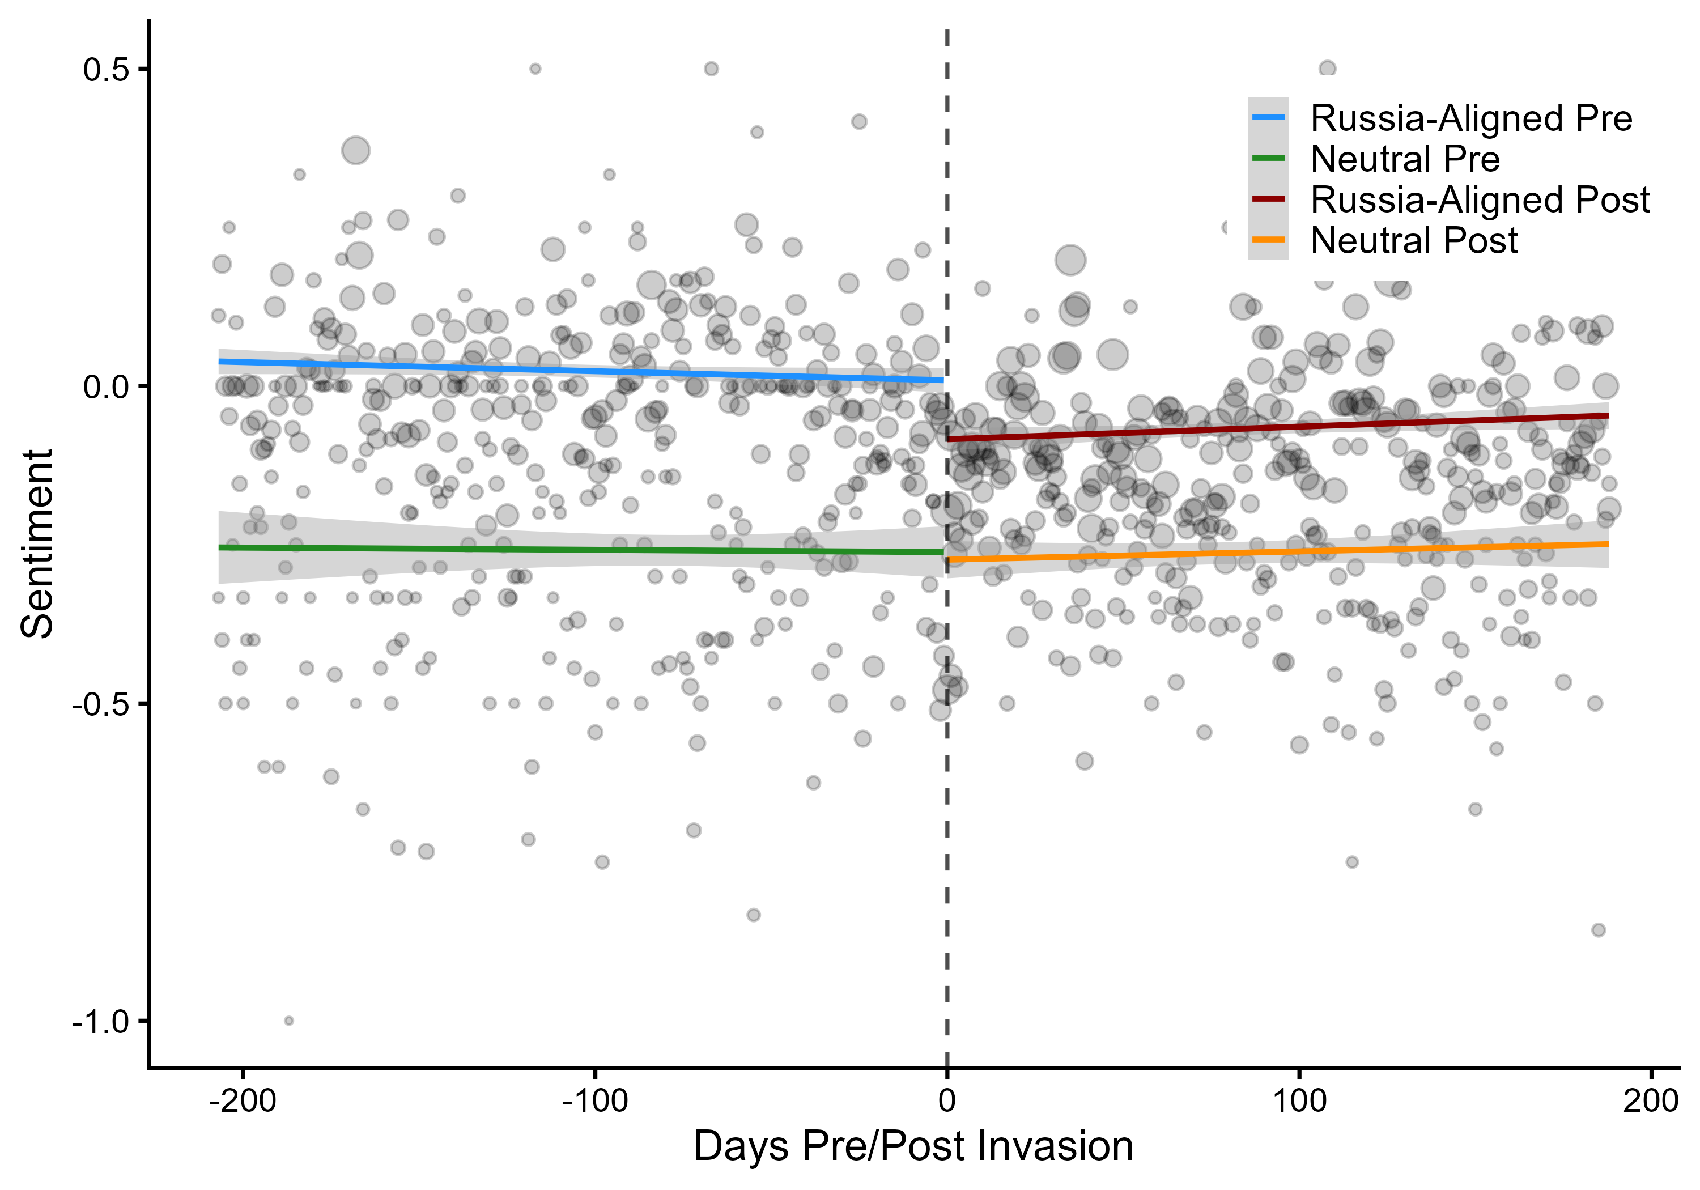
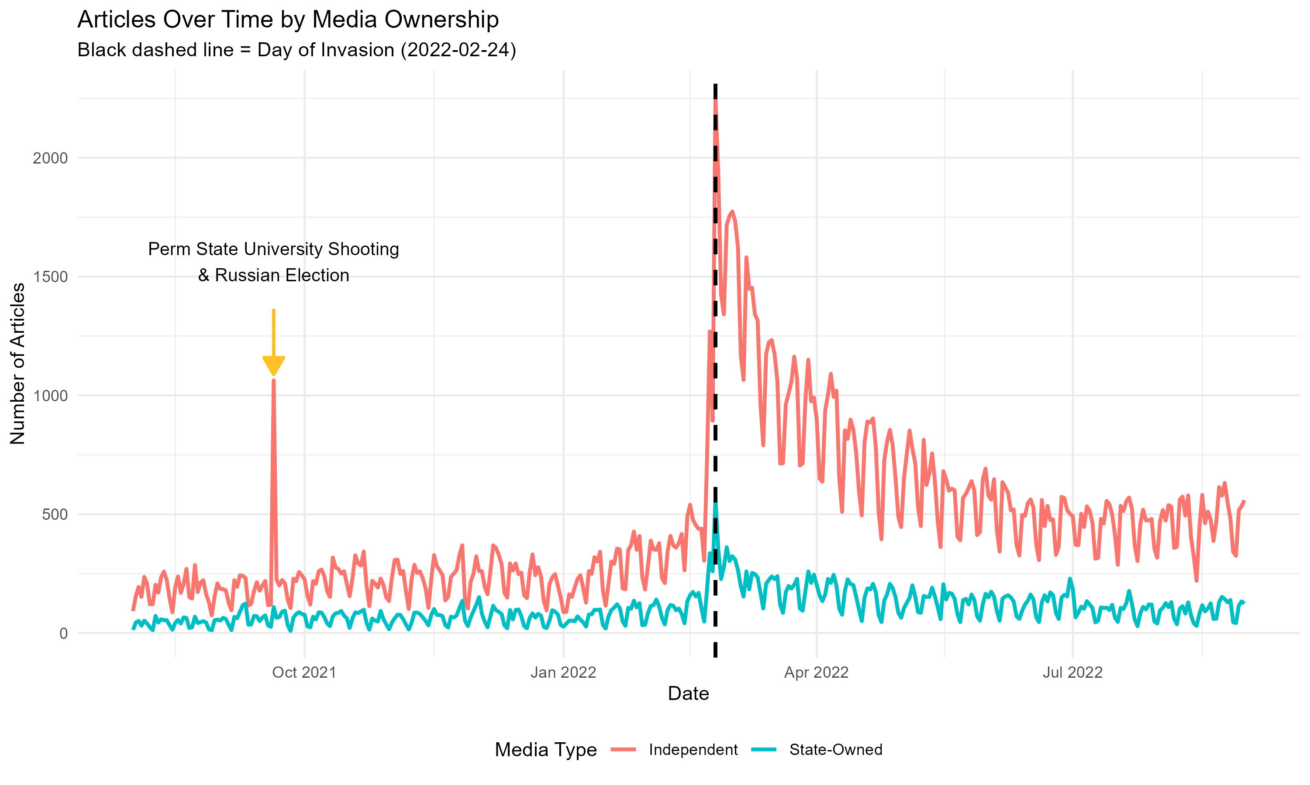
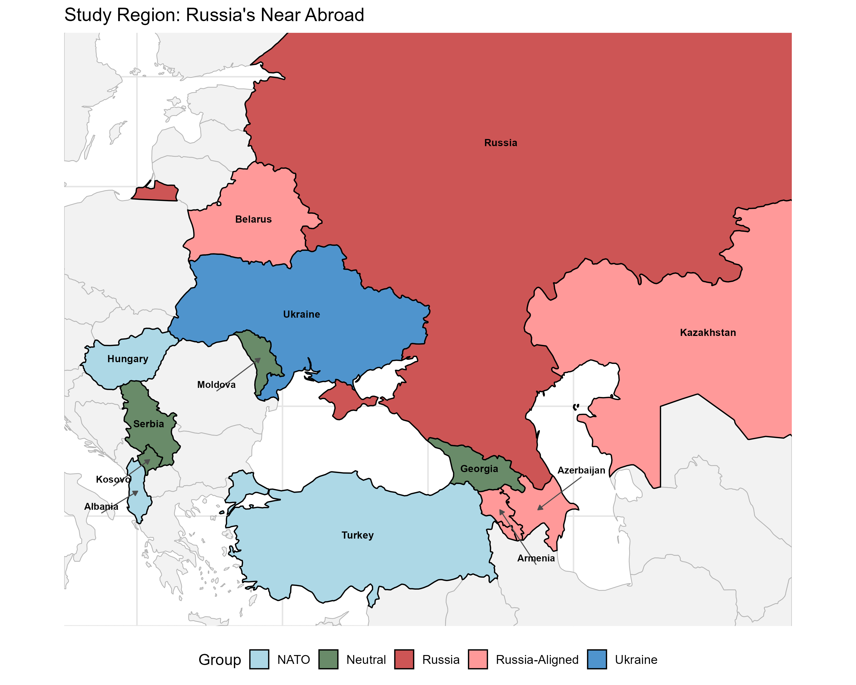
The Signaling Gap
State-Owned Media and the Strategic Management of Sentiment during the Russian Invasion of Ukraine
Donald Moratz and Sarah Gerstein · dmoratz@sas.upenn.edu
Abstract
Hypotheses
Results
Alliance commitments enable cooperation but can foreclose dissent: a state bound to a patron cannot openly break with it without risking its security guarantee. We argue state-owned media is an institutionally mediated channel — public enough for the foreign governments that monitor it to read, but not a formal act of state.
Across 174,094 articles from 11 countries around the 2022 invasion of Ukraine, states with Russian security agreements shifted more negative toward Russia than neutral states — even while refusing to condemn it through formal channels. We measure sentiment with a prompted large language model and identify the shift with a regression discontinuity.
H1 · Baseline shock — the invasion drove a region-wide negative shift toward Russia.
H2 · Readability — state media manages coverage more carefully than independent media.
H3 · The signal — Russia-aligned state media shifts more negative than neutral state media.
H1 — A real shock. Sentiment toward Russia fell 0.22 SD at the cutoff (p < 0.001); 0.18 SD without military coverage.
H2 — State media holds the line. Independent media fell 0.21 SD; state-owned only 0.11 SD. RDID interaction 0.22 (p < 0.05) among non-NATO outlets.
H3 pits the two accounts head-to-head:
H3 — Constrained states signaled loudest. Russia-aligned state media fell −0.22 SD (p < 0.05); neutral barely moved (−0.06, n.s.). Matched estimate −0.38 (p<0.05) — the opposite of domestic management prediction
Domestic management
Suppress coverage → predicts less negative
Signaling (our account)
Signal via media → predicts more negative
The Argument
Data: shifts more negative ✓ signaling, not suppression
The bind. A state dependent on a patron cannot openly dissent without risking the guarantee it relies on — yet silence risks being lumped in with the patron.
Three channels, one gap.
Formal channels (UN votes) are credible but costly — unusable under a patron's threat.
Private diplomacy is safe but unverifiable — cheap talk.
State media sits between: observable, but not a formal act of state.
Why it's credible. Readable (long read as regime preference), costly (negative coverage risks provoking the patron), and buffered (editorial separation keeps it below a formal break).
The calculus. Signaling risks retaliation\; silence risks being categorized with the aggressor. However, the higher costs associated with diplomatic isolation makes sending the signal rational, and the logic should travel to any patron–client hierarchy.
Data & Measurement
174,094 Russia-related articles, Aug 2021–Aug 2022; 11 countries, 61 sources (17 state-owned, 44 independent).
GPT-4o codes sentiment toward Russia (−1 / 0 / +1) from each title and first two sentences. F1 = 0.92 vs. a 100-article human standard — with no −1↔+1 cross-codings, a conservative measure.
Russia-aligned drops sharply at the cutoff; neutral stays flat.
In the outlet's own words. Armenia's state broadcaster, two months apart — January: Russia as an economic partner; March: ‘Russia walks out of the Council of Europe.’ Same outlet, opposite orientation — while Armenia withheld formal condemnation.
The Case: Why the 2022 Invasion
Robustness
A clean test needs three things, and February 24, 2022 supplies all three:
A discrete shock — a sharp rupture in the information environment, not a slow slide.
A constraint structure — states bound to Russia (CSTO + Azerbaijan) vs. neutral states with open channels.
Competing predictions — domestic-management and signaling disagree on which group shifts more.
Sensitivity (Cinelli–Hazlett). A confounder would need to be 1.5× as strongly associated with sentiment as the invasion itself to erase the H3 differential.
Placebo + ethnic partition. No discontinuity at the Dec 7 announcement; splitting by ethnic-Russian share yields no differential.
Daily Russia-related articles by ownership; dashed line marks the Feb 24 invasion.
Conclusion
Research Design
Connects patron–client theory and IR signaling — constrained clients use managed media to signal divergence from a patron.
Controlled-media sentiment is a deliberate signal of alignment toward a security partner — not a byproduct of domestic opinion.
Validates a long-standing intelligence practice — reading state media for regime preferences — long left unexamined.
H1 (within group). An RD at Feb 24 identifies the causal effect of the invasion on sentiment (rdrobust, MSE-optimal bandwidth).
H2 / H3 (across groups). A difference-in-discontinuities (RDID) compares how much more one group jumped at the cutoff:
β5 (T × G) is the differential discontinuity — causal within each group, but conditional on group membership across groups (stress-tested, not a causal effect of alignment).
Identification. Source-level Z-Score adjustments close country/ownership backdoors; topic FE absorb composition; WCR bootstrap handles the few clusters.
Key References
Cohen (1987). Theatre of Power. Longman.
Fearon (1997). Signaling Foreign Policy Interests. JCR 41(1).
Grembi, Nannicini & Troiano (2016). Do Fiscal Rules Matter? AEJ: Applied 8(3).
Cinelli & Hazlett (2020). Making Sense of Sensitivity. JRSS-B 82(1).

