Slide 1


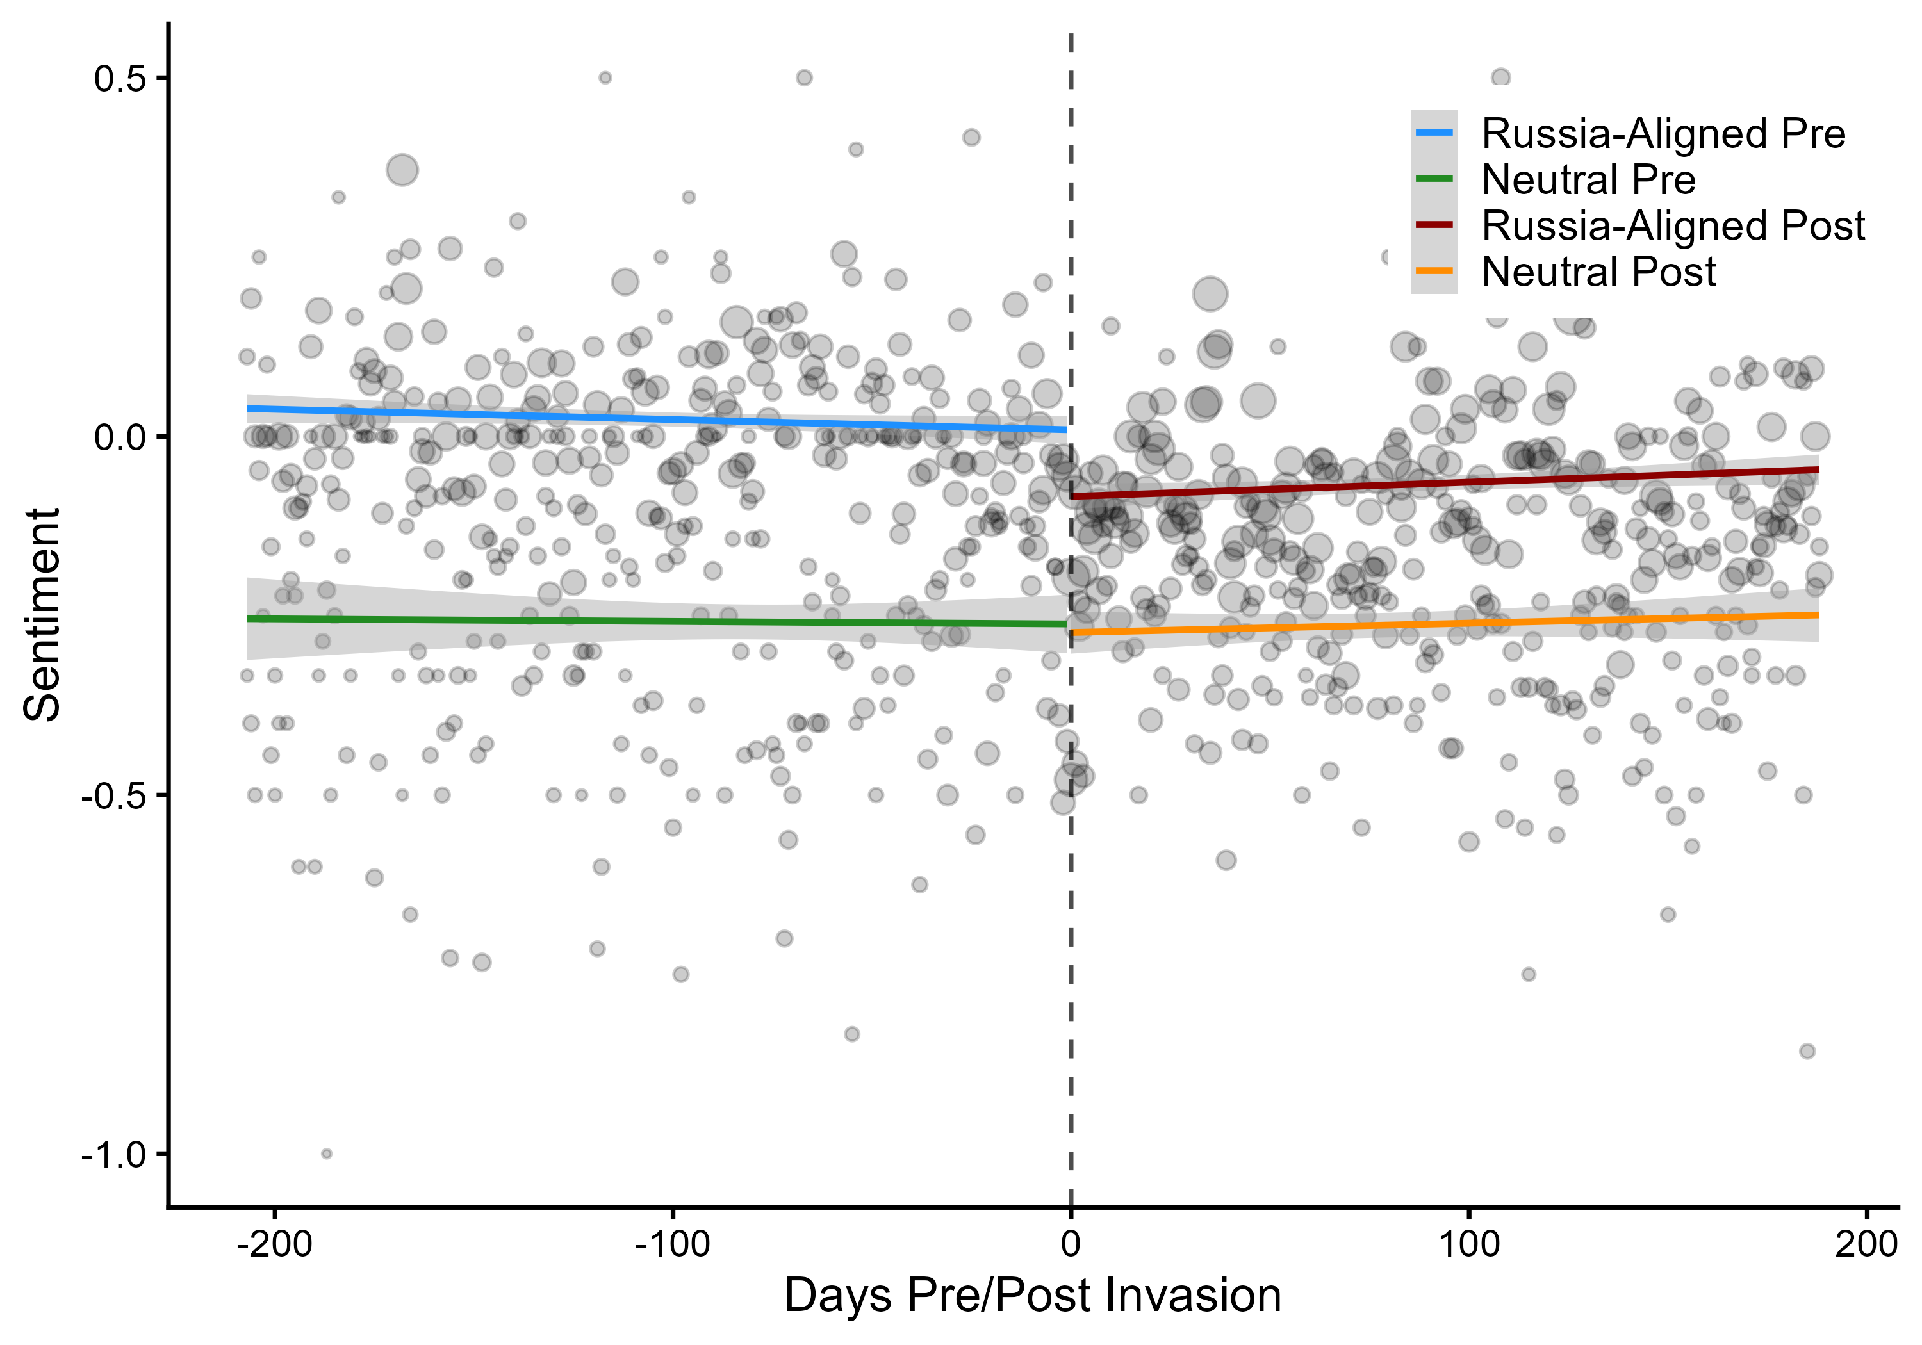
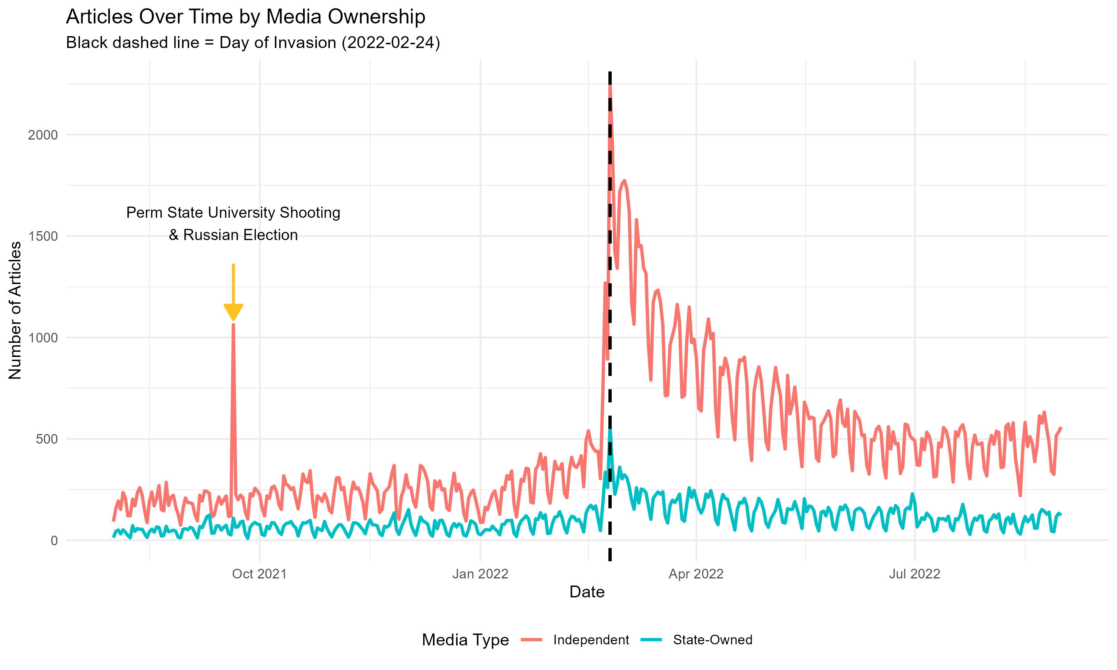
The Signaling Gap
State-Owned Media and the Strategic Management of Sentiment during the Russian Invasion of Ukraine
Donald Moratz and Sarah Gerstein · dmoratz@sas.upenn.edu
Abstract
The Case: Why the 2022 Invasion
Results
Alliance commitments enable cooperation but can foreclose dissent: a state bound to a patron cannot openly break with it without risking its security guarantee. We argue state-owned media is an institutionally mediated channel — public enough for the foreign governments that monitor it to read, but not a formal act of state.
Across 174,094 articles from 11 countries around the 2022 invasion of Ukraine, states with Russian security agreements shifted more negative toward Russia than neutral states — even while refusing to condemn it through formal channels. We measure sentiment with a prompted large language model and identify the shift with a regression discontinuity.
A clean test needs three things, and February 24, 2022 supplies all three:
• A discrete shock — a sharp rupture in the information environment, not a slow slide.
• Alliance constraints — states bound to Russia (CSTO + Azerbaijan) vs. neutral states with open channels.
• Competing predictions — domestic-management and signaling disagree on which group shifts more.
H1 — A real shock. Sentiment toward Russia fell 0.22 SD at the cutoff (p < 0.001); 0.18 SD without military coverage.
H2 — State media holds the line. Independent media fell 0.21 SD; state-owned only 0.11 SD. RDID interaction 0.22 (p < 0.05) among non-NATO outlets.
H3 — Constrained states signaled loudest. Russia-aligned state media fell −0.22 SD (p < 0.05); neutral barely moved (−0.06, n.s.). Matched estimate −0.38 (p<0.05) — the opposite of the domestic-management prediction.
Russia-aligned: Armenia, Azerbaijan, Belarus, Kazakhstan
Neutral: Georgia, Kosovo, Moldova, Serbia
Data & Measurement
The Argument
• 174,094 Russia-related articles, Aug 2021–Aug 2022; 11 countries, 61 sources (17 state-owned, 44 independent).
• GPT-4o codes sentiment toward Russia (−1 / 0 / +1) from each title and first two sentences. F1 = 0.92 vs. a 100-article human standard — with no −1↔+1 cross-codings, a conservative measure.
The bind. A state that depends on a patron for its security can't openly break with it without risking the guarantee it relies on — yet silence risks being lumped in with the patron.
The channel we test: state media. The state owns these outlets, so their coverage is a controlled choice, not an independent press responding to the market.
Why it works as a signal. Readable — foreign analysts monitor state outlets and treat them as regime-controlled, so a turn against Russia reads as a deliberate signal. Costly — negative coverage of a security patron risks provoking retaliation, so it's hard to fake.
The calculus. Signaling risks retaliation; silence risks being categorized with the aggressor. Because diplomatic isolation is the greater cost, sending the signal is rational — and the logic travels to any patron–client hierarchy.
The rival account. The dominant view treats state media as managing domestic opinion, not signaling outsiders — so a constrained state should mute criticism of its patron, not amplify it. The two accounts predict opposite shifts.
Russia-aligned drops sharply at the cutoff; neutral stays flat.
Daily Russia-related articles by ownership; dashed line marks the Feb 24 invasion.
Robustness
Methods Challenges
Sensitivity (Cinelli–Hazlett). A confounder would need to be 1.5× as strongly associated with sentiment as the invasion itself to erase the H3 differential.
Placebo + ethnic partition. No discontinuity at the Dec 7 announcement; splitting by ethnic-Russian share yields no differential.
Few-cluster inference. With only ~13 clusters in the state-media test, a wild cluster restricted bootstrap (Webb weights) leaves the H3 differential intact.
Hypotheses
A credible discontinuity design here — ultimately an RDID across groups — must clear three obstacles first:
• Composition, not tone. The invasion changes what outlets cover, not just how. Topic is a collider, so we block topic, country, and ownership together via source-level control.
• The collinearity bind. Each outlet sits in one group, so source fixed effects would absorb the very contrast we test. We z-score within source instead — the interaction stays estimable.
• Dates pile up. Hundreds of articles share a date, creating mass points that break a time RDD. We use publication date-time as the running variable, imputing missing times per outlet.
H1 · Baseline shock — the invasion drove a region-wide negative shift toward Russia.
H2 · Readability — state media manages coverage more carefully than independent media.
H3 · The Signal — Alliance-constrained state media shifts more negative than neutral state media.
Conclusion
• Connects patron–client theory and IR signaling — constrained clients use managed media to signal divergence from a patron.
• Controlled-media sentiment is a deliberate signal of alignment toward a security partner — not a byproduct of domestic opinion.
• Validates a long-standing intelligence practice — reading state media for regime preferences — long left unexamined.
H3 is where the two accounts split:
Domestic management
Suppress coverage → predicts less negative
Signaling (our account)
Signal via media → predicts more negative
Research Design
H1 (within group). An RD at Feb 24 identifies the causal effect of the invasion on sentiment (rdrobust, MSE-optimal bandwidth).
H2 / H3 (across groups). A difference-in-discontinuities (RDID) compares how much more one group jumped at the cutoff:
Key References
Data: shifts more negative ✓ signaling, not suppression
β5 (T × G) is the differential discontinuity — causal within each group, but conditional on group membership across groups (stress-tested, not a causal effect of alignment).
Cohen (1987). Theatre of Power. Longman.
Fearon (1997). Signaling Foreign Policy Interests. JCR 41(1).
Grembi, Nannicini & Troiano (2016). Do Fiscal Rules Matter? AEJ: Applied 8(3).
Cinelli & Hazlett (2020). Making Sense of Sensitivity. JRSS-B 82(1).

