Slide 1
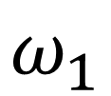
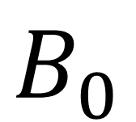
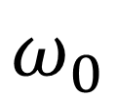
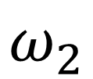
$$B_{0}$$
$$ω_{1}$$
$$ω_{2}$$
$$ω_{0}$$

Slide 2
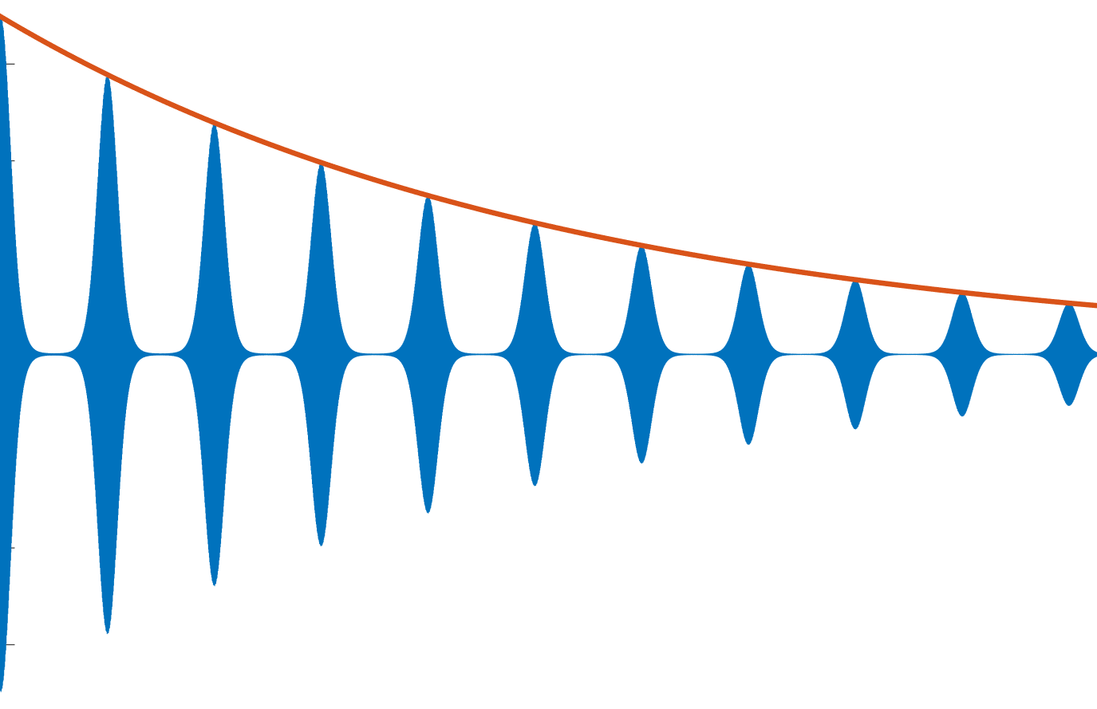


$$exp⁡(−\frac{t}{T_{2}^{∗}})$$
$$exp⁡(−\frac{t}{T_{2}})$$

